Slide 1
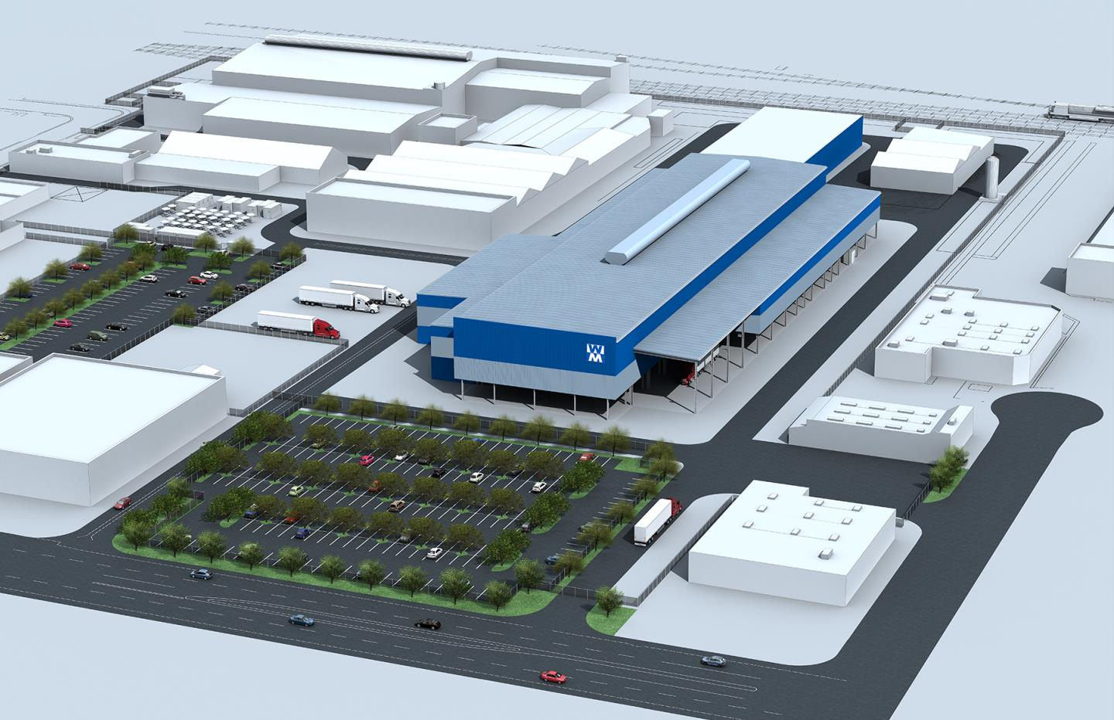
PLANT BUILDING DESIGN

Slide 2
AGENDA
1
Introduction
2
How is a food processing plant design distinct?
3
Premises, surroundings & building site
4
Exterior building design & construction
5
Interior building design & construction
6
Operational flow and facility layout
Notes:
2

Slide 3
INTRODUCTION
Plant Design
Plant design refers to the overall design of a manufacturing enterprise/ facility.
The objectives of designing & constructing a sanitary food handling facility are:
  To minimize harborages
  Eliminate the entrance of pests and other sources of contamination
Plant design specifies
  the equipment to be used
  performance requirements for the equipment
  interconnections and raw material flows in terms of flow charts and plant layouts
  the placement of equipment, storage spaces, shop facilities, office spaces, delivery and shipping facilities, access ways, site plans and elevation drawings
Notes:
3

Slide 4

INTRODUCTION
Plant Design
  required instrumentation and controls, and process monitoring and control interconnections
  utility and waste treatment requirements, connections and facilities
  the rationale for site selection
  the basis for selecting and sizing critical pieces of equipment
  ways in which the design was optimized and the engineering basis for such optimization
Notes:
4

Slide 5
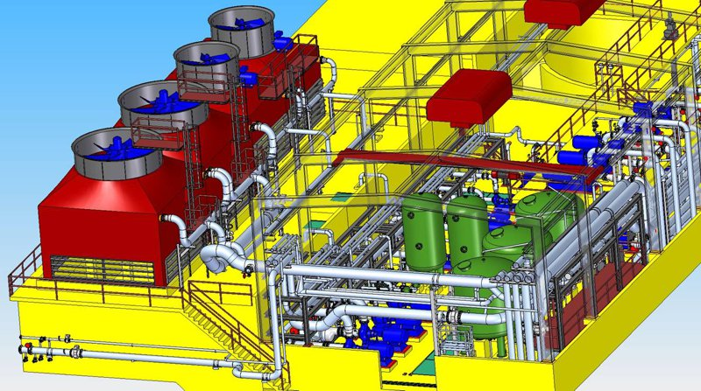
INTRODUCTION
Plant Design
Notes:
5

Slide 6
HOW IS A FOOD PROCESSING PLANT DESIGN DISTINCT?
Difference b/w food processing & non food processing plant
The main difference lies in
  Areas of the equipments
  Selection and sizing
  Working space design
Such differences arise due to:
  Storagse life of foods is relatively limited and strongly affected by temperature, pH, water activity, maturity, prior history, and initial microbial contamination levels.
  Very high and verifiable levels of product safety and sterility have to be provided.
  Foods are highly susceptible to microbial attack and insect and rodent infestation.
  Food processing generates wastes with high BOD loads.
Notes:
6

Slide 7
PREMISES, SURROUNDINGS & BUILDING SITE
Objectives regarding sanitary building site are to
Use every effort and means possible to minimize:
  harborages and infestations of vermin (e.g., rodents, insects, birds, other pests), mold and mildew, and microorganisms;and
  potential for contamination with environmental chemical pollutants
It is imperative that an adequate pest control management program is in place for food processing and handling facilities.
Proper records and documentation of a pest control program is important to the success of an overall sanitation program
Focus areas:
  Location
  Site condition, preparation & maintenance
  Exterior lighting
  Driveways & receiving areas
Notes:
7

Slide 8

PREMISES, SURROUNDINGS & BUILDING SITE
Location
Ideally
  The food processing facility should be located away from sources of contamination e.g., chemical plant, sewage treatment facility, salvage yard, livestock housing, cow pasture, or body of water).
  Surroundings of facility should be evaluated for potential sources of contamination.
  Special precsutions should be taken in casesources of contamination are found to be located near the plant to avoid odors & contaminants from entering the yard or the facility
Notes:
8

Slide 9
PREMISES, SURROUNDINGS & BUILDING SITE
Site condition, preparation & maintenance
When preparing a new site for construction:
  The site should be thoroughly cleaned of any potentially toxic materials and graded for appropriate drainage and prevention of standing or pooled water.
  Storm sewers should be designed and located to allow for adequate runoff and paving should be used to minimize dust.
  Landscaping should not be present too close to the building (trees and shrubbery should be no closer than 30 feet from the building, and grass coverings should end 30 inches from the building walls)
  Gravel buffer should be established between the building and landscaping to discourage rodents
  Area to be kept uncluttered and free of refuse, to discourage insects and other vermin from taking up residence.
  The drainage system/landscape design must be maintained appropriately to minimize standing water.
Notes:
9

Slide 10
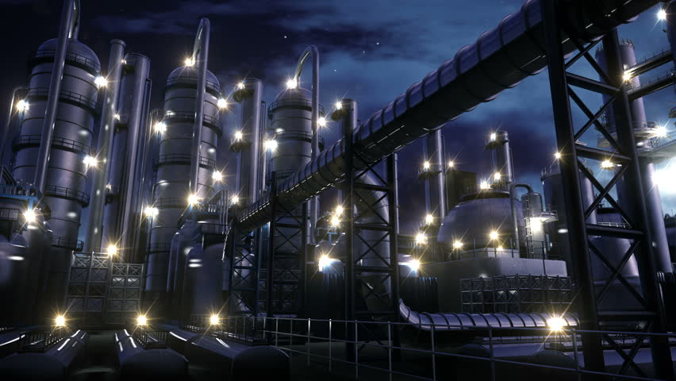
PREMISES, SURROUNDINGS & BUILDING SITE
Exterior Lighting
Exterior ligting attracts insects and hence location of these fixturez is of critical importance for preventing insects from entering the facility
The location of fixtures, especially when positioned over doorways, needs special attention.
Lighting be mounted on poles or standards, be at least 30 feet from buildings, and the light directed towards doorways and entrances
Lighting fixtures should be shielded with a non-breakable, transparent material.
Notes:
10

Slide 11
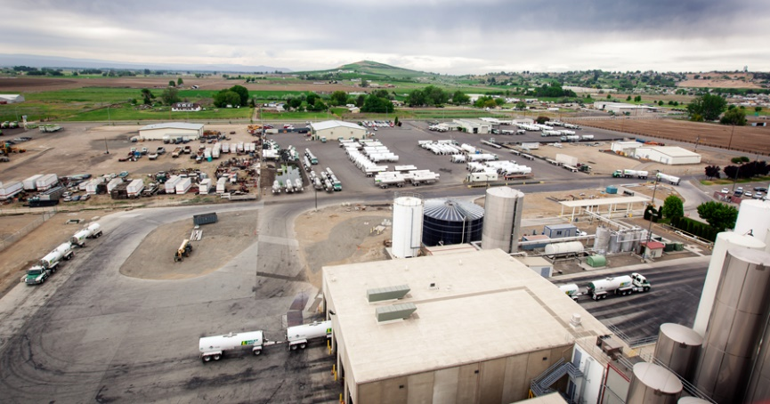
PREMISES, SURROUNDINGS & BUILDING SITE
Driveways and receiving areas
Receiving area is the last line of defense in protecting the building, care should be taken to make sure that such areas are designed to minimize contamination and intrusion from pests.
Driveways leading to receiving areas should be appropriately paved and constructed for adequate drainage.
Asphalt driveways should be avoided, as this material may attract rodents.
Drains should be designed with catch baskets for debris, and hose stations should be provided to facilitate cleaning and maintenance.
Bait stations and traps, where used, should be properly located.
Notes:
11

Slide 12
EXTERIOR BUILDING DESIGN & CONSTRUCTION
Objectives
The primary objective of sanitary design in building construction is to design and construct a building that is cleanable.
Other objectives are to minimize contamination and adequately seal food processing and handling areas from sources of contamination
Simple and inexpensive preventative measures can be built into building construction with regard to vermin proofing the building. For example, installing flanging to foundations below grade level will discourage rodents from burrowing under the floor slab.
Avoiding any horizontal ledges or overhangs in construction will discourage roosting or nesting of birds.
If ledges cannot be avoided, they should be sloped rather than flat or horizontal.
Preventing the entry of rodents and insects into buildings can be accomplished by sealing all openings to the outside which are 1/4 inch or greater.
Notes:
12

Slide 13
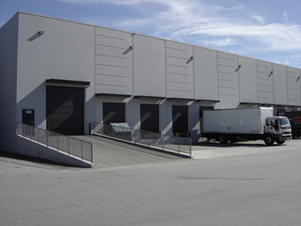
EXTERIOR BUILDING DESIGN & CONSTRUCTION
Loading Docks, Platforms, and Receiving Rooms
Receiving areas and rooms should be enclosed as much as is practicable
An improperly designed and constructed receiving room will provide an attractive harborage for birds, rodents, and insects
Loading docks should be at least 3 feet above ground with the underside lined with a smooth, galvanized metal or similar material with a 12 inch over-hang to prevent rodents from climbing into the building.
Properly installed rapid open/close doors or air curtains should be used to discourage entrance of insects and birds.
Overhangs should be constructed to be free of roosting and nesting areas for birds.
Notes:
13

Slide 14
EXTERIOR BUILDING DESIGN & CONSTRUCTION
Exterior Walls
Building materials used for exterior walls vary in their need for preventative maintenance with regard to re-caulking of joints. For example, a poured concrete wall, needs less maintenance than other materials because it does not have seams.
Low-density concrete block (e.g., cinder block), commonly used in domestic building, should be avoided unless an adequate sealer is used to avoid moisture intrusion and penetration of mold and mildew.
Concrete block walls should be sealed at the base and capped at the top.
Corrugated metal siding is the least desirable material for wall construction in a food handling facility.
If used, it is imperative that it be adequately caulked along the base and at the seams.
Notes:
14

Slide 15
EXTERIOR BUILDING DESIGN & CONSTRUCTION
Roofs
The roof should be designed and built so it can be kept clean, especially where there is the possibility of product spillage or deposition on the roof.
Food related dust (e.g. Flour, powdered milk, or grain) can accumulate on the roof and is an invitation to birds and insects.
Smooth membrane type roofs are often the most desirable type of roof for food processing facilities.
Tar and gravel roofs are usually not recommended as they tend to attract dust and are very difficult to clean and maintain.
Notes:
15

Slide 16
Exterior building design & construction
Openings into buildings
Any openings into buildings, including doors, windows, ventilation ducts, and other openings must be appropriately sealed and protected
Openings into the roof such as exhaust fans for air handling systems, ventilation ducts, and plumbing vent pipes must be sealed, and appropriately flashed and screened.
Windows are discouraged in food processing operations as they present sanitation problems due to glass breakage and overall maintenance considerations.
If used, windows should be designed to be flush with the inside wall and be permanently closed.
Sills should be sloped away from the wall at not less than a 45 degree angle to prevent birds from nesting or dust from collecting.
Notes:
16

Slide 17
INTERIOR BUILDING DESIGN & CONSTRUCTION
Objectives
The sanitary objectives for interior building design and construction are to:
  minimize potential harborages of pests and microorganisms;
  maximize cleanability; and
  maximize the protection of the food products from contamination.
  Having a facility designed and built to sanitary specifications does not guarantee a safe food product if the facility is not adequately cleaned and maintained on an appropriate schedule.
Notes:
17

Slide 18
INTERIOR BUILDING DESIGN & CONSTRUCTION
Interior Walls
A cleanable, sanitary wall is one that is
  hard, flat, and smooth;
  free of pits, cracks, checks, and crevices;
  impervious and non-absorbent;
  resistant to cleaning and sanitizing chemicals;
  corrosion resistant;
  durable, easily maintained, and wear resistant; and
  properly installed, sealed, and covered
Acceptable surfaces and materials for walls
  Seamless Poured Concrete is often recommended, because of its lack of seams and associated maintenance requirements. However, such walls should be finished smooth and sealed
Notes:
18

Slide 19
INTERIOR BUILDING DESIGN & CONSTRUCTION
Interior Walls
  Concrete Block walls should be heavy density, non-porous blocks. Concrete block walls should be installed in a stack bond pattern (with reinforcement), rather than a running bond pattern
Notes:
19

Slide 20
INTERIOR BUILDING DESIGN & CONSTRUCTION
Interior Walls
  Fiberglass Panels are a highly acceptable wall material and are commonly used in newly constructed facilities. Gel coated, reinforced fiberglass panels are most recommended
  Glazed Ceramic Tile, due to its durability and resistance to a wide range of chemicals, is the most highly recommended wall material in wet processing areas and is often used in dairy and beverage plants.
  Wood (e.g., plywood, pressed wood), due to its porosity, is not recommended and should be avoided for interior walls in food facilities. Wood cannot be adequately sealed.
  Metal panels (e.g., stainless steel, galvanized metal) are not usually recommended for walls in a food facility due to condensation problems. Plus, expansion and contraction of metal panels make maintenance of the seam seals very difficult.
Notes:
20

Slide 21
INTERIOR BUILDING DESIGN & CONSTRUCTION
Interior Walls
Walls should be covered with a light colored paint and caulked, sealed or grouted appropriately at joints and junctions.
Junctures between walls and ceilings, and between walls and floors should be rounded (or coved) with a radius of one inch or greater. Coving minimizes a right angle crevice, which is difficult to clean and maintain.
Notes:
21

Slide 22
INTERIOR BUILDING DESIGN & CONSTRUCTION
Ceilings
Improperly installed ceilings, ceilings that promote condensation, or poorly maintained ceilings (e.g., flaking paint) can increase the potential for overhead contamination of food products.
Concrete ceilings are often recommended due to durability and minimal maintenance requirements. The most recommended installation is the concrete slab with exposed double tee beam construction, which avoids ledges associated with I-Beam construction. Concrete ceilings should be ground smooth, appropriately finished, and caulked at the joints.
Metal ceilings are not recommended due to condensation maintenance problems. Joints in metal panel ceilings are very difficult to maintain
Wood ceilings, due to their porosity, are impossible to clean and maintain and must be avoided.
Dropped ceilings are acceptable only if properly installed. False ceilings, which create a crawl space above the ceiling for utilities and services, should be avoided
Notes:
22

Slide 23
INTERIOR BUILDING DESIGN & CONSTRUCTION
Insulation
Insulation should be installed so that it is not exposed and is sealed off from food processing and handling areas. The insulation material should be:
nontoxic;
odorless;
unattractive to pests; and
non-contaminating.
Fiberglass batting insulation should also be avoided as it attracts insects and rodents, and the fibers may become airborne causing a contamination hazard
Acceptable materials include: Styrofoam panels, foam glass, and urethane.
Notes:
23

Slide 24
INTERIOR BUILDING DESIGN & CONSTRUCTION
Floors
Floors should be smooth, impervious, non-absorbent, corrosion resistant, cleanable and in good repair. For safety considerations, floors should not be so smooth that they cause employees to slip and fall.
the floor should be installed to provide adequate slope for drainage and prevention of pooled water.
The most recommended are sealed concrete, epoxy sealed concrete, quarry tile, and glazed tile.
Unsealed concrete floors should be avoided as they are highly porous and break down with continued exposure to chemicals. Once cracks, crevices, spalls, or other damage occurs, a concrete floor is especially vulnerable to harboring microorganisms.
Notes:
24

Slide 25
INTERIOR BUILDING DESIGN & CONSTRUCTION
Drains
Floor drains are a major source of microbial contamination in a food processing facility. Floor drains should be:
  of adequate number and size;
  appropriately located;
  designed and installed so that they are cleanable; and
  maintained in good repair.
Circular, catch basket drains are most often recommended provided that they are appropriately sealed and grouted to the floor, and are maintained in good repair.
A trench drain should be constructed and installed to provide adequate slope or grade ensuring there is no standing water in the trench.
Notes:
25

Slide 26
INTERIOR BUILDING DESIGN & CONSTRUCTION
Interior Lighting
Light fixtures should be of the type approved for food facilities, and should be equipped with break resistant lenses or shatterproof shielding.
The fixtures should be designed to be moisture resistant and cleanable
A general suggested range of lighting recommendations is as below:
Area | Lighting Intensity (Foot Candles)
Raw material receiving | 20-30
Ingredient warehouse | 20-30
Bulk ingredient storage | 30-40
Processing departments | 55-65
Product inspection | 110-130
Packaging | 70-80
Notes:
26

Slide 27
INTERIOR BUILDING DESIGN & CONSTRUCTION
Interior Lighting
1 Foot Candle= 10.76 Lux
Area | Lighting Intensity (Foot Candles)
Finished product warehouse | 20-30
Maintenance areas | 70-80
Administrative offices | 60-90
Cafeteria | 40-50
Locker rooms/ restrooms | 30-50
Notes:
27

Slide 28
INTERIOR BUILDING DESIGN & CONSTRUCTION
Heating,Ventilation and Air Conditioning (HVAC) Systems
Heating, ventilation, and air conditioning (HVAC) systems function to maintain the temperature and humidity of a facility
Systems should be constructed, designed, installed, cleaned, and maintained so that they are not a source of contamination. For example, the air supply should be located to not draw air from nearby sources of contamination (e.g., chemicals, bird droppings); adequate filters should be installed (and changed frequently); and duct work should be located outside of the processing areas.
Air handling systems should be designed to be cleanable
Care should be used in using corrosive chemicals in cleaning these systems.
Notes:
28

Slide 29
INTERIOR BUILDING DESIGN & CONSTRUCTION
Hand washing sinks
Hand washing sinks, lavatories, or stations should be:
  conveniently located near food operations;
  of sufficient number based on the size and function of the operation;
  constructed and installed to meet plumbing codes including appropriate backflow prevention and no submerged inlets;
  installed with faucets of sanitary design (preferably foot or electric eye operated);
  supplied with hot (not steam) and cold water in order to provide an adequate flow of water at 85°–100°F;
  provided with an adequate supply of soap, single service towels, and a covered waste receptacle; and
  maintained, cleaned, and kept in good repair.
Notes:
29

Slide 30
INTERIOR BUILDING DESIGN & CONSTRUCTION
Employee Facilities, Locker Rooms & restrooms
Maintenance and construction recommendations for walls, ceilings, and floors of locker rooms, restrooms, and related facilities should meet the same criteria as those for other areas of the facility.
Lockers should be sealed to the wall and should have sloped, rather than flat, tops to prevent accumulation of dust and debris.
Employee facilities should not open directly into processing or other critical areas. Most food regulations require a two-door separation between locker rooms or restrooms and food processing areas or food handling areas.
Notes:
30

Slide 31
INTERIOR BUILDING DESIGN & CONSTRUCTION
Freezers, Refrigerators, and Coolers
Permanent freezing and refrigeration rooms should meet the same sanitary construction and design criteria as other rooms in the food facility
These units must be installed with sufficient space between the unit and the wall (approximately 18 inches) to allow accessibility for cleaning.
Refrigeration units, due to coils, fins, and other dust collection points, can also be a source of contamination. These units should be designed and installed for adequate cleaning.
A major contamination problem area is the condenser draining system. Drains, trays, and pans should be installed to prevent overhead contamination of stored food products, and should be flushed and cleaned daily
Drain lines exiting refrigeration rooms or boxes should be installed to drain into a floor drain, with an appropriate air gap, and should not drain directly into critical food processing and handling areas.
Notes:
31

Slide 32
INTERIOR BUILDING DESIGN & CONSTRUCTION
Overall “Protection from Contamination” Features of Interior Construction
A sanitary food processing and handling facility must also have designed-in (integrated) features to protect the food products from contamination
Facilities should be periodically inspected and evaluated for potential contamination of product due to the facilities themselves.
Utility and water supply lines, and other accoutrements hung or attached to the wall or ceiling must be appropriately caulked and sealed to the wall or mounted in such a way to allow cleaning behind and around. For example, it is recommended that a minimum of 1 inch clearance be allowed for cleaning around and behind items hung on walls
Electrical boxes and related equipment should be water proof and of acceptable sanitary design
Exposed threads should be minimized on hangers used for piping and other equipment or other attachments, as they accumulate dirt and dust.
Wherever appropriate, shielding should be provided over product conveyances and areas where food products are exposed.
Notes:
32

Slide 33
OPERATIONAL FLOW AND FACILITY LAYOUT
Operational Flow-Through Pattern
Ideally, a facility should be designed to provide a flow pattern for food products (as well as personnel and equipment) to prevent potential contact of the finished product with raw materials.
Flow should be in one direction and follow a logical sequence from raw material handling to finished product storage
Notes:
33

Slide 34
OPERATIONAL FLOW AND FACILITY LAYOUT
Operational Flow-Through Pattern
Notes:
34

Slide 35
OPERATIONAL FLOW AND FACILITY LAYOUT
Physical Separation
As much as is practicable, there should be a physical separation between raw and finished products and minimal entry into critical areas.
Such physical separation should be accomplished by installation of walls and doorways with anti-back tracking features, and by adjusting air handling systems to provide positive pressure in finished product rooms.
As the best physical separation can be undermined by human error or improper personnel flow, there should be an operational and philosophic separation between raw and finished product. This can be accomplished by barring employees working with raw materials from entering finished product rooms, this includes maintenance and janitorial staff.
Separation can also be accomplished by the installation of sanitizer systems (e.g., foot baths, spray systems) inside entrance doors to critical areas.
Notes:
35

