Slide 1
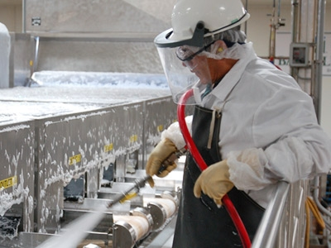
CONCEPTS OF CLEANING AND SANITIZATION

Slide 2
AGENDA
1
Why clean and sanitize?
2
Sanitization Controls
3
Soils in a food processing plant
4
How to clean?
5
Chemical selection and requirements
6
The 5 step process
7
Chemical safety

Slide 3
WHY CLEAN AND SANITIZE?
Prevent transfer of ingredients
Avoid microbial contamination
Same line. Cross contamination of products an chemicals is undesirable in case of many products being manufactured on the
This can lead to a number of problems- reduced product quality harm to health or life threatning circumstamnces in some cases.
Ensure Sanitization efficiency
Improve plant efficiency
Soils impacts the effectiveness of a sanitizer.
The less soil on the surface, the more effectice is the sanitization.
Soil contamination reduces the efficiency of the equipmemnt and the production process.

Slide 4
WHY CLEAN AND SANITIZE?
Increase ssafety
Positive financial impact
Facilities not cleaned regularly have potential safety risks- spills & falls.
Also, major incidents due to build up of soil in equipment can also occur.
  Reducing waste from spoilage can significantly extend the life of equipment and machinery
Minimize legal issues
Boost stakeholder confidence
Although it may not be common knowledge, there are often legal requirements for food facilities to clean surfaces and equipment to a specific standard
  The psychological benefits & confidence of clean, hygienic equipment & tidy surroundings have significant impact on both worker satisfaction and customer confidence.

Slide 5
SANITIZATION CONTROLS
Cleaning Vs. Sanitization
Cleaning
Sanitization
  Removes soils from the surfaces of equipment
  Reduces the micro-organisms on the surfaces
Remember: “An area must be cleaned before it can be sanitized. You can’t sanitize dirt !!
Key concepts of sanitization controls
What?
How?
Knowing what to clean?
What soils (dirt) are present
Best practices for cleaning steps & washing factors
Understanding how to handle cleaning chemicals safely

Slide 6
WHAT TO CLEAN?
Cleaning Areas
Keep in mind!
  Apart from food contact surfaces various other parts of the plant are to be cleaned and sanitized to maintain a sanitary environment for food processing
  Food Contact Surfaces (equipment surfaces, tables & preparation areas, conveyors, utensils, bins & totes, packaging materials)
  Outside of equipment (body, pipelines)
  Environment (floors, drains, walls, light fixtures)
  Equipment design and plant layout should be considered from a clean ability perspective. One needs to reach around and under equipment to clean it properly.

Slide 7
SOILS IN A FOOD PROCESSING PLANT
What are food soils (dirt)?
Types of Soils
  Unwanted matter on food-contact surfaces. Soil is visible or invisible. The primary source of soil is from the food product being handled. However, minerals from water residue and residues from cleaning compounds contribute to films left on surfaces.
  Microbiological biofilms also contribute to the soil buildup on surfaces.
Fats, oils & greases
Proteins
Carbohydrates and starches
Lime scale
Rubber marks
Corrosion deposits
Adhesives
Inks & dyes
Algae
Fungi

Slide 8
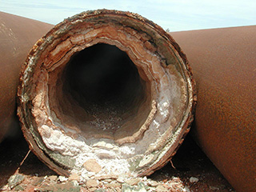
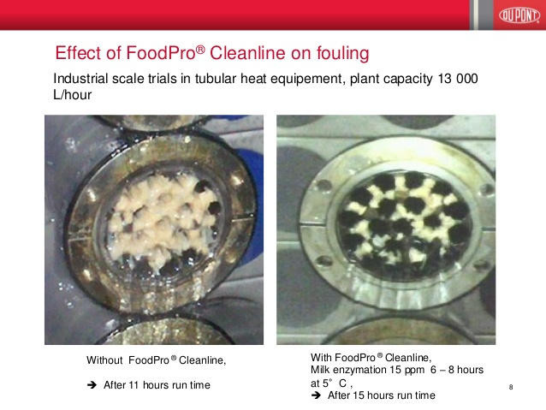
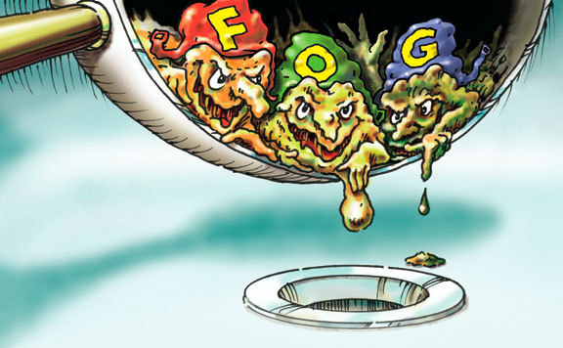
SOILS IN A FOOD PROCESSING PLANT
Lime scale
Fouling in product line
Fats, oils & greases

Slide 9
HOW TO CLEAN?
Follow SSOP’s
Sanitization Standard Operating Procedures (SSOP’s) are written step by step instructions on cleaning equipment , process lines, environmental areas & master sanitation schedules.
The specific steps used to clean & sanitize equipment & environmental areas are unique to each processor.
General types of sanitization
Thermal Sanitization: It involves the use of hot water or steam for a specified temperature and contact time.
Chemical Sanitization: It involves the use of an approved chemical sanitizer at a specified concentration and contact time.

Slide 10
HOW TO CLEAN?
Equipment classification
Mechanical Cleaning
Equipment can be categorized with regard to cleaning method as
CIP
COP
Manual
Often referred to as clean-in-place (CIP)
Requires no disassembly or partial disassembly
Clean-out-of-Place (COP)
Manual Cleaning
Can be partially disassembled and cleaned in specialized COP pressure tanks
Requires total disassembly for cleaning and inspection.

Slide 11
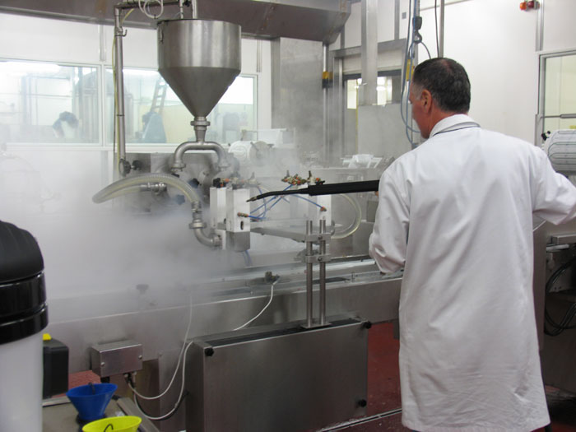
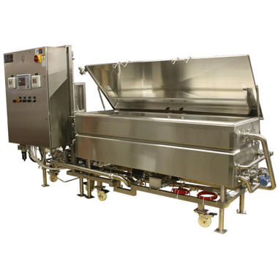
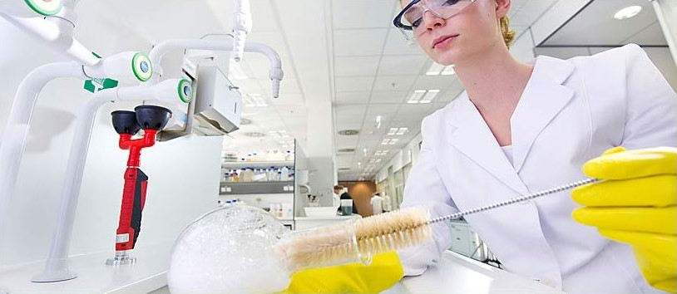
HOW TO CLEAN?
Mechanical Cleaning
Clean-out-of-Place (COP)
Manual Cleaning

Slide 12
CHEMICAL SELECTION & REQUIREMENTS
Selection
Requirements
  The selection of cleaning & sanitizing chemicals for use in a food processing facility depends upon
    Soil type
    Surface type
    Application method (CIP/COP/Manual)
    Water quality
Different parts of the plant require different types of cleaners. For E.g. CIP system does not require cleaners that foam as much as manual cleaners.
Sanitizers usually have a period of effectiveness that only lasts for several hours, so if you sanitize the equipment after cleaning it the night before, you may need to sanitize again just prior to processing.

Slide 13
THE 5 STEP PROCESS
Dry Cleaning
Simply using a broom or brush to sweep off food particles and soil from surfaces
Pre-rinse
  Uses warm water (100-120°F) to remove small particles missed in the dry cleaning step and prepares surfaces for application of detergent.
Wash
Remove all soils by following all SSOP’s for cleaning procedures and chemical selection
Factors: Time, Action, Concentration, Temperature

Slide 14
THE 5 STEP PROCESS
Wash (Time)
Too little, not enough surface interaction
Too much, temperature cools, detergent deposits
Just right, surface wets, soils are removed & washed away
Wash (Action- Mechanical Force)
  Loosens soils and disrupts biofilms
  Need to have contact with all surfaces
  Use turbulent flow, slugging
Wash (Chemical Concentration)
Too little, not enough cleaning power
Too much, reduced efficiency, leaves residues, money wasteage
Just right, does the job

Slide 15
THE 5 STEP PROCESS
Wash (Temperature)
Use the correct temperature according to the SSOP’s
Water should be 120°F at the end of wash cycle
Too hot: proteins denature & deposit, dangerous for personnel
Post-rinse
  Removes detergent and Chlorine
  Rinse water may be acidified (Acid rinse)
  Removes minerals and prevents mineral deposits
Sanitize
Reduces the number of microorganisms on the surface
Sanitizes surfaces before use
Only clean surfaces can be sanitized

Slide 16
CHEMICAL SAFETY
People that work with cleaning & lab chemicals should know
Correct chemical use
Chemical Properties
The right chemical & concentration
Correct mixing and usage procedures
How to label & store chemicals properly
The physical state, concentrarion, pH
Physical hazards(flammable, explosive, reactive)
Health hazards (burns, poisons etc)
Personal Protective Equipment
Examples
Gloves, lab coats, coveralls & footwear
Eye, face & head protection required
Use the correct materials for the task
Use chemical rated gloves, not latex gloves for handling cleaning chemicals
Wear a full mask when handling caustic & acidic cleaning chemicals.

Slide 17
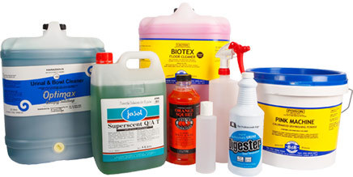
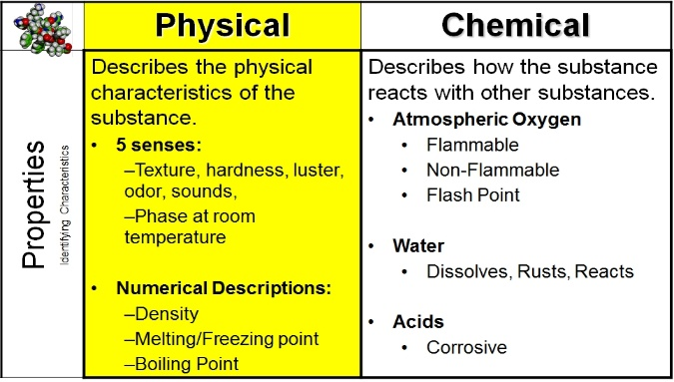
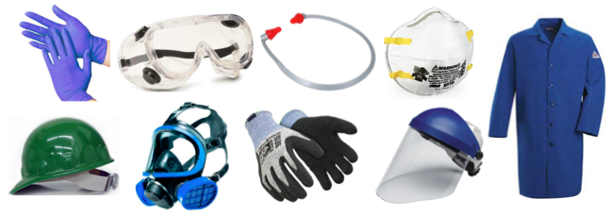
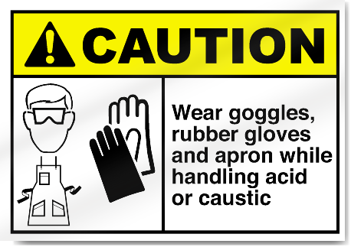
CHEMICAL SAFETY
People that work with cleaning & lab chemicals should know
Correct chemical use
Chemical Properties
Personal Protective Equipment
Examples

