Slide 1
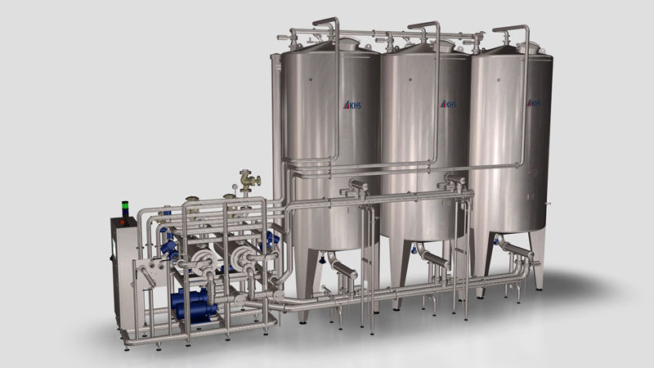
CLEAN IN PLACE (CIP)

Slide 2
AGENDA
1
What is CIP?
2
Why CIP?
3
5 T’s of CIP
4
Cleaning chemicals in CIP
5
Parameters specification for effective CIP
6
CIP and micro-organisms

Slide 3
WHAT IS CLEAN IN PLACE ?
CLEAN IN PLACE (CIP)
It is a method of cleaning the interior surfaces of pipes, vessels, process equipment, filters and associated fittings, without disassembly.
Industries that rely heavily on CIP are those requiring high levels of hygiene, .i.e. dairy, beverage, brewing, processed foods, pharmaceutical, and cosmetics.
CIP Design Principle
Depending on soil load and process geometry, the CIP design principle is one of the following
  deliver highly turbulent, high flow-rate solution to effect good cleaning (applies to pipe circuits and some filled equipment).
  deliver solution as a low-energy spray to fully wet the surface (applies to lightly soiled vessels where a static spray ball may be used).
  deliver a high energy impinging spray (applies to highly soiled or large diameter vessels where a dynamic spray device may be used).

Slide 4
WHY CLEAN IN PLACE
CIP systems have several advantages over the former manual cleaning
More consistent results
Better plant usage
Accurate and rapid monitoring
Repeatability
Less down time
Fully automated processes
Less manual work
Great safety
No need for dismantling equipment
Lesser human errors
Protection from heat and chemicals
Cost savings
Quality
Better usage of water, chemicals and energy
Consistency in terms of quality

Slide 5
5 T’S OF CIP
CIP effectiveness depends totally on the correct functioning of the 5 T’s
Titration
(1.5%)
Chemical concentration in the supply tanks, in the circuits
Turbulence (1.5m/s)
Flow velocity in all parts of the system being cleaned
Temperature (~70°C)
Temperature of the cleaning solution and water at the beginning & end of the cicut
Time
(15 min)
Duration of eachstep of th CIP procedure and the total CIP time
Technology (Design)
Total design of the complete line including all circuits to and from the chemical and water tanks

Slide 6
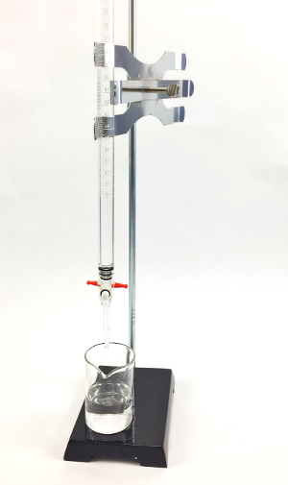
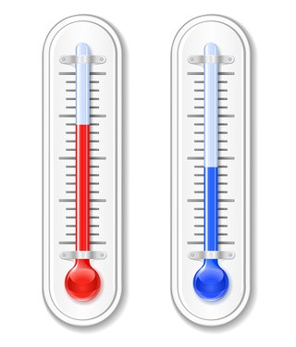

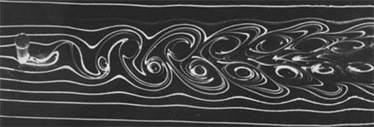
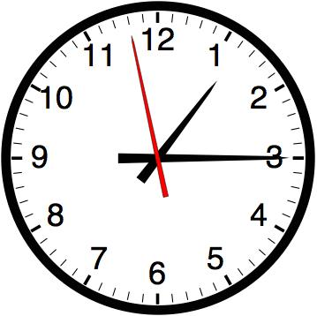
5 T’S OF CIP
Technology
Temperature
Titration
Time
Turbulence

Slide 7
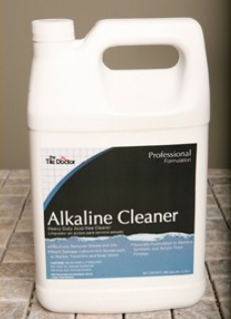
CLEANING CHEMICALS IN CIPITEMS
Alkaline Agents
Acid Agents
Alkaline cleaning solutions dissolve proteins and saponify salts
The typical and most frequent alkaline agent used in the composition of the detergents is Sodium Hydroxide (NaOH), otherwise known as caustic soda
Acid solutions are used for removing hard deposits such as milk stone (calcium phosphate) and water scale.
The deposits are typically formed on hot surfaces and they cannot dissolve in alkalis.
Acid solutions are most effective when used at pH 2.5 or lower & they leave surfaces without film
HNO3, H3PO4 are the most frequent acid agents used

Slide 8
PARAMETERS SPECIFICATION FOR EFFECTIVE CIPITEMS
Flow velocity
In all parts of the system it should be sufficient to cause turbulent flow. This is around 1.5-2 meters per second.
Below this laminar flow will occur which will not yield effective cleaning.
Spray pressure and pattern
Where spray balls and rotating jets are used in large tanks sufficient pressure should be used for full coverage.
Typical pressures are 1-3 bar for low pressure systems and 6 bar for high pressure. Flow rates of about 2 times the vessel’s volume per hour should be used.
Temperature
This impacts on the rate of chemical reaction. Typical temperatures can be around 85° C.

Slide 9
PARAMETERS SPECIFICATION FOR EFFECTIVE CIPITEMS
Detergent
This is normally achieved through a conductivity meter and control system linked to an automatic dosing system.
Recycling
Required to manage costs and environmental impact.
Solution recovery and reuse is ideal but must be controlled to avoid overloading of the solution and contamination risks.

Slide 10
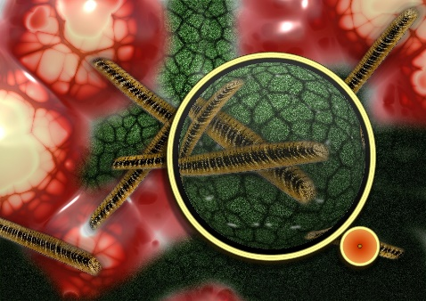
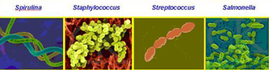
CIP AND MICRO-ORGANISMS
Soil on equipment can provide micro-organisms with nutrients for growth
Pathogenic microorganisms
Spoilage micro-organisms
Pathogenic micro-organisms are a major food safety concern since they cause food borne illnesses.
Pathogenic micro-organisms do not usually change the appearance, smell or taste of the contaminated food.
Examples of pathogenic micro-organisms are Salmonella spp. and some types of Escherichia coli.
Spoilage micro-organisms, although they are not a food safety concern, are a food quality concern since they deteriorate foods and reduce their shelf life.
Growth of spoilage micro-organisms produces undesirable changes in flavor, smell and appearance of the contaminated food.

