Slide 1
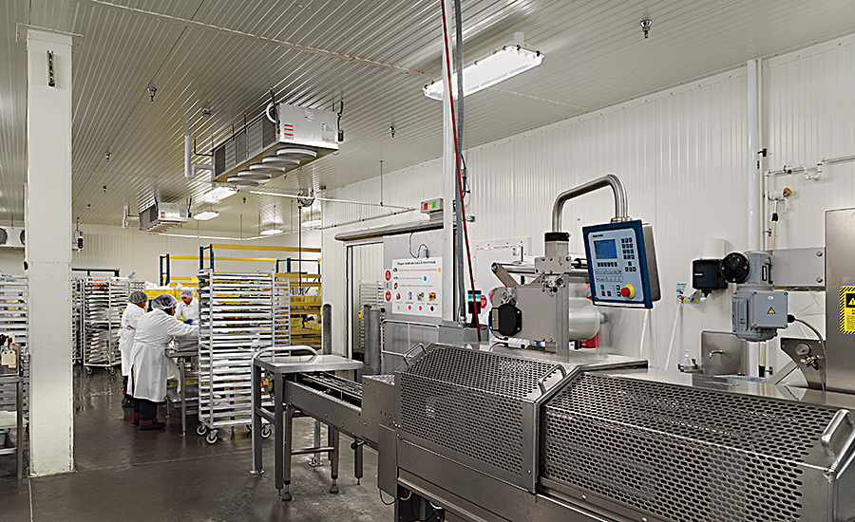
HYGIENIC DESIGN OF FOOD FACILITY

Slide 2
AGENDA
1
Hygienic food factory design
2
Barrier Technology
3
Zoning: Corestone for Food contamination prevention
4
Costruction of facilities
Notes:
2

Slide 3
HYGIENIC FOOD FACTORY DESIGN
Hygienic food factory design provides
Defence against external factory hazards
Defence against internal factory hazards – no harbourage sites and ease of cleaning
Internal flows of people, product, packaging, air and wastes to prevent cross-contamination
Security against deliberate contamination
The maintenance of hygienic conditions via structure rigidity – appropriate foundations, steelwork, floor slabs
The Maintenance of hygienic conditions via material durability
Compliance with customer/GFSI best practice
Notes:
3

Slide 4
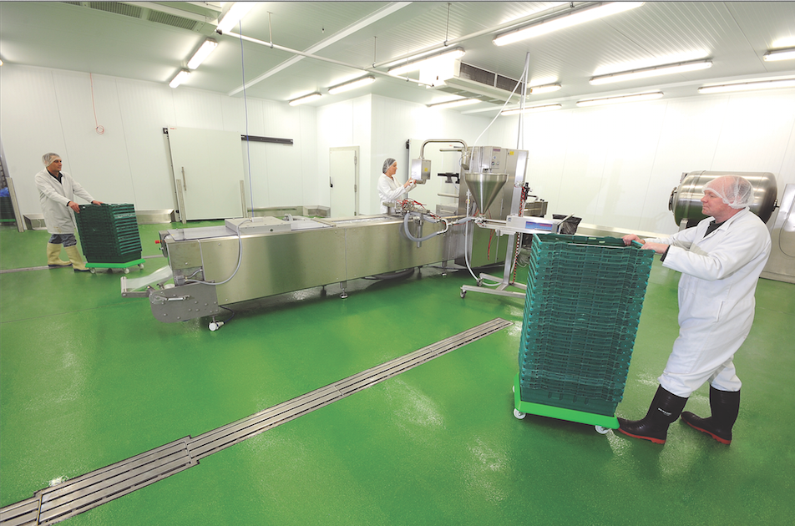
HYGIENIC FOOD FACTORY DESIGN
Hygienic food factory design provides
Notes:
4

Slide 5
HYGIENIC FOOD FACTORY DESIGN
Hygieninc food factory design provides
To control food safety, providing barriers to food contamination is a generally applied concept. The three barriers being:
  Outside premises
  Closing of factory buildings
  Segregation of restricted areas
Barrier 1: Outside premises
This is to prevent unauthorized access to the facility.
The access of transport vehicles with raw materials and end-products, personnel, domestic and non-domestic animals should be monitored and controlled.
Areas within a 3-m perimeter of the factory must be kept vegetation free to avoid pest breeding and harborage sites
Notes:
5

Slide 6
HYGIENIC FOOD FACTORY DESIGN
Barrier 2: Closing of factory buildings
All entrances/exits must be designed for control over access, flow or exit of personnel, raw and finished food products, air, process aids, waste, utilities and pests.
Floor drains must be screened to avoid rats from entering the food plant via sewers; ventilator openings, including vents in the roof, should be screened to prevent the entry of roof rats, insects and birds
Barrier 3: Segregation of restricted areas & processing equipment
Each area has different hygiene requirements and controlled access
Processing equipment (including storage and conveying systems), must have an adequate hygienic design and must be closed to protect the food product from external contamination.
Notes:
6

Slide 7
ZONING: CORESTONE FOR FOOD CONTAMINATION PREVENTION
Basic Hygiene Zone
Zone B
  Area in which a basic level of hygienic design requirements suffices.
  It encompasses areas in which products are produced that are not susceptible to contamination or that are protected in their final packages
Zone B₀
  Area outside the buildings within the perimeter of the site where the objective is to control or reduce hazards created by unauthorized personnel entry and hazards created by water, dirt, dust and presence of animals.
Zone B₁
  B1 zones include warehouses that store both raw materials and packed processed products, offices, workshops, power supply areas, canteens and redundant buildings/rooms.
  The objective is to control or reduce hazards created by birds and pests.
Notes:
7

Slide 8
ZONING: CORESTONE FOR FOOD CONTAMINATION PREVENTION
Medium Hygiene Zone
Zone M
  Area in which medium level of hygienic design requirements suffices.
  It includes process areas where products are produced that are susceptible to contamination, but where the consumer group is not especially sensitive and where no further microbial growth is possible in the product in the supply chain
  In this area, product might be exposed to the environment, during sampling and during the opening of equipment to clear blockages
  The objective is
    to control or reduce the creation of hazardous sources that can affect an associated area of higher zone classification
    the protection of the interior of food processing equipment from contamination when exposed to the atmosphere.
Notes:
8

Slide 9
ZONING: CORESTONE FOR FOOD CONTAMINATION PREVENTION
High Hygiene Zone
Zone H
  Area where the highest level of hygiene is required
  A “High Hygiene” room, which, in food processing is the equivalent of a cleanroom, must be completely contained
  Zone H is typical for open processing, where even short exposure of product to the atmosphere can result in a food safety hazard.
  Products and ingredients that are processed or stored and are destined for a highly susceptible consumer group (e.g., infant nutrition), are instant in nature or ready for consumption.
  The objective is
    To control all product contamination hazards and to protect the interior of food processing equipment from exposure to atmosphere. Filtered air must be supplied to this area.
Notes:
9

Slide 10
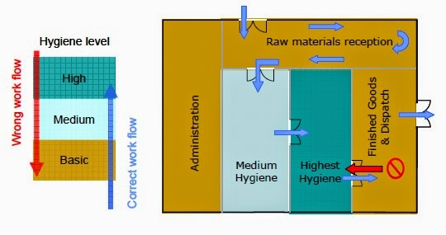
ZONING: CORESTONE FOR FOOD CONTAMINATION PREVENTION
Hygiene Zone
Notes:
10

Slide 11
CONSTRUCTION OF FACILITIES
1. Appropriate Layout
The layout and design of the food factory must be adapted to the hygienic requirements of a given process, packaging or storage area.
The interior of the factory must be designed so that the flow of material, personnel, air and waste can proceed in the right direction.
As they become incorporated into food products, raw materials and ingredients should move from the ‘dirty’ to the ‘clean’ areas
the flow of food waste and discarded outer packaging materials should be in the opposite direction.
To meet a possible increase of processing activities within the food plant in the future, the building and its food processing support systems should be designed so they can either be expanded, or another building and/or utilities can be added
Notes:
11

Slide 12
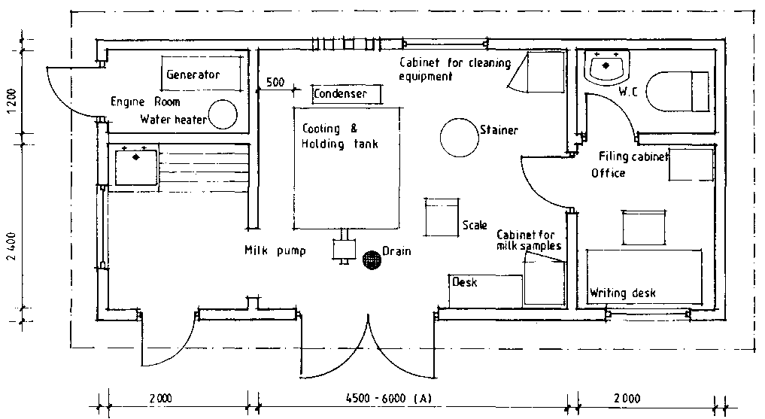
CONSTRUCTION OF FACILITIES
1. Appropriate Layout
Notes:
12

Slide 13

CONSTRUCTION OF FACILITIES
2. Pest Prevention
To exclude flooding and the entry of rodents, factories should be built at a higher level than the ground outside
Exterior doors should not open directly into production areas, and windows should be absent from food processing areas.
The number of loading docks should be minimal and be 1–1.2 m above ground level
Areas beneath docks should not provide harborages for pests, should be paved and should drain adequately
To prevent the entry of insects, dock openings should be provided with plastic strips or air curtains, and external lighting to illuminate these factory entrances should be placed in locations away from the factory building
Intruding insects can be attracted & killed within the factory by strategically positioned UV light electric grids or adhesive glue board traps.
Notes:
13

Slide 14
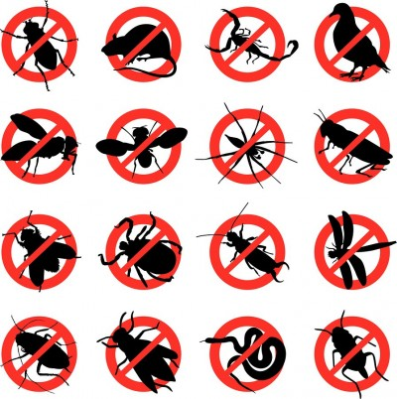
CONSTRUCTION OF FACILITIES
2. Pest Prevention
Notes:
14

Slide 15
CONSTRUCTION OF FACILITIES
3. Interior Hygienic Design Construction Materials
Construction materials for equipment and utility piping should be
hygienic (smooth, non-absorbent, non-toxic and easily cleanable)
chemical-resistant (to product, process chemicals, cleaning and sanitizing agents)
physically durable (unbreakable, resistant to steam, moisture, cold, abrasion and chipping)
easy to maintain
Materials used to construct process and utility systems located in the non-food contact area may be of a lower grade than those applied in the food contact zone.
Surfaces that are frequently wet should not be painted as the paint can crack, flake and chip.
Notes:
15

Slide 16
CONSTRUCTION OF FACILITIES
3. Interior Hygienic Design Construction Materials
Lead, mercury and cadmium should not be used within the factory.
In the food contact area, electric components must always be enclosed in junction boxes, casings, closed cable housings, cabinets, etc. or should be installed in non-product contact zones or in technical corridors
Alloys for food contact may only contain aluminum, chromium, copper, gold, iron, molybdenum, nickel, platinum, silver, titanium, zinc, carbon, etc.
Zinc, copper, aluminum, bronze, brass, carbon and galvanized and painted steel have poor resistance to detergents, disinfectants, acidic food and steam and must be avoided in food contact areas.
Epoxy can be used as floor, wall and ceiling coatings

Slide 17
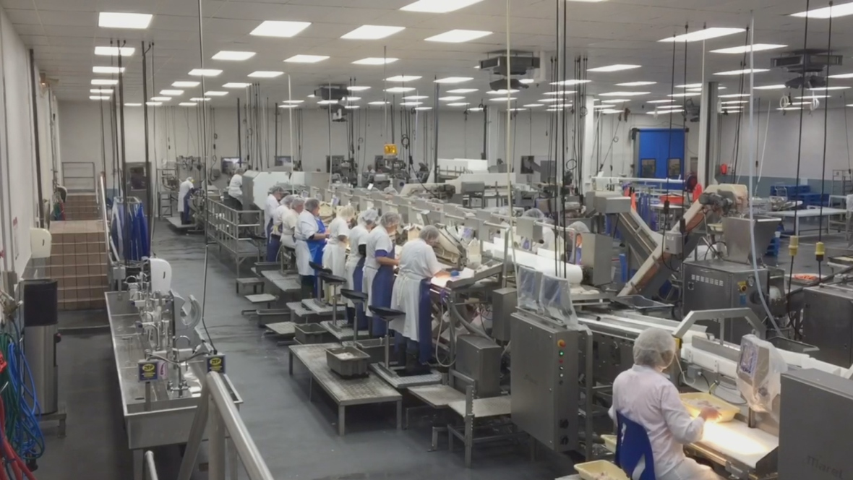
CONSTRUCTION OF FACILITIES
3. Interior Hygienic Design Construction Materials
Notes:
17

Slide 18
CONSTRUCTION OF FACILITIES
4. Integration of Piping
Utility piping in technical corridors or zone H areas should be integrated into wall compartments or the ceiling
If this is not possible, it is recommended to use open racks, fixed to the ceiling, or walls and columns close to the ceiling
sufficient clearance must be provided between pipe runs and adjacent surfaces so that both are readily accessible for cleaning and maintenance.
The pipe racks must be designed hygienically to minimize the presence of horizontal ledges, crevices or gaps where inaccessible dirt can accumulate
Food processing support piping should be directly routed from service rooms to process areas and should always be logical and simple.
The amount of utility piping should be minimized
Especially in process, hot water and process steam piping, standing “pools” of liquid that can support the growth of microorganisms must be avoided

Slide 19
CONSTRUCTION OF FACILITIES
4. Integration of Piping
To remove condensate, steam traps should be located at all low, convenient points along any extended pipe length. Steam purges for relief of steam condensate in a drain should be closely connected to that drain
Discharge of condensate from the system should be via an air break to prevent back-siphonage. Neither process nor utility piping should have dead legs.
Vertical entrance of piping into the equipment or equipment jacket is more hygienic than horizontal utility piping runs
Running of process and utility piping over open equipment in food preparation areas cannot be accepted, and nesting of ductwork should be avoided
Piping should be installed at least 6 cm from walls and floors to encourage thorough cleaning around it
Piping in corners should be avoided, as it hampers thorough cleaning. Process equipment shall be installed such that enough space is provided to facilitate pipe cleaning.

Slide 20
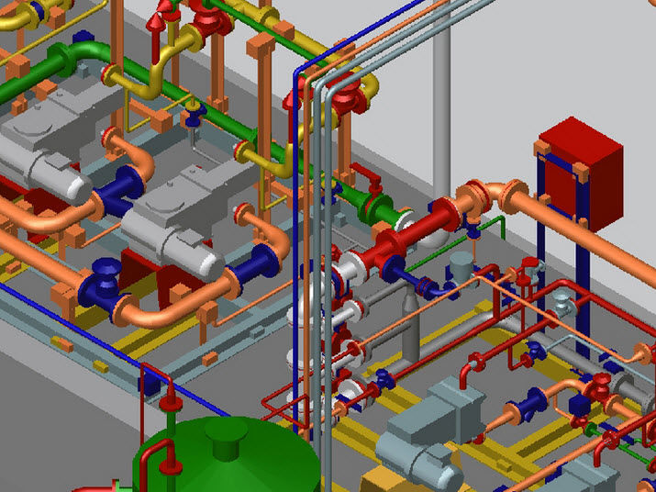
CONSTRUCTION OF FACILITIES
4. Integration of Piping

Slide 21
CONSTRUCTION OF FACILITIES
5. Penetration of Piping through Walls, Ceilings and Floors
Piping that transports dirty fluids should not run in the vicinity of or cross utilities that transport process aids, especially if these process aids are in direct contact with the food to be processed
food processing support piping should run uni-directionally, with the support piping running from the cleanest area toward the least clean areas.
Support systems should deliver a certain process aid first in the process area with the highest hygienic risk (zone H) and last in the zone of lowest hygienic risk (zone L).
Pipeline penetration through walls, ceilings and floors should be minimized, as holes in these areas can lead to sanitation problems and can invite the entry of insects and rodents.
Openings in floors for pipes should be guarded with a sleeve to avoid spill of cleaning solutions onto a lower floor. When several pipes penetrate the floor, a larger curbed floor can replace several pipe sleeves to improve the clean ability of the surrounding process environment

Slide 22
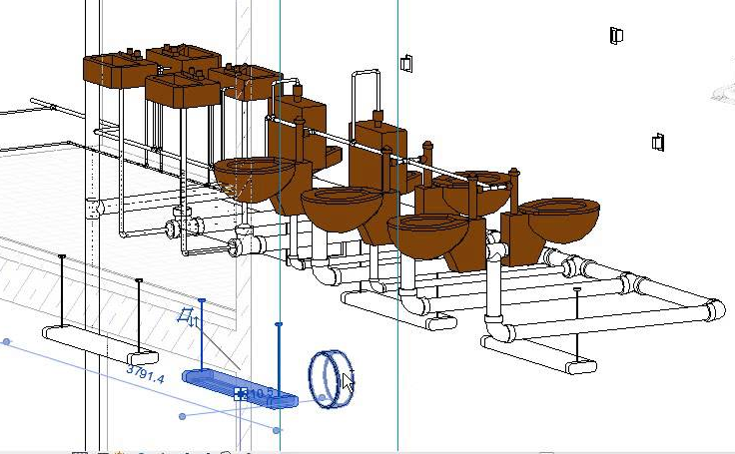
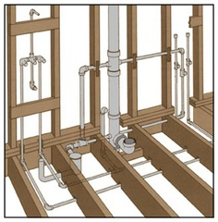
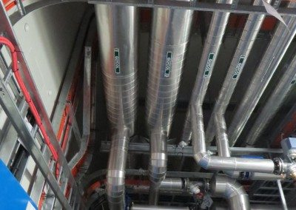
CONSTRUCTION OF FACILITIES
5. Penetration of Piping through Walls, Ceilings and Floors

Slide 23
CONSTRUCTION OF FACILITIES
6. Sanitary Insulation of Piping
Hot piping should not run in the neighborhood of piping that transports cold food products, cold process water, etc. The warm-up of these cold liquids can give rise to the growth of food pathogens
Insulation of hot piping is required, not only to economize on energy, but also to prevent excessive heating of the food production environment above acceptable temperatures.
Poorly insulated ethylene glycol and cold/chilled water piping can sweat or be covered with ice, resulting in dripping water
To avoid ingress of dust, vermin, etc. into the insulation, fully welded metal cladding or plastic covering be installed.
Damage to insulation can be inhibited by covering the pipe insulation with a smooth, hard, non-electrostatic, plastic cover, rather than steel sheet cladding

Slide 24
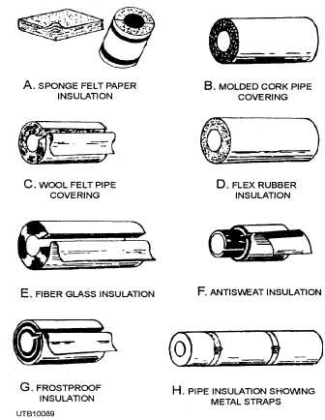
CONSTRUCTION OF FACILITIES
6. Sanitary Insulation of Piping

Slide 25
CONSTRUCTION OF FACILITIES
7. Hygienically Designed Transfer Panels
To make connections between different processing units in adjacent rooms, use hygienically designed transfer panels
Interconnection between the different ports should be made with sanitary U- and J-bends
Piping behind the transfer panel and the panel ports must be sloped to ensure proper drainage of residual liquid toward a drain pan
Ports should be capped when not in use to prevent any potential spill or contamination

Slide 26
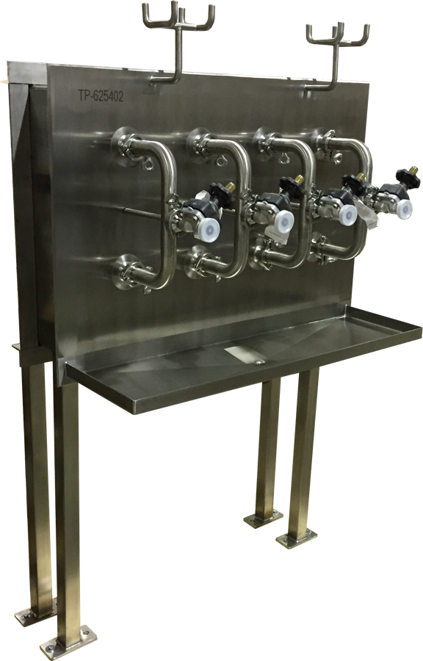
CONSTRUCTION OF FACILITIES
7. Hygienically Designed Transfer Panels

Slide 27
CONSTRUCTION OF FACILITIES
8. Chemical and Wear-resistant Floors
Floors should be sloped toward drains and provided with curbed wall floor junctions, with the curbs having a 30-degree slope to prevent accumulation of water, dust or soil.
Concrete flooring, including the high-strength granolithic concrete finishes, are suitable in warehouses where excellent resistance to heavy traffic is critical
Untreated concrete can be dusty if dry and highly susceptible to damage from water and acids when wet.
Concrete flooring is not recommended for high-care production areas, because it can spall and absorb water and nutrients, allowing microbial growth below the surface.

Slide 28
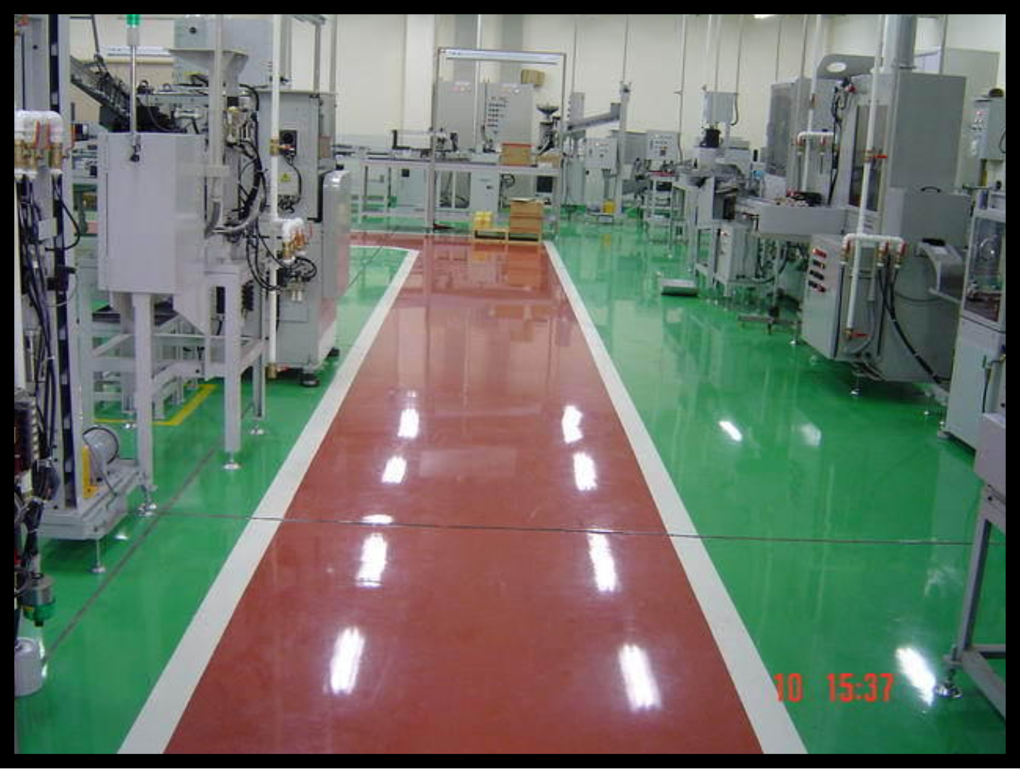
CONSTRUCTION OF FACILITIES
8. Chemical and Wear-resistant Floors

Slide 29
CONSTRUCTION OF FACILITIES
9. Pocket free drains
Drains should have appropriate capacity to avoid “ponding” of water and hence contamination in the area to be drained
The drain bodies must be free of pockets that can hold food soil; otherwise, they will cause odor problems
Only drains with an internal P-trap and atmospheric break should be used.
P-traps create a water-lock that keeps sewer gases out of the plant.

Slide 30
CONSTRUCTION OF FACILITIES
10. Balanced Air Supply and Exhaust System
Exhaust systems should have sufficient capacity to remove excess heat, dust, vapor, aerosols, odors and bio-burden from process rooms
The supply of filtered air in the room by the HVAC system must be large enough, otherwise the exhaust system will attempt to draw the required amount of air from adjacent less clean areas through doorways and windows.
Exhaust fans must be located outside the building to maintain a negative pressure in the portion of the duct system located within the building
If they are installed in the exhaust hood, the exhaust air is pushed through the duct and not pulled out. By pushing vapors, fumes, etc. through that duct, the system puts the exhaust duct under positive pressure, which can force dirty air back into the room through holes and gaps in the duct work.

Slide 31
CONSTRUCTION OF FACILITIES
11. Hygienically Designed Lighting
Lighting must illuminate horizontal and vertical working surfaces evenly, without causing glare and at an intensity of about 300–500 lux at normal working height
Walls and ceilings should be light-colored because that permits fast detection of dirt and soil on their surfaces. In contrast, dark-colored walls and floors require additional lighting.
Preference should be given to lighting mounted on ceilings rather than on walls, because process equipment, storage racks, etc. can form shadows that make cleaning and inspection of floor, walls or ceilings difficult. For the same reason, overhead piping may not obstruct lighting.
Selected lighting should produce little heat and UV light to prevent attraction of insects
To avoid projections that accumulate dust, they can be built into the ceiling or wall with a hermetically closed seal.

Slide 32
CONSTRUCTION OF FACILITIES
12. Hygienic Supply and Application of Electricity
In zone M areas, install individual cables or multiple cables of small diameter, sharing the same route, in conduits.
When two or more cables partly share a common route but go to different termination points, create an un-sealable opening that allow the cable(s) to enter or exit the conduit
For long distances, straight line, non-bundled electric cables should be mounted on wire trays, preferably separated from each other
Vertical cable trays are less prone to dust accumulation, and are more accessible for inspection and cleaning. The use of horizontal racks for electrical cabling should be minimized, or they should be protected by a removable lid or installed vertically (on their side) to minimize horizontal surfaces.
Electric components should be enclosed in dust- and water-tight cabinets or field boxes with all connections made at the bottom. Connections of cables and wires to housings must be sealed.

