Slide 1
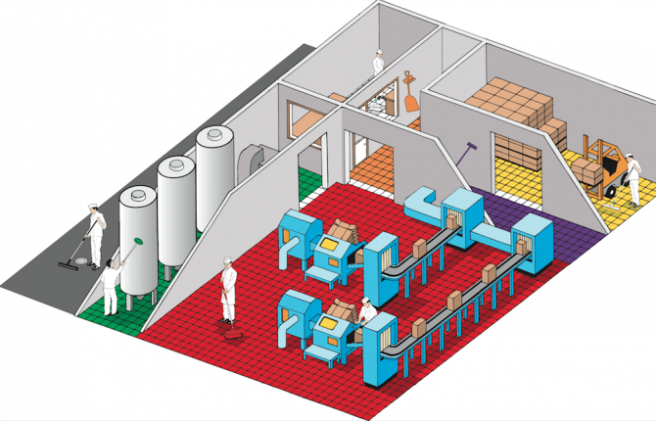
HYGIENIC ZONING

Slide 2
AGENDA
1
Hygienic Zoning
2
The How-Hygienic zoning behaviours
3
The What- Hygieninc Zoning
4
Primary objectives of Hygienic Zoning
5
Key concepts of zoning risk assesment
6
Key concepts of zoning plan
7
The hygiene zones
8
Implementation & verification of hygienic zoning
Notes:
2

Slide 3
HYGIENIC ZONING
Hygienic zoning
Hygienic zoning is a comprehensive plan that identifies and enables the required level of protection and care for the product
It involves
  Zoning risk assessment
  Zoning plan
  Zoning verification
Benefits
Maintains product in the main product flow: Quality
Prevents contamination of the product with substances that would adversely affect the health of a consumer: Safety
Reduces time required for an item of equipment to be cleaned: Efficiency

Slide 4
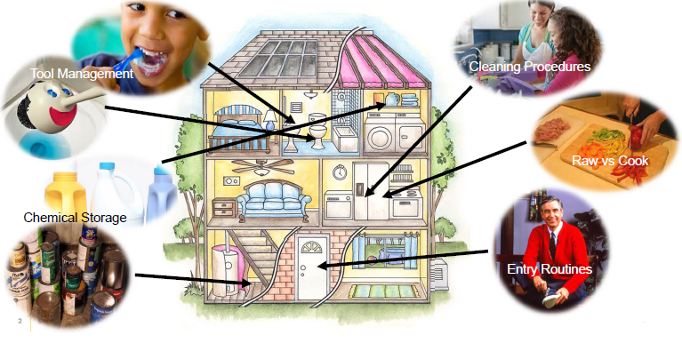
“THE HOW” HYGIENIC ZONING BEHAVIOURS

Slide 5
“THE WHAT” HYGIENIC ZONING
Identification and differentiation of areas within a facility for product and process protection

Slide 6
PRIMARY OBJECTIVES OF HYGIENIC ZONING
Hygienic zoning focuses on:
Prevention of micro-contamination of the environment, the equipment, raw & packaging materials, people and product
Prevention of Foreign Body contamination, whatever the size and nature, of the environment, the equipment, the raw & pack materials, people and the product
Prevention of cross-contamination between flows of people, waste and materials
Prevention of cross-contamination and cross contact between incompatible products or ingredients (e.g. allergens or micro-specification)
Establishment of basic environmental conditions necessary to produce safe product

Slide 7
KEY COMPONENTS OF ZONING RISK ASSESMENT
1
Consider a complete prevention approach, including:
  Microbiology
  Chemical
  Allergen
  Physical
  Pest
Insert your own
text here
2
Conducted by a cross functional team with representation from
  Operations
  Engineering
  Quality
  Product Development

Slide 8
KEY COMPONENTS OF ZONING RISK ASSESMENT
3
High risk and allergenic materials considered in risk assessment
  Including special considerations for segregation, handling, and movement of materials
Insert your own
text here
4
Maintenance areas and equipment storage (both temporary and permanent) should be considered in the risk assessment

Slide 9
KEY COMPONENTS OF ZONING PLAN
1
Zoning plan consists of the following:
  Zoning map(s)
  Local procedure, including rules for each zone
  Identification of barriers, both physical and virtual
  Verification plan
Insert your own
text here
2
Zoning maps typically include:
  Indication of hygienic zone
  People Movement: entry/exit points
  Material Movement: entry/exit points
  Waste Movement: collection, exit points
  Barriers/transitions between zones

Slide 10
KEY COMPONENTS OF ZONING PLAN
3
Zones should be clearly identified through marking, signage or physical barriers at transitions and entry/exit points
Insert your own
text here
4
Requirements for entry to production areas and transitions between zones are clearly defined for people and materials

Slide 11
KEY COMPONENTS OF ZONING PLAN
Zoning Maps can be created in:
• Excel
• AutoCAD
• Hand-drawn

Slide 12
THE HYGIENE ZONES

Slide 13
IMPLEMENTATION & VERIFICATION OF HYGIENIC ZONING
1
Site zoning plan should be supported by a verification plan with activities defined as appropriate for the site
Negative trends should lead to a Root Cause Analysis and Corrective Actions
2
Zoning plan should be communicated to all factory personnel
  Staff should understand which routines apply to their job function/activities
3
Visitors, contractors, service providers, other 3rd parties should be informed of the zoning plan PRIOR to Entry

