Slide 1

PATHOGEN ENVIRONMENT MONITORING

Slide 2
AGENDA
1
Pathogen Environment Monitoring Program
2
Getting Started
3
Plant layout
4
Sample locations & sanitary zoning
5
The Zones
6
Where are the bacteria hiding?
7
How do microbes move around?
8
Microbial transfer points
9
Corrective actions for positive results
Notes:
2

Slide 3

PATHOGEN ENVIRONMENT MONITORING PROGRAM
Pathogen Environement Monitoring (PEM)
The most effective tool for determining the effectiveness of a facility’s Salmonella controls is the implementation of an aggressive Pathogen Environmental Monitoring Program (PEM.)
A PEM is an on-going measure of the effectiveness of the overall Salmonella control program in the plant.
It is not, in itself a Salmonella control program.
It provides feedback on where efforts need to be directed for the overall control program.
One size program does not fit all.
Notes:
3

Slide 4
GETTING STARTED
The PEM Team
Assemble your team; designate a team leader
Assemble a cross functional team familiar with your operation to help identify potential areas of risk or concern, including:
  Quality manager
  Microbiologist
  Sanitation
  Operations Manager
  Plant Engineer
  Maintenance
  Line Supervisor
  Warehousing
Notes:
4

Slide 5
GETTING STARTED
The PEM Team
Understand your process flow with an emphasis on identifying potential points of product recontamination
  Blueprints and flow diagrams; walk the plant floor
Conduct environmental monitoring in raw and non productions areas - understand that you will occasionally find Listeria/Salmonella in those areas.
NEED TO DETERMINE AND UNDERSTAND THE RISK!
Notes:
5

Slide 6
PLANT LAYOUT
Hygenic zones of control assesment
Conduct a hygienic zone assessment to determine what is considered the Primary Pathogen Control Area (PPCA) in your facility
  Areas where post-lethality treated/finished product is exposed to the environment → high hygiene or high risk area.
Objectives of hygiene zones
Is to identify areas of high and low risk to the product within the manufacturing operation.
To prevent the spread of pathogens into the PPCA where protection of the exposed post-lethality product is critical.
Notes:
6

Slide 7
PLANT LAYOUT
Zone assesment
Conduct a hygiene zone assessment of the entire facility and create a color-coded map
  Evaluate all production areas, storage, receiving, warehousing and loading docks, employee facilities such as cafeterias, break rooms, locker rooms, washrooms, maintenance areas, offices/conference rooms, etc.
  Designate the PPCA, basic GMP areas, transition areas, and non-processing areas.
  Pay particular attention to areas within the facility where ingredients, products, or the environment could be a potential source of Listeria, Salmonella and other pathogens and a high potential to re-contaminate post-lethality treated product.
  Also pay attention to non-process areas such as forklift charging stations, refuse/recycling areas, restrooms and others that could impact the PPCA.
Notes:
7

Slide 8
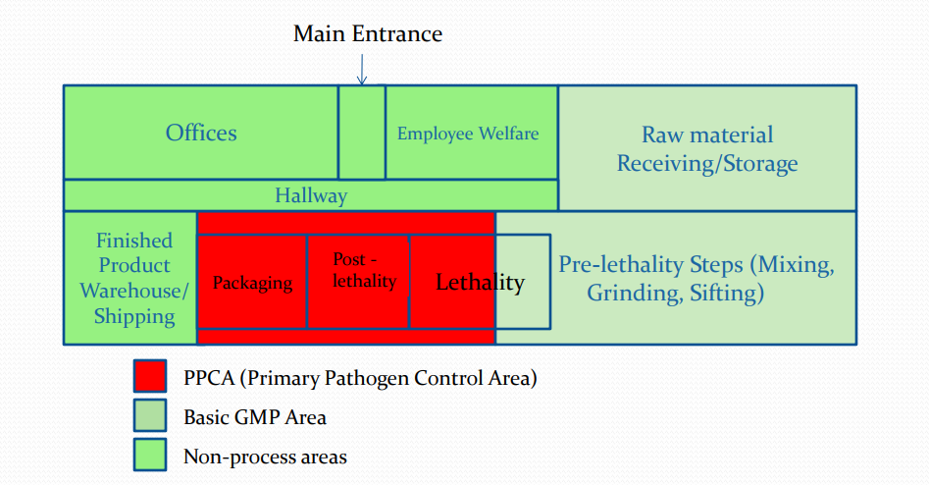
PLANT LAYOUT
Hygienic Zones of control
Notes:
8

Slide 9
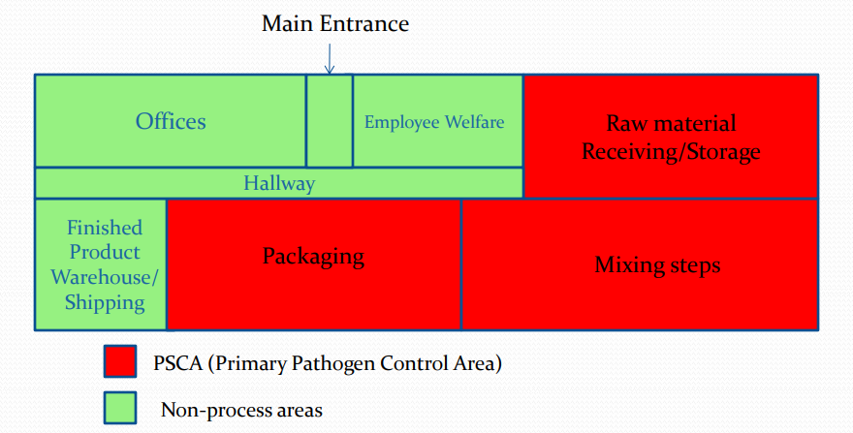
PLANT LAYOUT
Hygienic Zones of control
Notes:
9

Slide 10
SAMPLE LOCATIONS & SANITARY ZONING
Sanitary Zoning within an area/ room
1st - Map out the hygienic zones of control in the facility.
2nd - Select specific sampling sites within each room/area.
Use the sanitary zoning concept to aid in site selection and in tracking environmental data (the sanitary zoning concept is different than mapping hygienic zones of control within the facility).
In the sanitary zoning concept the plant operations are divided into four zones based on level of risk.
Notes:
10

Slide 11
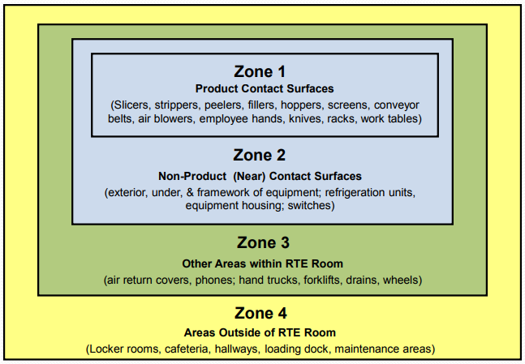
THE ZONES
Sanitary Zones
Notes:
11

Slide 12
THE ZONES
Zone 1
Zone 1: Areas in the plant that are direct product contact surfaces after the lethality or microbial reduction step (e.g. roaster) and before the product is sealed in the primary package
If there is no lethality step in the process - sites where the product is exposed to plant equipment and environment prior to sealing in the primary packaging
  Conveyor belts/buckets
  Utensils
  Employee hands (if touching product)
  Slicers/dicers; Product hoppers/bins/bin liners
  Discharge Chutes; Fillers
  Air blowers
  Control buttons/switches
Notes:
12

Slide 13
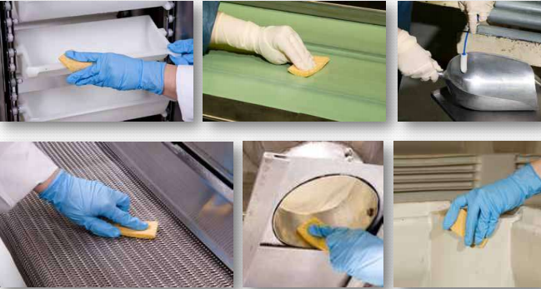
THE ZONES
Zone 1 Sampling
Notes:
13

Slide 14
THE ZONES
Zone 2
Zone 2: Non-product (Near) contact areas in the plant that are closely adjacent to product contact surfaces
  Equipment Exterior, under & Equipment framework
  Drip pans/shields/housings
  Control panels/buttons
  Overhead lights, refrigeration units/drip pans, conveyors, rail systems and pipes directly over zone 1 surfaces
  Computer screens
  Maintenance tools
  Drains located directly under equipment
  Motors located adjacent to lines
Notes:
14

Slide 15
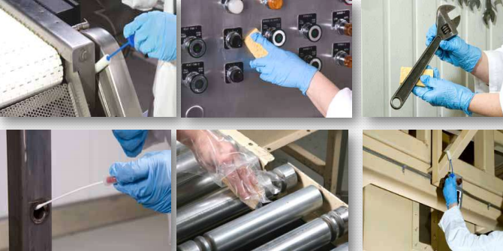
THE ZONES
Zone 2 Sampling
Notes:
15

Slide 16
THE ZONES
Zone 3
Zone 3: Non-product contact surfaces that are in open post-lethality product processing areas, but no closely adjacent to zone 1 surfaces
Zone 3 surfaces have the possibility of leading to product recontamination
  Floors, walls, ceilings
  Hoses. Pallets
  Drains
  Foot baths/ mats
  Brooms/ mops
  Condensate drip pans
  Trolleys, forklifts, walk-alongs, carts
  Toolboxes
Notes:
16

Slide 17
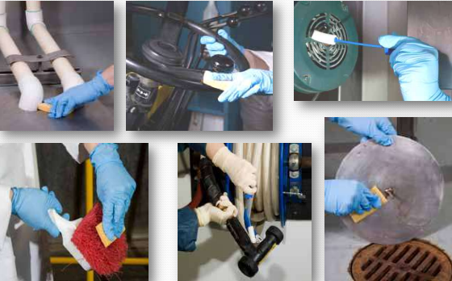
THE ZONES
Zone 3 Sampling
Notes:
17

Slide 18
THE ZONES
Zone 4
Zone 4: Areas that are more remote from post lethality product processing areas
Zone 4 areas if not maintained in good hygienic condition can lead to cross-contamination of zone 1– 3 areas
  Hallways
  Loading docks
  Bathrooms; Locker rooms
  Employee cafeteria/break rooms
  Raw material Coolers/freezers/Warehouses
  Maintenance shop
  Office areas
Notes:
18

Slide 19
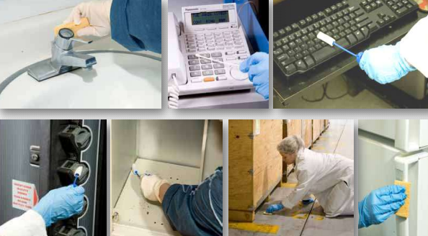
THE ZONES
Zone 4 Sampling
Notes:
19

Slide 20
WHERE ARE THE BACTERIA HIDING?
Microbial Growth Niches
Locations, often “hard to reach” places, harboring the organism after the routine sanitation process for that area has been competed
Places within food processing equipment and/or a food processing environment where microorganisms become established and multiply
Serves as a reservoir from which microorganisms are dispersed and contaminate equipment during operation
Behind O-rings, seals and gaskets on equipment and around doors (especially if old and brittle)
Spaces between metal: metal and metal: plastic joints and parts
Chain guards, motor covers and housings
Water-saturated insulation (e.g. in old spiral freezers, wrapped around pipes or behind fiberglass wall panels)
Notes:
20

Slide 21
HOW DO MICROBES MOVE AROUND?
Microbial Growth Niches
Movement of equipment parts during processing can dislodge organisms (from niche areas) into the environment
Via tools & other maintenance equipment
Via parts removed from equipment & set on food contact surfaces
Supplies, ingredients, people, equipment moved between and through hallways, non-product and raw areas
Through compressed air lines (point of use filter); air from automatic bag openers
Via moisture droplets or aerosols
  Operations
    Drain back-ups
    Kicked up by hose sprays
  Sanitation
    Kicked up by hose sprays
    From wash areas
Notes:
21

Slide 22
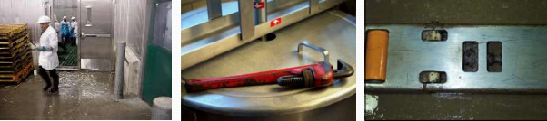
MICROBIAL TRANSFER POINTS
Transfer points
Transfer Point: Sites or carriers, such as employees and product handler’s gloves/clothing/boots, equipment or equipment parts, or maintenance tools, supplies and/or ingredients that may cross contaminate from one source to another prior to or during operations
Notes:
22

Slide 23
CORRECTIVE ACTIONS FOR POSITIVE RESULTS
In case of positive results
Your facility should have a pre-determined action plan that would be implemented in the event of a Salmonella , Listeria positive result
The action plan should be specific for each of the four zones and include
  Type of immediate corrective actions to be taken by zone
  Actions to be taken to verify Salmonella/Listeria has been eliminated from the area in question
  A root cause analysis to find the source of the contamination so that it can be prevented in the future
In the event of a Pathogen (Salmonella/Listeria) positive, the response team should conduct an in-depth investigation looking at
  Any maintenance disruptions/activities
  In-plant construction
  Unplanned down time
  Other non-standard production activities (e.g. R&D plant trial)
Notes:
23

