Slide 1

LABORATORY SAFETY

Slide 2

AGENDA
1
Introduction
2
General safety rules
3
PPE & personal hygiene
4
Housekeeping
5
Safety equipment
6
Electrical
7
Vacuum operations
Notes:
2

Slide 3
AGENDA
8
Handling glassware
9
Mechanical equipment
10
Compressed gas cylinders
11
Centrifuge safety
12
Safe sonication
13
Black and white photographic processing
14
Colour photographic processing
Notes:
3

Slide 4

INTRODUCTION
People who work in laboratories are exposed to many kinds of hazards.
Laboratories, involve a greater variety of possible hazards than most workplaces, and some of those hazards call for precautions not ordinarily encountered elsewhere.
Lab employee means those involved in testing, chemical handling and their direct supervision.

Slide 5
GENERAL SAFETY RULES
No running, or horseplay in laboratory areas shall be permitted.
No employee should work alone in a laboratory when performing a task that is considered unusually hazardous by the Chief Chemist.
Close supervision, CCTV monitoring system, no-movement personal alarms, personal H2S alarms, etc should be considered for such tests.
Lifting of heavy items must be performed in the proper fashion, using the legs to lift, and not the back.
Chief Chemist shall ensure MSDS (Material Safety Data Sheet) for all chemicals handled are readily available for lab personnel.
Portable multi gas monitor shall be available with the Lab Shift Supervisor.
Avoid draining of chemicals in to the common drainage system.
Used samples shall be disposed to the slop system and integrity of the slop system shall be ensured all times.
Expired chemicals shall be disposed as per MSDS and Environmental Procedures

Slide 6
PPE & PERSONAL HYGIENE
Laboratory personnel shall wear safety boots or special laboratory safety shoes.
They shall not wear sandals, open-toed shoes or slippers.
They shall always wear fire and chemical resistant lab coat.
Lab jackets or coats should have snap fasteners rather than buttons so that they can be readily removed.
These coats are to be fastened closed while working and removed prior to exit from the laboratory.
Long legged long sleeved clothing shall be worn underneath.
Employees shall wear Rubber or Plastic Aprons for laboratory work, like washing glassware, which require handling of relatively large quantities of corrosive liquids in open containers.
Lab Employees shall wear appropriate hand gloves as per MSDS and/or the equipment operating manual.
If the gloves become contaminated they should be removed and discarded as soon as possible.

Slide 7

PPE & PERSONAL HYGIENE
Lab Employees shall not wear contact lenses and they shall wear safety glass/chemical goggles or face shield as per MSDS.
For most situations, safety glasses with side shields are adequate. Where there is a danger of splashing chemicals, goggles are required.
More hazardous operations include conducting reactions, which have potential for
explosion, and using or mixing strong caustics or acids. In these situations, a face shield
or a combination of face shield and safety goggles or glasses should be used (Ex:
washing glassware in chromic acid solution, grinding materials, or laboratory operations in
reduced or excess pressure or temperature). “DO NOT WEAR CONTACT LENSES” sign
shall be displayed.

Slide 8
PPE & PERSONAL HYGIENE
Wash promptly whenever a chemical has contacted the skin.
Know what you are working with and have the necessary cleaning/neutralization material on hand and readily available.
Laboratory clothing should be kept clean and replaced when necessary.
Clothing should be replaced or laundered using appropriate decontamination procedures whenever contamination is suspected.
Lab coats are not to be worn outside the laboratory, especially in rest room or break facilities.
Any lab coats, respirators, or other protective gear must be left in the lab areas.
Employees must, as a matter of routine, be responsible for washing, cleaning, and any other decontamination required when passing between the lab and the other areas.
Washing should be done with soap and water; do not wash with solvents.
Contaminated lab coats shall not be washed at home with other cloths.
First aid kit shall be available and updated regularly.
Inhalation is one of the four modes of entry for chemical exposure.
Do not drink, eat, smoke, or apply cosmetics in the laboratory or chemical storage areas.

Slide 9
HOUSEKEEPING
Each laboratory employee shall be responsible for maintaining the cleanliness of his/her area as the work allows.
It is the responsibility of everyone working in the laboratory to make certain that the laboratory is left clean after work is performed.
Spills shall be cleaned immediately using proper absorbents and dispose as per Environment Procedures.
Spills shall be reported as per Environmental Incident Reporting System.
Reagents and equipment items should be returned to their proper place after use.
This also applies to samples in progress.
Contaminated or dirty glassware should be placed in specific cleaning areas and not allowed to accumulate.
Chemicals, especially liquids, shall not be stored on the floor, except in closed-door cabinets suitable for the material to be stored.
Reagents, solutions, glassware, or other apparatus shall not be stored in hoods.
Besides reducing the available workspace, they may interfere with the proper airflow pattern and reduce the effectiveness of the hood as a safety device.

Slide 10
HOUSEKEEPING
Each laboratory employee shall be responsible for maintaining the cleanliness of his/her area as the work allows.
It is the responsibility of everyone working in the laboratory to make certain that the laboratory is left clean after work is performed.
Spills shall be cleaned immediately using proper absorbents and dispose as per Environment Procedures.
Spills shall be reported as per Environmental Incident Reporting System.
Reagents and equipment items should be returned to their proper place after use.
This also applies to samples in progress.
Contaminated or dirty glassware should be placed in specific cleaning areas and not allowed to accumulate.
Chemicals, especially liquids, shall not be stored on the floor, except in closed-door cabinets suitable for the material to be stored.
Reagents, solutions, glassware, or other apparatus shall not be stored in hoods.
Besides reducing the available workspace, they may interfere with the proper airflow pattern and reduce the effectiveness of the hood as a safety device.

Slide 11
HOUSEKEEPING
Counter tops should be kept neat and clean.
Bench tops and fume hoods shall not be used for chemical storage.
All work done in fume hoods shall be performed in the "Safety Zone", (6" minimum from the sash).
Stored items, equipment, and glass tubing shall not project beyond the front of shelf or counter limits.
Stored items or equipment shall not block access to the fire extinguisher(s), safety equipment, emergency exits or other emergency items.
No combustible material such as paper shall be stored in labs and chemical storage areas.
All working surfaces and floors should be cleaned regularly.
All containers must be labelled with at least the identity of the contents and the hazards
those chemicals present to users.

Slide 12
SAFETY EQUIPMENT
Workers in a laboratory environment are surrounded by physical and chemical hazards, and the potential for accident and injury is always present.
Adequate safety equipment in good working order shall be provided to prevent accidents and injury.
Fire Extinguishers & Other Fire Equipment
  Laboratory personnel should be adequately trained regarding pertinent fire hazards associated with their work, first aid fire fighting.
  Employees shall be familiar with the location of fire extinguishers and other fire equipment.
  If an employee notices a fire extinguisher discharged or not fully charged, an extinguisher with the safety pin pulled out, an extinguisher obstructed from view, or one not hanging in its proper location, he/she shall notify lab supervisor & fire section immediately.
  Lab employees shall carry out monthly check of extinguishers to see they are in place, seal intact with valid sticker and fill a checklist.
  Fire section shall annually test these.

Slide 13

SAFETY EQUIPMENT
Safety Showers/Eyewash
  Employees should familiarize themselves with the location and operation of the nearest safety shower/eye wash.
  In the case of a corrosive liquid spill, the employee should remove the affected portion of clothing to reduce potential contact.
  Removal of clothing should be done while the individual is under the activated shower.
  Safety showers/eyewash shall be checked daily at the beginning of morning shift.
  Safety engineer shall audit these weekly.
  Any repair shall be attended immediately.
  Always flood the eyes for at least 15 to 30 minutes to be sure there is no residue of the corrosive liquid.
  Flush from the eye outward.

Slide 14
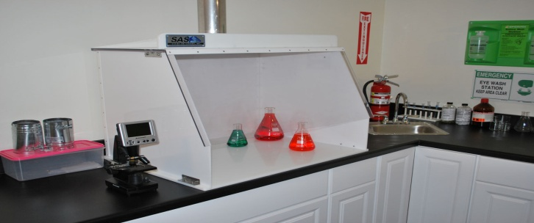
SAFETY EQUIPMENT
Ventilation Hoods
The primary purpose of a laboratory hood is to keep toxic or irritating vapours and fumes out of the general laboratory working area.
A secondary purpose is to serve as a shield between the worker and equipment being used when there is the possibility of an explosive reaction.
This is done by lowering the sash of the hood.
  Work that involves hazards and noxious materials, which are toxic, odorous, volatile or harmful, shall be conducted within a laboratory hood.
  Avoid creation of strong cross drafts (100 fpm) caused by open doors and windows, air conditioning and/or heating vents, or personnel movement.
  Drafts will pull contaminants from the hood and into the laboratory.
  When not in use, the sash of the hood should be kept closed.
  Work should be performed as deeply within the fume hood as possible.

Slide 15
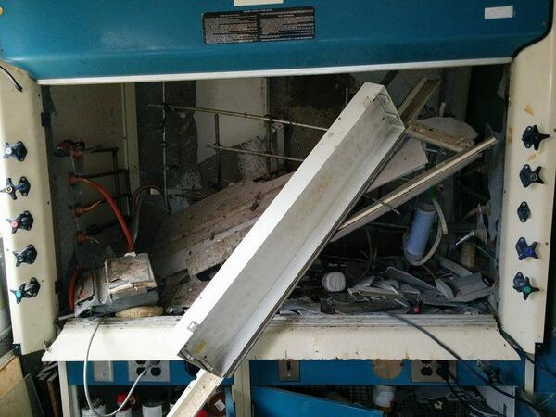
SAFETY EQUIPMENT
Hoods shall not be used as a means of disposing of toxic or irritating chemicals, but only as a means of removing small quantities of vapour which might escape during laboratory operations.
Always look to assure fan motor power switch is in the "on" position with indicator light on before initiating experiment.
Note: Some hoods do not have individual "on/off” switches and remain "on“ Continuously.
An emergency plan should be prepared in the event of ventilation failure or other unexpected occurrence such as fire or explosion in the hood.

Slide 16
ELECTRICAL
All electrical equipment shall be of approved type (UL listed, FM approved or equivalent).
Extension cords shall not be used as a substitute for permanent wiring. Use of Multi-outlet adaptors should be avoided.
Grounded plugs must be used.
Only non-sparking motors can be used in hazardous areas, around flammable gases and solvents.
If a sparking stirrer motor must be used, both the Experiment Safety Plan and the Hazard Review Checklist must address its use and a procedure must be written to ensure sufficient ventilation and fail-safe emergency shutdown.
Explosion-Proof Refrigerators: If there is a need to refrigerate a substance that is flammable, it shall be refrigerated in an UL listed or FM approved explosion-proof Refrigerator.
This refrigerator is designed as such that any flammable vapours in the refrigerator do not contact sparks.
This refrigerator must not be used for the storage of food.

Slide 17
ELECTRICAL
All electrical equipment shall be of approved type (UL listed, FM approved or equivalent).
Extension cords shall not be used as a substitute for permanent wiring. Use of Multi-outlet adaptors should be avoided.
Grounded plugs must be used.
Only non-sparking motors can be used in hazardous areas, around flammable gases and solvents.
If a sparking stirrer motor must be used, both the Experiment Safety Plan and the Hazard Review Checklist must address its use and a procedure must be written to ensure sufficient ventilation and fail-safe emergency shutdown.
Explosion-Proof Refrigerators: If there is a need to refrigerate a substance that is flammable, it shall be refrigerated in an UL listed or FM approved explosion-proof Refrigerator.
This refrigerator is designed as such that any flammable vapours in the refrigerator do not contact sparks.
This refrigerator must not be used for the storage of food.

Slide 18
VACUUM OPERATIONS
When working with a vacuum, be aware of implosion hazards. Apply vacuum only to glassware specifically designed for this purpose, i.e., heavy wall filter flasks, desiccators, etc.
Vacuum pumps with belt, must always have a belt guard.
The use of a vacuum for the distillation of the more volatile solvents, e.g. Ether, low boiling petroleum ether and components, methylene chloride, etc. should be avoided whenever possible.
In situations requiring reduced pressure, two alternatives should be considered
  Utilization of Root vac System, or
  Solvent recovery via atmospheric pressure distillation (preferred method).
When a vacuum is supplied by a compressor or vacuum pump to distil volatile solvents, a cold trap should be used to contain solvent vapours.
Cold traps should be of sufficient size and low enough temperature to collect all condensable vapours present in a vacuum system.
If such a trap is not used, the pump or compression exhaust must be vented to the outside using explosion proof methods (diluting, etc).

Slide 19
HANDLING GLASSWARE
Glass breakage is a common cause of injuries in laboratories not only to lab personnel, but members of the janitorial staff as well.
Only glass in good condition should be used.
The apparatus should be set up in a clean and dry area.
Be certain that the equipment is firmly clamped and is kept well back from the edge of the laboratory bench.
Position and clamp the reaction apparatus thoughtfully in order to permit manipulation without the need to move apparatus until the entire reaction is completed.
Combine reagents in appropriate order, and avoid adding solids to hot liquids.
Keep workspace uncluttered.
Only the required materials/equipment, instructions, notebook and pen should be present.
Keep the work area free from extraneous chemicals, scraps of paper and paper towels.
Keep all other glassware far back where it will not be knocked over.
When using glass tubing, all ends should be fire polished.
Lubricate tubing with glycerine or water before inserting into rubber stoppers or rubber tubing.

Slide 20
HANDLING GLASSWARE
Discard or send for repair all broken, chipped, starred or badly scratched glassware in containers specifically designated for broken glass.
Used chemical bottles and Broken glass shall be disposed as per Environment (Waste Disposal) Procedures.
Wear leather gloves when picking up broken glass.
All broken glass disposal containers shall be clearly marked "DANGER - BROKEN GLASS“.
Limit quantities to avoid back injury.
Protect hands with leather gloves when inserting glass tubing.
Use glassware of the proper size.
Allow at least 20% free space. Grasp a three-neck flask by the middle neck, not a side neck.
Flasks that contain solutions to be refluxed should have 50% free space.
Conventional laboratory glassware must never be pressurized.

Slide 21
MECHANICAL EQUIPMENT
If a cooling bath is required for use on a vacuum system (or any other system) and ice water is not cold enough, dry ice in an organic liquid should be used instead of liquid nitrogen whenever possible.
Hardware, regulators, glassware, solvents, dry chemicals, acids, etc., stored in the laboratory must be isolated from each other in separate cooling bath to prevent breakage and to avoid other undesirable interactions.
Any equipment or experiment that is operated overnight/unmanned must have emergency information displayed.

Slide 22
COMPRESSED GAS CYLINDERS
Many laboratory operations require the use of compressed gases for analytical or instrument operations.
Depending on the particular gas, there is a potential for simultaneous exposure to both mechanical and chemical hazards.
Gases may be combustible, explosive, corrosive, poisonous, inert, or a combination of hazards.
Additional hazards of reactivity and toxicity of the gas, as well as asphyxiation, can be caused by high concentrations of even "harmless" gases such as nitrogen.
Compressed gas cylinders shall be kept vertical, chained, away from direct sunlight and heat sources.
Protective caps shall be in place when not in use.
Incompatible gases shall be stored separately.
Tubing from cylinder manifold to the service point shall follow standard colour code or labelling.

Slide 23
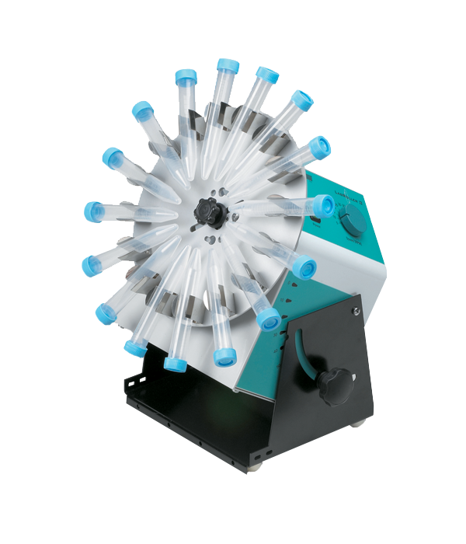
CENTRIFUGE SAFETY
Centrifuge operation can be dangerous if not properly handled. Following is a general guideline
  Before using any centrifuge review the manufacturer’s manuals.
  Obtain a copy of the manual if it is not available. Check rotor for rough spots, pitting & discoloration.
  Consult manufacturer if any defect is found.
  High-speed rotor heads are prone to metal fatigue.
  Each rotor should be accompanied by its own logbook indicating the number of hours run at top or de-rated speeds.
  Do not exceed the design mass for the maximum speed of the rotor. Failure to observe this precaution can result in dangerous and expensive rotor disintegration.
  Make sure rotor, tubes and spindle are dry and clean and that the rotor is properly seated and secured to the drive hub.

Slide 24
CENTRIFUGE SAFETY
  Tubes must be properly balanced in rotor (½ gram at 1 G is roughly equivalent to 250 Kg @ 500,000 G's).
  Before use, tubes should be checked for cracks.
  The inside of cups should be inspected for rough walls caused by erosion and adhering matter should be removed.
  Metal or plastic tubes (other than nitrocellulose) should be used whenever possible.
  Use sealed rotors, sealed buckets, or a guard bowl with gasketed cover as well as safety centrifuge tubes (tube or bottle carrier with sealable cap or "O" gasketed cap).
  After use, tubes, rotors, and centrifuge interiors should be cleaned and disinfected.
  If a tube breaks, the centrifuge should be turned off, allowed to stand undisturbed for 15 minutes before opening.
  Clean and disinfect the rotor.
  Cleaning and disinfection of tubes, rotors and other components requires considerable care.
  No single method is suitable for all items, and the various manufacturers’ recommendations must be followed to avoid rotor fatigue, distortion and corrosion.
  Once run is complete, make sure the rotor has STOPPED before opening the centrifuge lid.

Slide 25
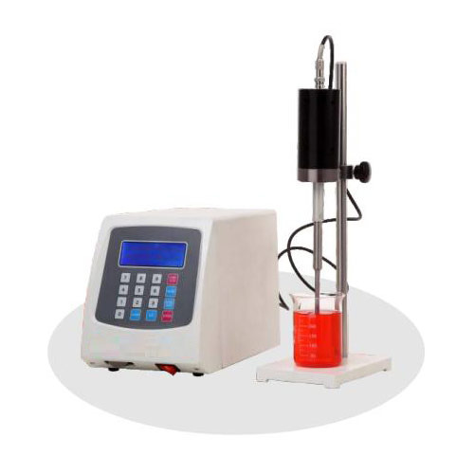
SAFE SONICATION
Ultrasonicators use high frequency sound waves (16 -100 kHz) for cell disruption and other purposes.
This "ultrasound", conducted through air, does not pose a direct hazard to humans, but the associated high volumes of audible sound can cause a variety of effects, including headache, nausea and tinnitus.
Direct contact of the body with high intensity ultrasound should be avoided.
Ultrasonic equipment in the lab should be enclosed in a box lined with acoustically absorbing materials to reduce (mostly inaudible) emissions.

Slide 26
BLACK AND WHITE PHOTOGRAPHIC PROCESSING
A wide variety of chemicals are used in black and white photographic and radiographic film processing.
Film developing is usually done in dark rooms.
Print processing uses tray processing, with successive developing baths, stop baths, fixing baths, and rinse steps.
Other treatments include use of hardeners, intensifiers, reducers, toners, and hypo eliminators.
Refer MSDS for hazards and precautions
When mixing powdered chemicals, use a glove box (a cardboard box with glass or Plexiglas top, and two holes in the sides for hands and arms), local exhaust ventilation, or wear an approved toxic dust respirator.
Wear gloves, goggles and protective apron when mixing concentrated photo chemicals.
Always add any acid to water, never the reverse.
An eyewash fountain and emergency shower facilities should be available.
Do not store photographic solutions in glass containers.
Do not put your bare hands in developer baths. Use tongs instead.

Slide 27
COLOUR PHOTOGRAPHIC PROCESSING
Colour processing is much more complicated than black and white processing, and there is a wide variation in processes used by different companies.
Colour processing can be either done in trays or in automatic processors.
Refer MSDS for hazards and precautions.
Wear gloves and goggles when handling colour developers.
Wash gloves with an acid-type hand cleaner, and then water before removing them.
Colour processing needs more ventilation than black and white processing due to the use of solvents and other toxic components at elevated temperatures.
Some automatic processors can be purchased with an exhaust, which would need to be ducted to the outside.
Use premixed solutions whenever possible.
Wear gloves, goggles and protective apron when mixing and handling colour-processing chemicals.
diluting solutions containing concentrated acids, always add the acid to the water.
An eyewash and emergency shower should be available.
A water rinse step is recommended between acid bleach steps and fixing steps to reduce the production of sulphur dioxide gas.

