Slide 1
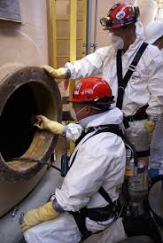
CONFINED SPACE ENTRY

Slide 2
AGENDA
1
Definitions.
2
Hazard atmosphere.
3
Identification & analysis of confined space
4
Responsblity.
5
Confined space entryprocedures.
Notes:
2

Slide 3
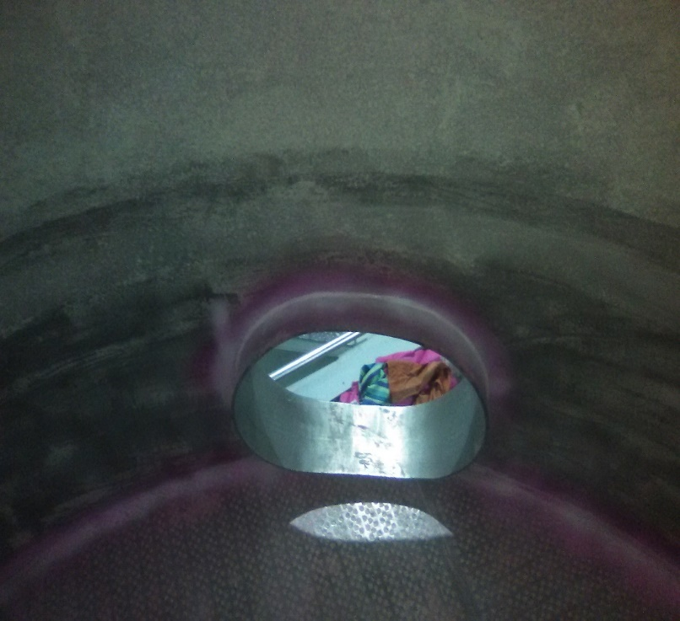
CONFINED SPACE ENTRY
PMG professional safety and health standard
To describe procedures for entering confined spaces and permit required confined spaces which will comply with applicable regulations and provide for the safety of all entrants

Slide 4
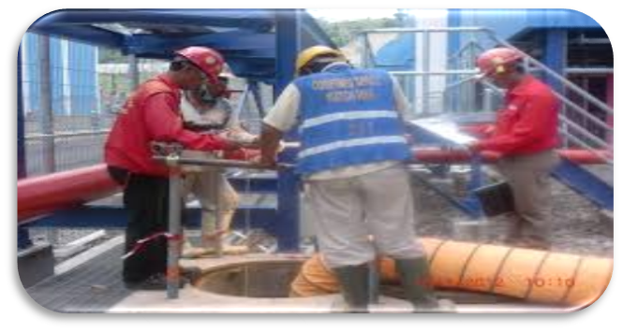
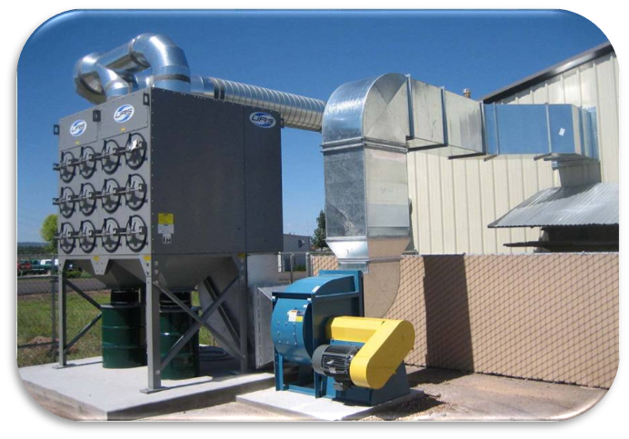
DEFINITION
Attendant
Blanking or blinding
An individual stationed outside the confined space who monitors the entrants inside the confined space. There must be at least one attendant for each confined space. Attendants must meet regulatory requirements to perform this job.
Absolute closure of a pipe, line, or duct by the fastening of a solid plate that is capable of withstanding the maximum pressure of the pipe, line, or duct with no leakage beyond the plate

Slide 5
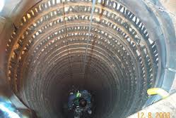
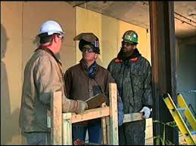
DEFINITION
Entry
Entry Supervisor
When any part of the employees’ body breaks the plane of any opening of the permit required confined space and performs any work inside that space.
A person, who authorizes entry into permit confined space, knows the hazards, authorizes job operation within space, and can terminate entry and permit

Slide 6
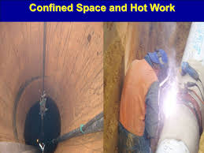

DEFINITION
Hot Work
Non-Permit
Work that could result in a source of ignition such as welding cutting, burning or heating which can cause additional hazards within a confined space. A hot work permit must be issued for all hot work to be performed within a confined space.
"Non-permit confined space" means a confined space that does not contain or, with respect to atmospheric hazards, have the potential to contain any hazard capable of causing death or serious physical harm. "Oxygen deficient atmosphere" means an atmosphere containing less than 19.5 percent oxygen by volume.

Slide 7
HAZARDOUS ATMOSPHERE
An atmosphere that exposes employees to a risk of death, incapacitation, injury or acute illness from one or more of the following causes:
  An atmospheric oxygen concentration below 19.5 percent or above 23.5 percent;
  A flammable gas, vapours, or mists in excess of 10 percent of its lower explosive limit (LEL)
  An atmospheric concentration at or above the permissible exposure limit of any substance considered toxic.
  An airborne combustible dust at a concentration that obscures vision at a distance of five feet (1.52M) or less;
  Any atmospheric condition recognized as immediately dangerous to life or health.

Slide 8

HAZARDOUS ATMOSPHERE
  Contains a material that has the potential for engulfing an entrant.
  Has an internal configuration such that an entrant could be trapped or asphyxiated by inwardly converging walls or by a floor that slopes downward and tapers to a smaller cross-section.
  Contains any other recognized serious safety or health hazard.

Slide 9
HAZARDOUS ATMOSPHERE
Confined space
Confined Space refers to any place, including any vessel, tank, container, pit, bund, chamber, cellar or any other similar space which, by virtue of its enclosed nature, creates conditions that give rise to a likelihood of an accident, harm or injury of such a nature as to require emergency action due to
The presence or reasonable foreseeable presence of:
    flammable or explosive atmospheres
    harmful gas, fume or vapour
    free flowing solid or an increasing level of liquid
    excess of oxygen
    excessively high temperature
    the lack or reasonably foreseeable lack of oxygen
.

Slide 10
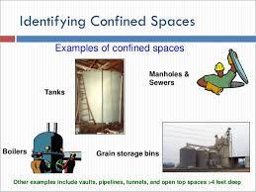
IDENTIFICATION AND ANALYSIS OF CONFINED SPACES
All areas such as pits, vaults, and tunnels, and new equipment such as tanks, silos, and vats will be identified and evaluated by a qualified person before classification as a confined space and before entry by any individual.

Slide 11

IDENTIFICATION AND ANALYSIS OF CONFINED SPACES
ANALYSIS OF HAZARDS
All areas such as pits, vaults, and tunnels, and new equipment such as tanks, silos, and vats will be thoroughly-evaluated for all hazards and potential hazards before an entry is allowed or planned.
This evaluation must be done by a qualified person. Depending upon the potential hazards, all applicable procedures in this Program will apply.
If conditions of an existing confined space change which may affect the potential hazards, a qualified person will re-evaluate the space for potential hazards.
If the classifications of the space changes due to different or new hazards, the appropriate control measures will be taken.

Slide 12

IDENTIFICATION AND ANALYSIS OF CONFINED SPACES
Prevention of unauthorized entry
Post signs "Danger Confined Space-Enter by Permit Only" by each confined space entrance (as applicable) in order to prevent unauthorized entry.
If covers have been removed from pits and vaults, the openings must be promptly guarded by railings, wooden horses, barrier tape, etc. and suitable warning signs if the confined space is to be left unattended for any reason.
The attendant and supervisor in charge of preventing unauthorized entries during a confined space entry. Anyone approaching the immediate confined space area will be stopped by the attendant or supervisor.

Slide 13

IDENTIFICATION AND ANALYSIS OF CONFINED SPACES
Permit space
Permit required in a confined space that has one or more of the following characteristics:
  Contains or has a potential to contain a hazardous atmosphere.
  Contains a material that has the potential for engulfing an entrant.
  Has an internal configuration such that an entrant could be trapped or asphyxiated by inwardly covering walls or by a floor that slopes downward and tapers to a smaller cross-section.
  Contains any other recognized serious safety or
health hazard.
Each Permit-Required Confined Space will be marked

Slide 14

IDENTIFICATION AND ANALYSIS OF CONFINED SPACES
Entries Rules:
No employee may enter a confined space until all hazards are eliminated
Upon entry if hazards are identified or suspected, including asbestos, exit the area immediately and contact the project manager or supervisor.
Only trained and authorized employees may enter a confined space or act as an attendant.
No Smoking is permitted in a confined space or near entrance/exit area. No running vehicles are permitted near the entrance.
During confined space entries, an attendant must present at all times.

Slide 15

IDENTIFICATION AND ANALYSIS OF CONFINED SPACES
Entries Rules
Constant visual or voice communication will be maintained between the attendant and employees entering a confined space.
No bottom or side entry will be made or work conducted below the level of any hanging material or material that could cause engulfment.
All openings to confined spaces must be protected by a temporary barrier (such as barrier tape or a railing) when covers are removed.
When the possibility of a release of hazardous energy exists, the appropriate lockout/ tag out procedures shall be utilized.

Slide 16
IDENTIFICATION AND ANALYSIS OF CONFINED SPACES
Entries Rules
Air monitoring is required before entering any permit-required confined space. For a clean isolated confined space the air monitoring must have been conducted within two hours of entry.
For all other confined spaces the air monitoring must have been conducted within 15 minutes of entry.
Atmospheric testing will check for oxygen levels (must be between 19.5% and 23.5%), carbon monoxide (must be less than 35 ppm), hydrogen sulphide (must be less than 10 ppm), and explosive gas levels (must be lower than 10% of the lower explosive limit).
If the minimum oxygen content of 19.5 percent cannot be maintained by forced air ventilation, entry will not be permitted. Additional ventilation and oxygen level monitoring is required when welding is performed.
Air monitoring results will be made immediately available to all entrants or their authorized representative. Re-testing the space will be done upon entrant’s (or authorized representative) request.

Slide 17
IDENTIFICATION AND ANALYSIS OF CONFINED SPACES
Entries Rules
When continuous forced air ventilation is used to eliminate a hazardous atmosphere, air should be taken from a clean source and should be continued until all employees have left the space. This method shall not be used if asbestos is present in the space.
All required personal protective equipment shall be worn.
If an emergency entry rescue becomes necessary, the Fire Department should be notified at 101 immediately
A Confined Space Entry Permit must be completed before any worker enters a Permit Required Confined Space.
The completed permit shall be made available and posted from the time of entry until work is completed and the permit is cancelled.

Slide 18
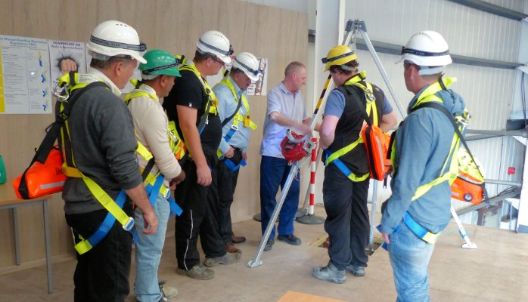
IDENTIFICATION AND ANALYSIS OF CONFINED SPACES
Entries Rules
Permits will expire before the completion of the shift, if any pre-entry conditions change, or when work is completed, permits will be maintained on file for 12 months.

Slide 19
RESPONSIBILITY
Management
Ensure proper training for entry and rescue teams
Ensure proper health surveillance for people authorized to enter confined spaces
Provide proper equipment for entry and rescue teams
Ensure confined space assessments have been conducted
Ensure all permit required confined spaces are posted
Annually review this program and all Entry Permits
Evaluate Rescue Teams/Service to ensure they are adequately trained and prepared
Ensure rescue team at access during entry into spaces with Immediately Dangerous to Life and Health atmospheres

Slide 20

RESPONSIBILITY
Environmental Health and Safety (EHS)
Inform contractor of the locations of permit required confined spaces and the hazards involved including notification of the presence of asbestos
Ensure that the contractor’s confined space program and permit is compliant with all regulatory requirements
Coordinate entry when employees of more than one employer are involved. If employees will be entering a space with a contractor the permit must be used.
Notify EHS whenever new manholes are added to the campus infrastructure so the space can be evaluated and mapped.

Slide 21

RESPONSIBILITY
Project Managers
Annually review program and all Entry Permits
Set up dates for entry rescue teams training.
Provide and or assist with required training to employees who are authorized to enter permit required confined spaces.
Provide technical assistance to the departments as needed

Slide 22
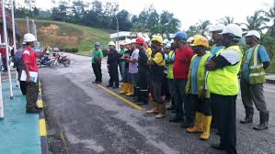
RESPONSIBILITY
Contractor Responsibilities
Obtain all available information regarding permit space hazards and entry operations from the Project Manager.
Have a permit space entry program that is compliant with all regulatory requirements and inform the Project Manager of the permit space program that will be followed.

Slide 23
RESPONSIBILITY
Contractor Responsibilities
Ensure that employees making the entry are properly trained.
Provide the equipment and resources necessary for safe entry.
Post permit at entry site for the duration of the entry.
Inform Project Manager of any hazards confronted or created in the permit space through a debriefing or during the entry operation.

Slide 24
RESPONSIBILITY
Entry Supervisor
The following entry supervisor duties are required:
  Know the hazards that may be faced during entry, including the mode, signs or symptoms, and consequences of exposure.
  Verify by checking that necessary information has been entered on the permit, all tests specified by the permit have been conducted and that all procedures and equipment specified by the permit are in place before endorsing the permit and allowing entry to begin.
  Ensure that a permit has been posted at the job site.
  Verify that rescue services are available, and that the means for summoning them are operable.

Slide 25
RESPONSIBILITY
Entry Supervisor
The following entry supervisor duties are required:
  Ensure barriers or barricades are in place.
  Remove unauthorized persons who enter or attempt to enter the space during entry operations.
  Determine that entry operations and entry conditions are maintained based on the hazards and operations performed within the space remain consistent with the permit terms.
  Terminate the entry and cancel the permit when the entry is complete or there is a need for terminating the permit.

Slide 26
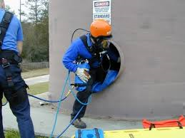
RESPONSIBILITY
Entry Attendants
At least one attendant is required outside the permit space into which entry is authorized for the duration of the entry operation.
Responsibilities include:
  Maintain continuous verbal or radio communication with entrants as necessary to monitor entrant status and alert entrants of the need to evacuate.
  Summon rescue and other emergency services as soon as the attendant determines the entrants need assistance to escape the permit space hazards
  Does not participate in other duties that would interfere with monitoring and protecting the entrants.

Slide 27
RESPONSIBILITY
Entrants
All entrants must be authorized by the entry supervisor to enter permit spaces.
Entrants must observe all entry procedures and must have received the required training.
  Know the hazards that may be faced during entry, including the mode, signs or symptoms, and consequences of the exposure.
  Properly use the equipment required for safe entry.
  Communicate with the attendant as necessary to enable the attendant to monitor the status of the entrants and to enable the attendant to alert the entrants of the need to evacuate the space, if necessary.

Slide 28
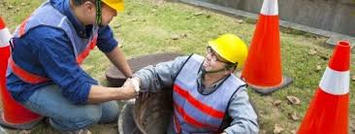
RESPONSIBILITY
Entrants
Exit the permit space as quickly as possible whenever the attendant or entry supervisor gives an order to evacuate the permit space, the entrant recognizes any warning signs or symptoms of exposure to a dangerous situation, the entrant detects a prohibited condition, or an evacuation alarm is activated.

Slide 29
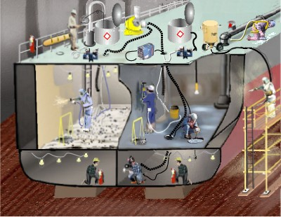
RESPONSIBILITY
Hazard control
Types of Hazards:
  Explosive / Flammable Atmospheres
  Toxic Atmospheres
  Engulfment
  Asphyxiation
  Entrapment
  Slips & Falls
  Chemical Exposure
  Electric Shock
  Thermal / Chemical Burns
  Noise & Vibration
  Airborne Fibres, Dusts

Slide 30
RESPONSIBILITY
Engineering Controls
Administrative Controls
Lock entry points to prohibit unauthorized entry
Temporary forced mechanical ventilation eliminating hazardous atmosphere (shall not be used if asbestos is present)
Temporary Lighting
Signs
Employee training
Entry procedures
Atmospheric Monitoring
Rescue procedures
Use of prescribed PPE

Slide 31
RESPONSIBILITY
Occupational health controls
Employees must undergo health surveillance as appropriate to the conditions before training and work in confined spaces:
  At regular intervals (defined by local legislation, or local safety experience if legislation is not specific, in no case longer than 3 years) and
  After experiencing certain illnesses.
Where the hazard of confined space working is compounded by the specific hazards of :
  Excessive heat or cold,
  Any type of contact with chemical substances or
  Requirement to use breathing equipment, the medical assessment should take into account all additional requirements relating to such exposure

Slide 32
CONFINED SPACE ENTRY PROCEDURES
Required SOP
Basic requirements
A SOP must be developed for each space to standardize the entry procedure. The SOP outlines:
  Hazards
  Hazard Control and Abatement
  Acceptable Entry Conditions
  Means of Entry
  Entry Equipment Required
  Emergency Procedures
Each employee who enters or is involved in the entry must:
  Understand the procedures for confined Space Entry
  Know the Hazards of the specific space
  Review the specific procedures for each entry
  Understand how to use entry and rescue equipment

Slide 33

CONFINED SPACE ENTRY PROCEDURES
Required SOP
A SOP must be developed for each space to standardize the entry procedure. The SOP outlines:
  Hazards
  Hazard Control and Abatement
  Acceptable Entry Conditions
  Means of Entry
  Entry Equipment Required
  Emergency Procedures

Slide 34
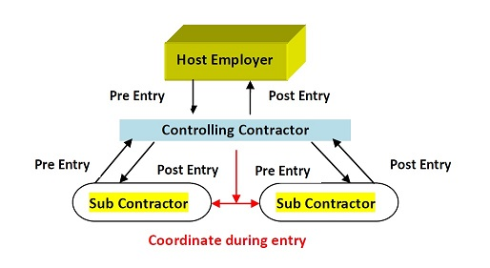
CONFINED SPACE ENTRY PROCEDURES
Contractors Entry
Prior to All work by non-company employees that involves the entry into confined spaces will follow the procedures of this standard.
The information of this standard and specific hazard of the confined spaces to be entered will be provided to Contractor Management commencing entry or work.

Slide 35
CONFINED SPACE ENTRY PROCEDURES
Training
Training for Confined Space Entry includes:
  Duties of Entry Supervisor, Entrant and Attendants
  Confined Space Entry permits and procedures
  Hazards of Confined Spaces
  Use of Air Monitoring Equipment
  First Aid and CPR Training
  Emergency Action and Rescue Procedures
  Confined Space Entry and Rescue Equipment
  Rescue training, including entry and removal from representative spaces Employee health and fitness-to-work assessment by qualified personnel in view of specific confined space entry hazards

