Slide 1

CONSTRUCTION SAFETY
PERSONAL PROTECTIVE EQUIPMENT'S

Slide 2
ABOUT PMG
“BUILDING FOOD FACTORIES WITH TOP QUALITY STANDARDS OF NESTLE, MONDELEZ,ABBOTT, DANONE USING 3D DESIGN AND HYGIENIC ENGINEERING.”
At PMG, we deliver Engineering Design and Project Management scopes in Food and Beverage industry. Our team of design engineers and engineering executives has rich experience in Project Planning, Design, Execution and Commissioning with key competencies in areas like 3D Plant Design, Hygienic Engineering, and Project Management. Our safe-by-choice, result-oriented, and pro-active work-ethics allow us deliver work scopes meeting objectives, complete stakeholder alignment and first-time quality.
PMG Knowledge Repository: Targeted Knowledge Sharing & Skill Development
Precise and focused training modules for the exhaustive set of people working in manufacturing industry, instilling qualities of self-belief, creative thinking & widened perspective.
Clear Learning Objectives
Focused approach to skill development and knowledge sharing
Progressive Evaluation
Gauging improvement on every step and keeping audience connected.
After-training follow-ups
We systematically track differential progress of recipients after the training.
Audience Specific Approach
Programs are fine-tuned to the ability and interests of the recipients.
Multiple Awe-moments
Awe-moments are refreshing and increase receptivity many-fold.
Seasoned Trainers
PMG trainers are subject matter experts with substantial work experience.

Slide 3
AGENDA
1
Personal Protective Equipments (PPE’S).
2
Eyes and Face Protection.
3
Respiratory Protection.
4
Potencial Hazards.
5
Type of Respitory Hazards.
6
Foot Protection.
7
Hand Protection.
8
Head Protection.
9
Hear Protection.
Notes:
3

Slide 4

PERSONAL PROTECTIVE EQUIPMENT'S
Personal Protective Equipment's (PPE’S)
PPE is equipment worn by a worker to minimize exposure to specific occupational hazards.
Examples of PPE include respirators, gloves, aprons, fall protection, and full body suits, as well as head, eye and foot protection.
Using PPE is only one element in a complete safety program that would use a variety of strategies to maintain a safe and healthy occupational environment.

Slide 5
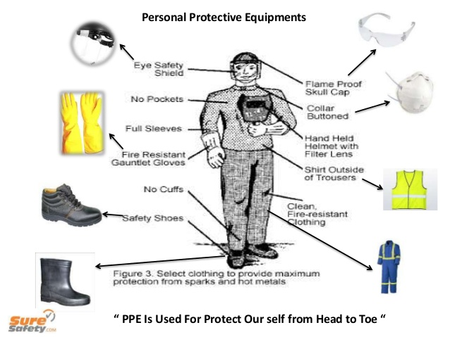
PERSONAL PROTECTIVE EQUIPMENT'S
Personal Protective Equipment's (PPE’S)
Use of PPE’S
  The use of personal protective equipment (and administrative controls) is lowest on the list of Control priorities.
  These controls should not be relied on as the primary means of risk control until the options higher in the list of control priorities have been exhausted.

Slide 6
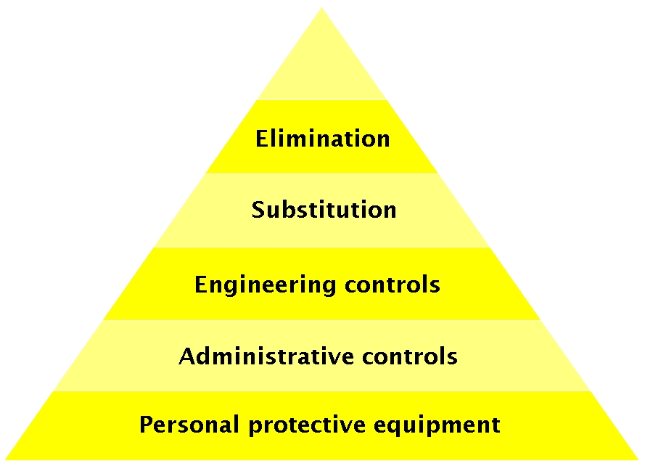
PERSONAL PROTECTIVE EQUIPMENT'S
Personal Protective Equipment's (PPE’S)
Control Measure
  Use of personal protective equipment should only be considered as a control measure when exposure to the risk cannot be reduced in any other way.
  Use of personal protective equipment can be regarded as a temporary or interim measure until further controls are put in place.
  Personal protective equipment can also be used effectively in conjunction with other measures to manage exposure to a risk.

Slide 7
PERSONAL PROTECTIVE EQUIPMENT'S
Personal Protective Equipment's (PPE’S)
Decisions about PPE use must consider its
  Safety Hazards
    Restricted movement due to weight
    Restricted vision due to visual field limitations
    Difficulty communicating due to face protection
  Physiological/Psychological stressors
    Psychological stress resulting from confining nature of full suits.
    Heat stress and risk of dehydration
    The highest levels of PPE generally cannot be worn continuously for more than 30 minutes

Slide 8
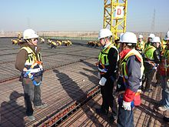
PERSONAL PROTECTIVE EQUIPMENT'S
Personal Protective Equipment's (PPE’S)
Choosing the right personal protective equipment for the task
  Assess the risks for every task in the workplace and choose the correct PPE for that task. PPE must:
    Be appropriate for the job
    Fit the operator correctly
    Be accompanied by training on its proper use
    Be clean and functional
    Be regularly serviced by appropriately trained staff.

Slide 9
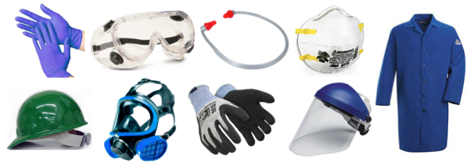
PERSONAL PROTECTIVE EQUIPMENT'S
Personal Protective Equipment's (PPE’S)
Personal Protective Equipment's for.
  Eye and Face Protection
  Foot Protection
  Hand Protection
  Head Protection
  Hearing Protection

Slide 10
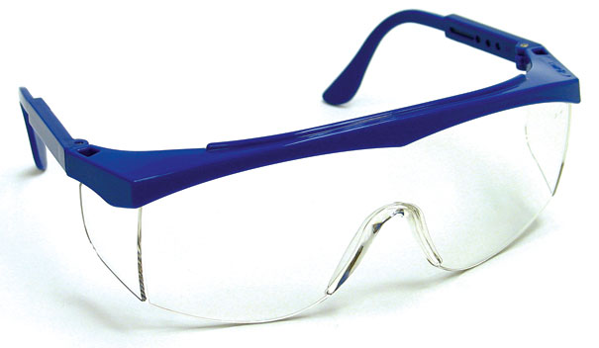
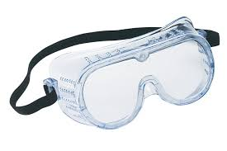
EYES & FACE PROTECTION
Safety Glasses
Goggles
  Safety glasses are perhaps the most widely used type of eye protection.
  While they may look similar to regular glasses, they are much stronger and more resistant to impact and heat than regular glasses.
  In addition, most safety glasses are equipped with side shields that give you protection from hazards that may not be directly in front of you.
  Goggles give you more protection than safety glasses because they fit closer to your face.
  Because goggles surround the eye area, they give you more protection in situations where you might encounter splashing liquids, fumes, vapours, powders, dusts, and mists.
  Different types of goggles are available. They must indicate that they are chemical splash Goggles to be worn for that purpose.

Slide 11
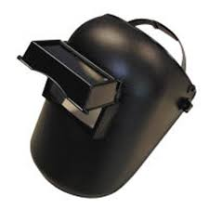
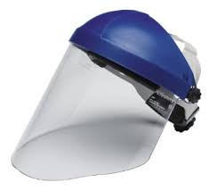
EYES & FACE PROTECTION
Welding Helmets
Face Shields
Welding helmets provide both face and eye protection.
Welding helmets use special absorptive lenses that filter the intense light and radiant energy that is produced during welding operations, as with face shields, safety glasses or goggles should be worn when using a welding helmet.
Face shields offer you full face protection and are often used around operations which expose you to molten metal, chemical splashes, or flying particles.
Many face shields can be used while wearing a hard hat.

Slide 12
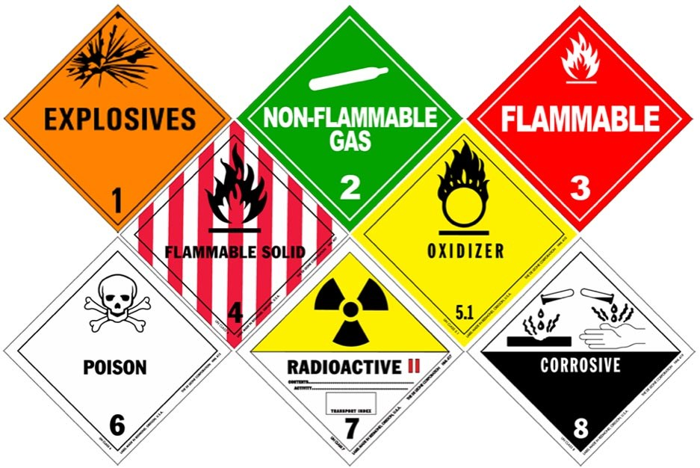
EYES & FACE PROTECTION
Potential Hazards
Dusts, Powders, Fumes, and Mists
Small particles of matter can enter your eyes and damage them.
Preparations such as grinding, chiselling, sanding, hammering, and spraying can create small airborne particles; particles that can injure your eyes.

Slide 13

EYES & FACE PROTECTION
Potential Hazards
Toxic Gases, Vapours, and Liquids
Toxic chemicals in the form of gases, vapours, and liquids can damage your eyes.
Always read the appropriate MSDS before working with any hazardous material.
Some manufacturing processes produce hazardous gases, vapours and liquids.
Always check with your supervisor or safety manager to learn the type of eye or face protection you will need to use in order to work safely.

Slide 14
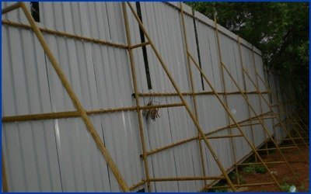
EYES & FACE PROTECTION
Protective Measures
Work Area Barriers
Operations such as sanding, grinding, welding, and lathe operations produce dust, vapours, and flying particles.
To protect other workers, work area barriers such as movable screens and barriers should be set up to separate workers and bystanders from hazardous operations.

Slide 15


EYES & FACE PROTECTION
Flying Objects or Particles
Large Objects
Operations such as grinding, chiselling, sanding, and hammering often create flying objects or particles that can damage your eyes.
  Swinging chains, cables and ropes
  Tools that are thrown or fall.
  Any sharp objects such as knives, scissors, pencils, etc.
  Walking or falling into obstructions can damage your eyes or face.

Slide 16
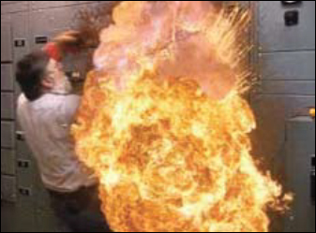
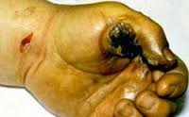
EYES & FACE PROTECTION
Molten Metals
Electrical Hazards
Operations which involve or produce molten metal’s, if splashed, splattered, or dripped into the eyes, cause severe burns and tissue damage
Any time you work around electricity, there is the potential for arcs and sparks to occur.
Take time to talk with your supervisor or safety manager concerning the type of eye protection you should wear if you will be working around electrical hazards.

Slide 17
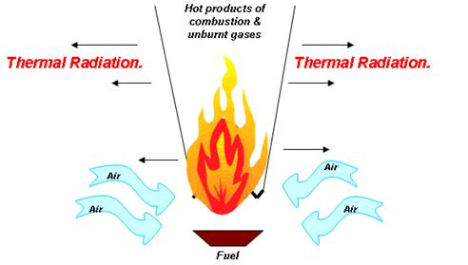
EYES & FACE PROTECTION
Thermal and Radiation Hazards
  Operations such as welding, metal cutting, and working around furnaces can expose your eyes to heat, glare, ultraviolet, and infrared radiation.
  Check with your supervisor or safety manager to learn the specific type of eye protection you will need to use during these types of operations.

Slide 18
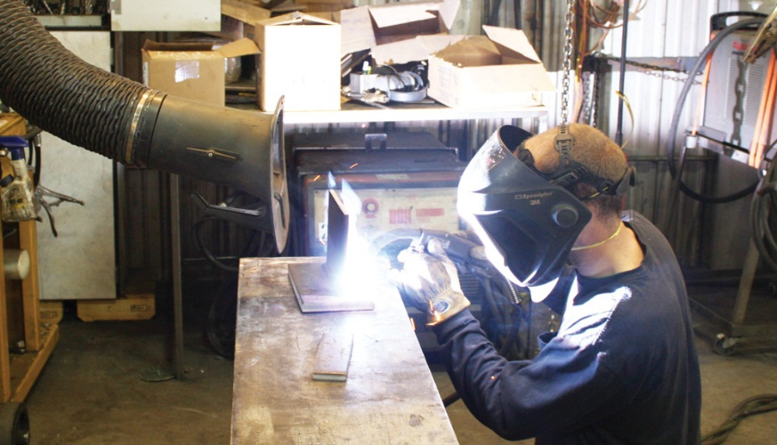
EYES & FACE PROTECTION
Protective Measures
Operations which use or produce vapours, gases, mists, dusts, powders, and other airborne particles should be ventilated.
Ventilation, along with damping systems, can significantly reduce the amount of airborne particles that could be hazardous to your eyes

Slide 19

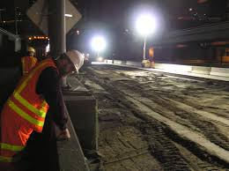
EYES & FACE PROTECTION
Lighting
Signs and Warnings.
  Good lighting is important in work areas. Good lighting reduces eye strain and glare.
  It also promotes both safety and improved productivity.
  Obstructions and protruding objects should be identified and marked.
  Use caution when working around obstructions and protruding objects.

Slide 20
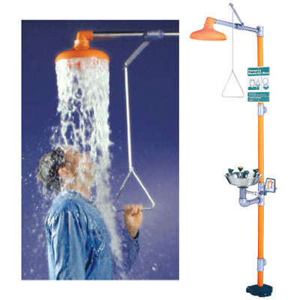
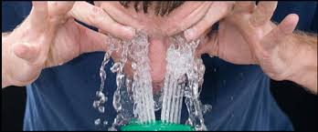
EYES & FACE PROTECTION
Eyewash Stations
Eyewash stations should be located within 100 feet of your work area.
If you accidentally get something in your eyes, go directly to the eyewash station and flush your eyes with water for 15 minutes.
Be sure to hold your eyes open with your fingers and "look" directly into the water streams.
CAUTION: Some chemicals are water reactive and become toxic when mixed with water. Talk with your supervisor or safety manager about the chemicals you will be using on your job. Be familiar with the MSDS for all chemicals used in your job.

Slide 21
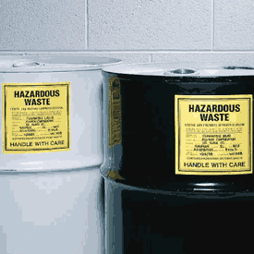
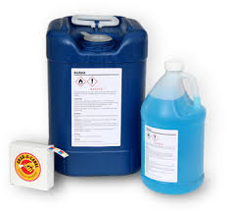
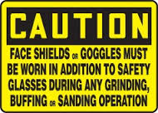
EYES & FACE PROTECTION
Safe Work Practices
Read and follow all warnings and precautions that may be found on equipment and hazardous materials;
Do not throw tools or participate in horseplay;
Keep sharp or pointed objects away from your eyes; and
Follow your supervisor's or safety manager's suggestions and recommendations for working safely

Slide 22
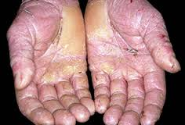
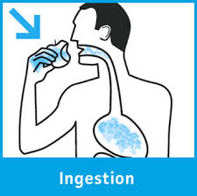
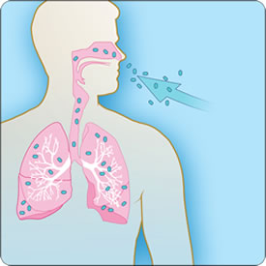
RESPITORY PROTECTION
Health Hazards
It is important, though, to remember that hazardous materials only present a health hazard when they come into contact with your body.
Hazardous materials can enter your body in three ways:
  Ingestion
  Skin Absorption
  Inhalation
Because many substances which are health hazards can become airborne, knowing how to protect you is very important
  Skin Absorption
INHALATION

Slide 23

RESPITORY PROTECTION
Inhalation
Inhalation Of the three ways that hazardous materials can enter your body, inhalation is the most common route of exposure for most materials which are health hazards.
This includes breathing in dust, fumes, oil mist, and vapours from solvents and various gases.

Slide 24
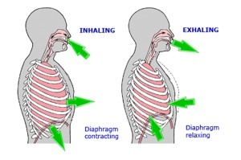
RESPITORY PROTECTION
The Breathing Process
To better understand how health hazards can enter your body by inhalation, let's take a closer look at the breathing process :-
Whenever you take a breath, oxygen rich air is taken into your body through your mouth and nose, goes down your windpipe and into your lungs.
In your lungs, there are tiny air sacs called alveoli.
These delicate air sacs then transfer the oxygen that is in the air into your blood. At the same time the oxygen is being absorbed into your bloodstream, carbon dioxide is being transferred from your blood stream into the air sacs.
When you breathe out, you are ridding your body of gaseous wastes.

Slide 25
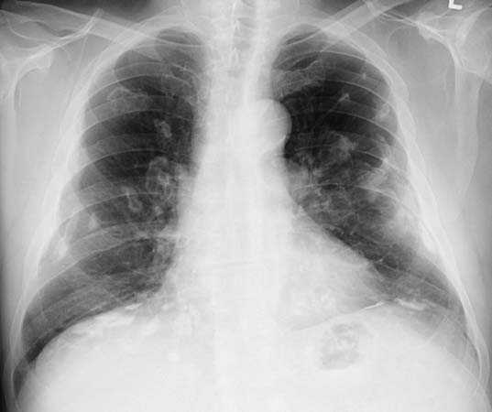
RESPITORY PROTECTION
Lung Damage
Inhaling hazardous materials damages the delicate structure of your lungs.
Lungs that have been damaged are more susceptible to respiratory diseases.
These diseases often cannot be cured, and eventually lead to death.
In short, respiratory protection is serious business.

Slide 26

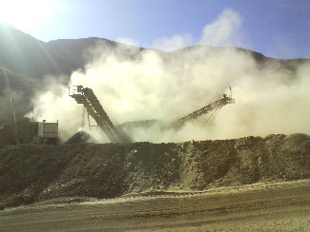
POTENTIAL HAZARD
Vapours
Dusts
Vapours are substances that are created when a solid or liquid material evaporates.
Materials that evaporate easily at room temperature include paint thinner, solvents, and gasoline
  Dusts are formed whenever solid material is broken down into tiny particles.
  Dusts are often produced during sanding and grinding operations.

Slide 27
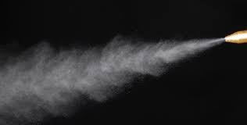

POTENTIAL HAZARD
Mists & Sprays
Fogs
  Mists and sprays are very small droplets of liquid material suspended in the air.
  They are often produced by spray and coating operations.
  Fogs are vapours which have condensed into tiny airborne particles or droplets.
  An example of a hazardous fog would be an insect foggier used to rid industrial and residential areas of ticks and fleas.

Slide 28
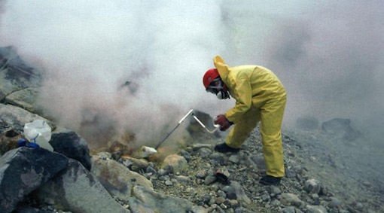

POTENTIAL HAZARD
Gases
Fumes
  Gases are materials that become airborne at room temperature. Gases may have an odour, but many do not. Some gases can be seen, but again, others cannot. Gases may be heavier than air, or lighter than air.
  Fumes can occur whenever a metal, plastic, or polymer is subjected to a high heat during such processes as welding and soldering operations

Slide 29

POTENTIAL HAZARD
Electrical Shocks
Accidents involving electricity result in electrical shocks and burns.

Slide 30
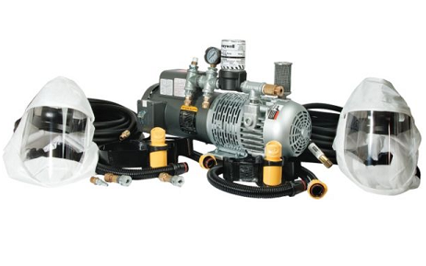
RESPIRATORY PROTECTION.
There are two major categories of respirators:
Air Purifying Respirators:-
  These types of respirators include:
  Air Purifying Disposable Particulate Masks;
  Air Purifying Half Mask Respirators;
  Air Purifying Full Face Mask Respirators;
  Gas Masks
  Powered Air Purifying

Slide 31
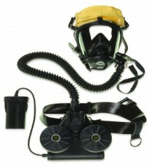
RESPIRATORY PROTECTION.
There are two major categories of respirators:
Airline Respirators;
  Emergency Escape Breathing Apparatus; and
  Self-Contained Breathing Apparatus (SCBA).

Slide 32
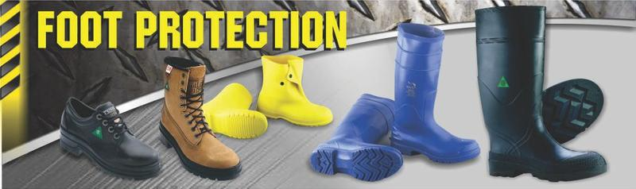
FOOT PROTECTION
Safety shoes are required where the potential for serious injury to the foot may result from an employee's daily job duties.
Foot injuries may occur in areas where there is rolling or falling objects, objects piercing the sole, or where feet are exposed to electrical hazards.
Safety shoes are required where the potential for serious injury to the foot may result from an employee's daily job duties. Foot injuries may occur in areas where there is rolling or falling objects, objects piercing the sole, or where feet are exposed to electrical hazards.

Slide 33
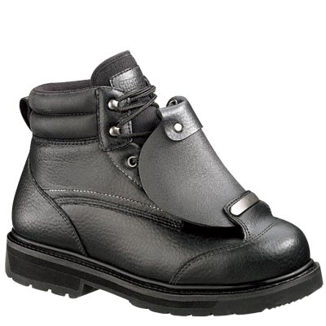
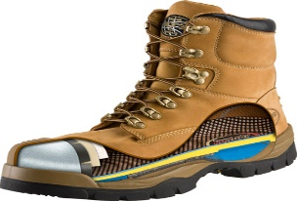
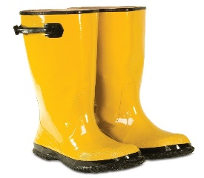
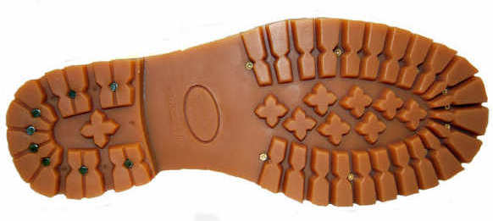
FOOT PROTECTION
There are many types of footwear that are designed to protect your feet.
Steel toe footwear
Metatarsal footwear
Steel toe footwear protects your toes from falling objects and from being crushed.
Metatarsal footwear have special guards that run from your ankle to your toes and protect your entire foot.
Reinforced sole footwear
Latex/Rubber footwear
Reinforced sole footwear have metal reinforcement that protects your foot from punctures.
Latex/Rubber footwear resists chemicals and provides extra traction on slippery surfaces.

Slide 34
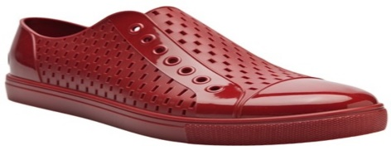
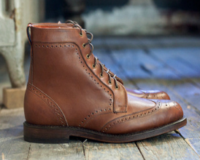
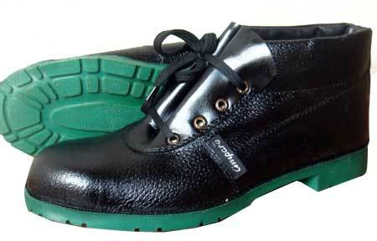
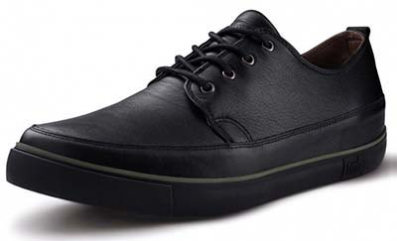
FOOT PROTECTION
There are many types of footwear that are designed to protect your feet.
PVC footwear
Butyl footwear
PVC footwear protects your feet against moisture and improves traction.
Butyl footwear protects against most ketenes, aldehydes, alcohols, acids, salts, and alkalis.
Nitrile footwear
Vinyl footwear
Nitrile footwear resists animal fats, oils, and chemicals.
Vinyl footwear resists solvents, acids, alkalis, salts, water, grease, and blood.

Slide 35

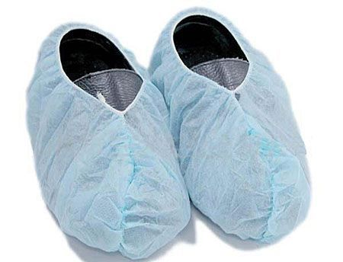
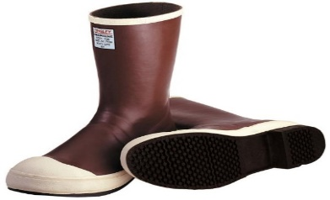
FOOT PROTECTION
There are many types of footwear that are designed to protect your feet.
Electrostatic dissipating footwear
Disposable footwear
Electrostatic dissipating footwear conducts static electricity to floors that are grounded.
Disposable footwear includes shower slippers, clear polyethylene and nonwoven booties used in dust free work areas.
Electrical hazard footwear
Electrical hazard footwear are insulated with tough rubber to prevent shocks and burns from electricity.

Slide 36
FOOT PROTECTION
Wearing and Using Safety Footwear
Select and use the right kind of footwear for the job you are going to be performing. Footwear should meet or exceed the standards.
Avoid footwear made of leather or cloth if you work around acids or caustics. These chemicals quickly eat through the leather or cloth, and can injure your feet.
Select footwear that fit.
Inspect your footwear before you use them. Look for holes and cracks that might leak.
Replace footwear that is worn or torn.
After working with chemicals, hose your footwear with water to rinse away any chemicals or dirt before removing your footwear.
Avoid borrowing footwear. Footwear is Personal Protective Equipment's.
Store footwear in a clean, cool, dry, ventilated area.

Slide 37

HAND PROTECTION
Human hands are unique.
No other creature in the world has hands that can grasp, hold, move, and manipulate objects like human hands.
They are one of your greatest assets. And, as such, must be protected and cared for.
WARNING: Toxic substances are poisonous substances that can be absorbed through your skin and enter your body.

Slide 38
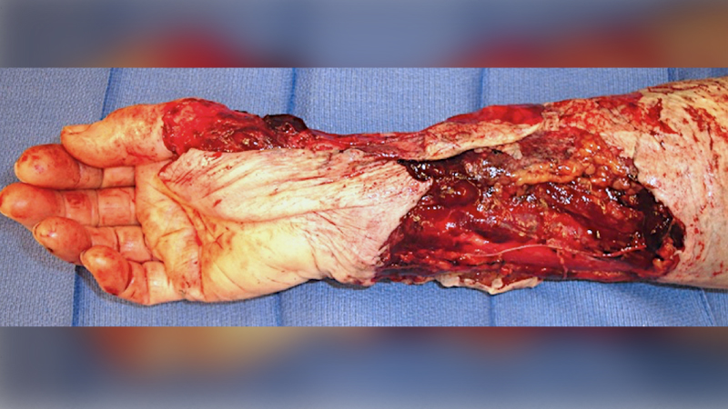
HAND PROTECTION
Types of Injuries
Traumatic Injuries
  Tools and machines with sharp edges can cut your hands.
  Staples, screwdrivers, nails, chisels, and stiff wire can puncture your hands.
  Getting your hands caught in machinery can sprain, crush, or remove your hands and fingers.

Slide 39
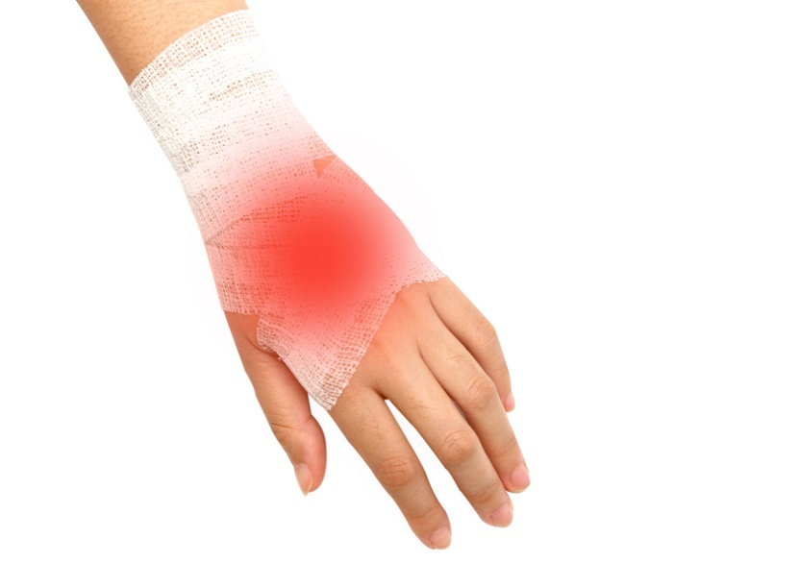
HAND PROTECTION
Types of Injuries
Contact Injuries
  Coming into contact with caustic or toxic chemicals
  Biological substances
  Electrical sources
  Extremely cold or hot objects can irritate or burn

Slide 40
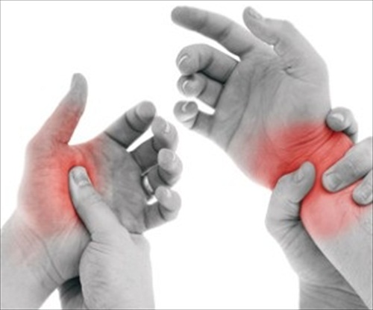
HAND PROTECTION
Types of Injuries
Repetitive Motion Injuries
Whenever repeat the same hand movement over a long period of time, its run the risk of repetitive motion problems as:
  Overuse of a particular muscle or group of muscles
  Vibrating equipment
  Working in cold temperatures
  Poor posture or a non-ergonomically designed workspace
  Forceful activities
  Holding the same posture for prolonged periods
  Direct pressure to particular areas
  Carrying heavy loads
  Fatigue

Slide 41
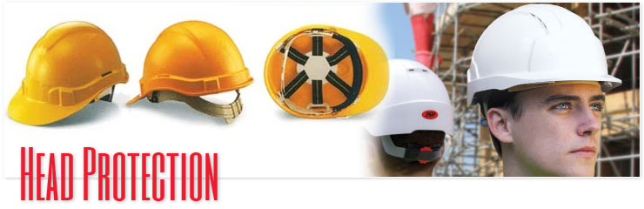
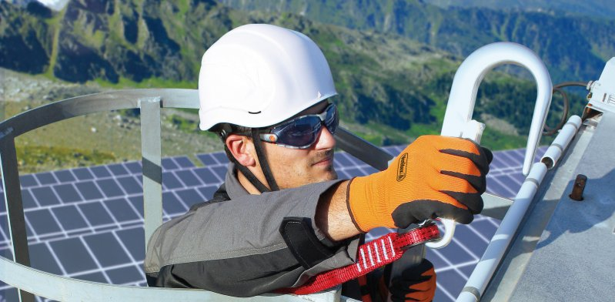
HEAD PROTECTION
Your head is a very delicate part of body. In and around head are:
  Eyes
  Ears
  Nose
  Mouth and
  Brain
  NOTE: Injuries to the head are very serious. For this reason, head protection and safety are very important.

Slide 42
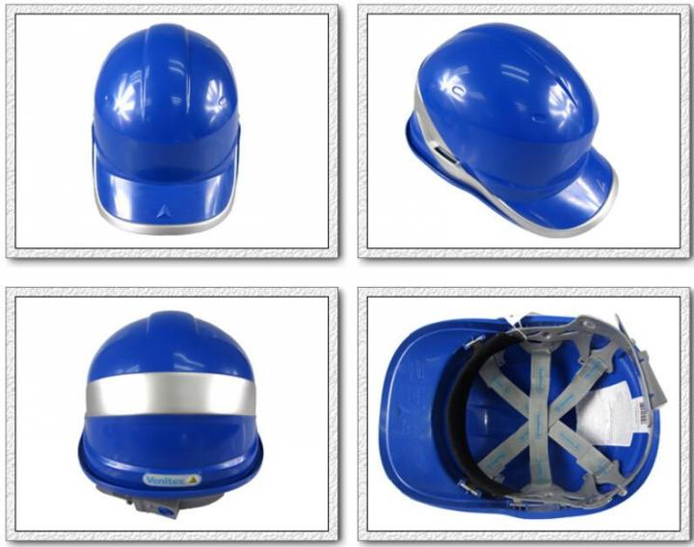
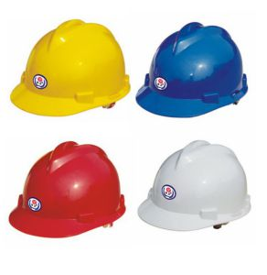
HEAD PROTECTION
Wearing Hard Hats
  Always wear your hard hat while you are working in areas where there are potential head hazards.
  Adjust the suspension inside your hard hat so that the hat sits comfortably, but securely on your head.
  Inspect the shell of your hard hat for cracks, gouges, and dents. Inspect the suspension system for frayed or broken straps.
  Never paint, scratch or drill "air holes" in your hard hat. You may apply reflective plastic tape if you must work at night. Never use metal tape on your helmet because it can conduct electricity.
  Never carry personal belongings such as cigarettes, lighters, or pens in your hard hat.

Slide 43
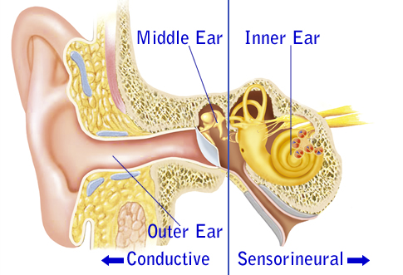
HEAR PROTECTION
Hearing protection awareness
There are two types of Hearing loss
Conductive
Sensory

Slide 44
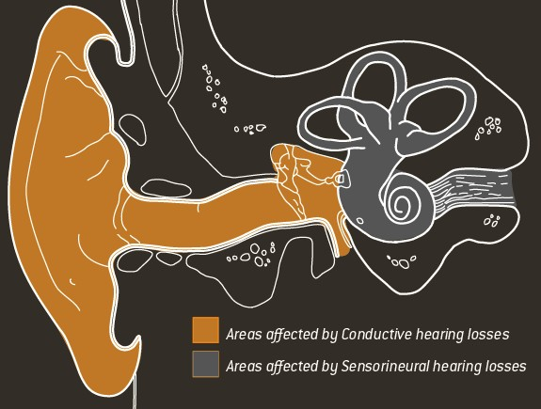
HEAR PROTECTION
Conductive hearing loss
Conductive hearing Loss is caused by damage to or a malfunction of the outer and middle ear. It results in a decrease in your hearing, but you can still understand speech.
Several medical disorders cause conductive hearing loss. These disorders can be treated medically or surgically. These disorders are:
  Middle ear infections
  Perforation of the eardrum
  Fixation of the ossicular chain
  Otosclerosis

Slide 45

HEAR PROTECTION
Sensory Hearing Loss
Sensory hearing loss is a hearing loss caused by damage to or a malfunction of the inner ear, auditory nerve, or the brain. It makes it more difficult to understand speech, but it does not result in a decrease in loudness.
Causes of sensory hearing loss are:
  Hereditary
  Damage to fetes
  Aging
  Noise
  Disease
  Injury
  Drugs
Sensory hearing loss CANNOT be corrected medically or surgically. It is permanent

Slide 46



HEAR PROTECTION
Types of hearing protection devices
Foam Earplugs
PVC Earplugs
Earmuffs
PVC Earplugs
Foam Earplugs
Earmuffs

Slide 47
Our Clients

