Slide 1
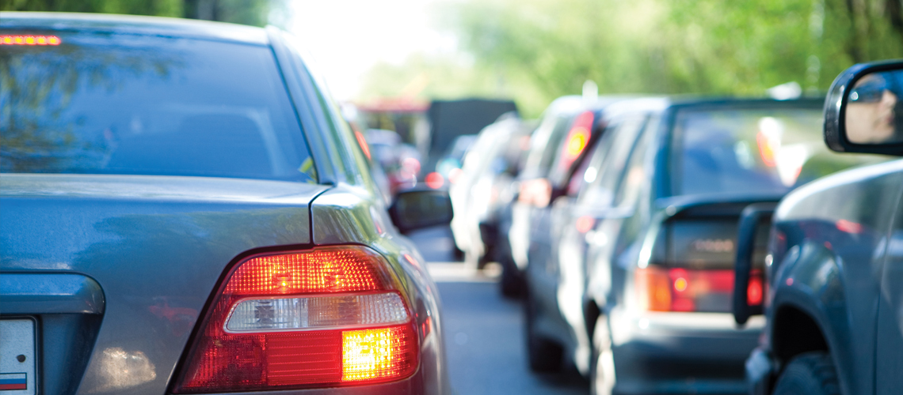
DEFENSIVE DRIVING

Slide 2
ABOUT PMG
“BUILDING FOOD FACTORIES WITH TOP QUALITY STANDARDS OF NESTLE, MONDELEZ,ABBOTT, DANONE USING 3D DESIGN AND HYGIENIC ENGINEERING.”
At PMG, we deliver Engineering Design and Project Management scopes in Food and Beverage industry. Our team of design engineers and engineering executives has rich experience in Project Planning, Design, Execution and Commissioning with key competencies in areas like 3D Plant Design, Hygienic Engineering, and Project Management. Our safe-by-choice, result-oriented, and pro-active work-ethics allow us deliver work scopes meeting objectives, complete stakeholder alignment and first-time quality.
PMG Knowledge Repository: Targeted Knowledge Sharing & Skill Development
Precise and focused training modules for the exhaustive set of people working in manufacturing industry, instilling qualities of self-belief, creative thinking & widened perspective.
Clear Learning Objectives
Focused approach to skill development and knowledge sharing
Progressive Evaluation
Gauging improvement on every step and keeping audience connected.
After-training follow-ups
We systematically track differential progress of recipients after the training.
Audience Specific Approach
Programs are fine-tuned to the ability and interests of the recipients.
Multiple Awe-moments
Awe-moments are refreshing and increase receptivity many-fold.
Seasoned Trainers
PMG trainers are subject matter experts with substantial work experience.

Slide 3
AGENDA
1
Introduction.
2
Safe Driving
3
Fitness to driver
4
What Causes Road Accidents.
Notes:
3

Slide 4
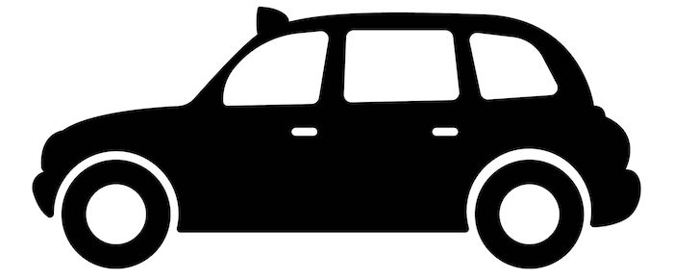
INTRODUCTION
It is a set of driving skills that allows you to defend yourself against possible collisions caused by bad drivers, drunk drivers, and poor weather.
If you look ahead and keep your eyes moving, you will spot potential hazards more easily.
Once you have identified a potential hazard and decided what to do, act immediately.
Defensive drivers are able to avoid dangers on the road by using their safe driving practices.
Don't make assumptions about another drivers intentions. If you expect drivers in parked vehicles to remain parked at all times, always yield at intersections, or remain in one lane at all times, etc.
Expect other drivers to make mistakes and be prepared to react. If a mistake is made, you will be ready to defend yourself.
Never assume that other drivers are sober, alert, and follow the rules of the road at all times.

Slide 5
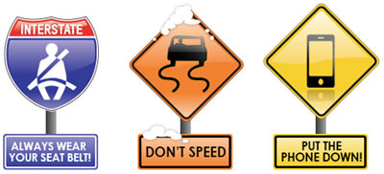
INTRODUCTION
Tips for defensive driving:
Plan ahead for the unexpected.
Be able to control speed
Be prepared to react to other drivers
Do not expect the other driver to do what you think he or she should do
Respect other users of the roadway.
Be aware of driving in special road and weather conditions
Be alert and avoid distractions, e.g., cell phone use, eating.

Slide 6
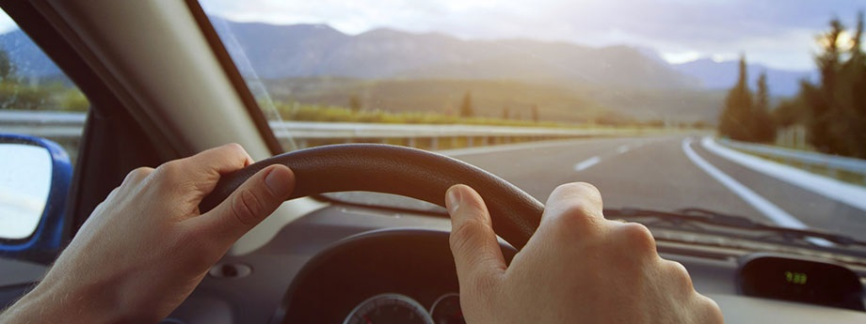
SAFE DRIVING
Drivers must hold a valid driving licence while driving.
It is vitally important to understand and obey all the rules of the road and to update on road safety.
Drivers have an individual responsibility for their driving behaviour.
Drivers must assess their fitness to drive.
Never drink and drive.
Never drive under the influence of drugs.
Never drive when tired.
Drivers must wear a seat belt on every journey
Before setting off, always plan your route and check for weather and traffic updates.
Always drive at the appropriate speed for the prevailing conditions.
Always use daytime running lights and slow down or even cancel your journey in severe weather conditions [rain, fog, high winds, ice or snow]

Slide 7
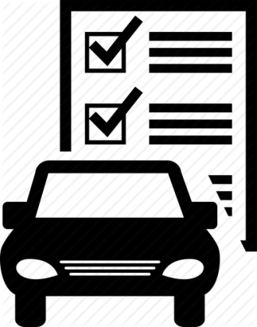
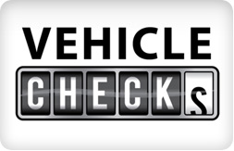

SAFE DRIVING
Safe Vehicle
Always carry out a vehicle pre-check before using your vehicle.
This should be done daily and a more detailed check should be carried out weekly or as prescribed by your employer.
Make sure loads are securely stowed or fastened in the vehicle.
If carrying loads on the vehicle, loads must be appropriately stowed and restrained to prevent any movement during transit.

Slide 8
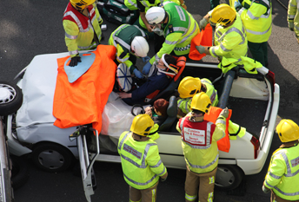
SAFE DRIVING
Dealing with Collisions and Emergencies
Personal safety and the safety of any passengers should always be your first consideration.
Use your hazard warning lights and hi-visibility clothing to make sure you and your vehicle can be seen by other road users.
Collisions that result in injury while driving for work should be reported.

Slide 9

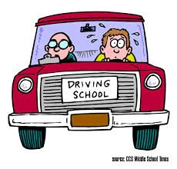

SAFE DRIVING
Driver Training
Drivers should consider maintaining their skill and knowledge by undergoing regular refresher training.
Your employer may have specific vehicle familiarisation or refresher training procedures in place.
When required to drive a vehicle with which you are not familiar take time to inform yourself on the safe operation of that vehicle type before going on any journey.

Slide 10


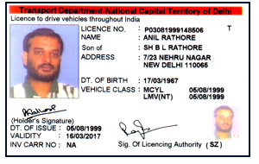
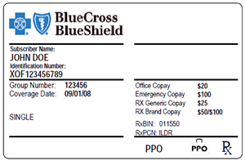
SAFE DRIVING
Driver Qualification and Authorisation
As part of driving for work policy and procedures, you should be authorised to drive for work by your employer and you should submit the following documentation to your employer to verify that you are suitably qualified and authorised to drive:-
  Valid driving licence for the category of vehicle
  Driving licence endorsements or penalties
  Proof of insurance and type of use
  Details of any medical conditions related to driving

Slide 11
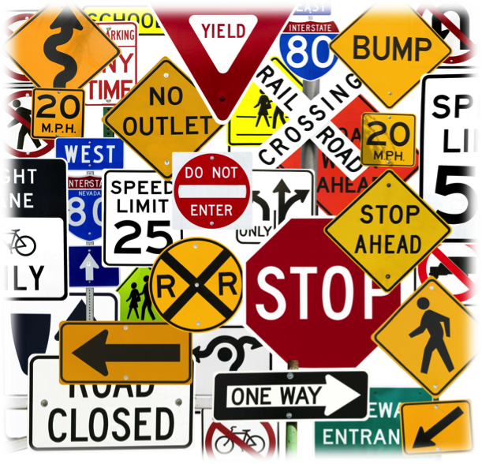

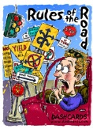
SAFE DRIVING
Knowledge of rules of the road
Driver must have a satisfactory knowledge of the rules of the road to get a driving licence.
Drivers must regularly update themselves on road safety rules.

Slide 12
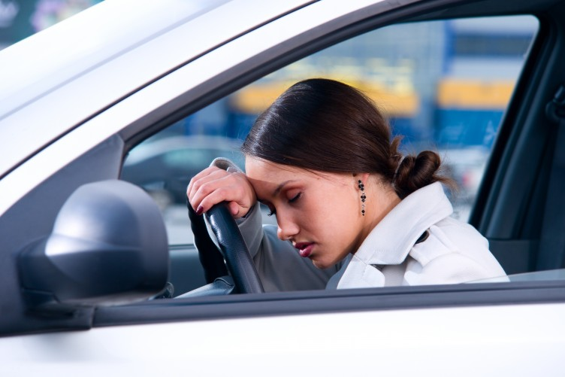
FITNESS TO DRIVE
Knowledge of rules of the road
You should report to work fit for all work activities including driving duties.
If you are not fit for work, it is your responsibility to inform your manager.
Your physical health, psychological and emotional state and your general attitude towards driving play a major part in your fitness to drive

Slide 13
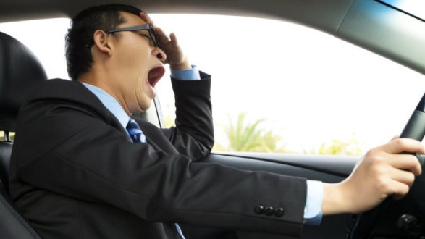
FITNESS TO DRIVE
Knowledge of rules of the road
It is important to remember that your fitness to drive can be negatively affected by:
  Fatigue
  Alcohol
  Drugs
  Temporary illness
  A medical condition
  Daily stress events

Slide 14
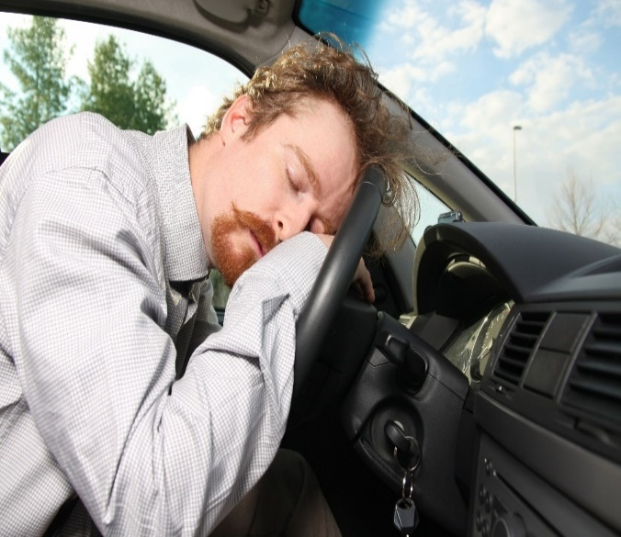
FITNESS TO DRIVE
Fatigue
Fatigue is a major contributor cause of fatal and serious injury vehicle collisions and incidents.
You are most likely to feel sleepy when driving:
  ▲On long journeys on monotonous roads
  ▲Between 2 am and 6 am
  ▲Between 2 pm and 4 pm
  ▲After having less sleep than normal
  ▲After drinking alcohol
  ▲After taking medicines which cause drowsiness
  ▲On journeys home after night shifts
  ▲On journeys after a very long working day
NOTE- Do not continue to drive if you are suffering from fatigue tiredness kills.

Slide 15
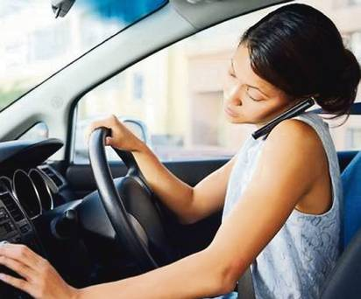
FITNESS TO DRIVE
Measures to tackle driver fatigue
Most, if not all, of the risk could be avoided by awareness and planning. You can counteract fatigue in a number of ways.
Measures to tackle driver fatigue
  Avoid driving by:
    Using the phone, email, video-conferencing or public transport to do business
    Car-sharing to reduce number of journeys you take

Slide 16
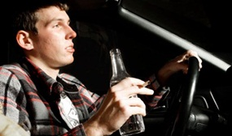
FITNESS TO DRIVE
Measures to tackle driver fatigue
Avoid the most dangerous times
  Avoid driving:
    At night, [especially after a long shift]
    After drinking alcohol
    After taking medicine that makes you drowsy
    In poor weather conditions

Slide 17
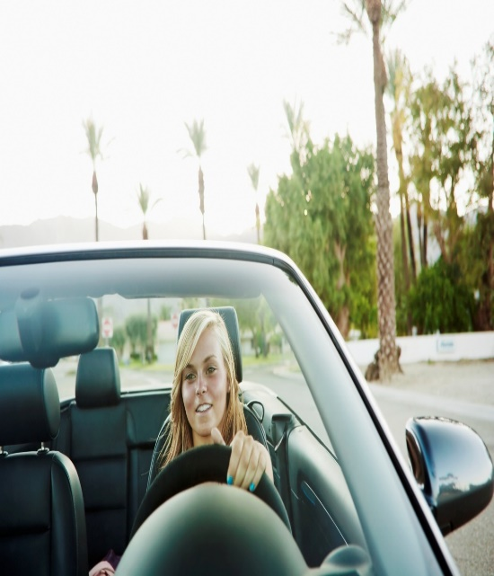
FITNESS TO DRIVE
Measures to tackle driver fatigue
Reduce your driving time:
Take a break at regular intervals or after every two hours of driving
Follow any safe or legal limits set by your employer on maximum driving distances and journey times
Make sure you comply with drivers’ hours and tachygraphy rules, if you are subject to them
Resist the temptation to carry on if you feel tired
If possible, share the driving with a colleague
If necessary, plan an overnight stop into your work schedule

Slide 18
FITNESS TO DRIVE
Measures to tackle driver fatigue
Make sure you are well rested
Avoid driving when you would normally be asleep
Make sure you get plenty of sleep before a long drive
Keep meals light during or immediately before you drive. Heavy meals can make you drowsy
Stop if you feel tired
If you start to feel tired
Find somewhere safe to stop (not the hard shoulder)
Take two strong caffeine drinks and have a ‘catnap’ for 15 – 20 minutes
Find somewhere suitable to sleep overnight, if necessary
Discuss concerns with your manager
If you are concerned about your driving hours, journeys or schedules or if you find yourself driving when too tired, discuss this with your line manager

Slide 19
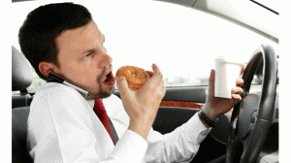
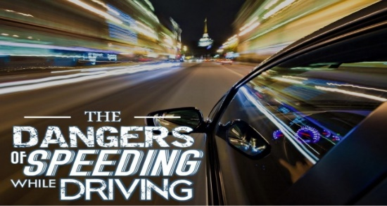
WHAT CAUSES ROAD ACCIDENT
Destructed Driving
Speeding
  The number one cause of car accidents is not a criminal that drove drunk, sped or ran a red light.
  Distracted drivers are the top cause of car accidents in the U.S. today.
  A distracted driver is a motorist that diverts his or her attention from the road, usually to talk on a cell phone, send a text message or eat food
  You’ve seen them on the highway.
  Many drivers ignore the speed limit and drive 10, 20 and sometimes 30 mph over the limit.
  Speed kills, and travelling above the speed limit is an easy way to cause a car accident.
  The faster you drive, the slower your reaction time will be if you need to prevent an auto accident

Slide 20
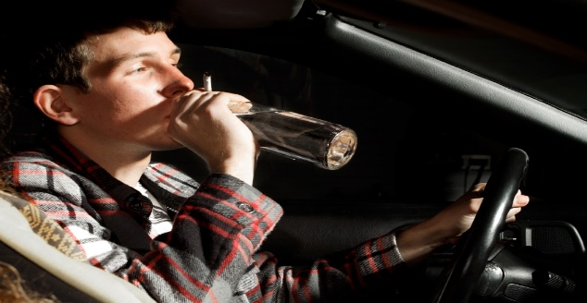
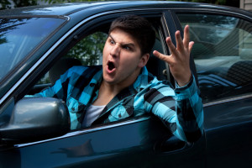
WHAT CAUSES ROAD ACCIDENT
Drunk Driving
Reckless Driving
  When you drink, you lose the ability to focus and function properly and its very dangerous when operating a vehicle.
  Driving under the influence of alcohol causes car accidents every day, even when they are one the top causes that can be avoided.
  If you don’t drive carefully, and you may end up in a needless car accident.
  That’s what often happens to reckless drivers who speed, change lanes too quickly or tailgate before causing a car accident.
  Reckless drivers are often impatient in traffic so be sure to take extra care around aggressive drivers

Slide 21
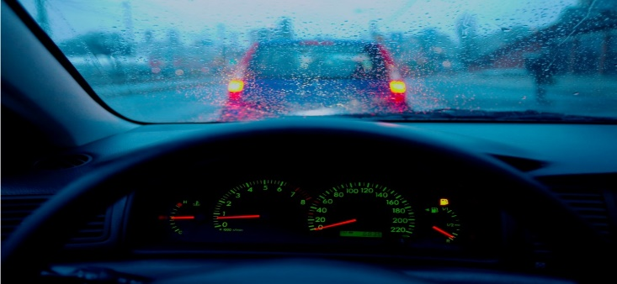
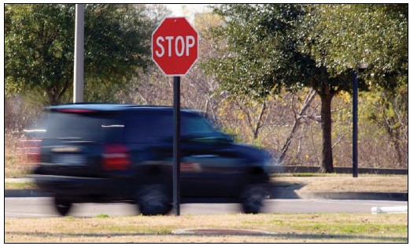
WHAT CAUSES ROAD ACCIDENT
Rain
Running Stop Sign
  If the weather gets bad so do the roads.
  Car accidents happen very often in the rain because water creates slick and dangerous surfaces for cars, trucks, and motorcycles and often causes automobiles to spin out of control or skid while braking.
  To avoid a car accident, drive extra careful when it rains.
  Stop signs should never be ignored, but when they are, serious car accidents are often the result.
  Each year, thousands of car accidents occur because one driver ran a stop sign.
  Many rollover accidents and side-impact car accidents result from drivers that run stop signs.
  You should always look both ways when proceeding through a stop sign.

Slide 22
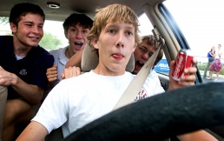
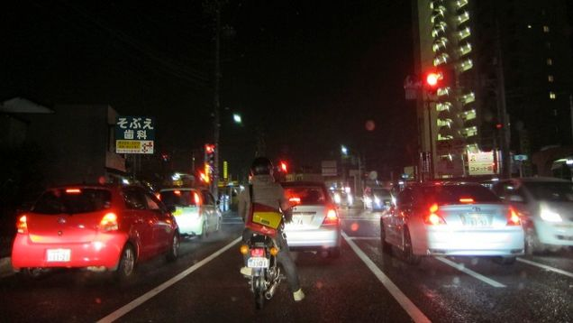
WHAT CAUSES ROAD ACCIDENT
Teenage Drivers
Night Driving
  Youth is wasted on the young, but careful driving is never wasted on young drivers.
  Unfortunately, teenagers aren’t often known for their carefulness.
  When teen drivers hit the roads they don’t always know what to do and that lack of experience ends up causing car accidents.
  Driving in the daylight can be hazardous, but driving at night nearly doubles the risk of a car accident occurring.
  When you can’t see what’s up ahead you don’t know what to anticipate as you drive towards it.
  As the sun goes down, your awareness of the road and cars around you must go up.

Slide 23
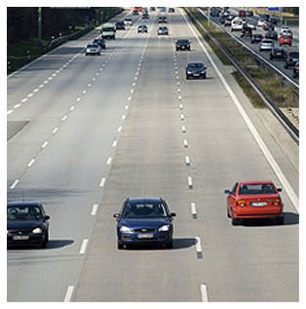
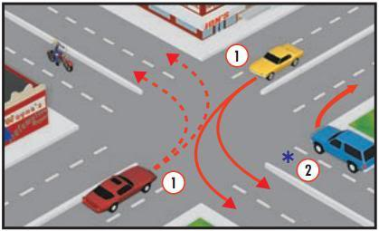
WHAT CAUSES ROAD ACCIDENT
Wrong Way Driving
Improper Turns
  Everyone has lapses in judgment, but when behind the wheel of a car, those clouded instincts can be deadly.
  You can turn down a street thinking it is a normal right turn, when in actuality, it is a one-way street in the opposite direction.
  When you go the wrong way, everyone is in danger because as you head towards a car accident.
  The reason that we have stop lights, turn signals, and lanes designated for moving either right or left as opposed to straight is because when drivers ignore the rules of the road, car accidents are often the result.
  To prevent a car accident, always look for signs and obey the proper right-of-way before you make a turn.

Slide 24
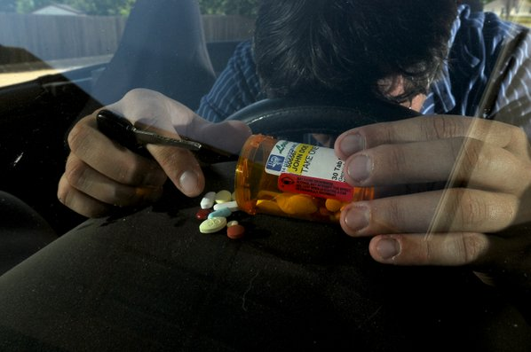
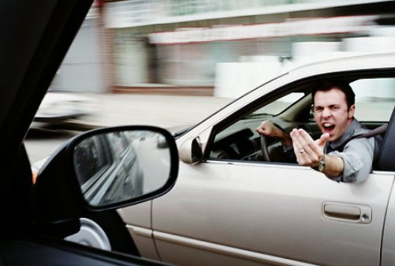
WHAT CAUSES ROAD ACCIDENT
Driving Under the Influence of Drugs
Road Rage
  It’s not only alcohol that is dangerous when mixed with drivers on the road.
  Drugs, both legal and illegal, can impair your ability to fully function as a driver.
  If your mind isn’t clear and you don’t have complete control over your body, getting behind the wheel can lead to serious car accidents.
  Everyone has been angry at another driver for one reason or another, but some drivers let their rage overcome them.
  By tailgating another driver in anger or speeding past another driver only to pull in front of them and brake, these road “rages” cause many needless car accidents each year.

Slide 25
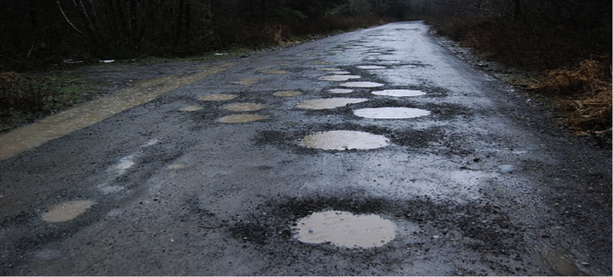
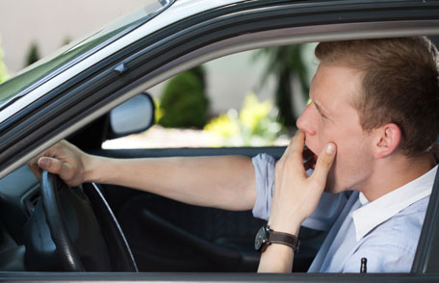
WHAT CAUSES ROAD ACCIDENT
Potholes
Drowsy Driving
  Drivers run the risk of losing control of their car or blowing out a tire when they drive over these potholes.
  If you see a pothole in your car’s path, you can avoid a car accident by making sure that your tires do not drive over it
  Driver fatigue isn’t talked about a lot, but how well can we expect anyone to drive when they’re having trouble staying awake.
  Most of the car accidents caused by drowsy driving occur at night.
  If you find yourself wanting to fall asleep at the wheel, pull over when it’s safe and try to take a quick 30 minute power nap

Slide 26
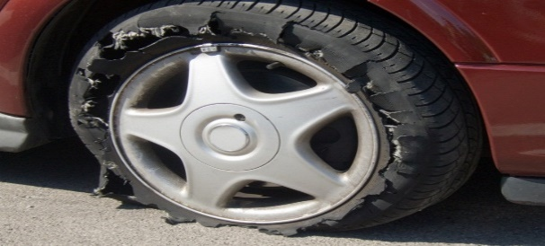
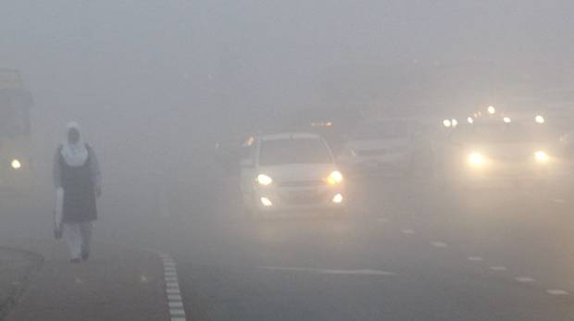
WHAT CAUSES ROAD ACCIDENT
Tyre Blow Out
Fog
  Most highways are littered with the scattered remains of a tire blowout.
  Tire blowouts can cause you to lose control of your vehicle, and they are especially dangerous for bigger automobiles like semi-trucks.
  When encountering a tire blowout, try to maintain control of your vehicle and pull over safely and you will likely avoid a serious car accident
  Fog isn’t the most common weather occurrence, and that’s good news for car accidents statistics.
  Driving is a skill that requires the ability to see, but fog makes it extremely difficult to see sometimes more than a car length in front of you.
  Avoid car accidents by using your head lights — and never your high beams — when driving in the fog

Slide 27
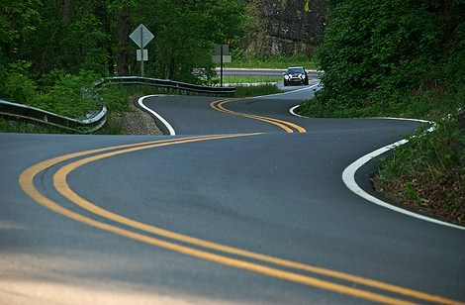
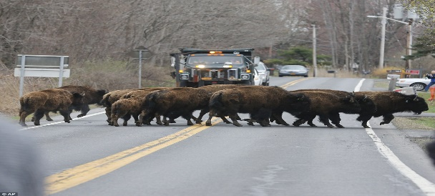
WHAT CAUSES ROAD ACCIDENT
Deadly Curves
Animal Crossing
  Some people call them dead man’s curves, but everyone should be careful when approaching a curve.
  Many motorists have lost control of their cars along a dangerous curve and lost their lives in a car accident.
  So when you approach these signs, take head of the posted
  While drivers are required to know the rules of the roadway, wild animals do not take driver’s education.
  Wild animals will wade out into the street, and it’s up to you to make sure that you don’t get into a car accident with them.
  Take caution when you see an animal crossing sign and use your high beams when travelling in rural, woody areas

Slide 28
Our Clients

