Slide 1
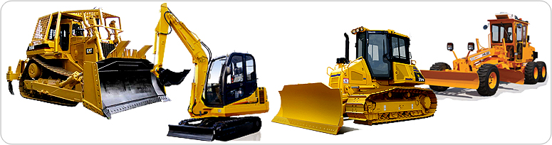
CONSTRUCTION SAFETY
EARTH MOVING EQUIPMENT’S

Slide 2
AGENDA
1
Earth Moving Equipment Definition.
2
General Requirment for Construction Equipment.
3
The General Standards for Electrical Apply to Moving Vehicles.
4
Inspection.
5
Earth Moving Equipments.
6
Conclusion.
7
Heavy Equipment Operation.
Notes:
2

Slide 3
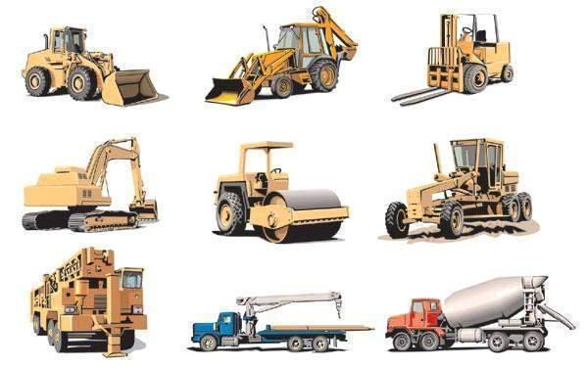
DEFINITION
Earth Moving Equipment
Earth Moving Equipment's- a machine for excavating, pushing, or transporting large quantities of earth.
Construction vehicles and equipment pose a serious risk to construction workers.
According to the National Institute for Occupational Safety and Health (NIOSH), each year more than 100 workers at street and highway construction sites are killed, and over 20,000 are injured.
Vehicles and equipment operating in and around the work zone are involved in over half of the worker fatalities in the construction industry.

Slide 4
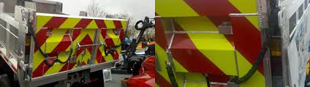
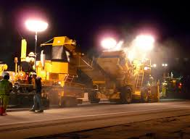
GENERAL REQUIREMENTS
Construction Equipment
Workers involved in night projects, as well as approaching vehicles on a highway, need to be able to spot and avoid construction equipment.
Any equipment left overnight at a jobsite adjacent to a highway, or left overnight next to an area where construction work is still in progress, has to be lit or equipped with reflectors.

Slide 5
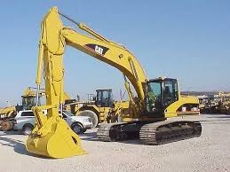
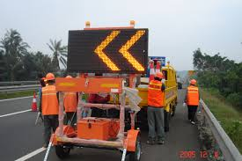
GENERAL REQUIREMENTS
Construction Equipment
If that is unfeasible, look for barricades with flashing lights or reflectors to be placed between the stationary equipment and the active portion of the jobsite or the oncoming traffic.
Any heavy machinery or equipment with elevated parts (cranes, bulldozer blades, dump truck bodies, and so on) should be lowered or blocked when they’re not being used, or when someone is repairing the equipment.

Slide 6
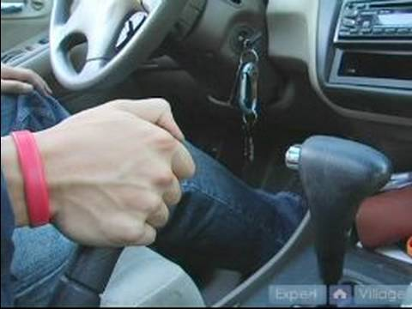
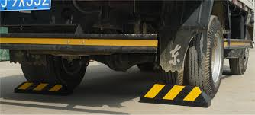
GENERAL REQUIREMENTS
Construction Equipment
When working around parked moving equipment, check to make sure the parking brake is always set. If equipment is parked on a slope, it is important to note if the parking brake is set and the wheels are chocked.
Unattended equipment should always be left in neutral, with the motor stopped and the brakes set, unless specific requirements of the job require otherwise.

Slide 7
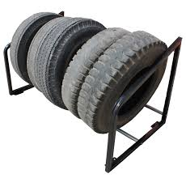
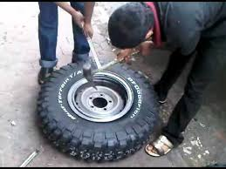
GENERAL REQUIREMENTS
Construction Equipment
Split rim wheels can be another danger to keep your eye out for when on the job site. Rim sections can blow out, causing a safety risk. Split rim wheels, as well as rims with locking rings or any similar device, should always be worked on by properly trained employees.
In addition, a safety tire rack, a cage, or some kind of equivalent protection should always be used when inflating, mounting, or dismounting tires installed on split rims. Any glass used in the cab of a moving construction vehicle should be safety glass. The glass should not introduce any visible distortion that might affect the safe operation of the machine

Slide 8
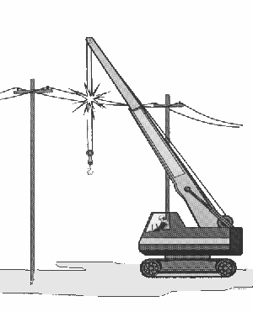
ELECTRICAL SAFETY APPLY TO MOVING VEHICLES
The general standards for electrical safety apply to moving vehicles. In general, this means
  Unless power lines are de-energized and visibly grounded, or insulating barriers have been put up, there should be a clearance of at least 10 feet between any equipment and the power lines
    If the operator’s view of the power lines is impeded, another worker should observe the work and warn the operator if he or she gets close to violating the minimum clearance.
    Unless a utility representative indicates that the line has been de-energized and grounded, assume it is live and dangerous.
    Always remove combustible and flammable materials from an area where you might accidentally contact a live power line

Slide 9
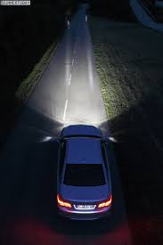
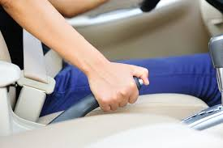
ELECTRICAL SAFETY APPLY TO MOVING VEHICLES
All motor vehicles on a construction site should have a service brake system, an emergency brake system, and a parking brake system (the three systems can use common components).
Brakes are essential safety systems, and should always be inspected and maintained in top condition.
Any time visibility warrants extra light (which includes any time vehicles are used at night), all vehicles should have at least two headlights and two taillights. Just like brakes, lights are absolutely essential for safety in fog, smoke, or night conditions, and should always be maintained in operating condition.
Every vehicle on a job site should have working brake lights and an audible warning device, regardless of the lighting or visibility conditions.

Slide 10
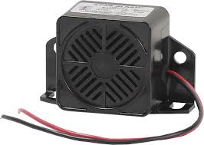
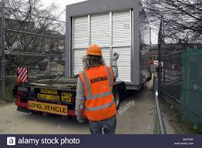
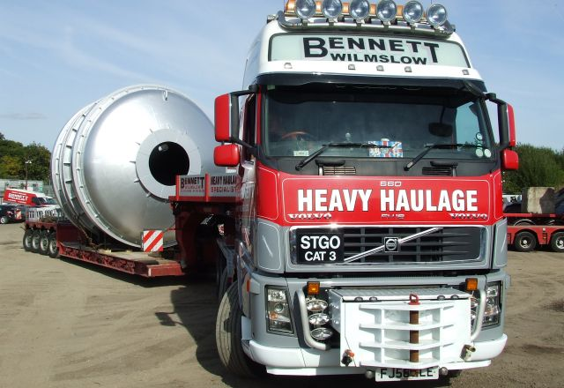
ELECTRICAL SAFETY APPLY TO MOVING VEHICLES
Haulage vehicles that are loaded by cranes, power shovels, loaders, or similar equipment need to have a shield or canopy that can protect the operator and any passengers from falling objects.
A signalman observes the vehicle, and signals the driver when it is safe to back up.
The vehicle has a back-up alarm, audible to all nearby workers above the surrounding noise level.

Slide 11
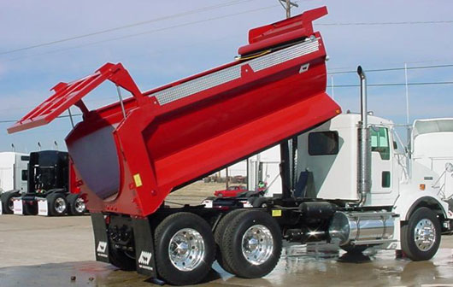
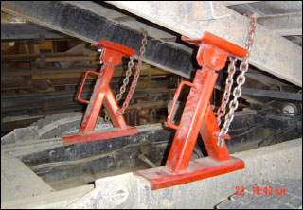
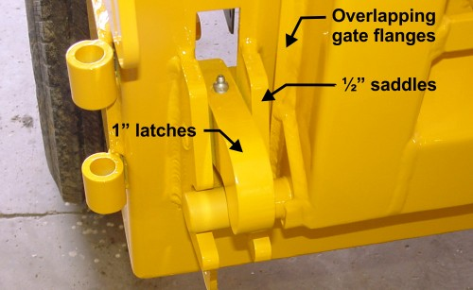
ELECTRICAL SAFETY APPLY TO MOVING VEHICLES
The dump body truck
  The dump body truck The dump body of a truck must have permanent supports.
  The supports need to be lockable so that the body doesn’t accidentally fall while workers are performing maintenance or inspections.
  The hoisting and dumping controls should have a latch, or some other device that will prevent the dumping mechanism from accidentally tripping or starting.
  The trip handles for the tailgates of a dump truck should be arranged so that the operator is clear while dumping takes place.

Slide 12

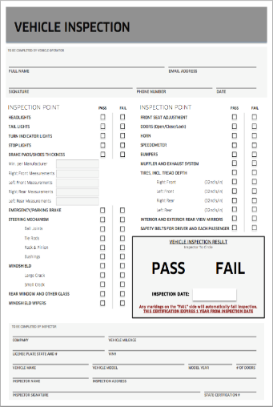

INSPECTION
All of the vehicles used at a jobsite should be checked at the start of each shift to make sure that its parts, equipment, and accessories are in safe operating condition and free of any damage that might cause a failure.
Any defects should be fixed before anyone uses the vehicle.
Vehicles should have fenders if at all possible, or mud flaps if the vehicle is unable to equip fenders.
  Important inspection items include:
    Trailer brake connections
    Emergency brake
    Parking brake system and hand brake
    Service brakes
    Tires
    Horn

Slide 13
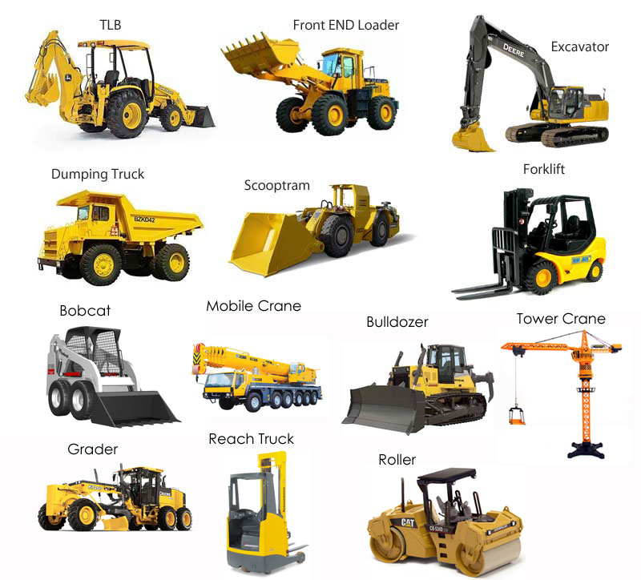
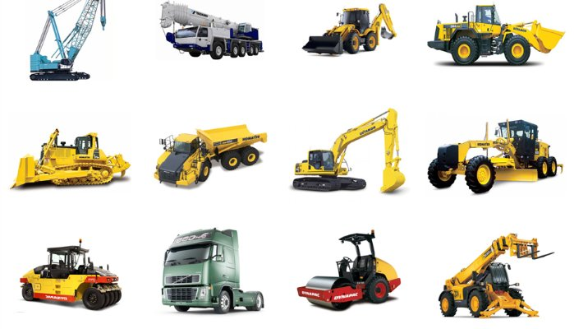
EARTHMOVING EQUIPMENT
Earthmoving equipment includes scrapers, loaders, crawler tractors, wheeled tractors, bulldozers, off-highway trucks, graders, agricultural and industrial tractors, and similar equipment.
Like any other motor vehicle, they are safe when used properly and with the proper considerations, and can be very dangerous otherwise

Slide 14
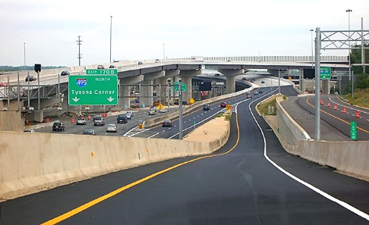
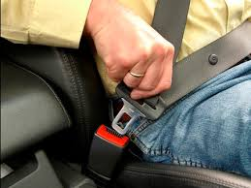

EARTHMOVING EQUIPMENT
Seat belts are necessary on almost all earthmoving equipment. The exceptions are equipment which is always operated standing up, or equipment which does not have a roll-over protective structure (ROPS) or adequate canopy protection. Although it almost goes without saying, seat belts should always be used by operators while the engine is running.
Construction equipment should only be moved on access roads and grades that are constructed and maintained to safely support them. Make sure emergency ramps and beams have been constructed in order to restrain and control runaway vehicles. Earthmoving equipment like trucks, scrapers, tractors, and trailers that can reach speeds of 15 miles per hour should generally have fenders or mud flaps, in order to protect nearby workers from flying dirt and debris.

Slide 15

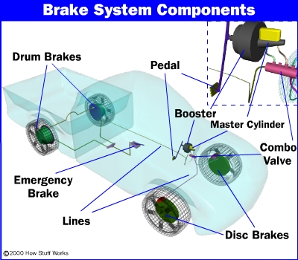
EARTHMOVING EQUIPMENT
All earthmoving equipment needs a service braking system that can stop and hold the vehicle while it’s fully loaded. The Society of Automotive Engineers publishes minimum performance criteria for brake systems in heavy equipment, and their published material should be consulted if more detailed information about brake systems is required.
Machines that can move in more than one direction, like rollers, compacters front- end loaders, bulldozers, and similar equipment, need to be equipped with a horn. The horn should be distinguishable from the surrounding noise at the jobsite, and should always be maintained. Like other motor vehicles on the jobsite, earthmoving and compacting equipment with an obstructed rear view should not be backed up, unless it has a reverse signal alarm or a signalman indicates that it’s safe to move in reverse

Slide 16
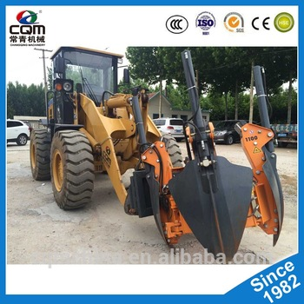
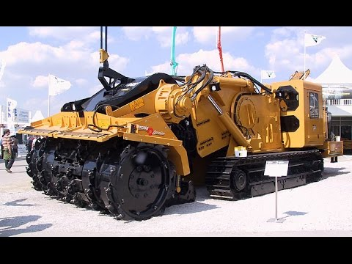
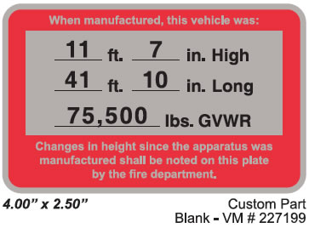
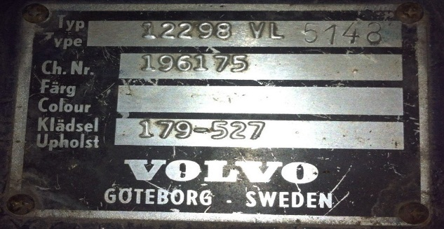
EARTHMOVING EQUIPMENT
Any modifications or additions that might affect the capacity or safe operation of a piece of jobsite equipment have to be approved, in writing, by the manufacturer.
The capacity, operation, and maintenance instruction plates, tags, or decals need to reflect any changes that have been made, so anyone who looks at the records or uses the machine are aware of the changes.
Be aware that the original safety factor of the equipment should never be reduced by this kind of modification.
Scissor points on front-end loaders, as well as similar features on other earthmoving equipment, can be dangerous to the vehicle operator in the normal course of work at the site.
The point should be equipped with guards.

Slide 17
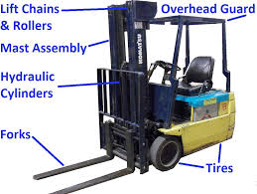
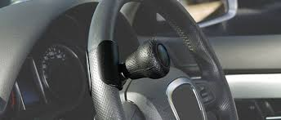
EARTHMOVING EQUIPMENT
Steering or spinner knobs should not be attached to the steering wheel of a truck or earthmoving vehicle, unless the steering mechanism is of a type that prevents road reactions from causing the steering hand wheel to spin.
The steering knob shall be mounted within the periphery of the wheel.
All high lift rider industrial trucks must be equipped with overhead guards.
keeps current specifications for the configuration and structural requirements for overhead guards.
NOTE: No unauthorized personnel should ever be allowed to ride on a powered industrial truck.

Slide 18


CONCLUSION
Earth moving equipment and motor vehicles on the construction site are the cause of over half of all construction accidents.
With the pointers in this course, you should have a better idea of how to avoid common pitfalls and keep your life expectancy in the high percentile you deserve.

Slide 19
GENERAL HEAVY EQUIPMENT OPERATION
Key Engineering Controls and Work Practices
All vehicles must have:
  A service brake system, an emergency brake system, and a parking brake system
  Working headlights, tail lights, and brake lights
  An audible warning device (horn)
  Intact windshield with working windshield wipers
Ensure that all operators have been trained on the equipment they will use
Check vehicles at the beginning of each shift to ensure that the parts, equipment, and accessories are in safe operating condition. Repair or replace any defective parts or equipment prior to use
Do not operate vehicle in reverse with an obstructed rear view unless it has a reverse signal alarm capable of being heard above ambient noise levels or a signal observer indicates that it is safe to move

Slide 20
GENERAL HEAVY EQUIPMENT OPERATION
Vehicles loaded from the top (e.g., dump trucks) must have cab shields or canopies to protect the operator while loading
Ensure that vehicles used to transport workers have seats, with operable seat belts, firmly secured and adequate for the number of workers to be carried
Equipment should have roll-over protection and protection from falling debris hazards as needed
Prior to permitting construction equipment or vehicles onto an access roadway or grade, verify that the roadway or grade is constructed and maintained to safely accommodate the equipment and vehicles involved
Do not modify the equipment's capacity or safety features without the manufacturer's written approval

