Slide 1
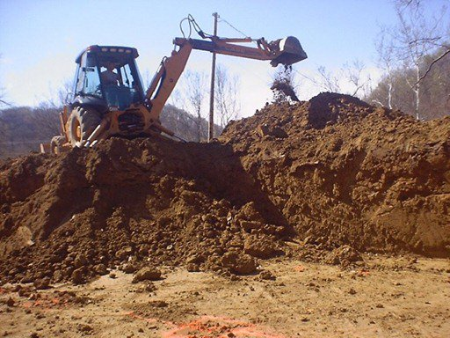
EXCAVATION PROCEDURE

Slide 2
ABOUT PMG
“BUILDING FOOD FACTORIES WITH TOP QUALITY STANDARDS OF NESTLE, MONDELEZ,ABBOTT, DANONE USING 3D DESIGN AND HYGIENIC ENGINEERING.”
At PMG, we deliver Engineering Design and Project Management scopes in Food and Beverage industry. Our team of design engineers and engineering executives has rich experience in Project Planning, Design, Execution and Commissioning with key competencies in areas like 3D Plant Design, Hygienic Engineering, and Project Management. Our safe-by-choice, result-oriented, and pro-active work-ethics allow us deliver work scopes meeting objectives, complete stakeholder alignment and first-time quality.
PMG Knowledge Repository: Targeted Knowledge Sharing & Skill Development
Precise and focused training modules for the exhaustive set of people working in manufacturing industry, instilling qualities of self-belief, creative thinking & widened perspective.
Clear Learning Objectives
Focused approach to skill development and knowledge sharing
Progressive Evaluation
Gauging improvement on every step and keeping audience connected.
After-training follow-ups
We systematically track differential progress of recipients after the training.
Audience Specific Approach
Programs are fine-tuned to the ability and interests of the recipients.
Multiple Awe-moments
Awe-moments are refreshing and increase receptivity many-fold.
Seasoned Trainers
PMG trainers are subject matter experts with substantial work experience.

Slide 3
AGENDA
1
Introduction.
2
Excavation Highlights.
3
Definitions.
4
Responsiblities
5
Procedure
6
General Excavation.
7
Guidline and Procedures.
8
Safety Aspects.
Notes:
3

Slide 4
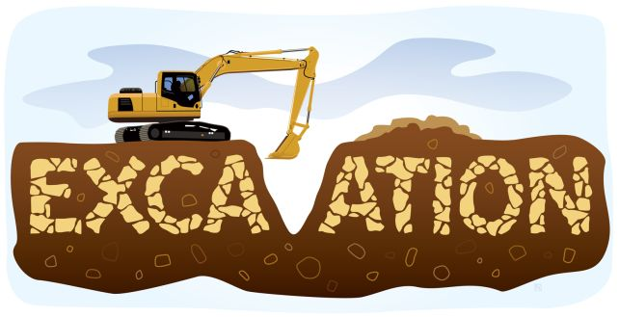
INTRODUCTION
Excavation and trenching are among the most hazardous construction operations.
This Procedure is developed to cover the safe practices required for excavation in general and specially for shoring and sloping in excavation and trenching jobs.
This Procedure provides guidelines and procedure to protect personnel, property and equipment from hazards associated with excavation related activities.
This Procedure role and responsibilities of all personnel associated with shoring and sloping in excavation jobs to discharge their duties effectively.

Slide 5
EXCAVATION (HIGHLIGHTS)
NO Excavation work to commence without proper Work Permit.
All the Excavations, more than 5 feet (1.5 meter) deep shall require shoring or sloping.
Excavated material must be kept at least 3 feet (1 meter) away from the edge of the excavation.
If the distance of the barricade is less than 6ft (1.8m) from the edge of the pit, Hard Barricades should be installed.
If the trench is 4 feet (1.2 meter) or more deep it should be provided with standard ladder to facilitate safe entry and exit.

Slide 6
EXCAVATION (HIGHLIGHTS)
Scope and field of application
  This standard applies to all factories and project sites.
  Roles and responsibilities have been defined for the persons associated with the excavation activities.
  The practices which have been identified here are equally applicable across all factories and project sites.

Slide 7
DEFINITIONS
TRENCH
  Generally long, narrow, and deeper than its width, but the width of a trench is not greater than 4.5 meter (15 feet) at the bottom.
  Relatively small volume of earth involved.
  Used for installation or maintenance of underground pipelines, conduit, cables, or footings for buildings without basement.
  Size generally makes shoring more economical than sloping of banks.
EXCAVATION-
  Any man-made cut, cavity, trench or depression in earth surface formed by earth removal.
  Relatively large volume of earth is involved.
  Generally have relatively equal dimensions of width and length.
  Depth will vary but usually is lesser than the smaller dimension.
  Used for basements, installation or maintenance of underground tanks and pipelines, piling, culverts, and larger spread footings.
  Size generally makes sloping of banks more economical than shoring.

Slide 8
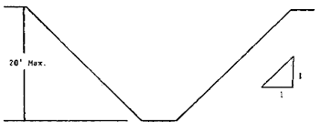
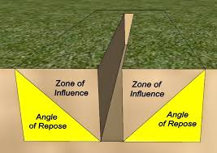
DEFINITIONS
Shoring
Angle of repose
It is a temporary structure that supports the sides of an excavation and protects against cave –in.
The greatest angle above the horizontal plane at which the material rests without sliding.

Slide 9
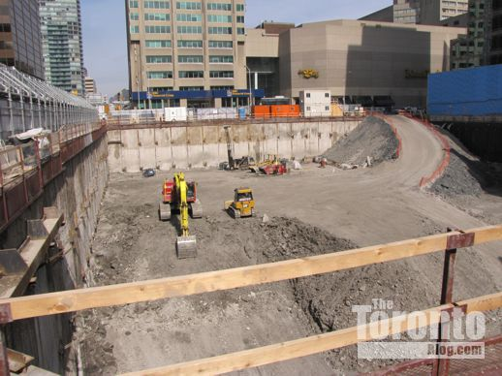
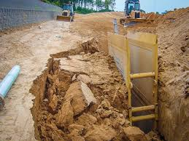
DEFINITIONS
Ramp
Cave-in
An inclined walking surface specifically provided to gain access from one point to another and is constructed from earth or from structural members such as steel or wood.
Separation of mass of soil or rock material from the side of an excavation or loss of soil from under a trench shield or supporting system and its sudden movement into the excavation in quantity that it could entrap, bury, injure or immobilize a person(s).

Slide 10
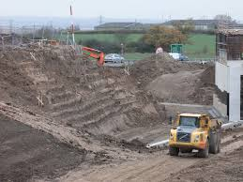
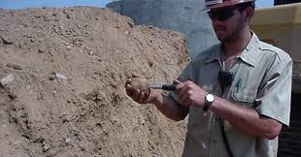
DEFINITIONS
Benching
Competent Person(s)
Method of protection to prevent cave-ins by excavating the sides of an excavation to form one or series of steps usually with vertical or near vertical surfaces between levels
Those who by extensive knowledge, training, and experience have successfully demonstrated their ability to carry out sloping and shoring of an excavation and authorised by management.

Slide 11

RESPONSIBILITY
Competent Person Responsibilities
Departments are expected to maintain safe and healthy living, learning, and working environments for faculty, staff, students, and visitors to our campus.
Each department performing excavation work must appoint a "competent person(s)" to ensure compliance.
Departments must ensure that all persons designated as competent persons have attended training.

Slide 12
RESPONSIBILITY
Departmental Responsibilities
Competent persons designated by the department will perform the following tasks once they have received safety training.
  Be familiar with soil analysis and determine the class of soil for each excavation.
  Determine the appropriate protective system needed to prevent potential cave-in. be familiar with protective systems and how to use them.
  Determine the appropriate methods to eliminate or control for all hazards, including protection from potential cave-in.
  Conduct site inspections in accordance with the requirements outlined in this program and maintain necessary documentation.
  Ensure employee training for all employees entering excavations greater than four feet deep.
  Ensure appropriate personal protective equipment is provided and worn.

Slide 13

RESPONSIBILITY
Employees
Employees who work in or around excavations must:
  Following the requirements
  Attend required training
  Wear assigned personal protective equipment

Slide 14

PROCEDURE
The standard ensures that necessary precautions are taken to safeguard the underground services, human lives, property etc. while carrying out excavation work.
Excavation examples include digging, road cutting, removing soil, chipping & grading etc.
Excavation work is usually required for underground utilities like electrical cables, communication cables, utility lines, fire hydrant lines etc.
Excavations are also required for equipment and building foundations.
Excavation can be done either by using mechanical equipment or manually.

Slide 15
GENERAL EXCAVATION
All the Excavations, more than 5 feet (1.5 meter) deep shall require shoring or sloping.
Excavated material must be kept at least 3 feet (1 meter) away from the edge of the excavation.
Excavated material must not be permitted to accumulate in the work area or aisles. It should be shifted away.
Excavation bracing and shoring must be checked by competent person, prior to starting the job, subsequently on daily basis and also after every rain and storm.

Slide 16
GENERAL EXCAVATION
Power supply to all electrical equipment/lights should be through ELCB (Earth Leakage Circuit Breakers, Tripping at 30mA current leakage to earth).
No hot work to be done in excavation without a valid hot work permit.
In locations where oxygen deficiency or gaseous conditions are possible, air in the excavation shall be tested. Controls, as set forth in Confined Space Entry (GI 18.041), shall be established to assure acceptable atmospheric conditions.
When flammable gases are present, adequate ventilation shall be provided and/or sources of ignition shall be eliminated.
Confined space permit should be taken for excavations if it comes under the purview of confined space standard/procedure.

Slide 17
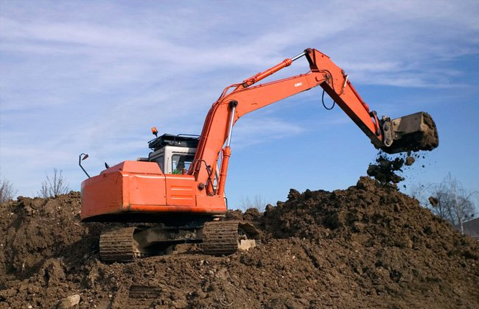
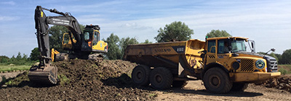
GUIDELINE & PROCEDURES
Excavation clearance
Excavation work permit shall be taken before carrying out any excavation.
When excavation work is to be undertaken outside the facilities, irrespective of the depth of excavation, all statutory clearances shall be obtained prior to commencing the work.
The engineer (originator) shall be responsible for the co-ordination with all the departments and obtaining excavation work permit.

Slide 18

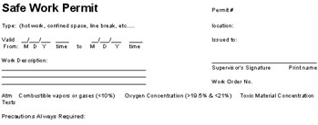

GUIDELINE & PROCEDURES
Work Permit
Ensure excavation Work permit is obtained as per the Work permit system Conduct risk assessment (like HIRA, JSA etc.) before issuance of Work Permit.
Separate Work Permits will be taken for specific activities within the excavated area e.g. confined space, hot work etc.

Slide 19
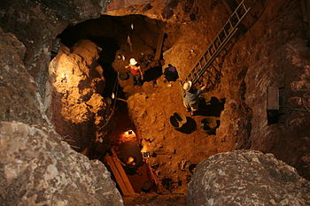
SAFETY ASPECTS
Following important safety aspects shall be implemented during execution of excavation activity:
  Safe access must be provided to excavations by means of ladders, stairs or ramps.
  Provision of safe means of access & egress to workers. e.g. clear passage for entry and exit, ladder, stair case, slope, steps etc. shall be ensured.
  If the excavation is 4 feet (1.2 meter) or more deep it should be provided with standard ladder to facilitate safe entry and exit.
  The ladder must be provided at every 25 feet (8 meter) interval.
  The height of the ladder should extend up to 3.3 feet (1 meter) from the top of ground surface. The ladder must be firmly secured.
  Ensure cross-over over trenches have a minimum width of 0.5 meter. The cross-over should be firmly secured and provided with guard rails (top rail, mid-rail and toe-guard).

Slide 20

SAFETY ASPECTS
Caution & Barricades
Excavations should be barricaded to prevent employees and others falling into them.
Provide barricading of the area and display of warning signboard in Hindi / English / regional language at conspicuous locations.
Suitable warning sign, such as fluorescent warning tapes, flashing lights, shall be provided to warn the persons in night.
No trench, ditch or other excavation shall be left overnight without barricades and warning signs.
Adequate illumination should be provided in the night and in day as per site condition so that the area will be visible.
Barricades or portions of barricades, if required to be removed for work temporarily shall be done after taking additional safeguards (e.g. extra supervision, people wearing fall protection etc.) till they are restored, as soon as practicable.

Slide 21

SAFETY ASPECTS
Caution & Barricades
The warning barricades must be 6 feet away from the edge of the excavation (caution tape & sign board). Caution tape must be at two levels i.e. 0.5 meter and 1.0 meter height from the ground.
The barricades installed closer than 6 feet (1.8 meter) from the edge of the excavation, must be hard barricade which can withstand 100 kg load / thrust. Hard barricade shall have horizontal members at 0.5 meter and 1.0 meter respectively from the ground with adequate vertical supports. This provision can be considered by engineer-in-charge even for more than 6 ft. distance if the situation so demands.
If the depth of the pit is more than 6 feet (1.8 meters), any person between the barricade and the edge of the pit shall wear fall protection (full body harness with double lanyard)

Slide 22
SAFETY ASPECTS
Precautions against cave in, seepage
If it is necessary to place or operate power shovels, derricks, trucks, materials, or other heavy objects on a level above and near an excavation, the side of the excavation shall be sheet-piled, shored, and braced as necessary to resist the extra pressure due to such superimposed loads.
When vehicles or equipment operate or are allowed adjacent to excavations, wheel stopper (chock) and/or fixed barriers shall be installed.
To avoid the vehicle falling into the excavated pit, it is advisable that the slope should be away from the excavation.
Where vehicles or equipment operate near excavations, the sides must be shored or braced as necessary to withstand the force exerted by the superimposed load.
  Sides must be shored or braced as necessary to withstand the force exerted by the superimposed load.

Slide 23
SAFETY ASPECTS
Preparation
Study the soil characteristics with reference to angle of repose.
See that excavated area is not blocking the access to the site for both man and material.
If access is blocked due to the excavation work, inform security/ emergency response team and install necessary signage (alternate route) at appropriate locations.
Ensure that there are no vibrations from an external source which may impact the excavation.
Ensure that consideration has been given to proximity of adjacent structures while finalizing the method of excavation.
Stability of the adjacent structures should be considered as part of the preparation step.
All efforts, such as checking drawings, surface markers, using cable detector etc will be made to locate underground utilities before starting any excavation work.

Slide 24
SAFETY ASPECTS
Supervision, workforce and Inspection
It should be ensured that all excavations are supervised by Nestle engineer.
Nestle engineer/ supervisor will give Tool Box Talks regarding safety measures to be observed to the workers involved in excavation work before starting the job.
This should cover the excavation method to be adopted, explain the hazards and safeguards identified through the Risk Assessment (e.g. HIRA, JSA).
Confirm that PPEs provided are as per the work permit.
If there is a possibility of accumulation of water in the pit and the depth of pit is more than 7 feet (2.2 meter), people working inside the pit must wear a full body harness secured to a lifeline anchored outside the excavation.
At any given time, only minimum person(s) shall be allowed to enter the excavation.
People not required to be working inside the pit should not be allowed inside the barricaded area.
Each excavation shall be inspected daily by the competent person.
Additional inspections should be done for any change in conditions due to heavy rains, storms etc.

Slide 25
SAFETY ASPECTS
Precautions during job
During excavation, unexpected utilities are discovered, contractor should stop excavation and immediately notify the site engineer.
Work shall be resumed only after obtaining further clearance from the competent person.
Hand tool excavation: tools shall be provided with insulated handles.
Machine excavation: No person shall enter within the swing area of excavator machines.
Movement of vehicle and heavy cranes shall be 3 feet (1 meter) away or 1.5 times the depth of excavation, whichever is greater.
Loose excavated material must be placed no closer than 3 feet from the edge of the excavations.
In any case it shall be outside the excavation barricaded area.
Precautions must be taken to prevent loose excavated material falling into the excavated area.
The safe disposal area and the method of disposal of loose excavated material should be defined.
All electrical equipment and electrical connections shall be tested and validated by electrical department.

Slide 26
SAFETY ASPECTS
Dewatering
In case ground water is entering excavated area, ensure continuous dewatering is done
Persons shall not work in excavations that contain water unless precautions have been taken to protect persons from hazards posed by water accumulation.
The precautions taken shall include, providing adequate shoring to protect from cave-ins, water removal to control the water level and ensuring people inside the excavation are using full body safety harness and life lines.
Dewatering from the pit shall be done at remote location to avoid backflow to the pit. If fuel driven water removal equipment is used, it should be placed outside the pit at a safe location.
If excavation work interrupts the natural drainage of surface water, diversion ditches, bunds, or other suitable means will be used to prevent surface water from entering the excavation.
Precautions shall also be taken to provide adequate drainage of the area adjacent to the excavation

Slide 27
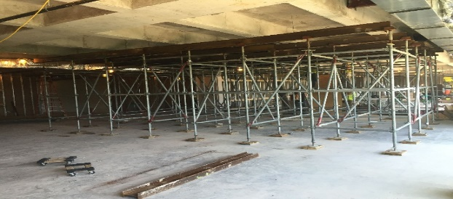
SAFETY ASPECTS
Shoring
Bracing or shoring of trenches shall be carried along with the excavations.
Trenches 5 feet (1.5 meter) or deeper must be shored or sloped back to the angle of repose.
Any excavation in unstable ground will require shoring or sloping.
An adequate supply of materials such as timbers, trench sheets & props with which to shore the sites of excavation must be delivered to the site before starting excavation.
Material used for sheeting, shoring or bracing must be of good condition.
Shoring with Galvanized Iron (GI) sheets shall be firmly supported by steel/ scaffold pipes with spacing of 4 ft. in horizontal & vertical direction with cross bracing & shall be suitably clamped/ secured.
For shoring extending below the water table proper means of water drainage with the means of weep holes or other means shall be ensured.

Slide 28
SAFETY ASPECTS
Sloping
For sloping of sides/angle of repose, please refer to Table below
Soil or Rock Type | Type of strata | Indicative Soil bearing capacity in T/m2 | Maximum Slope (H:V) | Maximum Slope (Degrees)
Stable Rock | Solid rock, Shale or cemented | 45 to 90 | Vertical | 90
Type A | Soft and hard murrum | 20 to 45 | 0.75:1 | 53
Type B | Clay and cohesive soil | 15 to 20 | 1:1 | 45
Type C | Sandy soil, broken rock, gravel and Black cotton soil | 0 to 15 | 1.5:1 | 34
 | Loose sand | 0 to 4 | 2:1 | 26

Slide 29
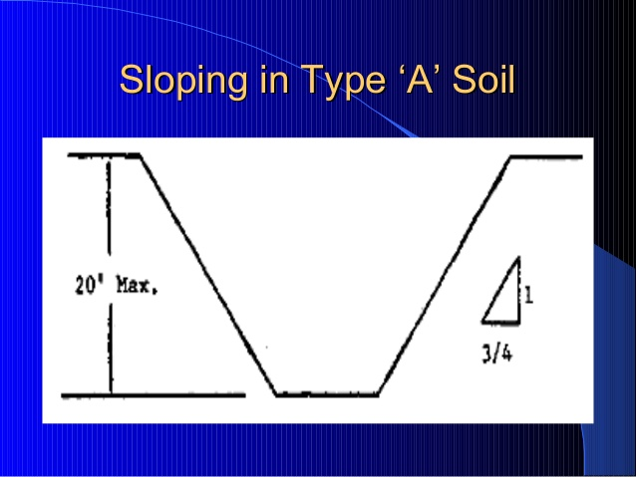
SAFETY ASPECTS
Excavations made in type A Soil
All simple slope excavations 20 feet (6 meter) or less in depth will have a maximum allowable slope of 3/4:1.
All benched excavations 20 feet (6 meter) or less in depth will have a maximum allowable slope of 3/4 to 1 and maximum bench dimensions as indicated.
All excavations 8 feet (2.5 meter) or less in depth which have unsupported vertically sided lower portions will have a maximum vertical side of 3 1/2 feet (1.1 meter).
All excavations more than 8 feet (2.5 meter) but not more than 12 feet (4.5 meter) in depth with unsupported vertically sided lower portions will have a maximum allowable slope of 1:1 and a maximum vertical side of 3 1/2 feet (1.1 meter).
All excavations 20 feet (6 meter) or less in depth which have vertically sided lower portions that are supported or shielded will have a maximum allowable slope of 3/4:1. The support or shield system shall extend at least 18 inches (0.5 meter) above the top of the vertical side.

Slide 30
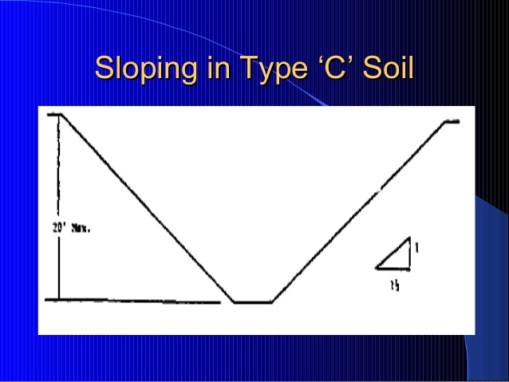
SAFETY ASPECTS
Excavations Made in Type C Soil
All simple slope excavations 20 feet (6 meter) or less in depth will have a maximum allowable slope of 1 1/2:1.
All excavations 20 feet (6 meter) or less in depth which have vertically sided lower portions will be shielded or supported to a height at least 18 inches above the top of the vertical side. All such excavations will have a maximum allowable slope of 1 1/2:1.
A daily inspection checklist. Inspection shall be carried out by the competent person every day till the work inside the excavation is completed and the excavation pit is back-filled.
Typical Signs to be used:

Slide 31
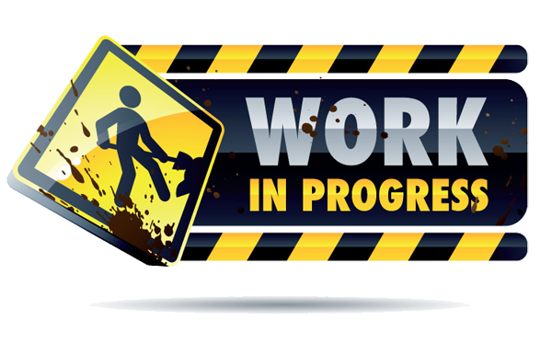

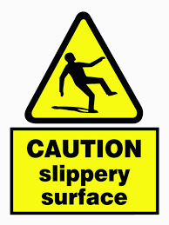

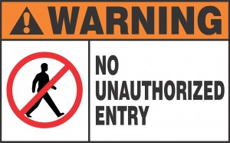
SAFETY ASPECTS
Typical Signs
Work In Progress
Caution : Men At Work
No Un Authorized Entry
Caution ; Slippery Surface
No Smoking

Slide 32
SAFETY ASPECTS
Potential Hazards
Falling of persons into excavated trench or pit
Collapse of excavation sides and falling of excavated material onto persons working within excavation trench or pit
Collapse of temporary arrangements (shoring etc.) made to support sides of excavation.
Collapse of adjacent structure due to excavation.
Persons within excavation pit struck by fall of spoils from excavator buckets and other objects dropped on them.
Worker hit by reckless driving / operation of equipment.
Falling of workmen through bottom of excavation into abandoned empty bore of pile, disused shaft or disused sewer line or other cavities in the ground.
Persons within excavation struck by other objects falling due to work being done at higher elevation in the nearby vicinity.
Risk of electrocution from cables crossing or used for lighting purpose in vicinity.
Risk of injury due to protruding nails, sharp edges in shoring.

Slide 33
SAFETY ASPECTS
Potential Hazards
Falling of persons while climbing or getting down into excavation
Spiking of underground electric cables with resulting flash burns and electric shock.
Flooding with risk of drowning.
Striking and breaking other underground utilities such as – gas (fire and explosive hazard), water (flooding), and sewage (toxic gases).
Fire and explosion from flammable gases heavier than air and vapours especially LPG, entering excavation.
Poisoning from gases entering from pipelines or outside.
Suffocation / Poisoning due to burning of torches, etc. used in excavation and insufficient ventilation, or from exhaust gases produced by plants and machinery used in connection with the excavation,
Toxic and radioactive hazards from the ground itself, usually resulting from its previous occupancy.
Accidental explosion through use of explosive in excavation.
Objects getting to eyes while chiselling rock, using jack hammers in hard strata, concrete.

Slide 34
Our Clients

