Slide 1
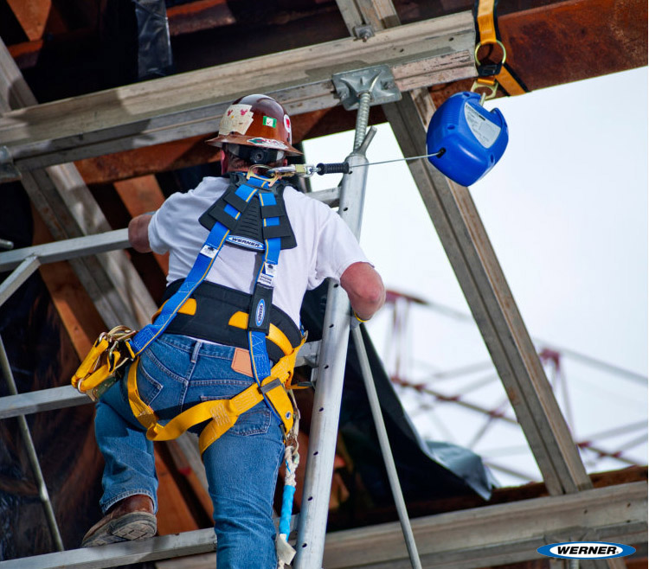
CONSTRUCTION SAFETY
FALL PROTECTION

Slide 2
ABOUT PMG
“BUILDING FOOD FACTORIES WITH TOP QUALITY STANDARDS OF NESTLE, MONDELEZ,ABBOTT, DANONE USING 3D DESIGN AND HYGIENIC ENGINEERING.”
At PMG, we deliver Engineering Design and Project Management scopes in Food and Beverage industry. Our team of design engineers and engineering executives has rich experience in Project Planning, Design, Execution and Commissioning with key competencies in areas like 3D Plant Design, Hygienic Engineering, and Project Management. Our safe-by-choice, result-oriented, and pro-active work-ethics allow us deliver work scopes meeting objectives, complete stakeholder alignment and first-time quality.
PMG Knowledge Repository: Targeted Knowledge Sharing & Skill Development
Precise and focused training modules for the exhaustive set of people working in manufacturing industry, instilling qualities of self-belief, creative thinking & widened perspective.
Clear Learning Objectives
Focused approach to skill development and knowledge sharing
Progressive Evaluation
Gauging improvement on every step and keeping audience connected.
After-training follow-ups
We systematically track differential progress of recipients after the training.
Audience Specific Approach
Programs are fine-tuned to the ability and interests of the recipients.
Multiple Awe-moments
Awe-moments are refreshing and increase receptivity many-fold.
Seasoned Trainers
PMG trainers are subject matter experts with substantial work experience.

Slide 3
AGENDA
1
Fall Protection
2
Definitions
3
Guard Rails
4
Personal Fall Arrest Systems.
5
Floor Covering.
6
Excavations.
7
Over Hand Bricklaying and Related Work .
8
Roof Work on low Sloped Roofs .
9
General Industry Standard.
Notes:
3

Slide 4
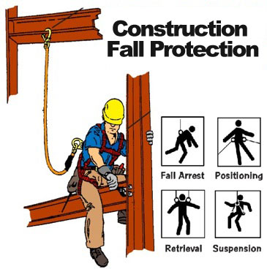
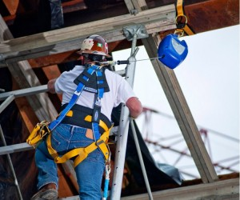
FALL PROTECTION
Fall protection is the backup system planned for a worker who could loose his or her balance at height, in order to control or eliminate injury potential.

Slide 5
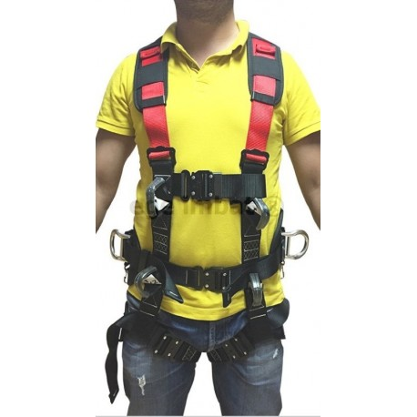
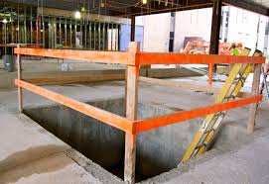
DEFINITIONS
Body Harness
Floor Hole or Opening Cover
Straps which may be secured about the employee in a manner that will distribute the fall arrest forces over at least the thighs, pelvis, waist, chest and shoulders with means for attaching it to other components of a personal fall arrest system.
A cover which completely covers the floor hole or opening, is secured against dislodgement, and is capable of supporting at least twice the maximum anticipated load without failure

Slide 6
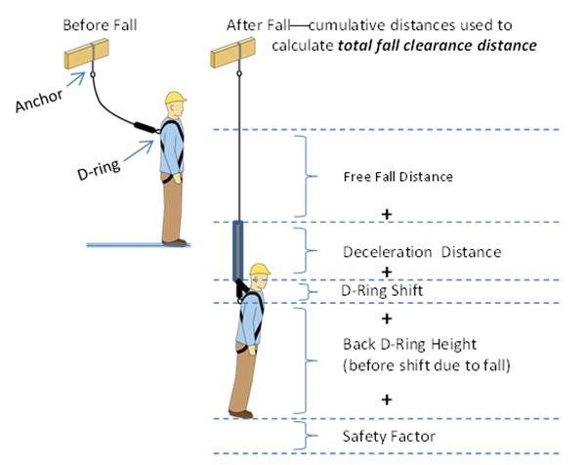
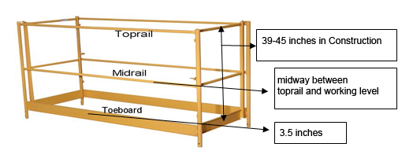
DEFINITIONS
Fall Hazard Exposure
Guardrail System
Any floor opening, unprotected side or edge, or wall opening which an employee approaches within 6 feet without a guardrail system, floor opening cover, personal fall arrest system, or safety net system.
A top rail 42 + 3 inches high, a toe board 4 inches high, and a mid rail located between the top rail and toe board.
A guardrail system must be capable of withstanding a force of 91.7 Kg in any outward or downward direction on the top rail and a force of 68 Kg in any outward or downward direction on the mid rail without failure.

Slide 7
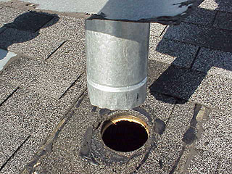
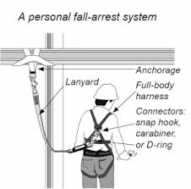
DEFINITIONS
Opening
Personal Fall Arrest System
A gap or void 30 inches or more high and 18 inches or more wide, in a wall or partition, through which employees can fall to a lower level.
A system used to arrest an employee in a fall from a working level. It consists of an anchorage, connectors, a body harness and may include a lanyard, deceleration device, lifeline, or suitable combinations of these. All lanyards and other fall arrest devices must have locking snap hooks.

Slide 8
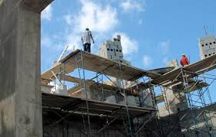
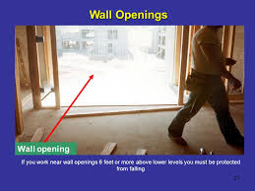
DEFINITIONS
Walking/Working Surface
Wall Opening
A surface on which an employee walks or works, including, but not limited to, floors, roofs, ramps, bridges, runways, formwork, concrete reinforcing steel and walkways.
An opening in any wall or partition which is less than 39 inches above the walking/working surface, is at least 30 inches high, and is at least 18 inches wide, and has an outside bottom edge which is 6 feet or more above a lower level.

Slide 9
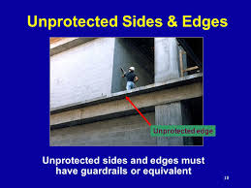
DEFINITIONS
Unprotected Side or Edge
Walking/working surface side or edge 6 feet or more above a lower level which does not have a guardrail system at least 39 inches high.

Slide 10
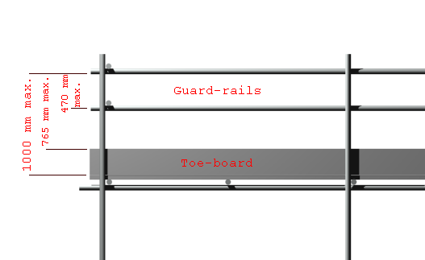
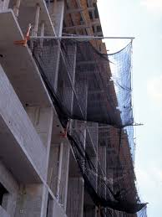

DEFINITIONS
Protection from Falling Objects:
When employees are potentially exposed to falling objects, employers must provide hard hats and must implement one of the following:
  Toe boards or screens.
  Erect a canopy structure to catch falling objects.
  Barricade the area under the working area to keep employees (and others) away from the fall hazards.
Toe boards or screens
Erect a canopy structure to catch falling objects
Barricade the area under the working area to keep employees

Slide 11
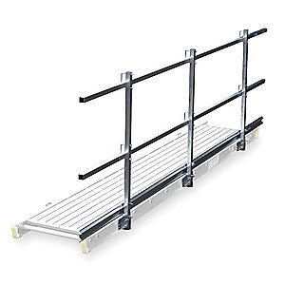
GUARD RAILS
Top edge height of top rails must be 42 inches + 3 inches above the walking/working surface. Guardrail systems must be able to withstand a force of at least 200 pounds (applied within 2 inches of the top edge) in any outward or downward direction.
  Steel or plastic banding cannot be used at top rails or mid rails. If wire rope is used for top rails, it must be flagged at every 6-foot intervals with highly visible material.
  Top edge height of top rails must be 42 inches + 3 inches above the walking/working surface.
  Guardrail systems must be able to withstand a force of at least 200 pounds (applied within 2 inches of the top edge) in any outward or downward direction.
  Steel or plastic banding cannot be used at top rails or mid rails. If wire rope is used for top rails, it must be flagged at every 6-foot intervals with highly visible material.

Slide 12
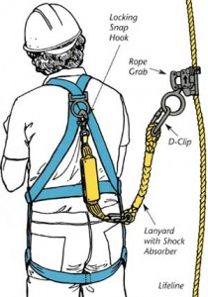
PERSONAL FALL ARREST SYSTEMS
All personal fall arrest system components must be kept in good operating condition.
Personal fall arrest components must be thoroughly inspected by the user prior to each use.
Defective personal fall arrest system components must be removed from service immediately and repaired or discarded

Slide 13
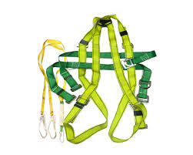
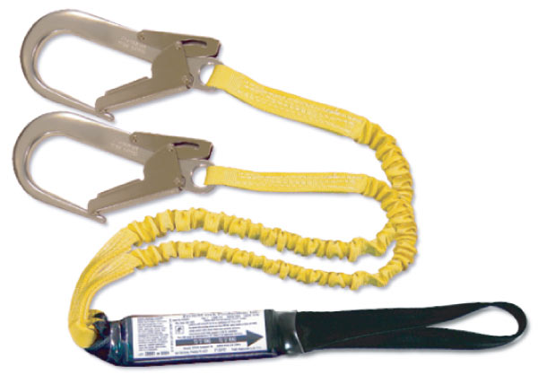
PERSONAL FALL ARREST SYSTEMS
Belts, Lanyards and Lifelines
Body belts are no longer acceptable as part of a personal fall arrest system. (However, the use of a body belt is acceptable in a positioning device system.)
Full body harnesses, lanyards and lifelines must be worn by all employees working 6 feet or more above a lower level, if guardrails or safety net systems are not used for fall protection.
Body harnesses must be equipped with Dee-rings and locking snap hooks that have a minimum tensile strength of 5,000 pounds.
Lanyards and lifelines must have a minimum breaking strength of 5,000 pounds.
Lanyards must not be used for anything other than fall protection.

Slide 14
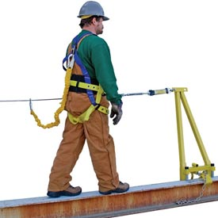
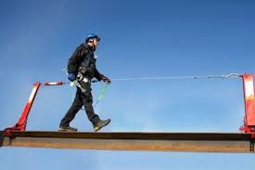

PERSONAL FALL ARREST SYSTEMS
Belts, Lanyards and Lifelines
There must be one vertical lifeline for each person. Warning Lines and Controlled Access Zones:
Warning lines must be erected no less than 6 feet nor more than 25 feet from the unprotected or leading edge. This designates a “Controlled Access Zone”.
The control (or warning) line must extend along the entire length of the unprotected or leading edge.
When the control line is used to control access to areas where overhand bricklaying is being conducted, the controlled access zone shall be defined by a control line erected not less than 10 feet nor more than 15 feet from the working edge.
It must extend for a distance sufficient for the controlled access zone to enclose all working employees.

Slide 15
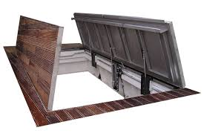
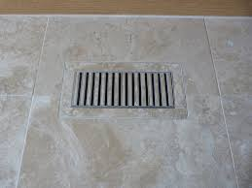
FLOOR COVERS
Must support twice the weight of people, equipment and materials that might be on the cover at any one time.
Must be secured to prevent displacement by the wind, employees or equipment.
Must be marked with the word “HOLE” or “COVER” to provide warning of the hazard. (This does not apply to manhole covers or grates used on streets or roads.)

Slide 16
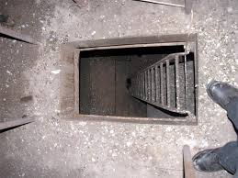
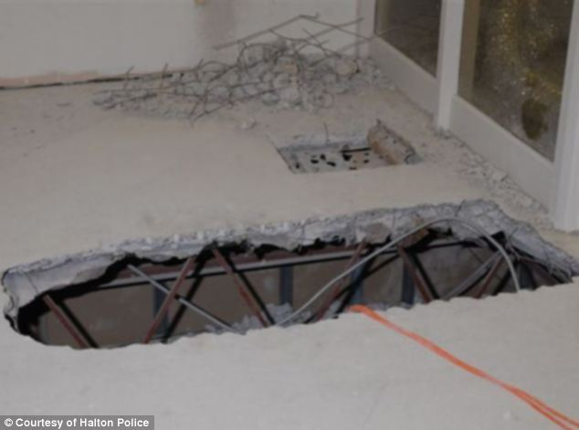
FLOOR COVERS
A hole is defined as a gap of 2 inches or more in its least dimension on a floor, roof or other walking/working surface.
Employees must be protected from falling through holes more than 6 feet above the lower level by personal fall arrest systems, covers, or guardrails erected around the holes.
If the drop from the hole is less than 6 feet, but the floor hole is above dangerous equipment, guardrails must be on all sides of the hole OR the equipment must be guarded.

Slide 17
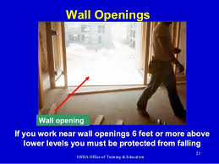
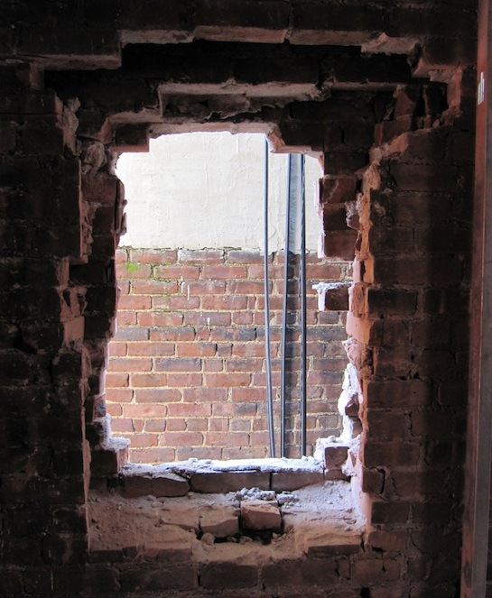
FLOOR COVERS
Wall Openings
If the wall opening is less than 39 inches above the walking/working surface, at least 30 inches high, and at least 18 inches wide, and has an outside bottom edge which is 6 feet or more above a lower level:
It must be guarded by guardrails unless a safety net or a personal fall arrest system is used.
If a safety net is used, it cannot be greater than 30 feet below the walking/working surface.

Slide 18
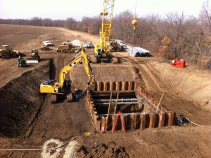
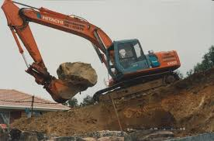
EXCAVATIONS
Excavation fall hazard exposures must be eliminated by either:
  A guardrail system,
  A fence or barricade which restricts access to the excavation area,
  A solid and substantial excavation covering capable of supporting the maximum anticipated load without failure, or
  The use of personal fall arrest systems.

Slide 19
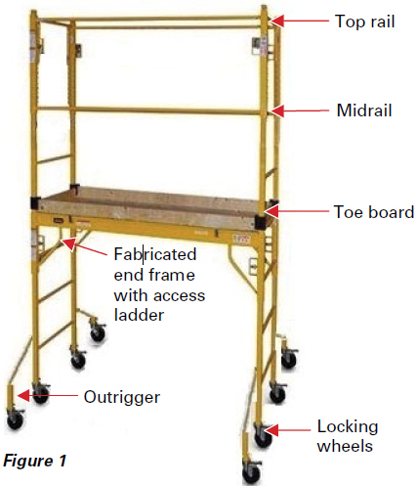
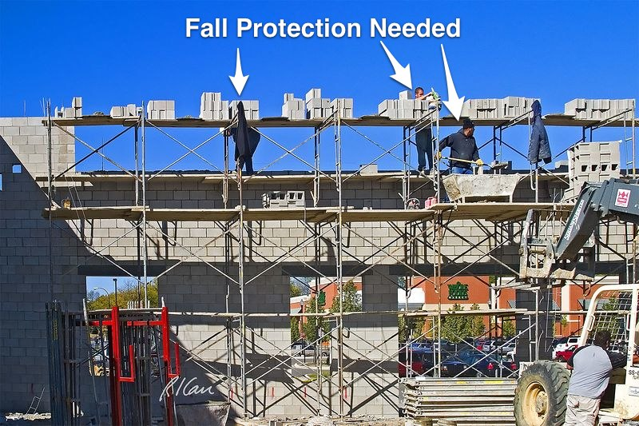
EXCAVATIONS
All scaffolds more than 10 feet above the ground must be equipped with guardrail systems, which include top rails, mid rails and toe boards.
Overhead protection, such as decking or debris net, is required when working:

Slide 20
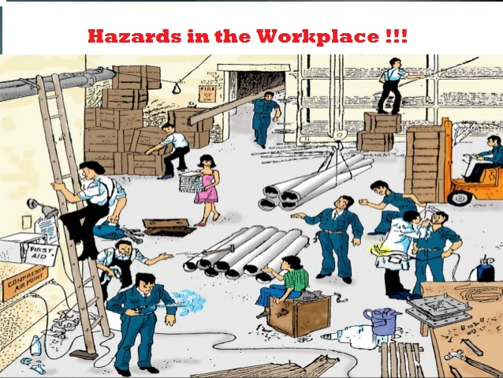
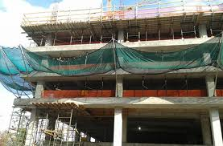
EXCAVATIONS
Beneath ongoing work
In areas where debris may fall.

Slide 21
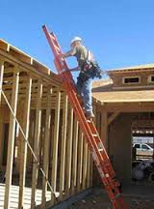
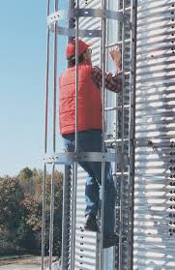
EXCAVATIONS
Ladders
Portable extension ladders must extend 3 feet above the upper working level and must be tied off or held by an employee when in use to prevent dislodgement.
Permanent, or fixed, ladders over 20 feet in length and ladders at elevated locations must be equipped with caging.

Slide 22
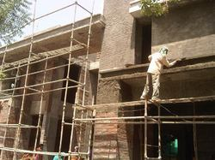
OVERHAND BRICKLAYING AND RELATED WORK
Employees performing overhand bricklaying work 6 feet or more above a lower level, must be protected by guardrails, safety nets, personal fall arrest systems or must work in a controlled access zone.
The controlled access zone must be defined by a control line not less than 10 feet or more than 15 feet from the working edge.
When employees have to reach greater than 10 inches below the level of the walking/working surface on which they are working, they must be protected from falling by guardrails, safety nets, or personal fall arrest systems.

Slide 23
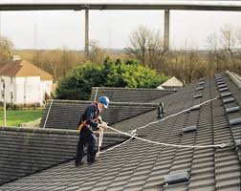
OVERHAND BRICKLAYING AND RELATED WORK
When the leading edge is greater than 6 feet above the ground (or the lower level):
Employees must be protected by a guardrail, safety net, personal fall arrest system
Warning line and guardrail
Warning line and safety net
Warning line and personal fall arrest system.

Slide 24
GENERAL INDUSTRY STANDARD
Guarding Floor and Wall Openings and Holes, states that
Every open-sided floor or platform 4 feet or more above the floor or ground level must be guarded by a standard railing on all open sides except where there is entrance to a ramp, stairway, or a fixed ladder.
In addition to the railing, toe boards must be provided wherever persons can pass underneath or there is moving machinery or equipment in which falling materials could create a hazard.
Every runway must be guarded by a standard railing on all open sides 4 feet or more above floor or ground level. Wherever tools, machine parts, or materials are likely to be used on the runway, a toe board must also be provided on each exposed side.
Where there is the potential for persons who enter runways to become exposed to machinery, electrical equipment, or dangers other than a falling hazard, additional guarding may be essential for protection.

Slide 25
Our Clients

