Slide 1
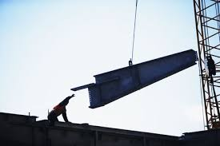
FIELD LEVEL
HAZARD ASSESSMENT

Slide 2
ABOUT PMG
“BUILDING FOOD FACTORIES WITH TOP QUALITY STANDARDS OF NESTLE, MONDELEZ,ABBOTT, DANONE USING 3D DESIGN AND HYGIENIC ENGINEERING.”
At PMG, we deliver Engineering Design and Project Management scopes in Food and Beverage industry. Our team of design engineers and engineering executives has rich experience in Project Planning, Design, Execution and Commissioning with key competencies in areas like 3D Plant Design, Hygienic Engineering, and Project Management. Our safe-by-choice, result-oriented, and pro-active work-ethics allow us deliver work scopes meeting objectives, complete stakeholder alignment and first-time quality.
PMG Knowledge Repository: Targeted Knowledge Sharing & Skill Development
Precise and focused training modules for the exhaustive set of people working in manufacturing industry, instilling qualities of self-belief, creative thinking & widened perspective.
Clear Learning Objectives
Focused approach to skill development and knowledge sharing
Progressive Evaluation
Gauging improvement on every step and keeping audience connected.
After-training follow-ups
We systematically track differential progress of recipients after the training.
Audience Specific Approach
Programs are fine-tuned to the ability and interests of the recipients.
Multiple Awe-moments
Awe-moments are refreshing and increase receptivity many-fold.
Seasoned Trainers
PMG trainers are subject matter experts with substantial work experience.

Slide 3
AGENDA
1
Definition
2
Field Assessment
3
The Model & Tools
Notes:
3

Slide 4
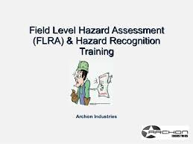
DEFINITION
A hazard assessment is an evaluation of a work place, or work situation, to identify the potential for hazards that an employee may encounter while performing the job.
A Field Level Risk Assessment (FLRA) is a technique that focuses on job tasks as a way to identify hazards before they result in injury, illness, property damage, or worse.
It focuses on the relationship between the worker, the task, the tools, and the work environment.
Ideally, after you identify uncontrolled hazards, you will take steps to eliminate or reduce them to an acceptable risk level.
It is a method that individuals and crews use to eliminate or minimize potential losses (to people, property, materials or environment) during the course of doing work.

Slide 5
FIELD LEVEL RISK ASSESSMENT
What is Field Level Risk Assessment?
It is a mental process used by both individual supervisors and workers.
It is a problem solving process that uses discussion on the job site.
It includes writing down the outcomes of the discussion. This part is optional but strongly recommended

Slide 6
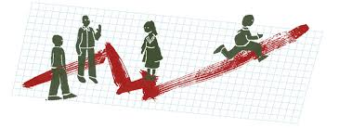
FIELD LEVEL RISK ASSESSMENT
Field Level Risk Assessment is a way for workers and crews to:
  Learn how to decrease risk and increase the reliability of work.
  Reduce the number and associated costs of incidents, accidents and injury.

Slide 7

FIELD LEVEL RISK ASSESSMENT
Tools that help workers stop think and put controls in place.
Training for supervisors and workers.
Sample forms that can be used to document field level risk assessments and make improvements.

Slide 8
FIELD LEVEL RISK ASSESSMENT
Benefits of field level risk assessment benefits of field level risk assessment for companies
  Improved work methods and productivity
  Direct cost savings
  Wcb premium reduction
  Decreased costs to pass on to customers. A competitive edge.
  Better data to improve company safety
  Reduction in the “emotional” costs of accidents and injuries
  Increased trust and confidence of workers
  Due diligence

Slide 9
FIELD LEVEL RISK ASSESSMENT
For workers
Reduced probability of injuries
More security for their families
Improved morale
Opportunity to make work place improvements
Opportunity for recognition of increased contribution to the company
Improved ability to think critically

Slide 10
THE MODEL AND TOOLS
Supervisor and crew discuss the work to be done on the day of the job. Together they:
  Identify the job steps.
  Identify the hazards associated with each step.
  Assess the level of risk for each hazard.
  Identify and put in place the controls to effectively control the risk
The Supervisor:
  Prepares and leads Field Level Risk Assessment discussions
  Documents this information on a form prepared for this purpose.
  Submits the documentation for analysis and review.
  Makes completed form available to crew.

Slide 11
THE MODEL AND TOOLS
Each worker:
  Stops and thinks about hazards, risks and controls while working.
Specifically assigned personnel:
  Review the field level risk assessment data to identify ways to reduce hazards and risk on an ongoing basis.
When is Field Level Risk Assessment done?
  At the beginning of a new job or new shift
  When new workers come on site
  When the information about the work changes (e.g. changed plans, unexpected characteristics of the task such as new configuration of equipment)
  Whenever job site conditions change (e.g. weather, availability of tools etc.)

Slide 12
THE MODEL AND TOOLS
Who does Field Level Risk Assessment?
  The supervisor thinks through the process to prepare for meeting with the crew.
  The supervisor leads a discussion with the crew encouraging their analysis and feedback.
  The worker does it as a mental process as he/she works.
Why Do Field Level Risk Assessment?
  To fulfil the employer requirements of the Occupational Health and Safety Act.
  Employers are required “to ensure as far as it is reasonably practicable” the health and safety of workers present at the work site.
  Employers are required to make sure workers are aware of their health and safely responsibilities.

Slide 13
THE MODEL AND TOOLS
To reduce losses due to uncontrolled hazards. Field Level Risk Assessment:
  Facilitates a safer working environment for people.
  Helps to minimizes or eliminates losses to property, materials and the environment.
Where is Field Level Risk Assessment done?
  The most logical place to begin is to review your accident and illness reports.
  Is there a work area that seems to have more accidents and injuries than others?
  Is there a type of injury that seems to occur more frequently than others?

Slide 14
THE MODEL AND TOOLS
Where to Begin Continued
If injury and illness reports do not point you towards a place to begin, consider beginning with:
  Near Misses
  New Tasks Or Positions
  Tasks That Have Changed
  Non-Routine Jobs
  Routine Jobs

Slide 15

THE MODEL AND TOOLS
Falling Objects
Are there objects which may fall from above onto employees
Employees working overhead
Tools or materials handled above your head

Slide 16
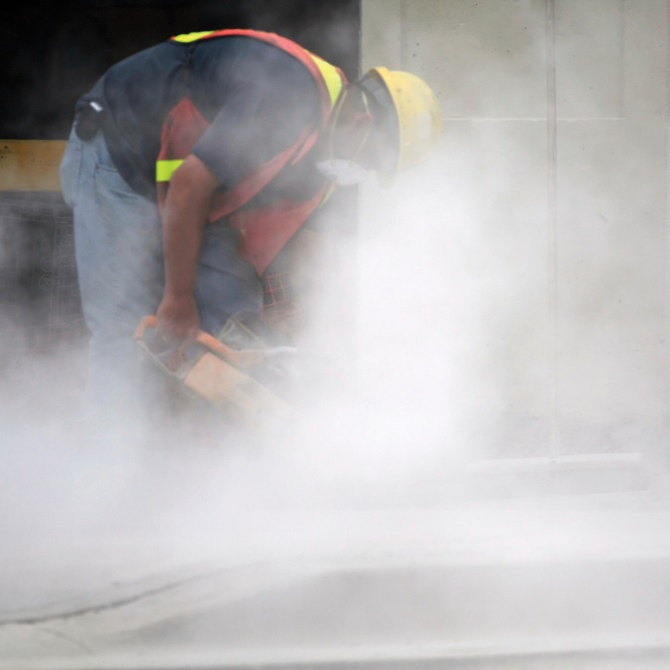
THE MODEL AND TOOLS
Harmful Dusts/Fumes
Are employees exposed to chemicals or harmful dusts/mists/fumes? Examples:
  Any chemical which poses a health hazard
  Asbestos
  Welding fumes
  Solder fumes
  Silica
  Post Blast Airborne Toxins

Slide 17

THE MODEL AND TOOLS
Energy Sources
Are there energy sources which could be harmful if accidental release or start-up occurs
  Electrical
  Pneumatic
  Hydraulic
  Thermal
  Mechanical
  Gravity

Slide 18
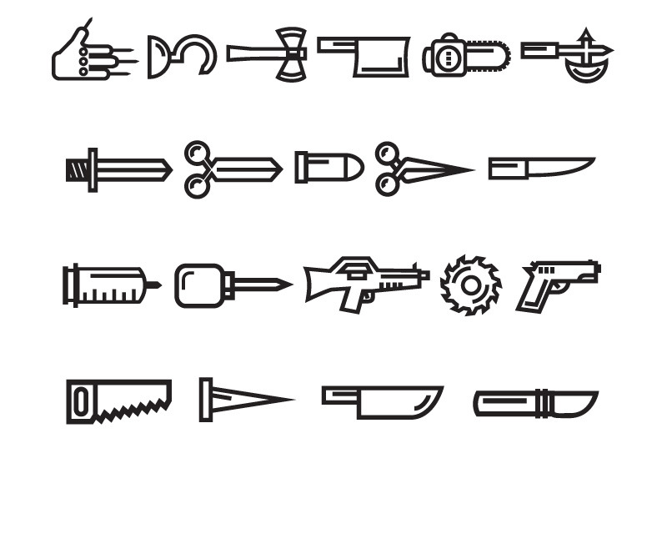
THE MODEL AND TOOLS
Sharp Objects
Are there sharp objects which could cut or pierce the body
  Glass
  Knife blades
  Sheet metal
  Nail guns
  Needles
  Splinters (wood)
  Burrs (metal)

Slide 19

THE MODEL AND TOOLS
Temperature Extremes
Are there hot or cold surfaces which could burn or freeze employees
  Welded parts
  Cryogenic materials
  Autoclaves

Slide 20
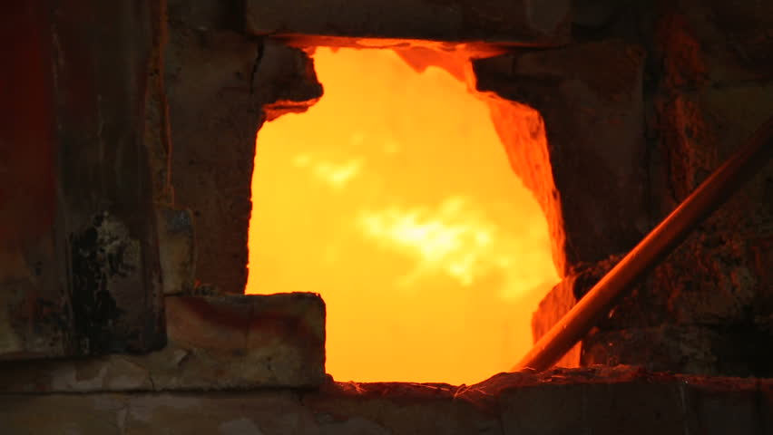
THE MODEL AND TOOLS
Ovens/stoves
Molten metals

Slide 21

THE MODEL AND TOOLS
Light Radiation
Is there light radiation which could be harmful to the skin or eyes
  Welding
  Cutting
  Lasers
  X-ray

Slide 22

THE MODEL AND TOOLS
Flying Debris
Will employee be operating, or be exposed to, tools/equipment which may generate flying debris
  Hammering
  Sawing
  Chipping
  Grinding
  Drilling
  Buffing
  Cutting

Slide 23

THE MODEL AND TOOLS
Excessive Noise
Will employee be operating, or be exposed to, tools/equipment which may generate excessive noise
  Jack-hammering
  Woodworking machinery
  Metalworking machinery
  Operating heavy equipment

Slide 24
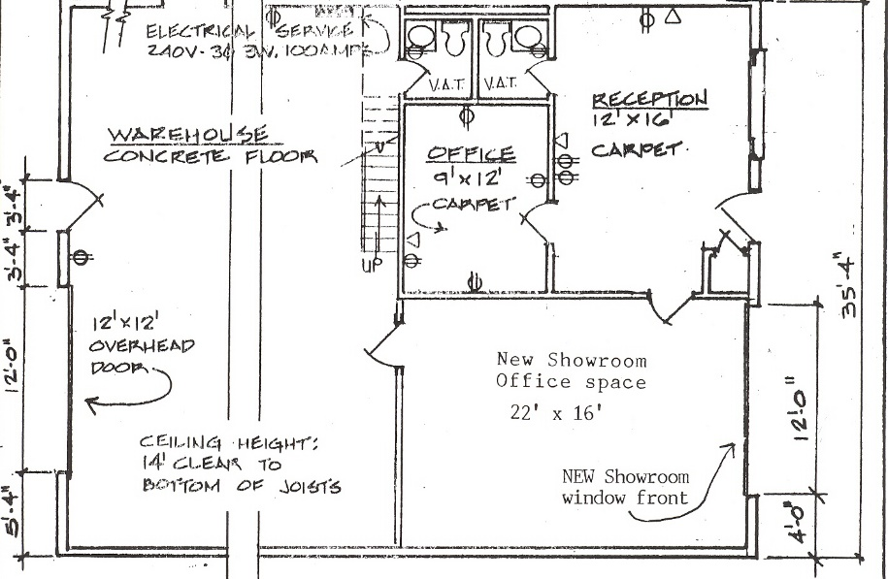
THE MODEL AND TOOLS
Workplace Layout
Does the layout of the workplace create a potential hazard
  Fall hazards of 6 feet.
  Low clearances
  Confined spaces
  Open holes

Slide 25
THE MODEL AND TOOLS
Fire/Explosions
STEP 1
Is there the potential for a fire or explosion
STEP 2
Once the hazards have been identified, you must implement effective controls to eliminate the hazard, reduce the hazard to an acceptable manner, or protect the employee.
STEP 3
Evaluate the level of risk for each hazard to help determine what type of control should be implemented to reduce exposure.
STEP 4
Select an appropriate solution to each hazard.
  Always consider eliminating the hazard (if possible) first.
  If elimination is not possible, consider reducing the hazard to an acceptable level.
  If an acceptable level cannot be reached, select and provide appropriate personal protective equipment for the employee.

Slide 26
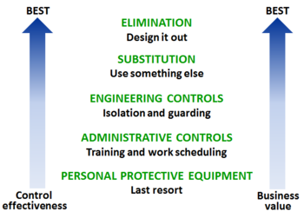
THE MODEL AND TOOLS
Engineering Controls
Engineering controls eliminate exposure to the hazard. They are;
  Relatively permanent
  can be costly
  can be time-consuming
EXAMPLES
  Isolation
  Process Change
  Design
  Workplace Layout
  Substitution
  Ventilation

Slide 27
THE MODEL AND TOOLS
Isolation
Isolate the employee from the hazard.
  Control rooms
  Machine guarding
  Protective barriers and shields
  Guardrails
  Clearance distances
Process Change
  Can a non-hazardous process be substituted for a hazardous process

Slide 28
THE MODEL AND TOOLS
Work Area Layout
Can a hazardous work area layout be improved.
Chemical storage area was moved away from hot work and electrical hazards.
Can a non-hazardous product be substituted for a hazardous product
  Pesticides
  Solder
  Cleaning agents
  Solvents

Slide 29
THE MODEL AND TOOLS
Administrative Controls
Administrative controls reduce employee exposure to a hazard
  They do NOT eliminate the hazard, but provide an acceptable way to work around the hazard
EXAMPLES
  Reduction - Can you reduce the frequency of performing the hazardous task?
  Rotation
Can employees be rotated to reduce exposure time
    Micro breaks should be taken throughout shift
  Training- Can employees are trained to recognize hazards and employ safe work practices

Slide 30

THE MODEL AND TOOLS
Protect The Employee
  If the hazard cannot be eliminated or reduced to an acceptable level, the employee must be protected from exposure.
  This protection requires that the employee wear and/or use appropriate personal protective equipment as a last line of defence

Slide 31
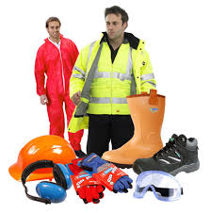
THE MODEL AND TOOLS
Personal Protective Equipment
Hard Hat
Steel Toe Boots
Gloves
Safety Glasses
Face Shields
Respirators
Hearing Protection
Coveralls
Long Sleeves

Slide 32
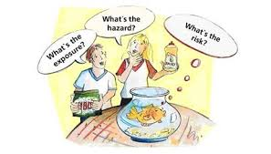
THE MODEL AND TOOLS
Summary
  Identify hazards in the workplace that could result in injury or illness.
  Evaluate the level of risk to help determine what controls to implement.
  Select an appropriate solution to control the hazard and/or protect the employee.

Slide 33
Our Clients

