Slide 1

Emergency
&
First Aid

Slide 2
ABOUT PMG
“BUILDING FOOD FACTORIES WITH TOP QUALITY STANDARDS OF NESTLE, MONDELEZ,ABBOTT, DANONE USING 3D DESIGN AND HYGIENIC ENGINEERING.”
At PMG, we deliver Engineering Design and Project Management scopes in Food and Beverage industry. Our team of design engineers and engineering executives has rich experience in Project Planning, Design, Execution and Commissioning with key competencies in areas like 3D Plant Design, Hygienic Engineering, and Project Management. Our safe-by-choice, result-oriented, and pro-active work-ethics allow us deliver work scopes meeting objectives, complete stakeholder alignment and first-time quality.
PMG Knowledge Repository: Targeted Knowledge Sharing & Skill Development
Precise and focused training modules for the exhaustive set of people working in manufacturing industry, instilling qualities of self-belief, creative thinking & widened perspective.
Clear Learning Objectives
Focused approach to skill development and knowledge sharing
Progressive Evaluation
Gauging improvement on every step and keeping audience connected.
After-training follow-ups
We systematically track differential progress of recipients after the training.
Audience Specific Approach
Programs are fine-tuned to the ability and interests of the recipients.
Multiple Awe-moments
Awe-moments are refreshing and increase receptivity many-fold.
Seasoned Trainers
PMG trainers are subject matter experts with substantial work experience.

Slide 3
AGENDA
1
An Emergency
2
First Aid
3
Fire
4
Severe Weather
5
What’s In a First Aid Kit
6
Basic First Aid Instructions
Notes:
3

Slide 4
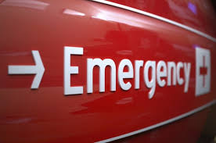
AN EMERGENCY
An incident, to be an emergency, conforms to one or more of the following:
  Poses an immediate threat to life, health, property, or environment
  Has already caused loss of life, health detriments, property damage, or environmental damage has a high probability of escalating to cause immediate danger to life, health, property, or environment

Slide 5

FIRST AID
First aid refers to medical attention that is usually administered immediately after the injury occurs and at the location where it occurred.
It often consists of a one-time, short-term treatment and requires little technology or training to administer.
First aid can include cleaning minor cuts, scrapes, or scratches; treating a minor burn; applying bandages and dressings; the use of non-prescription medicine; draining blisters; removing debris from the eyes; massage; and drinking fluids to relieve heat stress

Slide 6
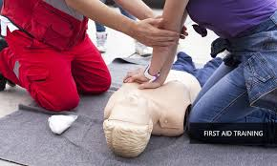
FIRST AID
Preplanning
Familiarize yourself with the emergency action plan and building layout for your camp area so you will know what to do in the event of any emergency.
Be alert for potential severe weather and know proper emergency procedures.
Have a stocked first aid kit readily available and have appropriate first aid training

Slide 7
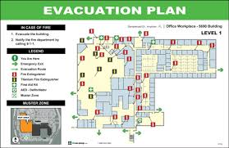
FIRST AID
Building Evacuation Maps
Look for Evacuation Maps for building(s) you will be in.
Maps show exit routes from building, severe weather shelter areas and locations of fire extinguishers, pull stations, and other emergency equipment.
Maps should be posted in buildings.

Slide 8
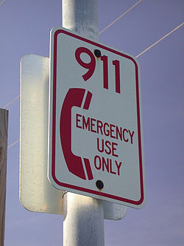
FIRST AID
Calling on Emergency
First responders will initiate notification of appropriate authorities, within the chain of command.
Be prepared to tell them:
  Your exact location, including building name, and room number.
  Your name and phone number you are calling from.
  Details of your emergency and what happened.
  Names, titles, departments, and telephone numbers of individual.

Slide 9
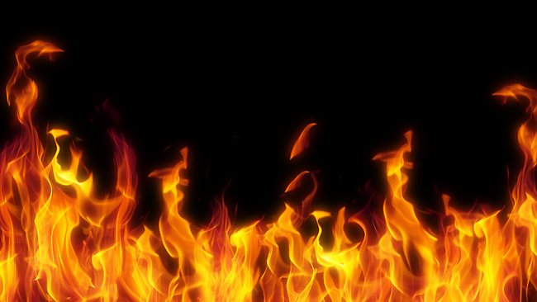
FIRE
Assess the situation.
Activate the nearest fire alarm.
Evacuate the building in a calm and orderly manner.
Use a fire extinguisher-
  If you have been trained.
  If you can do so without risk to yourself.
  Account for all building occupants after evacuation.

Slide 10
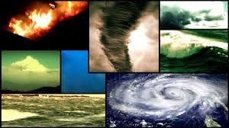
SEVERE WEATHER
Be familiar with the building’s notification plan.
Know where the shelter areas are and how to get to them quickly.
Know the terms:
  Tornado watch – conditions favourable
  Tornado warning – tornado sighted, move to shelter
  If outside & sirens go off, seek shelter indoors.
  Remain in shelter until warning expires or danger is past.

Slide 11
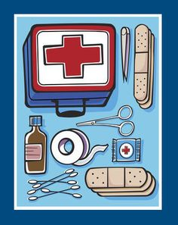
WHAT’S IN A FIRST AID KIT
Kits vary in contents but most kits have the following items:
  Band-Aids / adhesive bandages
  Gauze pads and tape
  Scissors, cold pack
  Wound bandage / compress
  Eye pads / eye wash solution
  First aid / burn cream
  Antibiotic ointment
  Ace shield or barrier mask for providing CPR
  Forceps / tweezers
  Disposable thermometers
  First aid instruction booklet

Slide 12
WHAT’S IN A FIRST AID KIT
Emergency Action Steps
  ASSESS: the situation – is it safe?
  THE VICTIM: are they responsive?
  ALERT: call on emergency number or activate the emergency action plan.
  ATTEND: to the victim. Check for life threatening conditions first.

Slide 13
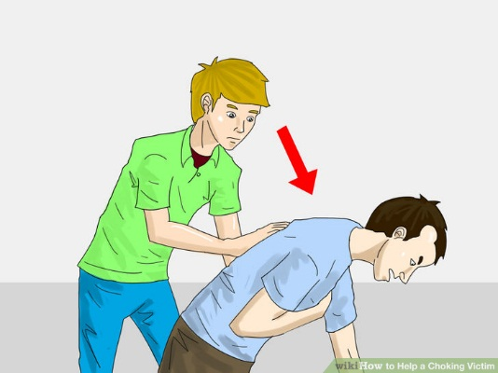
BASIC FIRST AID INSTRUCTIONS
Choking: severe airway blockage
Victim is responsive:
  Quickly ask, “Are you choking?”
  If the victim nods yes, or is unable to talk speak, or cough – act quickly.
  Stand behind the victim
  Make a fist and place the thumb side of that hand against the victim’s abdomen, just above the navel and below the ribs. Grasp fist with the other hand.
  Quickly thrust inward and upward into the abdomen
  Repeat thrusts until object is expelled or victim becomes unresponsive

Slide 14
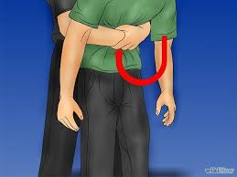
BASIC FIRST AID INSTRUCTIONS
Choking: severe airway blockage
Victim is unresponsive
  If needed, help the victim to the ground and alert Emergency Medical Service (EMS) / call on emergency number.
  Begin chest thrusts as you would with CPR. Each time the airway is opened look for the object in the victim’s throat and if you can see it, remove it – being careful not to lodge the object further into the victim’s throat.
  Continue chest thrusts until EMS / Paramedics arrive, or the victim shows signs of breathing /responsiveness.

Slide 15
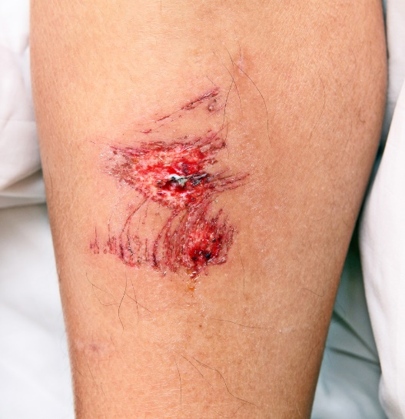
BASIC FIRST AID INSTRUCTIONS
Minor Wounds
Minor wounds include abrasions, lacerations, punctures and incisions. The most significant issues to consider with any open wound are control of bleeding and infection.
Signs and Symptoms:
  Break, cut or opening in the skin
  Bleeding – may be minor, moderate or severe
  Bruising and pain
  Infection
  Progressing shock

Slide 16
BASIC FIRST AID INSTRUCTIONS
Minor Wounds
First Aid:
  If bleeding, apply direct pressure with a clean cloth or absorbent pad
  Wash area with antibacterial soap and clean until there appears to be no foreign matter in the wound
  Cover area with an adhesive bandage or gauze wrap.

Slide 17
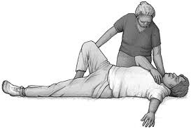
BASIC FIRST AID INSTRUCTIONS
Shock
Shock develops when not enough blood flows to the vital organs of the body.
Victims with shock may stop responding. Common causes of shock are:
  Severe bleeding
  Nervous system injuries
  Heart attack or other heart problem
  Severe burns
  Severe allergic reaction
  Dehydration
Signs and Symptoms:
  Dizziness, faint or weak feeling
  Rapid, shallow breathing
  Anxiety, restlessness, agitation, or confusion
  Cool and clammy to the touch
  Pale or greyish skin
  Thirst
  Nausea or vomiting

Slide 18
BASIC FIRST AID INSTRUCTIONS
Shock
First Aid:
  Help person lie on their back.
  Keep victim lying flat with feet slightly elevated if possible.
  Cover person to keep them warm, but prevent overheating.
  Ensure an open airway for victim and adequate breathing.
Monitor victim and administer CPR if necessary

Slide 19
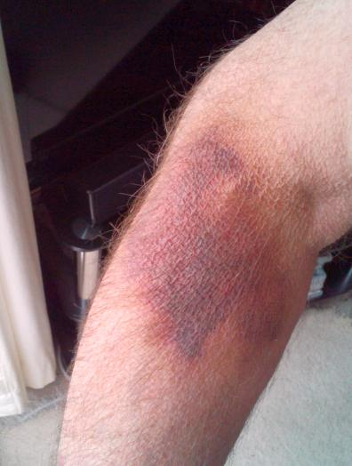
BASIC FIRST AID INSTRUCTIONS
Bruising
Caused by broken blood vessels leaking blood under the skin. Bruising can be minimal or large and severe.
Signs and Symptoms:
  Pain and swelling
  Discoloration: new bruising will be dark purple / older bruising will fade to greenish yellow
First Aid:
  Apply ice to injury to reduce pain, bleeding and swelling
  To prevent frost bite to the injured area, place a thin towel or cloth between the skin and ice.
  Limit ice application to 20 minutes on, 20 off.

Slide 20
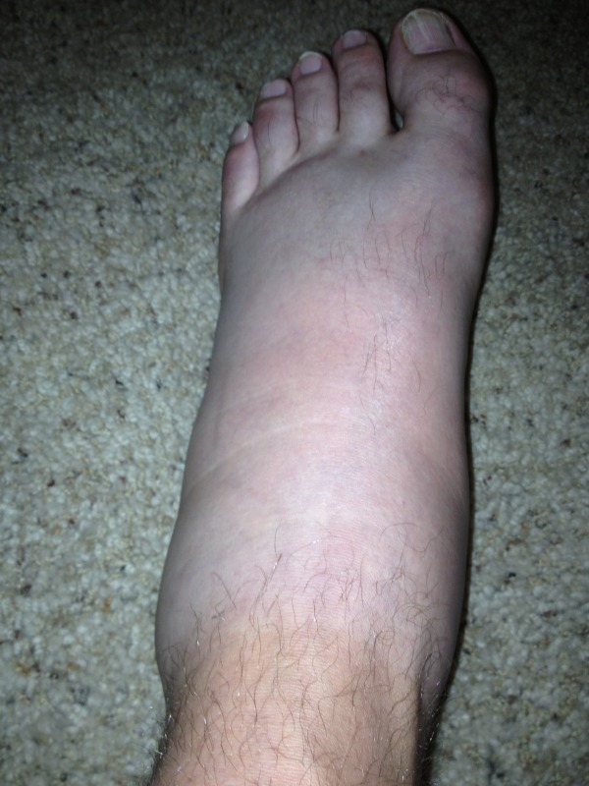
BASIC FIRST AID INSTRUCTIONS
Crush Injury
Occurs when a body part is subjected to a high degree of force or pressure . Example: smashed fingers in door.
Signs and Symptoms:
  Pain and swelling
  Discoloration and sometimes deformity
First Aid:
  Apply ice just as you would with a bruising injury
  If pain is severe and does not lessen with ice or there is decreased sensation, weakness, or paleness of the skin in the affected area, seek emergency care

Slide 21
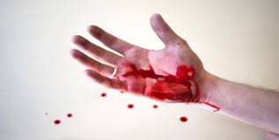
BASIC FIRST AID INSTRUCTIONS
Severe Bleeding
Emergency Action Steps:
  Assess the scene – if the scene is unsafe or becomes unsafe, get out! Only move the patient if absolutely necessary.
  Assess the victim - Tap shoulder, shout name. No response?? Alert – Have someone call for help. If you are alone – make the call yourself
  Attend to any life threatening problems.

Slide 22
BASIC FIRST AID INSTRUCTIONS
Severe Bleeding
Apply Direct Pressure:
  Rip or cut away clothing so wound can be seen.
  Place an absorbent pad directly over the wound.
  Apply firm, direct pressure over the wound.
  The victim can assist if they are able.
Apply Pressure Bandage:
  Wrap a conforming bandage securely over the pad to maintain pressure and hold the gauze in place.
  Bandage should be loose enough so a finger can slip under the bandage.

Slide 23
BASIC FIRST AID INSTRUCTIONS
Severe Bleeding
If Bleeding Continued:
  As the first dressings become soaked with blood, apply more pads, dressings and maintain firm, direct pressure.
  Do not remove the first dressings, just continue to add more if soaking through continues.
Managing Shock:
  Ensure an open airway for the victim and adequate breathing.
  Keep the bleeding under control.
  Prevent chilling or overheating.
  Keep victim lying flat with feet slightly elevated if possible.

Slide 24
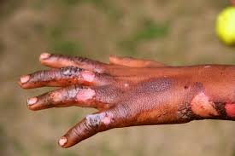
BASIC FIRST AID INSTRUCTIONS
Burns: Minor / Major
Thermal burns are caused by sun, fire, hot liquids or objects and sometimes hot gases.
Chemical burns are caused by contact with wet or dry chemicals.
Electrical burns are caused by contact with electrical wires, current, or lightening.
Burns on the face, hands, feet, and genitals can be particularly serious.
Burns can cause tremendous damage to the body. They can cause extreme pain, scarring, massive infection, organ failure, and even death.
A rescuer’s highest priority is personal safety.
If a victim is on fire, tell him/her to STOP, DROP, and ROLL.
If a victim is in contact with electricity DO NOT TOUCH them until the source of electricity has been shut off.

Slide 25
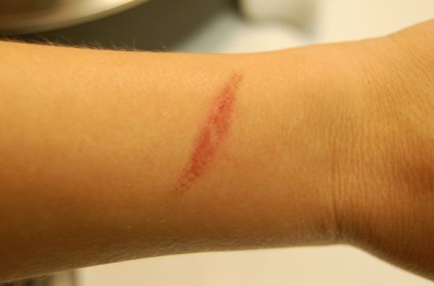
BASIC FIRST AID INSTRUCTIONS
Minor burns
Signs and Symptoms:
  Pain, Redness
  Swelling, Blisters
First Aid:
  Expose the burn
  Cool burns with cold water and continue until pain lessens
  After cooling, cover with a dry, sterile bandage or clean dressing
  Protect from friction /pressure
  DO NOT pop blisters or apply any ointment or other substance

Slide 26
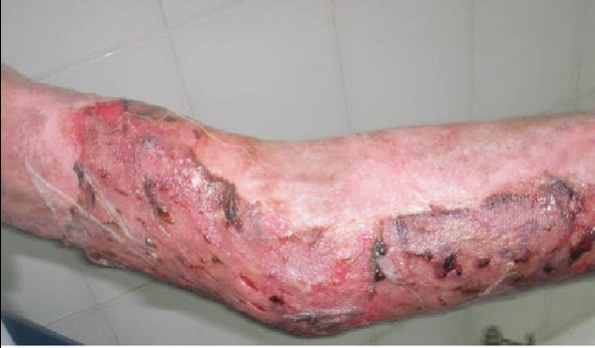
BASIC FIRST AID INSTRUCTIONS
Minor burns
Signs and Symptoms:
  Dry/leathery, white, or blackened, charred skin
First Aid:
  Assess/Alert/Attend to any life threatening problems
  Call emergency contact number and Activate EMS
  If caused by a liquid chemical, flush with large amounts of water right away if you are fully trained in First Aid

Slide 27
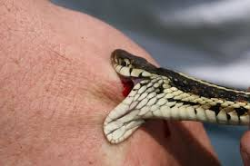
BASIC FIRST AID INSTRUCTIONS
Bites and Stings
Bites and stings that could require first aid care can occur from a wide variety of sources.
Most only cause minor discomfort and can easily be treated by a first aid provider.
However bites and stings from venomous snakes, insects or animals can cause intense pain and swelling.
Bites from humans and animals such as dogs, cats, bats etc.
Can cause severe injury and infection, including tetanus and rabies.
Some people have severe allergic reactions to bites or stings that can be life threatening.
In these cases, the most important first aid measure is rapid access to advanced emergency medical care.

Slide 28
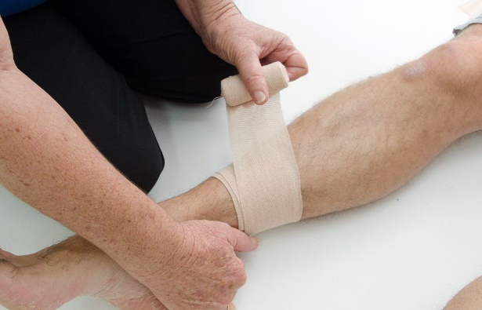
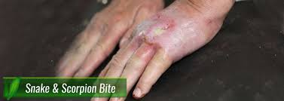
BASIC FIRST AID INSTRUCTIONS
Bites and Stings First Aid
General Signs and Symptoms associated with bites and stings:
  redness
  swelling
  pain
  itching
  nausea
  problems breathing
General First Aid for bites and stings:
  remove jewellery and constrictive clothing
  wash the area with soap and clean water
  cover the area with an adhesive bandage or gauze wrap
  apply ice if needed to reduce pain and swelling

Slide 29
BASIC FIRST AID INSTRUCTIONS
Eye Injuries
Eye injuries can range from minor irritations to severe and sight threatening.
Injuries are frequently caused by objects in the eye, burns, and blunt force injuries. Any of these conditions or situations can lead to permanent loss of vision.
Prevention for an eye injury.
  Wear protective eyewear during risky activities.
    Wear safety glasses with side shields anytime you might be exposed to flying particles, objects or dust.
  Wear goggles when exposed to chemicals
    Even if you're just a bystander. Protective eyewear counts during sports, too. Any sport featuring a ball, racket or flying object poses a potential risk of eye injury.
  Don't mix products. Keep all chemicals and sprays in safe areas.

Slide 30
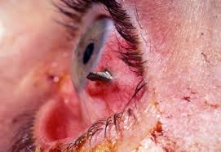
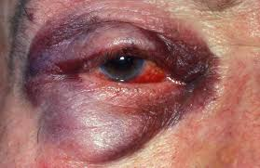
BASIC FIRST AID INSTRUCTIONS
Eye Injuries and First Aid
Signs and Symptoms:
  Pain, redness, stinging
  Burning, itching
  Bleeding/bruising in or around eyes
  Sensitivity to light
  Decreased or double vision
  Loss of vision
  Something actually visibly stuck in eye
First Aid Interventions:
  Rinse eye with saline solution or tap water if saline is not available.
  Do not try to remove object
  Do not allow the victim to rub or apply pressure to the injured eye
  Cover the eye lightly with a gauze pad or clean cloth
  Seek medical attention

Slide 31
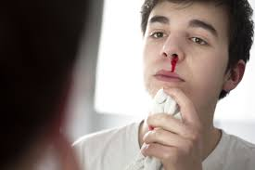
BASIC FIRST AID INSTRUCTIONS
Nosebleeds and First Aid
Most nosebleeds are not serious and can be handled by a first aid responder.
Most will stop on their own or with simple first aid actions.
In some cases nosebleeds can indicate a more serious condition which may require ongoing medical attention.
If the nose bleed is related to an injury, the victim should be assisted in finding medical assistance urgently.
Some people may be taking medications that make them more prone to bleeding. These people should also seek care urgently.

Slide 32
BASIC FIRST AID INSTRUCTIONS
Nosebleeds and First Aid
Signs and symptoms to monitor:
  Bleeding from one or both nostrils
  Bleeding in the back of the throat, causing the victim to vomit blood
First Aid Interventions:
  Sit upright and lean forward.
  By remaining upright, you reduce blood pressure in the veins of your nose.
  his discourages further bleeding. Sitting forward will help you avoid swallowing blood, which can irritate your stomach.

Slide 33
BASIC FIRST AID INSTRUCTIONS
Nosebleeds and First Aid
Have the victim spit out blood that collects in the back of the throat or mouth.
Pinch the nose firmly.
Use your thumb and index finger to pinch your nostrils shut.
Breathe through your mouth. Continue to pinch for five to 10 minutes.
Pinching sends pressure to the bleeding point on the nasal septum and often stops the flow of blood.
To prevent re-bleeding, don't pick or blow your nose and don't bend down for several hours after the bleeding episode. During this time remember to keep your head higher than the level of your heart.

Slide 34
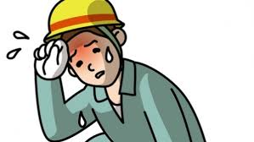
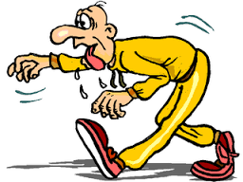
BASIC FIRST AID INSTRUCTIONS
Heat Exhaustion & Heat Stroke
Causes of heat exhaustion include exposure to high temperatures, particularly when combined with high humidity, and strenuous physical activity.
Without prompt treatment, heat exhaustion can lead to heatstroke, a life-threatening condition.
Fortunately, heat exhaustion is preventable.
Heatstroke occurs if your body temperature continues to rise.
At this point, emergency treatment is needed.
In a period of hours, untreated heatstroke can cause damage to your brain, heart, kidneys and muscles.
These injuries get worse the longer treatment is delayed, increasing your risk of very serious complications.

Slide 35
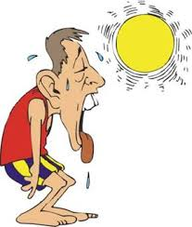
BASIC FIRST AID INSTRUCTIONS
Heat Exhaustion & Heat Stroke
Signs and Symptoms:
  Cool, moist skin with goose bumps when in the heat
  Heavy sweating
  Faintness
  Dizziness
  Fatigue
  Weak, rapid pulse
  Low blood pressure upon standing
  Muscle cramps
  Nausea
  Headache

Slide 36
BASIC FIRST AID INSTRUCTIONS
Heat Exhaustion & Heat Stroke
First Aid Interventions:
  Stop all activity and rest
  Move to a cooler place
  Drink cool water or sports drinks
  Contact your doctor if your signs or symptoms worsen or if they don't improve within one hour. Seek immediate medical attention if your body temperature reaches 104°F (40°C) or higher.

Slide 37
BASIC FIRST AID INSTRUCTIONS
Heat Exhaustion & Heat Stroke
Signs and Symptoms:
  High body temperature. A body temperature of 104°F (40°C) or higher is the main sign of heatstroke.
  A lack of sweating. In heatstroke brought on by hot weather, skin will feel hot and dry to the touch.
  Nausea and vomiting. Victim may feel sick to their stomach or vomit.
  Flushed skin. Skin may turn red as body temperature increases.
  Rapid breathing. Breathing may become rapid and shallow.
  Racing heart rate. Pulse may significantly increase because heat stress places a tremendous burden on the heart to help cool the body.
  Headache. Victim may experience a throbbing headache.

Slide 38
BASIC FIRST AID INSTRUCTIONS
Heat Exhaustion & Heat Stroke
Confusion. Victim may have seizures, hallucinate, or have difficulty speaking or understanding what others are saying
First Aid Interventions:
  If you think a person may be experiencing heatstroke, seek immediate medical help. Call your local emergency services number.

Slide 39
Our Clients

