Slide 1
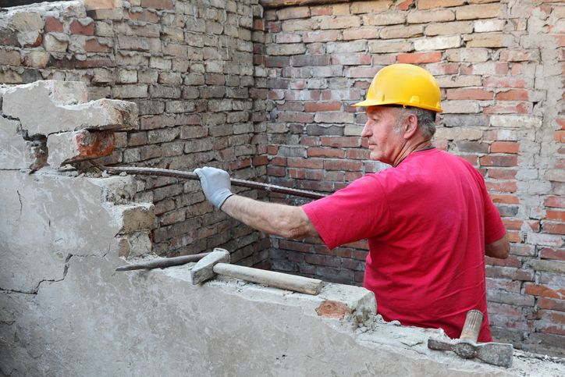
HAZARDS
IN
CONSTRUCTION

Slide 2
ABOUT PMG
“BUILDING FOOD FACTORIES WITH TOP QUALITY STANDARDS OF NESTLE, MONDELEZ,ABBOTT, DANONE USING 3D DESIGN AND HYGIENIC ENGINEERING.”
At PMG, we deliver Engineering Design and Project Management scopes in Food and Beverage industry. Our team of design engineers and engineering executives has rich experience in Project Planning, Design, Execution and Commissioning with key competencies in areas like 3D Plant Design, Hygienic Engineering, and Project Management. Our safe-by-choice, result-oriented, and pro-active work-ethics allow us deliver work scopes meeting objectives, complete stakeholder alignment and first-time quality.
PMG Knowledge Repository: Targeted Knowledge Sharing & Skill Development
Precise and focused training modules for the exhaustive set of people working in manufacturing industry, instilling qualities of self-belief, creative thinking & widened perspective.
Clear Learning Objectives
Focused approach to skill development and knowledge sharing
Progressive Evaluation
Gauging improvement on every step and keeping audience connected.
After-training follow-ups
We systematically track differential progress of recipients after the training.
Audience Specific Approach
Programs are fine-tuned to the ability and interests of the recipients.
Multiple Awe-moments
Awe-moments are refreshing and increase receptivity many-fold.
Seasoned Trainers
PMG trainers are subject matter experts with substantial work experience.

Slide 3
AGENDA
1
Construction hazards
2
Cause of accident in construction
3
Fire and explosion in construction site
Notes:
3

Slide 4
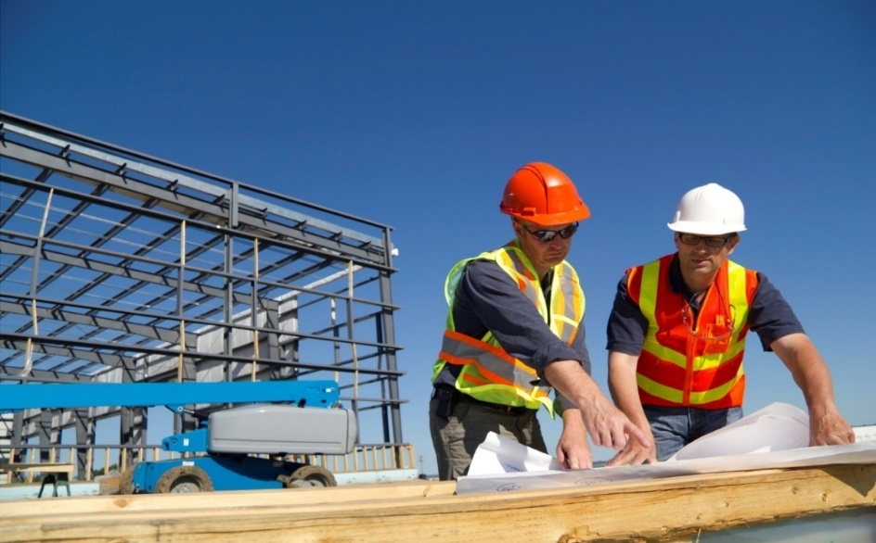
CONSTRUCTION HAZARDS
Construction jobs are considered a very hazardous job.
Construction job comprises activities on the ground, above the ground, and under the ground.
The structures involved may be buildings, bridges, towers, chimneys, dams, barrages, tunnels, etc. Safety aspects need due consideration during the following stages of construction.
  Prior to construction.
  During construction.
  After construction

Slide 5
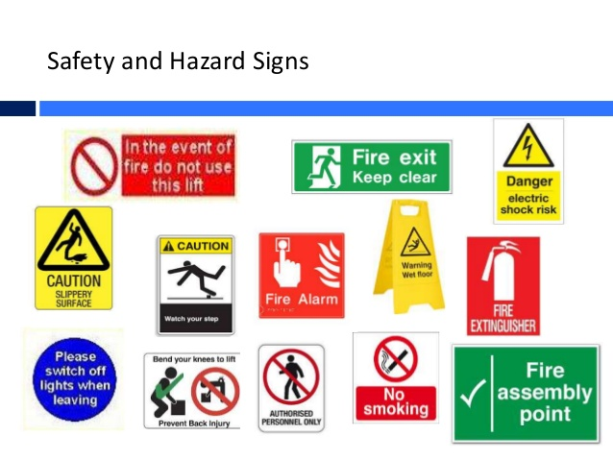
CONSTRUCTION HAZARDS
The following common hazards are found in construction job.
  Falling hazards i.e.
  Person falling from height.
  Material falling from height.
  Electrical hazards.
  Fire and explosion hazards.
  Other accidental hazards like during material handling, loading and unloading, working in confined space, during excavation job, ,piling job, during trial of machinery equipment after completion of construction.

Slide 6
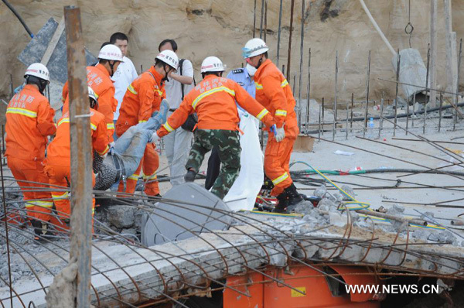
CAUSES OF ACCIDENT IN CONSTRUCTION
There may be the following reasons which may cause accident in construction job :
  Lack of proper supervisions.
  Lack of proper training of workers and poor skillness.
  Frequent changing of workers due to temporary nature of work or migratory type of labors.
  Faulty structural design.
  Sub standard and defective materials of construction.
  Carelessness and irresponsibility of work force in the execution of construction.
  Improper planning or lay out.
  Safe work procedure not laid down.
  Safe work procedure not explained to concerned workers.
  Proper safety appliances not used.
  Proper scaffolds not used.

Slide 7
CAUSES OF ACCIDENT IN CONSTRUCTION
  Safe approach to and from pit not provided.
  Opening and gaps left uncovered at ground level.
  Safe approach to work at height not provided.
  Opening and gaps left uncovered at height.
  Hand railings and toe guards not provided on the roof of the building.
  Hand railings and toe boards not provided on staircases and platforms.
  Loose materials kept at height on the edge of roof , scaffolds, and walkways.
  Shoring not done on pit wall or deep excavated pit.
  Under cutting of pit wall.
  Using structure to reach place of work, like using column or get down through structure instead of safe approach.
  Passing between stationary wagons.
  Transferring heavy loads with out any precaution to prevent their fall.
  Fatigue or over strain due to continuous working for long hours and no proper rest.
  Work with out job clearance and work permit.

Slide 8
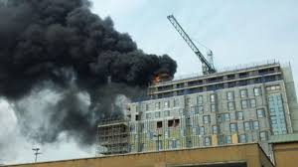
FIRE AND EXPLOSION IN CONSTRUCTION SITE
Fire and explosion take place at construction site due to the following reasons.
  Due to welding , gas cutting& loose electric wiring.
  Burning of paints on wood works.
  Storage of timbers and other combustible materials at construction site.
  Use of explosive materials in demolitions.
  Work in compressed air atmosphere/ confined space.
  Storage and use of flammable materials.

Slide 9
Our Clients

