Slide 1

HEALTH HAZARDS IN
CONSTRUCTION

Slide 2
ABOUT PMG
“BUILDING FOOD FACTORIES WITH TOP QUALITY STANDARDS OF NESTLE, MONDELEZ,ABBOTT, DANONE USING 3D DESIGN AND HYGIENIC ENGINEERING.”
At PMG, we deliver Engineering Design and Project Management scopes in Food and Beverage industry. Our team of design engineers and engineering executives has rich experience in Project Planning, Design, Execution and Commissioning with key competencies in areas like 3D Plant Design, Hygienic Engineering, and Project Management. Our safe-by-choice, result-oriented, and pro-active work-ethics allow us deliver work scopes meeting objectives, complete stakeholder alignment and first-time quality.
PMG Knowledge Repository: Targeted Knowledge Sharing & Skill Development
Precise and focused training modules for the exhaustive set of people working in manufacturing industry, instilling qualities of self-belief, creative thinking & widened perspective.
Clear Learning Objectives
Focused approach to skill development and knowledge sharing
Progressive Evaluation
Gauging improvement on every step and keeping audience connected.
After-training follow-ups
We systematically track differential progress of recipients after the training.
Audience Specific Approach
Programs are fine-tuned to the ability and interests of the recipients.
Multiple Awe-moments
Awe-moments are refreshing and increase receptivity many-fold.
Seasoned Trainers
PMG trainers are subject matter experts with substantial work experience.

Slide 3
AGENDA
1
The Occupational Health & Safety Act
2
Employer Responsblity.
3
Method of Hazard Assesments.
4
Hazard Assesment Benifits.
5
Hazard Elimination & Control.
Notes:
3

Slide 4
THE OCCUPATIONAL HEALTH & SAFETY ACT
The Occupational Health and Safety Act, amended in December 2002, incorporate the Occupational Health and Safety Regulation and Code.
The Regulation came into effect as of March 2003 and the Code was released in October 2003 with an enforcement date of April 30, 2004.

Slide 5

EMPLOYER RESPONSIBILITY
Assess a work site and identify existing or potential hazards before work begins at the work site.
Prepare a report of the results of a hazard assessment and the methods used to control or eliminate the hazards identified.
Ensure that the date on which the hazard assessment is prepared or revised is recorded on it.
Ensure that the hazard assessment is repeated
  At reasonably practicable intervals to prevent the development of unsafe and unhealthy working conditions.
  When a new work process is introduced.
  When a work process or operation changes.
  Before the construction of a new work site

Slide 6
EMPLOYER RESPONSIBILITY
The objective of this module is to provide the workman with a general
  Understanding of the following:
    What a hazard assessment is.
    Types of hazards within the workplace.
    Different methods used in hazard assessment.
    Benefits of performing hazard assessments.
    Hazard elimination and control measures.
  A hazard is any condition at the worksite that has the potential to cause injury, illness or loss.
  A hazard assessment is a systematic and ongoing approach aimed at identifying all known hazards associated with the job.
Types of hazards
  In order to perform a hazard assessment it is important to understand the different types of hazards that you may encounter.

Slide 7

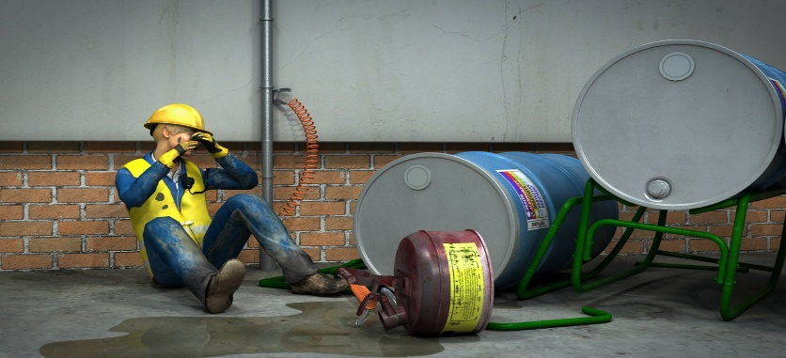
EMPLOYER RESPONSIBILITY
In order to perform a hazard assessment it is important to understand the different types of hazards that you may encounter.
Chemical - chemical hazards include mists, vapours gases, fumes, dusts, liquids and pastes whose chemical composition can create problems.

Slide 8


EMPLOYER RESPONSIBILITY
Types of hazards
Biological - biological hazards include insects, rodents, mold, fungi, bacteria, viruses, and other agents.
Ergonomic - ergonomic hazards include such issues as workstation design, work posture, poor tool design, manual materials handling, work-rest cycles, repetition, local contract stresses, and seating.

Slide 9

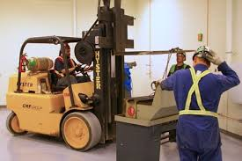
METHOD OF HAZARD ASSESSMENT
Physical inspections : Doing a walkthrough of the workplace and identifying the hazards. Usually with the assistance of a Workplace Inspection Checklist.
Task or job hazard analysis: Breaking down the actions required in the job into individual tasks then identifying the hazards involved with each task.

Slide 10


METHOD OF HAZARD ASSESSMENT
Process analysis: Follow a work process from start to finish and identify the hazards involved at each stage.
Incident investigation findings

Slide 11

METHOD OF HAZARD ASSESSMENT
Benefits
The hazard assessment process is very beneficial in many ways including the following:
  Reducing the number and severity of workplace injuries.
  Identifying the need for worker training.
  Training and education of staff/students.
  Identifying poor or missing procedures.
  Developing safe work procedures.
  Increasing worker participation and ownership of workplace health and safety.
  Reducing damage to equipment and property.
  Providing a useful tool when investigating incident.
  Identifying the personal protective equipment necessary to perform a task.
  Eliminating known hazards from the task.

Slide 12
METHOD OF HAZARD ASSESSMENT
Benefits
THE HAZARD ASSESSMENTS SHOULD BE CONDUCTED
  Workers and supervisors should collaborate to complete the Task Hazard Assessments.
  Workers are the ones who perform these tasks on a regular basis and are therefore most
  familiar with the associated hazards.
HAZARD ASSESSMENTS SHOULD BE CONDUCTED WHEN-
  Situations in which hazard assessments need to be conducted:
    Initially to develop a baseline assessment.
    Periodically to ensure workers are following correct procedures and using the
    Appropriate equipment.
    When new work processes are introduced.
    Before the construction or renovation of a new worksite to anticipate potential
    Problems and prevent them from being built into the process or operation.
    When performing workplace inspections to help minimize the length of time that Workers are exposed to a particular hazard.

Slide 13

HAZARD ELIMINATION & CONTROL
Engineering Controls
Provide the highest degree of control because they eliminate or control the hazard at its source.
Engineering controls are the Preferred method of eliminating, isolating or minimizing hazards.
Examples of engineering controls include

Slide 14
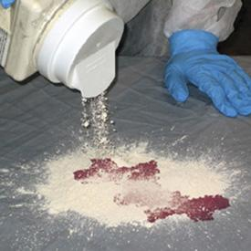
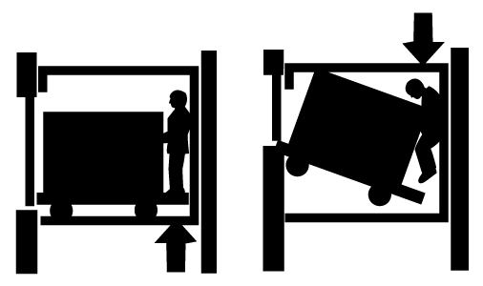
HAZARD ELIMINATION & CONTROL
Substitution: substituting or replacing one substance or process with a less hazardous option.
Elimination: eliminating the hazardous job, tool, process machine or Substance.

Slide 15
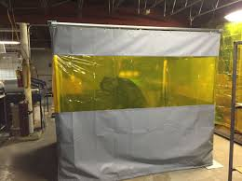
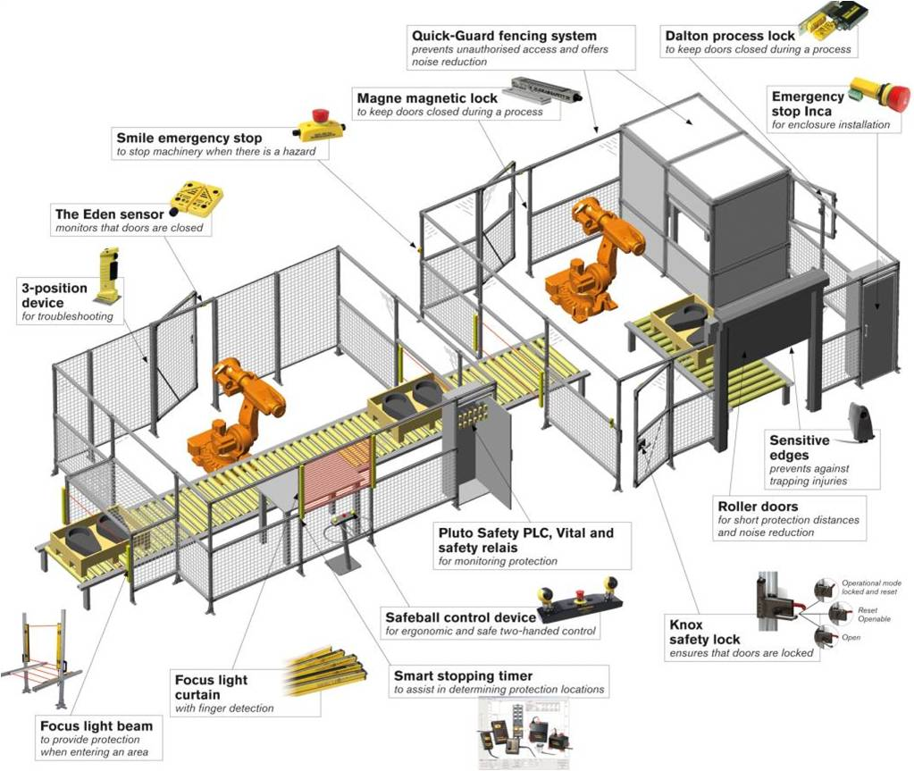
HAZARD ELIMINATION & CONTROL
Redesign: “engineering out” hazards through the redesigning of the work site, workstations, work processes and jobs.
Isolation: isolate the hazard through containment or enclosure.

Slide 16


HAZARD ELIMINATION & CONTROL
Automation: some processes can be automated or mechanized.
Barriers: blocking the hazards to keep workers away from the hazard.
Automation
Barriers

Slide 17
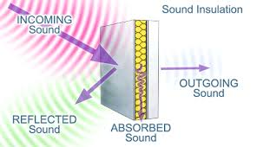
HAZARD ELIMINATION & CONTROL
Absorption: absorbing the hazard (for example: using baffles to block or absorb noise).

Slide 18

HAZARD ELIMINATION & CONTROL
Dilution: some hazards can be diluted or dissipated.
Administrative Controls - used when engineering controls are not possible or practical, administrative controls are the next approach to isolating, minimizing or otherwise controlling hazards.
Examples of administrative controls include:
  Safe work procedures which describe how to perform a job in a correct manner from start to finish.
  Safe work permits.
  Work/rest schedules to reduce worker exposure to hazardous substances or conditions.
  Scheduling hazardous work during times when exposure to other workers is limited.
  Monitors and alarms systems.
  Medical screening, including pre-employment and ongoing examinations.
  Controls on purchasing.
  Training and safety meetings.
  Posters, bulletins, and newsletters

Slide 19
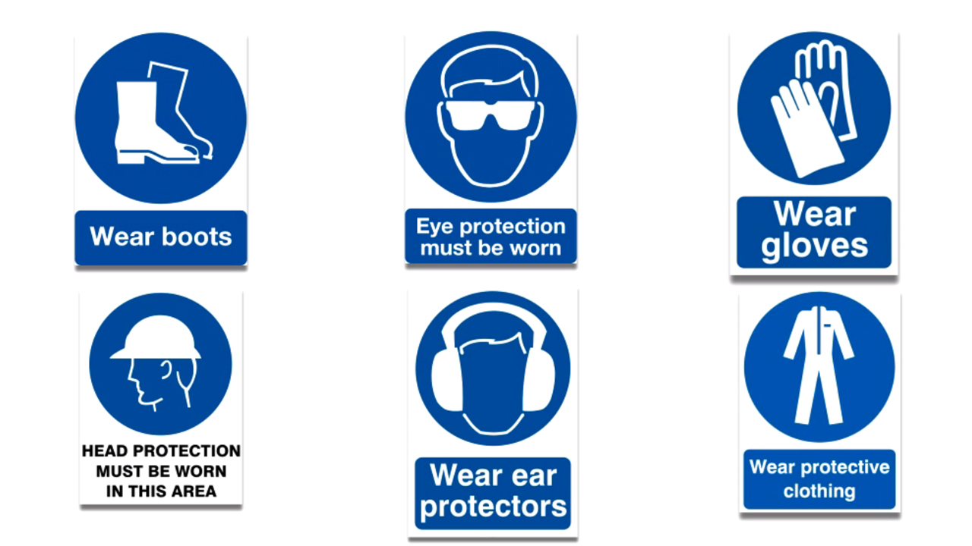
HAZARD ELIMINATION & CONTROL
Personal Protective Equipment (PPE) - used as the last resort, workers may need to use PPE to lessen the potentially harmful effects of exposure to a hazard.
The equipment must be used properly and consistently to be effective.
  Safety eyewear to protect the eyes against flying debris.
  Hard hats to protect the head against injury from falling objects.
  Safety boots to reduce the risk of foot injuries.
  Respiratory protective equipment to protect the lungs against harmful Dusts and Vapours.

Slide 20
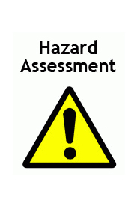
HAZARD ELIMINATION & CONTROL
Hazard assessment
  The severity of the hazard.
  The complexity of the causes.
  Future changes to the work site or process.
  Persons affected – higher priority when more people are affected by a hazard.
  Multiple hazards – higher priority when a job or process exposes the workers
Involved to multiple hazards.
  Lost days – higher priority for a job that has a high number of lost days.

Slide 21
Our Clients

