Slide 1
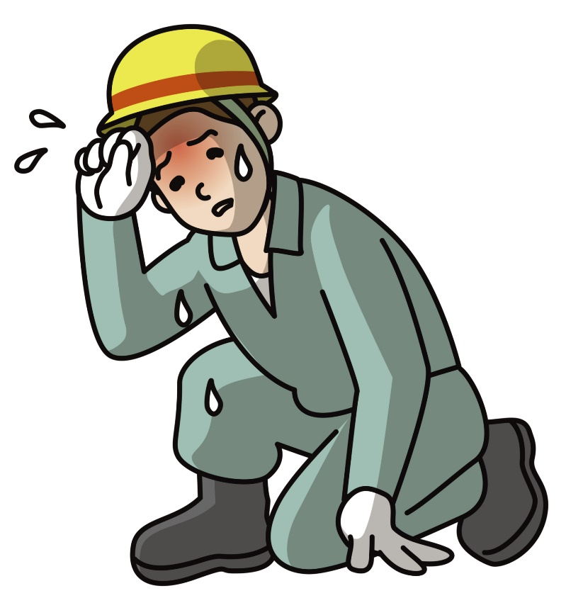
HEAT STRESS

Slide 2
ABOUT PMG
“BUILDING FOOD FACTORIES WITH TOP QUALITY STANDARDS OF NESTLE, MONDELEZ,ABBOTT, DANONE USING 3D DESIGN AND HYGIENIC ENGINEERING.”
At PMG, we deliver Engineering Design and Project Management scopes in Food and Beverage industry. Our team of design engineers and engineering executives has rich experience in Project Planning, Design, Execution and Commissioning with key competencies in areas like 3D Plant Design, Hygienic Engineering, and Project Management. Our safe-by-choice, result-oriented, and pro-active work-ethics allow us deliver work scopes meeting objectives, complete stakeholder alignment and first-time quality.
PMG Knowledge Repository: Targeted Knowledge Sharing & Skill Development
Precise and focused training modules for the exhaustive set of people working in manufacturing industry, instilling qualities of self-belief, creative thinking & widened perspective.
Clear Learning Objectives
Focused approach to skill development and knowledge sharing
Progressive Evaluation
Gauging improvement on every step and keeping audience connected.
After-training follow-ups
We systematically track differential progress of recipients after the training.
Audience Specific Approach
Programs are fine-tuned to the ability and interests of the recipients.
Multiple Awe-moments
Awe-moments are refreshing and increase receptivity many-fold.
Seasoned Trainers
PMG trainers are subject matter experts with substantial work experience.

Slide 3
AGENDA
1
Introduction
2
Body react to heat
3
Risk of heat related illness
4
Cause of heat stress and heart related illness
5
Symptoms of heat related illness
6
Treatment for heat related illness
7
Prevention of heat related illness
Notes:
3

Slide 4
AGENDA
8
Prevent dehydration
9
Provide personal protective equipment's
10
Training
11
Acclimatisation
12
Identify who is at risk
13
Monitor health
Notes:
4

Slide 5
HEAT STRESS
In many jobs heat stress is an issue all year round but this information is also applicable during the hot summer months where there may be an increased risk of heat stress for some people.
Heat stress occurs when the body’s means of controlling its internal temperature starts to fail.
As well as air temperature, factors such as work rate, humidity and clothing worn while working may lead to heat stress.
It may not be obvious to someone passing through the workplace that there is a risk of heat stress

Slide 6
BODY REACT TO HEAT
The body reacts to heat by increasing the blood flow to the skin’s surface and by sweating.
This cools the body as heat is carried to the surface from within by the increased blood flow and sweat evaporates.
Heat can also be lost by radiation and convection from the body’s surface.
Heat stress situation
Someone wearing protective clothing and performing heavy work in hot and humid conditions could be at risk of heat stress because:
  Sweat evaporation is restricted by the type of clothing and the humidity of the environment.
  Heat will be produced within the body due to the work rate and if insufficient heat is lost deep body temperature will rise.

Slide 7

BODY REACT TO HEAT
  As deep body temperature rises the body reacts by increasing the amount of sweat produced, which may lead to dehydration.
  Heart rate also increases which puts additional strain on the body.
  If the body is gaining more heat than it can lose then the deep body temperature will continue to rise.
  Eventually it reaches a point where the body’s control mechanisms start to fail.
  The symptoms will get worse the longer someone remains working in the same conditions.

Slide 8
BODY REACT TO HEAT
Heat stress can affect individuals in different ways and some people are more susceptible to it than others.
Typical symptoms are:
  An inability to concentrate;
  Muscle cramps;
  Heat rash;
  Severe thirst – a late symptom of heat stress;
  Fainting;
  Heat exhaustion – fatigue, giddiness, nausea, headache, moist skin;
  Heat stroke – hot dry skin, confusion, convulsions and eventual loss of consciousness. This is the most severe disorder and can result in death if not detected at an early stage.

Slide 9
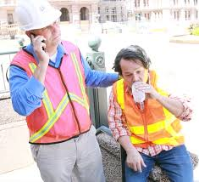
RISK OF HEAT RELATED ILNESS
Anyone can suffer from heat-related illness, but those most at risk are:
  People over 65 years, particularly those living alone or without air conditioning.
  Babies and young children
  Pregnant and nursing mothers
  People who are physically unwell, especially with heart disease, high blood pressure or lung disease.
  People on medications for mental illness.
Elderly people are more prone to heat stress than younger people because their body may not adjust well to sudden or prolonged temperature change.
They are also more likely to have a chronic medical condition and be taking medication that may interfere with the body’s ability to regulate temperature.

Slide 10
CAUSE OF HEAT STRESS AND HEART RELATED ILNESS
There are many factors which can cause heat stress and heat-related illness, including:
  Dehydration – to keep healthy, our body temperature needs to stay around 37°C.
  The body cools itself by sweating, which normally accounts for 70 to 80 per cent of the body’s heat loss.
  If a person becomes dehydrated, they don’t sweat as much and their body temperature keeps rising.
  Lack of airflow – working in hot, poorly ventilated or confined areas.
  Sun exposure – especially on hot days, between 11am and 3pm.
  Hot and crowded conditions – people attending large events (concerts, dance parties or sporting events) in hot or crowded conditions may also experience heat stress that can result in illness.
  Bushfires – exposure to radiant heat from bushfires can cause rapid dehydration and heat-related illness. Bushfires usually occur when the temperature is high, which adds to the risk.

Slide 11
CAUSE OF HEAT STRESS AND HEART RELATED ILNESS
Symptoms vary according to the type of heat-related illness.
Babies and young children may show signs of restlessness or irritability and have fewer wet nappies.
Older people may become lightheaded, confused, weak or faint.
Some heat-related illness and common symptoms include:
  Deterioration in existing medical conditions – this is the most common health problem of heat stress.
  Heat rash – sometimes called ‘prickly heat’, this is a skin irritation caused by excessive sweating.
  It can occur at any age, but is most common in young children.
  It looks like a red cluster of pimples or small blisters.
  It is most likely to occur on the neck and upper chest, in the groin, under the breasts and in the elbow creases.

Slide 12
CAUSE OF HEAT STRESS AND HEART RELATED ILNESS
Heat cramps – these include muscle pains or spasms, usually in the abdomen, arms or legs.
  They may occur after strenuous activity in a hot environment, when the body gets depleted of salt and water.
  They may also be a symptom of heat exhaustion.

Slide 13
SYPTOMS OF HEAT RELATED ILNESS
Dizziness and fainting – heat-related dizziness and fainting results from reduced blood flow to the brain.
  Heat causes an increase in blood flow to the skin and pooling of blood in the legs, which can lead to a sudden drop in blood pressure.
  There can be a feeling of light-headedness before fainting occurs.
Heat exhaustion – this is a serious condition that can develop into heatstroke.
  It occurs when excessive sweating in a hot environment reduces the blood volume.
  Warning signs may include paleness and sweating, rapid heart rate, muscle cramps (usually in the abdomen, arms or legs), headache, nausea and vomiting, dizziness or fainting.

Slide 14
SYPTOMS OF HEAT RELATED ILNESS
Heatstroke – this is a medical emergency and requires urgent attention.
  Heatstroke occurs when the core body temperature rises above 40.5 °C and the body’s internal systems start to shut down.
  Many organs in the body suffer damage and the body temperature must be reduced quickly.
  Most people will have profound central nervous system changes such as delirium, coma and seizures.
  The person may stagger, appear confused, have a fit or collapse and become unconscious.
  As well as effects on the nervous system, there can be liver, kidney, muscle and heart damage.
  The symptoms of heatstroke may be the same as for heat exhaustion, but the skin may be dry with no sweating and the person’s mental condition worsens.

Slide 15
TREATMENT FOR HEAT RELATED ILNESS
Treatment options vary according to the type of heat-related illness. Apply first aid and seek medical assistance immediately if you, or someone you are with, shows any sign of heat exhaustion or heatstroke.
Heat cramps – treatment
  Treatment for heat cramps includes:
    Stop activity and sit quietly in a cool place.
    Increase fluid intake. Rest a few hours before returning to activity.
    Seek medical help if there is no improvement.
Heat rash – treatment
  Treatment for heat rash includes:
    Move the person to a cooler, less humid environment.
    Keep the affected area dry.
    Try using unperfumed talcum powder to increase comfort.
    Avoid using ointments or creams, as they keep the skin warm and moist, and may make the condition worse.

Slide 16
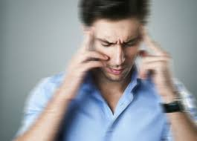
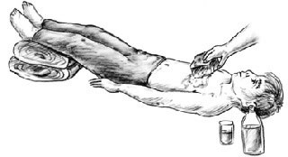
TREATMENT FOR HEAT RELATED ILNESS
Dizziness and fainting – treatment
  Treatment for dizziness or fainting includes:
    Get the person to a cool area and lay them down.
    If fully conscious, increase fluid intake.
Heat exhaustion – treatment
  Treatment for heat exhaustion includes:
    Get the person to a cool area and lay them down.
    Remove outer clothing.
    Wet skin with cool water or wet cloths.
    Increase fluid intake if they are fully conscious.
    Seek medical advice.

Slide 17
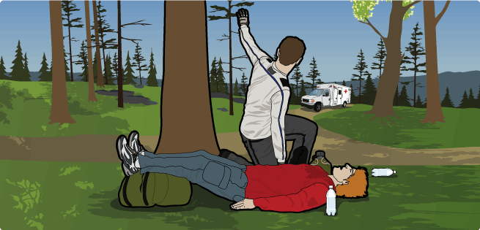
TREATMENT FOR HEAT RELATED ILNESS
Heatstroke is a medical emergency and requires urgent attention:
Heatstroke – treatment
  Call triple zero (102) for an ambulance.
  Get the person to a cool, shady area and lay them down while you’re waiting for emergency medical help.
  Remove clothing and wet their skin with water, fanning continuously.
  Do not give the person fluids to drink.
  Position an unconscious person on their side and clear their airway.
  If medical attention is delayed, seek further instructions from ambulance or hospital emergency staff.

Slide 18
PREVENTION OF HEAT RELATED ILNESS
Prevention is the best way to manage heat-related illness.
Some tips to prevent heat stress include:
  Drink plenty of water – you need to drink more during hot weather, regardless of how active you are, even if you don't feel thirsty (check with your doctor if you are on limited fluids or fluid pills).
  Avoid alcohol or drinks that contain lots of sugar.
  Don’t have extremely cold liquids, as they may cause stomach cramps.
  Avoid exposure to heat – stay out of the sun as much as you can,
  Protect yourself outside – if you must be outdoors, remember to protect yourself from the sun – ‘slip, slop, slap’ by covering exposed skin with lightweight clothes, using sunscreen and wearing a hat, ‘seek’ shade and ‘slide’ on sunglasses.
  Plan ahead – too much activity on a hot day can lead to heat stress. If you can, restrict activity to cooler parts of the day. Avoid physical activities like sport, renovating and gardening.
  Take it easy – rest often and, whenever possible, stay indoors or in the shade.

Slide 19
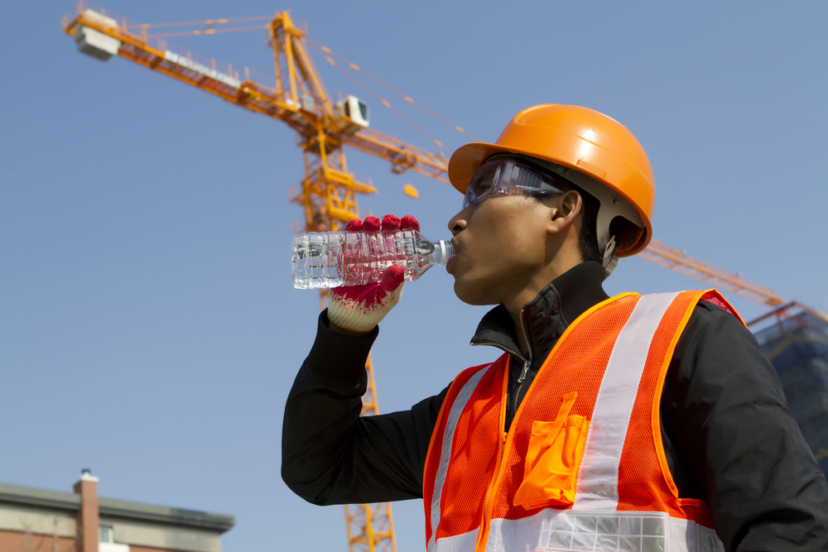
PREVENTION OF HEAT RELATED ILNESS
Stay cool – and keep air circulating around you.
Draw your blinds or curtains and use a fan or air conditioning.
Keep yourself cool by using wet towels, putting your feet in cool water and taking cool (not cold) showers.
Keep up your energy levels – eat smaller meals more often and cold meals such as salads.

Slide 20
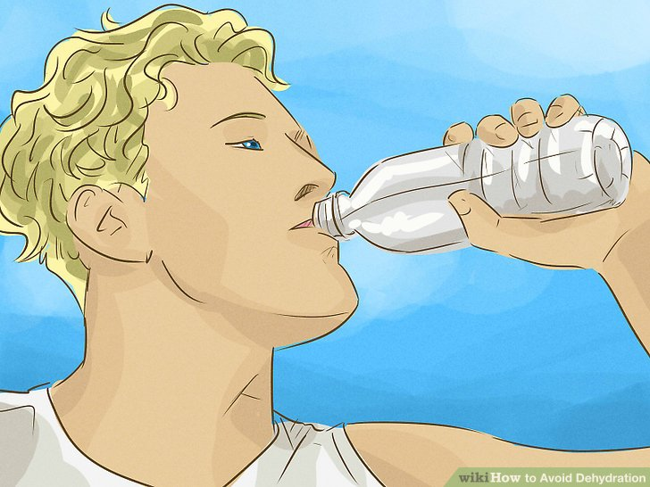
PREVENT DEHYDRATION
Working in a hot environment causes sweating which helps keep people cool but means losing vital water that must be replaced.
Provide cool water in the workplace and encourage workers to drink it frequently in small amounts before, during (this is not possible in some situations eg respiratory protective equipment use or asbestos removal) and after working.

Slide 21
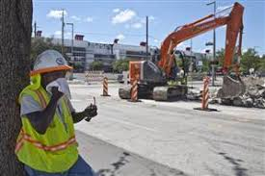
PROVIDE PERSONAL PROTECTIVE EQUIPMENTS
Specialised personal protective clothing is available which incorporates, for example, personal cooling systems or breathable fabrics.
This may help protect workers in certain hot environments.
Protective clothing or respiratory protective equipment is often provided to protect from a hazard at work e.g. asbestos.
This type of equipment, while protecting the employee from this hazard may expose the employee to heat stress.

Slide 22

TRAINING
Provide training for your workers, especially new and young employees telling them about the risks of heat stress associated with their work, what symptoms to look out for, safe working practices and emergency procedures.
HEAT STRESS

Slide 23
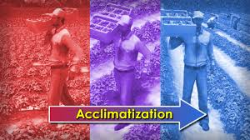
ACCLIMATISATION
Allow workers to acclimatise to their environment and identify which workers are acclimatised/assessed as fit to work in hot conditions.

Slide 24
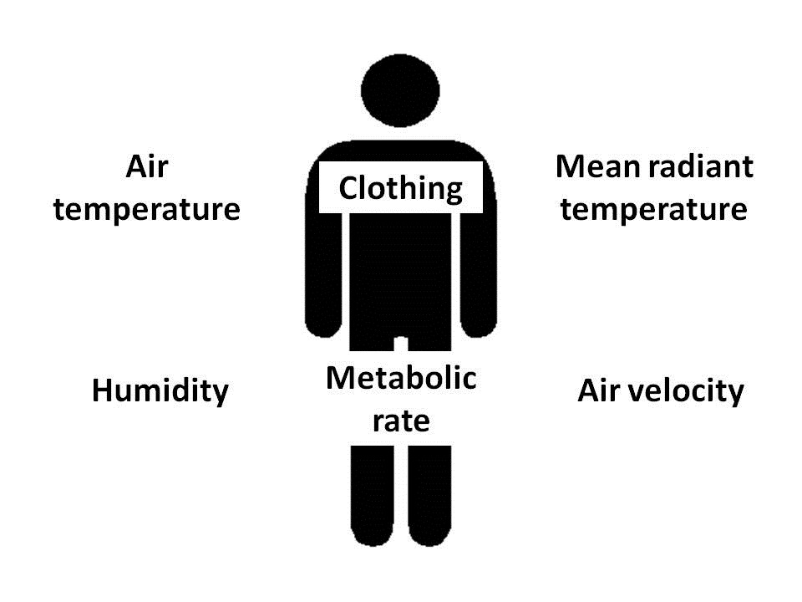
IDENTIFY WHO IS AT RISK
Identify employees who are more susceptible to heat stress either because of an illness/condition or medication that may encourage the early onset of heat stress, eg those with heart conditions.
Advice may be needed from an occupational health professional or medical practitioner.

Slide 25
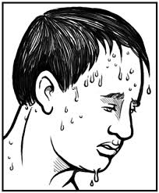
MONITOR HEALTH
Monitor the health of workers at risk.
Where it is considered that a residual risk remains after implementing as many control measures as practicable, you may need to monitor the health of workers exposed to the risk.
Seek advice from occupational health professionals with a good working knowledge of the risks associated with working in heat stress situations.

Slide 26
Our Clients

