Slide 1
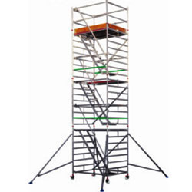
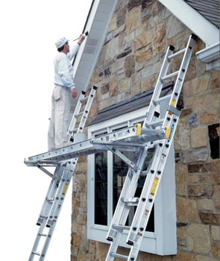
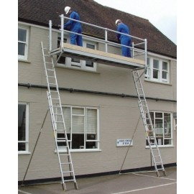
LADDER AND SCAFFOLDING SAFETY TRAINING

Slide 2
ABOUT PMG
“BUILDING FOOD FACTORIES WITH TOP QUALITY STANDARDS OF NESTLE, MONDELEZ,ABBOTT, DANONE USING 3D DESIGN AND HYGIENIC ENGINEERING.”
At PMG, we deliver Engineering Design and Project Management scopes in Food and Beverage industry. Our team of design engineers and engineering executives has rich experience in Project Planning, Design, Execution and Commissioning with key competencies in areas like 3D Plant Design, Hygienic Engineering, and Project Management. Our safe-by-choice, result-oriented, and pro-active work-ethics allow us deliver work scopes meeting objectives, complete stakeholder alignment and first-time quality.
PMG Knowledge Repository: Targeted Knowledge Sharing & Skill Development
Precise and focused training modules for the exhaustive set of people working in manufacturing industry, instilling qualities of self-belief, creative thinking & widened perspective.
Clear Learning Objectives
Focused approach to skill development and knowledge sharing
Progressive Evaluation
Gauging improvement on every step and keeping audience connected.
After-training follow-ups
We systematically track differential progress of recipients after the training.
Audience Specific Approach
Programs are fine-tuned to the ability and interests of the recipients.
Multiple Awe-moments
Awe-moments are refreshing and increase receptivity many-fold.
Seasoned Trainers
PMG trainers are subject matter experts with substantial work experience.

Slide 3

AGENDA
1
Introduction
2
Duties under the law
3
Type of scaffolds
4
Scaffolding materials
5
Inspection and maintenance
6
Erecting, dismantling and modifying a scaffold
7
Dismantling a scaffold safely
8
Altering a scaffold
9
Common hazards and risk controls
Notes:
3

Slide 4
AGENDA
10
Electric lines
11
Entry and exit
12
Falls
13
Falling objects
14
Ladders
15
Ground conditions
16
Loading
17
Supporting structures
18
Unauthorised access
Notes:
4

Slide 5
INTRODUCTION
A scaffold is a temporary structure erected to support access or working platforms.
  Scaffolds are commonly used in construction work so workers have a safe, stable work platform when work cannot be done at ground level or on a finished floor.
Scaffolding means the individual components, for example tubes, couplers or frames and materials that when assembled form a scaffold.
  Scaffolding is classified as plant under Work Health and Safety Act.
Scaffolding work is erecting, altering or dismantling a temporary structure erected to support a platform and from which a person or object could fall more than 4 metres from the platform or the structure.
  Scaffolding work must be undertaken by a person holding the appropriate class of high risk work licence.
  This definition applies whenever the term ‘scaffolding work’ is used.

Slide 6
DUTIES UNDER THE LAW
Everyone in the workplace has work health and safety duties.
A range of people have specific responsibilities for scaffolds and scaffolding including
Designers, scaffolding contractors and workers who carry out scaffolding work.
  A person conducting a business or undertaking has the primary duty to ensure, so far as is reasonably practicable, workers and other people are not exposed to health and safety risks arising from the business or undertaking.
  This duty requires the person to manage risks by eliminating health and safety risks so far as is reasonably practicable, and if it is not reasonably practicable to eliminate the risks, by minimising those risks so far as is reasonably practicable.
  It also includes ensuring so far as is reasonably practicable the:
    Safe erection, alteration, dismantling and use of scaffolds, and Safe use, handling, storage and transport of scaffolding.
    The WHS Regulations include specific duties for a person conducting a business or undertaking with management or control of scaffolding plant, powered mobile plant and plant that lifts or suspends loads.

Slide 7
DUTIES UNDER THE LAW
Designers, manufacturers, importers and suppliers of scaffolding or scaffolds must ensure, so far as is reasonably practicable, the plant or structure they design, manufacture, import or supply is without risks to health and safety.
This duty includes carrying out analysis, testing or an examination and providing specific information about the plant. Information must, so far as is reasonably practicable, be passed on from the designer through to the manufacturer and supplier to the end user.
People installing, constructing or commissioning scaffolding or scaffolds must ensure, so far as is reasonably practicable, all workplace activity relating to the plant or structure including its decommissioning or dismantling is without risks to health or safety.
In this Guide the scaffolding contractor is the person responsible for installing, constructing and commissioning scaffolds
Officers, such as company directors, have a duty to exercise due diligence to ensure the business or undertaking complies with the WHS Act and Regulations.
Workers and other people at the workplace must take reasonable care for their own health and safety, co-operate with reasonable policies, procedures and instructions and not adversely affect other people’s health and safety.

Slide 8
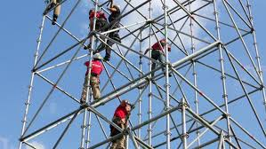
TYPE OF SCAFFOLDS
Following are types of Scaffolding in construction:
  Single scaffolding
  Double scaffolding
  Cantilever scaffolding
  Suspended scaffolding
  Trestle scaffolding
  Steel scaffolding
  Patented scaffolding
  Air Lift Scaffolding

Slide 9
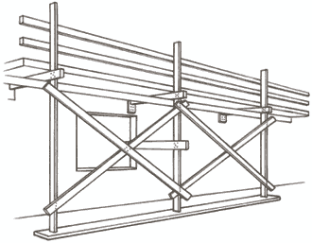
TYPE OF SCALFFOLDS
Single Scaffolding
Single scaffolding is generally used for brick masonry and is also called as brick layer’s scaffolding. Single scaffolding consists of standards, ledgers, putlogs etc., which is parallel to the wall at a distance of about 1.2 m.
Distance between the standards is about 2 to 2.5 m.
Ledgers connect the standards at vertical interval of 1.2 to 1.5 m.
Putlogs are taken out from the hole left in the wall to one end of the ledgers.
Putlogs are placed at an interval of 1.2 to 1.5 m.

Slide 10
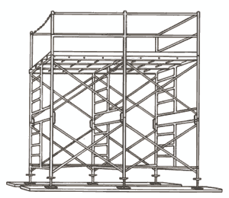
TYPE OF SCALFFOLDS
Double Scaffolding
Double Scaffolding is generally used for stone masonry so, it is also called as mason’s scaffolding.
In stone walls, it is hard to make holes in the wall to support putlogs.
So, two rows of scaffolding is constructed to make it strong.
The first row is 20 – 30 cm away from the wall and the other one is 1m away from the first row.
Then putlogs are placed which are supported by the both frames.
To make it more strong rakes and cross braces are provided.
This is also called as independent scaffolding.

Slide 11
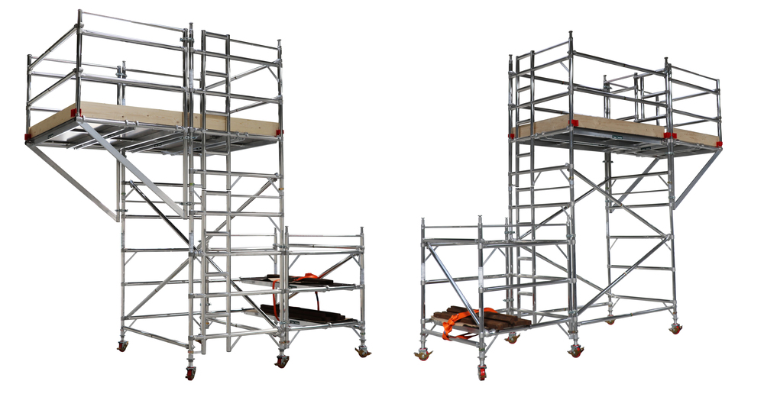
TYPE OF SCALFFOLDS
Cantilever Scaffolding
This type of scaffolding in which the standards are supported on series of needles and these needles are taken out through holes in the wall.
This is called single frame type scaffolding. In the other type needles are strutted inside the floors through the openings and this is called independent or double frame type scaffolding. Care should be taken while construction of cantilever scaffolding.
Generally cantilever scaffoldings are used under conditions such as
  When the ground does not having the capacity to support standards.
  When the Ground near the wall is to be free from traffic.
  When upper part of the wall is under construction.

Slide 12
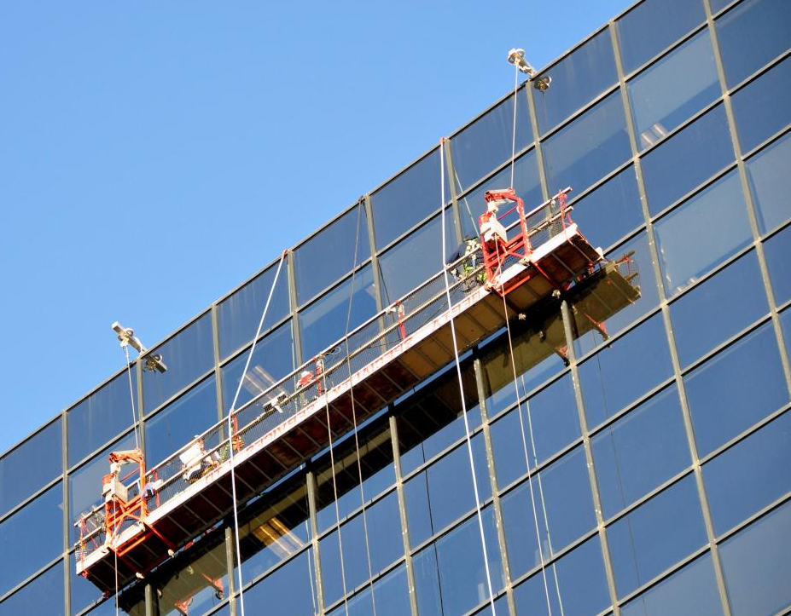
TYPE OF SCALFFOLDS
Suspended Scaffold
In suspended scaffolding, the working platform is suspended from roofs with the help of wire ropes or chains etc.
it can be raised or lowered to our required level.
This type of scaffolding is used for repair works, pointing, paintings etc.

Slide 13
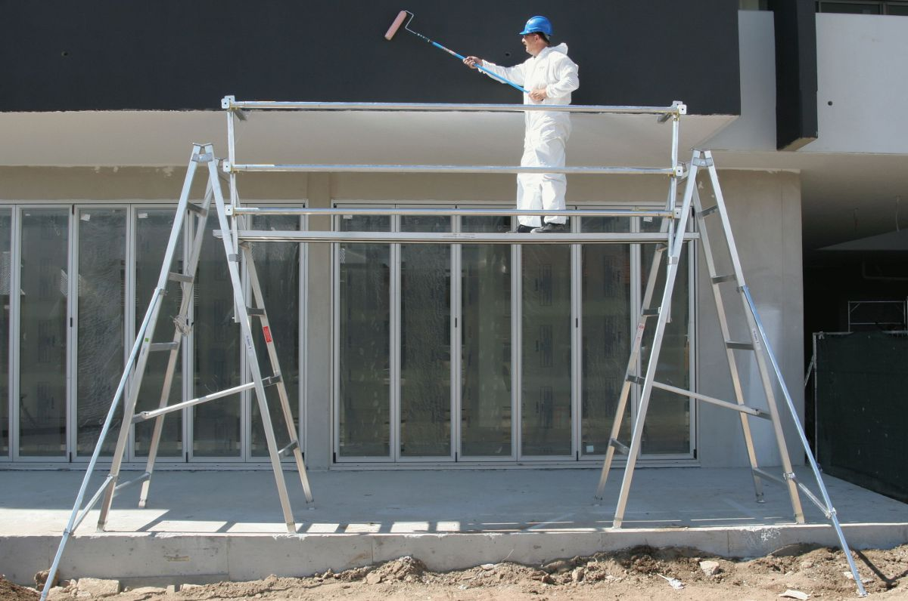
TYPE OF SCALFFOLDS
Trestle Scaffold
In Trestle scaffolding, the working platform is supported on movable tripods or ladders.
This is generally used for work inside the room, such as paintings, repairs etc., up to a height of 5m.

Slide 14
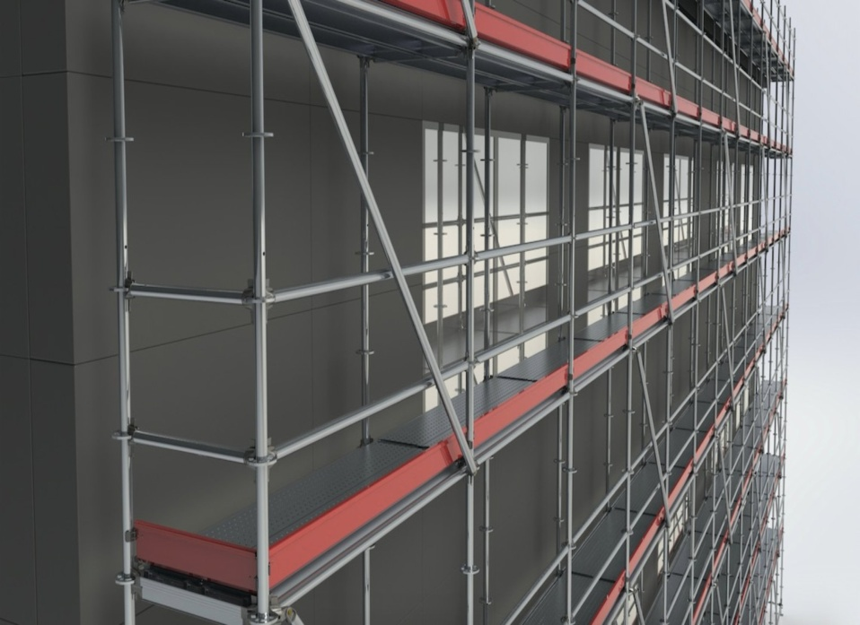
TYPE OF SCALFFOLDS
Steel Scaffolding
Steel scaffolding is constructed by steel tubes which are fixed together by steel couplers or fittings.
It is very easy to construct or dismantle.
It has greater strength, greater durability and higher fire resistance.
It is not economical but will give more safety for workers. So, it is used extensively nowadays.

Slide 15
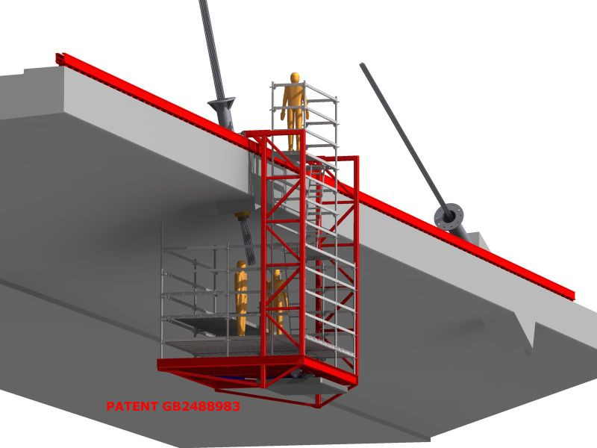
TYPE OF SCALFFOLDS
Patented Scaffolding
Patented scaffoldings are made up of steel but these are equipped with special couplings and frames etc.,
These are readymade scaffoldings which are available in the market.
In this type of scaffolding working platform is arranged on brackets which can be adjustable to our required level

Slide 16
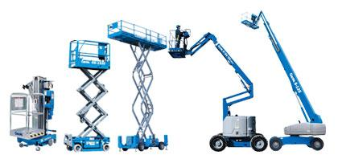
TYPE OF SCALFFOLDS
Aerial Lift
They are also known as aerial platforms.
The most common are vehicle-mounted aerial platforms (scissor type), and vehicle-mounted aerial lifts with telescopic and rotating boom.
They allow workers to access multiple levels in order to do their job.

Slide 17
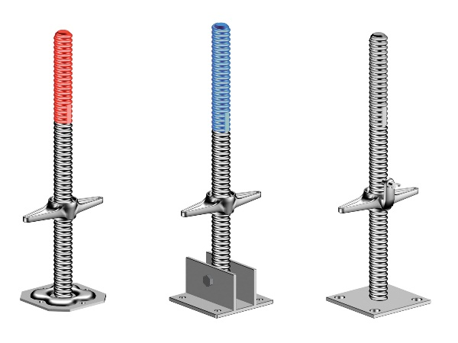
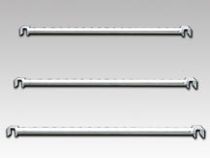
TYPE OF SCALFFOLDS
Aerial Lift
  Base Plate/ Jacks- to safe carry and spread the load.
    A metal plate with a spigot for distributing the load from a standard or raker or other load –Bearing tube.
    An adjustable base plate is a metal base plate embodying a screw jack
  Transom- to produce a rigid unit that speeds scaffold erection significantly resulting in large saving on labour coast.
    A lube or beam spanning across ledgers to form the support for board forming the working platform or to connect the outer standards to the inner standards

Slide 18
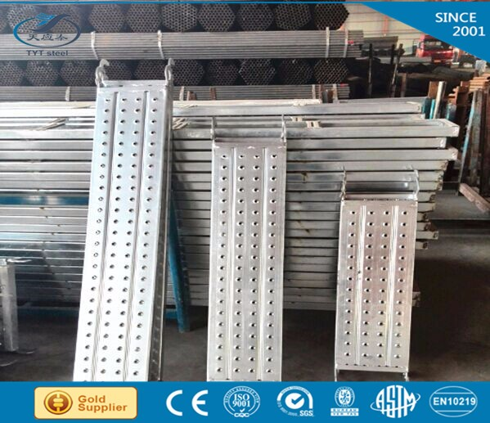
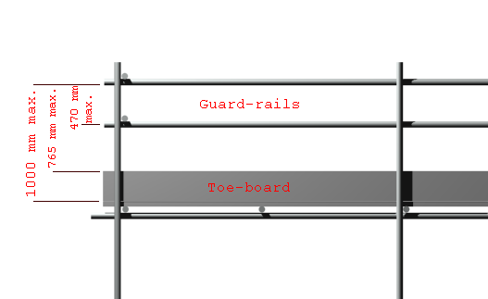
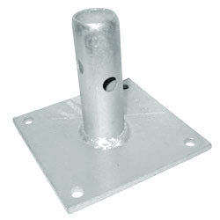
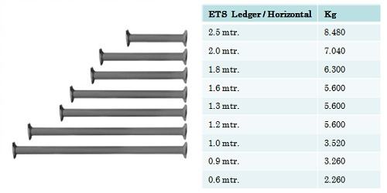
  SCAFFOLD MATERIAL
  Boards/ Planks – to Carry and / or use as a working platform.
Sole Plates – A timber, concrete or metal bearer used to distribute the load from a standard or base plate to the ground.
Ledger- The assembly of ledger and putlogs forming each horizontal level of a scaffold. The lift height is the vertical distance between two lifts, measured centre to centre
Guardrails- A rail or barrier secured to standards or upright members, and erected along the exposed side ands of working platform to prevent persons from falling. A lower rail which is fixed to standard midway the guard rail and platform is termed a mid rail.

Slide 19
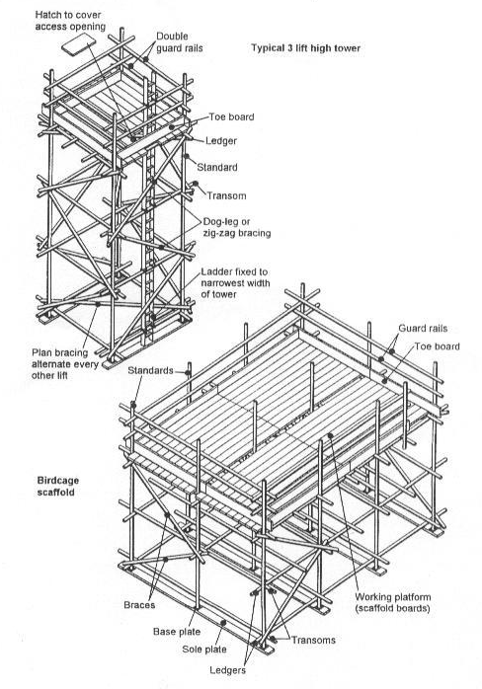
  SCAFFOLD MATERIAL
Braces- A member placed diagonally with respect to the vertical or horizontal member of scaffold and fix to them to afford stability.
Standard- An upright member used for transmitting the weight of the load from the working platform to the base of scaffolding.

Slide 20
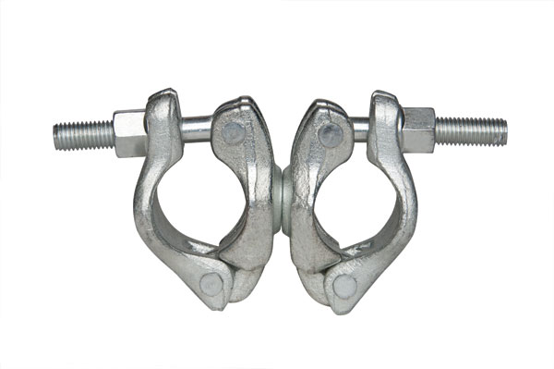
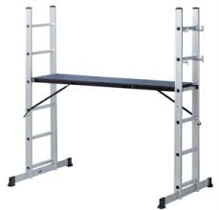
  SCAFFOLD MATERIAL
Couplers - A fitting used to fix scaffold tube together.
  Right- angle coupler: A coupler used to join tubes at right angle.
  Swivel coupler: A coupler for joining tubes at an angle other than
Ladder- a portable appliance consisting of two stiles joined by steps or rungs designed for the purpose of climbing and descending of scaffolding.

Slide 21
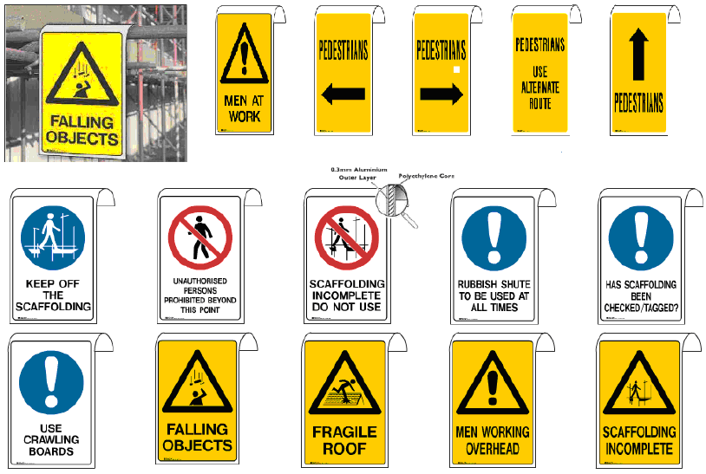
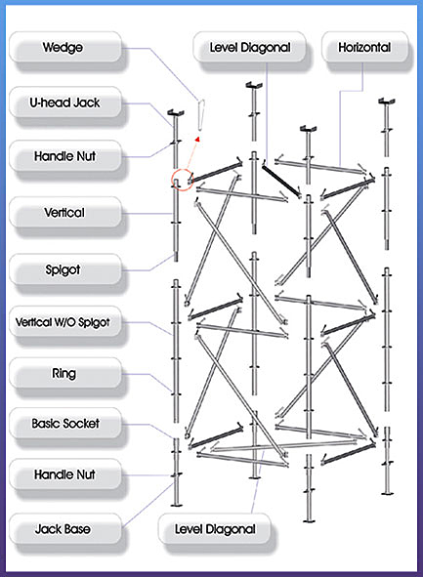
  SCAFFOLD MATERIAL
Signage’s- used when erection alteration and dismantling of scaffolding structure to avoid unauthorized person climbed and / or use the scaffold.
Scaffold system- The scaffold tag system has been developed to ensure the health and safety of all person using the scaffolding erected and dismantling by central scaffolding and rigging services.

Slide 22
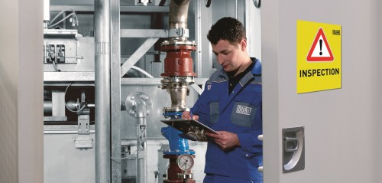
    INSPECTION AND MAINTANANCE
A person with management or control of a scaffold at a workplace has a responsibility to ensure
a scaffold is inspected and maintained so it is safe to use.
This includes inspections at hand-over
and post-handover and after scaffold repairs, modifications or additions.

Slide 23
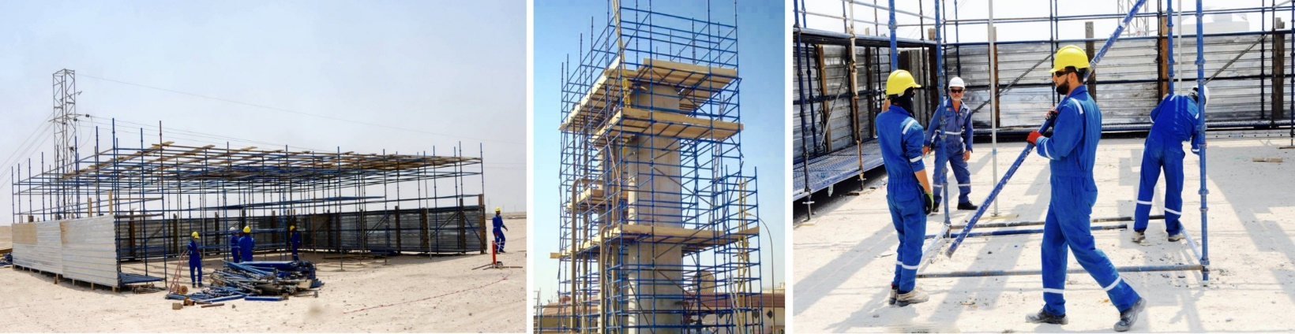
      ERECTING A SCAFFOLD SAFELY
The sequence of work should be planned and followed for each type of scaffold to be constructed.
The sequence of work should include consideration of the following unless you have developed an alternative process that provides an equivalent or higher level of work health and safety

Slide 24
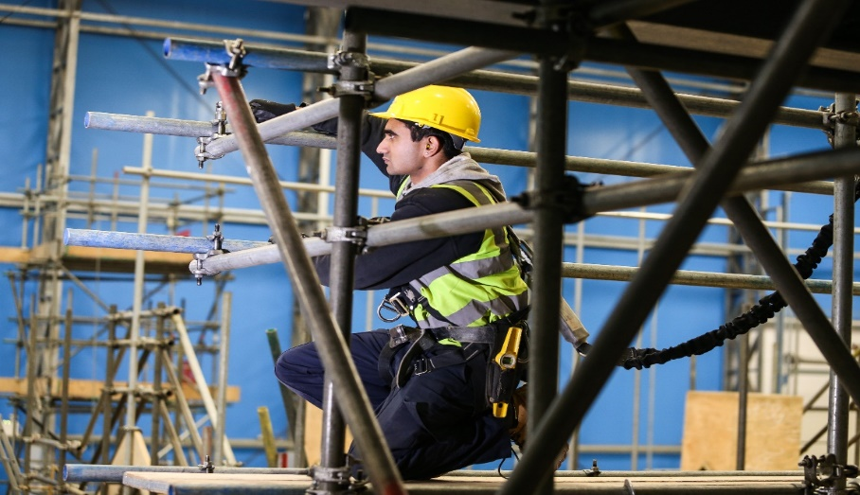
      ERECTING A SCAFFOLD SAFELY
Erecting a scaffold safely will include preparing the foundations for the scaffold, installing sole boards and base plates where required, and erecting the scaffold including for adequate access and work platforms that minimise the risk to those doing the scaffolding work and people who will use the scaffold.

Slide 25
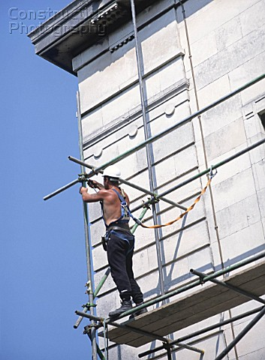
      ERECTING A SCAFFOLD SAFELY
Foundation
  Scaffold foundations should be designed and constructed to carry and distribute the full weight of the scaffold including both dead and live loads.
  Ground conditions, the effects of the weather—particularly wind and rain—and live loads should be considered when designing and preparing the scaffold foundation.

Slide 26
      ERECTING A SCAFFOLD SAFELY
Sole Boards and Base
  Plates boards and base plates should evenly distribute the load from the scaffold to the supporting surface to provide scaffold stability.
  A sole board distributes the load from a load-bearing member to a supporting surface and is intended for use underneath base plates.
  Both sole boards and base plates may be required for use on less stable surfaces, for example soil, gravel or fill.
  The size of the sole board will vary depending on the supporting surface.

Slide 27
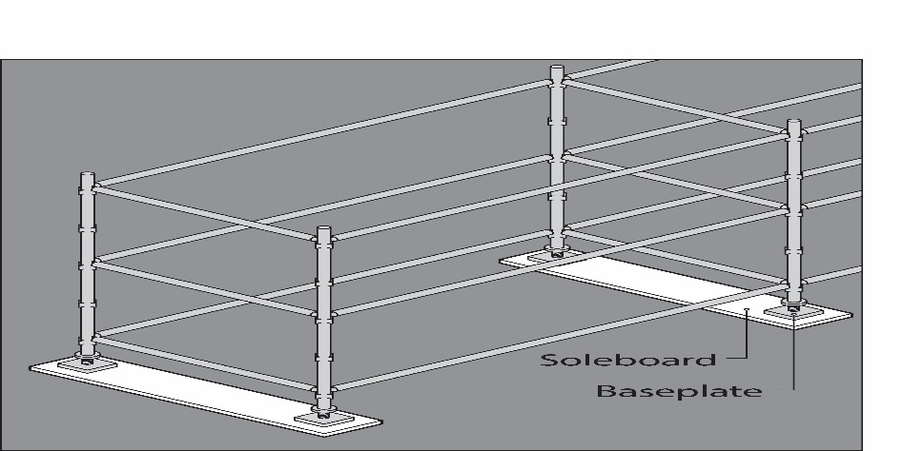
      ERECTING A SCAFFOLD SAFELY
  They can be placed under a single standard or multiple standards Where necessary a competent person should determine the bearing capacity of the ground or other supporting structure.
  Sole boards and base plates should be level. Adjustable bases can be used on uneven surfaces for modular scaffold systems to give a level base lift.
  No part of the base plate or adjustable base should protrude over the side of the sole board to ensure the loads are carried evenly on the sole board.
  Needles and spurs should be considered where ground conditions are very unstable.

Slide 28
      ERECTING A SCAFFOLD SAFELY
Scaffold Erection
The following safe work practices should be used when erecting a scaffold:
  Develop and follow a methodical work sequence—e.g. in a SWMS or scaffolding plan.
  Scaffold fittings and other connections should be securely tightened where required. Fittings should be in accordance with the manufacturer’s or designer’s specifications and the scaffolding plan.
  Scaffolding including all bracing and ties, guy ropes or buttresses should be installed as the scaffold
  is erected.

Slide 29
      ERECTING A SCAFFOLD SAFELY
  Consider using specifically designed loading platforms or back propping to prevent overloading the building floor or the scaffold.
  Get certification from a competent person before erecting scaffold on awnings.
  Check live loads arising from the work of erecting or dismantling the scaffold are within the specification for the final design—the number of workers on the scaffold at any one time may need to be limited.
  Work from a full deck of planks whenever possible.
  Do not overload scaffold bays with scaffolding awaiting installation.
  Do not climb on guardrails to gain extra height.

Slide 30
      ERECTING A SCAFFOLD SAFELY
Scaffold Erection
  Do not climb on outside of scaffold.
  Implement measures to control the risk of a fall if the internal gap—the gap between the inner edge of the length of the platform and the face of the building or structure immediately beside the platform—on scaffolds including hanging bracket scaffolds is greater than 225 mm. For example, install:
    edge protection, and
    extra scaffold planks to minimise the size of the internal gap.

Slide 31
      ERECTING A SCAFFOLD SAFELY
After enough components of the scaffold have been erected to support it, immediately install:
  A platform at least 450 mm wide along the full length of the section of scaffold
  Edge protection across the space between the standards forming the outer frame of the scaffold at the level the scaffold has reached.
  A way to access the scaffold e.g. temporary stairs or a ladder to the level the scaffold has reached.
  Before the next level of the scaffold is erected, a platform should be installed not more than two metres below the position of the next level.
  When erecting scaffolding:
  A section of the platform may be left open to allow the passing of planks or other scaffolding between levels.

Slide 32
      DISMANTLING A SCAFFOLD SAFELY
The following safe work practices should be used when dismantling a scaffold:
  Edge protection and a way to enter the scaffold can be removed as the scaffold is dismantled, provided it is removed at the last possible stage.
  Where possible a platform of at least 450 mm wide at the level the dismantling has reached should be in place.
  Ensure when dismantling the scaffold the platform immediately below the level the worker is standing on has a full set of planks across its width and is no lower than 2 metres.
  A section of the scaffold may be left open to allow the lowering of planks or other scaffolding
  between levels.
  Scaffolding should never be dropped in an uncontrolled way when dismantling the scaffold.

Slide 33
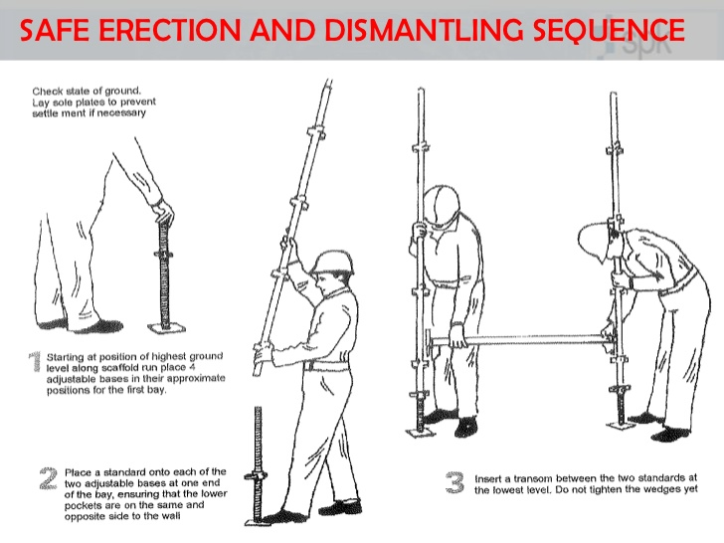
      DISMANTLING A SCAFFOLD SAFELY

Slide 34
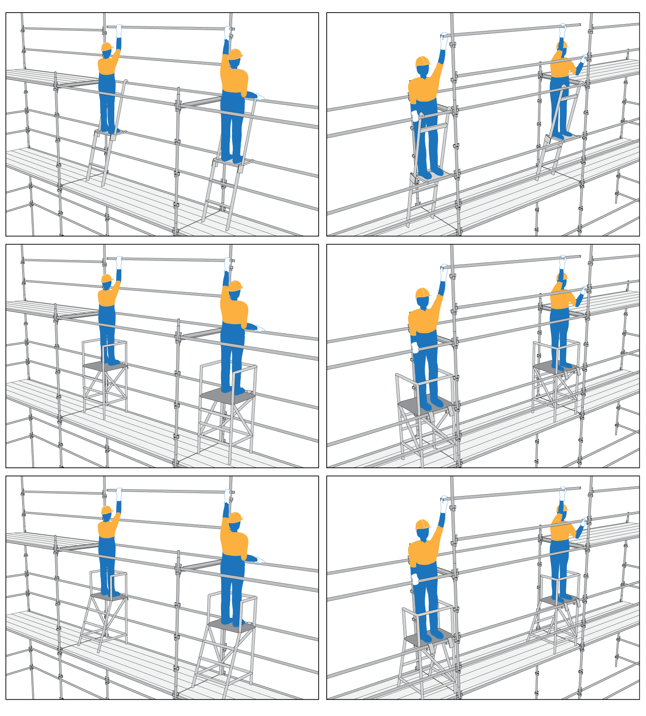
ALTERING A SCAFFOLDING
The following should be considered to control risks associated with scaffolds and scaffolding work.
More specific requirements apply to suspended, cantilevered, spur or hung scaffolds and a scaffold from which a person or thing could fall more than 4 metres

Slide 35
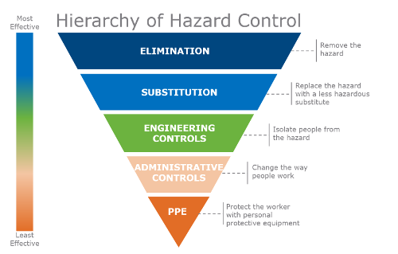
COMMON HAZARDS AND RISK CONTROLS
When altering a scaffold you should:
  Consult the scaffold designer before making alterations
  Ensure scaffold alterations are in accordance with the scaffolding plan
  Ensure alterations do not compromise the structural integrity of the scaffold,
  Ensure systems are in place to identify unauthorised interference with the scaffold e.g. regular inspections.

Slide 36
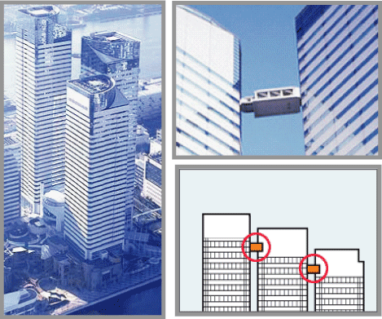
COMMON HAZARDS AND RISK CONTROLS
Adjacent building or structures
No part of the scaffolding work should adversely affect the structural integrity of other buildings.
Ensure risks are controlled to prevent injury to people or damage to adjacent buildings or structures from the:
  Collapse of the scaffold onto an adjacent building or structure
  Collapse of an adjacent building or structure, or a part of a building or structure due to scaffolding work or related activities

Slide 37
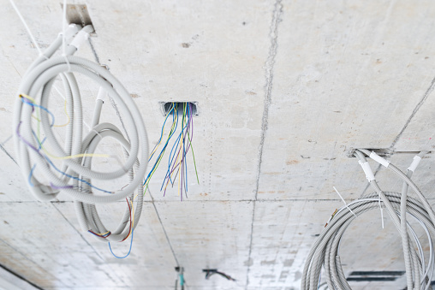
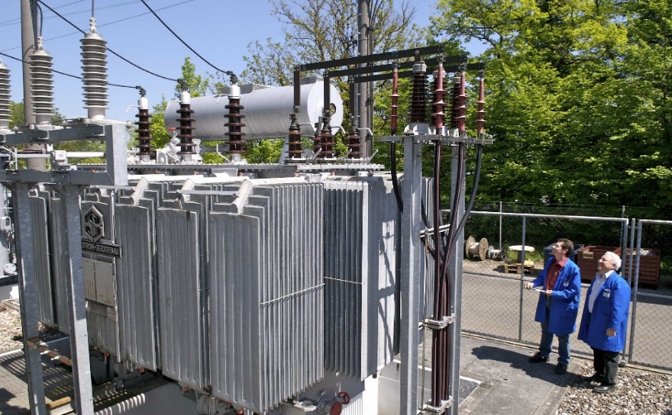
ELECTRIC LINES
Electric lines whether overhead or underground can be a significant hazard.
Construction work carried out on or near energised electrical installations or services is high risk construction work and a SWMS must be prepared before this work starts

Slide 38
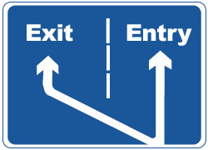
ENTRY AND EXIT
Safe entry and exit is required for workers when erecting, using and dismantling a scaffold.
Common means of entry and exit include:
  Temporary stairs or ladder access systems installed at the start of erection and progressed with the scaffold
  Permanently installed platforms or ramps e.g. part of an adjacent building
  Personnel hoists—non-mechanical forms of exit e.g. a ladder or stair tower should be provided in case of emergency, and
  The existing floor level of a building if entry from there is safe.

Slide 39
FALLS
A risk to health and safety associated with a fall by a person from one level to another that is reasonably likely to cause injury to the person or any other person must be managed. Hazards that may increase the risk of falls include:
  Poor environmental conditions
  Strong winds that may cause workers to lose balance
  Rain causing slippery work surfaces
  Glare emitted from work surfaces or poor lighting affecting visibility
  Materials, equipment or protruding objects below or in adjoining work areas like:
  Pallets of construction materials
  Vertical reinforcing steel

Slide 40

FALLS
  Rubbish skips
  Exposed starter bars
  Large tools
  Void areas not identified or protected e.g. ladder access voids
  Incomplete scaffolds or loose scaffolding in areas where work is being done or is likely to be done
  Inadequate training, instruction and supervision of scaffold workers.

Slide 41
FALLS
Passive engineering controls like handrails and edge protection can minimise the risk of a fall during work at height. Catch platforms can be used to minimise the distance a person could fall during work at height and also to catch falling objects.
Fall arrest systems should only be used during the following scaffold activities:
  Erecting or dismantling drop or hung scaffolds where the scaffold is constructed from top to bottom—this allows for a clear fall zone in the event of a fall.
  Fixing and removing trolley tracks on suspension rigs.
  Erecting or dismantling cantilevered needles and decking between the needles. Fall arrest systems could also be used when the first lift of scaffold is erected where workers are standing on the deck between the needles.
  Erecting and dismantling the first lift of a cantilevered scaffold including the first platform.
  Attaching and removing spurs projecting from the supporting structure.

Slide 42

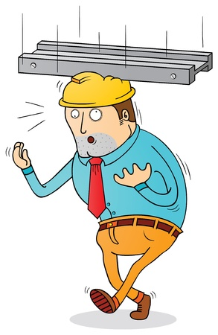
FALLING OBJECTS
Falling object risk control measures include fall arrest platforms, overhead protective structures, perimeter containment screens and exclusion zones to eliminate or minimise the risk of falling objects.

Slide 43
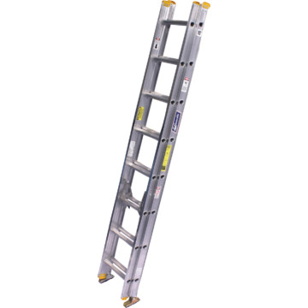
LADDER
Ladders may be used where entry to the working platform is needed by only a few people and where tools and equipment can be delivered separately to the working platform, for example by materials hoist, crane or a rope and gin wheel. Ladders used for entry to or exit from a scaffold should be:
  Fixed industrial single ladders—not extensions ladders.
  Located within a separate ladder access bay of the scaffold wherever space permits.
  Set up on a firm, level surface, be securely fixed and not used on scaffold bays to gain extra height above the scaffold structure.

Slide 44
LADDER
If the access bay is part of the working platform a trap door should be provided.
Ladder entry should be far enough away from the working platform where possible to prevent people falling through openings.
Engineering controls and safe work procedures should be implemented so that the trap door remains closed while working from the platform.
Platforms should also allow correct use of ladders, for example a person passing through the trap door should not need to hold it open.
Gates should be self-closing and not open away from the platform.
Ladders should not be used as a work platform or to gain extra height to carry out work from a scaffold.

Slide 45
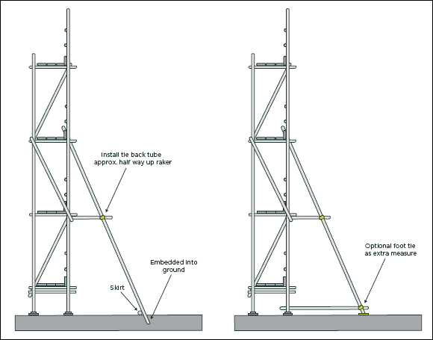
GROUND CONDITION
Ground conditions should be stable and those doing the scaffolding work should be aware of any factors that may affect ground stability before the scaffold is erected or during its use

Slide 46
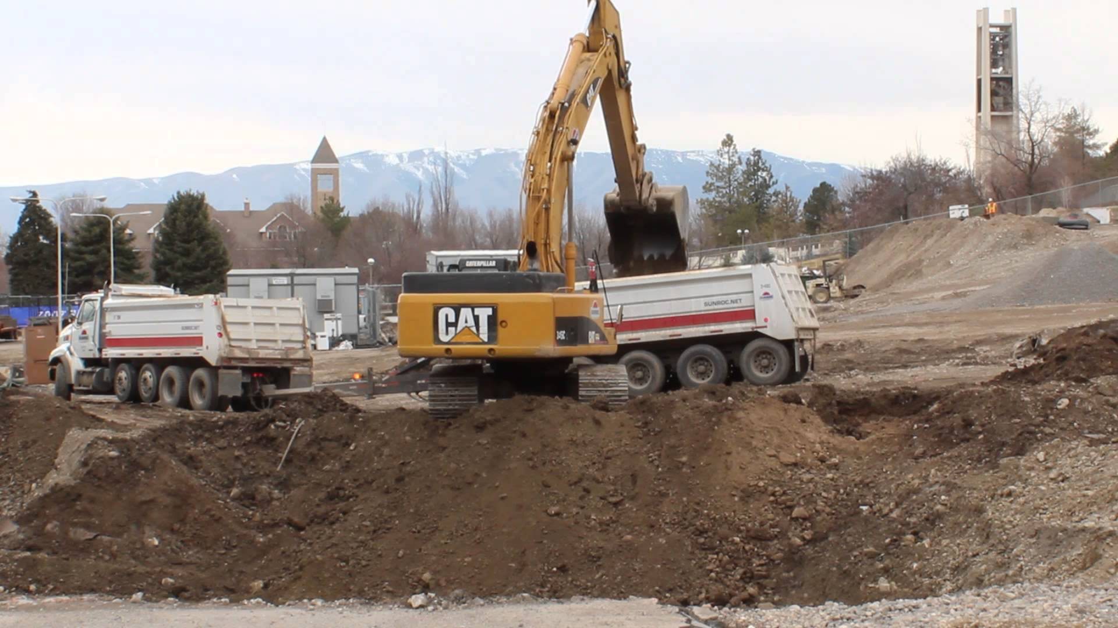
LOADING
A scaffold should be designed for the most adverse combination of dead and live loads that can reasonably be expected during the period the scaffold is in use.
Dead loads relate to the self-weight of the scaffold structure and scaffolding including:
  Working, catch or access platforms
  Stairways, ladders, screens and sheeting
  Platform brackets, suspension ropes, secondary ropes, traversing ropes and tie assemblies, and
  Hoists and electrical cables.
  Live loads include the:
  Weight of people
  Weight of materials and debris
  Weight of tools and equipment
  Environmental loads e.g. wind, rain etc.
  Impact forces.

Slide 47
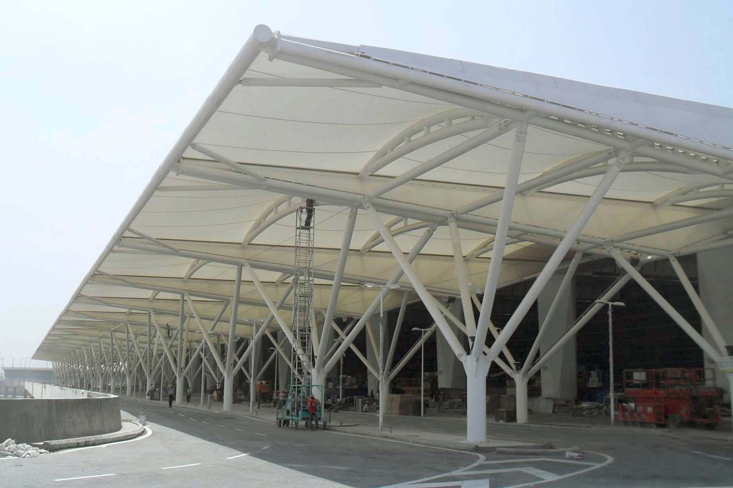
SUPPORTING STRUCTURES
You should consider the capability of a supporting structure such as a building to bear the most adverse combination of loads possible when erecting and using the scaffold.

Slide 48

UNAUTHORIZED ACCESS
You should consider the capability of a supporting structure such as a building to bear the most adverse combination of loads possible when erecting and using the scaffold.

Slide 49
Our Clients

