Slide 1
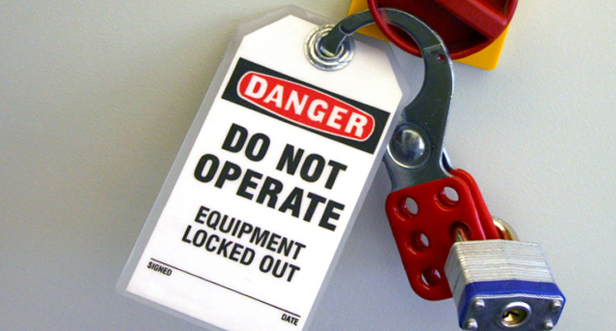
CONSTRUCTION SAFETY
lock out-TAG OUT

Slide 2
ABOUT PMG
“BUILDING FOOD FACTORIES WITH TOP QUALITY STANDARDS OF NESTLE, MONDELEZ,ABBOTT, DANONE USING 3D DESIGN AND HYGIENIC ENGINEERING.”
At PMG, we deliver Engineering Design and Project Management scopes in Food and Beverage industry. Our team of design engineers and engineering executives has rich experience in Project Planning, Design, Execution and Commissioning with key competencies in areas like 3D Plant Design, Hygienic Engineering, and Project Management. Our safe-by-choice, result-oriented, and pro-active work-ethics allow us deliver work scopes meeting objectives, complete stakeholder alignment and first-time quality.
PMG Knowledge Repository: Targeted Knowledge Sharing & Skill Development
Precise and focused training modules for the exhaustive set of people working in manufacturing industry, instilling qualities of self-belief, creative thinking & widened perspective.
Clear Learning Objectives
Focused approach to skill development and knowledge sharing
Progressive Evaluation
Gauging improvement on every step and keeping audience connected.
After-training follow-ups
We systematically track differential progress of recipients after the training.
Audience Specific Approach
Programs are fine-tuned to the ability and interests of the recipients.
Multiple Awe-moments
Awe-moments are refreshing and increase receptivity many-fold.
Seasoned Trainers
PMG trainers are subject matter experts with substantial work experience.

Slide 3
AGENDA
1
Introduction
2
Definition
3
General requirements
4
Application of control
5
Additional requirement
Notes:
3

Slide 4

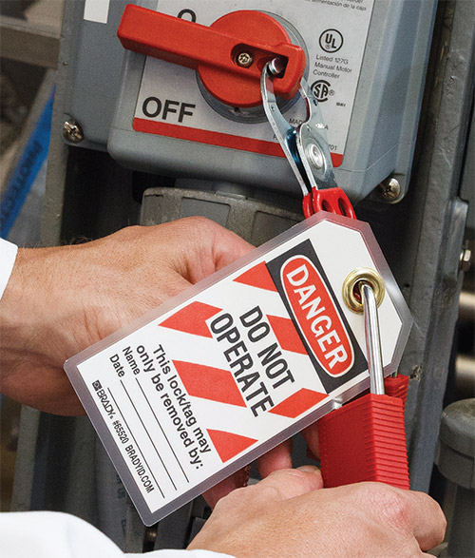
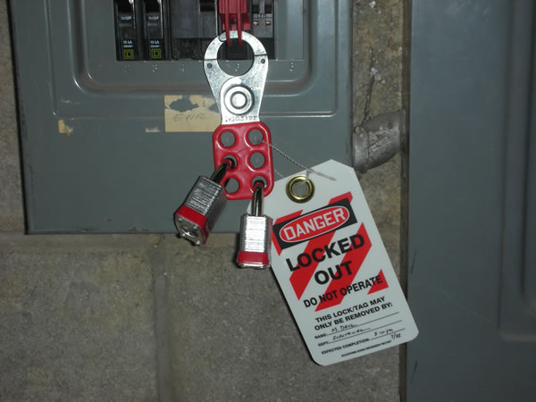
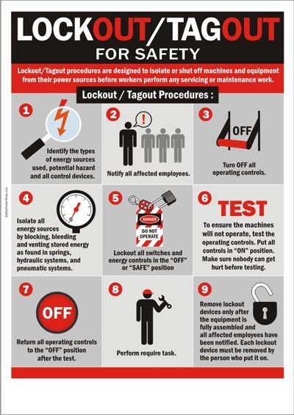
INTRODUCTION
Lock out-tag out (LOTO) or lock and tag
A safety procedure which is used in industry to ensure that dangerous machines are properly shut off and not able to be started up again prior to the completion of maintenance or servicing work.

Slide 5
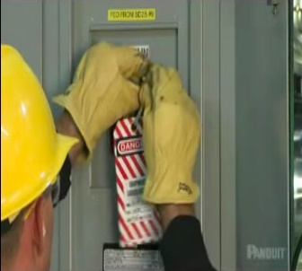

DEFINITION
Affected employee
Authorized employee
Affected employees and all other employees are required to recognize when energy control procedures are being used, understand the purpose of the procedure, and understand the critical importance of not attempting to start up or use equipment that has been locked out or tagged out.
The lockout/tagout standard requires that before the machine or equipment is turned off, the authorized employee must be knowledgeable of the following:
  Recognition of applicable hazardous energy sources.
  Details about the type and magnitude of the hazardous energy sources present in the work area.
  The methods and means necessary to isolate and control hazardous energy sources.

Slide 6

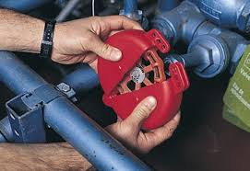
DEFINITION
Capable of being locked out
An energy-isolating device will be considered to be capable of being locked out if either it is designed with a hasp or other attachment or integral part to which, or through which, a lock can be affixed, or if it has a locking mechanism built into it.
Other energy-isolating devices will also be considered to be capable of being locked out if lock out can be achieved without the need to dismantle, rebuild, or replace the energy-isolating device or permanently alter its energy control capability.

Slide 7

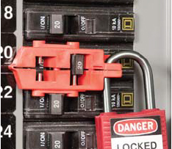
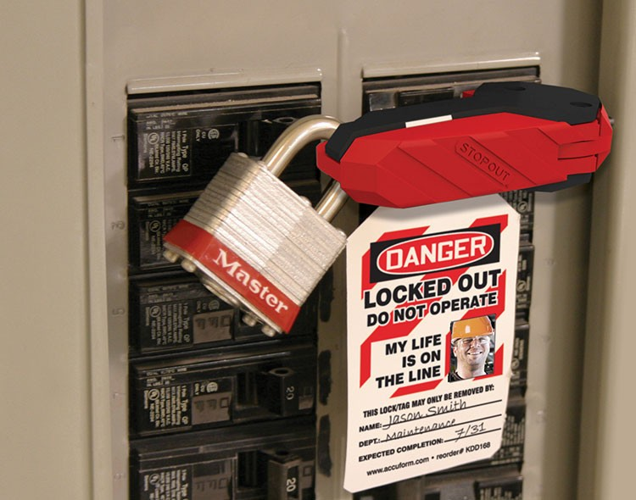
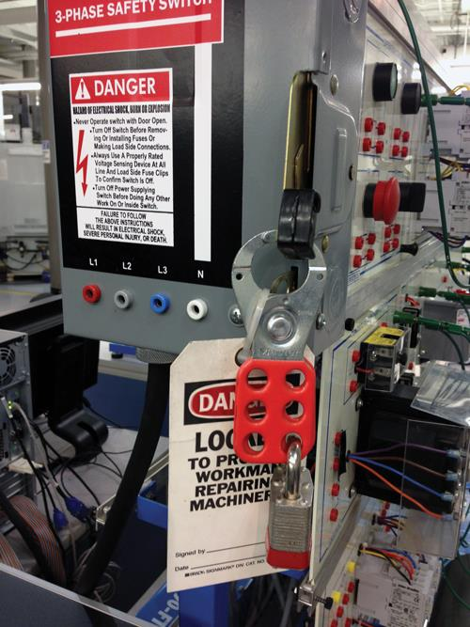
DEFINITION
Energized
Connected to an energy source or containing residual or stored energy.

Slide 8
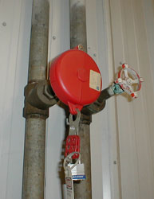

DEFINITION
Energy-isolating device
Energy source
A mechanical device that physically prevents the transmission or release of energy, including, but not limited to, the following: a manually operated electrical circuit breaker; a disconnect switch; a manually operated switch by which the conductors and, in addition, no pole can be operated independently; a slide gate; a slip blind; a line valve; a block; and any similar device used to block or isolate energy. The term does not include a push button, selector switch, and other control circuit-type devices.
Any source of electrical, mechanical, hydraulic, pneumatic, chemical, thermal, or other energy.

Slide 9
DEFINITION
Hot tap
Lock out
A procedure used in the repair, maintenance, and services activities, which involves welding on a piece of equipment (pipelines, vessels, or tanks) under pressure, in order to install connections or appurtenances. It is commonly used to replace or add sections of pipeline without the interruption of service for air, gas, water, steam, and petrochemical distribution systems.
The placement of a lock out device on an energy-isolating device, in accordance with an established procedure, ensuring that the energy-isolating device and the equipment being controlled cannot be operated until the lock out device is removed. lock out device - A device that utilizes a positive means such as a lock, either key or combination type, to hold an energy-isolating device in a safe position and prevent the energizing of a machine or equipment.

Slide 10
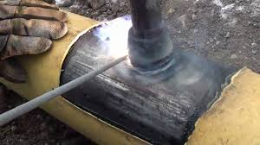
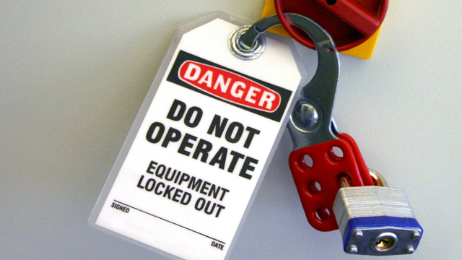
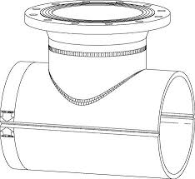
DEFINITION
Hot tap
Lock out

Slide 11
DEFINITION
Normal production operations
Servicing and/or maintenance
The utilization of a machine or equipment to perform its intended production function.
Workplace activities such as constructing, installing, setting up, adjusting, inspecting, modifying, and maintaining and/or servicing machines or equipment.
These activities include lubrication, cleaning or un jamming of machines or equipment and making adjustments or tool changes, where the employee may be exposed to start-up of the equipment or release of hazardous energy.

Slide 12
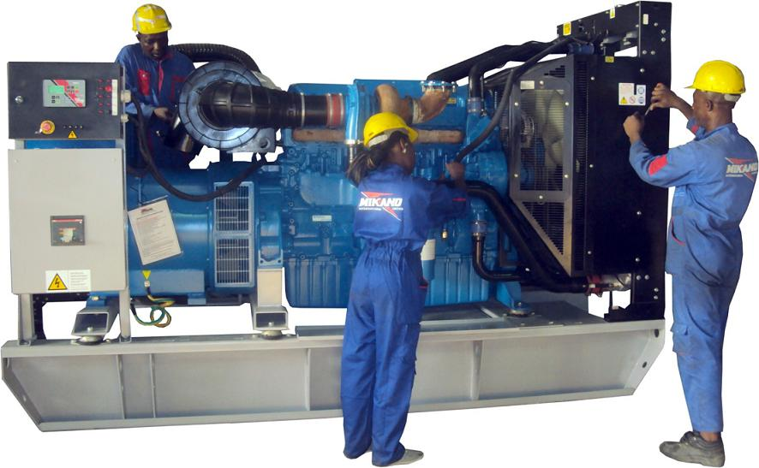
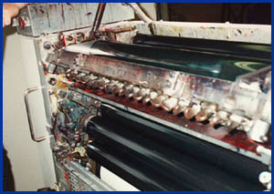
DEFINITION
Normal production operations
Servicing and/or maintenance

Slide 13
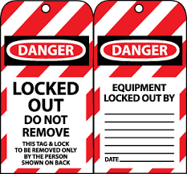

DEFINITION
Setting up
Tag out
Any work performed to prepare a machine or equipment to perform its normal production operation.
The placement of a tag out device on an energy-isolating device, in accordance with an established procedure, to indicate that the energy-isolating device and the equipment being controlled may not be operated until the tag out device is removed.

Slide 14
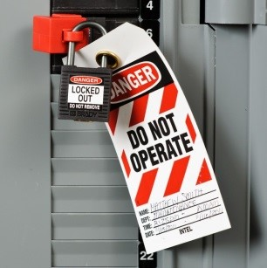
DEFINITION
Tag out device
A prominent warning device, such as tag and a means of attachment, which can be fastened securely to an energy-isolating device, in accordance with an established procedure, to indicate that the energy-isolating device and the equipment being controlled may not be operated until the tag out device is removed.

Slide 15
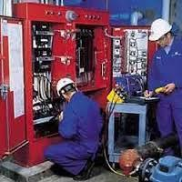

GENERAL REQUIREMENTS
Energy control program
Energy control procedures
Employee training
Periodic inspections
Any employee who services/maintains any equipment where unexpected energizing or stored energy release could cause injury isolates and renders it inoperative first.
If an energy isolating device is capable of being locked out, the employer's energy control program shall utilize lock out, unless the employer can demonstrate that the utilization of a tag out system will provide full employee protection
Energy isolating devices designed to accept lock out devices whenever:
  Replacement or major repair, renovation or modification of equipment is performed
  New machines or equipment are installed

Slide 16
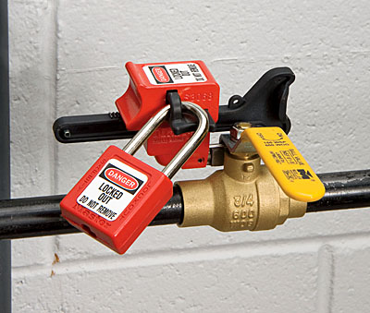
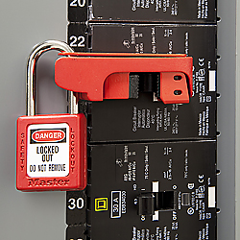
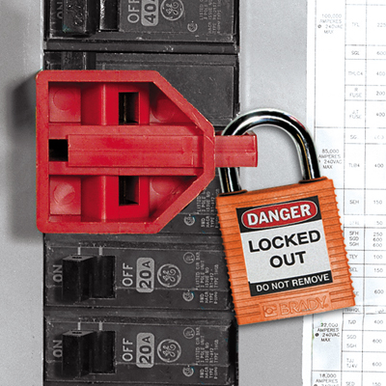
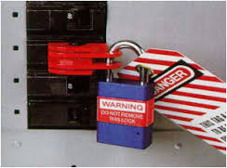
GENERAL REQUIREMENTS
Full employee protection
When tag out device used on energy isolation device capable of being locked out:
  same location as potential lock out device
  demonstrably equivalent program
May require additional safety elements

Slide 17
GENERAL REQUIREMENTS
Energy control procedure
Procedures shall be developed, documented and utilized for the control of potentially hazardous energy when employees are engaged in the activities covered by this section.
Exception with all 8 elements listed in standard
Outline scope, purpose, authorization, rules, techniques for control of hazardous energy, including:
  Specific intended use of the procedure;
  Specific steps for shutting down, isolating, blocking and securing equipment
  Specific steps for placement, removal, transfer of lock out/tag out devices and responsibility for them
  Specific requirements for testing equipment to verify effectiveness of lock out devices, tag out devices, and other energy control measures.

Slide 18
GENERAL REQUIREMENTS
Protective materials and hardware
Locks, tags, chains, wedges, key blocks, adapter pins, self-locking fasteners, or other hardware shall be provided by the employer for isolating, securing or blocking of equipment from energy sources
lock out and tag out devices must be:
  Singularly identified
  The only device(s) used for controlling energy
  Not used for other purposes
  And shall meet the following requirements:
Capable of withstanding environment for maximum time period
Moisture or corrosives must not make tag deteriorate
Standardized
  Color
  Shape
  Size

Slide 19
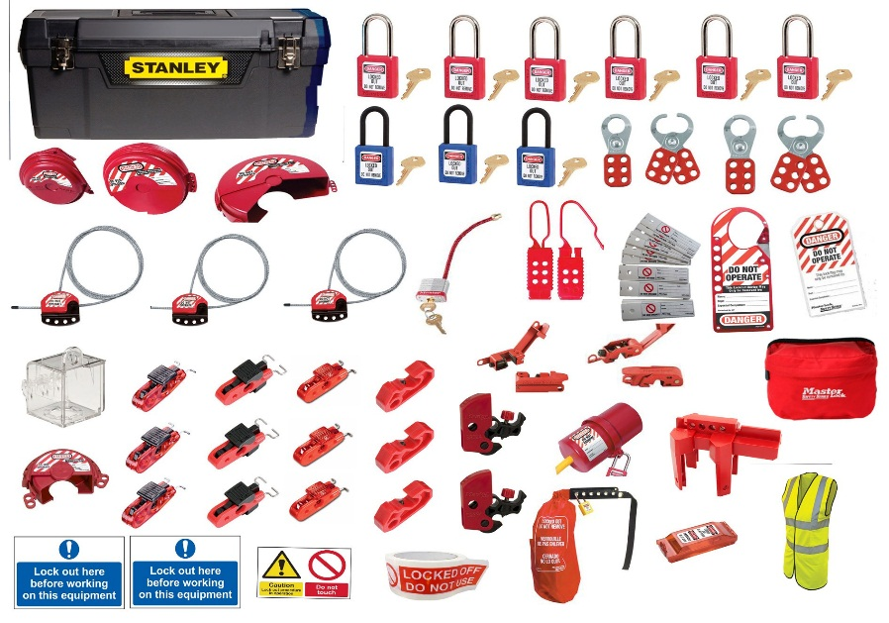
GENERAL REQUIREMENTS
Protective materials and hardware

Slide 20
GENERAL REQUIREMENTS
Protective materials and hardware
Lock out devices:
  Substantial enough to prevent removal without excessive force or unusual techniques such as bolt cutters
Tag out devices:
  Substantial enough to prevent inadvertent or accidental removal
  Non-reusable attachment means
  Attachable by hand, self-lockable
  At least equivalent to nylon cable tie
Lock out and tag out devices indicate identity of employee applying devices

Slide 21
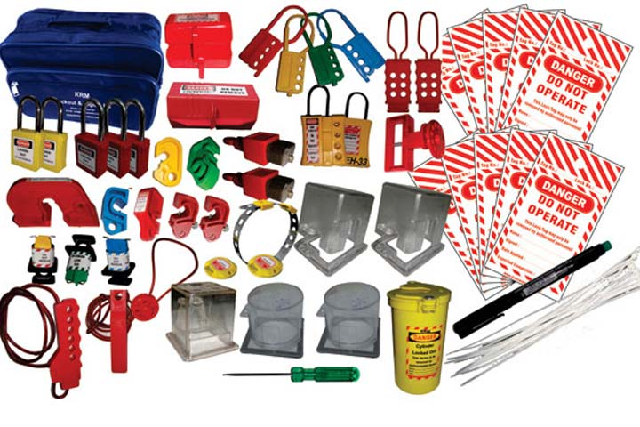
GENERAL REQUIREMENTS
Protective materials and hardware
Energy control procedure inspected at least annually:
  By authorized employee not using the procedure being inspected
  Correct any deviations
Review employee responsibilities with:
  Each authorized employee – lock out
  Each affected or authorized employee – tag out

Slide 22
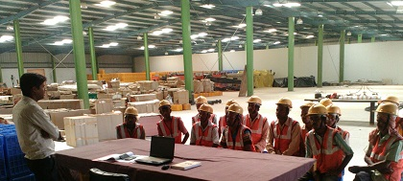
GENERAL REQUIREMENTS
Training and communication
Employee Training Requirements
Ensure employees understand purpose and function of energy control program
Ensure employees acquire skills required for safe application, usage, removal of energy controls
Authorized employee:
  Recognition of hazardous energy sources
  Type and amount of energy in workplace
  Methods and means for energy isolation
Affected employee:
  Purpose and use of procedure
Other employees in area:
  Procedure and prohibition on restarting

Slide 23
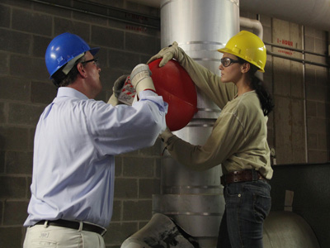
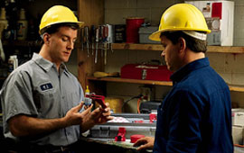
GENERAL REQUIREMENTS
Train on limitations of tags
Warning devices do not provide physical restraint that a lock would
Tag not to be removed without owner’s authorization, bypassed, ignored, defeated
Must be legible / understandable to work
Must withstand environmental conditions
False sense of security
Attach securely: avoid accidental removal

Slide 24
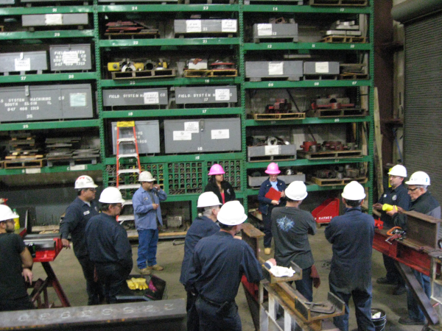
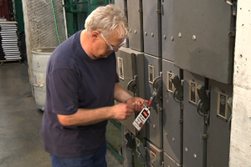
GENERAL REQUIREMENTS
Employee Retraining
Energy Isolation
For all authorized or affected employees when:
  Job assignment changes
  Equipment or processes present new hazard
  Energy control procedure changes
  Knowledge / use of program is inadequate
Certify employee training up to date
Only the authorized employees performing the servicing or maintenance may apply lock out/tag out

Slide 25
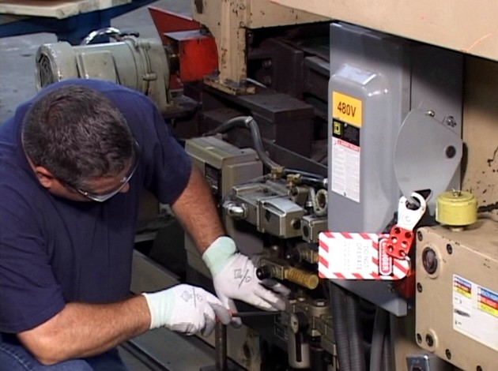
GENERAL REQUIREMENTS
Notification of Employees
Affected employees must be notified
  By employer or authorized employee
  Of application and removal of lock out and tag out devices
  Before controls are applied
  After controls are removed

Slide 26
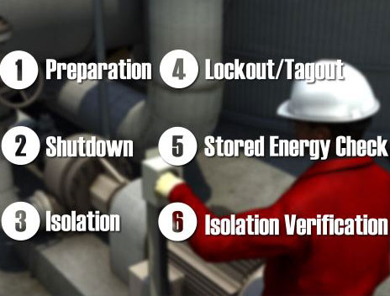
APPLICATION OF CONTROL
Order of Operation for Application of Control
Preparation for shutdown
Equipment shutdown – orderly
Equipment isolation
lock out or tag out device application
Stored energy relieved; continue while re-accumulating
Verification of isolation
Test and return to “off” position

Slide 27
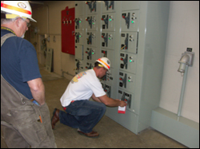
APPLICATION OF CONTROL
Release from lock out/Tag out
Before lock out or tag out devices removed and energy restored, ensure:
Machine or equipment:
  Inspect area; remove nonessential items
  Ensure equipment components intact
Employees:
  Ensure all employees safe or removed
  Before restart, notify affected employees of removal
Each lock out/tag out device removed by employee who applied the device
  If not available, removed under employer direction
  from energy control program must be in use!
Verify that applying employee is not at facility
Make all reasonable efforts to contact/notify
Ensure authorized employee knows of removal before resuming work at facility

Slide 28
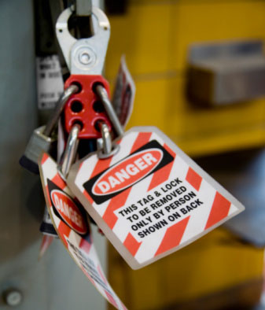
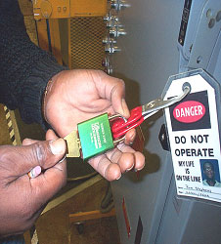
ADDITIONAL REQUIREMENT
      Testing and Positioning
Temporary removal of lock out/tag out devices for testing/positioning:
  Clear tools and materials
  Remove employees from equipment area
  Remove lock out/tag out devices
  Energize and test or position
  De-energize systems and reapply energy control measures to continue servicing

Slide 29
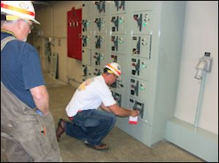
ADDITIONAL REQUIREMENT
      Outside Personnel
Contractors and other outside personnel:
  On-site employer and outside employer inform each other of lock out/tag out procedures
  On-site employer complies with outside employer’s energy control program

Slide 30
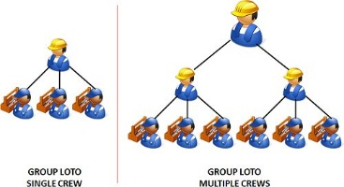
ADDITIONAL REQUIREMENT
Group lock out or Tag out
Procedure must provide protection equivalent to personal lock out/tag out device
Primary responsibility is vested in an authorized employee for a set number of employees working under the protection of a group lock out or tag out device (such as an operations lock);
When more than one crew, craft, department, etc. is involved:
  Designated authorized employee takes lock out/tag out control responsibility
  Coordinates affected work forces
  Ensures continuity of protection
Each authorized employee affixes personal lock out/tag out device to group lock out device when beginning work
Each removes personal device when stopping work on this equipment

Slide 31
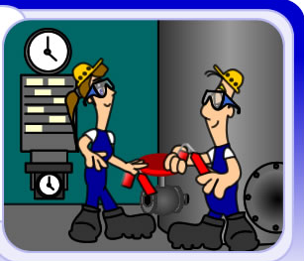
ADDITIONAL REQUIREMENT
Shift or Personnel Changes
Specific procedures in energy control plan
Ensure continuity of lock out/tag out protection
Orderly transfer of lock out/tag out device protection between shifts
Minimize exposure to hazards from unexpected energization or release

Slide 32
Our Clients

