Slide 1
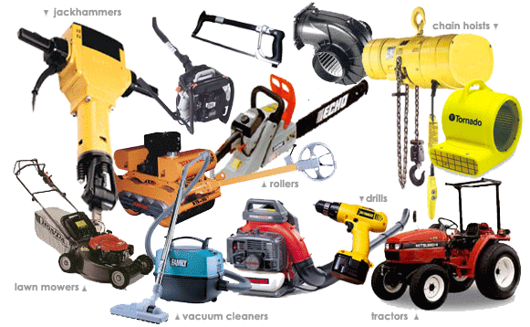
MACHINERY, TOOLS
AND
EQUIPMENT

Slide 2
ABOUT PMG
“BUILDING FOOD FACTORIES WITH TOP QUALITY STANDARDS OF NESTLE, MONDELEZ,ABBOTT, DANONE USING 3D DESIGN AND HYGIENIC ENGINEERING.”
At PMG, we deliver Engineering Design and Project Management scopes in Food and Beverage industry. Our team of design engineers and engineering executives has rich experience in Project Planning, Design, Execution and Commissioning with key competencies in areas like 3D Plant Design, Hygienic Engineering, and Project Management. Our safe-by-choice, result-oriented, and pro-active work-ethics allow us deliver work scopes meeting objectives, complete stakeholder alignment and first-time quality.
PMG Knowledge Repository: Targeted Knowledge Sharing & Skill Development
Precise and focused training modules for the exhaustive set of people working in manufacturing industry, instilling qualities of self-belief, creative thinking & widened perspective.
Clear Learning Objectives
Focused approach to skill development and knowledge sharing
Progressive Evaluation
Gauging improvement on every step and keeping audience connected.
After-training follow-ups
We systematically track differential progress of recipients after the training.
Audience Specific Approach
Programs are fine-tuned to the ability and interests of the recipients.
Multiple Awe-moments
Awe-moments are refreshing and increase receptivity many-fold.
Seasoned Trainers
PMG trainers are subject matter experts with substantial work experience.

Slide 3
AGENDA
1
Introduction
2
Hazards of hand tools
3
Dangers of power tools
4
Guards
5
Operating controls and switches
6
Electric tools
7
Portable abrasive wheel tools
8
Pneumatic tools
9
Liquid fuel tools
10
Powder-actuated tools
11
Hydraulic power tools
Notes:
3

Slide 4
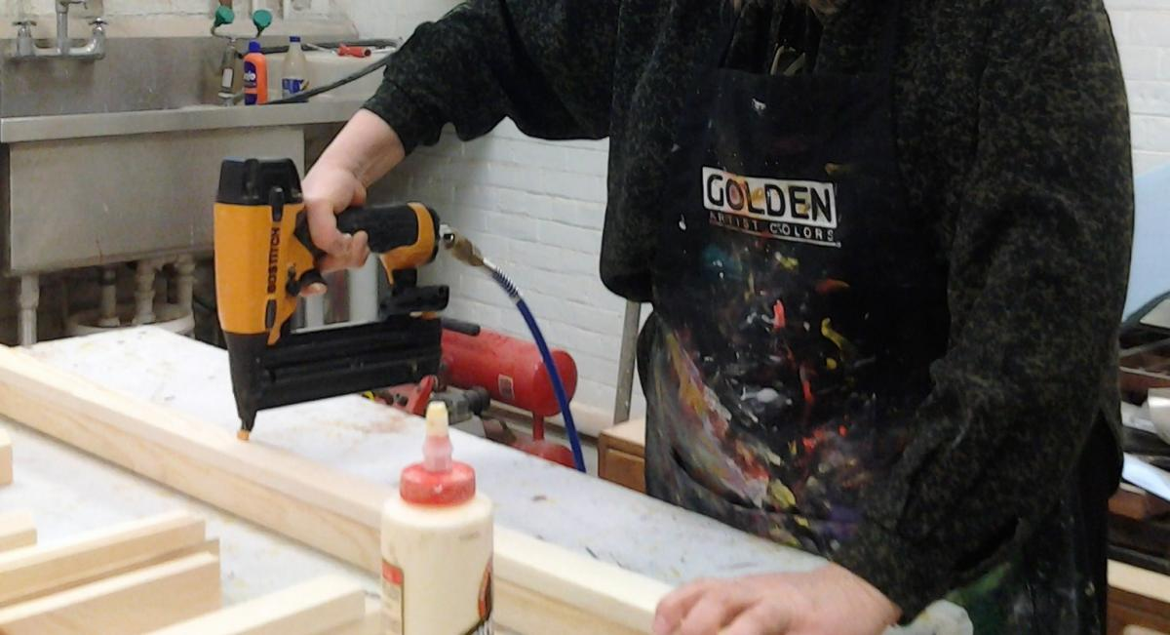
INTRODUCTION
Employees work with machines, tools and equipment every day. Workplaces couldn't operate without them; however, interacting with them has potential for serious injuries or fatalities if they are not used and maintained properly.

Slide 5

HAZARDS OF HAND TOOLS
Hand tools are tools that are powered manually.
Hand tools include anything from axes to wrenches.
The greatest hazards posed by hand tools result from misuse and improper maintenance.

Slide 6
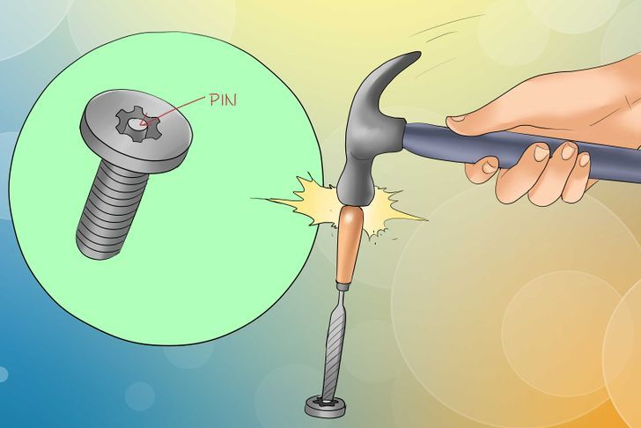

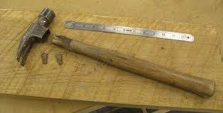
HAZARDS OF HAND TOOLS
If a chisel is used as a screwdriver, the tip of the chisel may break and fly off, hitting the user or other employees.
If a wooden handle on a tool, such as a hammer or an axe, is loose, splintered, or cracked, the head of the tool may fly off and strike the user or other employees.

Slide 7
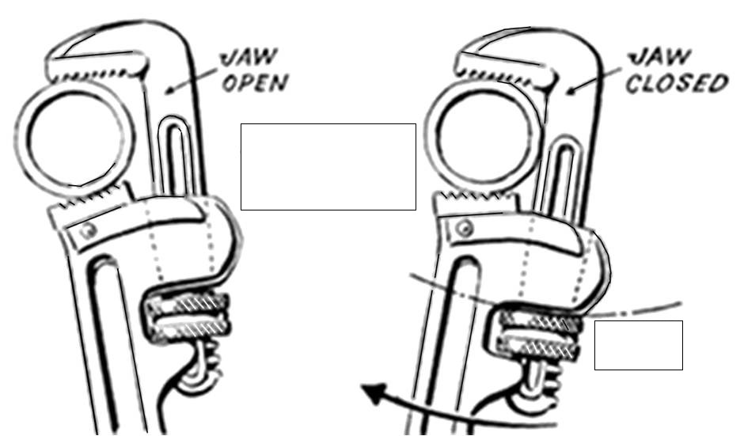
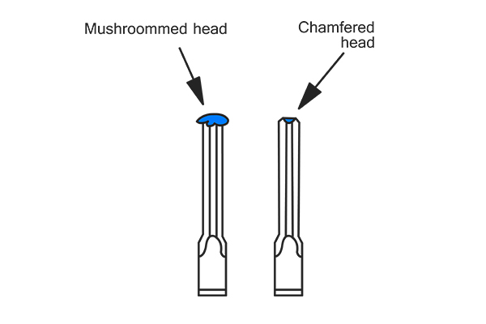
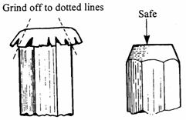
HAZARDS OF HAND TOOLS
If the jaws of a wrench are sprung, the wrench might slip.
If impact tools such as chisels, wedges, or drift pins have mushroomed heads, the heads might shatter on impact, sending sharp fragments flying toward the user or other employees

Slide 8

HAZARDS OF HAND TOOLS
Employees should be trained in the proper use and handling of tools and equipment.
Employees, when using saw blades, knives, or other tools, should direct the tools away from aisle areas and away from other employees working in close proximity.
Knives and scissors must be sharp; dull tools can cause more hazards than sharp ones.
Cracked saw blades must be removed from service wrenches must not be used when jaws are sprung to the point that slippage occurs.

Slide 9

HAZARDS OF HAND TOOLS
Impact tools such as drift pins, wedges, and chisels must be kept free of mushroomed heads.
The wooden handles of tools must not be splintered.
Iron or steel hand tools may produce sparks that can be an ignition source around flammable substances.
Where this hazard exists, spark-resistant tools made of non-ferrous materials should be used where flammable gases, highly volatile liquids, and other explosive substances are stored or used.

Slide 10



DANGERS OF POWER TOOLS
Appropriate personal protective equipment such as safety goggles and gloves must be worn to protect against hazards that may be encountered while using hand tools.
Workplace floors shall be kept as clean and dry as possible to prevent accidental slips with or around dangerous hand tools.
Power tools must be fitted with guards and safety switches; they are extremely hazardous when used improperly. The types of power tools are determined by their power source: electric, pneumatic, liquid fuel, hydraulic, and powder-actuated.

Slide 11
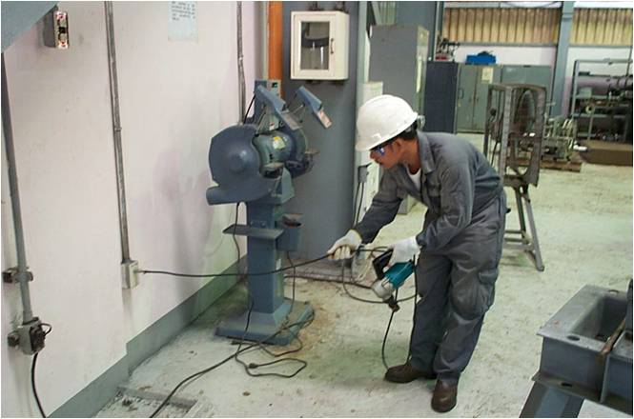
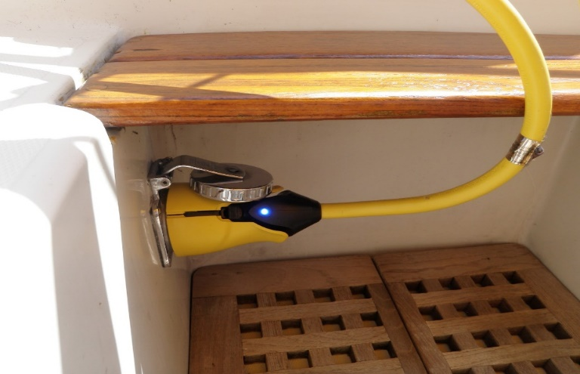
DANGERS OF POWER TOOLS
To prevent hazards associated with the use of power tools, workers should observe the following general precautions:
Never carry a tool by the cord or hose.
Never yank the cord or the hose to disconnect it from the receptacle

Slide 12
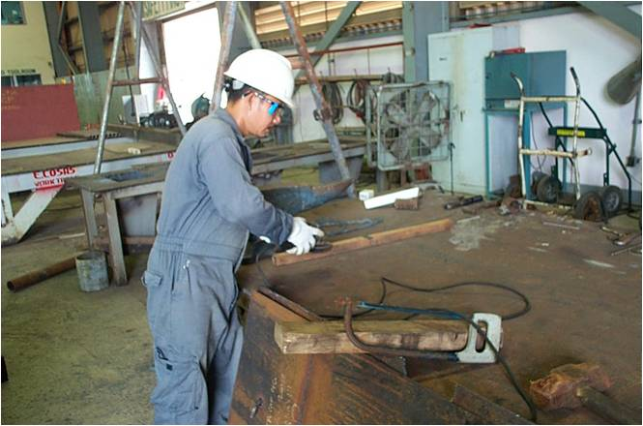
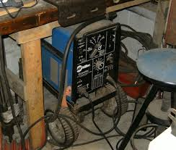
DANGERS OF POWER TOOLS
Keep cords and hoses away from heat, oil, and sharp edges.
Disconnect tools when not using them, before servicing and cleaning them, and when changing accessories such as blades, bits, and cutters.

Slide 13

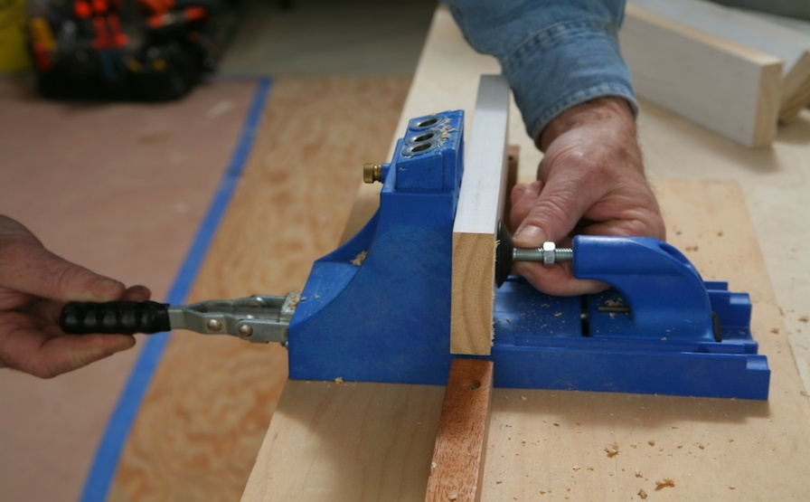
DANGERS OF POWER TOOLS
Keep all people not involved with the work at a safe distance from the work area.
Secure work with clamps or a vise, freeing both hands to operate the tool.

Slide 14



DANGERS OF POWER TOOLS
Avoid accidental starting. Do not hold fingers on the switch button while carrying a plugged-in tool. Maintain tools with care keep them sharp and clean for best performance.
Follow instructions in the user’s manual for lubricating and changing accessories.

Slide 15
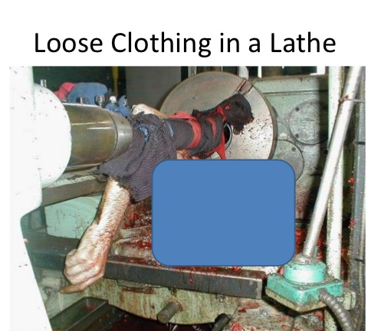
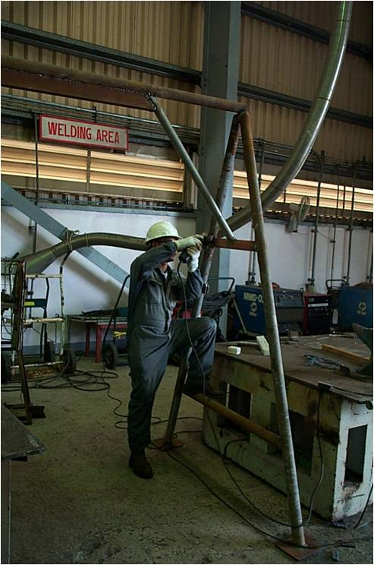
DANGERS OF POWER TOOLS
Be sure to keep good footing and maintain good balance when operating power tools.
Wear proper apparel for the task. Loose clothing, ties, or jewellery can become caught in moving parts.

Slide 16
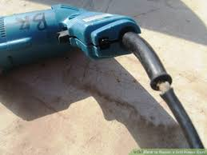
DANGERS OF POWER TOOLS
Remove all damaged portable electric tools from use and tag them: “Do Not Use.”

Slide 17
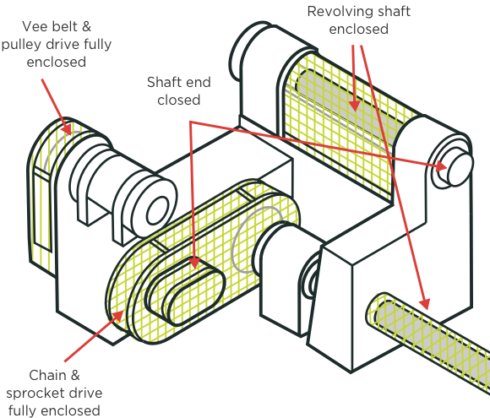
GUARDS
The exposed moving parts of power tools need to be safeguarded. Belts, gears, shafts, pulleys, sprockets, spindles, drums, flywheels, chains, or other reciprocating, rotating, or moving parts of equipment must be guarded.

Slide 18
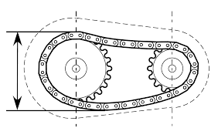
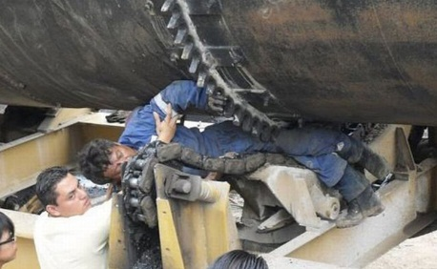
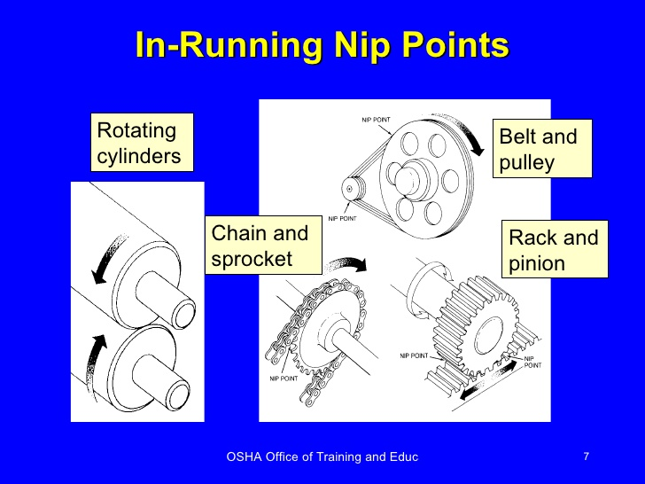
GUARDS
Machine guards, as appropriate, must be provided to protect the operator and others from the following:
  Point of operation
  In-running nip points
  Point of operation.
  In-running nip points.

Slide 19
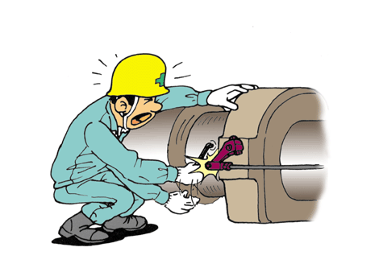
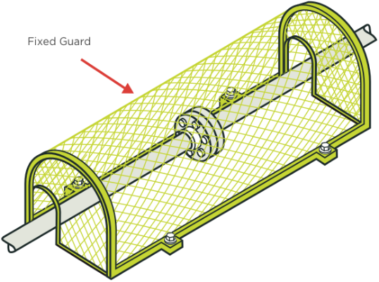
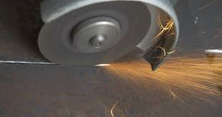

GUARDS
Machine guards, as appropriate, must be provided to protect the operator and others from the following:
  Rotating parts
  Flying chips and sparks
  Rotating parts
  Flying chips and sparks

Slide 20
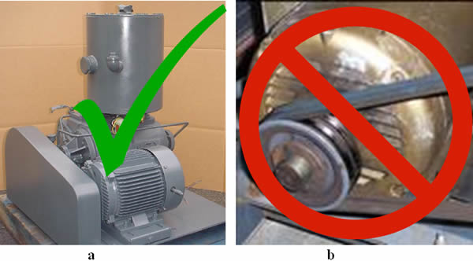
GUARDS
Safety guards must never be removed when a tool is being used. Portable circular saws having a blade greater than 2 inches (5.08 centimetres) in diameter must be equipped at all times with guards. An upper guard must cover the entire blade of the saw.
A retractable lower guard must cover the teeth of the saw, except where it makes contact with the work material. The lower guard must automatically return to the covering position when the tool is withdrawn from the work material.

Slide 21
OPERATING CONTROLS AND SWITCHES
The following hand-held power tools must be equipped with a constant-pressure switch or control that shuts off the power when pressure is released: drills; tappers; fastener drivers; horizontal, vertical, and angle grinders with wheels more than 2 inches (5.08 centimetres) in diameter; disc sanders with discs greater than 2 inches (5.08 centimetres); belt sanders; reciprocating saws; sabre saws, scroll saws, and jigsaws with blade shanks greater than 1 /4-inch (0.63 centimetres) wide; and other similar tools.
These tools also may be equipped with a “lock-on” control, if it allows the worker to also shut off the control in a single motion using the same finger or fingers. The following hand-held power tools must be equipped with either a positive “on-off” control switch, a constant pressure switch, or a “lock-on” control: disc sanders with discs 2 inches (5.08 centimetres) or less in diameter; grinders with wheels 2 inches (5.08 centimetres) or less in diameter; platen sanders, routers, planers,

Slide 22
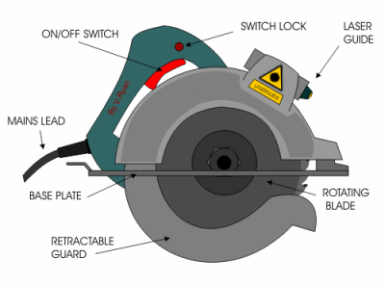
OPERATING CONTROLS AND SWITCHES

Slide 23
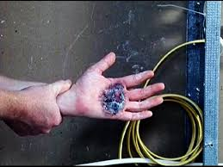

ELECTRIC TOOLS
Employees using electric tools must be aware of several dangers. Among the most serious hazards are electrical burns and shocks.
Electrical shocks, which can lead to injuries such as heart failure and burns, are among the major hazards associated with electrical powered tools. Under certain conditions, even a small amount of electric current can result in fibrillation of the heart and death. An electric shock also can cause the user to fall off a ladder or other elevated work surface and be injured due to the fall

Slide 24
ELECTRIC TOOLS
To protect the user from shock and burns, electric tools must have a three-wire cord with a ground and be plugged into a grounded receptacle, be double insulated, or be powered by a low voltage isolation transformer. Three-wire cords contain two current carrying conductors and a grounding conductor. Any time an adapter is used to accommodate a two-hole receptacle, the adapter wire must be attached to a known ground. The third prong must never be removed from the plug.
Double-insulated tools are available that provide protection against electrical shock without third-wire grounding. On double insulated tools, an internal layer of protective insulation completely isolates the external housing of the tool.

Slide 25
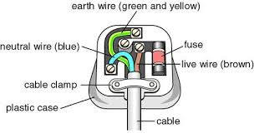
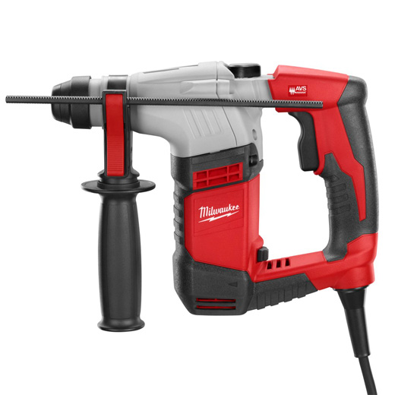
ELECTRIC TOOLS

Slide 26

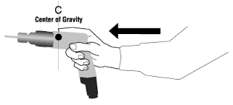
ELECTRIC TOOLS
The following general practices should be followed when using electric tools:
  Operate electric tools within their design limitations.
  Use gloves and appropriate safety footwear when using electric tools.
Operate electric tools within
their design limitations
Use gloves and appropriate safety footwear when using electric tools

Slide 27


ELECTRIC TOOLS
The following general practices should be followed when using electric tools:
  Store electric tools in a dry place when not in use.
  Do not use electric tools in damp or wet locations unless they are approved for that purpose.
Do not use electric tools in damp or wet
locations unless they are approved
for that purpose
  Store electric tools in a dry place when not in use

Slide 28

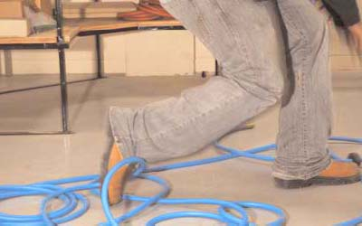
ELECTRIC TOOLS
The following general practices should be followed when using electric tools:
  Keep work areas well lighted when operating electric tools
  Ensure that cords from electric tools do not present a tripping hazard
  Keep work areas well lighted when operating electric tools.
  Ensure that cords from electric tools do not present a tripping hazard

Slide 29

PORTABLE ABRASIVE WHEEL TOOLS
Portable abrasive grinding, cutting, polishing, and wire buffing wheels create special safety problems because they may throw off flying fragments.

Slide 30

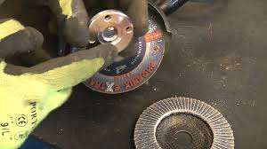

PORTABLE ABRASIVE WHEEL TOOLS
Abrasive wheel tools must be equipped with guards that:
Cover the spindle end, nut, and flange projections.
Maintain proper alignment with the wheel.
Do not exceed the strength of the fastenings.

Slide 31


PNEUMATIC TOOLS
Pneumatic tools are powered by compressed air and include chippers, drills, hammers, and sanders.
There are several dangers associated with the use of pneumatic tools. First and foremost is the danger of getting hit by one of the tool’s attachments or by some kind of fastener the worker is using with the tool.

Slide 32
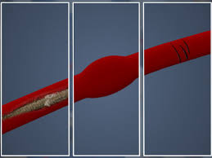
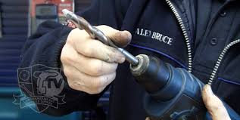
PNEUMATIC TOOLS
Pneumatic tools must be checked to see that the tools are fastened securely to the air hose to prevent them from becoming disconnected. A short wire or positive locking device attaching the air hose to the tool must also be used and will serve as an added safeguard.
When using pneumatic tools, a safety clip or retainer must be installed to prevent attachments such as chisels on a chipping hammer from being ejected during tool operation.

Slide 33

PNEUMATIC TOOLS
If an air hose is more than 1 /2-inch (12.7 millimetres) in diameter, a safety excess flow valve must be installed at the source of the air supply to reduce pressure in case of hose failure In general, the same precautions should be taken with an air hose that are recommended for electric cords, because the hose is subject to the same kind of damage or accidental striking, and because it also presents tripping hazards.

Slide 34
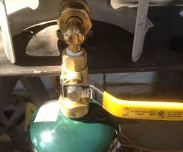
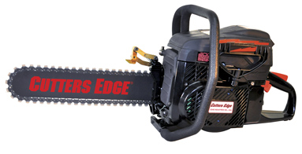
LIQUID FUEL TOOLS
Fuel-powered tools are usually operated with gasoline. The most serious hazard associated with the use of fuel-powered tools comes from fuel vapours that can burn or explode and also give off dangerous exhaust fumes. The worker must be careful to handle, transport, and store gas or fuel only in approved flammable liquid containers, according to proper procedures for flammable liquids.
Before refilling a fuel-powered tool tank, the user must shut down the engine and allow it to cool to prevent accidental ignition of hazardous vapours. When a fuel-powered tool is used inside a closed area, effective ventilation and/or proper respirators such as atmosphere-supplying respirators must be utilized to avoid breathing carbon monoxide. Fire extinguishers must also be available in the area.

Slide 35
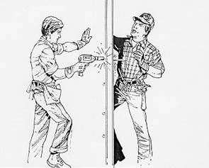
POWDER-ACTUATED TOOLS
Powder-actuated tools operate like a loaded gun and must be treated with extreme caution. In fact, they are so dangerous that they must be operated only by specially trained employees.

Slide 36
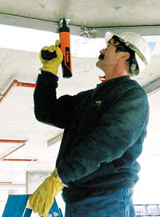
POWDER-ACTUATED TOOLS
When using powder-actuated tools, an employee must wear suitable ear, eye, and face protection. The user must select a powder level—high or low velocity—that is appropriate for the powder-actuated tool and necessary to do the work without excessive force.

Slide 37
POWDER-ACTUATED TOOLS
Safety precautions that must be followed when using powder actuated tools include the following:
  Do not use a tool in an explosive or flammable atmosphere.
  Inspect the tool before using it to determine that it is clean, that all moving parts operate freely, and that the barrel is free from obstructions and has the proper shield, guard, and attachments recommended by the manufacturer.
  Do not load the tool unless it is to be used immediately.
  Do not leave a loaded tool unattended, especially where it would be available to unauthorized persons.
  Keep hands clear of the barrel end.
  Never point the tool at anyone.

Slide 38
POWDER-ACTUATED TOOLS
When using powder-actuated tools to apply fasteners, several additional procedures must be followed:
  Do not fire fasteners into material that would allow the fasteners to pass through to the other side. Do not drive fasteners into very hard or brittle material that might chip or splatter or make the fasteners ricochet.
  Always use an alignment guide when shooting fasteners into existing holes.
  When using a high-velocity tool, do not drive fasteners more than 3 inches (7.62 centimetres) from an unsupported edge or corner of material such as brick or concrete.
  When using a high velocity tool, do not place fasteners in steel any closer than 1 /2-inch (1.27 centimetres) from an unsupported corner edge unless a special guard, fixture, or jig is used.

Slide 39
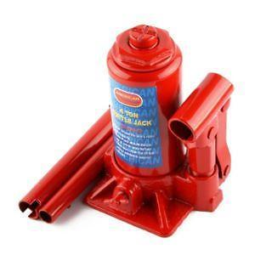
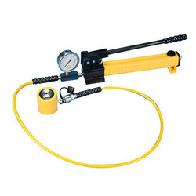
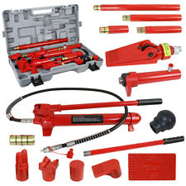
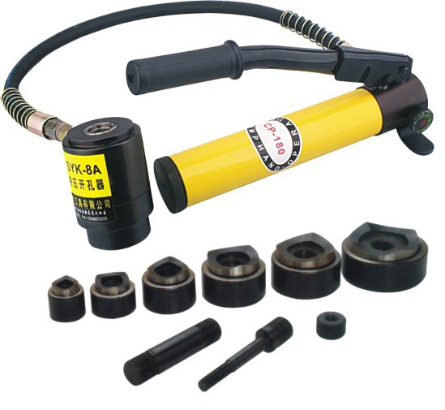
HYDRAULIC POWER TOOLS
The fluid used in hydraulic power tools must be an approved fire resistant fluid and must retain its operating characteristics at the most extreme temperatures to which it will be exposed. The exception to fire-resistant fluid involves all hydraulic fluids used for the insulated sections of derrick trucks, aerial lifts, and hydraulic tools that are used on or around energized lines. This hydraulic fluid shall be of the insulating type.

Slide 40

HYDRAULIC POWER TOOLS
To set up a jack, make certain of the following:
  The base of the jack rests on a firm, level surface
  The jack is correctly centred
  The jack head bears against a level surface
  The lift force is applied evenly

Slide 41
HYDRAULIC POWER TOOLS
Proper maintenance of jacks is essential for safety.
All jacks must be lubricated regularly. In addition, each jack must be inspected according to the following schedule:
  For jacks used continuously or intermittently at one site—inspected at least once every 6 months
  For jacks sent out of the shop for special work— inspected when sent out and inspected when returned, and
  For jacks subjected to abnormal loads or shock—inspected before use and immediately thereafter.

Slide 42
Our Clients

