Slide 1

HAZARD REPORTING

Slide 2
ABOUT PMG
“BUILDING FOOD FACTORIES WITH TOP QUALITY STANDARDS OF NESTLE, MONDELEZ,ABBOTT, DANONE USING 3D DESIGN AND HYGIENIC ENGINEERING.”
At PMG, we deliver Engineering Design and Project Management scopes in Food and Beverage industry. Our team of design engineers and engineering executives has rich experience in Project Planning, Design, Execution and Commissioning with key competencies in areas like 3D Plant Design, Hygienic Engineering, and Project Management. Our safe-by-choice, result-oriented, and pro-active work-ethics allow us deliver work scopes meeting objectives, complete stakeholder alignment and first-time quality.
PMG Knowledge Repository: Targeted Knowledge Sharing & Skill Development
Precise and focused training modules for the exhaustive set of people working in manufacturing industry, instilling qualities of self-belief, creative thinking & widened perspective.
Clear Learning Objectives
Focused approach to skill development and knowledge sharing
Progressive Evaluation
Gauging improvement on every step and keeping audience connected.
After-training follow-ups
We systematically track differential progress of recipients after the training.
Audience Specific Approach
Programs are fine-tuned to the ability and interests of the recipients.
Multiple Awe-moments
Awe-moments are refreshing and increase receptivity many-fold.
Seasoned Trainers
PMG trainers are subject matter experts with substantial work experience.

Slide 3
AGENDA
1
Policy
2
Procedure
3
Hazard
4
Reporting of accidents/incidents
Notes:
3

Slide 4
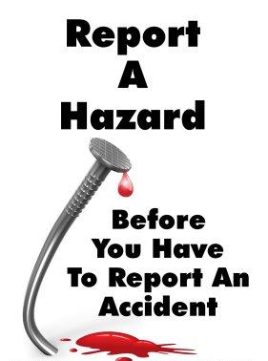
POLICY
The hazard reporting system is a worker-oriented process. Workers are in the best position to identify the hazards in the workplace because they are the ones who perform the work. Workers act as a second set of eyes for supervisors.

Slide 5

PROCEDURE
Worker Responsibilities
Report any perceived hazard verbally to the site supervisor.
Provide recommendations to the supervisor on how to eliminate or control the hazard.
If the supervisor does not respond to your concern you are to inform management.

Slide 6

PROCEDURE
Supervisor Responsibilities
Discuss the hazard and controls with the worker and complete the Hazard Identification Form.
Respond to the worker’s concern by the next shift.
Ensure that the form details the action or non-action which will be taken.
Provide a copy of the completed Hazard Identification Form to middle management.

Slide 7
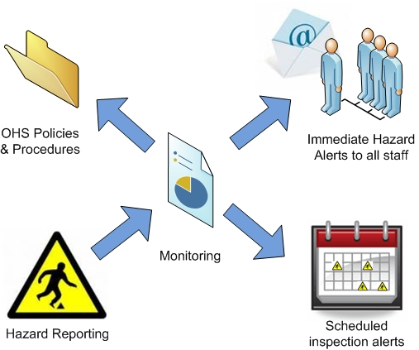
PROCEDURE
Middle Management Responsibilities
Ensure action is taken to address the hazard identified.
Initialize and date the Hazard Identification Form.

Slide 8
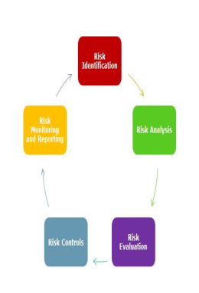
PROCEDURE
Hazard Identification and Reporting Procedure
A hazard is anything that has the potential to harm people. Hazards can include objects in the workplace, such as machinery or dangerous chemicals. Hazards can also be identified as the way things are done.
As a learner, visitor or contractor you have a duty to report any hazard or incident in a timely manner. This procedure outlines the methodology and tools that you are to use in the event you note a hazard at any of our sites or whilst on clinical placement. (Note: you may also be required to follow the procedures of any clinical placement Host Facility).

Slide 9
HAZARD
You are required to adhere to the following guidelines:
  Upon noting a hazard, if you determine that it is life threatening or injury causing you must take immediate action to safely remove the hazard or minimise the risk to others before any reporting of the hazard is completed.
  Upon noting a hazard, access the Hazard, Incident and Accident Identification.

Slide 10
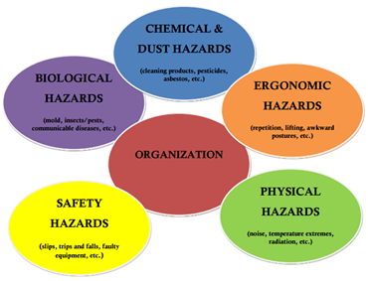
HAZARD
You are required to adhere to the following guidelines:
  Investigate any reported hazard
  Rectify the hazard incident as soon as possible
  Take all reasonable steps to ensure the location or activity is conducted in a manner that does not constitute a hazard
  Ensure hazard identification forms are available at our student services desk and on our website at all times

Slide 11
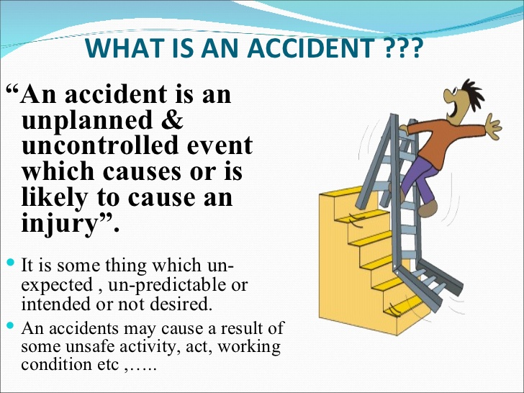
HAZARD
What is an Accident?
For the purpose of this procedure, an accident is defined as "any unplanned event that causes, or has the potential to cause, an injury or illness and/or damage to person, buildings, or the natural environment." Incidents range from serious incidents and emergencies to near-miss incidents where there is no actual injury or damage.

Slide 12
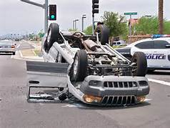

HAZARD
Types of Accidents
Auto Accident: Bodily injury or property damage caused by a land motor vehicle designed and registered for use on public roads.
General Liability Accident: Any injuries or damages to persons or property that are directly or indirectly attributable to the design, formulation, manufacture, distribution, use, operation, maintenance or repair of an entity; or the failure to warn of any such conditions

Slide 13
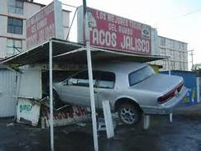
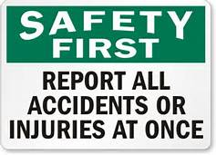
HAZARD
Types of Accidents
Property Damage: Property damage means physical injury to or destruction of tangible property including loss of use if the loss or use results from the physical injury or destruction of the property.
Accident Reporting: All accidents that arise must be reported. The immediate supervisor is responsible for ensuring the correct procedures are followed. Incidents that occur on the way to or from work, field activities must also be reported.

Slide 14

HAZARD
Reporting Procedures
Stay calm.
Bodily Injury – Secure medical attention for the injured party(ies)
Employees should report all accidents involving bodily injury immediately to supervisor, .
Complete Accident Report Form and forward to EHS Department.

Slide 15
REPORTING OF ACCIDENTS/INCIDENTS
Reporting of Accidents/Incidents
Injured person or the first-aider to report accident to designated person giving all relevant details.
Designated person to enter the detail in the accident book taking care to ascertain exactly what occurred.
Injuries which require the first aider to refer the injured person to hospital or to their doctor should be immediately notified to the senior company representative on site.
In such cases the senior company representative, accompanied by a representative of the employees, must investigate all the circumstances of how the injury was sustained and a company accident investigation report completed.
The findings of the investigation will be examined by the senior company representative and the chief executive with the objective of identifying measures to avoid a repetition.
These control measures will be introduced after consultation by the senior representative with staff on site.

Slide 16
REPORTING OF ACCIDENTS/INCIDENTS
Reporting of Accidents/Incidents
Injuries or incidents at work leading to ill health which result in an absence from work of more than 3 days must be notified to the Health and Safety Executive .
A copy of accident report should be sent to the chief executive immediately.
Injuries or incidents leading to ill health which are more serious than those mentioned above (including injuries leading to death) must be notified to the HSE immediately by the quickest possible means (i.e. by telephone.
The accident location should be barriered off pending an investigation into the circumstances of the incident,
This investigation should include statements from all witnesses and any plant or equipment involved in the incident should not be touched nor moved until the investigation has been concluded.
The investigators will discuss their findings with the chief executive to identify measures needed to avoid a repetition.
These measures will be introduced as soon as possible after consultation with the construction workers.

Slide 17
REPORTING OF ACCIDENTS/INCIDENTS
All reportable incidents must be reported within 24 hours.
Note: Reporting of accidents and occupational illnesses involving death, critical injury, lost time or health care (by a medical practitioner) is required for employees under both the Occupational Health and Safety Act and the Workplace Safety and Insurance Act.

Slide 18

REPORTING OF ACCIDENTS/INCIDENTS
Reporting of Death or Critical Injury
A critical injury is defined as an injury of a serious nature that:
  Places life in jeopardy
  Produces unconsciousness
  Results in substantial loss of blood
  Involves the fracture of a leg or arm, but not a finger or toe
  Involves the amputation of a leg, arm, hand or foot, but not a finger or toe
  Consists of burns to a major portion of the body
  Causes the loss of sight in an eye.

Slide 19
REPORTING OF ACCIDENTS/INCIDENTS
Reporting of Death or Critical Injury
A critical injury is defined as an injury of a serious nature that:
In addition to the reporting requirements outlined above, all critical injuries or fatalities must be immediately reported to the Ministry of Labour. Note that the reporting requirements to the Ministry of Labour for death or critical injury specify any person, so this reporting requirement is not limited to employees. Supervisors are therefore responsible for taking the following steps:
  Notify the appropriate joint health and safety committee for the workplace,
  If the injured person is an employee, notify the appropriate union (if any),
  Ensure that the site of the accident remains undisturbed until a Ministry of Labor inspector has arrived, and
  Investigate and prepare a written report on the circumstances of the accident.

Slide 20
Our Clients

