Slide 1
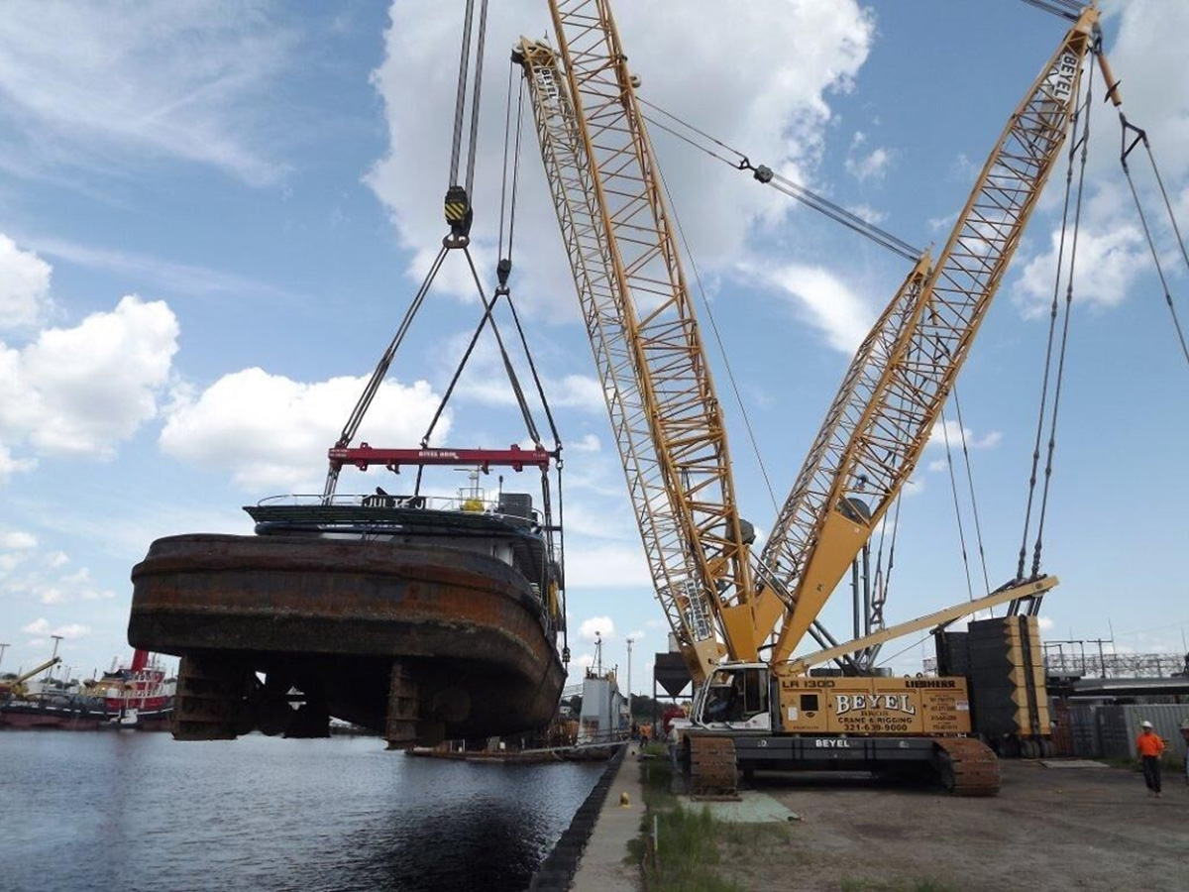
RIGGING

Slide 2
ABOUT PMG
“BUILDING FOOD FACTORIES WITH TOP QUALITY STANDARDS OF NESTLE, MONDELEZ,ABBOTT, DANONE USING 3D DESIGN AND HYGIENIC ENGINEERING.”
At PMG, we deliver Engineering Design and Project Management scopes in Food and Beverage industry. Our team of design engineers and engineering executives has rich experience in Project Planning, Design, Execution and Commissioning with key competencies in areas like 3D Plant Design, Hygienic Engineering, and Project Management. Our safe-by-choice, result-oriented, and pro-active work-ethics allow us deliver work scopes meeting objectives, complete stakeholder alignment and first-time quality.
PMG Knowledge Repository: Targeted Knowledge Sharing & Skill Development
Precise and focused training modules for the exhaustive set of people working in manufacturing industry, instilling qualities of self-belief, creative thinking & widened perspective.
Clear Learning Objectives
Focused approach to skill development and knowledge sharing
Progressive Evaluation
Gauging improvement on every step and keeping audience connected.
After-training follow-ups
We systematically track differential progress of recipients after the training.
Audience Specific Approach
Programs are fine-tuned to the ability and interests of the recipients.
Multiple Awe-moments
Awe-moments are refreshing and increase receptivity many-fold.
Seasoned Trainers
PMG trainers are subject matter experts with substantial work experience.

Slide 3
AGENDA
1
Introduction
2
Regulations
3
Hoisting and rigging hazards
4
Procedures and precautions
5
Definitions
6
Ensure that slings are protected at all sharp corners on heavy items
7
FIBRE ROPES
8
Inspection
9
Selection, use, and inspection of slings
10
Fibre rope and synthetic web
11
Wire ropes, chains, and ropes inspection
Notes:
3

Slide 4
INTRODUCTION
This manual is intended as a working guide for training workers and supervisors in the fundamentals of safe rigging and hoisting. The information covers not only ropes and knots but hoisting equipment from cranes to chain falls and rigging hardware from rope clips to spreader beams. Equally important is the attention paid at every point to correct procedures for inspection, maintenance, and operation. Knowledge of the equipment and materials with which we work is one of the most important factors in occupational health and safety. Each item has been designed and developed to serve a specific purpose. Recognizing its capabilities and limitations not only improves efficiency but minimizes hazards and helps prevent accidents.
This manual identifies the basic hazards in rigging and hoisting, explains the safeguards necessary to control or eliminate these hazards, and spells out other essential safety requirements. The information should be used in conjunction with the applicable regulations by contractors, supervisors, operators, riggers, and others delivering or receiving instruction in the basics of safe rigging and hoisting.

Slide 5
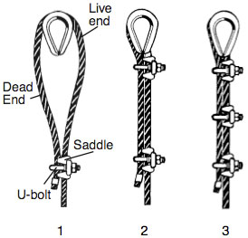
INTRODUCTION

Slide 6
REGULATIONS
There are various regulations under the Act for construction in particular. The most extensive are the Regulations for Construction Projects (Ontario Regulation 213/91).
There are also special regulations for controlled products under the Workplace Hazardous Materials Information System (WHMIS) and for designated substances such as asbestos.
Construction regulations are generally based on health and safety problems that have recurred over the years. In many cases, the regulations have been proposed jointly by management and labour groups as a means of controlling or eliminating problems that have historically resulted in fatalities, lost-time injuries, and occupational diseases.
The Regulations for Construction Projects have been periodically revised over the years. Review Ontario’s Occupational Health and Safety Act, Regulations for Construction Projects, and other applicable health and safety regulations to make sure that you know what to expect from others on the job – and what others expect from you.

Slide 7
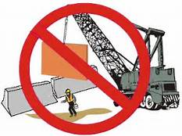
HOISTING AND RIGGING HAZARDS
Labour and management both have a responsibility to ensure the safety of all parties involved in hoisting and rigging. Major rigging operations must be planned and supervised by competent personnel to guarantee that the best methods and most suitable equipment are employed. It is imperative that all workers who prepare, use, and work with or around hoisting and rigging equipment are well trained in both safety and operating procedures.
All hoisting equipment should be operated only by trained personnel.
This section:
  Identifies common hazards and causes of hoisting and rigging accidents
  Specifies the procedures and precautions necessary for the safe rigging, lifting, and landing of loads
  Explains methods of determining load weight
  Provides weight tables for common construction materials.

Slide 8
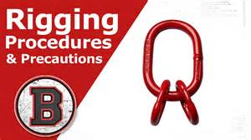
PROCEDURES AND PRECAUTIONS
Remember: The single most important precaution in hoisting and rigging is to determine the weight of the load before attempting to lift it. At the same time, riggers must also
  Determine the available capacity of the equipment being used
  Ring the load so that it is stable (unless the centre of gravity of the load is directly below the hook, the load will shift)
  Make allowances for any unknown factors. In addition, riggers must be aware of common hazards, factors that reduce capacity, the inspection and use of slings, and safe practices in rigging, lifting, and landing loads.

Slide 9
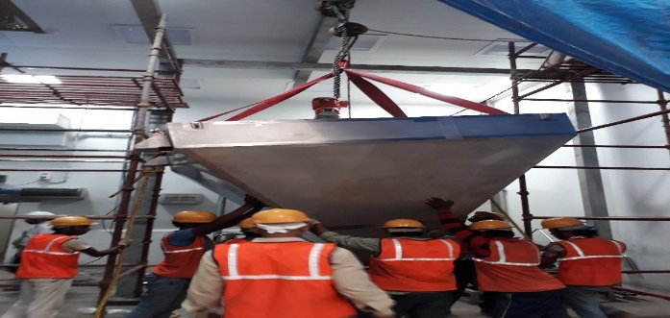
DEFINITIONS
Asymmetrical load. An object with an off-centre centre of gravity due to the object's irregular shape and/or composition.
Critical lifts require confirmation of engineering, or merit additional engineering input because of an item's or location's size, weight, close-tolerance installation, or high susceptibility to damage. These lifts could be either ordinary lifts or pre-engineered lifts, but with additional hazards that could result in significant delays to a program, undetectable damage resulting in future operational or safety problems, a significant release of radioactivity or other hazardous material, present a risk of injury personnel. Critical lifts must be made by Plant Engineering riggers or by approved contractors, and as such are not covered in this program.
                Incidental or ordinary lifts involve the use of basic hoisting equipment directly above the load. The load must also have certified lifting points or be relatively easy to sling.

Slide 10
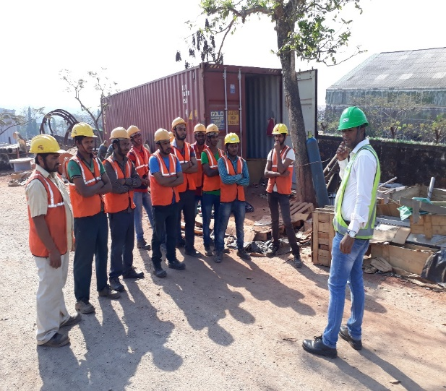
DEFINITIONS
Person-in-charge. Person appointed by the responsible manager or designee to direct critical or pre-engineered lifts. The person-in-charge must be present during the entire lifting operation and must have experience in handling similar types of equipment. The designated person-in-charge may be either a supervisor familiar with critical lift operations, or a person with special knowledge of the equipment and handling.
Symmetrical load. An object that, because of its uniform shape and composition, has its centre of gravity located exactly in its middle. Working Load Limit (WLL) not known. Know the working load limits of the equipment and tackle being used. Never exceed these limits.

Slide 11
DEFINITIONS
Defective components Examine all hardware, equipment, tackle, and slings before use. Destroy any defective components. Equipment merely discarded may be picked up and used by someone unaware of its defects.
Unsafe equipment Do not use any equipment that is suspected to be unsafe or unsuitable until its suitability has been verified by a competent person.
Hazardous wind conditions Never carry out any hoisting or rigging operation when winds create hazards for workers, the general public, or property. Assess load size and shape to determine whether high winds may cause problems. In particular, avoid handling loads that present large wind-catching surfaces. Even though the weight of the load is within the normal capacity of the equipment, high or gusting winds may prevent proper control during the lift. Wind-loading can be critical to how the load is rigged, lifted, and landed, with consequences for the safety of everyone involved. When winds reach 25-30 mph, consider limiting hoisting operations.

Slide 12
DEFINITIONS
Hazardous weather conditions. When the visibility of riggers or hoist crew is impaired by snow, fog, rain, darkness, or dust, strict supervision must be exercised and, if necessary, the lift should be suspended. At sub-freezing temperatures, supervision must ensure that no part of the hoisting device or tackle is shock-loaded or impacted, since brittle fracture of the steel may result.
Electrical contact. One of the most frequent killers of riggers is electrocution caused by an electrical arc or contact between the hoist, load line, or load and a live overhead power line. When a crane is operating near a live power line and the load, hoist lines, or any other part of the hoisting operation could encroach on the minimum permitted distance (see table below), specific measures described in the Construction Regulation must be taken. For example, constructors must have written procedures to prevent contact whenever equipment operates within the minimum permitted distance from a live overhead power line. The constructor must have copies of the procedure available for every employer on the project

Slide 13
DEFINITIONS
Hoist line not plumb. The working load limits of hoisting equipment apply only to freely suspended loads on plumb hoist lines. If the hoist line is not plumb during load handling, side loads are created which can destabilize the equipment and cause structural failure with no warning.
Factors that Reduce Capacity. The working load limits of all hoisting and rigging equipment are based on almost ideal conditions seldom achieved in the field. Riggers must therefore recognize the factors that can reduce the capacity of equipment.
Swing. The rapid swinging of suspended loads subjects equipment to additional stresses that can cause collapse. The force of the swinging action makes the load drift away from the machine, increasing the radius and side-loading the equipment. The load must always be kept directly below the boom point or upper load block.

Slide 14
DEFINITIONS
Condition of equipment. The rated working load limits apply only to equipment and hardware in good condition. Any equipment damaged in service should be taken out of service and repaired or destroyed.
Dynamic forces. The working load limits of most rigging and hoisting equipment are determined from static loads and the appropriate design factor is applied to account for dynamic motions of the load and equipment. To ensure that the working load limit is not exceeded during operation, allow for wind loading and other dynamic forces created by the normal operational movements of the machine and its load. Always avoid the sudden snatching, swinging, and stopping of suspended loads. Rapid acceleration and deceleration can only increase the stresses on both the machine and the tackle.
Weight of tackle. The rated loads of most hoisting equipment do not generally account for the weight of hook blocks, hooks, slings, equalizer beams, and other parts of the lifting tackle. Their combined weight must be subtracted from the load capacity of the equipment to determine the maximum allowable load to be lifted.

Slide 15
DEFINITIONS
Slings: After the hoist rope, the sling is the most commonly used piece of rigging equipment. Observe the following precautions with slings.
  Never use damaged slings. Inspect slings regularly to ensure their safety. Check wire rope slings for kinking, wear, abrasion, broken wires, worn or cracked fittings, loose seizing's and splices, crushing, flattening, and rust or corrosion. Pay special attention to the areas around thimbles and other fittings.
  Slings should be marked with an identification number and their maximum capacity on a flat ferrule or permanently attached ring. Mark the capacity of the sling for a vertical load or at an angle of 45°. Ensure that everyone is aware of how the rating system works.
  Avoid sharp bends, pinching, and crushing. Use loops and thimbles at all times. Corner pads that prevent the sling from being sharply bent or cut can be made from split sections of large diameter pipe, corner saddles, padding, or blocking.

Slide 16
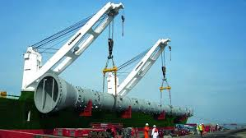
ENSURE THAT SLINGS ARE PROTECTED AT ALL SHARP CORNERS ON HEAVY ITEMS
Never allow wire rope slings, or any wire rope, to lie on the ground for long periods of time or on damp or wet surfaces, rusty steel, or near corrosive substances.
Avoid dragging slings out from underneath loads.
Keep wire rope slings away from flame cutting and electric welding.
Never make slings from discarded hoist rope.
Avoid using single-leg wire rope slings with hand-spliced eyes. The load can spin, causing the rope to unplay and the splice to pull out. Use slings with Flemish Spliced Eyes.

Slide 17
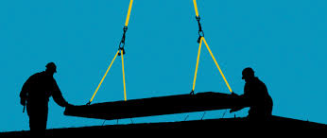
ENSURE THAT SLINGS ARE PROTECTED AT ALL SHARP CORNERS ON HEAVY ITEMS
Never wrap a wire rope completely around a hook. The sharp radius will damage the sling.
Avoid bending the eye section of wire rope slings around corners. The bend will weaken the splice or swaging. There must be no bending near any attached fitting.
Ensure that the sling angle is always greater than 45°. When the horizontal distance between the attachment points on the load is less than the length of the shortest sling leg, then the angle is greater than 60° and generally safe.

Slide 18
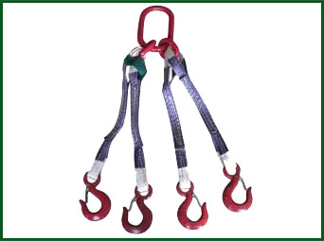
ENSURE THAT SLINGS ARE PROTECTED AT ALL SHARP CORNERS ON HEAVY ITEMS
Multi-leg slings. Do not assume that a multi-leg bridle sling will safely lift a load equal to the safe load on one leg multiplied by the number of legs. There is no way of knowing that each leg is carrying its fair share of the load. With slings having more than two legs and a rigid load, it is possible for some of the legs to take practically the full load while the others merely balance it.
As a result, when lifting rigid objects with three- or four-leg bridle slings, make sure that at least two of the legs alone can support the total load. In other words, consider multi-leg slings used on a rigid load as having only two legs. Where the load is flexible and can adjust itself to the sling legs, assume that each leg can take its own share of the load.
When using multi-leg slings to lift loads in which one end is much heavier than the other, the tension on the most heavily loaded leg is much more important than the total weight. The sling must be selected to suit the most heavily loaded leg rather than the total weight.

Slide 19
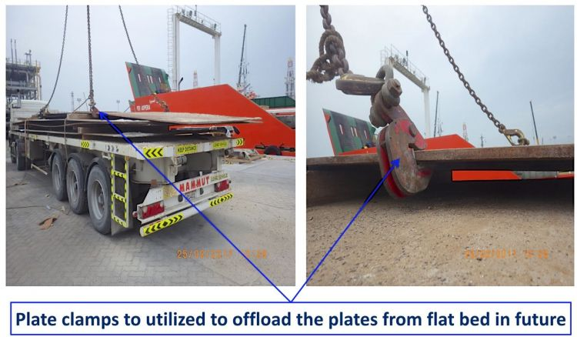
ENSURE THAT SLINGS ARE PROTECTED AT ALL SHARP CORNERS ON HEAVY ITEMS
Rig loads to prevent any parts from shifting or dislodging during the lift. Suspended loads should be securely slung and properly balanced before they are set in motion.
Keep the load under control at all times. Where personnel may be endangered by a rotating or swaying load, use one or more taglines to prevent uncontrolled motion.
Keep the load under control at all times. Where personnel may be endangered by a rotating or swaying load, use one or more taglines to prevent uncontrolled motion.
  Whenever 2 or more ropes are to be Use a Shackle
  Use Tag Lines to Control All Loads

Slide 20
ENSURE THAT SLINGS ARE PROTECTED AT ALL SHARP CORNERS ON HEAVY ITEMS
Loads must be safely landed and properly blocked before being unhooked and unslung.
Lifting beams should be plainly marked with their weight and designed working loads and should only be used for their intended purpose.
Never wrap the hoist rope around the load. Attach the load to the hook by slings or other rigging devices adequate and suitable to the load being lifted.
The load line should be brought over the load’s centre of gravity before the lift is started.
Keep hands away from pinch points as slack is being taken up.
Wear gloves when handling wire rope.
Make sure that everyone stands clear when loads are being lifted, lowered, and freed of slings. As slings are being withdrawn, their hooks may catch under the load and suddenly fly loose.

Slide 21
ENSURE THAT SLINGS ARE PROTECTED AT ALL SHARP CORNERS ON HEAVY ITEMS
Before making a lift, check to see that the sling is properly attached to the load.
Never work under a suspended load.
Never make temporary repairs to a sling. Procedures for proper repair should be established and followed.
Secure the unused legs of a multi-leg sling before it is lifted
Never point-load a hook unless it is designed and rated for such use.
Make sure that the load is free before lifting and that all sling legs are taking the load.
When using two or more slings on a load, ensure that they are all made from the same material.
Prepare adequate blocking before loads are lowered. Blocking can help prevent damage to slings.

Slide 22
FIBRE ROPES
Fibre Ropes, Knots, Hitches
Fibre rope is a commonly used tool which has many applications in daily hoisting and rigging operations.
Readily available in a wide variety of synthetic and natural fibre materials, these ropes may be used as
  Slings for hoisting materials
  Hand lines for lifting light loads
  Taglines for helping to guide and control loads
There are countless situations where the rigger will be required to tie a safe and reliable knot or hitch in a fibre rope as part of the rigging operation.
Fastening a hook, making eyes for slings, and tying on a tagline are a few of these situations.
This section addresses the correct selection, inspection, and use of fibre rope for hoisting and rigging operations. It also explains how to tie several knots and hitches.

Slide 23
FIBRE ROPES
Characteristics
The fibres in these ropes are either natural or synthetic. Natural fibre ropes should be used cautiously for rigging since their strength is more variable than that of synthetic fibre ropes and they are much more subject to deterioration from rot, mildew, and chemicals.
  Polypropylene is the most common fibre rope used in rigging. It floats but does not absorb water. It stretches less than other synthetic fibres such as nylon. It is affected, however, by the ultraviolet rays in sunlight and should not be left outside for long periods. It also softens with heat and is not recommended for work involving exposure to high heat.
  Nylon fibre is remarkable for its strength. A nylon rope is considerably stronger than the same size and construction of polypropylene rope. But nylon stretches and hence is not used much for rigging. It is also more expensive, loses strength when wet, and has low resistance to acids.

Slide 24
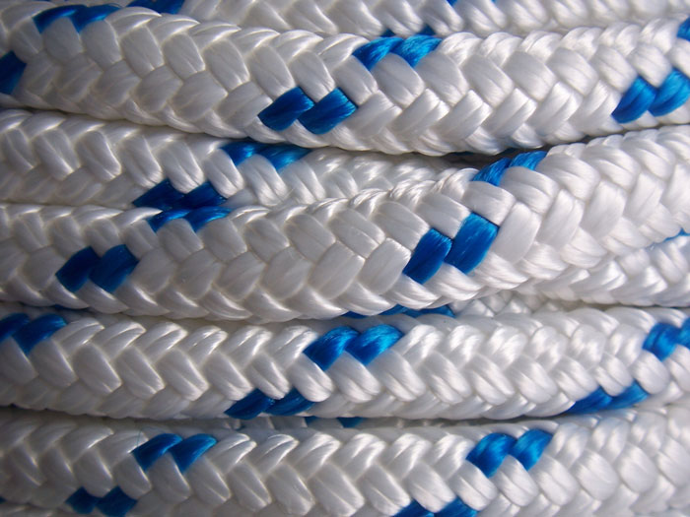
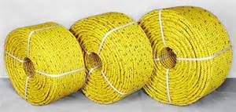
FIBRE ROPES
Characteristics
Polyester ropes are stronger than polypropylene but not so strong as nylon. They have good resistance to acids, alkalis, and abrasion; do not stretch as much as nylon; resist degradation from ultraviolet rays; and don’t soften in heat.
All fibre ropes conduct electricity when wet. When dry, however, polypropylene and polyester have much better insulating properties than nylon.

Slide 25
INSPECTION
Inspect fibre rope regularly and before each use. Any estimate of its capacity should be based on the portion of rope showing the most deterioration.
Check first for external wear and cuts, variations in the size and shape of strands, discolouration, and the elasticity or “life” remaining in the rope.
Untwist the strands without kinking or distorting them. The inside of the rope should be as bright and clean as when it was new. Check for broken yams, excessively loose strands and yarns, or an accumulation of powdery dust, which indicates excessive internal wear between strands as the rope is flexed back and forth in use
If the inside of the rope is dirty, if strands have started to unlay, or if the rope has lost life and elasticity, do not use it for hoisting.

Slide 26
INSPECTION
Safe Lifting Practices: Selection of the sling is only the first step in the rigging process. The next step is learning how to safely use it to hold and move a suspended load.
There are four primary factors to consider when lifting a load safely. These are:
  Load Size, Weight, and Centre of Gravity – The centre of gravity of an object is that point at which the entire weight may be considered to be concentrated. To make a level lift, the hoist hook must be located directly above this point. If the hook is too far to either side of the centre of gravity, dangerous tilting will result, causing unequal stress in the sling legs. Load imbalances must be corrected immediately.
  Number of Legs and Angle with the Horizontal – The smaller the angle between the sling legs and the horizontal, the greater the stress on the individual sling legs. This increased stress effectively decreases the weight that can be safely lifted with any given sling size. Large (heavy) loads can be safely moved by keeping this angle as large as possible and, when necessary, distributing the weight of the load among more sling legs.

Slide 27
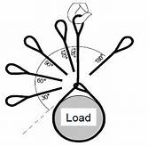
INSPECTION
Rated Capacity of the Sling – The rated capacity of a sling varies depending upon the type of material the sling is made of, the size of the sling, and the type of hitch. Workers must know the capacity of the sling, and can obtain this information through charts or tables available through the manufacturer. The rated capacity of a sling must not be exceeded, under any circumstances.
History of Care and Use – Mishandling and misuse of slings are the leading causes of sling failure. Following the manufacturer’s recommendations for proper care and use are essential for maximum sling service life and safety.

Slide 28
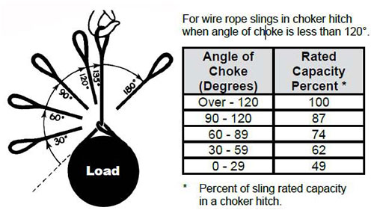
SELECTION, USE, AND INSPECTION OF SLINGS
Workers involved in hoisting and rigging must exercise care when selecting and using slings. The selection of slings should be based upon the size and type of the load, and the environmental conditions of the workplace. Slings should be visually inspected before each use to ensure their effectiveness. Improper use of hoisting equipment, including slings, may result in overloading, excessive speed (e.g., taking up slack with a sudden jerk, shock loading), or sudden acceleration or deceleration of equipment.
Factors to consider when choosing the best sling for the job include size, weight, shape, temperature, and sensitivity of the material being moved, and the environmental conditions under which the sling will be used. The following guide may be useful in selecting the appropriate sling:

Slide 29
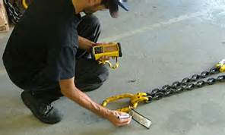
SELECTION, USE, AND INSPECTION OF SLINGS
Chains
Alloy steel chains are strong and able to adapt to the shape of the load. Care should be taken when using chain slings because sudden shocks will damage them. This may result in sling failure and possible injury to workers or damage to the load.
Chain slings must be visually inspected prior to use. During the inspection, pay particular attention to any stretching, nicks, gouges, and wear in excess of the allowances made by the manufacturer. These signs indicate that the sling may be unsafe and must be removed from service immediately.

Slide 30
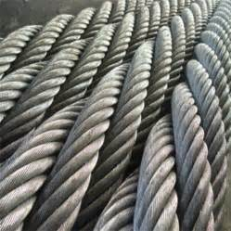
SELECTION, USE, AND INSPECTION OF SLINGS
Wire Rope
Wire rope is composed of individual wires that have been twisted to form strands. Strands are then twisted to form a wire rope. When wire rope has a fibre core, it is usually more flexible but less resistant to environmental damage. Conversely, wire rope with a core that is made of a wire rope strand tends to have greater strength and is more resistant to heat damage.
When selecting a wire rope sling to give the best service, there are four characteristics to consider: strength, ability to withstand fatigue (e.g., to bend without distortion), ability to withstand abrasive wear, and ability to withstand abuse.

Slide 31
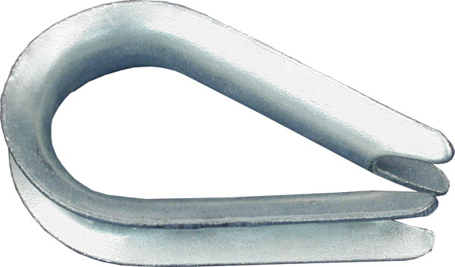
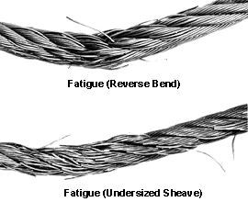
SELECTION, USE, AND INSPECTION OF SLINGS
Strength – Strength of wire rope is a function of its size (e.g., diameter of the rope), grade, and construction, and must be sufficient to accommodate the maximum applied load.
Fatigue (Bending without Failure) – Fatigue failure of wire rope is caused by the development of small cracks during small radius bends. The best means for preventing fatigue failure of wire rope slings is to use blocking or padding to increase the bend radius.
  Abrasive Wear – The ability of wire rope to withstand abrasion is determined by the size and number of the individual wires used to make up the rope. Smaller wires bend more readily and offer greater flexibility, but are less able to withstand abrasion. Larger wires are less flexible, but withstand abrasion better.

Slide 32
SELECTION, USE, AND INSPECTION OF SLINGS
Abuse – Misuse or abuse of wire rope slings will result in their failure long before any other factor. Abuse can lead to serious structural damage, resulting in kinks or bird caging. (In bird caging, the wire rope strands are forcibly untwisted and become spread outwards.) To prevent injuries to workers and prolong the life of the sling, strictly adhered to safe and proper use of wire rope slings.
Wire rope slings must be visually inspected before use. Slings with excessive broken wires, severe corrosion, localized wear, damage to end-fittings (e.g., hooks, rings, links, or collars), or damage to the rope structure (e.g., kinks, bird caging, distortion) must be removed from service and discarded.

Slide 33
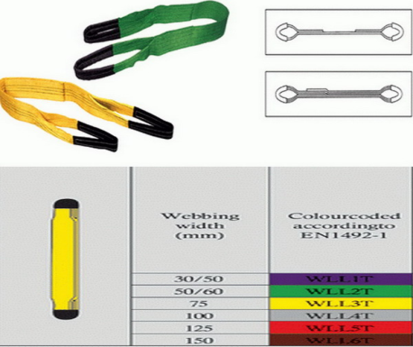
SELECTION, USE, AND INSPECTION OF SLINGS
Fibre rope and synthetic web slings are used primarily for temporary work, such as construction or painting, and are the best choice for use on expensive loads, highly finished or fragile parts, and delicate equipment.
Fibre rope slings deteriorate on contact with acids and caustics and, therefore, must not be used around these substances. Fibre rope slings that exhibit cuts, gouges, worn surface areas, brittle or discoloured fibres, melting, or charring must be discarded. A build-up of powder-like sawdust on the inside of a fibre rope indicates excessive internal wear and that the sling is unsafe. Finally, if the rope fibres separate easily when scratched with a fingernail, it indicates that the sling has suffered some kind of chemical damage and should be discarded.
Synthetic web slings are commonly made of nylon, polypropylene, or polyester and have the following properties in common:

Slide 34
FIBRE ROPE AND SYNTHETIC WEB
Strength - Depending upon their size, synthetic web slings can handle loads of up to 300,000 pounds.
Convenience and Safety - Synthetic web slings adjust to the load contour and hold it with a tight, non-slip grip.
        Load Protection - Unlike other sling materials, synthetic web is less likely to mar, deface, or scratch highly polished surfaces.
Shock Absorbency - Regardless of the construction material, shock loading (e.g., excessive speed, rapid acceleration or deceleration) of slings should be minimized. It should be noted that synthetic web slings can absorb heavy shocks without damage.
Temperature Resistance - The lifting capacity of synthetic web is unaffected by temperatures up to 180 degrees Fahrenheit.

Slide 35
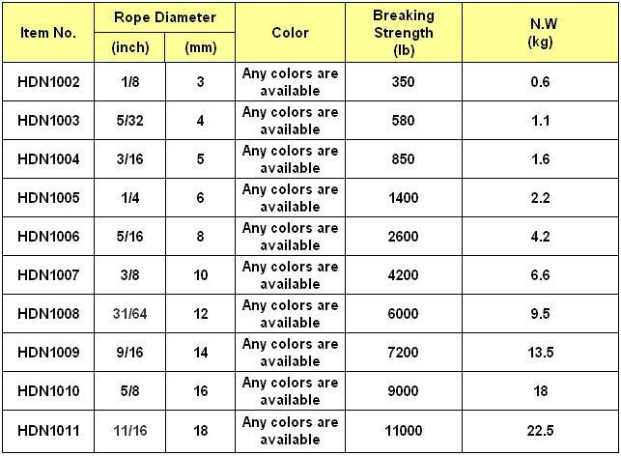
FIBRE ROPE AND SYNTHETIC WEB
Economy and Long Life
Synthetic web slings have a low initial cost and a long service life. They are unaffected by mildew, rot, or bacteria, resist some chemical action, and have excellent abrasion resistance.
Synthetic web slings must be inspected before use and should be removed from service if found to have acid or caustic burns, melting or charring of any part of the surface, snags, tears, or cuts, broken stitches, distorted fittings, or wear or elongation beyond the manufacturer’s specifications.

Slide 36
WIRE ROPES, CHAINS, AND ROPES INSPECTION
Wire ropes, chains, ropes, and other rigging equipment must be inspected prior to use and as necessary during use to ensure their safety.
Defective gear must be removed from service immediately.
Job or shop hooks and links or makeshift fasteners formed from bolts, rods, or other such attachments must not be used.
When U-bolts are used for eye splices, the U-bolt must be applied so that the “U” section is in contact with the dead end of the rope.
When U-bolt wire rope clips are used to form eyes, the following table must be used to determine the number and spacing of clips.

Slide 37
Our Clients

