Slide 1
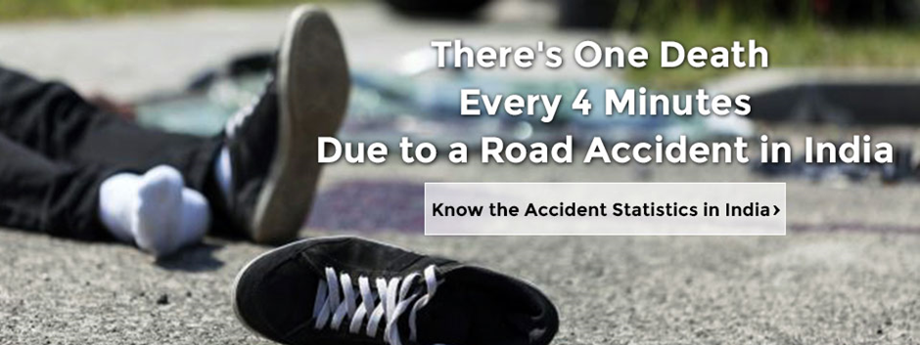
ROAD ACCIDENT STATISTICS IN INDIA
ROAD ACCIDENT STATISTICS
IN INDIA

Slide 2
ABOUT PMG
“BUILDING FOOD FACTORIES WITH TOP QUALITY STANDARDS OF NESTLE, MONDELEZ,ABBOTT, DANONE USING 3D DESIGN AND HYGIENIC ENGINEERING.”
At PMG, we deliver Engineering Design and Project Management scopes in Food and Beverage industry. Our team of design engineers and engineering executives has rich experience in Project Planning, Design, Execution and Commissioning with key competencies in areas like 3D Plant Design, Hygienic Engineering, and Project Management. Our safe-by-choice, result-oriented, and pro-active work-ethics allow us deliver work scopes meeting objectives, complete stakeholder alignment and first-time quality.
PMG Knowledge Repository: Targeted Knowledge Sharing & Skill Development
Precise and focused training modules for the exhaustive set of people working in manufacturing industry, instilling qualities of self-belief, creative thinking & widened perspective.
Clear Learning Objectives
Focused approach to skill development and knowledge sharing
Progressive Evaluation
Gauging improvement on every step and keeping audience connected.
After-training follow-ups
We systematically track differential progress of recipients after the training.
Audience Specific Approach
Programs are fine-tuned to the ability and interests of the recipients.
Multiple Awe-moments
Awe-moments are refreshing and increase receptivity many-fold.
Seasoned Trainers
PMG trainers are subject matter experts with substantial work experience.

Slide 3
AGENDA
1
Introduction
2
Road Accident Statics in India
3
Employee Right and responsibility
4
Vehicle Safety
5
Work zone traffic control
6
Road project and potential hazard
7
Temporary traffic control
8
Mobile work
9
Worker safety consideration
10
Traffic control hazards and injury prevention techniques
11
General prevention measures
12
Innovative technologies for Hazards

Slide 4
INTRODUCTION
This manual is intended as a working guide for training workers and supervisors in the fundamentals of safe rigging and hoisting. The information covers not only ropes and knots but hoisting equipment from cranes to chain falls and rigging hardware from rope clips to spreader beams. Equally important is the attention paid at every point to correct procedures for inspection, maintenance, and operation. Knowledge of the equipment and materials with which we work is one of the most important factors in occupational health and safety. Each item has been designed and developed to serve a specific purpose. Recognizing its capabilities and limitations not only improves efficiency but minimizes hazards and helps prevent accidents.
This manual identifies the basic hazards in rigging and hoisting, explains the safeguards necessary to control or eliminate these hazards, and spells out other essential safety requirements. The information should be used in conjunction with the applicable regulations by contractors, supervisors, operators, riggers, and others delivering or receiving instruction in the basics of safe rigging and hoisting.

Slide 5
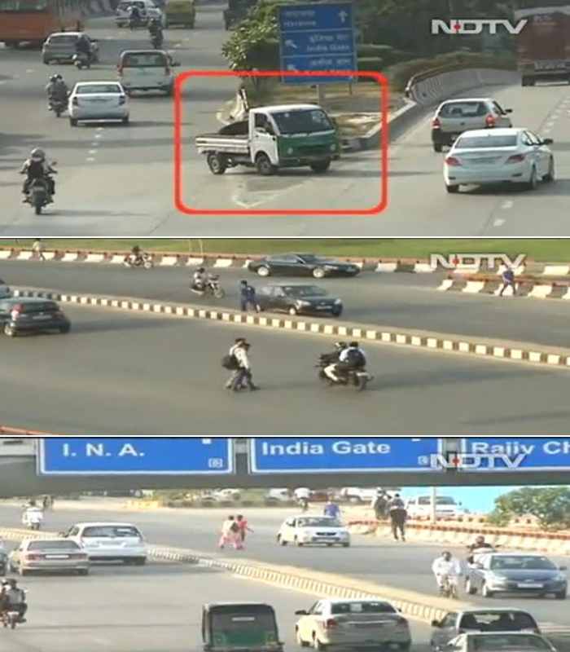
ROAD ACCIDENT STATISTICS IN Delhi-INDIA
5 lives end on Delhi’s roads every day.

Slide 6
EMPLOYEE RIGHTS AND RESPONSIBILITIES
As a worker, you have a legal right to:
  One serious road accident in the country occurs every minute and 16 die on Indian roads every hour.
  1214 road crashes occur every day in India.
  Two wheelers account for 25% of total road crash deaths.
  20 children under the age of 14 die every day due to road crashes in in the country.
  377 people die every day, equivalent to a jumbo jet crashing every day.
  Two people die every hour in Uttar Pradesh – State with maximum number of road crash deaths.
  Tamil Nadu is the state with the maximum number of road crash injuries.
  Top 10 Cities with the highest number of Road Crash Deaths (Rank –Wise).

Slide 7
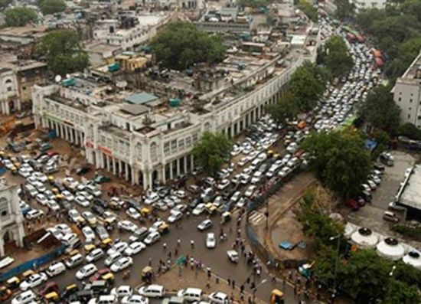
EMPLOYEE RIGHTS AND RESPONSIBILITIES
Drunken driving is one of the leading causes of road fatalities.
Delhi (City)
Chennai
Jaipur
Bengaluru
Mumbai
Kanpur
Lucknow
Agra
Hyderabad
Pune

Slide 8
VEHICLE SAFETY
Automobile safety is the study and practice of design, construction, equipment and regulation to minimize the occurrence and consequences of traffic collisions. Road traffic safety more broadly includes roadway design.
You must ensure that the steering, brakes, front and rear lamps, indicators, reflectors, rear view mirrors, safety belts, speedometer, tyres, windscreen wipers, horn and silencer are checked regularly.
You must put in place a system for the regular inspection and on-going maintenance of your vehicle and ensure it has a valid Certificate of Roadworthiness.
This involves implementing the following measures:
  Deciding how often a vehicle is to be inspected, taking into account the age, mileage and condition of the vehicle.
  Ensuring a daily walk-around check of the vehicle is performed before it is driven in a public place, which involves the inspection of both the inside and outside of the vehicle as well as examination of various items such as the mirrors, seatbelts, tyres, exhaust.
  Keeping records of all inspections, maintenance and repairs of the vehicle.

Slide 9

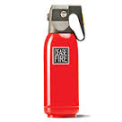
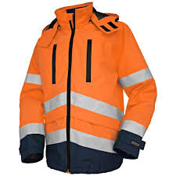
VEHICLE SAFETY
It would be useful to have the following items available for use in your vehicle:
  At least 1 high-viz vest or jacket (fluorescent and reflective).
  Fire Extinguisher.
  Mobile charging slot.
  The above are examples of items that might be useful in an emergency.
  You might choose to carry other items that you feel might be helpful.

Slide 10
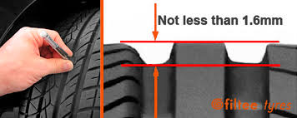
VEHICLE SAFETY
Tyres
Motor vehicles must be tested for their roadworthiness. This section sets out the minimum standards required for your vehicle.
You should check the following on a regular basis:
  Tread depth: Do not allow your tyres to wear down too much. Most vehicles on the road must have a minimum tread depth of 1.6mm over the main treads. For motorcycles and vintage vehicles the minimum tread depth is 1mm. However, make sure you replace your tyres before they become this worn.

Slide 11
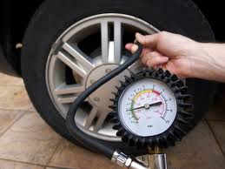
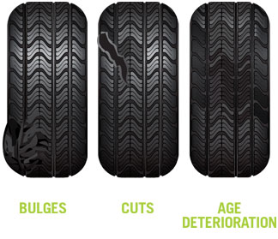
VEHICLE SAFETY
Tyres
  Pressure: Regularly check the pressure of every tyre, including the spare tyre, and pay attention to the recommended pressure levels. See the manufacturer’s specifications for correct inflation pressure.
  Checking for damage: Regularly examine your tyres for cuts, cracks and bulges, which could cause unexpected ‘blow-outs.

Slide 12
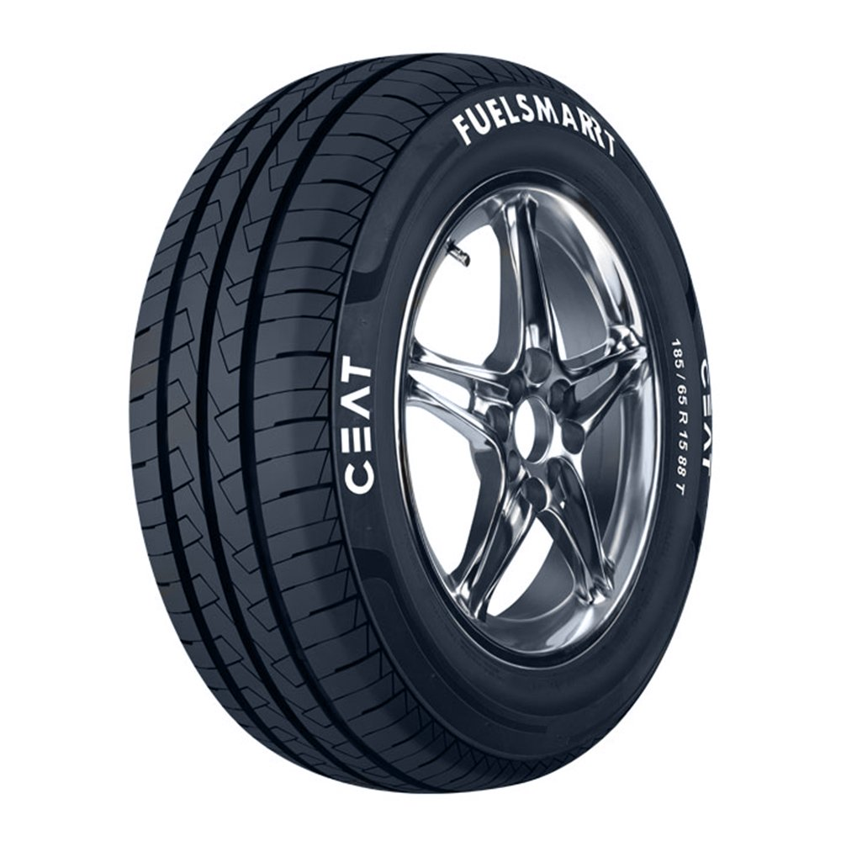
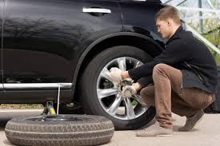
VEHICLE SAFETY
Tyres
Replacing tyres: For your safety only fit new and e-marked tyres bought from a reputable dealer. Do not mix radial and cross ply tyres on any one axle. Tyres must be the same on any axle.
Temporary use (space saver) spare tyres: Only use these tyres to complete a journey or make a journey to a tyre dealer. Do not travel at a speed in excess of the recommended speed stamped on the tyre

Slide 13
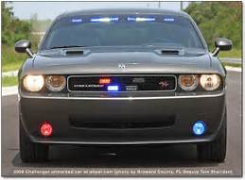
VEHICLE SAFETY
Lights and reflectors
Motor vehicles (except motorcycles or electric vehicles with a maximum speed of 38km/h) must have the following lights and reflectors:
  Lights and reflectors
    At the front:
    Two headlights (white or yellow)
    Two white sidelights
    Direction indicator lights (amber only)

Slide 14
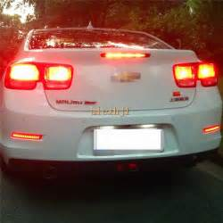
VEHICLE SAFETY
Lights and reflectors
    At the back:
    Two red lights (commonly known as tail lights)
    Two red brake lights
    Two red reflectors
    Number plate lighting
    Direction indicator lights (amber only)
Your lights, reflectors, number plate lighting and direction indicators will be effective only if you keep them clean and in good working order.
You must only use fog lights in dense fog or falling snow. Turn them off in clear weather or you will risk causing glare and may dazzle other drivers. You may fit high mounted rear brake lights if you wish, but fitting other optional lighting is controlled by law.

Slide 15
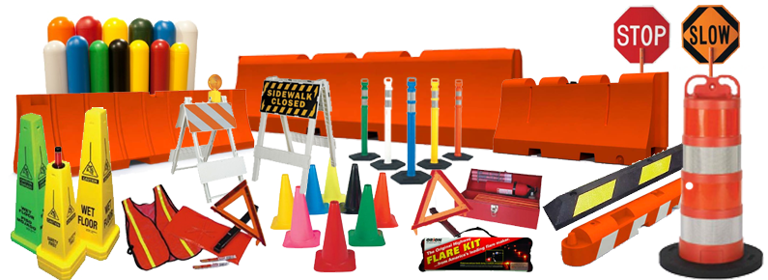
WORK ZONE TRAFFIC CONTROL
Traffic
A vehicles or people in the vehicles, a delay that involves transportation or movement through a designated location. An example of traffic is people driving in cars. An example of traffic is a heavy delay in a railroad system.
  Underlying principles of work zone traffic control
  Manual of Uniform Traffic Control Device (MUTCD)
  Hazards associated with work zone traffic control
  Injury prevention techniques
  Summary

Slide 16
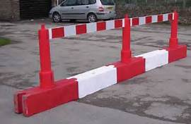
WORK ZONE TRAFFIC CONTROL
Type of Barrier
Rigid Barriers
They are usually constructed of reinforced concrete. A permanent concrete barrier will only deflect a negligible amount when struck by a vehicle. Instead, the shape of a concrete barrier is designed to redirect a vehicle into a path parallel to the barrier.

Slide 17
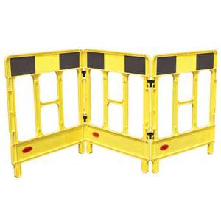
WORK ZONE TRAFFIC CONTROL
Type of Barrier
Flexible barriers (channelizing devices)
Provide nominal protection for workers flexible and deformable, do not cause damage if struck. Flexible barriers typically include channelizing devices such as drums and cones and are deformable in nature. They are commonly used to guide traffic through a work zone and to separate the travel lanes from the work area. Since flexible barriers are not rigid like concrete barriers, they do not provide as much protection to the workers, due to their flexible and deformable nature when struck. These types of channelizing devices are however, very effective in delineating travel lanes and guiding motorists through the work zone.

Slide 18
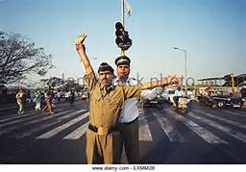

WORK ZONE TRAFFIC CONTROL
Traffic Control
Influences drivers’ perception of risk Provides information on potential hazards Minimizes aggressive behavior Assists in navigation Engineering concerns for work zones Primary focus:
Safe and efficient movement of vehicles through work zone Relatively less emphasis on safety of construction workers

Slide 19
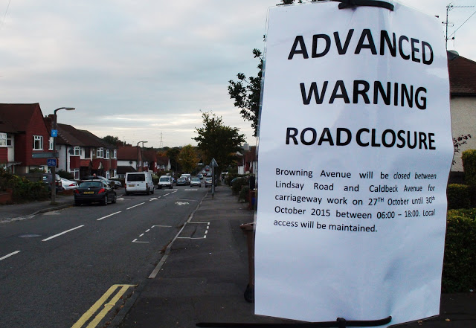
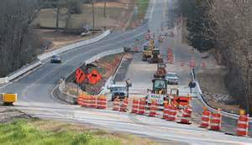
ROAD PROJECTS AND POTENTIAL HAZARDS
Components of Temporary Traffic Control Zones
Advanced Warning Area- In the advance warning area, the road users are informed about the upcoming work zone.
Transition Area- In the transition area, the road users are redirected out of their normal path using strategically placed tapers.

Slide 20
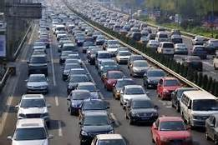
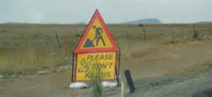
ROAD PROJECTS AND POTENTIAL HAZARDS
Components of Temporary Traffic Control Zones
Activity Area- In the activity area, the work activity occurs and is comprised of the work space, the traffic space and the buffer space.
  Work space
  Traffic space
  Buffer space
Termination Area- In the termination area, the traffic is redirected to its normal path and extends from the downstream end of the road work area to the last temporary traffic control device

Slide 21
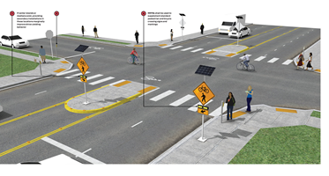
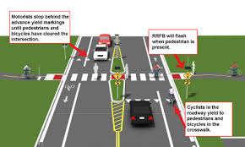
ROAD PROJECTS AND POTENTIAL HAZARDS
Components of Temporary Traffic Control Zones
Modifying traffic control strategies to influence drivers’ perception of risk Leads to more careful and slower driving Improves safety for the workers.
Examples:
  Providing active warning devices Illuminated arrow boards Reliable advisory speed limit Active message with flashers Narrower lane widths Longer and/or wider buffer zones Rigid barriers to separate workers from travel lanes

Slide 22
POSITIVE GUIDANCE’ APPROACH
When worker safety is considered in the highway construction/work zone traffic control design, several modifications to the existing traffic control strategies can be made to affect drivers’ perception of a heightened risk. Such risk perception by the drivers leads to more careful and slower driving, and often improves the overall safety of the workers. These design elements compromise, to some degree, the efficiency of traffic flow by forcing drivers to reduce their speed and drive cautiously through the work zone due to the increase in perceived risk. Such elements include the use of narrow lane widths, longer and/or wider buffer zones, and traffic barriers to separate the work area from the travel lanes. The use of these traffic control techniques may reduce the potential of severe traffic crashes and injury to motorists and workers.

Slide 23
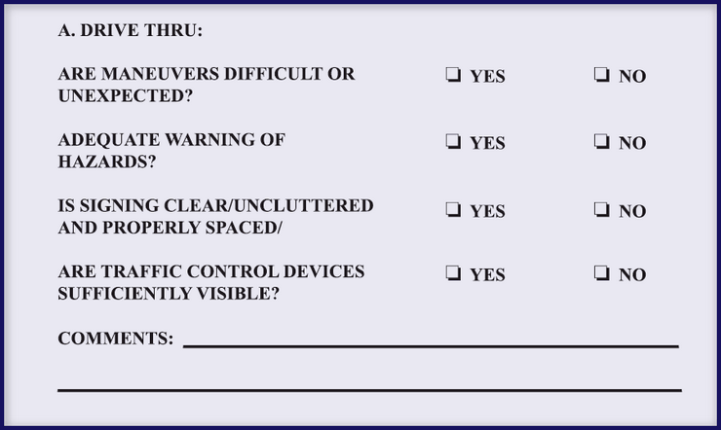
POSITIVE GUIDANCE’ APPROACH
May be used to improve safety in work zones Combines highway/traffic engineering features with what rational drivers expect Considers:
  Various age groups of drivers
  Complexity of work zone information handling
  Limited capability of humans for detecting, processing, and remembering information

Slide 24
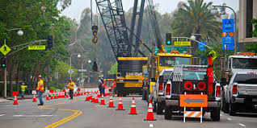
TEMPORARY TRAFFIC CONTROL
Work zones present constantly changing conditions
  Unexpected by the road user
  Creates higher degree of vulnerability for workers
  Workers
Temporary traffic control (TTC) devices include
  Signs
  Signals
  Markings
  Other devices
Used to regulate, warn, or guide road users

Slide 25
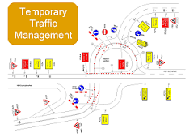
TEMPORARY TRAFFIC CONTROL
Temporary traffic control devices are used to regulate, warn, or guide road users, placed on, over or adjacent to a street, highway, pedestrian facility, or bikeway by authority of a public body or official having jurisdiction. These devices include signs, signals, markings, and other devices.

Slide 26
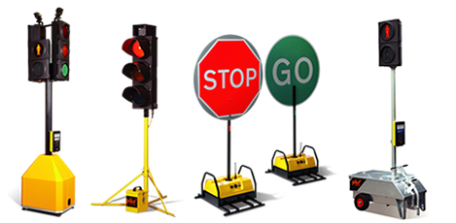
MOBILE WORK
Often involve frequent short stops for activities
  Such as litter cleanup, pothole patching, or utility operations, and are similar to short-duration operations.
TTC zones may includes:
  Warning signs, high-intensity rotating, flashing, oscillating, or strobe lights on a vehicle, flags, and/or channelizing devices.
  Flaggers.
  A shadow vehicle equipped with an arrow panel or a sign following the work vehicle.
  Appropriately colored and marked vehicles with signs, flags, high-intensity rotating, flashing, oscillating, or strobe lights, truck-mounted attenuators, and arrow panels or portable changeable message signs may follow a train of moving work vehicles.

Slide 27

MOBILE WORK
Mobile operations often involve frequent short stops for activities such as litter cleanup, pothole patching, or utility operations, and are similar to short-duration operations. Warning signs, high-intensity rotating, flashing, oscillating, or strobe lights on a vehicle, flags, and/or channelizing devices should be used and moved periodically to keep them near the mobile work area. Flaggers may be used for mobile operations that often involve frequent short stops. Mobile operations also include work activities where workers and equipment move along the road without stopping, usually at slow speeds. The advance warning area moves with the work area.

Slide 28
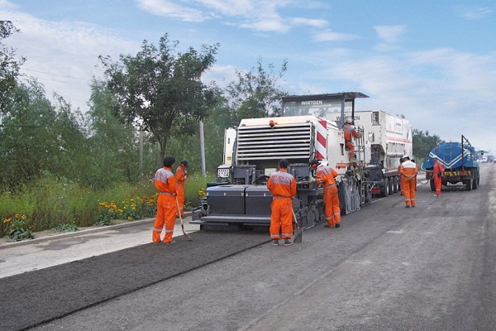
WORKER SAFETY CONSIDERATIONS
Key elements that SHOULD be considered to improve worker safety:
  Training
  Worker safety apparel
  Temporary traffic barriers
  Speed reduction measures
  Planning of activity area
  Planning for worker safety

Slide 29
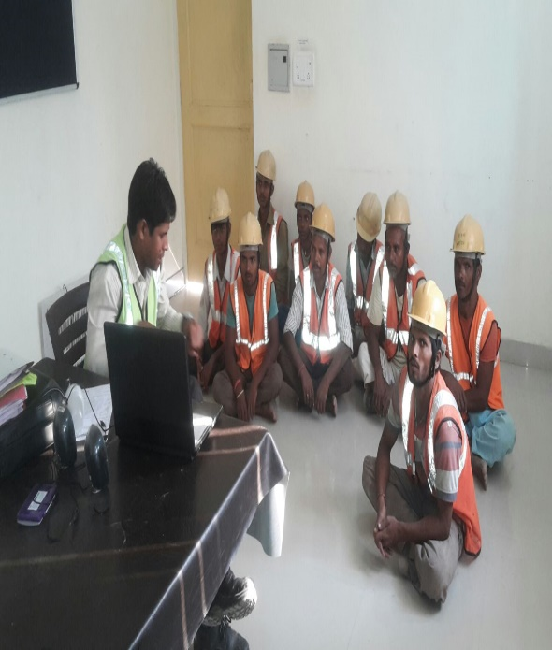
WORKER SAFETY CONSIDERATIONS
Training
All workers should be trained on how to work next to motor vehicle traffic in a way that minimizes their vulnerability”.
Training workers for safe working methods teaches the types of hazards associated with different types of work and how those hazards can be mitigated.
One of the most promising aspects of training is that it raises the awareness about potential hazards and injury prevention techniques.

Slide 30
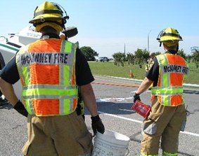
WORKER SAFETY CONSIDERATIONS
Worker safety apparel
All workers exposed to the risks of moving roadway traffic or construction equipment should wear high-visibility safety apparel

Slide 31
WORKER SAFETY CONSIDERATIONS
Temporary traffic barriers
Temporary traffic barriers shall be placed along the work space depending on factors such as the lateral clearance of workers from adjacent traffic, speed of traffic, duration and type of operations, time of day, and volume of traffic”.
The lateral clearance of workers from adjacent traffic is important to provide physical separation of the work area and the path of motorist traffic. When the speed of traffic is high, the barriers can be spaced relatively far apart, as compared to low speed applications. For mobile work, it is desirable to provide light weight temporary traffic barriers than concrete barriers, due to the moving nature and short duration of the work activities. If work is carried out at night, it is always desirable to have barriers with retro-reflective paint. When the traffic volumes are high, there is a higher probability that traffic may encroach into the work space if the barriers are not rigid and relatively heavy

Slide 32
WORKER SAFETY CONSIDERATIONS
Speed reduction measures
Reducing the speed of vehicular traffic, mainly through regulatory speed zoning, funneling, lane reduction, or the uniform law enforcement officers or flaggers, should be considered”.
Planning the activity area
Planning the internal work activity area to minimize backing-up maneuvers of construction vehicles should be considered to minimize the exposure to risk”.
Planning and operation of the internal work activity area is a crucial part of injury prevention. On-foot workers who work around equipment with increased blind spots and frequently changing path of travel have increased exposure to risk.

Slide 33

WORKER SAFETY CONSIDERATIONS
Planning for worker safety
A competent person designated by the employer should conduct a basic hazard assessment for the work and job classifications required in the activity area. This safety professional should determine whether engineering, administrative, or personal protection measures should be implemented”.
A job safety analysis (JSA) should be performed, listing all the hazards associated with a particular type of work and the methods to reduce the hazards associated with it. Frequent and regular inspections of the construction site should be conducted by a competent and designated person

Slide 34
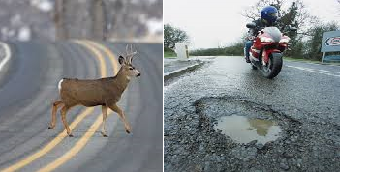
TRAFFIC CONTROL HAZARDS AND INJURY PREVENTION TECHNIQUES
Common Hazards
Hazards related to work zone traffic control can be broadly categorized into three basic types of hazards including passing motorists intruding into the work space, flagging hazards, and nighttime traffic control hazards

Slide 35
TRAFFIC CONTROL HAZARDS AND INJURY PREVENTION TECHNIQUES
Passing motorists intruding into the work space may occur for various reasons, some of which include high speed of motoring traffic, improper geometry of lane shift, improper traffic control and others.
Flagging is an inherently hazardous job since the flaggers stand close to the moving traffic and a lack of continuous alertness can jeopardize their safety any time.
Quite a bit of construction work is done at night in an effort to avoid the higher volume daytime hours and associated traffic delays, which may be the only positive benefit of night work. If traffic can be maintained at a reasonable level, it is generally preferred to conduct work during the day for the following reasons:
Night work is inherently more hazardous due to the reduced visibility and the much higher percentage of impaired drivers
Production and quality can suffer to some extent because of the difficulty of working under low light and portable light conditions

Slide 36
TRAFFIC CONTROL HAZARDS AND INJURY PREVENTION TECHNIQUES
Passing motorists intruding into the work space may occur for various reasons, some of which include high speed of motoring traffic, improper geometry of lane shift, improper traffic control and others.
Flagging is an inherently hazardous job since the flaggers stand close to the moving traffic and a lack of continuous alertness can jeopardize their safety any time.
Quite a bit of construction work is done at night in an effort to avoid the higher volume daytime hours and associated traffic delays, which may be the only positive benefit of night work. If traffic can be maintained at a reasonable level, it is generally preferred to conduct work during the day for the following reasons:
Night work is inherently more hazardous due to the reduced visibility and the much higher percentage of impaired drivers
Production and quality can suffer to some extent because of the difficulty of working under low light and portable light conditions

Slide 37
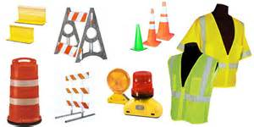
GENERAL PREVENTIVE MEASURES
Traffic Control
  Use additional warning devices
  Maintain signs properly
  Use Proper lane markings
Flaggers
  Use a flashing slow/stop paddle
On-foot workers
  Use portable radio communication equipment

Slide 38

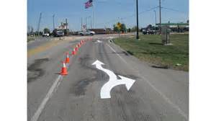
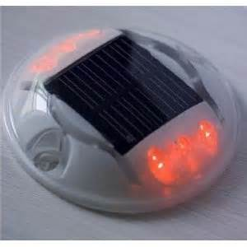
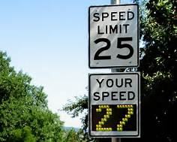


INNOVATIVE TECHNOLOGIES FOR HAZARD CONTROL
Vertical safety cade
CB wizard alert system
Radar triggered speed display
White lane drop arrows
Light guard lighted raised pavement markers
Removable orange strips
Flashing slow/stop paddle

Slide 39
INNOVATIVE TECHNOLOGIES FOR HAZARD CONTROL
Vertical Safety Cades
Vertical safety Cades may be used in place of standard channelizing devices. They are more visible than standard channelizing devices. Higher visibility may translate into improve driver actions, as a result of increased reaction time. This helps in reducing driving errors related expectancy violations.
They also provide additional guidance, as the arrows on the vertical safety cades indicate the direction of traffic to merge at a lane shift.
They are light and portable, so it is easy for the workers to place and remove them. In lieu of the following:
  This may reduce worker reluctance to ensure they are set up and maintained properly
  Since they have collapsible frames, they are easily recoverable for repeated use

Slide 40
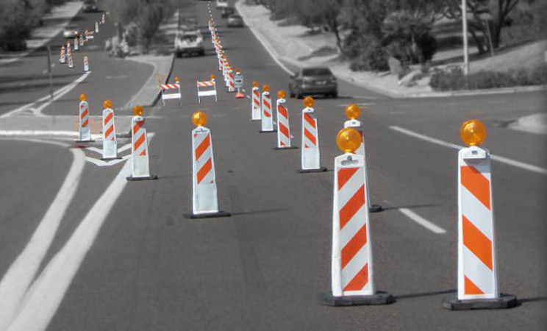
INNOVATIVE TECHNOLOGIES FOR HAZARD CONTROL
Vertical Safety Cades
Designed to replace standard channelizing devices
Better visibility
More positive guidance
Greater portability
Improved recoverability
Collapsible frame

Slide 41
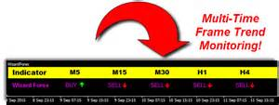
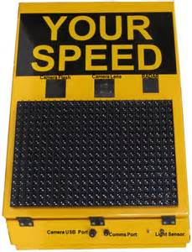
INNOVATIVE TECHNOLOGIES FOR HAZARD CONTROL
CB Wizard Alert System
Trailer-mounted system broadcasts a recorded message to all CB-equipped motorists
Notify drivers of downstream work zones allows truck drivers to lower their speeds in advance of work zone.
Radar-Triggered Speed Display
Back-lit dynamic speed display standard speed limit sign strobe flash (optional)
  Strobe will flash when a vehicle exceeds a certain speed
Trailer mounted

Slide 42
INNOVATIVE TECHNOLOGIES FOR HAZARD CONTROL
Radar-triggered speed displays are used to induce reaction to spontaneous speed of the moving traffic in the work zone. Since the motorists know what their speed is in the work zone, they will be encouraged to adjust their speed according to the speed as observed by an individual driver. The display is positioned such that it can show the speed of each vehicle, one at a time.
Vehicle/Mobile Equipment and Visibility Hazards
  Workers can be at risk of serious injury due to hazards involving vehicles and mobile equipment at industrial workplaces.
  Various types of vehicles, including tractors, trucks and mobile equipment such as forklifts, tow buggies and pallet walkies can be found in industrial workplaces. Incidents involving these vehicles have resulted in worker injuries, deaths and damage to property. There have also been a number of “near misses” in which incidents could have occurred.

Slide 43

INNOVATIVE TECHNOLOGIES FOR HAZARD CONTROL
Duties under the Occupational Health and Safety Act
Employers, supervisors, and workers have duties, some duties that apply to vehicle/mobile equipment and visibility hazards.

Slide 44
INNOVATIVE TECHNOLOGIES FOR HAZARD CONTROL
Employers
Ensure workers are provided with information, training and supervision to protect their health and safety. This may include training vehicle operators on a workplace’s rules for safe operation of vehicles, such as for speed limits, stopping at intersections, and hand and horn signals. Ensure equipment and protective devices are maintained in good condition.
Take every precaution reasonable in the circumstances to protect workers. This may include developing a traffic management program to protect vehicle operators and nearby workers, or other controls such as those mentioned below.

Slide 45
INNOVATIVE TECHNOLOGIES FOR HAZARD CONTROL
Employers
Use barriers, warning signs or other safeguards for the protection of all workers in areas where vehicle or pedestrian traffic may endanger the safety of any worker.
Use competent signallers when required and ensure they are stationed in the correct position.
Ensure lifting devices and mobile equipment are operated only by competent persons or by a worker who is being instructed and accompanied by a competent person.
Ensure artificial lighting is provided if there is inadequate natural lighting, and that shadows and glare are reduced to a minimum.
Ensure mobile equipment has head lights and tail lights to provide adequate illumination when lighting conditions are poor.
Ensure unattended vehicles are immobilized and secured against accidental movement.

Slide 46
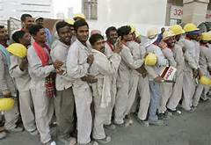
INNOVATIVE TECHNOLOGIES FOR HAZARD CONTROL
Workers
Report any traffic-related hazards, as well as any contraventions, to your supervisor or employer.
Work in compliance with the OHSA and Regulations for Industrial Establishments.
Use or wear the personal protective equipment that your employer requires to be used or worn.
Do not use or operate equipment or machines or work in a manner that may endanger yourself or any other worker.
Take every precaution reasonable in the circumstances for the protection of workers.
Ensure workers comply with the OHSA and Regulation for Industrial Establishments, including ensuring workers use any equipment, protective devices or clothing required by the employer.
Advise workers of the existence of any potential or actual hazards of which the supervisor is aware. This may include traffic hazards.

Slide 47
INNOVATIVE TECHNOLOGIES FOR HAZARD CONTROL
Engineering Controls
Designate routes for workers who work in close proximity to moving vehicles so they avoid vehicle traffic.
Install assistive devices on vehicles or in the workplace that can improve visibility:
Devices such as convex mirrors at intersections and warning lights to indicate the presence of vehicles/workers in the workplace.
Devices on vehicles such as mirrors, proximity sensing/viewing devices such as cameras, reversing alarms, communication radios and warning lights.
Eliminate or be aware of blind spots on vehicles, especially when equipment is in a raised position.
Ensure computer displays or other equipment added to a vehicle’s cab meet manufacturers’ recommendations and are sized and located so they do not interfere with an operator’s view.

Slide 48
INNOVATIVE TECHNOLOGIES FOR HAZARD CONTROL
Administrative controls
Create a Traffic Management Program: A written traffic management program for workplace traffic can reduce the risk of incidents involving vehicles and nearby workers. The program could address site and task-specific risks and should contain the following components:
  Before creating the program, a workplace traffic assessment is recommended to identify
  vehicle routes and walking routes for nearby workers
  Areas with greater collision risk due to the type of vehicle, pedestrian activities and/or area layout.
  All workers must be trained on the program. Temporary workers and contractors must also be aware of the program.
  Safety Standard for Lift Trucks (CSA Standard B335-04 (R2012)) has guidance on traffic management.
  Implement communication protocols, warning signs or other safeguards to protect workers around vehicle traffic.

Slide 49
Our Clients

