Slide 1
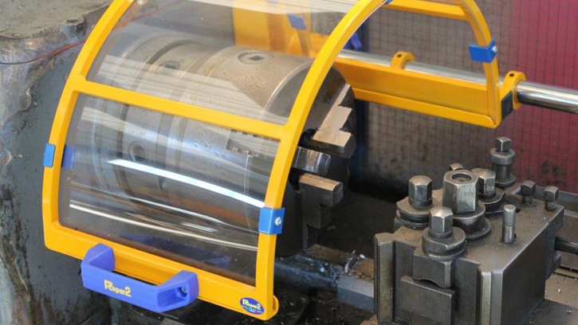
SAFETY OF MACHINERY - GUARDS

Slide 2
ABOUT PMG
“BUILDING FOOD FACTORIES WITH TOP QUALITY STANDARDS OF NESTLE, MONDELEZ,ABBOTT, DANONE USING 3D DESIGN AND HYGIENIC ENGINEERING.”
At PMG, we deliver Engineering Design and Project Management scopes in Food and Beverage industry. Our team of design engineers and engineering executives has rich experience in Project Planning, Design, Execution and Commissioning with key competencies in areas like 3D Plant Design, Hygienic Engineering, and Project Management. Our safe-by-choice, result-oriented, and pro-active work-ethics allow us deliver work scopes meeting objectives, complete stakeholder alignment and first-time quality.
PMG Knowledge Repository: Targeted Knowledge Sharing & Skill Development
Precise and focused training modules for the exhaustive set of people working in manufacturing industry, instilling qualities of self-belief, creative thinking & widened perspective.
Clear Learning Objectives
Focused approach to skill development and knowledge sharing
Progressive Evaluation
Gauging improvement on every step and keeping audience connected.
After-training follow-ups
We systematically track differential progress of recipients after the training.
Audience Specific Approach
Programs are fine-tuned to the ability and interests of the recipients.
Multiple Awe-moments
Awe-moments are refreshing and increase receptivity many-fold.
Seasoned Trainers
PMG trainers are subject matter experts with substantial work experience.

Slide 3
AGENDA
1
Introduction
2
Terms and definitions
3
Requirements for the design & construction of guard
4
Human Aspects
5
Guard Design Aspects
6
Selection of materials
7
Selection of types of guards
8
Selection of guards according to the nature and frequency of access required
9
Additional design and construction consideration
10
Information for use

Slide 4
INTRODUCTION
The structure of safety standards in the field of machinery is as follows:
  Type-A standards
  Type-B standards
  B1
  B2
  Type-C standards

Slide 5
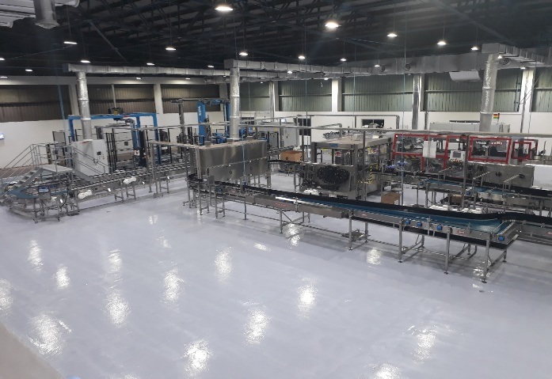
INTRODUCTION
The structure of safety standards in the field of machinery is as follows:
Type-A standards (basic safety standards) giving basic concepts, principles for design, and general aspects that can be applied to all machinery
Type-B standards (generic safety standards) dealing with one safety aspect or one or more type(s) of safeguard that can be used across a wide range of machinery:
  Type-B1 standards on particular safety aspects (e.g. safety distances, surface temperature, noise)
  Type-B2 standards on safeguards (e.g. two-hand controls, interlocking devices, pressure-sensitive devices, guards)
Type-C standards (machine safety standards) dealing with detailed safety requirements for a particular

Slide 6
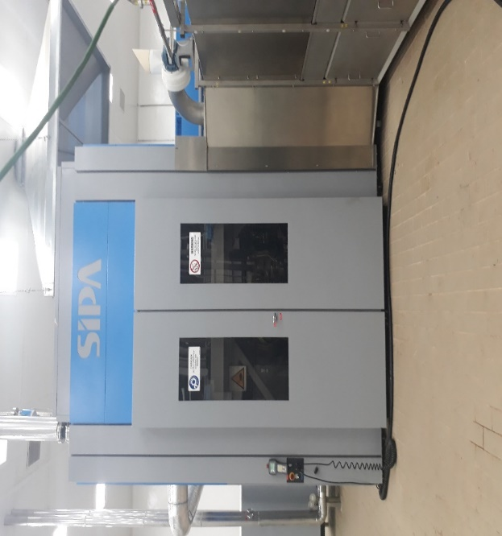
INTRODUCTION
Scope
This International Standard specifies general requirements for the design and construction of guards provided primarily to protect persons from mechanical hazards.
The requirements are applicable if fixed and movable guards are used. This International Standard does not cover those parts of guards which actuate this International Standard does not provide requirements for special systems relating specifically to mobility or to the ability to lift loads such as rollover protective structures (ROPS) and falling-object protective structures (FOPS).

Slide 7
TERMS AND DEFINITIONS
Guard
Part of a machine specifically used to provide protection by means of a physical barrier
  NOTE 1 Depending on its construction, a guard may be called casing, cover, screen, door, enclosing guard, etc.
  NOTE 2 A guards may act:
    Alone, in which case it is only effective when it is closed
    In conjunction with an interlocking device with or without guard locking, in which case protection is ensured whatever the position of the guard.

Slide 8
TERMS AND DEFINITIONS
Guard
Part of a machine specifically used to provide protection by means of a physical barrier
  NOTE 1 Depending on its construction, a guard may be called casing, cover, screen, door, enclosing guard, etc.
  NOTE 2 A guards may act:
    Alone, in which case it is only effective when it is closed
    In conjunction with an interlocking device with or without guard locking, in which case protection is ensured whatever the position of the guard.

Slide 9
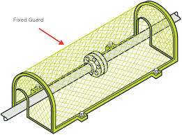
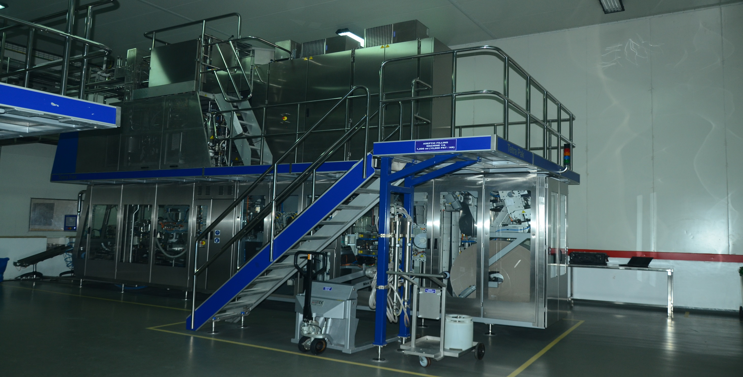
TERMS AND DEFINITIONS
Guard
Fixed guard
Guard kept in place, that is closed, either permanently (by welding, etc.), or by means of fasteners (screws, nuts, etc.) making removal/opening impossible without using tools
Enclosing guard
Guard which prevents access to the danger zone from all sides fence or tunnel guard.

Slide 10
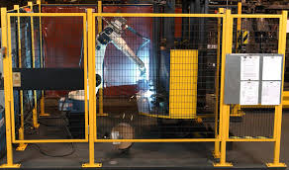
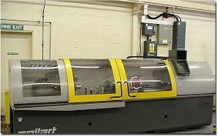
TERMS AND DEFINITIONS
Guard
Distance guard
Guard which does not completely enclose a danger zone, but which prevents or reduces access by virtue of its Dimensions and its distance from the danger zone, for example perimeter fence or tunnel guard.
Movable guard
Guard generally connected by mechanical means, for example with hinges or slides, to the machine frame or an adjacent fixed element and which can be opened without the use of tools

Slide 11

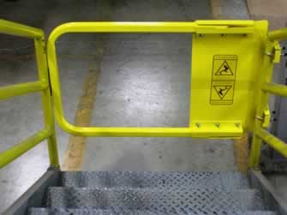
TERMS AND DEFINITIONS
Guard
Power-operated guard
Movable guard that is operated with the assistance of power from a source other than persons or gravity.
Self-closing guard
Movable guard operated by a machine element or by the work piece or a part of the machining jig, so that it allows the work piece to pass and then automatically returns to the closed position as soon as the work piece has vacated the opening through which it has been allowed to pass.

Slide 12
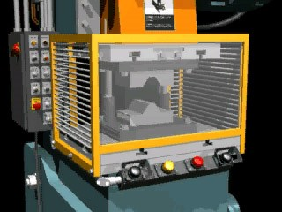
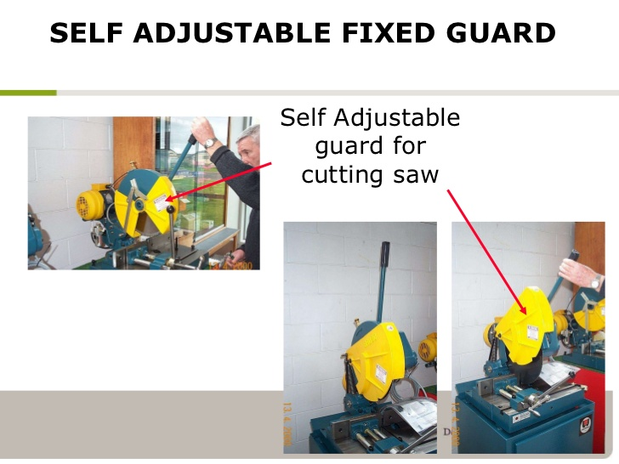
TERMS AND DEFINITIONS
Guard
Control guard
  Guard associated with an interlocking device2) so that:
  The hazardous machine functions “covered” by the guard cannot operate until the guard is closed
  Closing the guard initiates operation of the hazardous machine function
Adjustable guard
  Fixed or movable guard which is adjustable as a whole or which incorporates adjustable parts. The adjustment remains fixed during a particular operation.

Slide 13
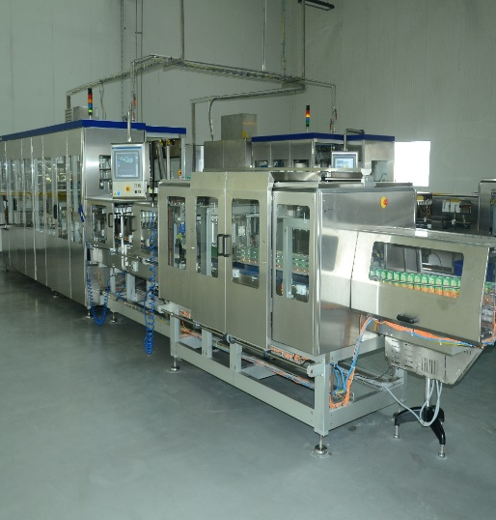
TERMS AND DEFINITIONS
Guard
Interlocking guard
  Guard associated with an interlocking device so that:
    The hazardous machine functions “covered” by the guard cannot operate until the guard is closed
    If the guard is opened while hazardous machine functions are operating, a stop instruction is given
    When the guard is closed, the hazardous machine functions “covered” by the guard can operate, but the closure of the guard does not by itself initiate their operation

Slide 14
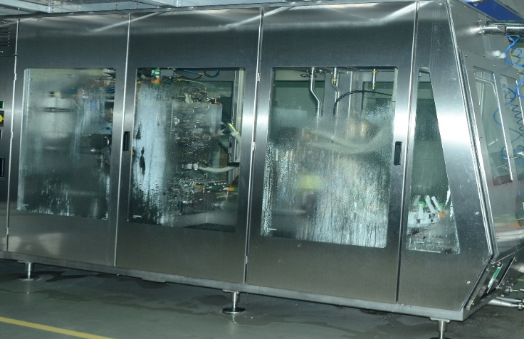
TERMS AND DEFINITIONS
Guard
Interlocking guard with guard locking
  Guard associated with an interlocking device2/4 and a guard locking device so that:
    The hazardous machine functions “covered” by the guard cannot operate until the guard is closed and locked.
    The guard remains closed and locked until the risk of injury from the hazardous machine functions has passes.
    When the guard is closed and locked, the hazardous machine function “covered” by the guard can operate, but the closure and locking of the guard do not by themselves initiate their operation.

Slide 15
TERMS AND DEFINITIONS
Guard
Guard closed position
  When performing the function for which it was designed, that is to prevent or reduce access to the danger zone and/or reduce exposure to hazards such as noise, radiation etc. a guard is closed
Guard open
  When it is not in the closed position, a guard is open

Slide 16
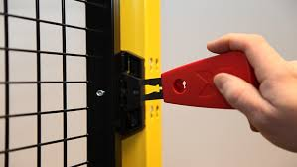

TERMS AND DEFINITIONS
Guard
Tool
  Implement such as a key or wrench designed to operate a fastener. An improvised implement such as a coin or a nail-file cannot be considered as a tool.
Use of a tool
  Use of a tool by an authorized person under known and predetermined circumstances as part of a safe system of work

Slide 17
TERMS AND DEFINITIONS
Guard
Frequency of access
  Number of occasions on which access is required or foreseeable within the guarded area per unit of time.
Risk assessment
  In order to select and design types of guards appropriate to particular machinery, it is important to assess the risk arising from the various hazards present at that machinery and the foreseeable categories of persons at risk

Slide 18
REQUIREMENTS FOR THE DESIGN & CONSTRUCTION OF GUARD
General
Proper consideration of foreseeable aspects of the machine environment and operation throughout the foreseeable life of the machine is necessary in the design and application of guards. Inadequate consideration of these aspects can lead to unsafe or inoperable machinery. This in turn can lead persons to defeat the guards provided, thus exposing them to greater risk.

Slide 19
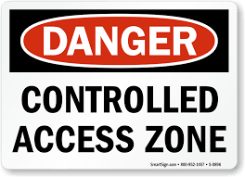
REQUIREMENTS FOR THE DESIGN & CONSTRUCTION OF GUARD
Access to danger zones
To minimize access to danger zones where practicable, guards and machinery shall be so designed as to enable routine adjustments, lubrication and maintenance to be carried out without opening or removing the guards.

Slide 20
REQUIREMENTS FOR THE DESIGN & CONSTRUCTION OF GUARD
Access to danger zones
Where access is required within the guarded area, this shall be as free and unobstructed as practicable.
The following are examples of reasons for access:
  Loading and unloading
  tool changing and setting
  measurement, gauging and sampling
  process observation
  maintenance and repair
  lubrication
  removal of waste material (for example scrap, swarf, spillage)
  obstruction removal
  Cleaning and hygiene

Slide 21
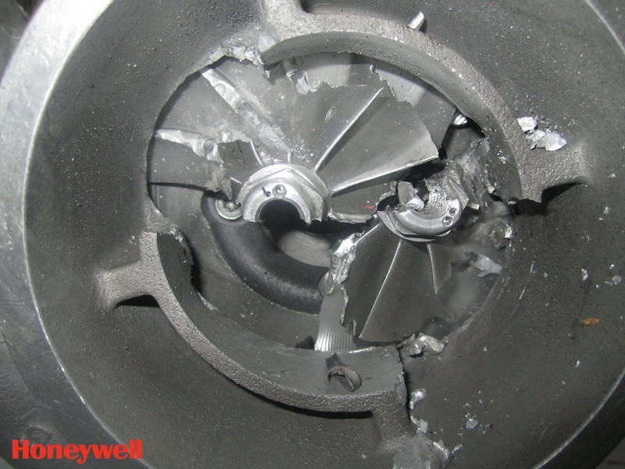
REQUIREMENTS FOR THE DESIGN & CONSTRUCTION OF GUARD
Containment of ejected parts
Where there is a foreseeable risk of ejection of parts (for example broken tooling, work piece) from the machine, the guard shall, as far as practicable, be designed and constructed from appropriate materials selected to contain such ejections

Slide 22
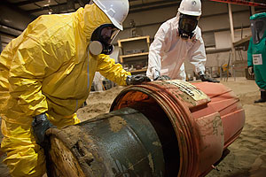
REQUIREMENTS FOR THE DESIGN & CONSTRUCTION OF GUARD
Containment of hazardous substances
Where there is a foreseeable risk of emission from the machine of hazardous substances (for example coolant, vapours, gases, sward, sparks, hot or molten material, dust) the guard shall be designed to contain these substances as far as practicable and suitable extraction equipment can be needed.
If a guard forms part of an extraction system, this function shall be considered in the design, selection of materials, construction and positioning of the guard.

Slide 23

REQUIREMENTS FOR THE DESIGN & CONSTRUCTION OF GUARD
Noise
Where a requirement has been established to reduce machine noise, guards shall be designed and constructed to give the required noise reduction whilst providing protection against the other hazards present at the machine. Guards acting as acoustic enclosures shall have adequately sealed joints to reduce the emission of noise.

Slide 24

REQUIREMENTS FOR THE DESIGN & CONSTRUCTION OF GUARD
Radiation
Where there is a foreseeable risk of exposure to hazardous radiation, guards shall be designed and appropriate materials selected to protect persons from the hazard. Examples include the use of darkened glazing to prevent weld flash or the elimination of openings in a guard around a laser.

Slide 25
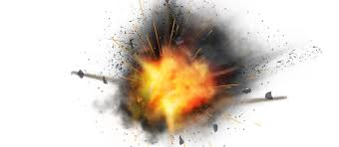
REQUIREMENTS FOR THE DESIGN & CONSTRUCTION OF GUARD
Explosion
Where there is foreseeable risk of explosion, guards shall be designed to contain or dissipate the released energy in a safe manner and direction (for example by use of “explosion relief” panels)

Slide 26
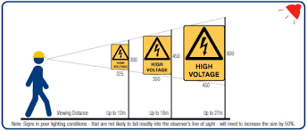
HUMAN ASPECTS
General
Safety distances
Reasonably foreseeable aspects of human interaction with machinery (for example when loading, maintaining or lubricating) shall be given proper consideration in the design and construction of guards.
Reasonably Guards intended for preventing access to danger zones shall be designed, constructed and positioned to prevent parts of the body from reaching danger zones

Slide 27
HUMAN ASPECTS
Viewing
Ergonomic aspects
To minimize the need to remove them, guards shall be designed and constructed to offer adequate viewing of the process.
Guards shall be designed and constructed taking into account ergonomic principles

Slide 28
HUMAN ASPECTS
Size and weight
Removable sections of guards shall be designed to be of a suitable size and weight to permit ease of handling.
Guards which cannot readily be moved or transported by hand shall be provided or be capable of being provided with suitable attachment devices for transport by means of a lifting gear.
The attachments or provisions can be, for instance:
  Standard lifting appliances with slings, hooks, eyebolts or simply tapped holes for appliance fixing
  Appliances for automatic grabbing with a lifting hook, when securing is not possible from the ground
  Lifting gear and appliances integrated into the guard
  An indication, on the guard itself and on some of its removable parts or in the information for use, of the value of their mass expressed in kilograms (kg)

Slide 29
HUMAN ASPECTS
Operating force
The observance of ergonomic principles in designing guards contributes to increasing safety by reducing stress and the physical effort of the operator.
This improves the performance and reliability of the operation, thereby reducing the probability of errors at all stages of machine use Operating forces can be reduced by the use of devices such as springs, counterbalances or gas struts.
Where guards are power operated, they shall not be capable of causing injury (for example from contact pressure, force, speed, sharp edges). Where a guard is fitted with a protective device which automatically initiates re-opening of the guard, the force to prevent the guard closing shall not exceed 150 N.
The kinetic energy of the guard shall not exceed 10 J. Where no such protective device is fitted, these values shall be reduced to 75 N and 4 J respectively

Slide 30
HUMAN ASPECTS
Intended use
Guards shall be designed so far as is practicable to take into account foreseeable use and reasonably foreseeable misuse

Slide 31
GUARD DESIGN ASPECTS
General
Crushing or trapping points
All foreseeable aspects of guard operation shall be given proper consideration at the design stage to ensure that the design and construction of the guard itself does not create a further hazard.
Guards shall be designed so as not to cause hazardous crushing or trapping points with parts of the machine or other guards

Slide 32
GUARD DESIGN ASPECTS
Durability
Hygiene
Guards shall be designed to perform their function properly throughout the foreseeable life of the machine, otherwise provision shall be made for the replacement of degradable parts.
Where applicable, guards shall be designed so as not to create hazards to hygiene by trapping items or material, for example food particles, stagnant fluids

Slide 33
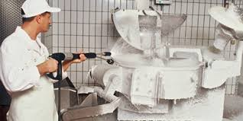
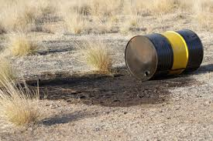
GUARD DESIGN ASPECTS
Cleaning
Exclusion of contaminants
Guards used in certain applications, notably for the processing of food and pharmaceuticals, shall be so designed that they are not only safe to use but can also be easily cleaned.
Where it is a requirement of the process, guards shall be designed to exclude contaminants from the process, for example in the food, pharmaceutical, electronic and related industries

Slide 34


GUARD DESIGN ASPECTS
Guard construction aspects
Sharp edges, etc.
The following aspects shall be considered in determining the methods to be used for the construction of guards.
Guards shall be constructed so as to be free of exposed sharp edges, corners or other hazardous projections.

Slide 35
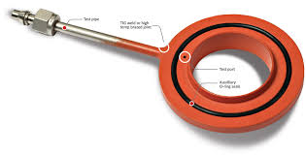
GUARD DESIGN ASPECTS
Integrity of joints
Removal only by tool
Welded, bonded or mechanically fastened joints shall be of sufficient strength to suit reasonably foreseeable loading. Where bonding agents are used, these shall be compatible with the process and materials being used. Where mechanical fastenings are used, their strength, number and spacing shall be sufficient to ensure the stability and rigidity of the guard.
Demountable parts of guards shall only be removable with the aid of a tool

Slide 36
GUARD DESIGN ASPECTS
Positive location of removable guards
Positive closing of movable guards
Where practicable, removable guards shall be unable to remain in place without their fixings.
The closed position of movable guards shall be determined positively. The guard shall be held in position against a stop by means of gravity, a spring, catch, guard locking device or other means.

Slide 37
GUARD DESIGN ASPECTS
Self-closing guards
Adjustable guards
The self-closing guard opening shall be limited to no more than that required for the passage of the work piece. It shall not be possible to block the guard in its open position. These guards can be used in conjunction with fixed distance guards.
Adjustable parts shall be such as to enable the opening to be restricted to a minimum consistent with the passage of material, and be easily adjustable without the use of a tool.

Slide 38
GUARD DESIGN ASPECTS
Movable guards
Control guards
The opening of movable guards shall require positive action and, where practicable, movable guards shall be attached to the machine or adjacent fixed elements so that they are retained, for example by hinges or slides, even when open. Such attachments shall only be removable with the aid of a tool
Control may be used only if all the following conditions are fulfilled:
  There is no possibility for an operator or a part of his body to remain in the danger zone or between the danger zone and the guard while the guard is closed
  The dimensions and shape of the machine allow for the operator or any person having to intervene on the machine to have a global view of the whole machine/process
  Opening the control guard or an interlocking guard is the only way to enter the danger zone

Slide 39
SELECTION OF MATERIALS
General
Impact resistance
The following aspects shall be considered in the selection of suitable materials for the construction of guards. These properties shall be maintained throughout the foreseeable life of the guard.
Guards shall be designed to withstand reasonably foreseeable impacts from parts of machinery, work piece, broken tooling, ejected solid or fluid matter, impact by the operator, etc.
Where guards are fitted with viewing panels, special consideration shall be given to the selection of materials and method of fixing them.
Materials shall be selected with properties suited to resist the mass and velocity of the ejected object or material.

Slide 40
SELECTION OF MATERIALS
Rigidity
Secure fixing
Support posts, guard frames and infill materials shall be selected and arranged to provide a rigid and stable structure and to resist deformation. This is especially important where deformation of material could be detrimental to maintaining safety distances.
Guards or parts of guards shall be secured by fixing points of adequate strength, spacing and number to remain secure under any foreseeable loading. Fixing can be by means of mechanical fasteners or clamps, welded or bonded joints or other means suited to the application.

Slide 41
SELECTION OF MATERIALS
Reliability of moving parts
Containment
Moving parts, for example hinges, slides, handles, catches, shall be selected to ensure reliable operation given their foreseeable usage and working environment.
Harmful substances, for example fluids, sward, dust, fumes, which can reasonably be foreseen, shall be contained within the guard by a suitable impermeable material.

Slide 42
SELECTION OF MATERIALS
Resistance to corrosion
Resistance to micro-organisms
Materials shall be selected which are resistant to foreseeable oxidation and corrosion from the product, process or environmental factors, for example from cutting fluids in machining operations or cleaning and sterilizing agents in food processing machinery. This can be achieved by the application of suitable protective coatings
Where there is a foreseeable risk to health from bacterial and fungal growth, such as in the food, pharmaceutical and related industries, materials used in the construction of guards shall be selected that inhibit this growth and can be easily cleaned and, if necessary, disinfected.

Slide 43
SELECTION OF MATERIALS
Non-toxicity
Machine viewing
Materials and finishes used shall be non-toxic in all foreseeable conditions of use and compatible with the process involved especially in food, pharmaceutical and related industries.
Where viewing of machine operation is required through the guard, materials shall be selected with suitable properties, for example if perforate material or wire mesh is used this should be of adequate open area and suitable colour to permit viewing. Viewing will be enhanced if the perforate material is darker than the area observed.

Slide 44
SELECTION OF MATERIALS
Transparency
As far as is practicable, materials used for viewing machine operation shall be selected from amongst those which retain their transparency despite age and use. Guards shall be designed to make provision for the replacement of degraded materials.
Certain applications can require the selection of materials or combinations of materials that are resistant to abrasion, chemical attack, degradation by ultraviolet radiation, dust attraction by static electrical charge, or surface wetting by fluids which impair transparency.

Slide 45
SELECTION OF MATERIALS
Stroboscopic effects
Electrostatic properties
Where there is a foreseeable hazard from stroboscopic effects, materials shall be selected which minimize this occurrence
Certain applications can require the selection of materials that do not retain an electrostatic charge, in order to avoid an accumulation of dust and particles as well as sudden electrical discharge with the associated risks of fire or explosion.
Guards can need to be earthed to avoid build-up of static charge to a hazardous level.

Slide 46
SELECTION OF MATERIALS
Thermal stability
Flammability
Materials shall be selected which do not degrade, that is which are not subject to brittle fracture, excessive deformation or emission of toxic or flammable fumes when exposed to the range of foreseeable temperature variations or sudden changes in temperatures.
Materials selected shall retain their properties in foreseeable climatic and workplace conditions.
Where there is a foreseeable risk of fire, materials selected shall be spark resistant and fire retardant and shall not absorb or emit flammable fluid, fumes, etc.

Slide 47
SELECTION OF MATERIALS
Noise and vibration reduction
Radiation protection
Where necessary, materials shall be selected to provide noise and vibration reduction. This can be achieved by means of insulation (putting an acoustic barrier in the path of the noise), and/or absorption (lining guards with appropriate acoustically absorbent materials) or by a combination of both.
Guard panels can also need to be suitably damped to minimize effects of resonance which can transmit or amplify noise
In certain applications, such as welding or the use of lasers, materials shall be selected that protect persons from harmful radiation.
For welding applications, this protection can be by means of a suitably tinted transparent screen which permits viewing but eliminates harmful radiation

Slide 48
SELECTION OF TYPES OF GUARDS
General
If the risk assessment has established a requirement for guards, they shall be selected in accordance with the following guidelines in selecting suitable guards, the appropriate phases of the life of the machinery shall be considered.
The most important selection criteria are:
  The probability and foreseeable severity of any injury as indicated by the risk assessment
  the intended use of the machine as defined in ISO/TR 12100-1:1992, 3.12; the hazards present at the machine (see clause 4 and clause 5 and ISO/TR 12100-1) the nature and frequency of access.

Slide 49
SELECTION OF TYPES OF GUARDS
Combination of different guards or of guards with other devices
It can be appropriate to use a combination of different types of guard. For example, if a machine has several danger zones and access is required to one of them during the operating phase, the guards can consist of a fixed guard combined with an interlocking movable guard

Slide 50
SELECTION OF TYPES OF GUARDS
Selection of guards according to the number and location of the hazards
Guards should be selected from the following in the order of priority given:
  Local guards enclosing individual danger zones if the number of danger zones to protect is low. This can provide an acceptable residual risk and permits access to non-hazardous machine parts for maintenance, setting, etc.

Slide 51
SELECTION OF TYPES OF GUARDS
Selection of guards according to the number and location of the hazards
Guards should be selected from the following in the order of priority given:
  Local guards enclosing individual danger zones if the number of danger zones to protect is low. This can provide an acceptable residual risk and permits access to non-hazardous machine parts for maintenance, setting, etc.
  Local guards enclosing individual danger zones if the number of danger zones to protect is low. This can provide an acceptable residual risk and permits access to non-hazardous machine parts for maintenance, setting, etc.
  A guard enclosing all the danger zones if the number or size of the danger zones is high. In this case, setting and maintenance points should, as far as possible, be located outside the guarded area.
  Partial distance guard if the use of an enclosing guard is impracticable and the number of danger zones to protect is low.
  Fully surrounding distance guard if the use of an enclosing guard is impracticable and the number or size of the danger zones is high. The flow chart in annex B illustrates this procedure.

Slide 52
SELECTION OF TYPES OF GUARDS
Selection of guards according to the number and location of the hazards
It can be beneficial to the production process to divide a guarded area into different sections, to enable actions (for example checking, adjustment) in one section to be carried out without affecting machine operation in another section.
The guarding for each section shall be in accordance with all the requirements of this International Standard.

Slide 53
SELECTION OF GUARDS ACCORDING TO THE NATURE AND FREQUENCY OF ACCESS REQUIRED
Moving transmission parts
Guards to protect against hazards generated by moving transmission parts, for example pulleys, belts, gears, racks and pinions, shafts, shall be either fixed guards
Where access is not required during use
Fixed guards should be used on account of their simplicity and reliability
Where access is required during the working cycle
The following types of guard should be used:
  Movable guard with interlock or with interlock with guard locking (see ISO 14119). If access is required for a very short working cycle, it can be preferable to use a power-operated movable guard.
  Control guard where the special conditions are met for use

Slide 54
SELECTION OF GUARDS ACCORDING TO THE NATURE AND FREQUENCY OF ACCESS REQUIRED
Where, due to the nature of the operation, access to the danger zone cannot be totally prohibited
  When tools, for example saw blades, need to be partially exposed the following guards are appropriate:
    Self-closing guard
    Adjustable guard (Add Pic accordingly)

Slide 55
ADDITIONAL DESIGN AND CONSTRUCTION CONSIDERATIONS
Climbing
Retained fastenings
Climbing on guards shall, as far as practicable, be inhibited by design. Consideration shall be given to this possibility in their construction and the selection of materials and shapes. For example, by eliminating horizontal structural members and the horizontal component of mesh fabric from the outside surface of the guard, climbing is made more difficult.
Where practicable, guard fastenings shall remain attached to the guard, as this reduces the likelihood of their being lost and not replaced( Add Pic)

Slide 56
ADDITIONAL DESIGN AND CONSTRUCTION CONSIDERATIONS
Vibration resistance
Warning signs
Where applicable, fastenings may need to be fitted with lock nuts, spring washers etc. to ensure that they remain attached to the guard
Where access within the guarded area can expose persons to residual risks, for example radiation, appropriate warning signs shall be placed at access points.

Slide 57
ADDITIONAL DESIGN AND CONSTRUCTION CONSIDERATIONS
Colour
Aesthetics
Hazards can be highlighted by the use of suitable colours. For example, if a guard is painted the same colour as the machine and the hazardous parts painted a contrasting bright colour, attention is drawn to the hazard when the guard is opened or left off.
As far as practicable, guards shall be designed so as to minimize adverse psychological effects

Slide 58
ADDITIONAL DESIGN AND CONSTRUCTION CONSIDERATIONS
Verification of the safety requirements
Impact strength
Certain aspects of guard design and construction shall be subject to verification by examination, inspection, testing or calculation. Where practicable, verification shall be carried out with the guard in its working situation.
Verification can be required for the resistance of guards to impact from persons, parts of tools, high pressure liquids, etc. Before carrying out this verification, it is necessary to identify the foreseeable impact hazard to which the guard may be subjected, for example low velocity impacts from persons, high velocity impacts from broken parts of tools, impact from high pressure fluids.

Slide 59
ADDITIONAL DESIGN AND CONSTRUCTION CONSIDERATIONS
Safety distances
Noise
Verification that guards comply with the required safety distances shall be by measurement guards are designed for containment of hazardous substances the performance of this function shall be verified. Where leakage is readily seen, visual inspection can be adequate. Where leakage cannot be seen, for example leakage of gas or vapour, an alternative verification method such as air sampling is required
Where a guard is designed to reduce noise, its acoustic performance shall be verified by taking noise readings.
Where normal usage of a guard involves the application of physical force, for example to open movable guards or to remove fixed guards, it may be necessary to verify that these forces are not excessive

Slide 60
ADDITIONAL DESIGN AND CONSTRUCTION CONSIDERATIONS
Visibility
Where the maintenance of visibility through the guard is essential to the proper functioning of the guard, this shall be verified under normal operating conditions by means of a visual check.

Slide 61
INFORMATION FOR USE
General
Guard hazards
The instructions for use shall contain the required information about guards and their functions, including installation and maintenance
Information shall be provided of any hazards associated with the guards themselves, for example flammability of materials.

Slide 62
INFORMATION FOR USE
Installation
Operation
Instructions shall be supplied for the correct installation of guards and associated equipment.
Instructions shall be provided directing the user to the correct operation of the guards, their interlocks, etc. Warnings against reasonably foreseeable misuse shall be given.

Slide 63
INFORMATION FOR USE
Removal of guards
Inspection and maintenance
Information shall be provided indicating any actions to be taken before guards may be removed safely, for example machine power isolation or dissipation of stored energy
Details shall be provided of inspections to be carried out and maintenance required for, for example:
  loss of or damage to any part of the guard, especially where this leads to deterioration of safety performance for example reduction of impact resistance from scratches to glazing materials
  replacement of wearing parts
  correct operation of interlocks

Slide 64

About PMG Consultants
PMG Consultants is group of competent people with expertise in respective domains. Delivering commitments, exceeding expectations & creating value for clients in every interaction is our non-negotiable objective. Using the most advanced design & collaboration work systems, we aspire to become Inspirational business partners for our clients.
Get in touch
We would love to hear from you. Gauge our capabilities by speaking to us. You can visit us at our New Delhi Design Office, or meet our representative at your location.
Our Office
Address:
162A/9, 3rd Floor, Kishangarh,
Vasant Kunj, , New Delhi, 110070
Phone: +91-9871115995, +91-11-23361790
Email: connect@pmg-consultants.com
Abhinav.pandey@pmg-consultants.com

