Slide 1

PINCH POINT

Slide 2
ABOUT PMG
“BUILDING FOOD FACTORIES WITH TOP QUALITY STANDARDS OF NESTLE, MONDELEZ,ABBOTT, DANONE USING 3D DESIGN AND HYGIENIC ENGINEERING.”
At PMG, we deliver Engineering Design and Project Management scopes in Food and Beverage industry. Our team of design engineers and engineering executives has rich experience in Project Planning, Design, Execution and Commissioning with key competencies in areas like 3D Plant Design, Hygienic Engineering, and Project Management. Our safe-by-choice, result-oriented, and pro-active work-ethics allow us deliver work scopes meeting objectives, complete stakeholder alignment and first-time quality.
PMG Knowledge Repository: Targeted Knowledge Sharing & Skill Development
Precise and focused training modules for the exhaustive set of people working in manufacturing industry, instilling qualities of self-belief, creative thinking & widened perspective.
Clear Learning Objectives
Focused approach to skill development and knowledge sharing
Progressive Evaluation
Gauging improvement on every step and keeping audience connected.
After-training follow-ups
We systematically track differential progress of recipients after the training.
Audience Specific Approach
Programs are fine-tuned to the ability and interests of the recipients.
Multiple Awe-moments
Awe-moments are refreshing and increase receptivity many-fold.
Seasoned Trainers
PMG trainers are subject matter experts with substantial work experience.

Slide 3
AGENDA
1
General information
2
Goal
3
Workplace injuries
4
Machine guarding
5
Loto
6
Material handling
7
Focous on job
8
Safety control for pinch points
9
Responsibility
Notes:
3

Slide 4
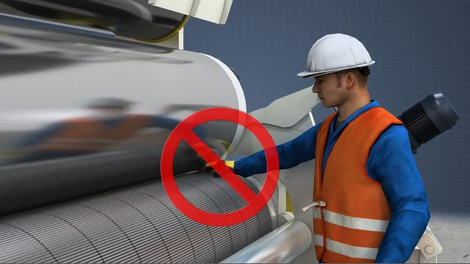
GENERAL INFORMATION
A Pinch Point is produced when 2 objects come together and there is a possibility that a person could be caught or injured when coming in contact with that area.
Pinch points commonly impact fingers / hands, but can impact any area of the body.
The injury resulting from a pinch point could be as minor as a blister or as severe as amputation or death.
Conveyors, gears, loaders, compactors and other moving equipment are examples of machinery with pinch points.

Slide 5
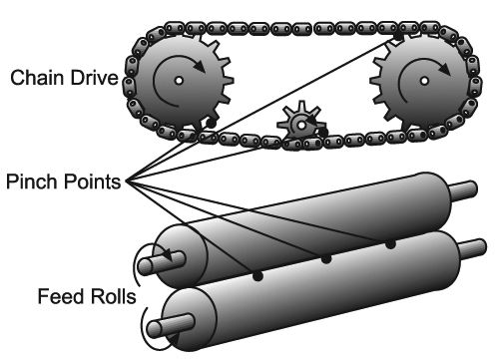
GOAL
Recognize pinch point hazards.
Know how to prevent pinch point injuries.

Slide 6
WORKPLACE INJURY
Workplace may occur when a body part gets caught in a pinch point
  Pinch point is a place where it’s possible for a body part to be caught:
    Between moving machine parts
    Between moving and stationary machine parts
    Between moving parts and materials being processed or manufactured
  Other pinch point situations, not covered by these OSHA regulations, include:
    Catching fingers, hands, toes, or feet under or between heavy crates or equipment or drums while moving them
    Slamming fingers or hands in a door
    Nipping fingers or hands with hand tools like pliers
    Nipping fingers or hands with equipment that has sliding parts or hinges
    Nipping fingers or hands while closing a container
    Getting clothing or jewellery tangled in a pinch point

Slide 7
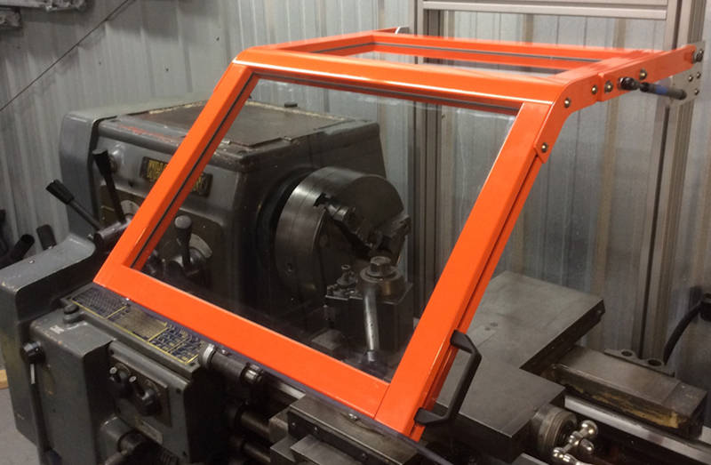
MACHINE GUARDING
Machine and Tool Guards Prevent Pinch Point Injuries
  On machines such as presses and rollers, requires guards to act as barriers between body parts and pinch points.
  Many tools also have guards to keep your body away from pinch points.
    Never remove or disable a machine guard or use a machine that has a missing or disabled guard.
    Never reach around, under, or through a guard.
    Report guards that are missing or not working properly.

Slide 8

LOTO
Switch Off and Lockout/Tag-out Equipment Before Repairing or Servicing
  A machine that starts up or moves accidentally can trap a hand or other body part in a pinch point.
  If you must place your hands near pinch points to repair, service, unjam, or adjust equipment:
    Turn off the machine.
    Have an authorized employee properly lock or tag out the energy controls.
    Perform the needed work.
    Have an authorized employee properly remove the lock or tag before you use the equipment.
Look for Possible Pinch Points before Starting Any Task
  Check the equipment you’re going to use to see where a body part could get caught.
  Plan the task to prevent pinch point injuries.

Slide 9

MATERIAL HANDING
Lift, Carry, and Place Containers and Equipment Carefully
  Lift the edge of a heavy item slightly before picking it up to get an idea of its weight.
    An item that’s too heavy or awkward to carry can slip and trap hands or feet in a pinch point.
    Get help or use material handling aids to move heavy or awkward items.
    When placing a heavy item on a shelf, pallet, floor, etc.:
  Make sure there’s enough room so it won’t land on your feet
  Slide the item into place, while moving feet and hands out of the way

Slide 10
FOCOUSE ON JOB
Give Even the Smallest Task Your Full Attention
  Pinch point injuries from doors, hinges, container lids, etc.
  usually occur when you’re distracted.
  Concentrate on what you’re doing at all times on the job.
  Don’t fool around or daydream at work
Common Causes of Injuries from Pinch Points
  Not paying attention to the location of hands and feet
  Walking or working in areas with mobile equipment and fixed structures
  Loose clothing, hair or jewellery getting caught in rotating parts or equipment
  Poor condition of equipment and guarding
  Dropping or carelessly handling materials or suspended loads
  Not using the proper work procedures or tools
  Reaching into moving equipment and machinery

Slide 11
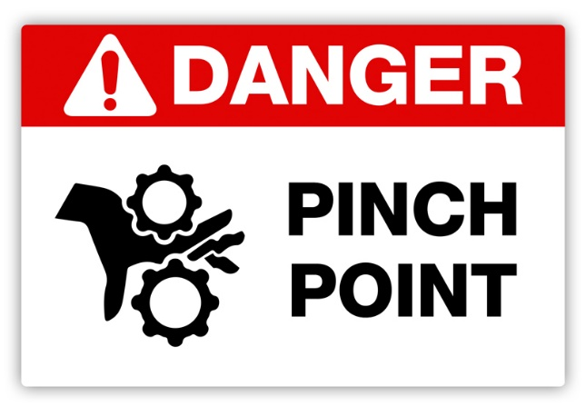
SAFETY CONTROL FOR PINCH POINTS
Machine guarding: Verify all guarding is in place and effective
Personal Protective Equipment: Heavy-duty leather gloves, metacarpal guards, forearm guards, etc. Note: Do not wear gloves around rotating machinery
Pre-work inspection: Identify potential pinch points before starting work
Stay in employee designated areas: Always make sure mobile equipment operators know your location
Lockout/Tag-out: Always verify the equipment is de-energized before starting any maintenance work
Alertness: Drowsiness leads to inattentive work habits and shortcuts
Operating manuals and work procedures: Always review these before starting work; pinch points may also be identified in these documents

Slide 12
SAFETY CONTROL FOR PINCH POINTS
Shortcuts Lead to Danger
  Often pinch-point injuries are the result of workers, who are not properly trained, don’t realize the dangers of machinery, or take shortcuts to get the work done more quickly, but end up injuring themselves instead.
  Never perform a task without proper training, by taking shortcuts, or bypassing procedures; the consequences could be serious.
Keep Your Guard Up
  In addition to making sure that workers understand how potentially dangerous pinch points can be, it is important to ensure equipment is properly guarded to keep workers away from hazardous areas.

Slide 13
SAFETY CONTROL FOR PINCH POINTS
Proper Lockout/Tag-out (LOTO) Reduces Pinch
  Point Hazards Because pinch-point injuries often occur when a machine is being stopped temporarily for service or cleaning,
  It is extremely important that workers follow necessary procedures for lockout and tag-out (LOTO).
  Workers can follow guard policies for when the machine is running, but when it’s stopped and the guard is removed, if the equipment is not de-energized, a worker is not safe.

Slide 14

RESPONSIBILITY
The best protection from pinch-point hazards comes not from procedures, but from the personal attention of employers and workers to potential hazards.
  Review the dangers of pinch points and the procedures for working safely on a regular basis.
  Perform frequent, targeted inspections to ensure that guards are not missing and procedures are being followed.
  Reward employees for identifying and reporting hazards and quickly resolve those hazards. Safety is everyone’s responsibility and should not be learned by accident.

Slide 15
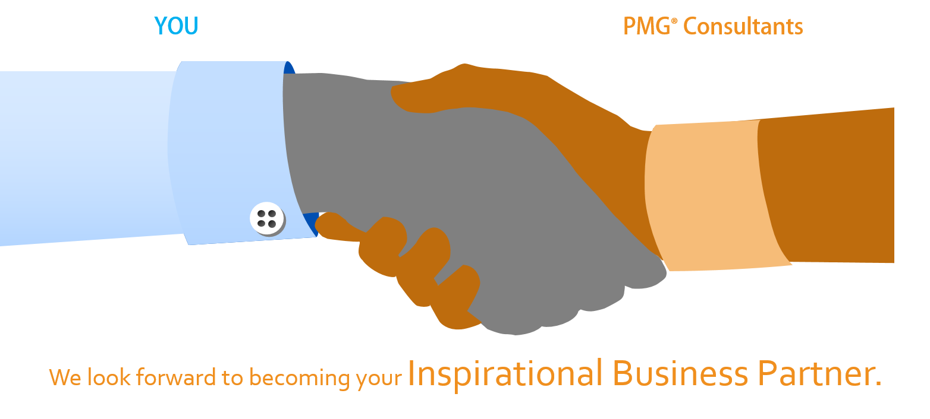
About PMG Consultants
PMG Consultants is group of competent people with expertise in respective domains. Delivering commitments, exceeding expectations & creating value for clients in every interaction is our non-negotiable objective. Using the most advanced design & collaboration work systems, we aspire to become Inspirational business partners for our clients.
Get in touch
We would love to hear from you. Gauge our capabilities by speaking to us. You can visit us at our New Delhi Design Office, or meet our representative at your location.
Our Office
Address:
162A/9, 3rd Floor, Kishangarh,
Vasant Kunj, , New Delhi, 110070
Phone: +91-9871115995, +91-11-23361790
Email: connect@pmg-consultants.com
Abhinav.pandey@pmg-consultants.com

