Slide 1
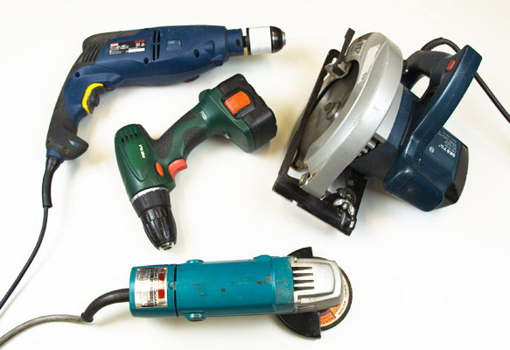
HAND AND PORTABLE
POWER TOOLS

Slide 2
ABOUT PMG
“BUILDING FOOD FACTORIES WITH TOP QUALITY STANDARDS OF NESTLE, MONDELEZ,ABBOTT, DANONE USING 3D DESIGN AND HYGIENIC ENGINEERING.”
At PMG, we deliver Engineering Design and Project Management scopes in Food and Beverage industry. Our team of design engineers and engineering executives has rich experience in Project Planning, Design, Execution and Commissioning with key competencies in areas like 3D Plant Design, Hygienic Engineering, and Project Management. Our safe-by-choice, result-oriented, and pro-active work-ethics allow us deliver work scopes meeting objectives, complete stakeholder alignment and first-time quality.
PMG Knowledge Repository: Targeted Knowledge Sharing & Skill Development
Precise and focused training modules for the exhaustive set of people working in manufacturing industry, instilling qualities of self-belief, creative thinking & widened perspective.
Clear Learning Objectives
Focused approach to skill development and knowledge sharing
Progressive Evaluation
Gauging improvement on every step and keeping audience connected.
After-training follow-ups
We systematically track differential progress of recipients after the training.
Audience Specific Approach
Programs are fine-tuned to the ability and interests of the recipients.
Multiple Awe-moments
Awe-moments are refreshing and increase receptivity many-fold.
Seasoned Trainers
PMG trainers are subject matter experts with substantial work experience.

Slide 3
AGENDA
1
Introduction
2
Hazards
3
General precautions
4
Hand tools
5
Portable tools
Notes:
3

Slide 4

INTRODUCTION
Hand and portable power tools enable workers to apply additional force and energy to accomplish a task.
Safety requires proper care supervision and selection while using these tools.

Slide 5

HAZARDS
Injuries such as burns, bruises, cuts, strains, eye injuries, electrical shock, fire, explosion of vapour / gases, falling tools and other objects may occur while using hand and portable power tools due to the following:
Use of damaged hand tools or tool getting dislodged from handle
  Wrenches with cracked or worn jaws
  Screwdrivers with broken tips, or stripped handles
  Hammers with chipped, mushroomed heads
  Broken, split or loose handle of the tool
  Mushroomed head on chisels.
Selection of wrong size or poor quality
Wrong type of tool for particular job or area
  Using an adjustable spanner instead of right size of ring spanner.
  Using a screwdriver as a chisel
  Using a portable power tool as a fixed tool

Slide 6

HAZARDS
Hazard of flying particles or pieces from damaged tool
Damaged insulation or improper joints / connections
Missing or damaged or loosely fitted guards
Failure to use PPE or use of improper PPE (personal protective equipment)
Unskilled employees handling or repairing power tools.
Tripping hazards due to blocking of way by wire, air hoses, or tool itself.
Sparks generated by the use of tools

Slide 7
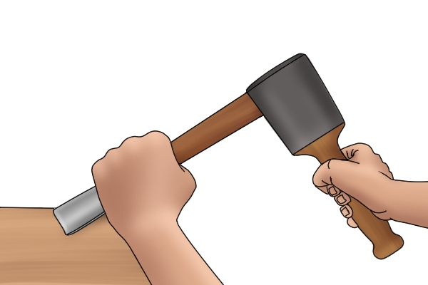
GENERAL PRECAUTIONS
Following sections apply to using and caring for all types of hand tools as well as portable power tools.
TRAINING CRAFTSMEN ON CORRECT USE OF TOOLS
  Craftsman shall be trained in the correct use of each type of hand or portable power tool.
  Engineer in charge shall ensure that his men are well trained on the use of hand or portable power tools.

Slide 8
GENERAL PRECAUTIONS
Storing of tools
Tools shall be stored in a safe and orderly manner.
Storekeeper shall ensure that only good tools are issued and defective tools are segregated for repair or disposal.
Storekeeper shall record the condition of the tool while issuing as well as receiving.
He shall be capable of identifying defective tools from good tools.
Tools should be kept clean and protected from corrosion or damage.
Moving and adjustable parts should be lubricated.

Slide 9
GENERAL PRECAUTIONS
Carrying tools
User should carry their tools to and from the work site in a toolbox, cabinet, or other appropriate tool holder pouch.
In this way, the user is protected as well as the tools.
User should never carry chisels, screwdrivers, and pointed tools with edges or point up either in their pocket or by hand.
They should carry such tools with points and cutting edges away from their bodies.
User should never carry tools in any way that might interfere with the free use of both hands when climbing a ladder or other structure.
They should use a strong bag, pouch, or similar container to hoist tools from the ground to the job.
They should not throw the tools up.
Tool should be returned in the same manner and not brought down by hand, carried in pocket or dropped on the ground.

Slide 10
GENERAL PRECAUTIONS
Using tools
User shall accept only good condition tools. User should check tools before use and from time to time.
User should be able to distinguish between good & damaged tools.
User shall not use damaged tools. Wooden handle of the tool shall be free of splinters, cracks and splits.
Handle shall be firmly fixed to the tool head. User shall select tools of correct size or capacity, type, shape and material.
Only good quality tools shall be procured.
User shall wear Proper PPE (ex. Earmuff for jackhammer, goggles for grinding).
He shall not hold the tools with slippery (oily or greasy) hands.
User or helper shall not position any part of their body on the path of tool‘s accidental release.
Appropriate work permit shall be obtained in work permit areas.
When working on small objects they must be clamped securely or a vice should
Be used to avoid hand injury.

Slide 11
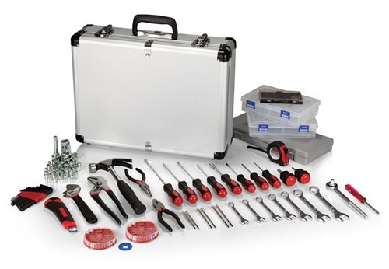
GENERAL PRECAUTIONS
Tools shall be prevented from falling from elevated place such as scaffolds, stepladder, or overhead piping.
Leaving tools overhead is especially hazardous where there is vibration or where people are moving.
Tools should not be kept unattended after use and they shall be kept in toolbox or designated place.
Tools should be used only for their intended purposes. (ex. Never use pliers should as wrench or screwdriver as a chisel.) Tools should not be modified.

Slide 12

HAND TOOLS
Hammers
User should select hammers for their intended use and use them only for those purposes.
User should always strike hammer blow squarely with hammer striking face parallel with the surface being struck.
When striking other tools, face of the hammers should be larger than the strike face of the tools (approximately 1 cm).
User shall not use a hammer to strike another hammer.
User shall not use a hard surface hammer to strike another harder surface.
User shall not use a hammer with loose or damaged handle.
Wooden handle shall not be replaced by a metal handle as it will not absorb impact.
Discard hammer if it shows dents, cracks, chips, mushrooms or excessive wear.
Redressing is not recommended.

Slide 13

HAND TOOLS
Spanners
User should position himself in a way that he will not lose balance and fall.
User should pull the wrench towards himself.
Extension pipes should not be used on the wrenches as it can exceed design torque.
Hammer shall be used only on wrenches designed for hammering.
Hammer wrench shall be held in place by a rope or tong and not by hand.
Ring and box wrenches should be used wherever possible and use of open or adjustable spanner should be limited for light loads only.
Pipe wrenches should not be used as spanners.

Slide 14
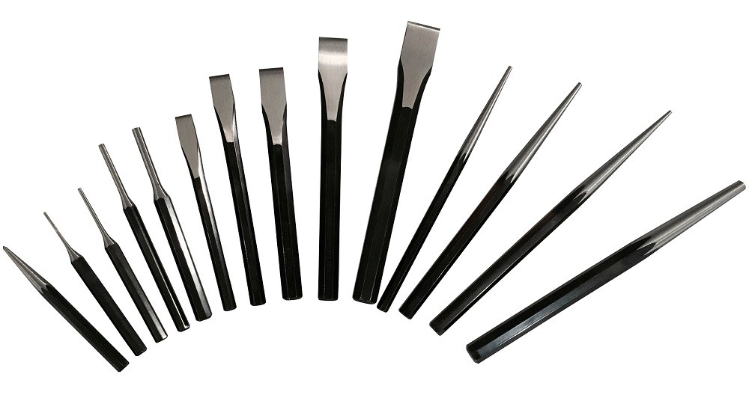
HAND TOOLS
Chisels & punches
Chisel should be large enough for the job and should be driven with a hammer of sufficient weight
Chisel should be held by a tong when hammered on by another person.
Mushroomed chisels and cracked or broken chisel handles should be replaced.
When sharpening a chisel original shape and angle must be maintained.
Chisel with rubber guard shall be used for concrete or hard surface chipping.
Punch should be straight and of suitable weight for the work.
Punch should be started with light tap and held securely.
When knocking out rivets and pins, work must begin with starting punch and end with a pin puncher.

Slide 15
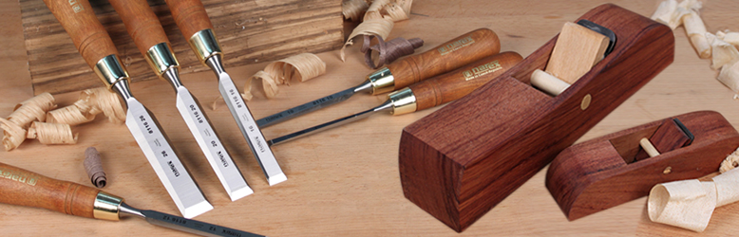
HAND TOOLS
Other hand tools
Files should be equipped with handles of proper size.
Proper size and shape of handsaw should be used.
Teeth of saw and blade must be properly protected when not in use.
Pieces of object being cut must be firmly held in place.
If long pieces are being cut a supporting bench or a helper must be used.
The hacksaw blade teeth should point forward and aligned properly.
Thin flat pieces should not be cut from edge to edge but should be securely clamped and cut so that several teeth are cutting at all times.
When swinging the pick or mattock, ensure that the area at rear and to the sides are clear.
Blade of shovel or spade should be sharp and free of jagged and split edges.

Slide 16

HAND TOOLS
Non-sparking tools
Non-sparking tools, made of non-ferrous material should be used while bolting and unbolting in hazardous area or working in areas containing volatile or flammable material. (ex. Brass hammer on wrench)
Working edges of these tools should be inspected more frequently to ensure if they have picked up any foreign material, which could produce friction sparks.

Slide 17

PORTABLE POWER TOOLS
Portable power tools are divided into five primary groups according to their power source, which are electrical, pneumatic, gasoline, hydraulic, and powder actuated.
This section mainly covers electrical and pneumatic tools used in industry.

Slide 18

PORTABLE POWER TOOLS
Hazards
Portable power tools present hazards similar to stationary machines performing the same functions.
Power tools have inherent risk because of its extreme mobility.
It can easily come in contact with operator's body. At the same time it is difficult to guard such equipment completely.
Dropping or rough handling can cause tools to break.
Also there is inherent hazards of the power source.

Slide 19
PORTABLE POWER TOOLS
Safety precautions
All portable power tools shall be equipped with spring loaded switch (dead man switch) which will actuate only when pressed.
User shall always disconnect the tool from power source before maintenance & attaching accessories.
Put guard back in place before reuse.
Isolate power when not in use.
User shall secure the tool in elevated places, so that it will not fall if the cord or hose is pulled.
User shall not wear loose clothing.
The tools should be suspended to avoid falling on the tool operator, when working overhead position with heavy tools.
Cords and hoses should be laid safely to avoid damage and tripping hazards.
Avoid laying cords or hoses over sharp edges.
Secure or clamp the work piece.
Only use accessories recommended by the manufactures.

Slide 20
PORTABLE POWER TOOLS
Portable electrical tools
The use of ground wire is mandatory for all electrical tools except the double insulated electrical tools.
Ground Fault Circuit Interrupter (GFCI)/ Earth Leakage
Circuit Breaker (ELCB) shall be used.
Electrical safety shall be referred for further details on electrical hazards and precautions.
In wet locations such as in tanks and boiler or on wet floors, low voltage hand tools up to 24 volts are recommended. Additional precautions such as rubber mat and rubber gloves shall be used.
Such tools shall be stamped by reputed certifying agency such as UL.
User shall check insulation of tools and cord before and after each use.
Heavy-duty shock resistant type plugs shall be used.
Proper extension cord shall be used where necessary.
Manufacturer’s original fittings shall not be altered and improper joints (tape connection) are not allowed.
Power cord of tool should not be used for raising, lowering or carrying the tool.

Slide 21
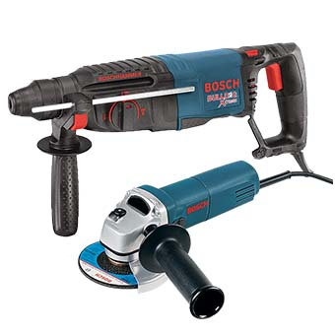
PORTABLE POWER TOOLS
Portable electric drill
  If bit is long enough to pass through material, protection against damage to property and injury to personnel must be provided at the far end.
  Telescopic or similar guard must be used, when operating a bench drill.
Portable electric grinder
  Grinding wheel should have the same maximum permissible working speed as the grinder or a higher safe speed.
  Wheel guard must be provided at all times
  Tool rest should be used and adjusted correctly.
  The rest should not be adjusted
  When grinder is in motion.

Slide 22

PORTABLE POWER TOOLS
Pneumatic tools
Good quality air hoses with proper pressure rating and standard coupling with locking arrangement shall be used.
Supply air pressure shall not exceed the design pressure of the tool and accessories.
Air hoses shall be coupled, locked and secured from undesired movement before opening air supply valve.
Air hose should not be used for cleaning dust on machines or clothing.
Before disconnecting air hose, supply valve shall be closed.
Jackhammer handle should be provided with heavy rubber grip to reduce vibration and fatigue.

Slide 23

About PMG Consultants
PMG Consultants is group of competent people with expertise in respective domains. Delivering commitments, exceeding expectations & creating value for clients in every interaction is our non-negotiable objective. Using the most advanced design & collaboration work systems, we aspire to become Inspirational business partners for our clients.
Get in touch
We would love to hear from you. Gauge our capabilities by speaking to us. You can visit us at our New Delhi Design Office, or meet our representative at your location.
Our Office
Address:
162A/9, 3rd Floor, Kishangarh,
Vasant Kunj, , New Delhi, 110070
Phone: +91-9871115995, +91-11-23361790
Email: connect@pmg-consultants.com
Abhinav.pandey@pmg-consultants.com

