Slide 1
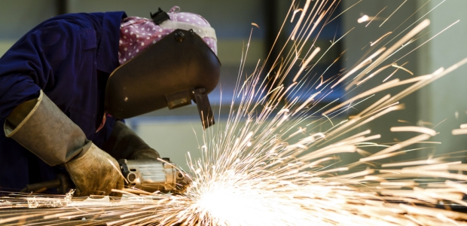
WELDING, CUTTING
AND
HEATING SAFE WORK PRACTICES

Slide 2
ABOUT PMG
“BUILDING FOOD FACTORIES WITH TOP QUALITY STANDARDS OF NESTLE, MONDELEZ,ABBOTT, DANONE USING 3D DESIGN AND HYGIENIC ENGINEERING.”
At PMG, we deliver Engineering Design and Project Management scopes in Food and Beverage industry. Our team of design engineers and engineering executives has rich experience in Project Planning, Design, Execution and Commissioning with key competencies in areas like 3D Plant Design, Hygienic Engineering, and Project Management. Our safe-by-choice, result-oriented, and pro-active work-ethics allow us deliver work scopes meeting objectives, complete stakeholder alignment and first-time quality.
PMG Knowledge Repository: Targeted Knowledge Sharing & Skill Development
Precise and focused training modules for the exhaustive set of people working in manufacturing industry, instilling qualities of self-belief, creative thinking & widened perspective.
Clear Learning Objectives
Focused approach to skill development and knowledge sharing
Progressive Evaluation
Gauging improvement on every step and keeping audience connected.
After-training follow-ups
We systematically track differential progress of recipients after the training.
Audience Specific Approach
Programs are fine-tuned to the ability and interests of the recipients.
Multiple Awe-moments
Awe-moments are refreshing and increase receptivity many-fold.
Seasoned Trainers
PMG trainers are subject matter experts with substantial work experience.

Slide 3
AGENDA
1
Definitions
2
Hazard precautions and safe work practices.
3
Welding work classification and requirements.
4
Preheating and heat treatment.
5
Hot tapping on live piping and equipment.
6
Tie-in on hydrocarbon contaminated lines.
7
Audit requirements.
Notes:
3

Slide 4
DEFINITIONS
Welding and Cutting.
  Welding involves joining two or more pieces of metal together to form a single piece.
  Molten metal is generated through an intense heat source, such as oxygen and fuel gas or an electrical arc.
  Common welding processes using an electrical arc include Shielded Metal Arc Welding, Gas Metal Arc Welding, and Gas Tungsten Arc Welding.
  Unlike welding processes which join two pieces of metal, cutting processes involve separating or severing a piece of metal through intense heat generated to melt the metal.
  Cutting processes include oxygen and fuel gas and electrical arc gouging.
Air-Tight Enclosure - means that
  Sparks and molten metal/splatters are completely contained and
  The natural air circulation is blocked which will contribute to an accumulation of toxic gas emanating from the electrodes or an inert condition caused by inert gas shielding process during welding and cutting works within the enclosure.

Slide 5
DEFINITIONS
Fire Watch is a person assigned in welding works to cover safety surveillance and response function on emergency situation, including first-aid fire fighting.
First-Aid Fire Fighting is a practical training on the use of fire extinguishers, fire hose and couplings, foam making equipment, operation of plant paging and fire alarm call points, and use of other first-aid fire fighting equipment available in premises.
Flameproof Tarpaulin Canvass is a cloth (glass fiber based or silica fiber based) used for welding work fire protection which does not burn or give off fumes when exposed to heat.
Heating, Preheating or Heat Treatment terminology used in this document is referred to ‘stress relieving’ requirements for piping, valves and vessels before and after welding work.
  Stress relieving is used to avert or relieve the detrimental effects of the high temperature and severe thermal gradients inherent in welding of metals.
  The terminology ‘welding works’ used in this document refers to welding, cutting and heating activities.

Slide 6
HAZARDS,PRECAUTIONS & SAFE WORK PRACTICES
Welding, Cutting and Heating Hazards
Welding, cutting and heating (herein after referred to as "welding work" for simplicity) activities involve many hazards as follows;
  Fire hazard: Open flame, electric arc, molten metal, sparks or hot surfaces igniting flammable or combustible material.
  Burn injuries caused by hot surfaces, sparks, slag or flame.
  Health hazards: eye or skin exposure to ultraviolet (UV) and infrared (IR) radiation; inhalation of dust, toxic fumes such as oxides of Nitrogen (NOx), Carbon Monoxide (CO), Ozone, etc. and Oxygen deficiency.
  Exposure to ultraviolet rays initially causes a painful and disabling but temporary form of conjunctivitis commonly known as "Arc eye".
  Looking directly into a powerful arc without eye protection can cause permanent eye damage.
  Ultraviolet affects the skin like severe sunburn.
  Infrared radiation has the effect of heating the body tissues on contact. If
  The intensity of heat due to infrared is not enough to cause a thermal burn, there is no further hazard.

Slide 7
HAZARDS,PRECAUTIONS & SAFE WORK PRACTICES
Welding, Cutting and Heating Hazards
  Hazards induced from preservative coatings on metal surface: The toxic hazard will depend on the, type of electrode used, the base metal being welded or cut, and whether the base metal is coated with flammable or toxic material (zinc, lead, paint, etc.)
  Ultraviolet rays can decompose some chlorinated hydrocarbon degreasing agents like Trichloroethylene, even at a considerable distance from the arc, to form highly toxic substances such as phosgene.
  In confined spaces, welding and cutting jobs may lead to oxygen deficient environment by consuming oxygen or displacing oxygen by inert gas.
  Mechanical hazards: unguarded rotating parts, flying particles, high pressure water in hydro jet cutting, noise.
  Compressed gas hazards (refer to relevant controlled SH&E document on Compressed Gas Cylinders Safe Work Practices)
  Electric shock (refer to relevant controlled SH&E document on Electrical Safety)

Slide 8
HAZARDS,PRECAUTIONS & SAFE WORK PRACTICES
General Precautions
All weld When practical, objects to be welded, cut or heated shall be moved to a designated safe location or, if the object cannot be readily moved, all movable fire hazards in the vicinity shall be taken to a safe place or otherwise protected (e.g. using flame retardant barricades, covers, blinding, etc.)
If the object cannot be moved and all the fire hazards cannot be removed, positive means shall be taken to confine the heat, spark, and slag to protect the unmovable fire hazard, from these.
The following welding equipment safety shall be strictly enforced:
  In equipment shall be properly maintained and regularly inspected by using a checklist (i.e. as per operating procedure).
  Two fire extinguishers (9 kg. DCP) shall be provided with each welding equipment, one to be kept at the work and the other at the machine. Plant extinguishers shall not be used for this purpose.
  Welding equipment shall be parked outside the battery limit whenever possible and when parked, it should be provided with wheel stoppers to prevent any movement.
  Location of welding equipment and laying of cables should not obstruct regular activities.

Slide 9
HAZARDS,PRECAUTIONS & SAFE WORK PRACTICES
Welding work in a Restricted Area shall be done after obtaining a Hot Work Permit and all requirements pertaining to hot work shall be enforced such as the Hot Work Risk Assessment for critical welding jobs in hazardous areas.
  The welder shall not work alone.
  The welder and helper must be trained on First-Aid Fire Fighting by Fire Fighting Trainers.
  When welding work is carried out in a workshop or any similar location classified as a permit free area, which is approved by Safety Department, a work permit is not required but the work shall be adequately supervised.
  The requirement for fire watch shall be decided by Area Safety Engineer and if required, shall be provided.
  Welding work on any tank, vessel or piping shall only be undertaken when it has been positively isolated from all sources of flammable hazards and established that it is free of flammable vapours or substances.

Slide 10
HAZARDS,PRECAUTIONS & SAFE WORK PRACTICES
  While welding on positively isolated short pipes, wedge opening should be provided towards the pipe to be welded or nearer to the welding joint.
  When cutting a long process pipe, where a gas test cannot be performed close to the point of cut, a cold cut test hole shall be drilled from top of pipe and flammable gases tested.
  If trapped liquid is suspected, a second hole may be drilled Holes in the ground or open sewers or cracks in pavement should be protected in a manner similar to hydrocarbon contaminated surfaces by flushing and covering.
  All sewers and catch basins on 15 meters from the work area shall be covered, plugged, isolated or secured
    To prevent hydrocarbon vapours from exiting the sewer or drain and reaching an area of hot work and
    To prevent sparks/molten metal from getting into the sewer .
  A catch basin equipped with a trap should be flushed continuously with water.
  Good housekeeping shall be maintained at work site.

Slide 11
HAZARDS,PRECAUTIONS & SAFE WORK PRACTICES
Enclosure of Welding and Cutting Area
Welding and cutting works generally require the protection of equipment and surrounding area from damage or fire ignition from the hot work activity.
This activity includes oxy-fuel metal cutting, light duty welding, heavy duty welding and arc gouging.
The following requirements shall be strictly enforced:
  The welding and cutting area must be totally enclosed, using a flameproof tarpaulin canvass in a manner to contain sparks, molten metal/splatters, block the view of the welding/cutting arc from passer-by, and isolate any nearby combustible fuel source from the hot work activity.
  The material of flameproof tarpaulin canvass shall be made from silica or glass fibres which have low off gassing and which may melt (but not burn) when contacted by flames, welding slag or splatter.
  Regular checks shall be carried out by the Work Permit Executor.
  For heavy and extreme duty operations of arc gouging and flame cutting in the running process units and piping, sheet metal shall be placed under the fire stream to lessen the chances of the molten metal melting through the flame proof tarpaulin canvass.

Slide 12
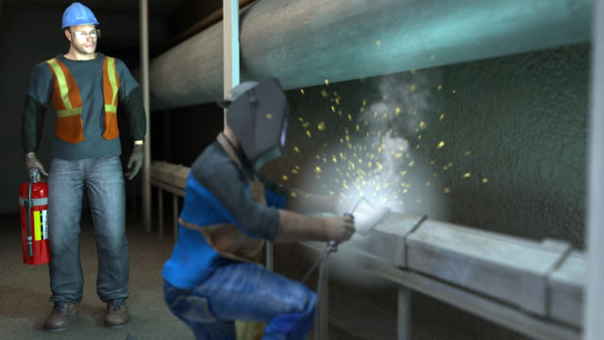
HAZARDS,PRECAUTIONS & SAFE WORK PRACTICES
Fire Watch Personnel
Work Permit Executor shall provide properly trained and equipped ‘fire watch’ Personnel.
The person assigned as a fire watch shall have no other duties,.
The fire watch person may do other safety-related task if the primary fire watch responsibility is not compromised.
The fire watch personnel equipment and knowledge shall include:
  Understands and capable to recognize hazards.
  Have appropriate functional fire extinguishing equipment readily available.
  Trained and certified in the equipment’s use and first-aid fire fighting.
  Fire Fighting Trainers shall train and certify the fire watch.
  Familiar with facilities for sounding an alarm in the event of a fire.
  Capable to communicate effectively with the workforce.

Slide 13
HAZARDS,PRECAUTIONS & SAFE WORK PRACTICES
Fire Watch Personnel
The fire watch personnel should understand his duties which include the
following:
  Shall continuously monitor and watches for fires in all exposed areas.
  Shall remain within 8 meters radius of work vicinity during welding / cutting until relieved by another fire watch.
  Shall maintain assigned suppression equipment within close proximity
  Shall be aware on the location and how to activate the nearest fire alarm.
  Shall activate the fire alarm when available equipment is not sufficient to suppress minor fire.
  Shall try to extinguish a fire only when obviously within the capacity of the available equipment.
  Shall maintain a watch for at least ½ hour after completion of welding and cutting works until the area has been inspected and found to be free of leaks and ignition sources (fires, hot spots or smouldering materials).

Slide 14
HAZARDS,PRECAUTIONS & SAFE WORK PRACTICES
Personal Protection
Respiratory Protection
  In confined spaces such as tanks, pressure vessel, large diameter pipelines, confined enclosures, etc., local exhaust or general ventilation system shall be provided to remove toxic gases, fumes, etc. and to maintain oxygen concentration above 19.5%. Pure oxygen shall not be used for ventilation.
  Local exhaust hoods shall be provided in welding shops or indoor enclosures.
  In confined spaces where hazard of oxygen deficiency may exist, airline mask shall be used.
Eye Protection
  Goggles or shields fitted with correct filter lens shall be used during welding and cutting operations.
  During welding eye protection shall be used by welder and his helper.
  Welder's Goggles shall be used when chipping, de-slagging and during gas welding
  Arc welder shall wear welder‘s shield.

Slide 15
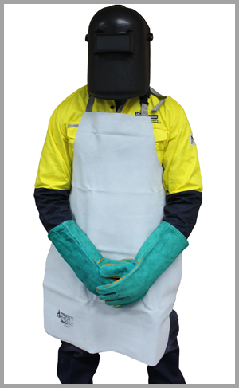
HAZARDS,PRECAUTIONS & SAFE WORK PRACTICES
Personal Protection
Protective Clothing and other PPE
  Fire retardant coveralls and apron shall be worn by welders and fabricators.
  Sleeves and collars of coveralls shall be kept buttoned up for protection against Ultraviolet and Infrared radiation.
  Welder’s safety boots shall be used for protection against heavy objects and sparks.
  For overhead work, caps or shoulder cover and skullcaps made of leather or suitable flame resistant material shall be used to prevent burn injuries.
  During overhead welding, ear protection is recommended against falling sparks.

Slide 16
WELDING WORK CLASSIFICATION & REQUIREMENTS
Gas Welding and Cutting
Gas welding and cutting operations utilize the heat of the flame obtained from the combustion of a fuel gas with oxygen.
Oxygen is normally supplied in cylinders containing 244 cu. feet of oxygen at a pressure of 2200 psig at 70ºF.
Acetylene is supplied in cylinders and dissolved in acetone over a porous material at a pressure of 250 psig at 70ºF.
Acetylene cylinders normally contain 300 cu. ft. Of acetylene.
Acetylene is explosive in a concentration range of 2% to 82% in air and therefore requires careful handling.
Refer to Compressed Gas Cylinders Safe Work Practices for the safety precautions related to storage, handling and use of cylinders and its fittings (regulators, gauges and hoses).
Acetylene gas becomes unstable at pressures above 15 psig and therefore
Acetylene regulator pressure shall not be allowed to exceed 15 psig.

Slide 17
WELDING WORK CLASSIFICATION & REQUIREMENTS
Gas Welding and Cutting
Acetylene cylinders shall be stored, handled and used in vertical position to avoid liquid acetone from escaping and damaging down-stream equipment.
If LPG is used as a fuel gas for cutting purpose, industrial type cylinders shall be used.
All cylinders shall be kept vertical and secured either in a cylinder trolley or floor support or lashed to a fixed support.
Cylinders shall not be located in any enclosed space where welding or cutting job is taking place.
Oxygen and acetylene cylinders shall be kept at least 15 ft. away from the blowtorch or any other source of ignition. Flash back arrestors and hose check valves shall be fitted to both oxygen and fuel gas regulators.
Spark lighters shall be used to light torches.
Oxygen and acetylene hoses shall be of different colors or otherwise identified and distinguished from each other.
When extinguishing the flame, shut-off the acetylene first by closing the torch control valve.

Slide 18
WELDING WORK CLASSIFICATION & REQUIREMENTS
Electric Arc Welding and Cutting
Engine of welding machine shall be stopped during refuelling.
Guards of rotating parts shall be kept in place. Welding machine shall be kept 15 meters away from sources of flammable hazards.
All welding leads and returns shall consist of flexible tough rubber covered cables, robust enough to withstand normal treatment over rough ground and pedestrian traffic. Where feasible, cables should be additionally protected by stringing overhead or by using cable covers.
The insulation of cables, electrode holders, plugs and sockets shall be regularly inspected.
Welding grounds and returns shall be securely attached to the work by cable lugs, (or clamps) in case of stranded conductor or by bolts for strip conductors.
Handle of electrode holder shall be made of non flammable insulating material and be free of joints or holes.
Electrode holders shall not be placed on the ground when not in use, Instead, it should be hanged or secured to prevent sparking.

Slide 19
WELDING WORK CLASSIFICATION & REQUIREMENTS
Electric Arc Welding and Cutting
The cable shall have adequate current carrying capacity to meet the job requirement.
Welding return lead shall be provided from the neutral terminal of each phase of an arc welding transformer, or the negative terminal of a DC Generator to the work piece.
When more than two welders are using the same welding machine, the polarity of each welding lead and return shall be the same.
When welding work is not in progress, even for a short period, the power source of the welding circuit shall be disconnected.
For all AC welding transformers low voltage winding shall not be earthed, but the transformer case shall be effectively bonded to an earthling system adjacent to the equipment.
For all AC driven DC welding generators, no earth connection shall be applied to either pole of the DC welding output.
The machine frame shall be effectively earthed.
The power supply plugs, receptacles and extension cords shall meet standard requirement.
Welding transformers shall not be attached to lighting circuits under any circumstances.

Slide 20
PREHEATING AND HEAT TREATMENT
Preheating and Heat Treatment requirements for piping, valves and vessels before and after welding are used to avert or relieve the detrimental effects of the high temperature and severe thermal gradients inherent in welding of metals.
Precautionary measures on possible electric shock, moving parts, and hot parts hazards shall be appropriately addressed, which include but not limited to the following:
Electric Shock Hazard Precautions.
  All connecting bus bars and coolant fittings should be enclosed to prevent unintentional contact.
  Dry, hole-free insulating gloves and body protection shall be worn.
  Employee shall be insulated from work and ground by the use of dry insulating mats or covers big enough to prevent any physical contact with the work or ground.
  Equipment operator shall always verify the supply ground and ensure that input power cord ground wire is properly connected to ground terminal in disconnect box or that cord plug is connected to a properly grounded receptacle outlet.
  All panels and covers shall be securely kept in place.

Slide 21
PREHEATING AND HEAT TREATMENT
Fire or Explosion Hazard Precautions
  The unit shall not be operated in explosive atmosphere
  The unit shall not be installed near flammables.
  All flammable materials shall be kept away (15 meters) from work area.
  The unit shall not be located on, over, or near combustible surfaces.
  Fire Watch shall be assigned along with a standby fire extinguisher.
Fumes and Gases Hazard Precautions
  Heating of certain materials, adhesives, and fluxes can produce hazardous fumes and gases.
  Appropriate respiratory protections should be used.
  Always refer to Material Safety Data Sheet (MSDS) and the manufacturer’s instruction for adhesives, fluxes, metals, consumables, coatings, cleaners, and degreasers.
  Heating shall not be permitted near degreasing, cleaning, or spraying operations.
  The heat can react with vapors to form highly toxic and irritating gases.
  Safe work practices for confined space entry shall be followed with continuous gas monitoring.

Slide 22
HOT TAPPING ON LIVE PIPING AND EQUIPMENT
In certain circumstances, welding is allowed on live lines and tanks due to difficulty in depressurizing and getting freed of flammable material.
Welding work on live pipelines and equipment includes welding of stubs on lines or vessels prior to drilling for hot tap, welding brackets on tanks, patchwork and box welding.
Such work requires extra precautions in addition to normal hot work precautions.
Risk assessment shall be carried out for all hot tapping and welding on live piping and equipment.
"Hot Tapping & Welding on Equipment and Piping” Procedures and requirements shall be strictly enforced.
Hot tapping shall be considered as a last resort and every effort shall be made to weld the tie-ins during shutdown.
Authority shall ensure that safe conditions for carrying out the job have been established.
Hot tapping and/or Welding Authorizations shall be available with the permit.
Executing authority shall continuously supervise the job.

Slide 23
TIE-IN ON HYDROCARBON CONTAMINATED LINES
A tie-in on hydrocarbon contaminated line involves the hazard of hot work on lines which have been taken out of service but cannot be entirely freed of gas or oil.
This type of work includes work on flare lines or long, large diameter lines which cannot be easily cleaned.
This work is normally carried out on open-ended lines, which will need to be blinded and possibly plugged by means of an expanding plug to isolate a small portion of the line near the point where the hot work is to be done.
A plug should be fixed at a minimum distance of ‘½ meter’ from the point of hot work and should be of an expanding type so as to make a tight seal.
If possible the space above the plug should be filled with water before welding.
The space behind the plug shall be vented to a safe location to avoid a pressure build-up.

Slide 24
AUDIT REQUIREMENTS
Compliance on the complete implementation of this guideline shall be regularly audited through the existing audit and inspection programs such as in the ‘Safety Performance Audit’ and ‘Work Permit Compliance Audit’ that is being carried out by the management team and Safety Section.

Slide 25
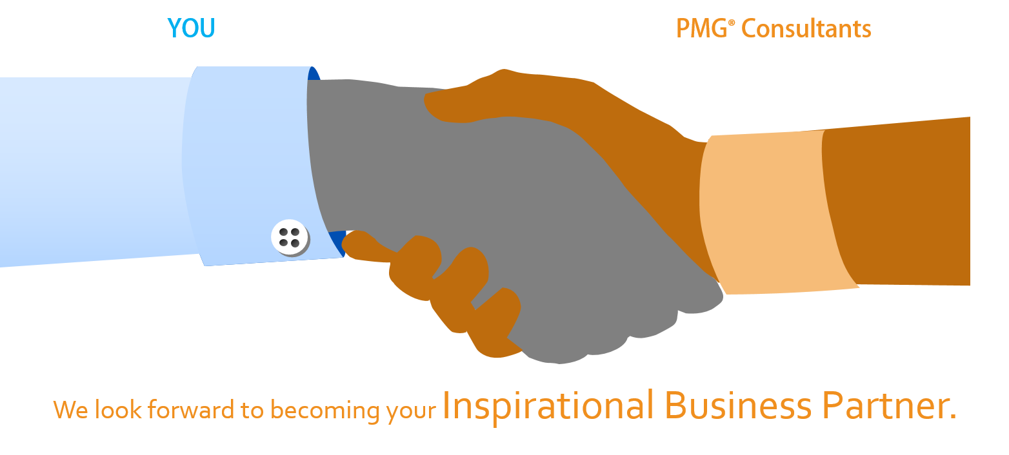
About PMG Consultants
PMG Consultants is group of competent people with expertise in respective domains. Delivering commitments, exceeding expectations & creating value for clients in every interaction is our non-negotiable objective. Using the most advanced design & collaboration work systems, we aspire to become Inspirational business partners for our clients.
Get in touch
We would love to hear from you. Gauge our capabilities by speaking to us. You can visit us at our New Delhi Design Office, or meet our representative at your location.
Our Office
Address:
162A/9, 3rd Floor, Kishangarh,
Vasant Kunj, , New Delhi, 110070
Phone: +91-9871115995, +91-11-23361790
Email: connect@pmg-consultants.com
Abhinav.pandey@pmg-consultants.com

