Slide 1

EMERGENCY PREPARDNESS AND REPONSE

Slide 2
ABOUT PMG
“BUILDING FOOD FACTORIES WITH TOP QUALITY STANDARDS OF NESTLE, MONDELEZ,ABBOTT, DANONE USING 3D DESIGN AND HYGIENIC ENGINEERING.”
At PMG, we deliver Engineering Design and Project Management scopes in Food and Beverage industry. Our team of design engineers and engineering executives has rich experience in Project Planning, Design, Execution and Commissioning with key competencies in areas like 3D Plant Design, Hygienic Engineering, and Project Management. Our safe-by-choice, result-oriented, and pro-active work-ethics allow us deliver work scopes meeting objectives, complete stakeholder alignment and first-time quality.
PMG Knowledge Repository: Targeted Knowledge Sharing & Skill Development
Precise and focused training modules for the exhaustive set of people working in manufacturing industry, instilling qualities of self-belief, creative thinking & widened perspective.
Clear Learning Objectives
Focused approach to skill development and knowledge sharing
Progressive Evaluation
Gauging improvement on every step and keeping audience connected.
After-training follow-ups
We systematically track differential progress of recipients after the training.
Audience Specific Approach
Programs are fine-tuned to the ability and interests of the recipients.
Multiple Awe-moments
Awe-moments are refreshing and increase receptivity many-fold.
Seasoned Trainers
PMG trainers are subject matter experts with substantial work experience.

Slide 3
AGENDA
1
What is emergency?
2
Purpose
3
Types of emergencies anticipated
4
Emergency plan
5
Handling emergency
6
Emergency control center (ecc)
7
Evacuation plan
Notes:
3

Slide 4
AGENDA
8
Duties & responsibilities
9
Action to tackle the emergency
10
Preventive steps to avoid/ minimize
11
Periodic testing of emergency response procedures
12
Training of emergency response personnel
13
Mutual assistance from neighboring organizations
Notes:
4

Slide 5

WHAT IS EMERGENCY?
Any Incident which occurs without giving any prior warning / intimation, which may result in loss or damage to life, property or both.
Types of emergencies anticipated
  Fire
  Accident
  Earthquake
  Medical Emergency
  Terrorists attack.

Slide 6
PURPOSE
To establish and maintain procedures to identify potential for & respond to accidents & emergency situations & for preventing & mitigating the environmental impacts that are associated with them.
Review and revise the emergency preparedness and response procedures, in particular, after the occurrence of accidents or emergency situations

Slide 7
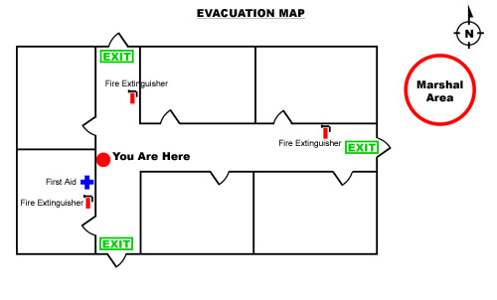
EMERGENCY PLAN
An Emergency plan enables any person to do the activity in the same sequence & reduces damage.
It helps in safe evacuation of people in the office & controls the extent of damage.

Slide 8
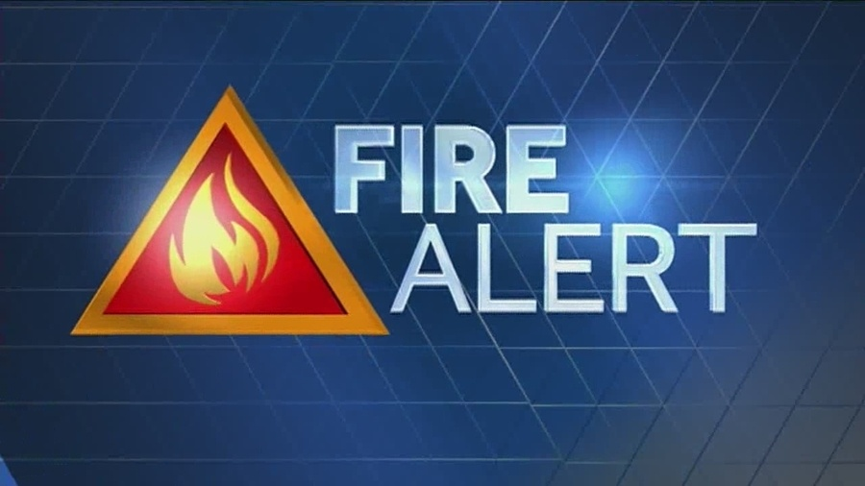
HANDLING EMERGENCY
Sequence of reporting/receiving & attending Emergencies:
  After observing the fire the employee will shout fire –fire alerting his fellow employee and try to extinguish the fire if minor with the help of fire extinguisher.
  If the fire is going to out of his control he should inform on telephone (Phone. No. 101) Installed at security, or through any running caller Security to raise an alarm (Siren), in case of siren failure security to raise the alarm using whistle.

Slide 9
EMERGENCY CONTROL CENTRE (ECC)
All others to be available at their usual place of work and to follow further instruction given by Chief Controller.
Site Controller / Co-coordinator to confirm from Security details of Emergency and after reporting to Chief Controller, proceed to Emergency Site along with the required team.
Chief Controller to remain available at the ECC.
Site Controller to give continuous feedback from the site to Chief Controller.
Chief Controller to raise evacuation alarm (if required) informing Security & call for additional help internal or external as required through the Co-coordinator.
Chief Controller to give all clear message once the emergency is tackled completely.

Slide 10
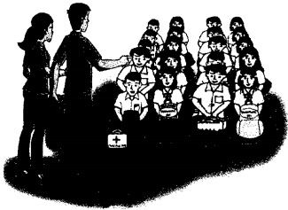
EVACUATION PLAN
All occupants to leave their place of work only after hear evacuation signal.
  All occupants working at (Mention Location) to (Mention Location) shall assemble at safe assembly point near the open space near ( Mention Area)
  All occupants, working near (Mention Area) to (Mention Area) shall assemble in front of (Mention Area)
Head count will be done by the responsible Engineer or supervisor at Safe Assembly Point.

Slide 11
DUTIES & RESPONSIBILITIES
Chief Controller-
Will be overall in-charge of the entire operation in case of Emergency
Security-
  To receive the correct information from the caller.
  On getting the message to raise emergency alarm (Siren), in case of siren failure security to raise the alarm using whistle.
  To arrange the attendance record & visitors book for co-coordinator.
  To stop all in & out movement of Employees, Visitors and Material (Except Emergency Team members)
  To help in evacuate in case required / instructed by Coordinator / Evacuation team.

Slide 12
DUTIES & RESPONSIBILITIES
Site Controller
  Will be overall in charge at the site of emergency during the entire Emergency.
  Fire Fighting Operation, Cordon off the area and ensure that nobody except team members are allowed in this area . Continuous feed back to chief controller about the emergency.
Coordinator
  To note time & sequence of events
  To arrange for Medical Services
  Uses utility team to Isolate required power supply
  Make secure valuable assets
  To assist emergency services on their arrival
  To control & instruct all assembled at the Safe Assembly area
  To consult chief controller regarding reoccupation of the premises
  To reset the power supply
  To arrange to resume normal business at the earliest.
  To arrange notification to Insurers & post incidence investigations. Teams.

Slide 13
DUTIES & RESPONSIBILITIES
Fire Fighting, Rescue & Evacuation team
  Will be responsible to rescue any person/s trapped / Injured & the fire fighting operation.
  Will be responsible for evacuating the personnel & visitors (if any) to safe assembly point & to take head count to ensure that no one is left behind.
  To guide & Assist Fire Brigade personnel on their arrival.
First Aid team
  Will be responsible for giving first aid to the injured.
  A ranging for their safe transportation to hospitals.
Utilities team
  Will be responsible for attending to any shut down during emergency & switching OFF supply / AC systems.
  To help & Assist Fire Brigade personnel on their arrival.
  To arrange for water for fire fighting.

Slide 14
ACTION TO TACKLE THE EMERGENCY
Serial No | Activity |  | Potential Hazard | Area |  | Action plan to tackle the emergency | Responsible
1 | Storage of LPG Cylinders |  | Fire, explosion or leakage | Project Site |  | 1. Alert all the employees. | Engineer &supervisor
 |  |  |  |  |  | 2. Try to isolate the leakage by closing the Valve.
 |  |  |  |  |  | 3. Inform security dept. & concerned Engineer & Supervisor.
 |  |  |  |  |  | 4.To evacuate Personnel, from the area likely to be affected
 |  |  |  |  |  | 5. Take the help of persons who are trained in fire fighting.
2 | Diesel unloading activity | Fire, Spillage |  |  | Diesel tank (stores),maintenance (DG area) | 1. Try to isolate the leakage by closing valve. | Engineer &supervisor
 |  |  |  |  |  | 2. Inform security dept. and concerned Engineer & Supervisor.
 |  |  |  |  |  | 3. Co-ordinate with House Keeping Dept. for controlling the spillage.
 |  |  |  |  |  | 4. Take the help of persons who are trained in fire fighting.

Slide 15
ACTION TO TACKLE THE EMERGENCY
Serial No | Activity | Potential Hazard | Area | Action plan to tackle the emergency | Responsible
3 | Storage of Paints, Thinners, Paint mixing & Paint application | Fire, Spillage | Store Room, Site. | 1. Try to extinguish the fire with the help of potable fire extinguisher if it is minor fire. | Department Head & Supervisor
 |  |  |  | 2. Remove Paint / Thinner drums away from fire spot.
 |  |  |  | 3. Inform security & safety and concerned supervisors.
 |  |  |  | 4. Co-ordinate with House Keeping Dept. For controlling the spillage.
 |  |  |  | 5. Take the help of persons who are trained in fire fighting.
 |  |  |  | 6. Do not pour water.
 |  |  |  | 7. To evacuate Personnel, from the area likely to be affected.
4 | Storage of Chemicals | Fire, Spillage, Generation of fumes | Project Site | 1. Use PPE like PVC coat, Pant, Acid, Alkali hand gloves for chemical handling, Helmets, face shield, gum boots. | Engineer & supervisor
 |  |  |  | 2. Flush out with Plenty of water.
 |  |  |  | 3. Inform security /safety dept. and concerned supervisors.
 |  |  |  | 4. Take the help of persons who are trained in fire fighting and chemical handling.

Slide 16
ACTION TO TACKLE THE EMERGENCY
Serial No | Activity | Potential Hazard | Area | Action plan to tackle the emergency | Responsible
5 | Storage of Chemicals or any other hazardous substances. | Fire, Explosion | Project Site | 1. Try to stop the leakage by closing valve of cylinders. | Department Head & supervisor
 |  |  |  | 2. in case of fire keep the cylinder cool by spraying water on the cylinder body
 |  |  |  | 3. If possible try to keep the leaky cylinder in open space.
 |  |  |  | 5. Storage of Acetylene Cylinders Fire, Explosion Work shop.
 |  |  |  | 6. Take the help of persons who are trained in fire fighting.

Slide 17
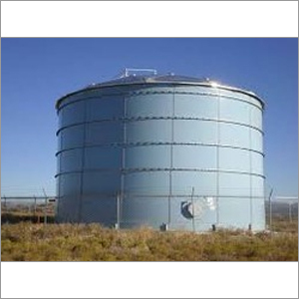
PREVENTIVE STEPS TO AVOID/ MINIMISE
Preventive steps to avoid/ minimize environmental damages and implementation of corrective & preventive actions
Following are the preventive steps to avoid the occurrence of emergency situation, concerned incident controllers, concerned engineers should ensure the same periodically.
  HSD Installation.
    Spillage of HSD/LDO/Kerosene should be avoided.
    Persons working in these areas should be familiar about Fire fighting.
    Any spillage/leak should be attended immediately.
    Area should be prohibited for smoking / unauthorized person.

Slide 18
PREVENTIVE STEPS TO AVOID/ MINIMISE
Preventive steps to avoid/ minimize environmental damages and implementation of corrective & preventive actions
  Storage of Chemicals
    Spillage of chemicals should be avoided.
    Persons working in these areas should be familiar about neutralizing the chemical spill & fire fighting.
    Any spillage/leak should be attended immediately.
    Area should be prohibited for smoking / unauthorized person.
    Chemicals, which are incompatible, should not be kept near each other.
    Use of PPE during handling of chemicals
    Keep MSDS available. Write safety instruction on boards mentioned in MSDS.

Slide 19
PREVENTIVE STEPS TO AVOID/ MINIMISE
  Storage of Paints, Thinners
    Spillage of paints/thinners should be avoided.
    Persons working in these areas should be familiar about Fire fighting.
    Any spillage/leak should be attended immediately.
    Area should be prohibited for smoking / unauthorized person.
    Mock drills should be conducted every in six months.
    Electrical equipment’s in this area should be of flame proof Type.

Slide 20
PREVENTIVE STEPS TO AVOID/ MINIMISE
Preventive steps to avoid/ minimize environmental damages and implementation of corrective & preventive actions
  Oxy-LPG Gas Cutting.
    Flash back arrester should be available on acetylene/fuel gas cylinder & torch end to avoid flash back phenomena.
    Gas cutting / welding torches should be checked frequently for gas leakage.
    Rubber hose pipes should be checked periodically.
    Replace the rubber pipe if it is deteriorated.
    Black color pipe for oxygen and maroon color pipe for acetylene should be used.
    Ensure that pressure gauges and regulators are working satisfactorily.
    Flammable material should not be kept near cutting location.
    Permit to work system should be followed. All safety precautions mentioned in permit form should be complied.

Slide 21
PREVENTIVE STEPS TO AVOID/ MINIMISE
  Electrical Short Circuit & Shock.
    Unauthorized person should not work on electrical equipment/live supply/machines
    Permit to work system should be followed. All safety precautions mentioned in permit form should be complied.
    Loose wires should not insert in elect panels/boards. Proper plugs (3 way pin) should be used.

Slide 22
PREVENTIVE STEPS TO AVOID/ MINIMISE
Preventive steps to avoid/ minimize environmental damages and implementation of corrective & preventive actions
  Scrap Yard & other area
    Permit to work system should be followed while carrying out welding work in this area.
    Flammable, combustible material should be kept away from source of ignition.
    Gangway, approach roads should be free from obstacles.
    Spillage of oil from presses should be avoided so that scrap yard area will not become oily. Periodic checking should be carried out.
    Employees working in this area should use PPE like safety shoes hand gloves.

Slide 23
PREVENTIVE STEPS TO AVOID/ MINIMISE
  Electrical panels / DB’s
    Do not carry out preventive maintenance in supply ON condition.
    While carrying out preventive maintenance do not keep any material in shirt pocket to avoid chance of falling it.
    Do not keep any material over OCB.
    Cleanliness should be maintained.
    Follow the detail procedure displayed in all panels and DB’s.

Slide 24
PREVENTIVE STEPS TO AVOID/ MINIMISE
Preventive steps to avoid/ minimize environmental damages and implementation of corrective & preventive actions
  Office area.
    Smoking is strictly prohibited inside the office.
    No open burning, heating, hot work activity.
    Switch off the electricity supply, when not required.
    Maintain good housekeeping inside the office and around the premises.
    Know the location & use of fire extinguisher, exits, and safe assembly point etc.
    Daily head count in the dept.

Slide 25
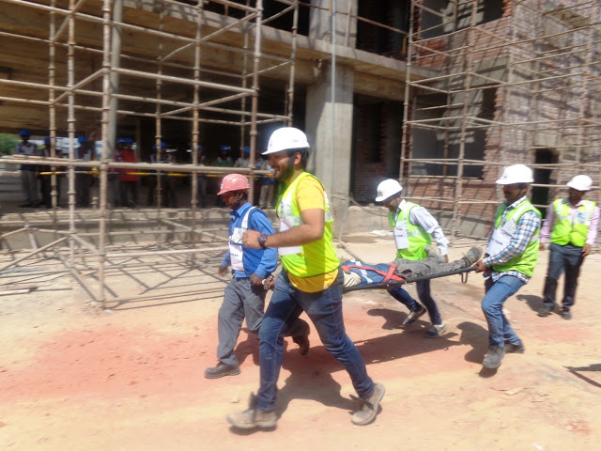
PERIODIC TESTING OF EMERGENCY RESPONSE PROCEDURES
Mock Drills will be conducted periodically to check the effectiveness of emergency preparedness plan.
Site controllers test the plan.
Mock drills will be conducted quarterly, to check the effectiveness of emergency preparedness and to create awareness in the minds of employees.

Slide 26
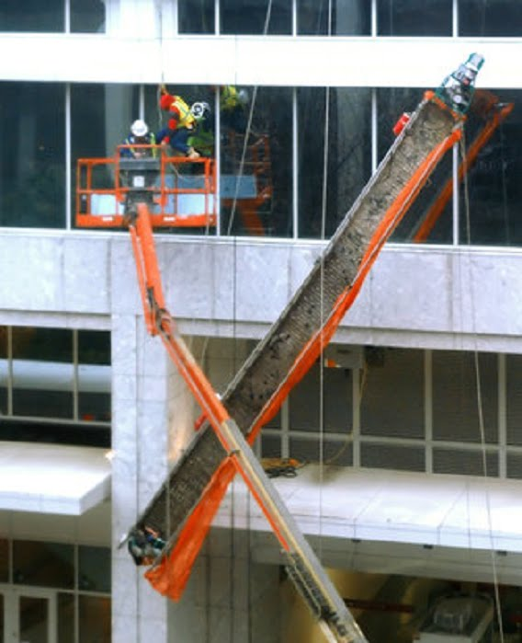
TRAINING OF EMERGENCY RESPONSE PERSONNEL
Training is imparted to all personnel dealing with emergency are trained by internal & external faculty.
Incident Controllers & Task force are trained in fire fighting, mitigation, rescue operations.

Slide 27

MUTUAL ASSISTANCE FROM NEIGHBOURING
Mutual assistance from neighboring organization can be assisted if, emergency not under control.

Slide 28

About PMG Consultants
PMG Consultants is group of competent people with expertise in respective domains. Delivering commitments, exceeding expectations & creating value for clients in every interaction is our non-negotiable objective. Using the most advanced design & collaboration work systems, we aspire to become Inspirational business partners for our clients.
Get in touch
We would love to hear from you. Gauge our capabilities by speaking to us. You can visit us at our New Delhi Design Office, or meet our representative at your location.
Our Office
Address:
162A/9, 3rd Floor, Kishangarh,
Vasant Kunj, , New Delhi, 110070
Phone: +91-9871115995, +91-11-23361790
Email: connect@pmg-consultants.com
Abhinav.pandey@pmg-consultants.com

