Slide 1
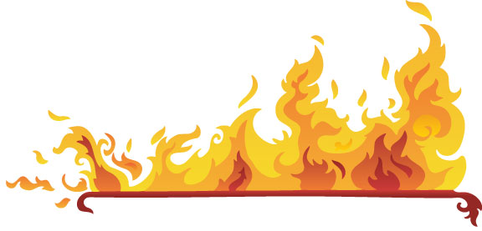
FIRE SAFETY

Slide 2
ABOUT PMG
“BUILDING FOOD FACTORIES WITH TOP QUALITY STANDARDS OF NESTLE, MONDELEZ,ABBOTT, DANONE USING 3D DESIGN AND HYGIENIC ENGINEERING.”
At PMG, we deliver Engineering Design and Project Management scopes in Food and Beverage industry. Our team of design engineers and engineering executives has rich experience in Project Planning, Design, Execution and Commissioning with key competencies in areas like 3D Plant Design, Hygienic Engineering, and Project Management. Our safe-by-choice, result-oriented, and pro-active work-ethics allow us deliver work scopes meeting objectives, complete stakeholder alignment and first-time quality.
PMG Knowledge Repository: Targeted Knowledge Sharing & Skill Development
Precise and focused training modules for the exhaustive set of people working in manufacturing industry, instilling qualities of self-belief, creative thinking & widened perspective.
Clear Learning Objectives
Focused approach to skill development and knowledge sharing
Progressive Evaluation
Gauging improvement on every step and keeping audience connected.
After-training follow-ups
We systematically track differential progress of recipients after the training.
Audience Specific Approach
Programs are fine-tuned to the ability and interests of the recipients.
Multiple Awe-moments
Awe-moments are refreshing and increase receptivity many-fold.
Seasoned Trainers
PMG trainers are subject matter experts with substantial work experience.

Slide 3
AGENDA
1
What is fire safety?
2
Responsibility for fire safety
3
Definition
4
Fire prevention
5
Cause of fire in the work place
6
Type of fire extinguisher
7
Fire safety training
8
Risk management

Slide 4
AGENDA
9
Fire prevention and protection
10
Emergency procedure
11
Automatic fire sprinkler and other suppression systems
12
Automatic fire detection and alarm systems
13
Flammable and combustible building materials
14
Flammable and combustible liquid and gas
15
Housekeeping
16
Hot work

Slide 5
WHAT IS FIRE SAFETY?
Fire safety is the set of practices intended to reduce the destruction caused by fire.
Fire safety measures include those that are intended to prevent ignition of an uncontrolled fire.
Those that are used to limit the development and effects of a fire after it starts.

Slide 6
RESPONSIBLITY FOR FIRE SAFETY
Fire safety is the responsibility of everyone involved in construction projects, including the construction industry, employers, workers, site visitors, and provincial and local authorities.
Each participant has a specific role that, when combined with the efforts of others, can help to reduce the risk of construction site fires.
The construction industry has made significant improvements in its efforts to support on-site safety over the years to provide resources and information to members, designers, builders and regulators.

Slide 7
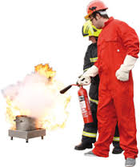
RESPONSIBLITY FOR FIRE SAFETY
Employers
Provincial Occupational Health and Safety regulations require the provision of a safe work environment.
  To properly implement and evaluate safety at their sites, employers should have a comprehensive policy that covers all levels of the company, from management to labour.
  Construction companies should emphasize the need for fire safety and create a mind-set amongst all employees that fire safety is a top priority

Slide 8

RESPONSIBLITY FOR FIRE SAFETY
Workers
Employees and others who may be affected by their actions Workers should:
  Report all potential fire hazards
  Observe all fire safety rules, procedures and codes of safe practices
  Use, with all reasonable care, the tools, safety equipment and personal protective equipment (PPE) appropriate to the worksite

Slide 9

RESPONSIBLITY FOR FIRE SAFETY
Site Visitors
Individuals visiting jobsites should be required to check in with the site supervisor, who should ensure visitors are made aware of the site safety procedures.
They should also be required to wear appropriate PPE, including, at minimum:
  Hard hat and safety vest
  Goggles
  Appropriate safety shoes or other footwear
  While on the jobsite, visitors should: Stay visible
  Remain alert and aware of their surroundings
  Never approach equipment unless the operator has acknowledged their presence
  Never park vehicles in a way that blocks fire department access

Slide 10

RESPONSIBLITY FOR FIRE SAFETY
Company Policy
No employee can be required to work at a jobsite they believe is not safe.
All construction companies should have a policy that makes the health and safety of employees the highest priority.
Eliminating unsafe working conditions and work practices begins with a company policy that establishes safety rules, policies and procedures that may be grounds for dismissal if not followed.

Slide 11
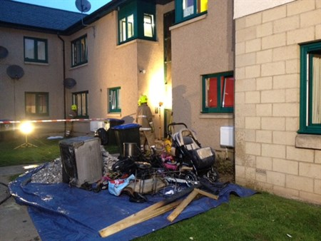
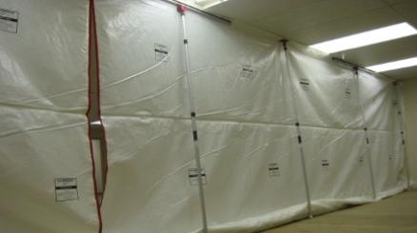
DEFINITION
Exposed combustible materials
Fire-resistant coverings
Combustible materials that are not protected by
  Heat, or an ignition source
  Fuel
  Oxygen
Coverings applied to construction elements to increase fire resistance, such as fire-rated gypsum board protecting timber or structural steel.

Slide 12
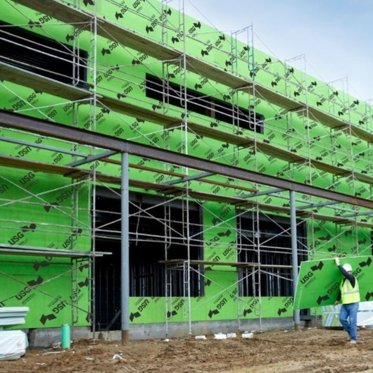
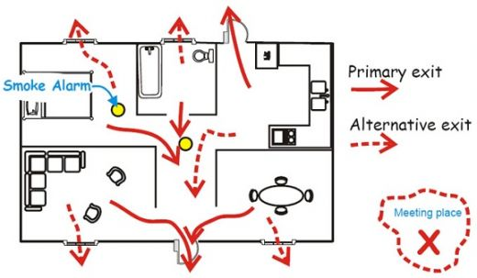
DEFINITION
Fire-preventative coverings
Fire Safety Plan (FSP)
Coverings, screens or treatments to combustible materials/construction elements that reduce the risk of ignition. Examples include fire-retardant treatments and non combustible sheathing.
A strategy document developed and implemented by the owner of a construction site to address fire prevention, occupant safety, and fire control and extinguishment.

Slide 13
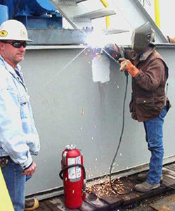
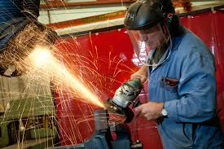
DEFINITION
Fire watch
Hot work
Typically consists of a trained person with a fire extinguisher whose sole job during the fire watch period is to guard against any fire ignition as a result of hot work activity.
Operations including cutting, welding, brazing, soldering, grinding, thermal spraying, thawing pipe, installation of torch-applied roof system or any other similar activity involving an open flame, sparks, friction or other heat or ignition source

Slide 14
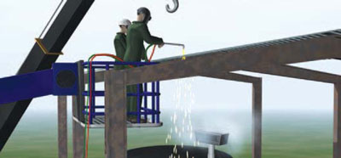
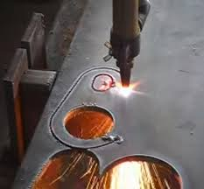
DEFINITION
Hot work equipment
Hot work area
Electrical or gas welding, soldering or cutting equipment used for hot work.
The area exposed to sparks, hot slag, radiant heat or convective heat as a result of hot work.

Slide 15
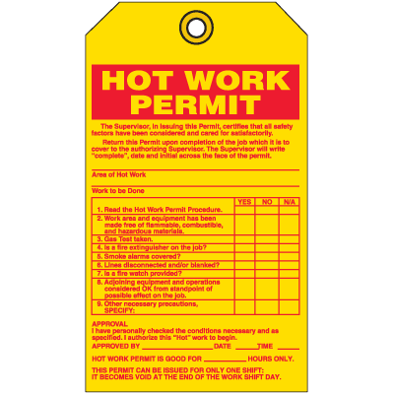
DEFINITION
Hot work permit
Hot work program
Permits issued by the responsible person at the facility that permit welding or other hot work to be performed and that outline requirements to meet for the work to be permitted to take place.
Allows approved personnel to oversee and issue permits for hot work conducted by their personnel or at their facility. The intent is that trained, on-site, responsible personnel ensure that the required hot work safety measures are taken.

Slide 16
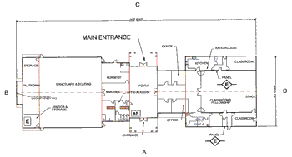
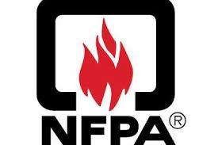
DEFINITION
NFPA Standard
Pre-fire or pre-incident plan
A standard developed by the National Fire Protection Association (NFPA), an organization that creates and maintains fire protection standards and codes for use and adoption by local governments. Although based in the United States,
A strategy document and site map indicating all hazards and resource locations related to a property before a fire takes place, to improve the effectiveness of the fire response.

Slide 17
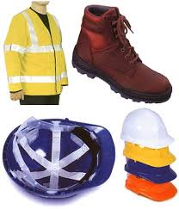
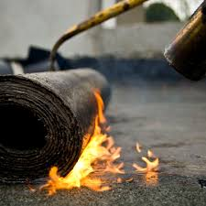
DEFINITION
Personal protective equipment (PPE)
Torch-applied roof system
Equipment worn to protect human safety, such as hard hats, safety vests, goggles and appropriate footwear
Bituminous roofing systems using membranes that are adhered by heating with a torch and melting an asphalt back-coating instead of mopping hot asphalt for adhesion.

Slide 18
FIRE PREVENTION
Company Policy
Fires are classified according to the nature of the material being burned (the fuel), and whether live electrical equipment is present. The primary purpose for classifying fires is to identify the type of material required to extinguish them.
  Class A fires are fires in ordinary combustibles such as wood, paper, cloth, trash, and plastics.
  Class B fires are fires in flammable liquids such as gasoline, petroleum oil and paint. Class B fires also include flammable gases such as propane and butane. Class B fires do not include fires involving cooking oils and grease.
  Class C fires are fires involving energized electrical equipment such as motors, transformers, and appliances. Remove the power and the Class C fire becomes one of the other classes of fire.
  Class D fires are fires in combustible metals such as potassium, sodium, aluminum, and magnesium.

Slide 19
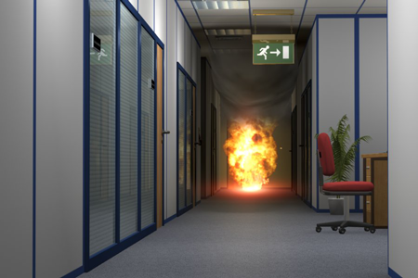

Causes of Fire in the
Workplace

Slide 20
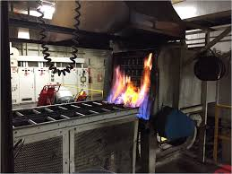
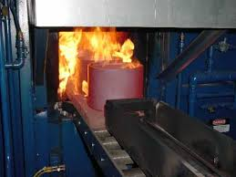
CAUSE OF FIRE IN THE WORK PLACE
Following common workplace fire hazards and controls
  Heating equipment, such as improperly installed, operated, or maintained furnaces. Every furnace or heater has minimum clearance distances on all sides and above
  make sure to keep material and building components away from this area.
  Never store combustible material in furnace rooms. And do not use temporary heating units in public buildings.

Slide 21
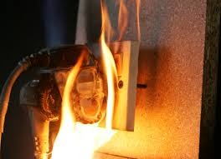
CAUSE OF FIRE IN THE WORK PLACE
  Electrical. Misused, overloaded, damaged, or improperly maintained electrical equipment is a common cause of workplace fires.
  Do not leave cords coiled up when plugged in.
  Only use extension cords for temporary power for equipment in use at the moment.
  Use multiple outlet strips for computer equipment, not for appliances or other electric equipment.
  Avoid overloading circuits

Slide 22
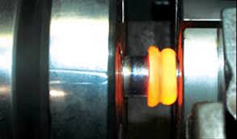
CAUSE OF FIRE IN THE WORK PLACE
Mechanical friction
  Improperly maintained or cleaned mechanical equipment can lead to a fire.
  Keep bearings properly lubricated and aligned.
  And keep conveyors and mobile equipment cleaned and free of accumulations of combustible material.

Slide 23
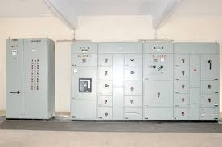
CAUSE OF FIRE IN THE WORK PLACE
Housekeeping
  Poor housekeeping practices are a common cause of fire.
  Avoid excessive storage of boxes and other combustible material.
  Make sure stored material never blocks exits, walkways, electrical panels, or emergency equipment.

Slide 24
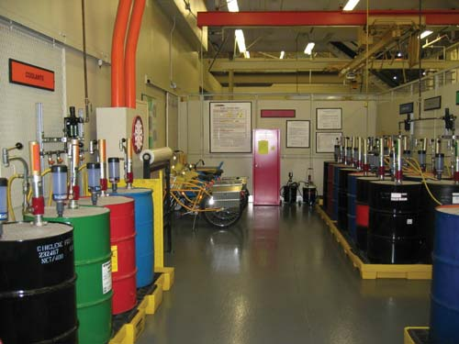
CAUSE OF FIRE IN THE WORK PLACE
Proximity hazards
  Watch out for hazards outside of buildings, such as other buildings within 100 feet of your site.
  Other hazards include nearby fuel tanks, dumpsters, and weeds, grass, and brush.

Slide 25
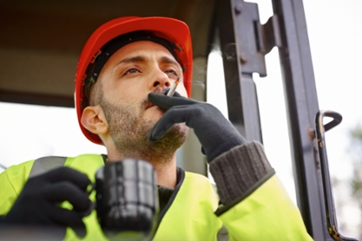
CAUSE OF FIRE IN THE WORK PLACE
Smoking
If you still permit smoking in your facility you may want to reconsider.
Unauthorized smoking or poor setup of smoking areas can put everyone at risk for fire.

Slide 26
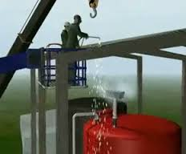
CAUSE OF FIRE IN THE WORK PLACE
Special hazards
  Take extra precautions if you have cutting/welding and other hot work that can produce flames, slag, or sparks.
  Other special hazards include flammable liquid storage and handling; spontaneous combustion from oily rags, chemicals, hay, and leaves; commercial cooking equipment; and LPG and natural gas.

Slide 27
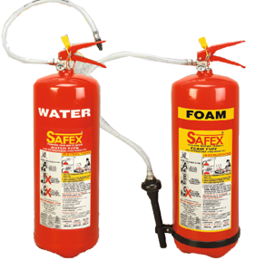
TYPE OF FIRE EXTINGUISHERS
Water and Foam
Water and Foam fire extinguishers extinguish
The fire by taking away
The heat element of
The fire triangle.
Foam agents also separate the oxygen element from the other elements.
Water extinguishers are for Class A fires only
They should not be used on Class B or C fires.
The discharge stream could spread
The flammable liquid in a Class B fire or could create a shock hazard on a Class C fire.

Slide 28
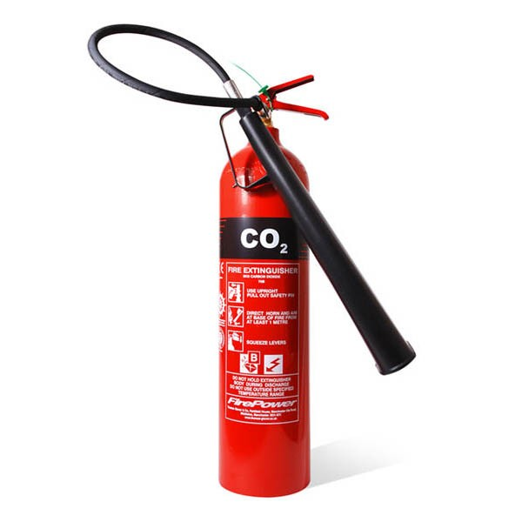
TYPE OF FIRE EXTINGUISHERS
Carbon Dioxide
Carbon Dioxide fire extinguishers extinguish fire by taking away
The oxygen element of the fire triangle and also be removing the heat with a very cold discharge.
Carbon dioxide can be used on Class B & C fires.
They are usually ineffective on Class A fires.

Slide 29
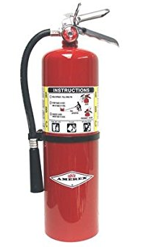
TYPE OF FIRE EXTINGUISHERS
Dry Chemical
Extinguish the fire primarily by interrupting the chemical reaction of the fire triangle.
Today's most widely used type of fire extinguisher is the multipurpose dry chemical that is effective on Class A, B, and C fires.
This agent also works by creating a barrier between the oxygen element and the fuel element on Class A fires.
Ordinary dry chemical is for Class B & C fires only.
It is important to use the correct extinguisher for the type of fuel! Using the incorrect agent can allow the fire to re-ignite after apparently being extinguished successfully.

Slide 30
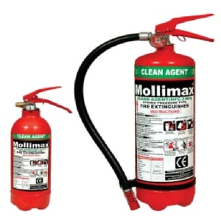
TYPE OF FIRE EXTINGUISHERS
Halogenated or Clean Agent
Extinguishers include the halo agents as well as the newer and less ozone depleting halo carbon agents.
They extinguish the fire by interrupting the chemical reaction of the fire triangle.
Clean agent extinguishers are primarily for Class B & C fires.
Some larger clean agent extinguishers can be used on Class A, B, and C fires

Slide 31
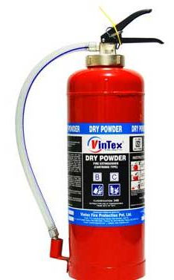
TYPE OF FIRE EXTINGUISHERS
Cartridge Operated Dry Chemical
Cartridge Operated Dry Chemical fire extinguishers extinguish the fire primarily by interrupting the chemical reaction of the fire triangle.
Like the stored pressure dry chemical extinguishers, the multipurpose dry chemical is effective on Class A, B, and C fires. This agent also works by creating a barrier between the oxygen element and the fuel element on Class A fires.
Ordinary dry chemical is for Class B & C fires only. It is important to use the correct extinguisher for the type of fuel! Using the incorrect agent can allow the fire to re-ignite after apparently being extinguished successfully.

Slide 32
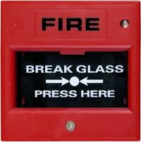
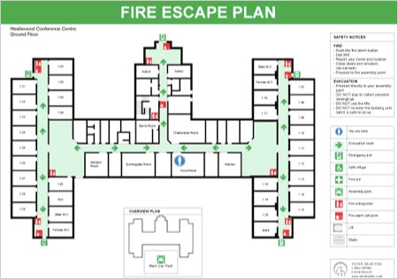
FIRE SAFETY TRAINING
Discovering a fire
Hearing the fire alarm
Personnel should be made aware of the method of raising the alarm in a premises; this should include the position of manual fire alarm call points and their method of operation.
Personnel should be made aware of the evacuation procedures in their premises. They should be shown escape routes and final exits; they should also be made aware of fire doors and their purpose in protecting escape routes

Slide 33
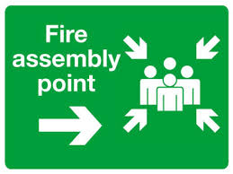
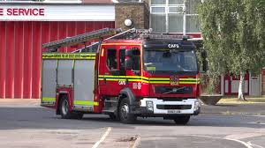
FIRE SAFETY TRAINING
Assembly points
Calling the Fire and Rescue Service
Personnel should be shown their ‘Fire Assembly Point’ and made aware of the need to ensure everybody have been accounted for.
Personnel should be made aware of the method of calling the fire service and the location of telephones.

Slide 34
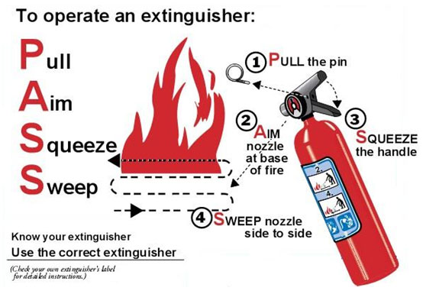
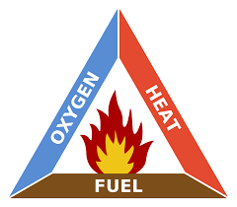
FIRE SAFETY TRAINING
The fire triangle
Use of fire extinguishers
A basic knowledge of the theory of fire
Personnel should be trained in the safe use of fire extinguishers. It is not acceptable to say “employees are not expected to use an extinguisher and therefore they don’t need to know”.
.

Slide 35
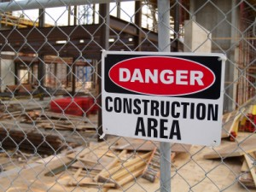
RISK MANAGEMENT
Construction Site Danger
The leading causes of fire in buildings under construction or demolition are: incendiary or suspicious events, smoking, open flames (e.g. from hot work), embers and heating equipment.
  Waste
  Gases, solvents and many paints and adhesives
  Gas cylinders
  Electrical equipment
  Smoking on site
  Escape routes
  Temporary buildings

Slide 36
RISK MANAGEMENT
Fire Prevention Planning
Fire prevention planning, which includes the development of a formal Fire Safety Plan, should be completed before the project begins.
Assessing risks by asking questions such as:
  Where are fires most likely to occur?
  Are employees properly trained to identify and prevent conditions that may lead to fires, and react appropriately if a fire starts?
  Are means of egress (exiting) kept clear of obstruction,
  Identifying and implementing actions to address the risks, such as employee training.

Slide 37
RISK MANAGEMENT
Fire Prevention Planning
Communicating the plan to everyone involved in the worksite (including management, contractors and employees) through written policies and procedures, signage and information/training sessions.
Continually evaluating and revising the plan to keep pace with the constant changes at a construction site, including:
  New contractors or employees;
  Changes in types and quantities of materials;
  Changes in water supply; and,
  Deliveries or completed work that blocks evacuation routes.
Maintaining accurate records and keeping them available for inspection by fire authorities.
Ongoing training and drilling to keep the information top-of-mind among those at the worksite, and to solicit input for improvements. Tactics can include weekly walk-through and “toolbox talks.”

Slide 38
FIRE PREVENTION AND PROTECTION
Electrical supplies and equipment
All electrical systems and equipment, including temporary installations, should be installed and maintained in accordance with applicable regulations by a qualified technician. Poor installation and maintenance can lead to a build up of heat or arcing and sparking, all of which have the potential to ignite any nearby combustibles.
Electrical equipment, including portable devices and electrical cords, should be regularly maintained and inspected as part of day-to-day routines, and any problems should be reported and fixed immediately.
Faulty or damaged equipment should be removed from use immediately, labelled, and either removed from the site or secured to prevent future use.

Slide 39
FIRE PREVENTION AND PROTECTION
Electrical supplies and equipment
Any equipment that operates at temperatures above 75°C should be securely fastened to prevent hot parts of the equipment from coming in contact with combustible materials.
Fragile components, such as temporary lights, should be equipped with guards to prevent accidental damage. ο Low-voltage equipment should be used when possible.
Electrical cabling, especially temporary installations, should be protected against damage from construction activities.
Temporary wiring should be removed as soon as it is no longer needed.
When using metal halide lights for temporary lighting, only use fixtures equipped with Type O lamps. Any other type of lamp could present a severe fire risk if it fails prematurely. Combustible and flammable materials should not be stored directly below the light fixture in the event of a catastrophic light failure.
Special consideration should be given to equipment located near storage of flammable gases or liquids.
Where possible, main switches should be turned off when work ceases, and all equipment unplugged when not in use.

Slide 40
EMERGENCY PROCEDURES
General Preparation
Clear signage should be provided and maintained in prominent positions showing the locations of fire department access routes, escape routes, standpipes, and fire extinguishers provided for use by trained staff.
Signs should be reviewed regularly and replaced or repositioned as necessary.
Assembly points should be designated in advance and clearly identified.
Employers should provide training on emergency procedures, including how to raise the alarm to all workers at the site.
Drills should be conducted to test the procedures and ensure workers and supervisors are familiar with their roles and responsibilities.
Security personnel should be instructed to open gates or barriers and provide ready access to the fire department in the event of an emergency or an inspection visit.

Slide 41
EMERGENCY PROCEDURES
During emergencies Evacuation and Egress Preparation
Adequate paths of travel to exits and evacuation routes should be provided at all times, taking into account the number of people, activities being undertaken, and occupant capabilities. Routes should also be designated through large open-plan areas.
Two ways out should be provided whenever possible, particularly if working at height or below ground level.
Multi-storey projects that have progressed to 10 metres or more above ground level should have permanent or temporary stairs to the ground that are accessible from each working level.

Slide 42
EMERGENCY PROCEDURES
During emergencies Evacuation and Egress Preparation
Signage showing the fastest way out should be clearly visible, and should be regularly monitored and relocated as necessary as construction progresses and conditions change.
Regular checks should be undertaken to ensure exits and evacuation routes are kept clear of obstructions and provided with clear signage. These checks should be undertaken daily or weekly, depending on the risks associated with the site.
Combustible materials and liquids should never be stored in an evacuation route.
Building exits should never be blocked or locked while people are in the buildings.
Staff should be advised to make themselves aware of escape routes and that routes could change without notice.

Slide 43
EMERGENCY PROCEDURES
During emergencies
An assembly site away from the premises should be designated in advance and communicated to everyone on the site. If acetylene cylinders are stored on site, the assembly site should be at least 200 metres away from the location of the cylinders.
Once a fire alarm has been raised, the fire department should be contacted and all occupants should evacuate the building and/or worksite and make their way to the assembly site, ensuring that fire service access points are not obstructed.
If the building fills with smoke, occupants should stay low and follow the wall, if possible, as they exit.
A designated person should confirm that all occupants have been accounted for (using documentation such as sign-in sheets, employee lists and work schedules), and provide the information to the fire department. It is important that the fire department know if anyone may be in the building, so a system to track site occupants at all times is critical.

Slide 44
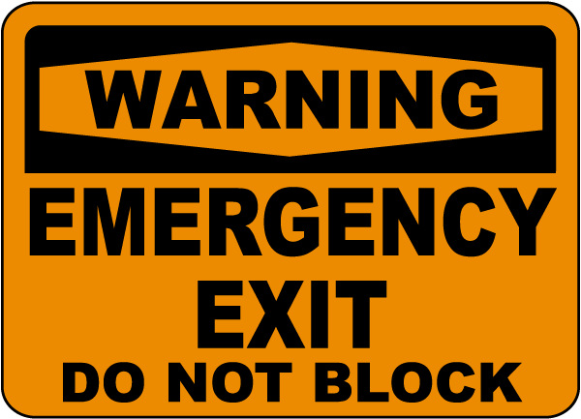
EMERGENCY PROCEDURES
Temporary Exiting
Existing exits should not be impaired or impeded by new construction. In the event that temporary exiting is required, blocked exits should be minimized.
Temporary floor signs should be provided in any stairwell connecting three or more floors, indicating the floor number, roof access and direction to exits.
If the building is over one storey in height, at least one stairwell should be provided that is in usable condition at all times.
A stairwell should be extended upward as each floor is installed with new construction.

Slide 45
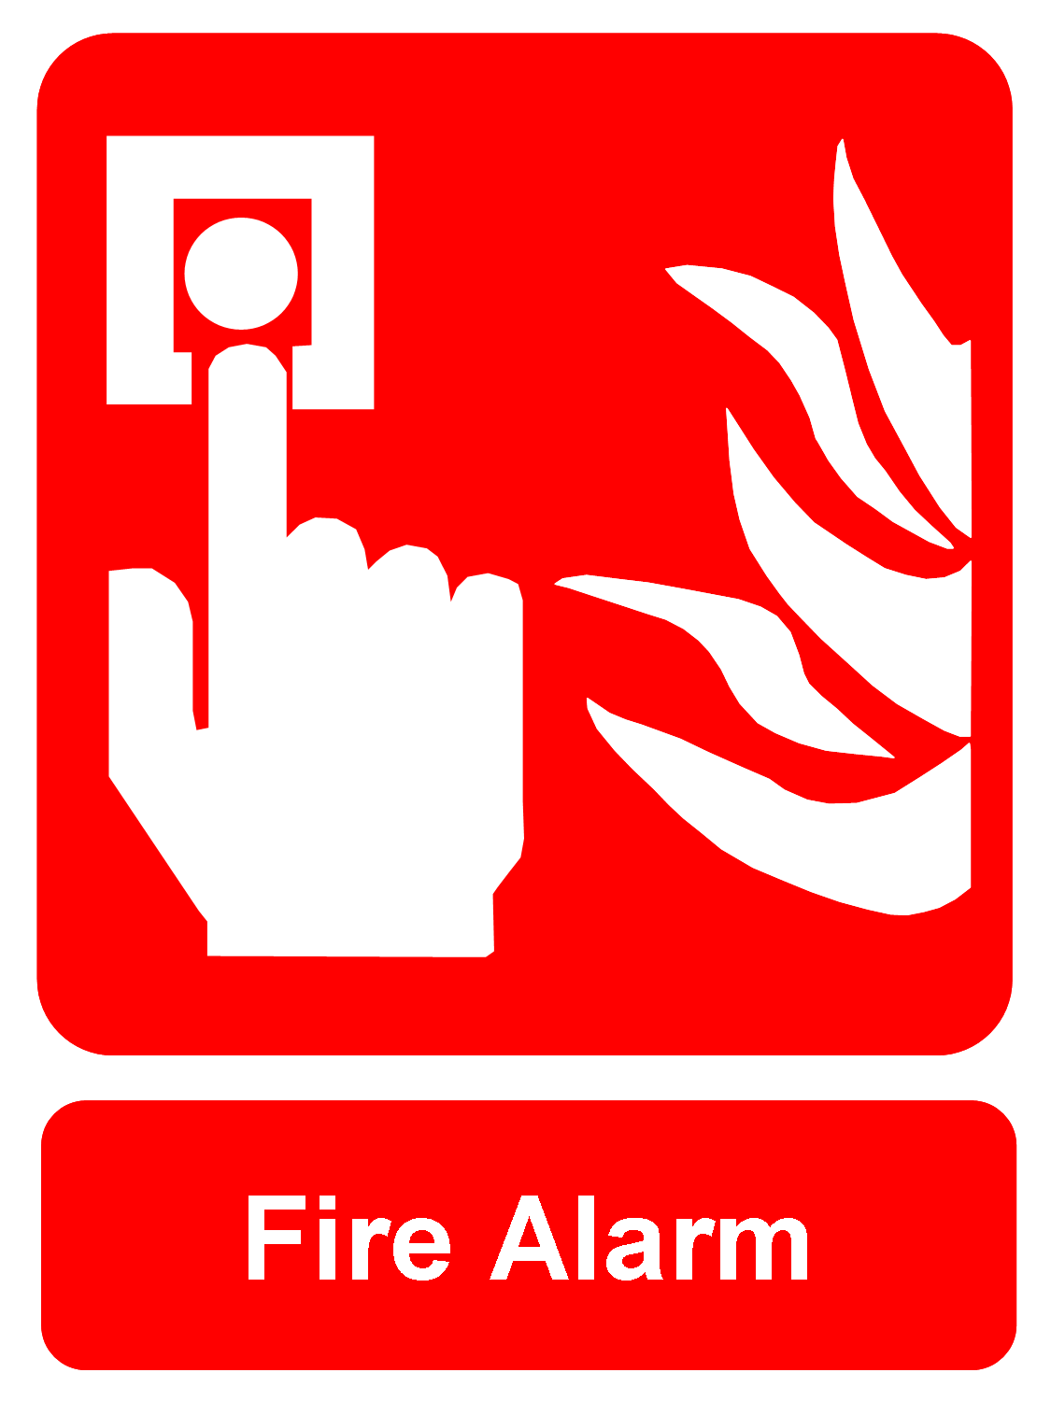
EMERGENCY PROCEDURES
Fire Alarm Systems
It is everybody’s responsibility to immediately raise the alarm in cases of fire or other emergency on a site. Where the installation of permanent automatic detection and alarm systems is not practical during construction, a temporary means of fire warning should be established to allow staff to raise an alarm across the site if a fire is detected, and to alert the fire department.
  They are distinctive and clearly audible above background noises in all areas
  All staff and inducted visitors are trained/instructed so that they can recognize the fire/emergency alarm and understand what action to take
  The devices are distributed throughout the site, and staff is aware of their locations and trained in their use.

Slide 46
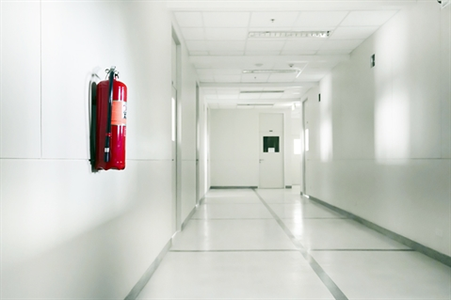
EMERGENCY PROCEDURES
Fire Extinguisher
Extinguishers should be installed in unobstructed and easily accessible locations in accordance with NFPA 10 Standard for Fire Extinguishers. They should be installed on each storey, adjacent to each required exit, temporary exit or stairway, and near areas where combustibles are stored and hot work is carried out.
At least one Class A, B and C fire extinguisher of the appropriate size should be provided at all times.
Ride-on mechanically-propelled equipment should carry an appropriate fire extinguisher when possible.

Slide 47
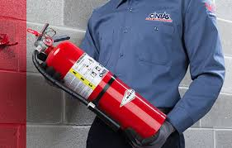
EMERGENCY PROCEDURES
Employees should be made familiar with the location of all fire extinguishers on site.
Extinguishers should be provided for fire watch personnel while hot work is being undertaken, and at any other locations identified through risk assessments or required as part of a standard safe work method.
Fire extinguishers should be maintained and regularly inspected, and staff should be trained in the use of manual fire fighting equipment.
As construction progresses, the adequacy of portable fire fighting equipment should be reviewed as part of the periodic site fire assessment.

Slide 48
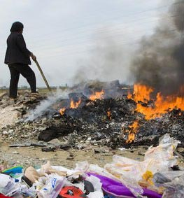
EMERGENCY PROCEDURES
Open and Waste Fires
Open fires, including the burning of waste materials, should be prohibited on the construction site.
Combustible waste materials should be regularly removed from the site rather than burned.
Use of warming devices, such as heating drums, should be located outside of any structure. If they are intended to be used, a risk assessment should first be undertaken.

Slide 49
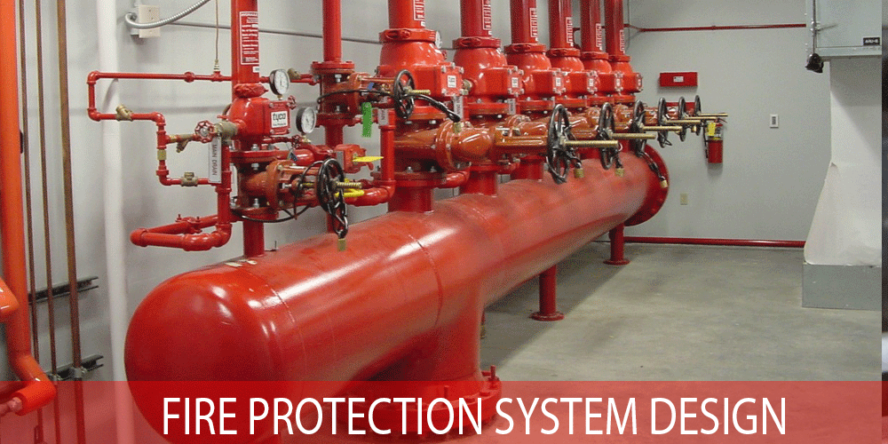
EMERGENCY PROCEDURES
Fire Protection Systems
When the following fire protection systems are to be installed in the completed building,
The project should be planned to bring them into operation as early as possible during the course of construction

Slide 50
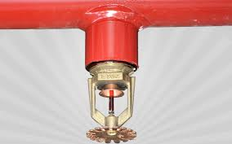
AUTOMATIC FIRE SPRINKLER AND OTHER SUPPRESSION SYSTEMS
When possible, automatic fire sprinkler systems should be progressively brought into service on each floor as construction takes place.
Early installation is particularly important when the building design relies on a sprinkler system to supplement fire separations (e.g. waiving requirements for spandrels or reducing fire-resistance levels) or to control fire spread when combustible materials are exposed during construction.
Progressive installation may not be practical in colder regions during the winter, due to the lack of insulation or heating in the unfinished buildings.
There is potential for damage to sprinklers from nearby construction tasks when installation is performed before the building is completed, so special care and/or replacement of damaged components may be necessary.

Slide 51
FLAMMABLE AND COMBUSTIBLE BUILDING MATERIAL
Deliveries of wood framing and other combustible materials should be planned to minimize the time they are stored on site.
Combustible building materials and scrap lumber should be stored in a secure area at least 22 metres away from any buildings or partially constructed buildings, or any area where hot work is undertaken.
When not in use, mops used to spread bitumen for hot surface applications should be stored in a safe location at a safe distance away from buildings.

Slide 52
FLAMMABLE AND COMBUSTIBLE BUILDING MATERIAL
If there is no alternative to storing combustible building materials within or close to a building under construction, the storage area should:
  Have controlled access
  Not be in an area where hot work is being carried out
  Be in either an area covered by the site fire-detection system or included in the route of regular fire checks
  Have fire fighting equipment close by
  Be protected from ignition sources where practical by fire preventative covers.

Slide 53
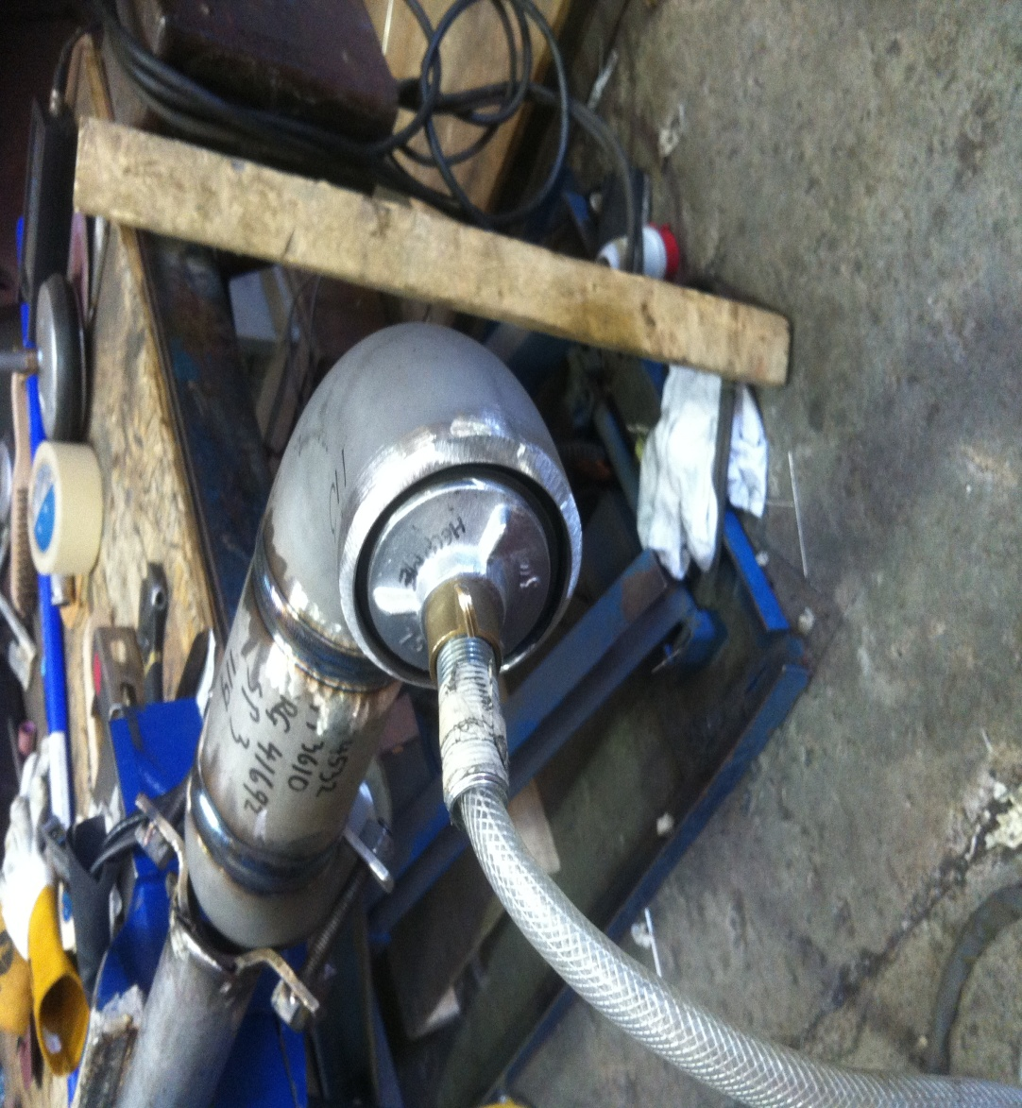
FLAMMABLE AND COMBUSTIBLE LIQUID AND GASES
Some of the main fire prevention methods are as follows:
  Gas-line purging requirements:
  Gas lines should be purged to the outdoors.
  Gas lines should be continuously monitored to the point of discharge. If done indoors, a combustible gas detector should be used to monitor the point of discharge.
  Ignition sources should be kept at least three metres away from the point of discharge.
  The discharge point should be at least three metres from openings and eight metres from any intakes.
  Any non-purging employees should be evacuated.
  Purging should be stopped when 90 per cent gas volume is reached.

Slide 54
FLAMMABLE AND COMBUSTIBLE LIQUID AND GASES
Workers should be instructed and trained in the storage and handling of flammable and combustible liquids and gases.
Storage of flammable liquids and gases should be limited to a day’s supply.
When not in use, flammable liquids and gases should be stored in closed, clearly labelled containers/cylinders compliant with NFPA standards, in a secure area – preferably an open compound at least 10 metres from permanent and temporary buildings and 20 metres from structures fabricated predominantly with combustible materials.
In enclosed settings, care should be taken to avoid build up of explosive fumes.
Automatic flammable-gas detection equipment should be considered for enclosed storage areas.

Slide 55
FLAMMABLE AND COMBUSTIBLE LIQUID AND GASES
All electrical fittings in storage areas, such as lights and switches, should be suitable for an environment where a flammable or explosive atmosphere may be present.
All sources or potential sources of ignition should be eliminated or controlled where an explosive atmosphere exists or is likely to exist.
Flammable liquids and gases should be stored separately from materials that could intensify the fire or present a toxic hazard, such as oxygen, acetylene and chlorine.
Flammable liquids, compressed gases and/or liquid propane gas should not be stored together.

Slide 56
FLAMMABLE AND COMBUSTIBLE LIQUID AND GASES
Empty and full gas cylinders should be separated, and empty cylinders marked to allow staff and fire fighters to identify them easily.
Clear signage should be provided identifying the materials being stored and prohibiting smoking, open flame, hot work and the use of mobile phones in and around the storage area.
The use of acetylene should be minimized and spare cylinders should not be kept on site. As soon as the work is completed, acetylene cylinders should be returned to the storage area.
Leaks or spills should be dealt with promptly and safely.

Slide 57
FLAMMABLE AND COMBUSTIBLE LIQUID AND GASES
Flammable liquids should never be used when there are open flames or sources of ignition nearby. For example, fuel tanks of heating devices should never be refilled while the device is in operation or is hot enough to ignite the liquid.
Propane cylinders should not be placed closer than three metres to a source of ignition unless they are part of hand-held equipment part of a lead pot used in plumbing or electrical work, part of a propane-powered or propane-heated vehicle, or are protected by a barrier, wall or other separation.
The accumulation of static charge during the transfer of flammable or explosive substances from one container to another should be prevented by electrically bonding the containers.
Liquids should only be used for their intended purposes. For example, gasoline should not be used to start a fire or used as a cleaning agent.
Proximity to flammable liquids and gases should be considered in hot-work risk assessments.

Slide 58
HOUSE KEEPING
Housekeeping’ involves keeping the worksite tidy and safe, ensuring combustible materials are stored in safe designated areas, as well as spotting hazards and taking action against them.
  Keeping the premises clear of all kinds of refuse and process waste.
  Ensuring waste and excess debris or scrap is swept up and removed from the premises at least daily.
  Ensuring all areas in and around the building site are kept free from accumulated packing materials, such as empty wooden crates, straw, plastic products, paper, etc.

Slide 59
HOUSE KEEPING
  Ensuring appropriate metal bins (or dumpsters with lids for some items) are provided for disposal of combustible waste materials such oily rags
  Keeping storage areas accessible to fire fighters.
  Clearing spaces around stacks of stored materials and ensuring adequate gangways are present between them.
  If a sprinkler system is installed, arranging all stacks of material to ensure they do not impede the effective operation of sprinklers.
  Locating dumpsters at least 15 metres away from the building (the farther away, the better). If a dumpster is located within the footprint of the building, then an on-site guard should be assigned or hired to monitor it.

Slide 60
HOT WORK
Work that generates open flames, heat and/or sparks – is a common cause of fires on construction sites. Hot work operations may include cutting, welding, brazing, soldering, grinding, and thermal spraying, thawing of pipe, and installation of torch-applied roof systems.
Training
  Anyone performing hot work should be trained in proper equipment operation, handling and storage of welding materials, compressed gas safety, chemical hazards, and working procedures.
  Additional training may also be required in the proper selection and use of specialized personal protective equipment.
  Training in confined space entry is necessary before any hot work is performed in a confined space area.
  Anyone performing hot work should be trained in emergency procedures such as how to raise the alarm, call the fire department, and safely evacuate the area in the event of fire.

Slide 61

About PMG Consultants
PMG Consultants is group of competent people with expertise in respective domains. Delivering commitments, exceeding expectations & creating value for clients in every interaction is our non-negotiable objective. Using the most advanced design & collaboration work systems, we aspire to become Inspirational business partners for our clients.
Get in touch
We would love to hear from you. Gauge our capabilities by speaking to us. You can visit us at our New Delhi Design Office, or meet our representative at your location.
Our Office
Address:
162A/9, 3rd Floor, Kishangarh,
Vasant Kunj, , New Delhi, 110070
Phone: +91-9871115995, +91-11-23361790
Email: connect@pmg-consultants.com
abhinav.pandey@pmg-consultants.com

