Slide 1
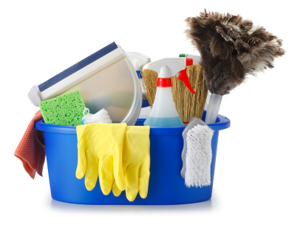
HOUSE KEEPING

Slide 2
ABOUT PMG
“BUILDING FOOD FACTORIES WITH TOP QUALITY STANDARDS OF NESTLE, MONDELEZ,ABBOTT, DANONE USING 3D DESIGN AND HYGIENIC ENGINEERING.”
At PMG, we deliver Engineering Design and Project Management scopes in Food and Beverage industry. Our team of design engineers and engineering executives has rich experience in Project Planning, Design, Execution and Commissioning with key competencies in areas like 3D Plant Design, Hygienic Engineering, and Project Management. Our safe-by-choice, result-oriented, and pro-active work-ethics allow us deliver work scopes meeting objectives, complete stakeholder alignment and first-time quality.
PMG Knowledge Repository: Targeted Knowledge Sharing & Skill Development
Precise and focused training modules for the exhaustive set of people working in manufacturing industry, instilling qualities of self-belief, creative thinking & widened perspective.
Clear Learning Objectives
Focused approach to skill development and knowledge sharing
Progressive Evaluation
Gauging improvement on every step and keeping audience connected.
After-training follow-ups
We systematically track differential progress of recipients after the training.
Audience Specific Approach
Programs are fine-tuned to the ability and interests of the recipients.
Multiple Awe-moments
Awe-moments are refreshing and increase receptivity many-fold.
Seasoned Trainers
PMG trainers are subject matter experts with substantial work experience.

Slide 3
AGENDA
1
Definiton
2
Effective Workplace Housekeeping
3
Eleminate Fire Hazards
4
Control Dust
5
Avoid Racking Materials
6
Prevent Falling Objects

Slide 4
AGENDA
7
Clear clutter
8
Store material properly
9
Use and inspection PPE’S and store tools
10
Determine frequency
11
Create written rules
12
Good housekeeping

Slide 5
DEFINITON
To some people, the word “housekeeping” calls to mind cleaning floors and surfaces, removing dust, and organizing clutter.
But in a work setting, it means much more. Housekeeping is crucial to safe workplaces.
It can help prevent injuries and improve productivity and morale, as well as make a good first impression on visitors; it also can help an employer avoid potential fines for non-compliance.
The practice extends from traditional offices to industrial workplaces, including factories, warehouses and manufacturing plants that present special challenges such as hazardous materials, combustible dust and other flammables.

Slide 6
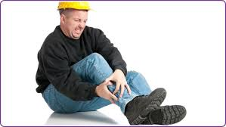
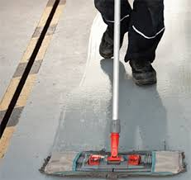
EFFECTIVE WORKPLACE HOUSEKEEPING
Prevent slips, trips and falls
Slips, trips and falls were the second leading cause of nonfatal occupational injuries or illnesses involving days away from work in 2013, according to data from the Bureau of labour Statistics.
Employers should select adequate flooring (e.g., cement, ceramic tile or another material), as different types of flooring hold up better under certain conditions

Slide 7
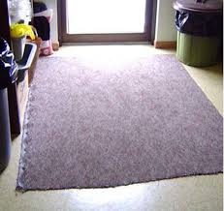
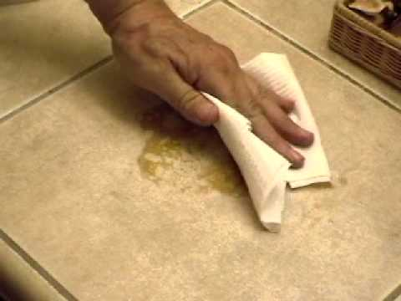
EFFECTIVE WORKPLACE HOUSEKEEPING
Prevent slips, trips and falls
All workplaces should be “kept clean and orderly and in a sanitary condition.” The rule includes passageways, storerooms and service rooms. Floors should be clean and dry. Drainage should be present where “wet processes are used.”
Things like oils and grease – if you don’t use the right kind of cleaning protocols, you’ll just spread slipperiness around rather than getting it up and off the floor.

Slide 8
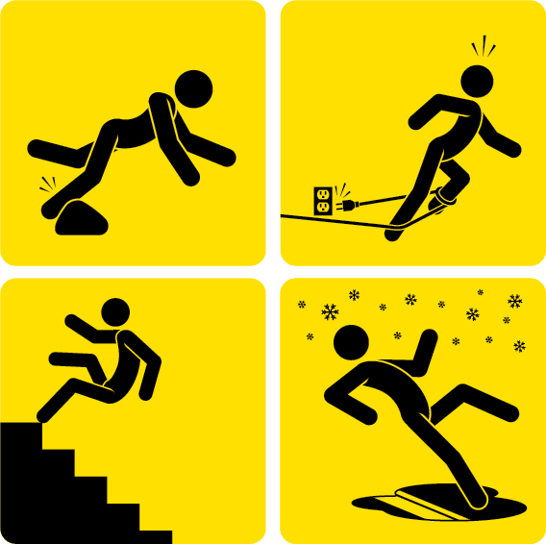
EFFECTIVE WORKPLACE HOUSEKEEPING
Prevent slips, trips and falls
To help prevent slip, trip and fall incidents Occupational Health and Safety recommend the following:
  Report and clean up spills and leaks keep aisles and exits clear of items.
  Consider installing mirrors and warning signs to help with blind spots.
  Replace worn, ripped or damage flooring.
  Consider installing anti-slip flooring in areas that can’t always be cleaned.
  Use drip pans and guards.
In addition, provide mats, platforms, false floors or “other dry standing places” where useful, every workplace should be free of projecting nails, splinters, holes and loose boards. Employers should audit for trip hazards, and encourage workers to focus on the task at hand.

Slide 9
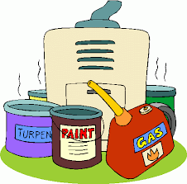
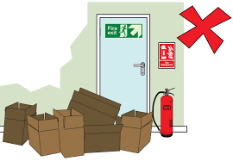
ELEMINATE FIRE HAZARDS
Combustible Material
Employees are responsible for keeping unnecessary combustible materials from accumulating in the work area.
Combustible waste should be “stored in covered metal receptacles and disposed of daily

Slide 10
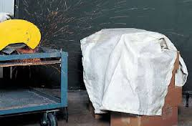
ELEMINATE FIRE HAZARDS
Precautionary measures for fire safety:
Keep combustible materials in the work area only in amounts needed for the job. When they are unneeded, move them to an assigned safe storage area

Slide 11
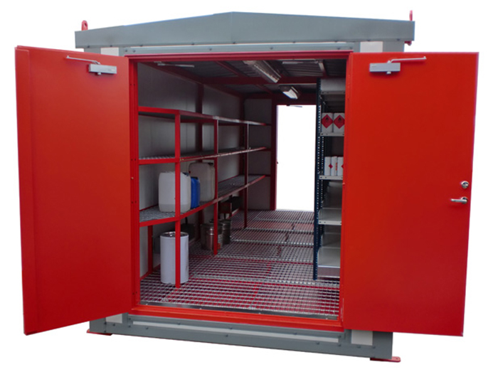
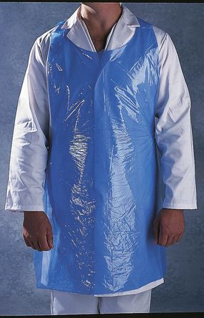
ELEMINATE FIRE HAZARDS
Storage
Store quick-burning, flammable materials in designated locations away from ignition sources.
Avoid contaminating clothes with flammable liquids. Change clothes if contamination occurs

Slide 12
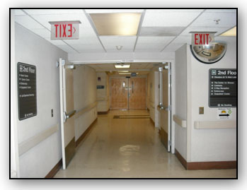
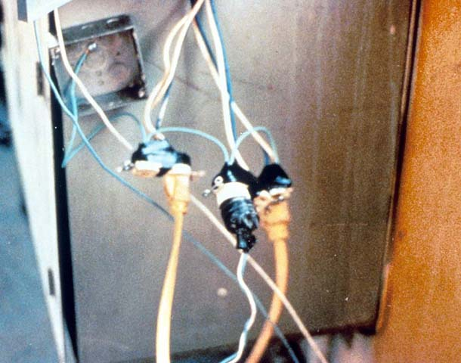
ELEMINATE FIRE HAZARDS
Keep passageways and fire doors free of obstructions. Stairwell doors should be kept closed. Do not store items in stairwells.
Hazards in electrical areas should be reported, and work orders should be issued to fix them.

Slide 13
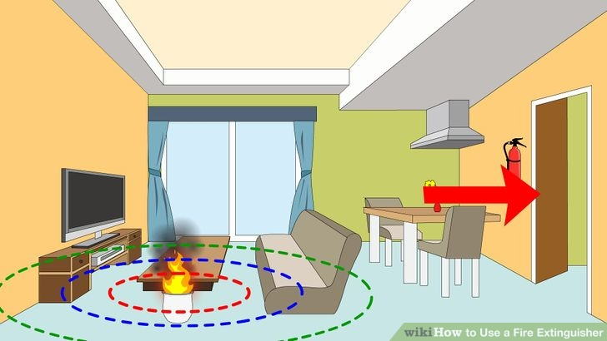
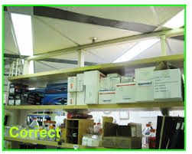
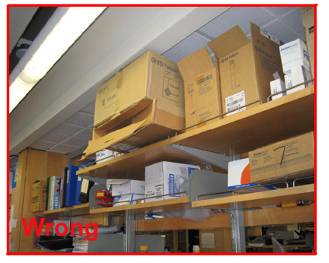
ELEMINATE FIRE HAZARDS
Keep materials at least 18 inches away from automatic sprinklers, fire extinguishers and sprinkler controls. The 18-inch distance is required, but 24 to 36 inches is recommended. Clearance of 3 feet is required between piled material and the ceiling. If stock is piled more than 15 feet high, clearance should be doubled.

Slide 14
CONTROL DUST
Dust accumulation of more than 1/32 of an inch – or 0.8 millimetres – covering at least 5 percent of a room’s surface poses a significant explosion hazard, This dust accumulation is about as thick as a dime or paper clip.
An industrial hygienist should test the workplace for exposures if air quality and dust are concerns.
NFPA 654– a standard on preventing fire and dust explosions – addresses identifying hazard areas, controlling dust and housekeeping.
The standard states that vacuuming is the “preferred” method of cleaning. Sweeping and water wash-down are other options. “Blow-downs” using compressed air or steam is allowed for inaccessible or unsafe surfaces.
Industrial vacuums can clean walls, ceilings, machinery and other places.

Slide 15
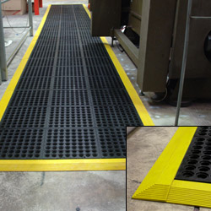
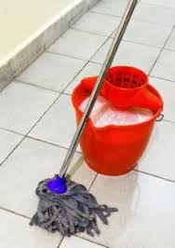
AVOID TRACKING MATERIALS
Work-area mats – which can be cloth or sticky-topped – should be kept clean and maintained. This helps prevent the spread of hazardous materials to other work areas or home, Check all mats to ensure they are not tripping hazards.
Additionally, separate cleaning protocols may be needed for different areas to prevent cross-contamination, avoid using the same mop to clean both an oily spill and in another area, for example.

Slide 16
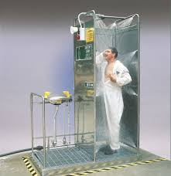
AVOID TRACKING MATERIALS
If the materials are toxic, industrial hygiene testing, uniforms and showering facilities might be needed.
Employees who work with toxic materials should not wear their work clothes home.

Slide 17
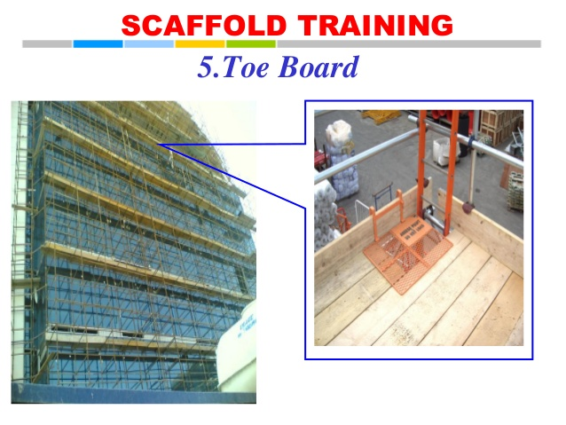
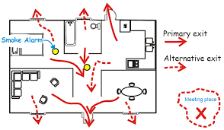
PREVENT FALLING OBJECTS
Protections such as a toe board, toe rail or net can help prevent objects from falling and hitting workers or equipment.
Keep layout in mind so workers are not exposed to hazards as they walk through areas.

Slide 18
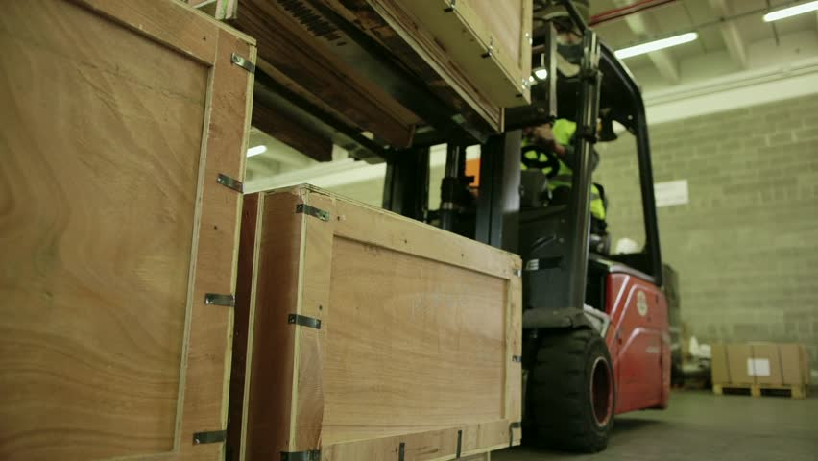
PREVENT FALLING OBJECTS
Other tips include stacking boxes and materials straight up and down to keep them from falling, Place heavy objects on lower shelves, and keep equipment away from the edges of desks and tables. Also, refrain from stacking objects in areas where workers walk, including aisles.

Slide 19
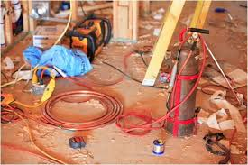
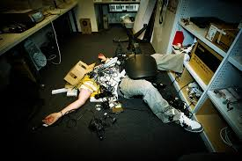
CLEAR CLUTTER
A cluttered workplace can lead to ergonomics issues and possible injuries because workers have less space to move.
“When an area is cluttered, you’re going to likely have a cut or laceration injury. “You’re not going to have as much room to set up your workstation like you should and move around. You’re going to be twisting your body rather than moving your whole body.”

Slide 20
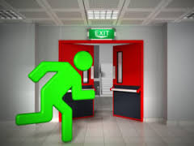

CLEAR CLUTTER
Compensation recommends that workers return tools and other materials to storage after using them, and dispose of materials that are no longer needed.
“Keep aisles, stairways, emergency exits, electrical panels and doors clear of clutter, and purge untidy areas. Empty trash receptacles before they overflow.

Slide 21
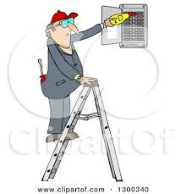
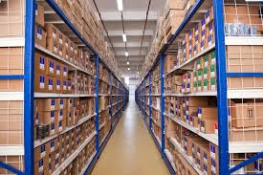
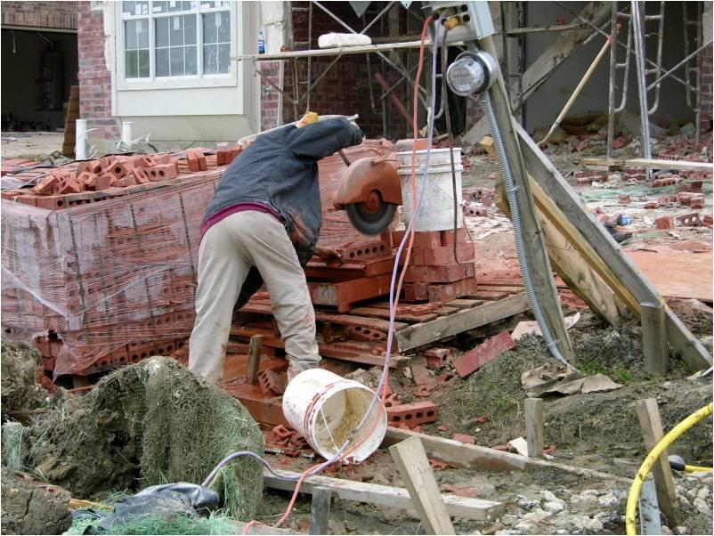
STORE MATERIAL PROPERLY
Storage areas should not have an accumulation of materials that present hazards for tripping, fire, explosion or pests.
Some workers make the mistake of storing ladders or other items inside electrical closets where they can block an electrical panel, creating a fire hazard and violating regulations.
Unused materials and equipment should be stored out of the way of workers. Avoid using workspaces for storage, and remember to put everything back in its proper place

Slide 22
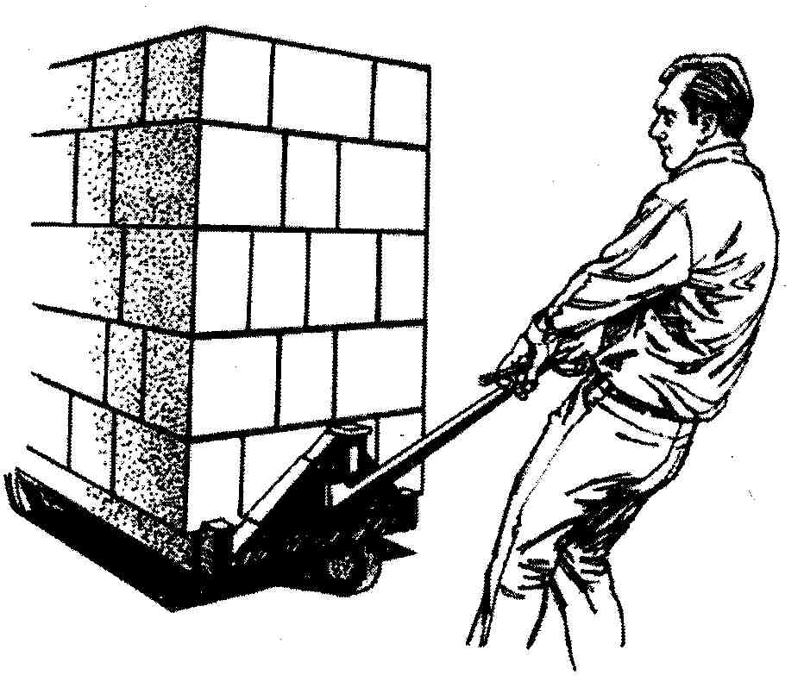
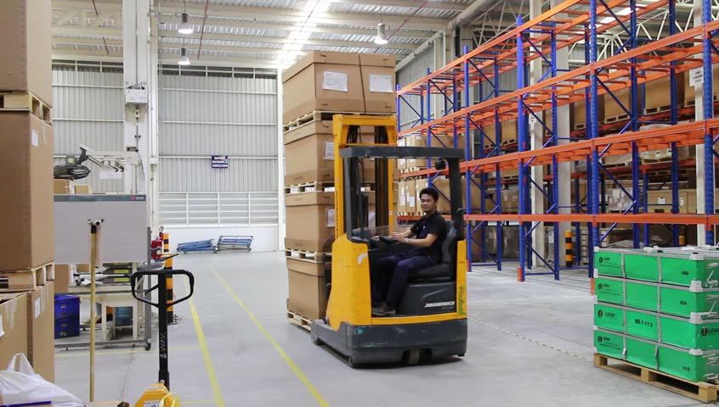
STORE MATERIAL PROPERLY
Keeping a storage space nearby so workers is encouraged to use it.
“There’s a responsibility to keep your work area in order and return tools to where they belong, the storage space, if readily useable, is designed in such a way where it can be used without stretching too far or lifting heavy loads.
They’re more likely to use it than if they have to go quite a ways to place something.
They’re going to keep something rather than go back because they have to take the extra time to get it.”

Slide 23


USE AND INSPECT PERSONAL PROTECTIVE EQUIPMENT AND TOOLS
Compensation cases stemming from employees who did not wear PPE when cleaning up spills or other material, such as broken glass or plywood, and then suffered cuts or splinters.
Wear basic PPE – such as closed-toe shoes and safety glasses – while performing housekeeping.
Determine what type of PPE to don based on the potential risks.
Regularly inspect, clean and fix tools. Remove any damaged tools from the work area.

Slide 24


USE AND INSPECT PERSONAL PROTECTIVE EQUIPMENT AND TOOLS
All workers should participate in housekeeping, especially in terms of keeping their own work areas tidy, reporting safety hazards and cleaning up spills, if possible.
“Every worker does have a role in housekeeping, “If they see something is becoming a problem, they need to report it.”

Slide 25
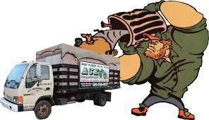
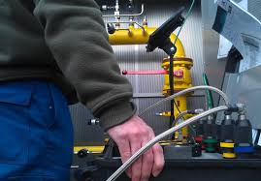
USE AND INSPECT PERSONAL PROTECTIVE EQUIPMENT AND TOOLS
Before the end of a shift, workers should inspect and clean their workspaces and remove unused materials. This dedication can reduce time spent cleaning later.
How much debris or contaminants the workplace releases can help determine the frequency of housekeeping. A company should have a mixture of deep cleaning and more frequent, lighter cleaning that involves sweeping and responding to spills.

Slide 26
CREATE WRITTEN RULES
Housekeeping policies should be put in writing, they are formal and defined.
Written protocols could specify which cleaners, tools and methods should be used.
There are many gaps in the effectiveness of floor cleaning in the operations “It is an area that sometimes gets overlooked.
Think long-term
Housekeeping should be more than a one-time initiative – it should continue through monitoring and auditing. Keep records; maintain a regular walkthrough inspection schedule, report hazards and train employees to help sustain housekeeping.
Set goals and expectations, and base auditing on those goals, Gary said.
“Housekeeping issues are very common.
They can be easy to fix.

Slide 27

GOOD HOUSEKEEPING
Identify potential causes of Slip Trip Fall (STFs) at your work site.
Wet, greasy or slippery walking surfaces
Uneven walking surfaces
Lose flooring or carpeting
Clutter or trash on the floors or walkways
Changing from one type of flooring to another
Sloped walking surfaces
Elevated work surfaces without adequate rails
Inadequate lighting

Slide 28

GOOD HOUSEKEEPING
Identify potential causes of Slip Trip Fall (STFs) at your work site.
Damaged or uneven stairs
Open desk or file cabinet drawers
Damaged or improper use of ladders or step-stools
Electrical cords or cables
Unguarded floor openings
Ramps or other sloped surfaces without slip-resistant
Unexpected placement of equipment or furniture
Wet leaves or pine needles
Weather hazards: rain, snow, ice, sleet

Slide 29
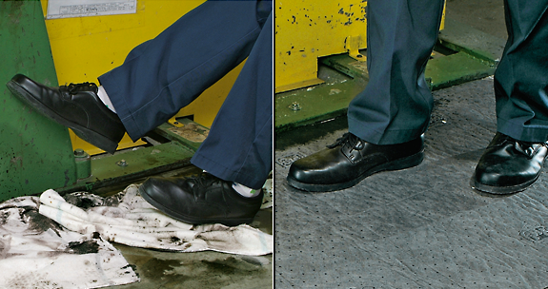
GOOD HOUSEKEEPING
Devise a plan to eliminate potential hazards.
Assigning cleaning/tidying responsibilities to individual or groups of employees;
Reorganizing the workspace so furniture or other objects do not create obstacles;
Creating and using extra space for storage of tools and materials;
Repairing damaged floors or walking surfaces
Creating traction on slippery surfaces
Developing a policy for keeping electrical cords or wires out of walking space ensuring that employees wear appropriate footwear

Slide 30
GOOD HOUSEKEEPING
Devise a plan to eliminate potential hazards.
Keeping work areas and passages well-lit
Confirming that light switches are easily accessible and easy to find
Developing a sub-plan to reduce hazardous conditions in poor weather
Devising a clear notification process for employees to report dangerous conditions establishing housekeeping procedures as part of a daily routine

Slide 31
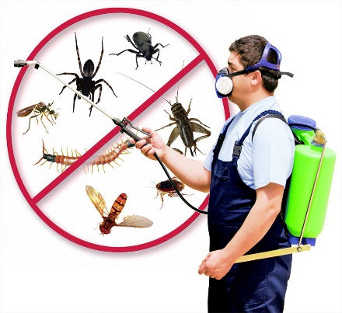
GOOD HOUSEKEEPING
Pest Control
All broken windows should be repaired and the building kept tight to deny access to the mill from birds, rodents or other factors which may adversely affect the quality of the finished feed.
Insects and rodents
  The plant and warehouse should be baited and fogged as needed using approved pest control methods.
  Baits and fumigation should be done by trained personnel, preferably an approved, licensed pest control agency.
  A record should be kept of all pesticides used and the type of applications.

Slide 32
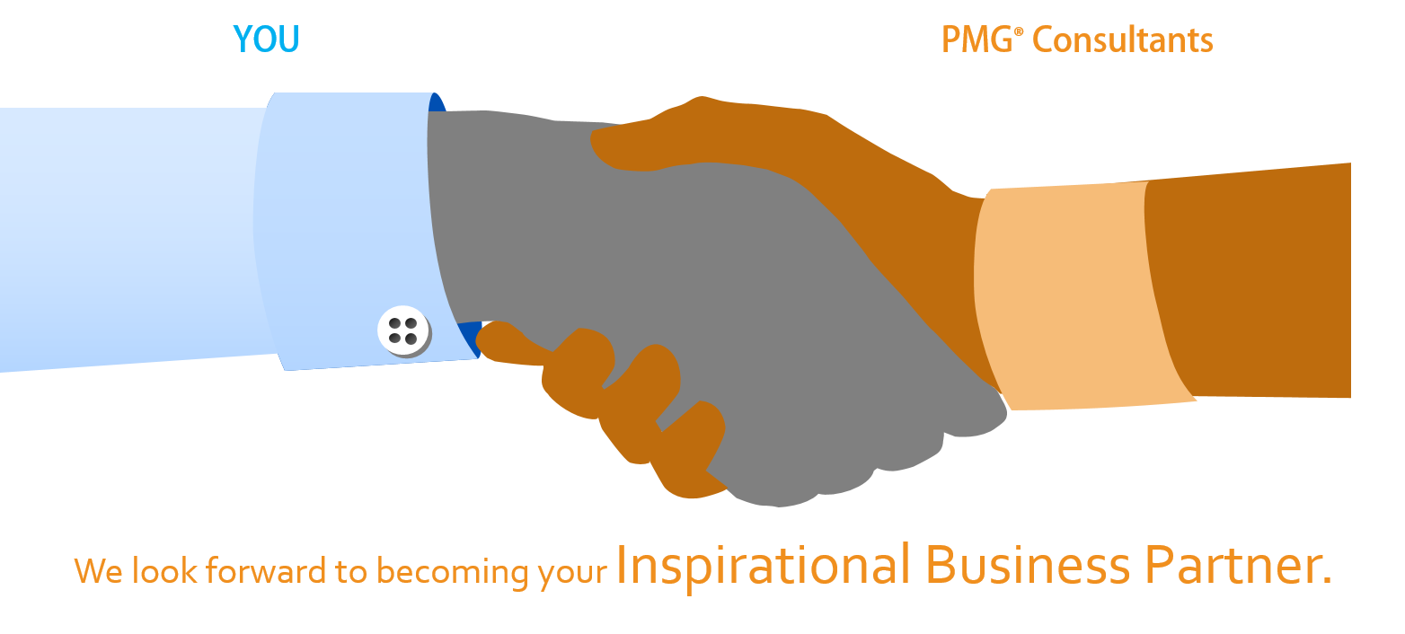
About PMG Consultants
PMG Consultants is group of competent people with expertise in respective domains. Delivering commitments, exceeding expectations & creating value for clients in every interaction is our non-negotiable objective. Using the most advanced design & collaboration work systems, we aspire to become Inspirational business partners for our clients.
Get in touch
We would love to hear from you. Gauge our capabilities by speaking to us. You can visit us at our New Delhi Design Office, or meet our representative at your location.
Our Office
Address:
162A/9, 3rd Floor, Kishangarh,
Vasant Kunj, , New Delhi, 110070
Phone: +91-9871115995, +91-11-23361790
Email: connect@pmg-consultants.com
Abhinav.pandey@pmg-consultants.com

