Slide 1
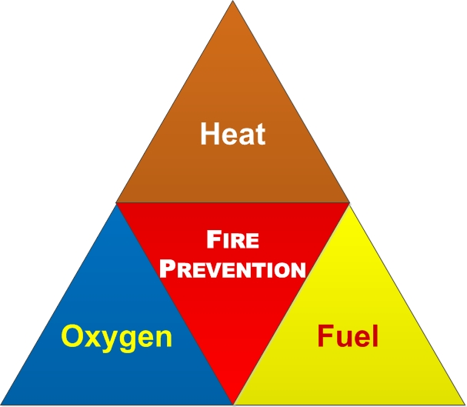
FIRE PREVENTION

Slide 2
ABOUT PMG
“BUILDING FOOD FACTORIES WITH TOP QUALITY STANDARDS OF NESTLE, MONDELEZ,ABBOTT, DANONE USING 3D DESIGN AND HYGIENIC ENGINEERING.”
At PMG, we deliver Engineering Design and Project Management scopes in Food and Beverage industry. Our team of design engineers and engineering executives has rich experience in Project Planning, Design, Execution and Commissioning with key competencies in areas like 3D Plant Design, Hygienic Engineering, and Project Management. Our safe-by-choice, result-oriented, and pro-active work-ethics allow us deliver work scopes meeting objectives, complete stakeholder alignment and first-time quality.
PMG Knowledge Repository: Targeted Knowledge Sharing & Skill Development
Precise and focused training modules for the exhaustive set of people working in manufacturing industry, instilling qualities of self-belief, creative thinking & widened perspective.
Clear Learning Objectives
Focused approach to skill development and knowledge sharing
Progressive Evaluation
Gauging improvement on every step and keeping audience connected.
After-training follow-ups
We systematically track differential progress of recipients after the training.
Audience Specific Approach
Programs are fine-tuned to the ability and interests of the recipients.
Multiple Awe-moments
Awe-moments are refreshing and increase receptivity many-fold.
Seasoned Trainers
PMG trainers are subject matter experts with substantial work experience.

Slide 3
AGENDA
1
Introducton.
2
General information.
3
Notification and reporting.
4
Action on hearing emergency siren.
5
Use of fire fighting equipment .
6
Smoking.
7
Use of fire fighting equipment with igniton potential.
8
Refueling.
9
Isolation of fire water network.
10
Roads and emergency.
Notes:
3

Slide 4
INTRODUCTION
Fire is one of the most common effects of industrial incidents resulting in loss of lives, property and business as well as damage to the environment.
A fire prevention program, aims at minimizing the fire hazard, which can be best achieved by increasing the fire safety awareness of everyone at the plant site.
This regulations and general guidelines on fire prevention and first-aid fire fighting to be followed by all persons at sites.
Action to be taken on noticing a fire or other emergency incident or on hearing an emergency siren, etc.

Slide 5
GENERAL INFORMATION
All persons must familiarize themselves with their respective workplaces and the surroundings, with special attention to the following:
  Emergency Communication Systems
  Testing schedule of Emergency Sirens
  Location and types of first aid fire fighting equipment
  Emergency exits
All persons shall familiarize themselves with the purpose, scope and contents of Major Incident Procedure Plan (MIPP) and shall fully understand their role, functions and the procedure to be followed in case of an emergency situation at their work sites.
In addition, each person shall be familiar with the evacuation procedure of his workplace.
Visitors shall be briefed by the sponsoring division.

Slide 6
NOTIFICATION AND REPORTING
Emergency Communications Control Centre (ECCC), i.e. the Fire Station control desk is the focal point of all initial and much of the subsequent communications associated with handling of an emergency incident.
Any incident, e.g. injury, hazardous gas or liquid release, fire, explosion, oil pollution, etc.
Must be notified immediately to the ECCC by:
  Calling the ECCC Operator on Emergency Telephone no101
  Actuating the Break Glass Fire Alarm, and subsequently calling on Emergency
The following information should be given when reporting an emergency incident:
  Location - be exact and precise as possible
  Nature - fire, gas release etc., as appropriate
  Casualties (if any), - as far as can be readily determined
  Name of caller – employee no. job etc.
  Any other relevant, helpful, essential details

Slide 7
ACTION ON HEARING EMERGENCY SIREN
The following action shall be taken on hearing the emergency siren at any time
other than the routine testing of the siren.
  Do not panic, stay at your place, and be alert.
  Follow the instructions, which may be announced, on the Public Address System or by any authorized person in your area.
  All maintenance / construction activities in the affected area should be stopped with all equipment switched off.
  Leave the building with the rest of the class.
  Use exits indicated on the “Fire Action” notices displayed in every area and go to your assembly point.
  Do not use lifts.
  Do not re-enter the building until authorised to do so.
  Visitors will be told to leave by the person in charge of the group or by a staff member.
  The person in charge must ensure that they are aware of the location of escape routes

Slide 8
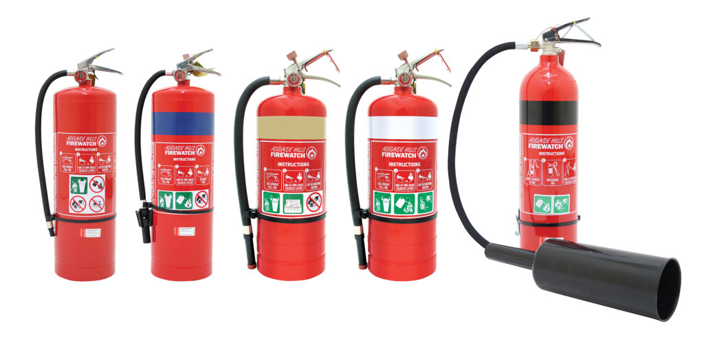
USE OF FIRE FIGHTING EQUIPMENT
First-aid fire fighting equipment
Portable extinguishers and hose reels are the first-aid fire fighting equipment provided in different locations, to be used by the trained occupants in the area, for initial fire fighting purposes.
The occupants shall familiarize themselves regarding correct type of fire extinguisher for the particular fire hazard.
User shall immediately inform the Fire Section for filling/replacement of used extinguishers and not return them as it is, to the original location.

Slide 9
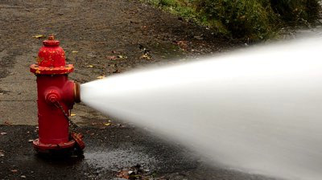
USE OF FIRE FIGHTING EQUIPMENT
Other fire fighting equipment and systems
Variety of fire fighting equipment and systems such as fire hydrant, fixed/portable monitors, foam units, water deluge/spray system, foam systems/stations etc.
Have been provided in different locations for protection of specific risks.
Only the fire crew or the trained auxiliary firemen (from Operations/Maintenance) shall use these equipment.
User shall obtain written authorization to using hydrants or firewater for any other purpose.
Under no circumstances the fire hoses and nozzles stored in the hose boxes shall be used by any one, except by the fire crew or the auxiliary firemen for fire fighting purposes.

Slide 10
USE OF FIRE FIGHTING EQUIPMENT
General guidelines
The fire fighting equipment shall not be used for any other purpose, except for fire fighting.
No one should tamper with the seals, labels, operating instructions etc., wherever provided on the equipment by the Fire Section.
The boxes containing fire-fighting equipment shall not be used for storing any other material.
Access to the fire fighting equipment shall never be blocked by parking vehicles, storing materials etc.
Asset custodian shall arrange to check the fire equipment in the respective area periodically and log the condition.
Any abnormality in fire extinguishers (such as missing, empty, damaged etc.) shall be reported to the fire section immediately for rectification.
Asset custodian shall initiate and follow up action for rectification of defects in fixed fire protection systems such as raising work order, etc.
Written authorization shall be required prior to undertaking maintenance of the fixed fire fighting systems as well as the fire detection and alarm systems.

Slide 11
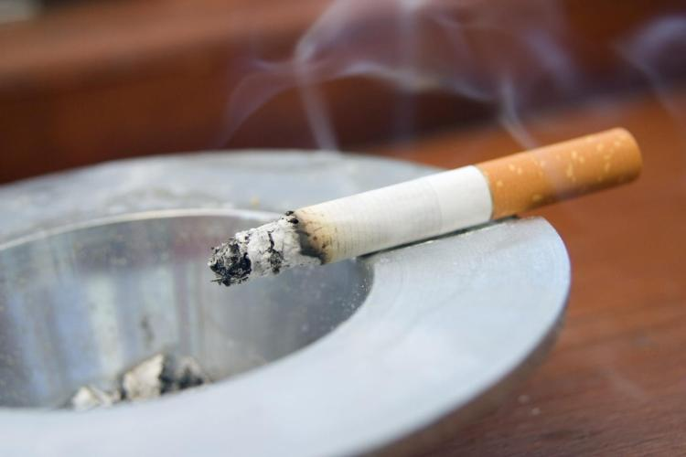
SMOKING
Smoking is prohibited inside the refinery except within the smoking booths and authorized locations for smoking which, shall be equipped with approved electric lighters.
Matches and lighters shall not be brought to the work site.
Smoking must be stopped at any location immediately on hearing siren or in case of emergency.
After smoking, the cigarettes must be extinguished in an extinguishing tray located in the smoking booth which, shall be filled with sand at all times.
The cigarette butts or the extinguishing trays shall not be thrown/emptied into the waste paper baskets.

Slide 12
USE OF EQUIPMENT/MACHINERY WITH IGNITION POTENTIAL
Ordinary electrical appliances (kettle, water boiler/cooler, room heaters, etc.) shall not be used in the hazardous area.
Kitchen appliances can be used only in approved locations such as kitchen, pantry, smoking shelter or dedicated cubicle.
Operator shelter or similar facility in hazardous area shall be equipped with explosion proof fittings/appliances (ex-proof AC, cooler, etc.)
A hot work permit shall be obtained for the use of open flame, power tools, machinery with ignition potential and portable instruments (e.g. welding equipment, grinder, drill, air compressor, cranes, thickness/vibration meters, etc.)
Non-intrinsically safe electronic items such as pager, mobile phone, calculator shall not be allowed in hazardous area.
Diesel engine driven equipment with, valid safety certificates are allowed in hazardous area.
These shall not be left unattended while running and shall be stopped in case of emergency.

Slide 13
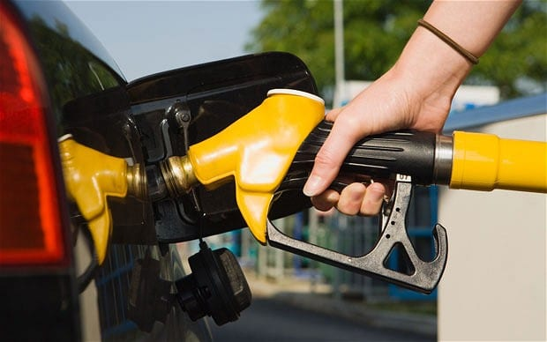
REFUELLING
Fuel stations
The vehicle engine shall be switched off before refuelling.
In case of any accidental overfilling or spillage of fuel, the engine shall not be started and the vehicle shall be pushed out manually to a safe location.
Fuel shall not be issued in bottles except when required as sample.
The vehicle receiving fuel shall not be left unattended.

Slide 14
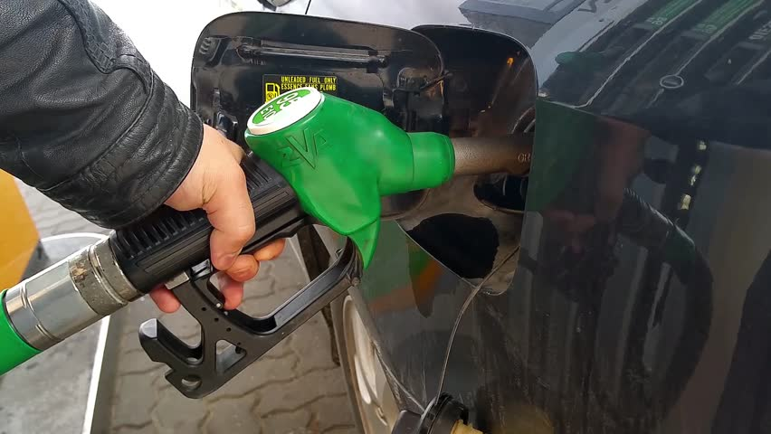
REFUELLING
Refuelling of site equipment
Equipment engine shall be stopped prior to refuelling.
Safety instructions for refuelling shall be displayed on the tanker (or laminated).
Fuel for refuelling (diesel) shall not be stored in refinery or other hazardous areas.
Bonding and grounding of fuel tanker or container with equipment shall be done.
Fuel shall not be transported in vehicles not certified for that purpose.

Slide 15
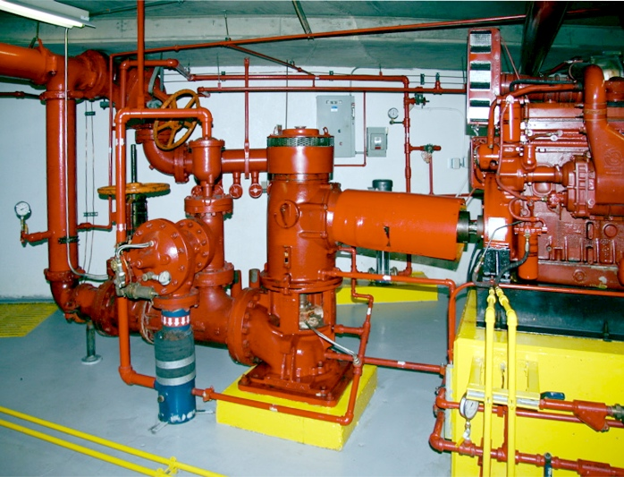
ISOLATION OF FIRE WATER NETWORK
The isolation valves provided on the fire water network shall be kept open.
If any section of the fire water network is required for maintenance purposes
isolation of firewater network shall be done only after proper authorization.

Slide 16
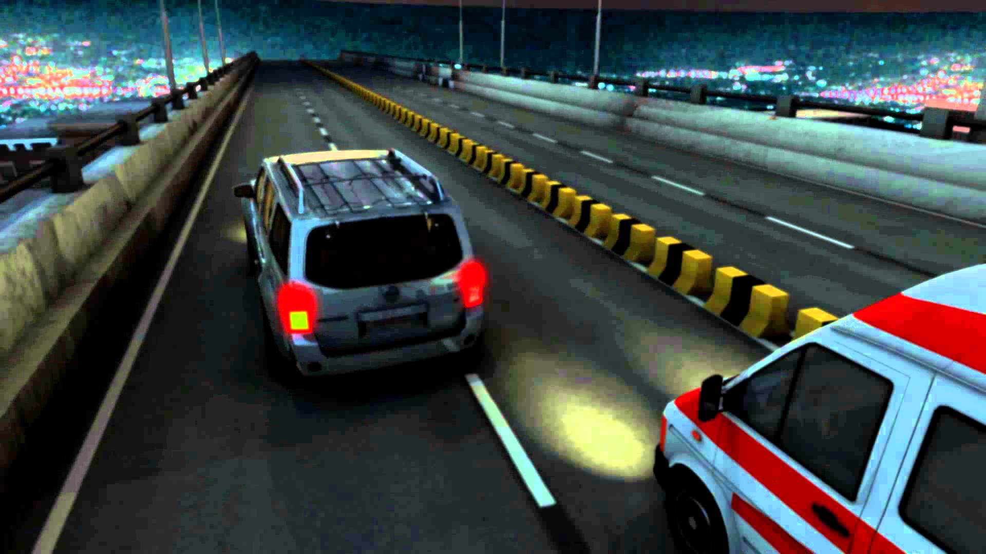
ROAD AND EMERGENCY ACCESS CLEARANCE
Roads and emergency access to units shall be kept clear of all obstructions to permit free passage to emergency response vehicles.
Speed restriction bumps should not be permitted on emergency routes (i.e. from Fire Station or clinic to hazardous area).
The emergency response vehicles will have the RIGHT OF WAY on all roads.
Other vehicles shall, when encountering emergency response vehicles; draw to the right hand side of road, stop and at night vehicles shall dim the headlights.
Authorized persons when proceeding to the emergency site should park their vehicles at a distance, stop the engine and leave the ignition keys in place.

Slide 17

About PMG Consultants
PMG Consultants is group of competent people with expertise in respective domains. Delivering commitments, exceeding expectations & creating value for clients in every interaction is our non-negotiable objective. Using the most advanced design & collaboration work systems, we aspire to become Inspirational business partners for our clients.
Get in touch
We would love to hear from you. Gauge our capabilities by speaking to us. You can visit us at our New Delhi Design Office, or meet our representative at your location.
Our Office
Address:
162A/9, 3rd Floor, Kishangarh,
Vasant Kunj, , New Delhi, 110070
Phone: +91-9871115995, +91-11-23361790
Email: connect@pmg-consultants.com
abhinav.pandey@pmg-consultants.com

