Slide 1
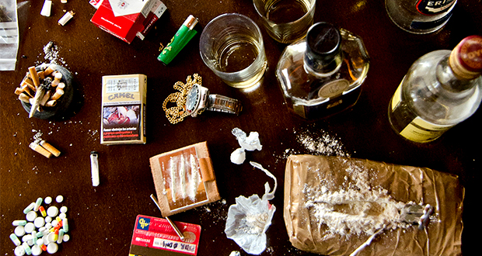
ALCOHOL
AND
DRUGS

Slide 2
ABOUT PMG
“BUILDING FOOD FACTORIES WITH TOP QUALITY STANDARDS OF NESTLE, MONDELEZ,ABBOTT, DANONE USING 3D DESIGN AND HYGIENIC ENGINEERING.”
At PMG, we deliver Engineering Design and Project Management scopes in Food and Beverage industry. Our team of design engineers and engineering executives has rich experience in Project Planning, Design, Execution and Commissioning with key competencies in areas like 3D Plant Design, Hygienic Engineering, and Project Management. Our safe-by-choice, result-oriented, and pro-active work-ethics allow us deliver work scopes meeting objectives, complete stakeholder alignment and first-time quality.
PMG Knowledge Repository: Targeted Knowledge Sharing & Skill Development
Precise and focused training modules for the exhaustive set of people working in manufacturing industry, instilling qualities of self-belief, creative thinking & widened perspective.
Clear Learning Objectives
Focused approach to skill development and knowledge sharing
Progressive Evaluation
Gauging improvement on every step and keeping audience connected.
After-training follow-ups
We systematically track differential progress of recipients after the training.
Audience Specific Approach
Programs are fine-tuned to the ability and interests of the recipients.
Multiple Awe-moments
Awe-moments are refreshing and increase receptivity many-fold.
Seasoned Trainers
PMG trainers are subject matter experts with substantial work experience.

Slide 3
AGENDA
1
Definition
2
General Employ training Covers
3
Effect of Drugs Abuse and Addiction
4
Drug Abuse Prevention
Notes:
3

Slide 4
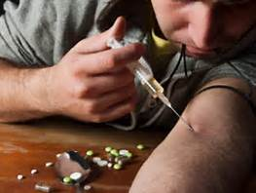
DEFINITION
Substance abuse, also known as drug abuse, is a patterned use of a drug in which the user consumes the substance in amounts or with methods which are harmful to themselves or others, and is a form of substance-related disorder.
Reduce health and social costs to the public of illegal drug use.
Drug dependence is a chronic, relapsing disorder that exacts an enormous cost on individuals, families, businesses, communities, and nations.
Addicted individuals frequently engage in self- destructive and criminal behaviour.
.

Slide 5
GENERAL EMPLOYEE AWARENESS TRAINING COVERS
Physical and mental effects of drug and alcohol abuse
Identifying drug and alcohol impairment
Reporting suspected impairment
Available intervention methods
Testing methods
Common myths regarding alcohol and other drugs
Effects of "hang over's" and legal substances on employee performance

Slide 6
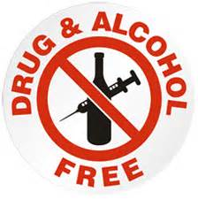

GENERAL EMPLOYEE AWARENESS TRAINING COVERS
In addition, DOT Employee Awareness Training Includes:
An overview of DOT testing rules and regulations regarding substance abuse
Procedures for testing safety sensitive employees
Specific drug testing protocol
Employer roles in the testing process
Ramifications of a positive test
Mode specific information

Slide 7
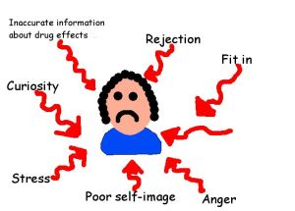
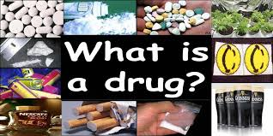
GENERAL EMPLOYEE AWARENESS TRAINING COVERS
In addition, DOT Employee Awareness Training Includes:
AIM
  Increased awareness about alcohol, cannabis, cocaine and New Psychoactive Substances (formerly known as ‘legal highs’)
  Information about the law and associated risks of misusing drugs
What is a drug?
  A drug is any chemical you take that affects the way your body and / or mind works
Why do people take drugs?
  People commonly fall into addiction because they begin using drugs to mask particular emotions that they are going through. The abuse makes them feel good and forget about the problem at hand. Eventually they think they can't live without drugs. Prescription drugs, street drugs and alcohol are more available than ever.

Slide 8
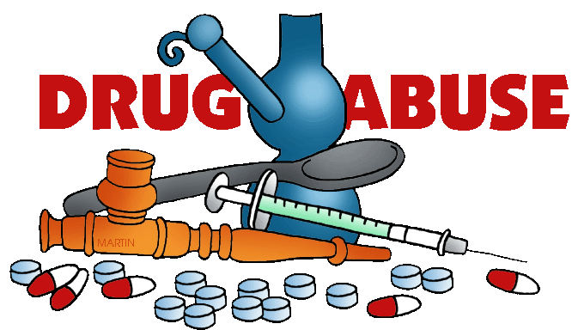
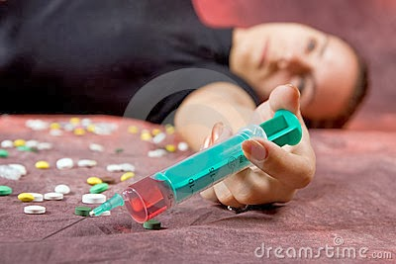
GENERAL EMPLOYEE AWARENESS TRAINING COVERS
In addition, DOT Employee Awareness Training Includes:
What do drugs lead to?
  Illegal drugs can cause things like hallucinations (seeing strange things), sickness, depression, liver and kidney problems and fits.
  Some illegal drugs can kill the first time the person takes them.
  Taking too much of any drug is called an overdose.
  A serious overdose of almost any drug can kill you
What is drug and drug abuse?
  Drug addiction is a chronic, often relapsing brain disease that causes compulsive drug seeking and use, despite harmful consequences to the drug addict and those around them.
  Drug addiction is a brain disease because the abuse of drugs leads to changes in the structure and function of the brain

Slide 9
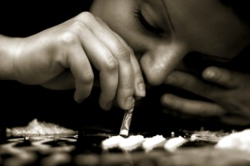
GENERAL EMPLOYEE AWARENESS TRAINING COVERS
In addition, DOT Employee Awareness Training Includes:
Why do people become drug addicts?
  To feel euphoric or feel nothing
  To feel more confident
  To work longer hours or enhance performance
  To belong to a social group (peer pressure)
  To kill time (alleviate boredom)
  To alleviate physical pain and other health problems
  Because it is a habit
  To satisfy cravings and avoid withdrawal symptoms
  For weight loss
  To experience an altered state of consciousness
  To unwind after a stressful day

Slide 10
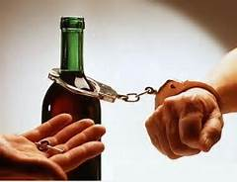
GENERAL EMPLOYEE AWARENESS TRAINING COVERS
In addition, DOT Employee Awareness Training Includes:
What is abuse of alcohol?
  Alcohol abuse is a previous psychiatric diagnosis in which there is recurring harmful use of ethanol despite its negative consequences.
  In 2013 it was reclassified as alcohol use disorder (alcoholism) along with alcohol dependence. Binge drinking is another form of alcohol abuse.

Slide 11
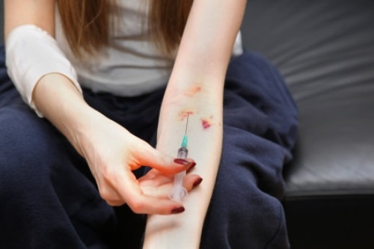
GENERAL EMPLOYEE AWARENESS TRAINING COVERS
In addition, DOT Employee Awareness Training Includes:
Why drug addiction is a disease?
  According to Drug Abuse.
  Gov, “Addiction is a chronic, often relapsing brain disease that causes compulsive drug seeking and use, despite harmful consequences to the addicted individual and to those around him or her.” But addiction is characterized by the inability to stop.
Why do people become drug addicts?
  This is why drug addiction is also a relapsing disease.
  They might take more of the drug, trying to achieve the same dopamine high.
  No single factor can predict whether a person will become addicted to drugs.
  A combination of genetic, environmental, and developmental factors influences risk for addiction.

Slide 12
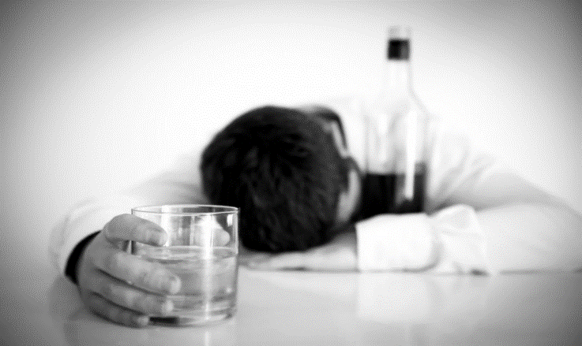
GENERAL EMPLOYEE AWARENESS TRAINING COVERS
In addition, DOT Employee Awareness Training Includes:
How alcohol is addictive?
  Heavy Drinkers' Response to Alcohol. The more they drink, the more endorphins are released,
  The happier they feel and the more likely they are to crave alcohol.
  When cravings meet physical dependence, binge drinking or alcohol abuse turns into alcohol addiction
What is alcohol addiction like?
  Alcohol abuse means having unhealthy or dangerous drinking habits, such as drinking every day or drinking too much at a time. If you continue to abuse alcohol,
  It can lead to alcohol dependence.
  Alcohol dependence is also called alcoholism.
  You are physically or mentally addicted to alcohol.

Slide 13
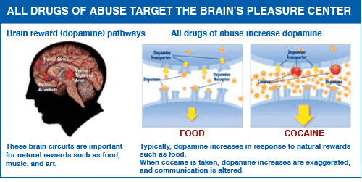
GENERAL EMPLOYEE AWARENESS TRAINING COVERS
In addition, DOT Employee Awareness Training Includes:
What is alcohol addiction like?
  Alcohol abuse means having unhealthy or dangerous drinking habits, such as drinking every day or drinking too much at a time.
  If you continue to abuse alcohol, it can lead to alcohol dependence. Alcohol dependence is also called alcoholism.
  You are physically or mentally addicted to alcohol.
How does drug addiction affect the brain?
  Drugs are chemicals that affect the brain by tapping into its communication system
  Interfering with the way neurons normally send, receive, and process information.
  Some drugs, such as marijuana and heroin, can activate neurons because their chemical structure mimics that of a natural neurotransmitter.

Slide 14
EFFECTS OF DRUG ABUSE AND ADDICTION
Drugs are chemicals
  Different drugs, because of their chemical structures, can affect the body in different ways.
  In fact, some drugs can even change a person's body and brain in ways that last long after the person has stopped taking drugs, maybe even permanently.
Depending on the drug
  It can enter the human body in a number of ways, including injection, inhalation, and ingestion.
  The method of how it enters the body impacts on how the drug affects the person.
  For example: injection takes the drug directly into the blood stream, providing more immediate effects; while ingestion requires the drug to pass through the digestive system, delaying the effects.

Slide 15
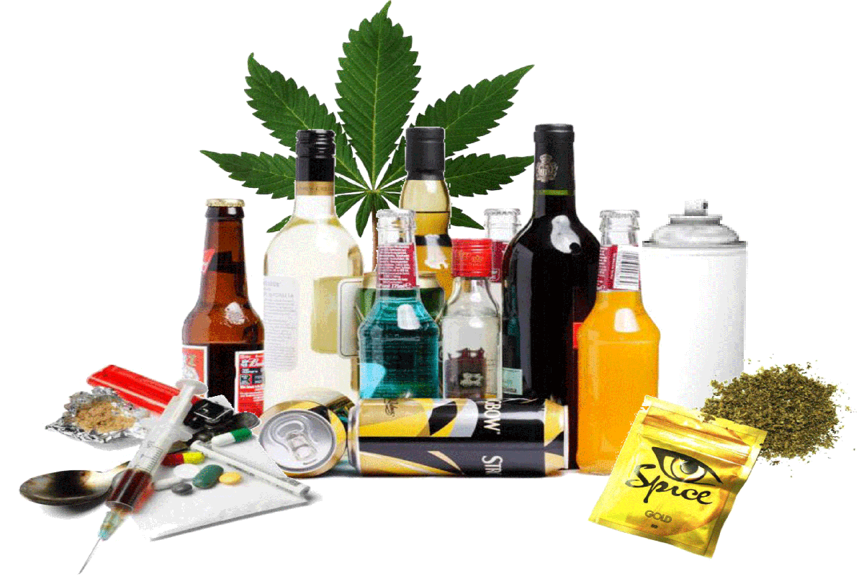
EFFECTS OF DRUG ABUSE AND ADDICTION
Most abused drugs
  Directly or indirectly target the brain's reward system by flooding the circuit with dopamine.
  Dopamine is a neurotransmitter present in regions of the brain that regulate movement, emotion, cognition, motivation, and feelings of pleasure.
  When drugs enter the brain, they can actually change how the brain performs its jobs.
  These changes are what lead to compulsive drug use, the hallmark of addiction.

Slide 16
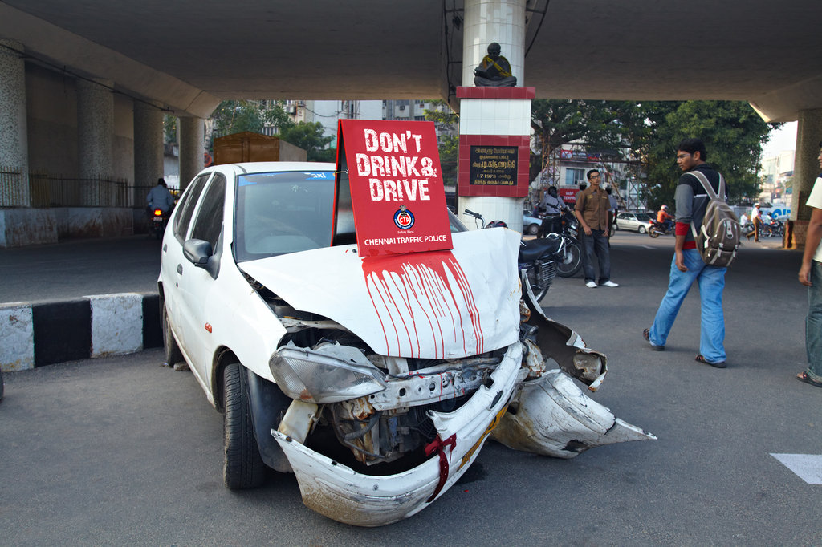
EFFECTS OF DRUG ABUSE AND ADDICTION
Injuries
  More deaths, illnesses and disabilities stem from substance abuse than from any other preventable health condition.
  Today, one in four deaths is attributable to illicit drug use.
  People who live with substance dependence have a higher risk of all bad outcomes including unintentional injuries, accidents, risk of domestic violence, medical problems, and death.

Slide 17
EFFECTS OF DRUG ABUSE AND ADDICTION
Health Problems
The impact of drug abuse and dependence can be far-reaching, affecting almost every organ in the human body. Drug use can:
  Weaken the immune system, increasing susceptibility to infections.
  Cause cardiovascular conditions ranging from abnormal heart rate to heart attacks. Injected drugs can also lead to collapsed veins and infections of the blood vessels and heart valves.
  Cause nausea, vomiting and abdominal pain.
  Cause the liver to have to work harder, possibly causing significant damage or liver failure.
  Cause seizures, stroke and widespread brain damage that can impact all aspects of daily life by causing problems with memory, attention and decision-making, including sustained mental confusion and permanent brain damage.
  Produce global body changes such as breast development in men, dramatic fluctuations in appetite and increases in body temperature, which may impact a variety of health conditions.

Slide 18
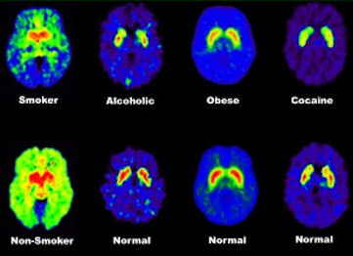
EFFECTS OF DRUG ABUSE AND ADDICTION
Effects on the Brain
Although initial drug use may be voluntary, drugs have been shown to alter brain chemistry, which interferes with an individual's ability to make decisions and can lead to compulsive craving, seeking and use. This then becomes a substance dependency.
  All drugs of abuse - nicotine, cocaine, marijuana, and others - effect the brain's "reward" circuit, which is part of the limbic system.
  Drugs hijack this "reward" system, causing unusually large amounts of dopamine to flood the system.
  This flood of dopamine is what causes the "high" or euphoria associated with drug abuse.
Behavioural Problems
  Aggressiveness
  Hallucinations
  Addiction
  Impaired Judgment
  Impulsiveness
  Loss of Self-Control

Slide 19
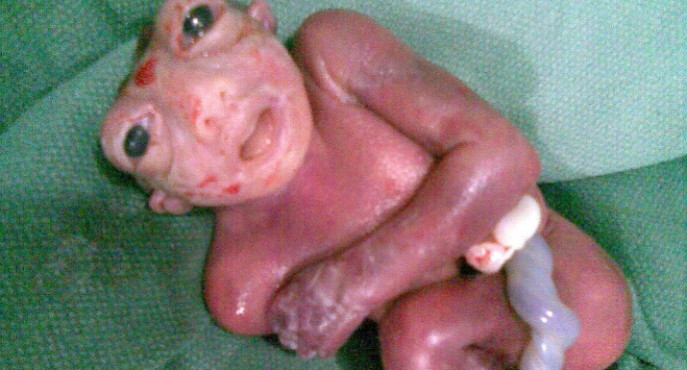
EFFECTS OF DRUG ABUSE AND ADDICTION
Birth Defect
  Use of illicit drugs such as marijuana, cocaine, Ecstasy and other amphetamines, and heroin
  These and other illicit drugs may pose various risks for pregnant women and their babies.
  Some of these drugs can cause a baby to be born too small or too soon, or to have withdrawal symptoms, birth defects or learning and behavioural problems.
  Additionally, illicit drugs may be prepared with impurities that may be harmful to a pregnancy.
  Finally, pregnant women who use illicit drugs may engage in hat place their pregnancy at risk, such as having extremely poor nutrition or developing sexually transmitted infections.

Slide 20
EFFECTS OF DRUG ABUSE AND ADDICTION
Why is it bad to do drugs?
  Illegal drugs aren't good for anyone, but they are particularly bad for a kid or teen whose body is still growing.
  Illegal drugs can damage the brain, heart, and other important organs. Cocaine, for instance, can cause a heart attack — even in a kid or teen.
Why we not to do Drugs
  Physical Addiction
    Drugs are physically addictive.
    The easy way to understand this is to recognize that using drugs causes enormous disruption in the systems and biological processes of the body, especially in the chemistry of your brain.
    To cope with this, the body compensates by adjusting its chemistry in terms of hormones, neurotransmitters and other substances.
    Taking drugs out of the equation at this point is like pulling one leg out from under a three-legged stool.
    The result is that the person experiences severely uncomfortable symptoms of withdrawal.
    A drug addict will, in fact, very often not even feel like himself or herself without using drugs

Slide 21
EFFECTS OF DRUG ABUSE AND ADDICTION
Why we not to do Drugs
  Emotional Addiction
    People normally start using drugs as a way to solve some type of problem, such as an unhappy home life, stress at work or social pressure.
    This doesn’t handle the problem, it only masks it.
    As time goes on, the person becomes more and more dependent on the drug as a coping mechanism and a way out.
    A person reaches a point where he or she has to get high to face an uncomfortable social situation, to perform at work or even merely to make it through the day.
  Enormous Expense
    Drugs are expensive even for casual use, but an addict needs to get high every week, every day or perhaps even several times per day.
    The costs of supporting such a habit can be astonishing.
    In other cases, the person is liable to resort to criminal activities to keep up the habit, or might look for cheaper, and more dangerous, ways to get high.

Slide 22
EFFECTS OF DRUG ABUSE AND ADDICTION
Degrade Your Health
    Most drugs can easily be recognized as being poisons, a fact that is reflected by the term, “intoxication,” used to refer to the state of being under the influence of drugs.
    When a person keeps using drugs over a long period, he or she will tend to have a weaker immune system, his or her internal organs and glands won’t work as well, and the person will likely be sick more often.
    Addicts typically also suffer health problems due to the fact that they don’t take as good care of themselves as they should, from neglecting to exercise to eating a diet heavy in junk food to staying up for long hours without proper rest.

Slide 23
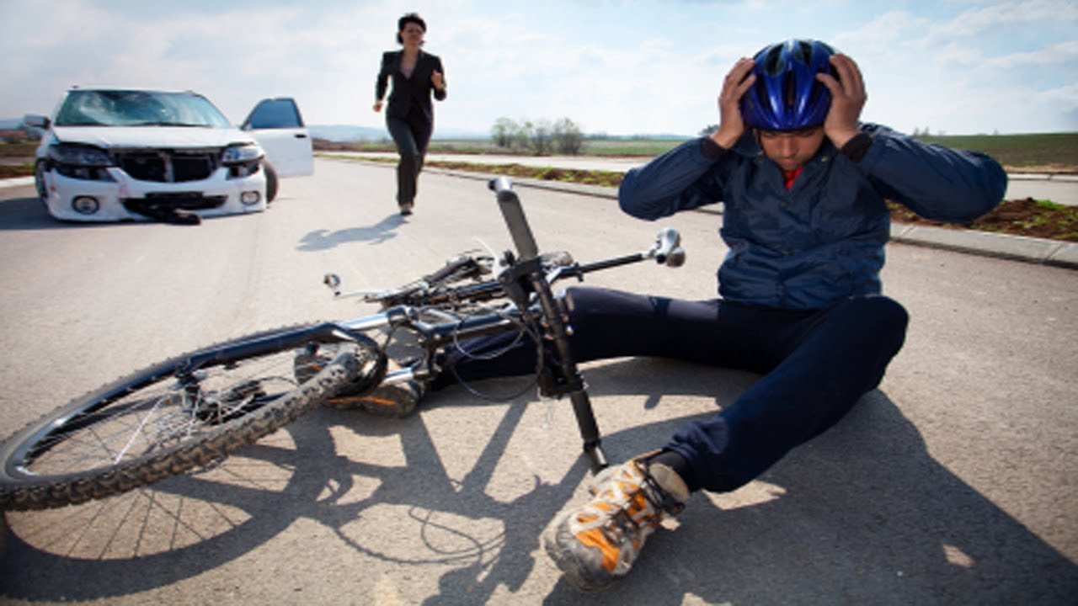
EFFECTS OF DRUG ABUSE AND ADDICTION
Accidents
    A drug addict is far more likely to end up in a car crash or other type of accident that may result in serious or even fatal injuries.
    Spending so much time under the influence of drugs tends to dull the senses, increase reaction time and impair judgment, whether or not the person is high at the time of the accident.
    To put it simply, people who use drugs don’t see the world around them as brightly and clearly as they should, and for this reason they are a serious liability to themselves and to the rest of us.

Slide 24
EFFECTS OF DRUG ABUSE AND ADDICTION
Arrest for Drug Possession
    With the exception of Washington and Colorado, it is illegal to possess drugs in any state, and even in those states where marijuana has been legalized it is still against the law to possess more than a small amount of the drug.
    An addict is at risk of being arrested for possession of drugs, and depending on the amount and type of drugs involved he or she may be charged with a misdemeanour or felony.
    Even if the person is able to avoid jail or prison, the arrest and possible conviction can carry consequences including heavy fines and court-ordered treatment, in addition to a lengthy period on probation and the prospect of having to live into the future with a criminal record.

Slide 25
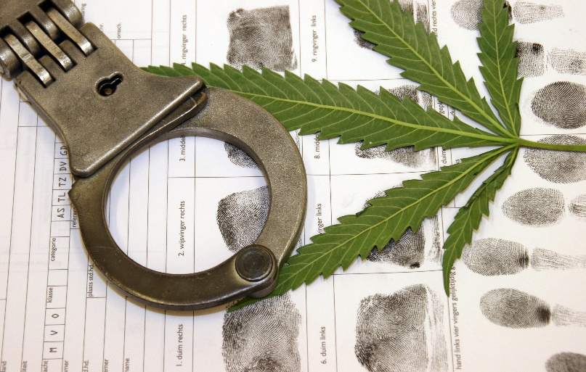
EFFECTS OF DRUG ABUSE AND ADDICTION
Arrest for Other Drug-Related Crimes
    Many drug addicts who manage to avoid an arrest for possession do still end up on the other side of the law for another reason.
    Very often, the person is arrested for theft, burglary or robbery when attempting to steal money or items that can be sold to raise money for drugs.
    In other cases, the person might be arrested for assault or another type of violent crime while acting under the influence of drugs. The addict might even be arrested for prostitution after resorting to this method of getting money to buy drugs.

Slide 26
EFFECTS OF DRUG ABUSE AND ADDICTION
Squandered Potential
    Even if the addict manages to avoid serious health complications and arrest, there is still the simple fact that drugs ruin lives.
    Getting high all the time tends to smother personal ambition, so that the person doesn’t feel like doing anything or getting anywhere in life.
    Mistakes, carelessness or perhaps even showing up to work high or using drugs in the workplace can all contribute to destroying the person’s goals and causing outrageous hardship.

Slide 27

EFFECTS OF DRUG ABUSE AND ADDICTION
Destroyed Personal Relationships
    Drugs change a person, and they do so in many ways. One of these has to do with the fact that the “new experiences” that the addict has been living through usually change the way that he or she looks at the world.
    The person changes so much that his or her friends and family may feel like they don’t know the person anymore. Drug addicts also tend to be secretive about their activities, where they have been and with whom.
    The loss of trust and of common ground upon which to meet very often means that the addict will become so greatly estranged from his or her family and friends that the relationship is, for all extents and purposes, over.

Slide 28
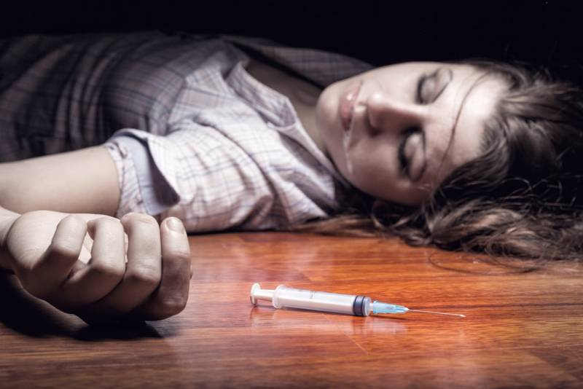
EFFECTS OF DRUG ABUSE AND ADDICTION
Overdose
    Finally the last reason not to do drugs, there is the constant threat of overdose. Addicts routinely suffer an overdose, one that is often fatal, because they were “chasing the dragon” by constantly looking for a new way to get high, to reclaim the experiences they used to have when using drugs.
    This usually means using more and more of the drug, which predictably can result in an overdose.
    In other cases, they may have been trying a new drug and used more than what might have been even somewhat safe.

Slide 29
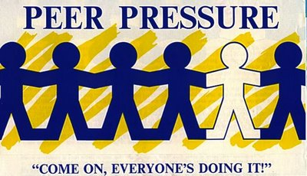
DRUGS ABUSE PREVENTION
The ways to help prevent drug abuse
Effectively deal with peer pressure
  The biggest reason teens start using drugs is because their friends utilize peer pressure.
  No one likes to be left out, and teens (and yes, some adults, too) find themselves doing things they normally wouldn’t do, just to fit in. In these cases, you need to either find a better group of friends that won’t pressure you into doing harmful things, or you need to find a good way to say no.
  Teens should prepare a good excuse or plan ahead of time, to keep from giving into tempting situations.

Slide 30
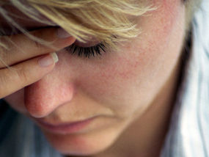
DRUGS ABUSE PREVENTION
The ways to help prevent drug abuse
Deal with life pressure
  People today are overworked and overwhelmed, and often feel like a good break or a reward is deserved.
  But in the end, drugs only make life more stressful and many of us all too often fail to recognize this in the moment.
  To prevent using drugs as a reward, find other ways to handle stress and unwind.
  Take up exercising, read a good book, volunteer with the needy, create something.
  Anything positive and relaxing helps take the mind off using drugs to relieve stress.

Slide 31

DRUGS ABUSE PREVENTION
The ways to help prevent drug abuse
Seek help for mental illness
  Mental illness and substance abuse often go hand-in-hand.
  Those with a mental illness may turn to drugs as a way to ease the pain.
  Those suffering from some form of mental illness, such as anxiety, depression or post-traumatic stress disorder should seek the help of a trained professional for treatment before it leads to substance abuse

Slide 32
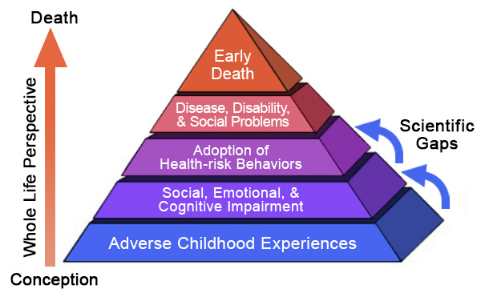
DRUGS ABUSE PREVENTION
The ways to help prevent drug abuse
Examine the risk factors
  If you’re aware of the biological, environmental and physical risk factors you possess, you’re more likely to overcome them.
  A history of substance abuse in the family, living in a social setting that glorifies drug abuse and/or family life that models drug abuse can be risk factors.

Slide 33
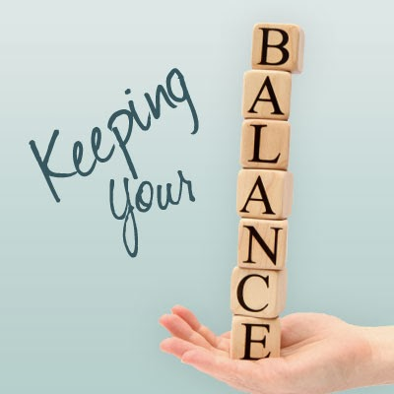
DRUGS ABUSE PREVENTION
The ways to help prevent drug abuse
Keep a well-balanced life
  People take up drugs when something in their life is not working, or when they’re unhappy about their lives or where their lives are going. Look at life’s big picture, and have priorities in order

Slide 34
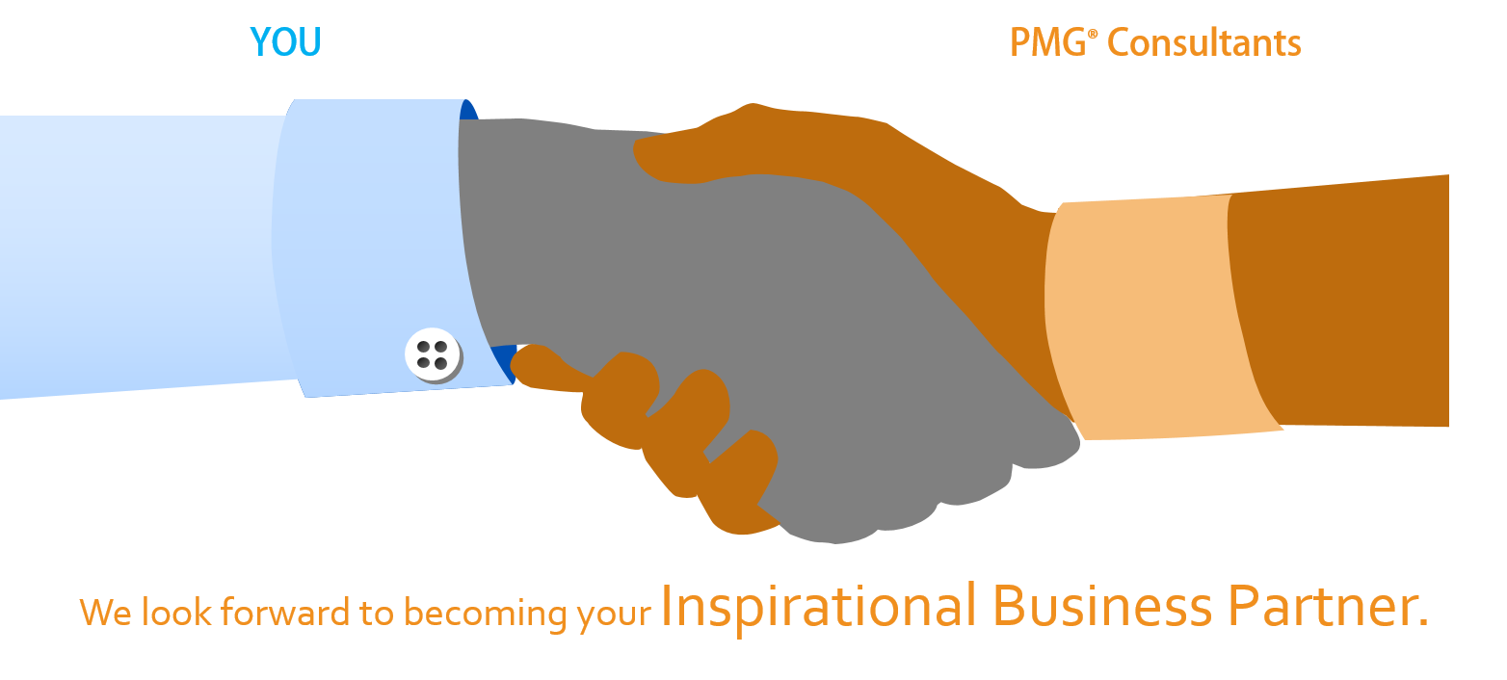
About PMG Consultants
PMG Consultants is group of competent people with expertise in respective domains. Delivering commitments, exceeding expectations & creating value for clients in every interaction is our non-negotiable objective. Using the most advanced design & collaboration work systems, we aspire to become Inspirational business partners for our clients.
Get in touch
We would love to hear from you. Gauge our capabilities by speaking to us. You can visit us at our New Delhi Design Office, or meet our representative at your location.
Our Office
Address:
162A/9, 3rd Floor, Kishangarh,
Vasant Kunj, , New Delhi, 110070
Phone: +91-9871115995, +91-11-23361790
Email: connect@pmg-consultants.com
abhinav.pandey@pmg-consultants.com

