Slide 1

CONFINED SPACE ENTRY
HAZARD

Slide 2
ABOUT PMG
“BUILDING FOOD FACTORIES WITH TOP QUALITY STANDARDS OF NESTLE, MONDELEZ,ABBOTT, DANONE USING 3D DESIGN AND HYGIENIC ENGINEERING.”
At PMG, we deliver Engineering Design and Project Management scopes in Food and Beverage industry. Our team of design engineers and engineering executives has rich experience in Project Planning, Design, Execution and Commissioning with key competencies in areas like 3D Plant Design, Hygienic Engineering, and Project Management. Our safe-by-choice, result-oriented, and pro-active work-ethics allow us deliver work scopes meeting objectives, complete stakeholder alignment and first-time quality.
PMG Knowledge Repository: Targeted Knowledge Sharing & Skill Development
Precise and focused training modules for the exhaustive set of people working in manufacturing industry, instilling qualities of self-belief, creative thinking & widened perspective.
Clear Learning Objectives
Focused approach to skill development and knowledge sharing
Progressive Evaluation
Gauging improvement on every step and keeping audience connected.
After-training follow-ups
We systematically track differential progress of recipients after the training.
Audience Specific Approach
Programs are fine-tuned to the ability and interests of the recipients.
Multiple Awe-moments
Awe-moments are refreshing and increase receptivity many-fold.
Seasoned Trainers
PMG trainers are subject matter experts with substantial work experience.

Slide 3
AGENDAda
1
Definition of Confined Space
2
Confined Space at Workplace
3
Flammable Atmosphere
4
Toxic Atmosphare
5
Details About CO Atmosphere
6
Irritant (Corrosive) Atmosphere
7
Asphyxiating Atmospheres
8
Mechnical Hazards
9
Thermal Effects
10
Noise
11
Vibration
12
Other Hazards

Slide 4
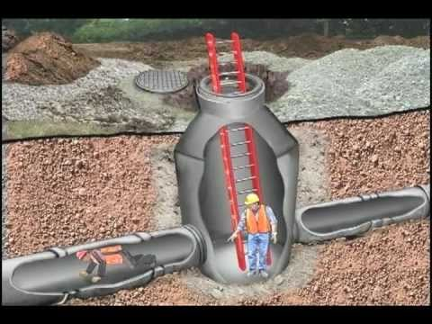
CONFINED SPACE ENTRY HAZARD
Definition of Confined Space?
It can be any space of an enclosed nature where there is a risk of death or serious injury from hazardous substances or dangerous conditions (e.g. lack of oxygen)

Slide 5
CONFINED SPACE ENTRY HAZARD
Confined spaces at workplace
Tanks
Storage bins
Boilers
Double hulls
Vats
Pumping stations
Kilns
Pits, sumps
Vaults
Vessels
Silos
Manholes
Pipelines
Water reservoirs
Sewers
Other similar spaces
Manure pits

Slide 6
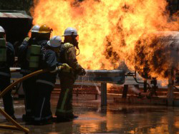
CONFINED SPACE ENTRY HAZARD
Flammable Atmospheres
A flammable atmosphere generally arises from enriched oxygen atmospheres, vaporization of flammable liquids, byproducts of work, chemical reactions, concentrations of combustible dusts, and desorption of chemical from inner surfaces of the confined space

Slide 7
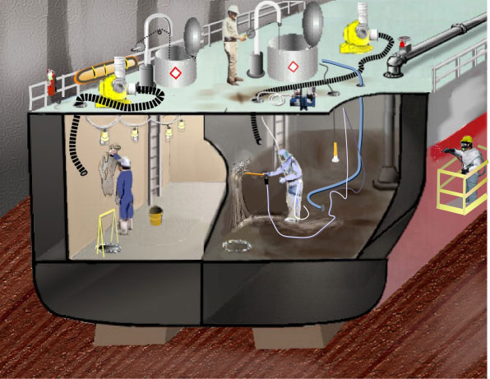
CONFINED SPACE ENTRY HAZARD
Flammable Atmospheres
Combustible gases and vapours
  The main parameters which describe the ability of mixtures of substances in air to propagate
  A flame and/or explode are flammable limits, flash points and auto-ignition temperatures.
  None of these parameters are basic physic-chemical properties of a substance or mixture but are defined by standard tests and, for this reason, values are given to the nearest integer.
  If the test conditions are varied, then the values of the parameters will change.
  In particular, values will change considerably if the concentration of oxygen in the mixture is changed.

Slide 8
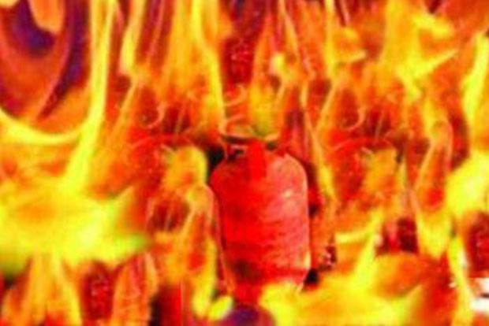
CONFINED SPACE ENTRY HAZARD
Combustible gases and vapours
The main parameters which describe the ability of mixtures of substances in air to propagate a flame and/or explode are flammable limits, flash points and auto-ignition temperatures.
None of these parameters are basic physic-chemical properties of a substance or mixture but are defined by standard tests and, for this reason, values are given to the nearest integer.
If the test conditions are varied, then the values of the parameters will change.
In particular, values will change considerably if the concentration of oxygen in the mixture is changed.

Slide 9
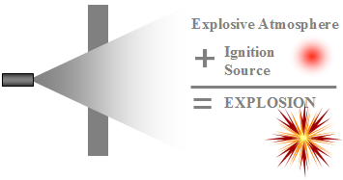

CONFINED SPACE ENTRY HAZARD
Combustible gases and vapours
By-products of work procedures
  The by-products of work procedures can generate flammable or explosive conditions within a confined space.
  Specific kinds of work such as spray painting can result in the release of explosive gases or vapours.
Welding
  Welding in a confined space is a major cause of explosions in areas that contain combustible gas.

Slide 10
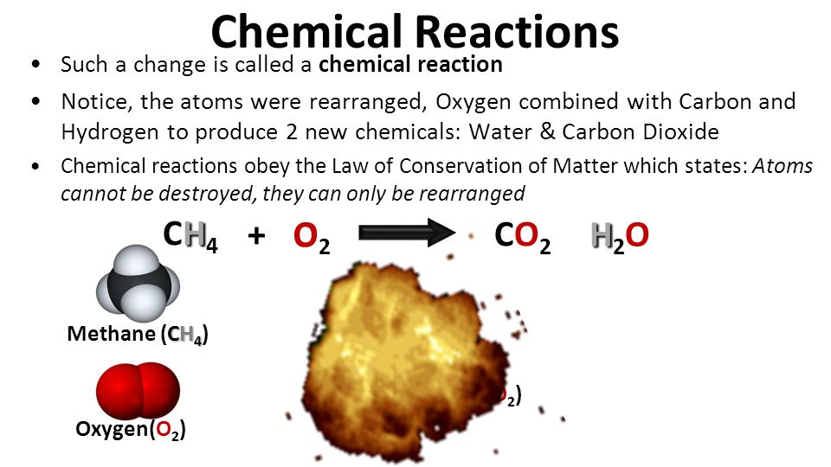
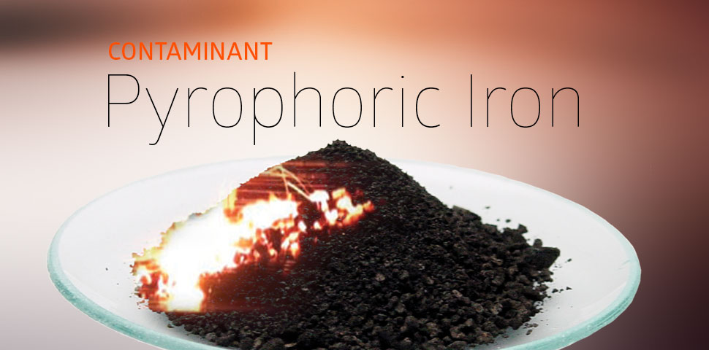
CONFINED SPACE ENTRY HAZARD
Combustible gases and vapours
Chemical reactions
  Chemical reactions forming flammable atmospheres occur when surfaces are initially exposed to the atmosphere, or when chemicals combine to form flammable gases.
  This condition arises when dilute sulphuric acid reacts with iron to form hydrogen or when calcium carbide makes contact with water to form acetylene.
Pyrophoric substances
  Deposits of pyrophoric substances (carbon, ferrous oxide, ferrous sulphate, iron, etc.) can be found in tanks used by the chemical and petroleum industry.
  These tanks containing flammable deposits will spontaneously ignite upon exposure to air.

Slide 11
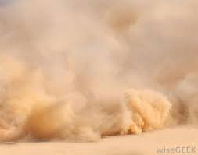
CONFINED SPACE ENTRY HAZARD
Combustible gases and vapours
Dust
  Combustible dust concentrations are usually found during the process of loading, unloading, and Conveying grain products nitrated fertilizers, finely ground chemical products, and any other combustible material.
  High charges of static electricity, which rapidly accumulate during periods of relatively low humidity (below 50%), can cause certain substances to accumulate electrostatic charges of sufficient energy to produce sparks and ignite a flammable atmosphere.
  These sparks may also cause explosions when the right air or oxygen to dust or gas mixture is present

Slide 12
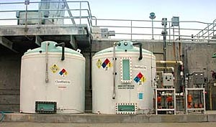
TOXIC ATMOSPHERE
Sources
The substances to be regarded as toxic in a confined space can cover the entire spectrum of gases, vapours, and finely divided airborne dust in industry.
  The manufacturing process (for example, in producing polyvinyl chloride, hydrogen chloride is used as well as vinyl chloride monomer, which is carcinogenic).
  The product stored [removing decomposed organic material from a tank can liberate toxic substances, such as hydrogen sulphide (H2S)].
  The operation performed in the confined space (for example, welding or brazing with metals capable of producing toxic fumes).
  During loading, unloading, formulation, and production, mechanical and/or human error may also produce toxic gases, which are not part of the planned operation

Slide 13
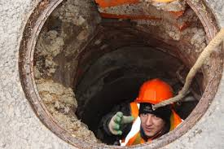
TOXIC ATMOSPHERE
Sources
The substances to be regarded as toxic in a confined space can cover the entire spectrum of gases, vapours, and finely divided airborne dust in industry
  Carbon monoxide (CO), which may build up in a confined space and which is an insidious toxic gas because of its poor warning properties
  In welding operations, oxides of nitrogen and ozone are gases of major toxicological importance, and incomplete oxidation may occur and carbon monoxide can form as a by-product.

Slide 14
DETAILS ABOUT CO ATMOSPHERES
Formation of CO
CO is formed from incomplete combustion of organic materials such as wood, coal, gas, oil, and gasoline. It can also be formed from microbial decomposition of organic matter in sewers, silos, and fermentation tanks.
  Decomposition reactions in sewage treatment plants. There have been fatal accidents due to and lack of ventilation in confined spaces.
  Formation of silo gas in grain storage elevators

Slide 15
DETAILS ABOUT CO ATMOSPHERES
Properties
CO is a relatively abundant odourless, colourless gas that has approximately the same density as air.
Therefore, any untested atmosphere must be suspect.
It must also be noted that a safe reading on a combustible gas indicator does not ensure that CO is not present.
Carbon monoxide must be tested for specifically.

Slide 16
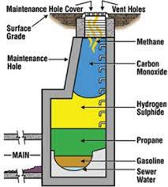
DETAILS ABOUT CO ATMOSPHERES
Formation of CO
Early stages of CO intoxication are nausea and headache.
Carbon monoxide may be fatal at 1000 ppm in air, and is considered dangerous at 200 ppm, because it forms carboxyhemoglobin in the blood, which prevents the distribution of oxygen in the body

Slide 17
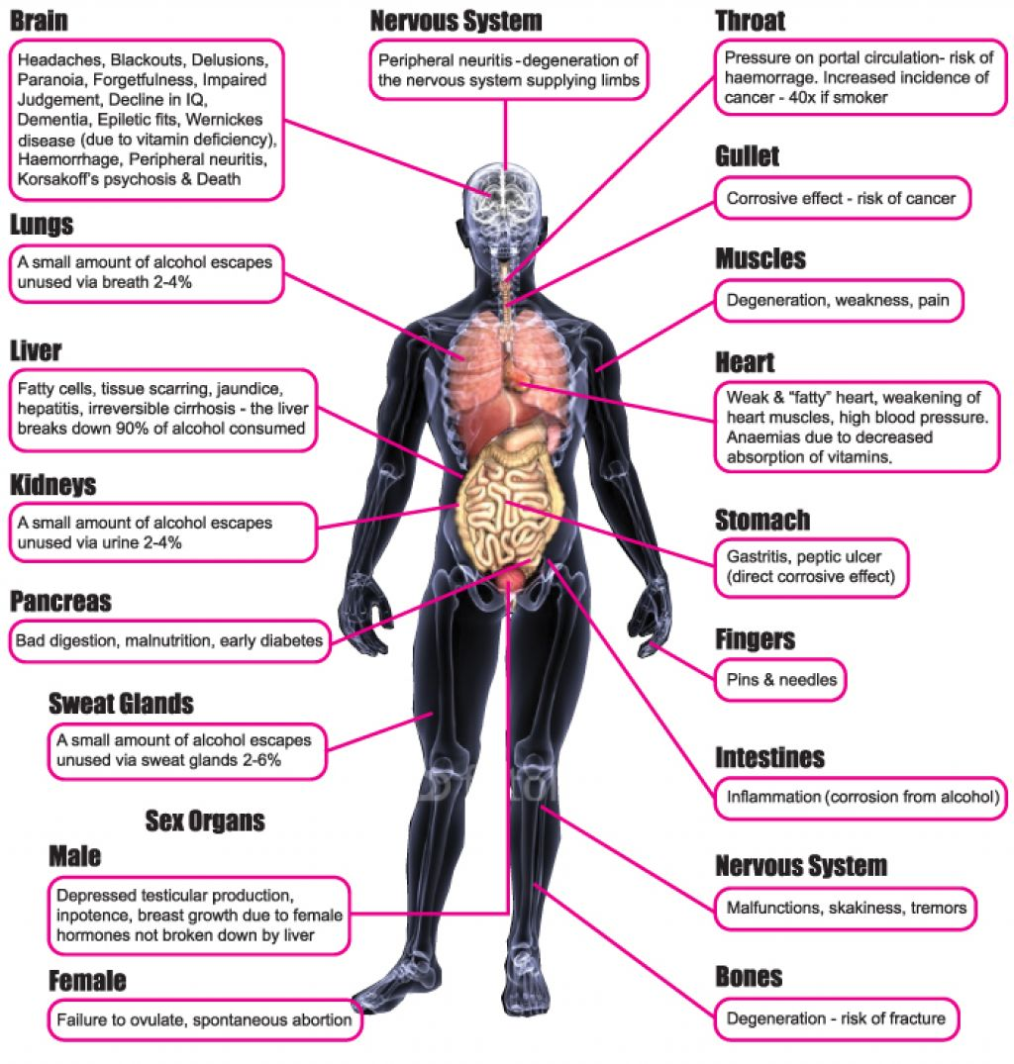
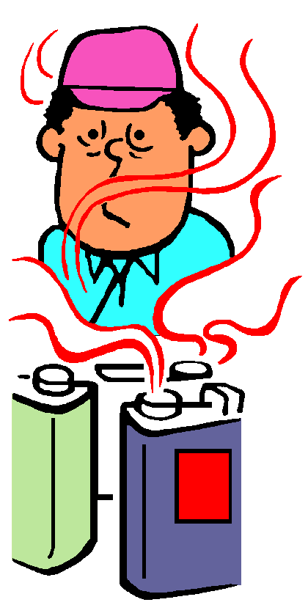
IRRITANT (CORROSIVE) ATMOSPHERES
Primary irritants
Secondary irritants
Primary irritants exert no systemic toxic effects (effects on the entire body).
Examples of primary irritants are chlorine, ozone, hydrochloric acid, hydrofluoric acid, sulphuric acid, nitrogen dioxide, ammonia, and sulphur dioxide
Secondary irritants are those that may produce systemic toxic effects in addition to surface irritation.
Examples of secondary irritants include benzene, carbon tetrachloride, ethyl chloride, trichloroethane, trichloroethylene, and chloropropene.

Slide 18
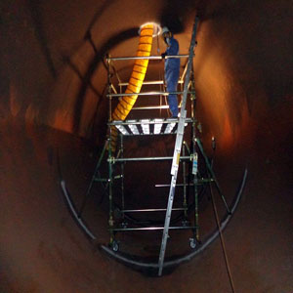
IRRITANT (CORROSIVE) ATMOSPHERES
Effect
Prolonged exposure at irritant or corrosive concentrations in a confined space may produce little or no evidence of irritation.
This may result in a general weakening of the defence reflexes from changes in sensitivity.
The danger in this situation is that the worker is usually not aware of any increase in his/her exposure to toxic substances

Slide 19
ASPHYXIATING ATMOSPHERES
Normal atmosphere
The normal atmosphere is composed approximately of 20.9% oxygen and 78.1% nitrogen, and 1% argon with small amounts of various other gases.
Reduction of oxygen in a confined space may be the result of either consumption or displacement.

Slide 20
ASPHYXIATING ATMOSPHERES
Oxygen consumption
The consumption of oxygen takes place during combustion of flammable substances, as in welding, heating, cutting, and brazing.
A more subtle consumption of oxygen occurs during bacterial action, as in the fermentation process.
Oxygen may also be consumed during chemical reactions as in the formation of rust on the exposed surface of the confined space (iron oxide).

Slide 21
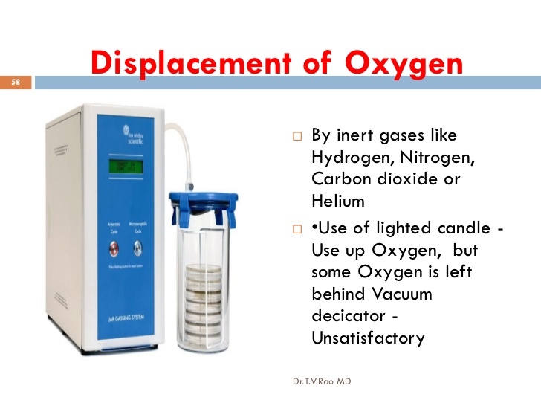
ASPHYXIATING ATMOSPHERES
Oxygen consumption
A second factor in oxygen deficiency is displacement by another gas.
Examples of gases that are used to displace air, and therefore reduce the oxygen level are helium, argon, and nitrogen.
Carbon dioxide may also be used to displace air and can occur naturally in sewers, storage bins, wells, tunnels, wine vats, and grain elevators

Slide 22
ASPHYXIATING ATMOSPHERES
Effect of oxygen deprivation
The consumption of oxygen takes place during combustion of flammable substances, as in welding, heating, cutting, and brazing.
A more subtle consumption of oxygen occurs during bacterial action, as in the fermentation process.
Oxygen may also be consumed during chemical reactions as in the formation of rust on the exposed surface of the confined space (iron oxide).

Slide 23
ASPHYXIATING ATMOSPHERES
Effect of oxygen deprivation
O₂ level | Effect
17 % | The first sign of hypoxia is deterioration of night vision, which is not noticeable until a normal oxygen concentration is restored. Physiologic effects are increased breathing volume and accelerated heartbeat.
14-16% | Increased breathing volume, accelerated heartbeat, very poor muscular coordination, rapid fatigue, and intermittent respiration
14-16% | Increased breathing volume, accelerated heartbeat, very poor muscular coordination, rapid fatigue, and intermittent respiration
6-10 % | Nausea, vomiting, inability to perform, and unconsciousness
Below 6% | Spasmodic breathing, convulsive movements, and death in minutes

Slide 24
MECHANICAL HAZARDS
Precautions
The following precautions need to be taken to prevent hazards due to mechanical effects:
  If activation of electrical or mechanical equipment would cause injury, each piece of equipment should be manually isolated to prevent inadvertent activation before workers enter or while they work in a confined space.
  The build-up of static charge due to mechanical cleaning, such as abrasive blasting, in connection with the potential presence of flammable vapours or gases, influence the precautions that must be taken.
  To prevent vapour leaks, flashbacks, and other hazards, workers should completely isolate the space. To completely isolate a confined space, the closing of valves is not sufficient. All pipes must be physically disconnected or isolation blanks bolted in place.

Slide 25
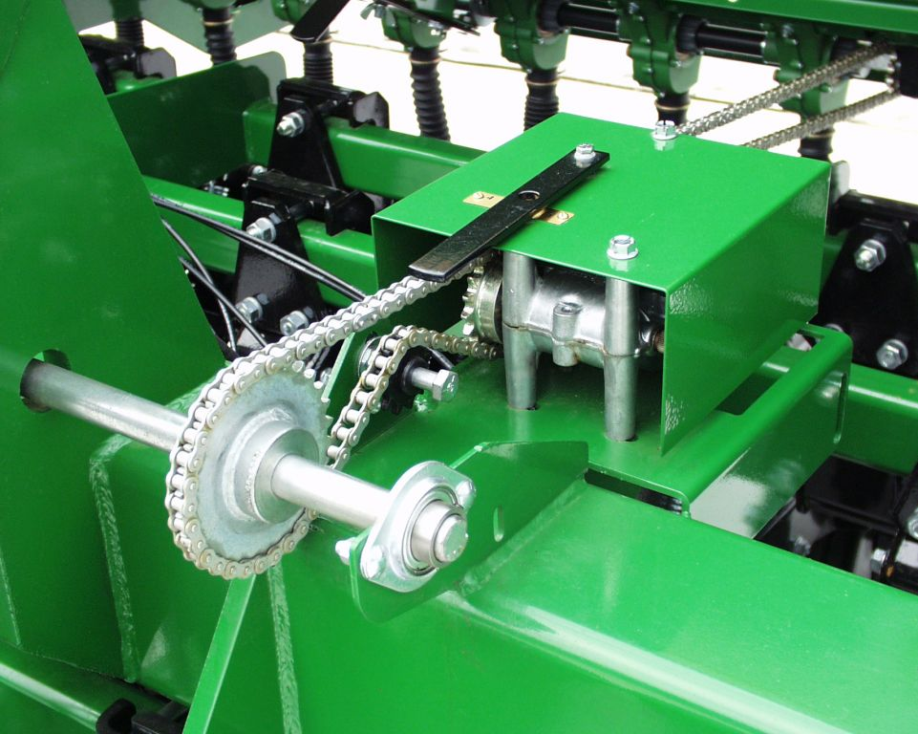
MECHANICAL HAZARDS
Precautions
  Other special precautions must be taken in cases where flammable liquids or vapours may re-contaminate the confined space. The pipes blanked or disconnected should be inspected and tested for leakage to check the effectiveness of the procedure.
  Other areas of concern are steam valves, pressure lines, and chemical transfer pipes.
  A less apparent hazard is the space referred to as a void, such as double walled vessels, which must be given special consideration in blanking off and inserting

Slide 26
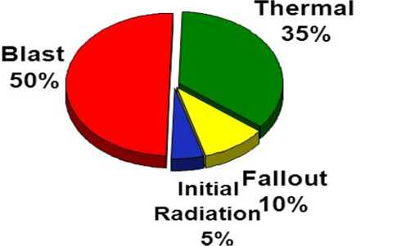
THERMAL EFFECTS
Factors involved
The following four factors influence the interchange of heat between people and their environment:
  Air temperature
  Air velocity
  Moisture contained in the air
  Radiant heat.
Because of the nature and design of most confined spaces, moisture content and radiant heat are difficult to control.

Slide 27
THERMAL EFFECTS
Effect of high temperature
Effect of low temperature
As the body temperature rises progressively, workers will continue to function until the body temperature reaches approximately 102ºF.
When this body temperature is exceeded, the workers are less efficient, and are prone to heat exhaustion, heat cramps, or heat stroke
In a cold environment, certain physiologic mechanisms come into play, which tend to limit heat loss and increase heat production.
The most severe strain in cold conditions is chilling of the extremities so that activity is restricted

Slide 28
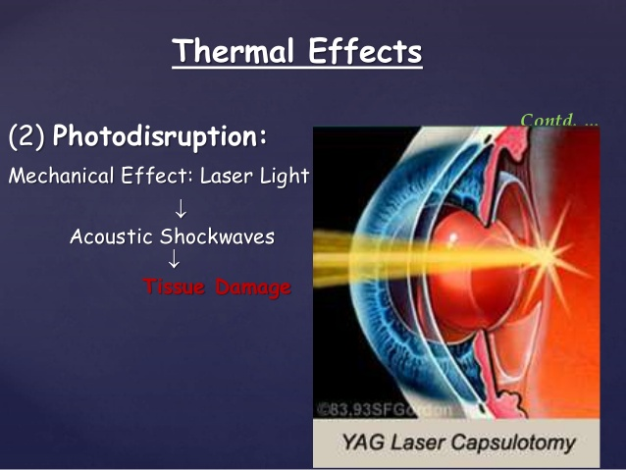
THERMAL EFFECTS
Working conditions
Protective insulated clothing for both hot and cold environments will add additional bulk to the worker and must be considered in allowing for movement in the confined space and exit time. Therefore, air temperature of the environment becomes an important consideration when evaluating working conditions in confined spaces.

Slide 29
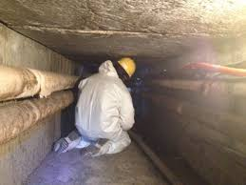
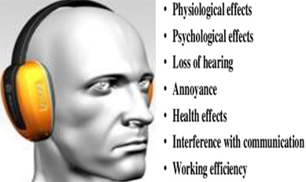
NOISE
Effect of confined space
Effect of noise
Noise problems are usually intensified in confined spaces because the interior tends to cause sound to reverberate and thus expose the worker to higher sound levels than those found in an open environment.
Intensified noise increases the risk of hearing damage to workers that could result in temporary or permanent loss of hearing

Slide 30

VIBRATION
Effect
Whole body vibration may affect multiple body parts and organs depending upon the vibration characteristics.
Segmental vibration, unlike whole body vibration, appears to be more localized in creating injury to the fingers and hands of workers using tools, such as pneumatic hammers, rotary grinders or other hand tools which cause vibration.

Slide 31
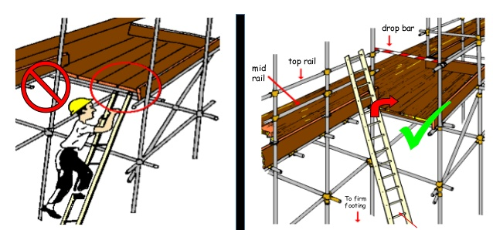
OTHER HAZARDS
Overview
Some physical hazards cannot be eliminated because of the nature of the confined space or the work to be performed.
These hazards include such items as scaffolding, surface residues, and structural hazards.
Scaffolding
Here are several hazards to watch out for when using scaffolding:
  Falls from elevation. This is the most common scaffolding hazard.
  Bad planking. Another cause of scaffold-related incidents is unsecured planking.
  Getting struck by falling tools or debris.
  Electrocution

Slide 32
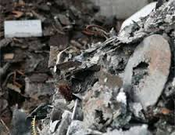
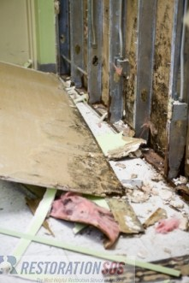
OTHER HAZARDS
Overview
Surface residues
  Surface residues in confined spaces can increase
  The already hazardous conditions of electrical shock, reaction of incompatible materials, liberation of toxic substances, and bodily injury due to slips and falls.
  Without protective clothing, additional hazards to health may arise due to surface residues
Structural hazards
  Structural hazards within a confined space such as baffles in horizontal tanks, trays in vertical towers, bends in tunnels, overhead structural members, or scaffolding installed for maintenance constitute physical hazards, which are exacerbated by the physical surroundings.
  In dealing with structural hazards, workers must review and enforce safety precautions to assure safety.

Slide 33

About PMG Consultants
PMG Consultants is group of competent people with expertise in respective domains. Delivering commitments, exceeding expectations & creating value for clients in every interaction is our non-negotiable objective. Using the most advanced design & collaboration work systems, we aspire to become Inspirational business partners for our clients.
Get in touch
We would love to hear from you. Gauge our capabilities by speaking to us. You can visit us at our New Delhi Design Office, or meet our representative at your location.
Our Office
Address:
162A/9, 3rd Floor, Kishangarh,
Vasant Kunj, , New Delhi, 110070
Phone: +91-9871115995, +91-11-23361790
Email: connect@pmg-consultants.com
abhinav.pandey@pmg-consultants.com

