Slide 1
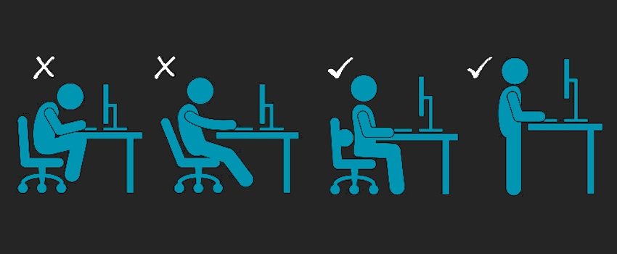
ERGONOMICS

Slide 2

AGENDA
1
What is Ergonomics?
2
Major Consideration
3
Function of Man
4
The Physicology of Work
5
Anthropometrics Consideration
6
Environmental Factor
Notes:
2

Slide 3
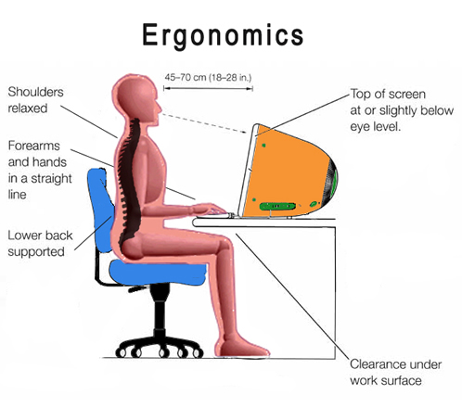
WHAT IS ERGONOMICS?
The science of designing the machine which man can sit is called Ergonomics.
It is also known as Human Engineering and Human Factor Engineering.

Slide 4
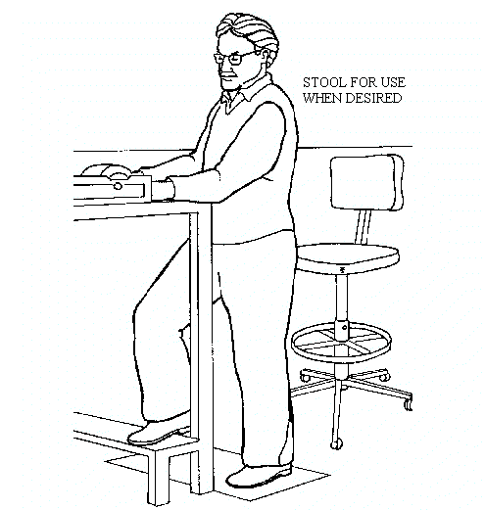
MAJOR CONSIDERATIONS
Designing machines and system to suit the man begins with a detailed study of the man machine system as a whole.
The major practical considerations involved in ergonomics are:
  An assessment of the functions performed by the man in the task.
  Physiological consideration- like work load, fatigue etc.
  Anthropometrics Consideration– such as dynamic and static body measurement of people in relation to the job performed.
  Environmental Factor – which affects work performance.
  Psychological factor – which affects work performance like monotony etc.

Slide 5

FUNCTION OF MAN
Man has three major functions to perform in any task :
  Function as a sensor --- sense ,see, hear, feel or understand.
  Function as data processor – Analyze data in the brain which issues instruction to the different parts of the body to perform actions.
  Function as a controller- It is action part of the task, mostly performed by muscle.
Example of all these three functions - A person driving a car, sees a red signal and takes action thereafter.

Slide 6
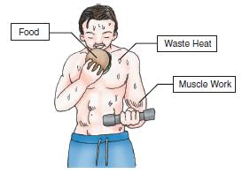
THE PHYSIOLOGY OF WORK
Foods are converted into energy.
This energy is utilized for work performed by the body and in body’s own activities like breathing, movement, respiration etc.
1 kilo calorie energy is equal to the energy required to raise the temperature of 1 kg. water by 1 degree centigrade.
About 4800k.cal/ day energy can be approximately taken as the maximum limit for continuous work.
Exceeding the limit of capacity in expenditure of energy can lead to fatigue.
It is followed by other physiological and psychological changes, like reduced alertness, longer reaction time, reduced muscular strength and fatigue.
At this stage to continue work is dangerous as the chances of errors and accidents are greatly increased.

Slide 7

THE PHYSIOLOGY OF WORK
Fatigue can also be caused by the following:
  Intensive mental work.
  Excessive hot / cold environment.
  High noise level.
  Poor lighting condition that lead to visual fatigue.
  Excessive strain on a few muscle.
  Psychological factor like anger, anxiety, worry, dislike of work etc.
  Illness, and poor nutrition.

Slide 8
ANTHROPOMETRICS CONSIDERATION
The word denotes considerations of dynamic and static body measurements of human body in the design of equipment to improve the efficiency and safety of the man.
The basic principle can be illustrated by the position of a light switch on the wall.
A six year old trying to put the switch on has to stretch and stand on his toes with all muscles strained.
His feet, legs, body, hands, neck and eyes have moved in the process.
An adult for whom the position of the switch is designed needs only the circular movement of the hands up and down from elbow onwards.
A person standing and doing assembly work on table moves different parts of his body
If the lay out of the table is such that he has to stretch and reach many components, different body muscles on the body work more than they should do.

Slide 9
ANTHROPOMETRICS CONSIDERATION
Instead, if the job can be done by sitting and the component can be reached easily his muscles do comparatively much less work. In the latter case , apart from reducing fatigue the person will be able to do more productive work in a given time.
In short the dimensions in job situation have to be selected to suit the dimension of men.
Dynamic body measurement also should be considered in designing jobs / equipment's.
On an assembly table , the parts which has to be pocked up many times can be arranged near the operator where there can be reached by the circular motion of hands from the elbow without lifting the arms.
The areas that falls within the reach involves minimum efforts from the workers.

Slide 10
ENVIRONMENTAL FACTORS
Poor environmental condition like excessive heat, higher noise level, presence of annoying and toxic contaminant in the atmosphere etc contribute to the physical stresses on the worker and consequently affect his performance.
Hence, these need to be considered in the study of man and his work.
Psychological Factor.
  A study of man and his work can never be complete without considering the psychological factor affecting man’s performance.
  These include:
Psychological effects produced by job situation like high noise level, heat, poor lighting etc.
  Job situation which provides fear, anxiety, tension , etc. in the mind of person.
  Job situation like monotony, repetition of work, giving fatigue, relation with supervisor and colleague etc. affects the performance and should be considered for making the job satisfying

