Slide 1
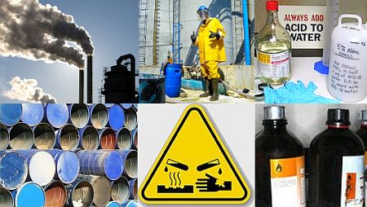
INDUSTRIAL TOXICOLOGY

Slide 2
AGENDA
1
Industrial Toxology.
2
Effects of toxic substances on the human system.
3
Factors influencing the effects of toxic materials
4
Toxic chemicals and their harmful effects on human system
Notes:
2

Slide 3
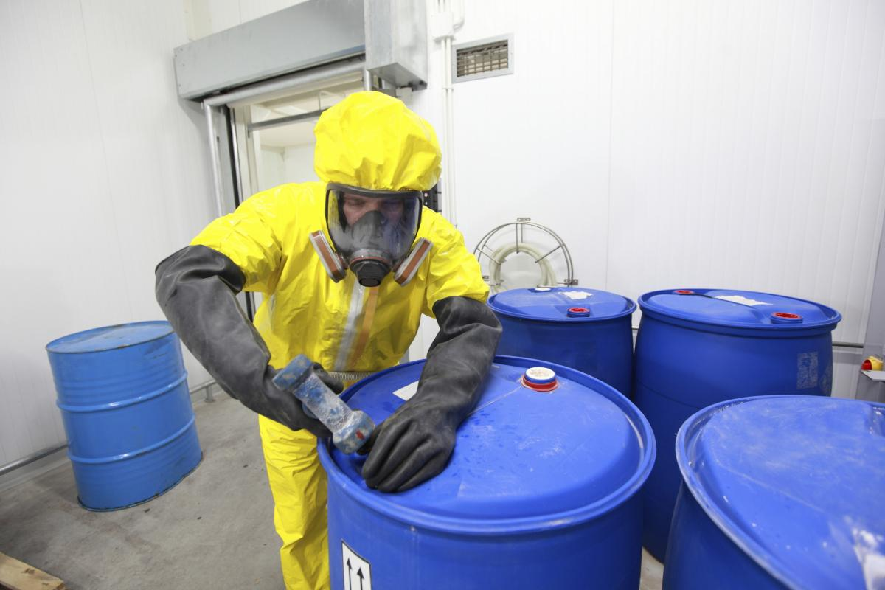
INDUSTRIAL TOXICOLOGY
Industrial toxicology is the scientific and systematic study of poisonous substances or toxic with reference to industry.
In industries the workmen may have to face chemical hazards of toxic nature in their workplace.
The toxic effects may be fatal or damage the human system in long run through cumulative action.
The toxicity of substance depends on the degree of exposure and the degree of exposure depends upon the time of exposure, the concentration of toxic substance as well as the susceptibility of the workers.

Slide 4
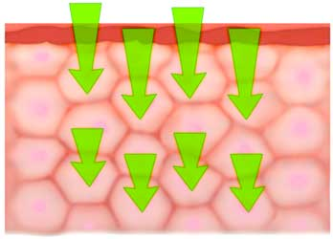

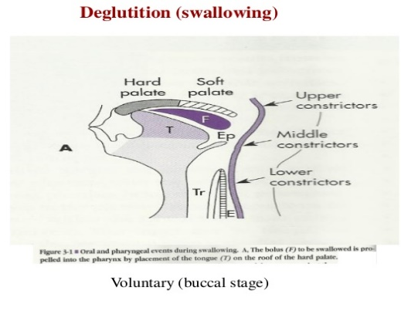

INDUSTRIAL TOXICOLOGY
Toxic may find entry into the human system in four way:
  Through absorption by skin.
  Through the respiratory system by inhalation.
  Through the gastro-intestinal tract by swallowing.
  Through other organs like eyes etc.

Slide 5
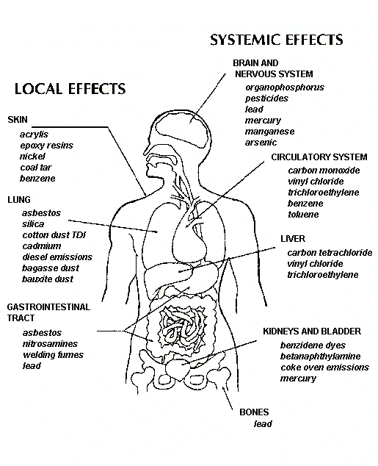
EFFECTS OF TOXIC SUBSTANCES ON THE HUMAN SYSTEM
The degree of danger associated with a toxic chemical may be expressed as serious, moderate, or mild depending upon the severity of the toxicity of the chemicals.
The effect of toxic chemical may be expressed as local or systemic .
Eyes may be affected by Ammonia. This is an example Of local effect, where as Lead poisoning affects blood forming cells, bones, and nervous system.
These are example of systemic effects.
The exposure period may be instantaneous or prolonged in respect of time.
Injury of limbs by corrosive like nitric acid is an example of instantaneous case where as silicosis resulting from inhalation of silica dust over a long period of time exposure is an example of prolonged cases.

Slide 6

FACTORS INFLUENCING THE EFFECTS OF TOXIC MATERIALS
The effects of toxic substance on the workman depend upon the following consideration:
  Absorption- Quicker the absorption more is the risk to the workman.
  Concentration and time of exposure- More the concentration and the time of exposure , more is the amount of toxic substances getting entry into the human body.
  Personal tolerance level- Certain person Can tolerate a particular toxic substance while other can not tolerate the same amount.
  Susceptibility- Susceptibility to toxic substance may vary from person to person.
  Personal hygiene and behavior - Proper maintenance of clothing's, cleanliness, tidy habits etc. play an important role as regard the effects of toxic substance on the human system.
  The state of the matter - Whether solid, liquid or gas, play an important role in connection with the effects of toxic substances on the human system. Gases form is more harmful than liquid or solid form

Slide 7
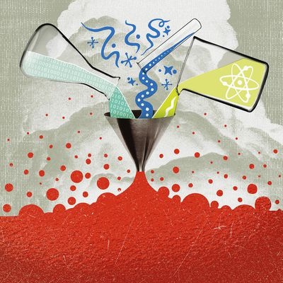
FACTORS INFLUENCING THE EFFECTS OF TOXIC MATERIALS
Units of Concentration
Concentration may be expressed in ppm( parts per million) as well as in mg/ M³ for gases , vapor and liquid where in case of solid( including solid particulates, salts, dust and fumes) concentration may be expressed in term of mg/ M³.

Slide 8
TOXIC CHEMICALS AND THEIR HARMFUL EFFECTS ON HUMAN SYSTEM
Some toxic chemicals and their harmful effects on human system.
Carbon monoxide- co on inhalation causes asphyxiation or breathlessness. In high concentration, carbon monoxide can cause death.
Carbon disulphide-On inhalation causes anesthetic effects. Central nervous system is also affected on prolonged exposure to carbon disulphide.
Chlorine- Inhalation causes irritation to mucous membrane i.e. eyes, nose etc.
Chromium- Chromium entering the body through inhalation or taking of food and water contaminated with chromium compounds can cause ulcer as well as cancer of certain vital organs of the body as for example lungs etc.

Slide 9
TOXIC CHEMICALS AND THEIR HARMFUL EFFECTS ON HUMAN SYSTEM
Some toxic chemicals and their harmful effects on human system.
Mercury- Mercury and its compound can cause adverse effects on the central nervous system of the human body.
Lead- lead poisoning badly affects the central nervous system as well as bones.
Naptha- Naptha on inhalation can cause breathlessness or even coma.
Methyl Isocyanate- It can affects the respiratory as well as gastro intestinal tract. It can cause fatal in case of high concentration.
Sulpher dioxide- Sulpher dioxide if inhaled causes irritation of throat, nose ,etc. and can cause death in high concentration.
Phosgene- Phosgene if inhaled seriously, affects the respiratory system etc. and can cause death in case of high exposure.

