Slide 1

PREVENTION OF OCCUPATIONAL DISEASE

Slide 2
AGENDA
1
What is an occupational disease
2
Common types of occupational diseases
3
Primary prevention
4
Secondary prevention
5
Tertiary prevention

Slide 3
WHAT IS AN OCCUPATIONAL DISEASE
An occupational disease is a disease or disorder that is caused by the work or working conditions.
This means that the disease must have developed due to exposures in the workplace and that the correlation between the exposures and the disease is well known in medical research. Or put in another way, it must not be likely, beyond reasonable doubt, that the disease was caused by factors other than work.
Examples of occupational diseases:
  Tennis elbow
  Allergy
  Hearing loss
  Asthma

Slide 4
WHAT IS AN OCCUPATIONAL DISEASE
Exposures in the workplace that may cause some of the above diseases:
  Repetitive work movements
  Work with arms lifted above shoulder height
  Heavy lifting work
  Work in a very noisy environment
  Work with hazardous substances
When there is adequate medical documentation that a disease is caused by a certain exposure, the disease is included on the list of occupational diseases.

Slide 5
WHAT IS AN OCCUPATIONAL DISEASE
Recognition of an occupational disease
In order for you to get compensation and other benefits as a consequence of a disease, the disease must be recognised as an industrial injury.
  A disease can be recognised in two different ways:
  If the disease and the exposure causing the disease are on the list of occupational diseases, we recognise the disease as an occupational disease
  If the disease is not on the list of occupational diseases, it is still possible to recognise it as an occupational disease if the Occupational Diseases Committee, in their recommendation, state that it is likely, beyond reasonable doubt, that the disease was caused by special factors in the workplace

Slide 6
COMMON TYPES OF OCCUPATIONAL DISEASES
People often confuse occupational disease with occupational injury.
Both occur at places of employment and frequently result in workers' compensation benefits, but they are quite different from one another.
An occupational injury is when an employee is involved in a type of accident that results in physical harm.
Occupational disease, on the other hand, is when an employee develops a sickness due to prolonged exposure to something that causes him or her to become ill.
Most of the time, the culprit is a type of toxic chemical.
These diseases can arise from worker or employer neglect, and many times the dangers were known beforehand but dismissed.

Slide 7
COMMON TYPES OF OCCUPATIONAL DISEASES
Chemical poisoning
  Chemical burns and poisoning can occur when you have been exposed to harmful chemical elements.
  Often this happens because a worker was not properly trained on how to handle these chemicals, or they were not given appropriate clothing or equipment when around these dangerous substances.
Mesothelioma
  A type of cancer that affects the thin membrane lining the abdomen is called peritoneal mesothelioma.
  There is another type that affects the chest area called pleural mesothelioma.
  Exposure to asbestos is responsible for nine out of ten mesothelioma cases.
  Common symptoms of this cancer include fatigue, shortness of breath, lack of appetite, crackles within the lungs, clubbing of fingers and toes as well as chest tightness and pain.
  People who work in plumbing, power stations and demolition work are more susceptible to this type of illness.

Slide 8
COMMON TYPES OF OCCUPATIONAL DISEASES
Industrial dermatitis
  This is caused when an employee's skin comes in direct contact with industrial irritants and can cause extreme cell damage.
  Prolonged exposure to these chemicals can lead to chronic dermatitis.
Industrial asthma
  Asthma can occur when workers are exposed to certain airborne toxins in the course of their work day.
  Often workers who lay cement or frequent construction sites can be harmed by breathing Potassium Dichromate.
  This form of asthma can be extremely serious if the person continues to breathe in these harmful substances.
Neurological disorders
  The nervous system is often a frequent target of toxins and can cause serious neurological issues if you are exposed to harmful contaminants.
  Frequent headaches, fatigue and light headedness are common symptoms of an oncoming disorder.

Slide 9

COMMON TYPES OF OCCUPATIONAL DISEASES
Stress related injuries
  Emotional stress injuries can be difficult to prove because you must show that the stress has come from work and not your personal life.
  Stress can result from many sources such as being overworked, an abusive boss, or dealing with difficult co-workers/employees.

Slide 10
PRIMARY PREVENTION
Aims to prevent disease or injury before it ever occurs. This is done by preventing exposures to hazards that cause disease or injury, altering unhealthy or unsafe behaviours that can lead to disease or injury, and increasing resistance to disease or injury should exposure occur. Examples include:
Medication
  Education about healthy and safe habits
  Pre-placement examinations
  Supervision of working environment
  Mechanization
Engineering
  Good housekeeping
  Design of building
  Mechanization
  Substitution
  Control of dust
  Isolation

Slide 11
PRIMARY PREVENTION
Personal Measures
Masks
Safety shoes
Aprons, Overalls
Screens & safety glasses
Earplugs, Earmuffs
Helmets

Slide 12
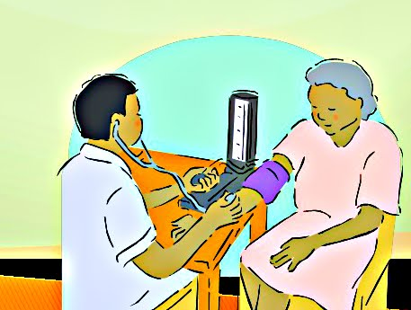
SECONDARY PREVENTION
Secondary prevention aims to reduce the impact of a disease or injury that has already occurred. This is done by detecting and treating disease or injury as soon as possible to halt or slow its progress, encouraging personal strategies to prevent reinjure or recurrence, and implementing programs to return people to their original health and function to prevent long-term problems. Examples include:
  Early Diagnosis and treatment
  Regular exams and screening tests to detect disease in its earliest stages (e.g. mammograms to detect breast cancer)
  Daily, low-dose aspirins and/or diet and exercise programs to prevent further heart attacks or strokes
  Suitably modified work so injured or ill workers can return safely to their jobs.

Slide 13
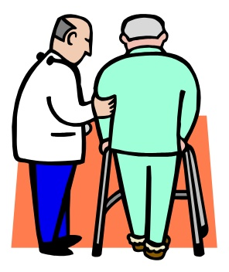
TERTIARY PREVENTION
Aims to soften the impact of an ongoing illness or injury that has lasting effects. This is done by helping people manage long-term, often-complex health problems and injuries (e.g. chronic diseases, permanent impairments) in order to improve as much as possible their ability to function, their quality of life and their life expectancy. Examples include:
  cardiac or stroke rehabilitation programs, chronic disease management programs (e.g. for diabetes, arthritis, depression, etc.)
  support groups that allow members to share strategies for living well
  vocational rehabilitation programs to retrain workers for new jobs when they have recovered as much as possible.

