Slide 1

OCCUPATIONAL HEALTH MANAGEMENT

Slide 2
ABOUT PMG
“BUILDING FOOD FACTORIES WITH TOP QUALITY STANDARDS OF NESTLE, MONDELEZ,ABBOTT, DANONE USING 3D DESIGN AND HYGIENIC ENGINEERING.”
At PMG, we deliver Engineering Design and Project Management scopes in Food and Beverage industry. Our team of design engineers and engineering executives has rich experience in Project Planning, Design, Execution and Commissioning with key competencies in areas like 3D Plant Design, Hygienic Engineering, and Project Management. Our safe-by-choice, result-oriented, and pro-active work-ethics allow us deliver work scopes meeting objectives, complete stakeholder alignment and first-time quality.
PMG Knowledge Repository: Targeted Knowledge Sharing & Skill Development
Precise and focused training modules for the exhaustive set of people working in manufacturing industry, instilling qualities of self-belief, creative thinking & widened perspective.
Clear Learning Objectives
Focused approach to skill development and knowledge sharing
Progressive Evaluation
Gauging improvement on every step and keeping audience connected.
After-training follow-ups
We systematically track differential progress of recipients after the training.
Audience Specific Approach
Programs are fine-tuned to the ability and interests of the recipients.
Multiple Awe-moments
Awe-moments are refreshing and increase receptivity many-fold.
Seasoned Trainers
PMG trainers are subject matter experts with substantial work experience.

Slide 3
AGENDA
1
Introduction
2
Occupational health management
3
First aid

Slide 4
INTRODUCTION
Target audience
Background information
Safety, health and environment officers at region/market level, plant managers, plant safety and environmental officers and safety and environmental committee members,
Technical managers at all levels,
All other site managers who are directly accountable for the safety management of the sites under their control.
The reporting of health and safety performance indicators covers all employees and contractors.
Helping to ensure company compliance with local health and safety legislation and disability discrimination legislation;
Assisting management in controlling sickness absence and its costs.
Reviewing the fitness of employees following a workplace accident or illness and overseeing rehabilitation to enable them to contribute to the business even if not fully fit.

Slide 5
INTRODUCTION
Background information
Background information
Helping to prevent costly mistakes both in human as well as financial terms by advising on fitness for the job.
Assessing risks relating to the health of individuals and groups engaged in particular tasks.
Monitoring employees' health on an on-going basis.
Managing access to and delivery of first aid services
Organizing health promotion activities to help keep your workforce fit.
Designing and providing programmers to tackle drug and alcohol abuse.
Providing help and advice to employees who travel abroad on company business.
Assessing employees' eligibility for long term disability benefits or retirement on health grounds.

Slide 6
OCCUPATIONAL HEALTH MANAGEMENT
Professional advice
Medical standards
General occupational health, nursing and clinical practices and company occupational health standards.
Specific location/ depot occupational health, nursing and clinical practices, general procedures related to human resources, safety, production and other departments.
An understanding of the company business and how occupational health services can assist management in achieving
The compilation and maintenance of medical records is of the utmost importance for the management of workplace health and safety related problems.
Records should be made of all consultations and treatments, by any medical professional managing the case,
Be clearly identified with the individual employee concerned, to the extent the consultation or treatment is work-related.
All records should be dated, legible and factual.

Slide 7
OCCUPATIONAL HEALTH MANAGEMENT
Professional advice
Medical standards
A medical record will be maintained for all employees within every location/depot/tsp/other establishment where Occupational Health Services are provided.
All records must be consistent with local privacy laws.
All consultations/treatments/medical restrictions will be recorded on an individual’s record so that any medical professional reviewing the case can identify trends/problems.
Security and confidentiality of such records will be the responsibility of the person in charge of the Occupational Health Unit.
All employees handling Occupational Health data and records are bound by the relevant professional secret obligations.

Slide 8
OCCUPATIONAL HEALTH MANAGEMENT
Privacy of medical data
Mandatory elements
Employee medical confidentiality and privacy rights should be respected in all circumstances.
Employee medical records obtained and/or kept by the company must be conserved in a way that ensures respect of the employee's rights to privacy.
This includes confidentiality beyond the local legal minimum requirements
Employees shall have the right to access all their personal medical records under the company's custody, on ad hoc request.
Provision of First Aid services for employees suffering an accident / acute illness whilst at work,
Provision of emergency responses in the event of a major site emergency occurring whilst employees are at work,
Ensuring the fitness of employees to work at commencement of employment,
Advising on the safe return to work of employees after accidents / illness

Slide 9
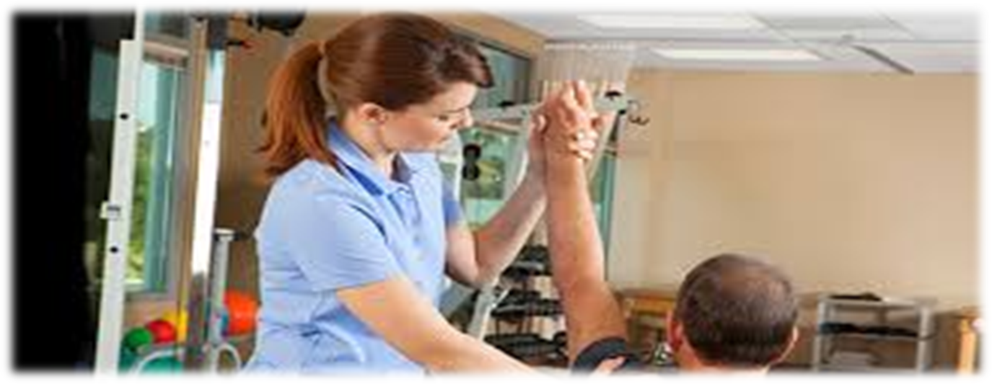
OCCUPATIONAL HEALTH MANAGEMENT
Mandatory elements
Mandatory elements
Ensuring the fitness of employees to undertake high risk activities:
  Fork lift truck drivers
  Employees working in confined spaces
  Employees working in extreme temperatures
  Employees working in high bay warehouses
  Employees driving on company business
Monitoring the health of employees exposed to environments known to have potential health effects, as required by local laws or regulations
  Noise, above 80 dB A
  Chemicals, as defined in local legislation
  Respiratory and skin sensitizers
  Vibration

Slide 10
FIRST AID
Definition and purpose
Mandatory elements
First aid is defined as any one-time treatment, and any follow-up visit for the purpose of observation, of minor scratches, cuts, burns, splinters, etc.
First Aid provision must be adequate and appropriate in the circumstances
To provide immediate assistance to casualties with both common injuries and illness and those likely to arise from specific hazards at work e.g., ammonia
To summon an ambulance or other professional help
First aid duties should be clearly defined in local site procedures.
The treatment of minor illnesses involving the administration of tablets and/or similar medicines falls outside the definition of First Aid.
Where a site decides that a first-aider is to administer/supply a limited list of simple medication
The site’s Medical Officer must provide appropriate training to those he/she authorizes to perform the task.

Slide 11
FIRST AID
Risk assessment
Risk provisions
Risk assessment must be undertaken to identify the likely nature of accidents, injury or workplace illness to help first–aid facilities and personnel
The first aid risk assessment should be reviewed regularly to take account of changes to the premises, personnel and operations.
If the first aid risk assessment identifies specific workplace hazard first-aiders must have special additional training to cope with injury or illness associated with the risk or hazard
Once the assessment of first aid requirements has been completed,
Provision should be made of materials, equipment and facilities needed to ensure the level of cover identified.
First aid equipment – this can vary, depending on the circumstances, as like small suitably stocked etc.
Soap and water should be available or alternatively moist individually wrapped cleansing wipes
Mains tap water for eye irrigation or at least a liter of sterile water or sterile normal saline (0.9%).

Slide 12
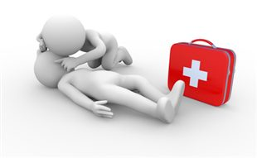
FIRST AID
First aid personnel
First aid personnel
First-aiders need to be easily identified by all personnel in the workplace.
Workplace hazards and risks
The size and geography of the site and where employees are working on shared or multi-occupied sites
The organisation’s history of accidents
The remoteness of the site from emergency medical services
The needs of travelling, remote and lone workers
Annual leave and other absences of first aiders and appointed persons
The number of visitors/ contractors/customers to the premises
Shutdown periods

Slide 13
FIRST AID
Fitness to work
Fitness to high risk activities
Employees are critical to the success of our business and it is essential to ensure, as far as reasonably practicable, that employees are fit to undertake their contractual duties.
It must be recognised that no person is 100% fit at all times due to illness which is non work related.
Illness caused by accident or work place exposure which affects their safety and ability to undertake their jobs.
Employees who are not 100% fit can be found alternative work, changes to job routine and hours worked to ensure a return to work
Lift Truck Operatives
Work in Confined Spaces
Use of Breathing Apparatus in emergency situations
Work in extreme temperatures – hot and cold
Work with Respiratory Sensitisers
Night workers
Suitably qualified medical officers or nurses must undertake medical assessments.
Results of assessments must be sent to the appropriate line manager without including any medical data.

Slide 14
FIRST AID
Pre-employment checks
Return to work
A prospective employee has no existing medical condition that could be exacerbated by the work offered.
A prospective employee has no medical condition which could be detrimental to their safe working, the safety of others or risk to product.
Specific requirements and exclusions for
    Food Handlers, Drivers,
    Cold Store Workers,
    Respiratory Sensitizers Handlers,
    Confined Space Workers,
    Breathing Apparatus Wearers,
    Nut Handlers, LGV Drivers etc.
An absence of three or more weeks,
An accident sustained at work,
Back/neck pain or disability,
Tenosynovitis/RSI problems,
Following an operation,
Psychiatric/stress related conditions,
Vertigo/dizziness/fits.

Slide 15
FIRST AID
Health surveillance
Testing for serious diseases
Préplacement examinassions,
Return to work assessments,
Surveillance of health records,
Symptom enquiry,
Biological monitoring,
Biological effect monitoring,
Noise levels in excess of 80dBA
Respiratory sensitizers
Any chemicals know to have adverse medical effects
Vibration
Carried out as part of a voluntary service;
Done with the informed consent of each employee tested;
Done by qualified medical personnel;
Conducted outside the workplace and
Results must be kept strictly confidential by the healthcare provider.
Procedures must be in place for dealing with positive tests for serious
diseases, including HIV/AIDS, that may arise in the course of employee health

Slide 16

About PMG Consultants
PMG Consultants is group of competent people with expertise in respective domains. Delivering commitments, exceeding expectations & creating value for clients in every interaction is our non-negotiable objective. Using the most advanced design & collaboration work systems, we aspire to become Inspirational business partners for our clients.
Get in touch
We would love to hear from you. Gauge our capabilities by speaking to us. You can visit us at our New Delhi Design Office, or meet our representative at your location.
Our Office
Address:
162A/9, 3rd Floor, Kishangarh,
Vasant Kunj, , New Delhi, 110070
Phone: +91-9871115995, +91-11-23361790
Email: connect@pmg-consultants.com
abhinav.pandey@pmg-consultants.com

