Slide 1
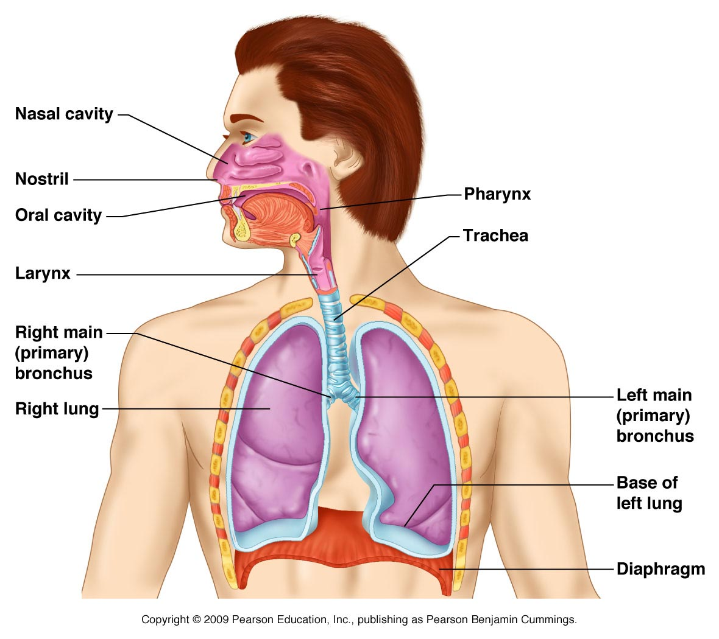
RESPIRATORY SYSTEM

Slide 2
ABOUT PMG
“BUILDING FOOD FACTORIES WITH TOP QUALITY STANDARDS OF NESTLE, MONDELEZ,ABBOTT, DANONE USING 3D DESIGN AND HYGIENIC ENGINEERING.”
At PMG, we deliver Engineering Design and Project Management scopes in Food and Beverage industry. Our team of design engineers and engineering executives has rich experience in Project Planning, Design, Execution and Commissioning with key competencies in areas like 3D Plant Design, Hygienic Engineering, and Project Management. Our safe-by-choice, result-oriented, and pro-active work-ethics allow us deliver work scopes meeting objectives, complete stakeholder alignment and first-time quality.
PMG Knowledge Repository: Targeted Knowledge Sharing & Skill Development
Precise and focused training modules for the exhaustive set of people working in manufacturing industry, instilling qualities of self-belief, creative thinking & widened perspective.
Clear Learning Objectives
Focused approach to skill development and knowledge sharing
Progressive Evaluation
Gauging improvement on every step and keeping audience connected.
After-training follow-ups
We systematically track differential progress of recipients after the training.
Audience Specific Approach
Programs are fine-tuned to the ability and interests of the recipients.
Multiple Awe-moments
Awe-moments are refreshing and increase receptivity many-fold.
Seasoned Trainers
PMG trainers are subject matter experts with substantial work experience.

Slide 3
AGENDA
1
Introduction
2
Objective Respiratory Hazards
3
Health Effects
4
Respiratory Protection

Slide 4
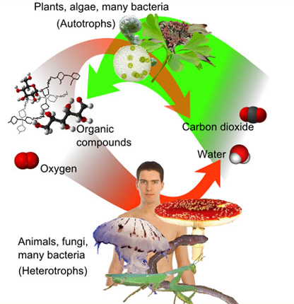
INTRODUCTION
Construction personnel are often exposed to respiratory hazards in the form of dangerous dusts, gases, fumes, mists, and vapours. In some cases, careful selection of materials and work practices can virtually eliminate respiratory hazards.
Where that is not possible, the next best choice is engineering controls such as fume exhaust systems that deal with the hazard at the source.
Respirators are the least preferred method of protection from respiratory hazards because they do not deal with the hazard at the source can be unreliable if not properly fitted and maintained may be uncomfortable to wear. In spite of these drawbacks, respiratory protective equipment is the only practical control in many construction operations.

Slide 5
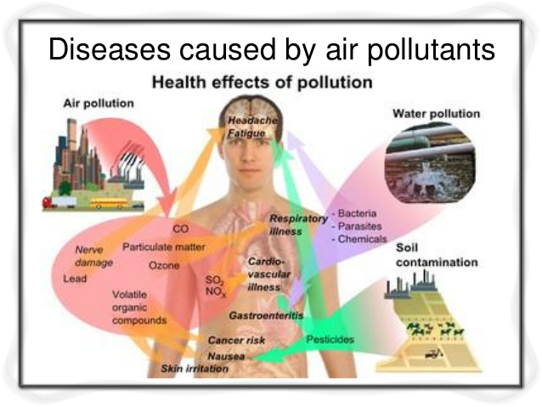
OBJECTIVES RESPIRATORY HAZARDS
Respiratory hazards may be present as :
  Gases
  Vapours
  Fumes
  Mists
  Dusts
  Bio aerosols (e.g., moulds)

Slide 6
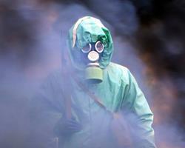
OBJECTIVES RESPIRATORY HAZARDS
Gases consist of individual molecules of substances, and at room temperature and pressure, they are always in the gaseous state. Common toxic gases found in construction are carbon monoxide from engine exhaust and hydrogen sulphide produced by decaying matter found in sewers and other places.

Slide 7

OBJECTIVES RESPIRATORY HAZARDS
Vapours are similar to gases except that they are formed by the evaporation of liquids (e.g., water vapour). Common vapours found in construction are produced by solvents such as xylene, toluene, and mineral spirits used in paints, coatings, and degreasers

Slide 8
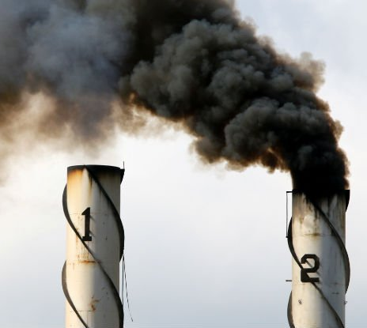
OBJECTIVES RESPIRATORY HAZARDS
Fumes are quite different from gases or vapours, although the terms are often used interchangeably. Technically, fumes consist of small particles formed by the condensation of materials which have been subjected to high temperatures. Welding fume is the most common type of fume in construction. Another example is pitch fume from coal tar used in built-up roofing.

Slide 9
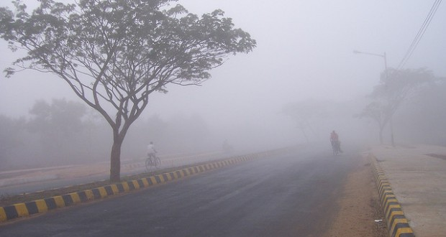
OBJECTIVES RESPIRATORY HAZARDS
Mists are small droplets of liquid suspended in air. The spraying of paint, form oils, and other materials generates mists of varying composition.

Slide 10
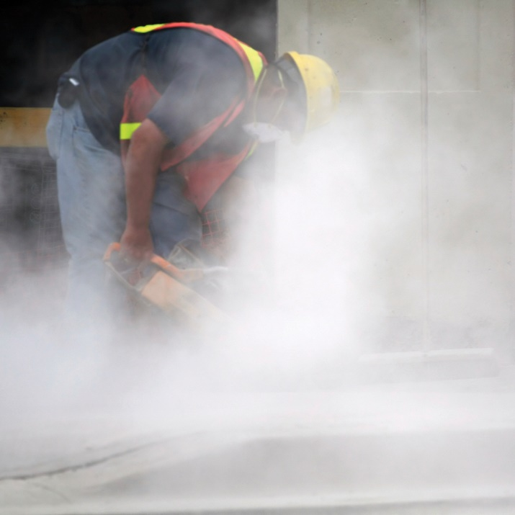
OBJECTIVES RESPIRATORY HAZARDS
Dusts are generated by crushing, grinding, sanding, or cutting and by work such as demolition. Two kinds of hazardous dust common in construction are fibrous dust from insulation materials (such as asbestos, mineral wool, and glass fibre) and non-fibrous silica dust from sandblasting, concrete cutting, or rock drilling.

Slide 11
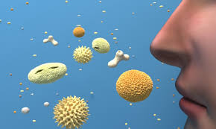
OBJECTIVES RESPIRATORY HAZARDS
Bioaerosols are airborne particles that contain microbes such as mould, bacteria, viruses, or pollen. If inhaled, they can cause infectious diseases (Legionellosis, Tuberculosis, etc.), respiratory infections, or allergic reactions.
In construction settings, respiratory hazards may be compounded, depending on the number and variety of jobs under way. For example, both mist and vapours may be present from paint spraying or both gases and fumes from welding.

Slide 12
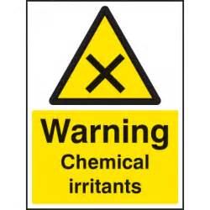
HEALTH EFFECTS
Inhalation hazards can be divided into the following classes based on the type of effects.
Irritants are materials that irritate the eyes, nose, throat, or lungs. This group includes fibreglass dust, hydrogen chloride gas, ozone, and many solvent vapours. With some materials (e.g., cadmium fume produced by welding or oxyacetylene cutting of metals coated with cadmium) the irritation leads to a pneumonia-like condition called pulmonary edema. This effect may not be apparent until several hours after exposure has stopped.

Slide 13
HEALTH EFFECTS
Asphyxiants are substances which result in inadequate oxygen in the body. They can be classified as either simple Asphyxiants or chemical Asphyxiants.
Simple Asphyxiants are other gases or vapours that cause oxygen to be displaced, creating an oxygen deficient atmosphere. For example, nitrogen used to purge tanks can displace oxygen, resulting in unconsciousness and even death for those who enter. Oxygen may also be consumed by chemical or biological activity such as rusting or bacteria digesting sewage.
Chemical Asphyxiants interfere with the body’s ability to transport or use oxygen. Two examples are carbon monoxide and hydrogen sulphide.

Slide 14
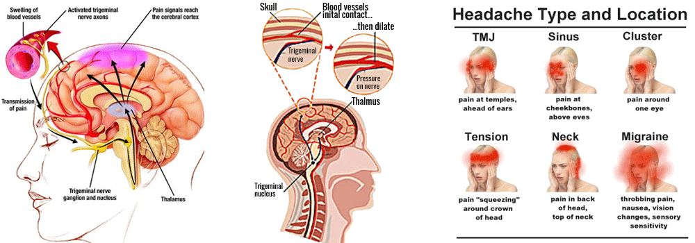
HEALTH EFFECTS
Central nervous system depressants interfere with nerve function and cause symptoms such as headache, drowsiness, nausea, and fatigue. Most solvents are central nervous system depressants.

Slide 15
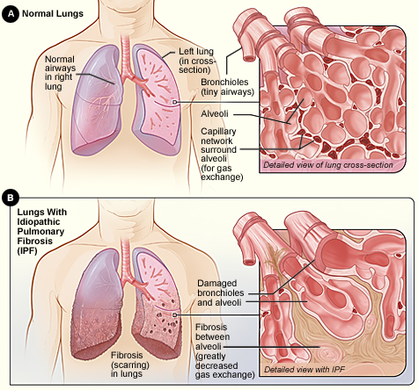
HEALTH EFFECTS
Fibrotic materials cause “fibrosis” or scarring of lung tissue in the air sacs. Common fibrotic materials found in construction include asbestos and silica.

Slide 16

HEALTH EFFECTS
Carcinogens cause or promote cancer in specific body organs. Silica, asbestos, and hexavalent chromium are examples of carcinogens.

Slide 17
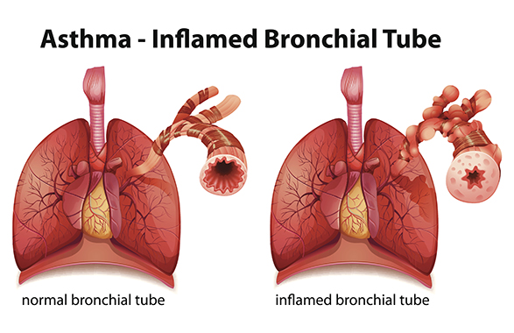
HEALTH EFFECTS
Dusts do not cause significant effects unless exposure is of high concentration and/or long duration. Excessive exposure to these substances can be adverse in itself or can aggravate existing conditions such as emphysema, asthma, or bronchitis. Examples include plaster dust, cellulose from some insulation, and limestone dust.

Slide 18
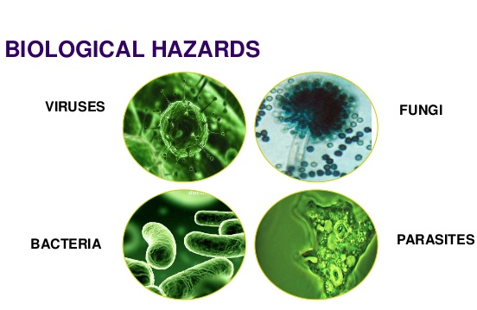
HEALTH EFFECTS
Biological hazards include moulds, bacteria, or viruses. If inhaled, they can cause eye, nose and throat irritation, hypersensitivity pneumonitis, or asthma.

Slide 19
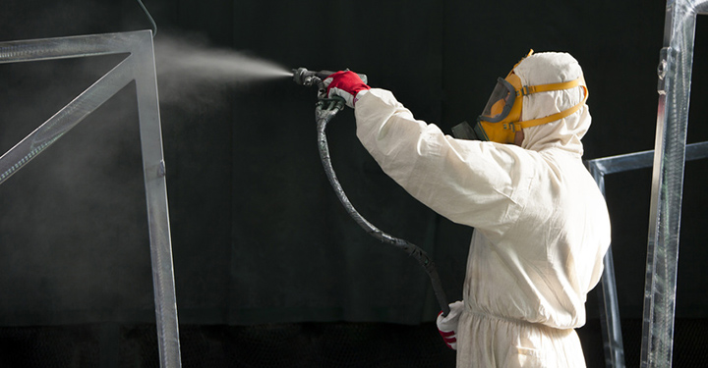
HEALTH EFFECTS
Respiratory sensitizers are chemicals such as Isocyanate in spray foam insulation or certain wood dusts. If inhaled, respiratory sensitizers can cause asthma.

Slide 20
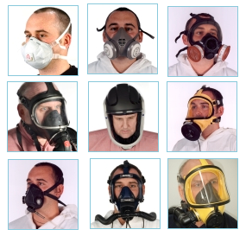
RESPIRATORY PROTECTION
Respiratory Protective Equipment
A wide variety of equipment can be used to protect workers from respiratory hazards. Devices range from a simple, inexpensive filtering face piece respirator to a sophisticated self-contained breathing apparatus. Generally, the equipment can be divided into two distinct classes air-purifying respirators and supplied air respirators.

Slide 21
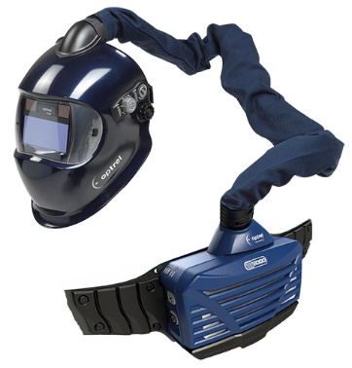
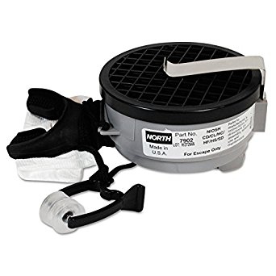
RESPIRATORY PROTECTION
Air-purifying Respirators
These devices purify the air drawn through them. There are two main types of air purifying respirators:
  Non-powered Air is drawn through the air-purifying filter, cartridge or canister by the wearer breathing in and creating a negative pressure in the face piece. Non-powered respirators depend entirely on the wearer breathing in (inhaling) and breathing out (exhaling) to deliver an adequate supply of purified breathing air.
  Powered These respirators have a blower carried by the wearer that passes contaminated air through an air purifying component and supplies the purified air to the wearer
  Air-purifying respirators have limitations and should not be used where there is insufficient oxygen (less than 19.5%) very high concentrations of contaminant are present.

Slide 22
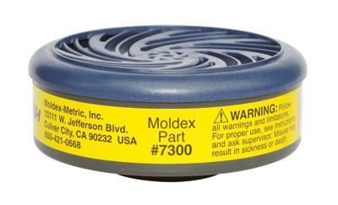
RESPIRATORY PROTECTION
Warning: Air-purifying respirators simply remove certain airborne hazards. They do not increase or replenish the oxygen content of the air and should never be worn in atmospheres containing less than 19.5% oxygen.

Slide 23
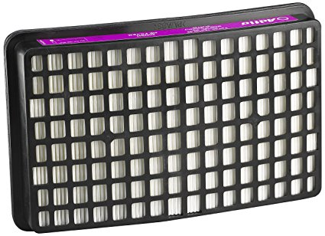
RESPIRATORY PROTECTION
Particulate Filters
This type removes solid particles such as dusts, fumes, or mists and operates like the air filter in a car engine. The devices may be filtering face piece respirators or respirators with replaceable filters. Different grades of filters are available, depending on the size of particles to be removed. When particulate filters fill up with dust or fume, they become harder to breathe through but are more efficient, since air is being filtered through the layer of trapped particles as well as the filter itself. While particulate filters can provide good protection against particles such as dusts, mists, or fumes, they cannot filter out gases or vapours because of the very small size of gas and vapour molecules.

Slide 24
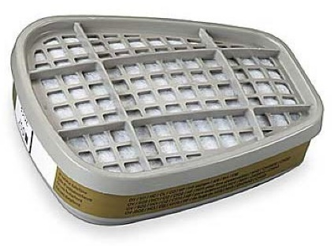
RESPIRATORY PROTECTION
Gas/Vapour Cartridge Filters
This type uses substances which absorb or neutralize gases and vapours. Unlike particulate filters, gas/vapour cartridge filters become less efficient the longer they are used. They act like sponges and, when full, allow gas or vapour to pass through without being absorbed. This is called “breakthrough.” Common gas/vapour cartridge filters include the following:
  “Organic Vapour Cartridges” usually contain activated charcoal to remove vapours such as toluene, xylene, and mineral spirits found in paints, adhesives, . and cleaners.
  “Acid Gas Cartridges” contain materials which absorb acids and may be used for protection against limited concentrations of hydrogen chloride, sulphur dioxide, and chlorine.
  “Ammonia Cartridges” contain an absorbent designed specifically to remove only ammonia gases.

Slide 25
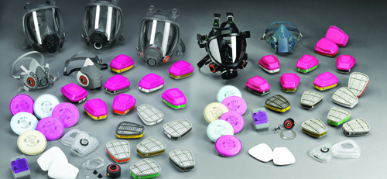
RESPIRATORY PROTECTION
Combination Particulate/Gas/Vapour Cartridge Filters
This type removes particulate matter, vapours, and gases from the air. It is used where more than one type of hazard is present or may develop.

Slide 26

About PMG Consultants
PMG Consultants is group of competent people with expertise in respective domains. Delivering commitments, exceeding expectations & creating value for clients in every interaction is our non-negotiable objective. Using the most advanced design & collaboration work systems, we aspire to become Inspirational business partners for our clients.
Get in touch
We would love to hear from you. Gauge our capabilities by speaking to us. You can visit us at our New Delhi Design Office, or meet our representative at your location.
Our Office
Address:
162A/9, 3rd Floor, Kishangarh,
Vasant Kunj, , New Delhi, 110070
Phone: +91-9871115995, +91-11-23361790
Email: connect@pmg-consultants.com
abhinav.pandey@pmg-consultants.com

