Slide 1
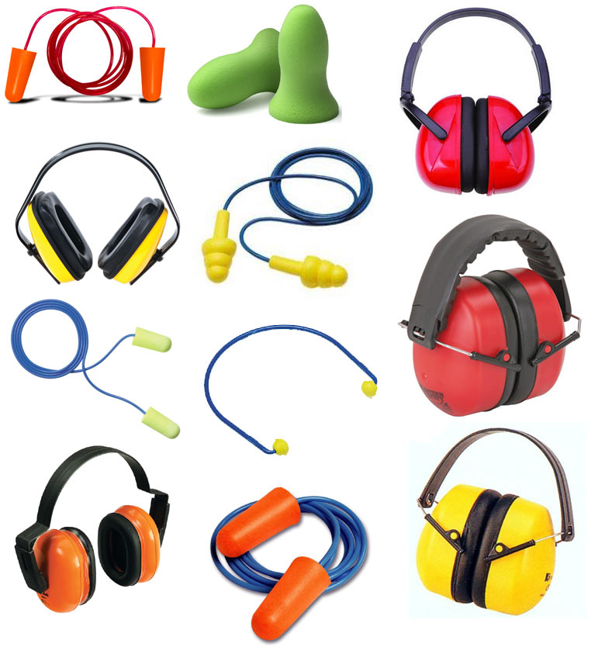
WORKPLACE NOISE HAZARD CONTROL

Slide 2
AGENDA
1
Introduction
2
Hearing loss
3
Dangerous noise levels
4
Identifying noise hazards
5
Noise assessments
Notes:
2

Slide 3
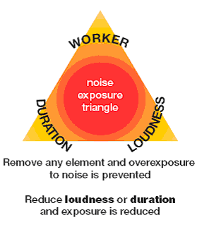
WORKPLACE NOISE HAZARD CONTROL
Introduction
Noise is an unwanted or damaging sound that may damage your hearing and cause other health effects such as stress, hypersensitivity to noise, increased blood pressure and increased heart rate. It can also interfere with communication at work, which could lead to accidents.

Slide 4
HEARING LOSS
Very loud sounds can cause the hair cells of the inner ear to collapse and flatten temporarily, resulting in deafness.
This may be temporary or permanent, depending on the noise level and length of exposure.
Temporary hearing loss may also be accompanied by a ringing sensation called tinnitus.
If high noise exposure is repeated over many years, the hair cells in the inner ear may also become permanently damaged resulting in permanent hearing loss.
Immediate permanent hearing loss can also occur if someone is exposed to very intense or explosive sounds e.g. a gunshot or explosion.
This type of damage is known as acoustic trauma. In some cases a very intense sound can actually perforate the eardrum.
The harmful effects of noise may be cumulative and not necessarily confined to the workplace.
For instance, the use of personal stereo units

Slide 5
DANGEROUS NOISE LEVELS
As people respond differently to noise, the exact level at which noise will cause damage is not certain for each person.
However, the amount of damage caused by noise depends on the total amount of energy received over time and each person's susceptibility to hearing loss.
Most people are protected from long-term damage in a working day (8 hours) by keeping exposure around the 85 decibel (dB)(A) level.
But if noise exposure becomes more intense, damage may occur in a shorter time.
The acceptable noise exposure standard in the workplace is 85 dB(A) averaged over an eight-hour period. This is not to imply that a safe condition exists at below 85 dB(A).
It simply means that an eight-hour exposure of 85 dB(A) is considered to represent an acceptable level of risk to hearing health in the workplace.
Impulse or sudden noise levels in excess of the peak exposure standard of 140 dB(C) are considered to be hazardous and capable of causing immediate hearing damage.

Slide 6
IDENTIFYING NOISE HAZARDS
You don't necessarily need specialist skills or equipment to make a preliminary assessment to identify sources of hazardous noise.
However it should be done in consultation with those who understand the work processes, such as affected workers and their Health and Safety Representatives (HSRs).
A walk-through inspection with relevant workers and HSRs will make a good start towards hazardous noise identification.

Slide 7
IDENTIFYING NOISE HAZARDS
A walk-through inspection will help determine:
  Sources of excessive noise
  Workers likely to be exposed to excessive noise
  Work practices that are noisy
  Ways of reducing noise levels.
This type of preliminary assessment should assist in establishing a list of most activities in your workplace that may pose a risk to a worker's hearing.
If you are unsure about the level of exposure or how to minimise the risks effectively

Slide 8
NOISE ASSESSMENTS
Definitions and control elements
Significant noise level
  Noise levels must be considered significant if a normal conversation cannot be conducted between two people at a distance of 1m or less apart without raising the voice.
  Noise exposure assessments must be conducted if employees complain of excessive noise.
Noise survey
  A survey of ambient noise levels must be conducted in all areas where noise levels are significant at least once every three (3) years, or when significant change is implemented (e.g. when line equipment is modified/added to existing facilities or when the results of Health surveillance show it to be necessary).

Slide 9
NOISE ASSESSMENTS
Definitions and control elements
Continuous noise
Varying noise
Noise presenting instantaneous sound pressure level fluctuations inferior or equal to 5 dB(A) during an observation period of 1 minute.
Noise presenting instantaneous sound pressure level fluctuations superior to 5 dB(A) during an observation period of 1 minute
Energy averaging laeq
Peak level
The formal definition is "when a noise varies over time, the Leq is the equivalent continuous sound which would contain the same sound energy as the time varying sound".
Peak levels are absolute levels and do not depend on length of exposure. High peak sound pressure levels present a risk of immediate and permanent hearing loss

Slide 10
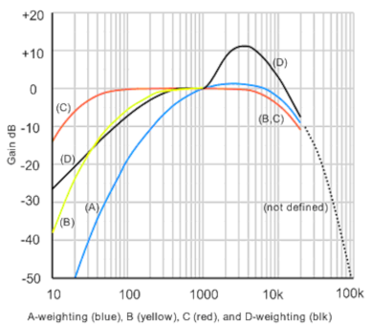
NOISE ASSESSMENTS
Definitions and control elements
Personal noise exposure
Frequency weighting
An assessment of personal noise exposure is triggered by an area noise survey and must be conducted by a competent person for a representative group of individuals likely to be exposed to ambient noise levels > 80 dB(A) LAeq. In the spirit of continual improvement (Plan, Check, Do, Act cycle), the assessments should cover all exposed workstations – and therefore all individuals exposed – with time, i.e. as assessments are updated in the PCDA cycle.
Continuous noise level is measured using the (A) weighting curve. Pulse or peak noise levels are measured using the (C) weighting.
For technical details, read reference literature and/or consult with specialists.

Slide 11
NOISE ASSESSMENTS
Definitions and control elements
Maximum permitted noise exposure
Mandatory hearing protection
The maximum personal noise exposure tolerated without mandatory hearing protection is below 85 dB(A) LAeq(8h).
If personal noise exposure levels are likely to equal or exceed 85 dB(A) LAeq (8h), or peak noise levels equal to or exceeding 140 dB (except emergency alarm sounds), the site management must investigate and implement – as part of the continual improvement process – a way to reduce this level.
If personal noise exposure cannot be reasonably and practically reduced to < 85 dB(A) LAeq (8h), by technical or organizational means, then suitable hearing protection is mandatory. The actions taken to maintain personal noise exposure below 85 dB(A) LAeq (8h) must be documented.
Individuals must not be exposed to ambient noise levels which equal or exceed 85 dB(A) LAeq(8h), 90 dB(A) for any length of time or 140 dB peak without appropriate hearing protection (except emergency alarm sounds).

Slide 12
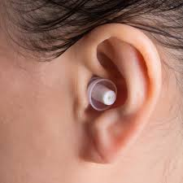
NOISE ASSESSMENTS
Definitions and control elements
Noise survey documenta­tion
Recommended hearing protection
The results of noise surveys and personal noise exposure assessments must be documented and the records must be retained for at least five (5) years
Some countries already require conservation of records for longer periods, as well as retaining records of at least two consecutive surveys. Noise surveys must be updated if there is any reason to suspect that the assessments are no longer valid.
Some hearing specialists recommend to implement hearing protection at 80 dB(A) LAeq(8h) already.
Almost MNC are empowered to mark their areas with this level of noise as "Hearing Protection Zones" if they decide so.

Slide 13
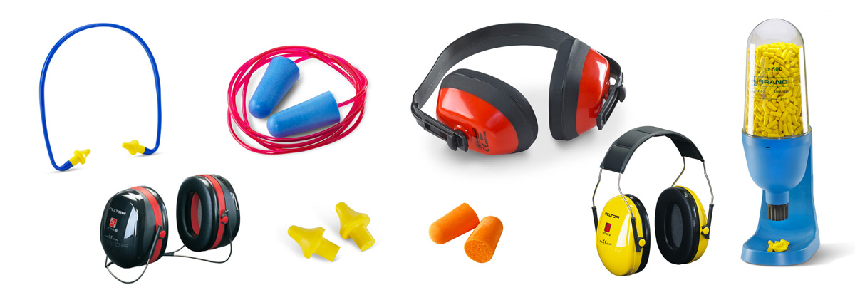
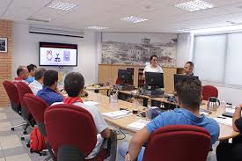
NOISE ASSESSMENTS
Definitions and control elements
Noise PPE
Training
Individuals working within a "Hearing Protection Zone", sites must be provided with adequate personal protective equipment such as
earplugs or ear cups,
based on risk assessment and practical measurements.
Adequate information and training must be provided to ensure that individuals understand the risks associated with exposure to excessive noise and the correct use of control measures provided for their protection

Slide 14
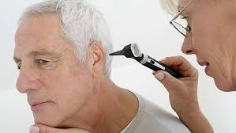

NOISE ASSESSMENTS
Definitions and control elements
Hearing surveillance
Medical surveillance documentation
Individuals working in areas where the ambient noise exceeds 80 dB(A) LAeq(8h) must be subject to periodic medical hearing surveillance, which includes audiometric testing
Records of this medical hearing surveillance must be kept as long as the individual works for Nestlé plus five (5) years or longer if required by the local legislation.
All medical surveillance records are subject to the local privacy laws.

Slide 15


NOISE ASSESSMENTS
Definitions and control elements
Audiometric testing
Employee participation
Audiometric tests should cover at least the 500 – 6,000 Hz range.
When involving external audiologists, sites must ensure they are adequately and officially qualified and/or licensed.
Participation of exposed employees (more than 80 dB(A) LAeq (8h)) in the audiometric test program is mandatory
New employees must be included as they arrive, if they will be exposed to noise hazard within the frame of their work for work place

Slide 16
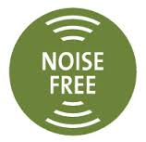
NOISE ASSESSMENTS
Definitions and control elements
Plant and process design
Plant and process design
Personal noise exposure must be considered in the design and specification of new installations, when equipment is added to existing facilities or when equipment is modified.
Purchase of equipment that would increase significantly the noise level in the area being considered should be avoided;
The measures required to maintain exposure below 85 dB(A) LAeq (8h) must be identified and implemented from the start of new installations or newly added/modified equipment.
Due to wear and tear, use of secondary equipment, and allowance for overtime working, the design target should be 83dB(A).
Hearing protection (PPE) must only be used as secondary protection or as a last resort.

Slide 17
NOISE ASSESSMENTS
Definitions and control elements
Reducing and eliminating sources of noise
Implementing a quieter way of doing the work
using quieter pieces of equipment
Introducing a low-noise purchasing policy for new equipment
Improving maintenance procedures
Fitting silencers to exhausts
Isolating or damping vibrating machinery by fitting anti-vibration mounts
Adding sound absorbing material to vibrating panels to reduce vibration
Enclosing noisy machinery
Erecting barriers and screens around noisy machinery and processes
Positioning noisy machinery and processes well away from workers
Using sound absorbing materials to reduce reflection of sound within buildings
  Limiting access by keeping people out of noisy areas
  Limiting time spent in noisy areas.

