Slide 1
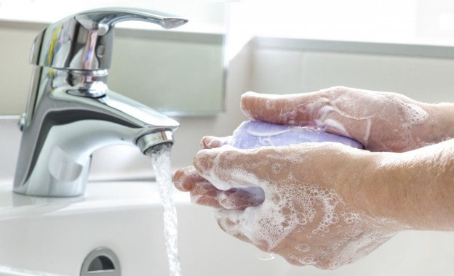
HYGIENE SAFETY

Slide 2
AGENDA
1
What are hygiene practices
2
Personal hygiene
3
Housekeeping
4
General ventilation
5
Cleaning and disinfection
6
Containment and other mean of engineering control
7
Lavatories and washing facilities
Notes:
2

Slide 3
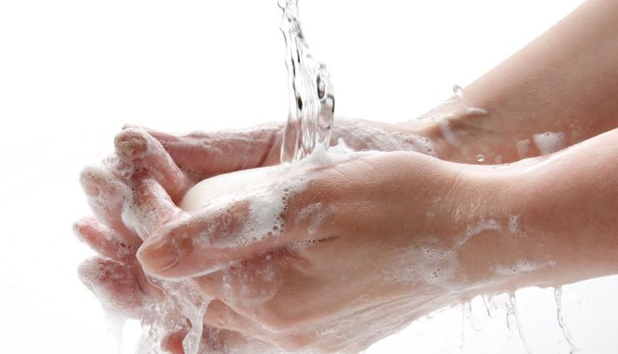
WHAT ARE HYGIENE PRACTICES.
According to the World Health Organization (WHO), "Hygiene refers to conditions and practices that help to maintain health and prevent the spread of diseases.“
Hygiene is a set of practices performed for the preservation of health

Slide 4
PERSONAL HYGIENE
Safety Point
Personnel should always wash the hands before preparing food.
Washing hands is one of the best ways to prevent the spread of bacteria.
All staff should carry clean clothes when working with food.
Theoretically they must dress clean work clothes before starting work and not to carry these clothes out of the food preparation area.
Clothes are a source of contamination with bacteria in food preparation areas.
Work clothes should be long sleeve and have bright colour (illumination) to see pollution and without external pockets.
This prevents the skin touches the food and prevents hair fall and items in pockets (which may contain bacteria).
Staff should keep hair tied back and take a hat or hair net when preparing food

Slide 5
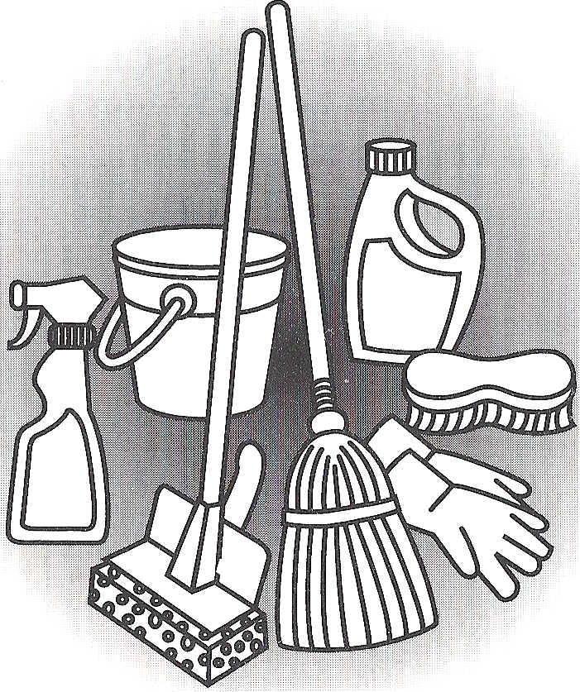
HOUSEKEEPING
Cleanliness
Good housekeeping means cleanliness and good order of equipment and facilities in a workplace.
A clean and tidy workplace is essential to ensure the health and safety of the workers

Slide 6
HOUSEKEEPING
Cleanliness
Regular cleaning of workplaces, equipment and devices should be carried out to ensure an adequate level of workplace hygiene.
A designated person should be assigned the responsibility to oversee such operations.
  Convenient locations in the workplace.
  The containers should be emptied daily, preferably near the end of each working day.
  Accumulation of dirt and refuse within the workplaces must be avoided.
  They should be removed with a suitable method from the floor or work benches regularly with a frequency compatible with the nature of the work conducted.
  Floor cleaning can be done by washing, sweeping, vacuum cleaning or other appropriate means
  Floor covering materials should be suitable for the work and easy to clean.
  The conditions of housekeeping can be easily assessed by visual observations.
  Records of maintenance work must be kept for evaluation of the performance, including information on the responsible person(s), contact and date/time of the action taken.

Slide 7
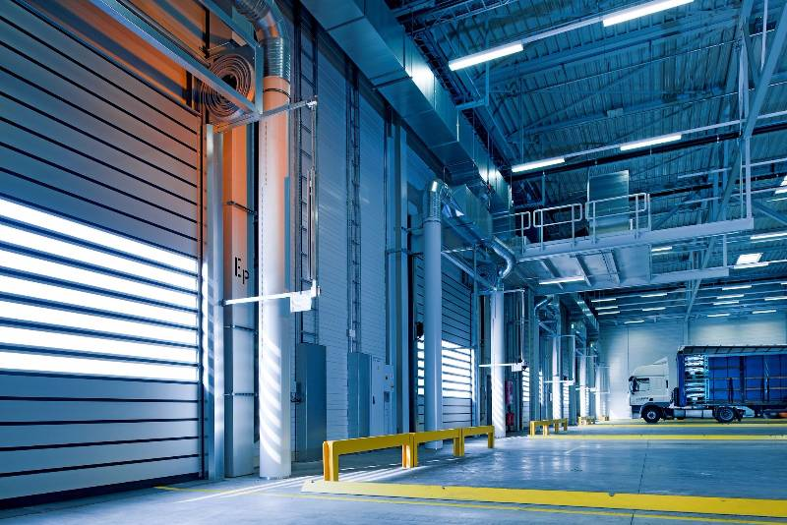
HOUSEKEEPING
Tidiness
Tidiness improves work performance and reduces accident.
Equipment, tools, containers and small items on work benches should be kept neat and arranged in an orderly fashion.
Sufficient space for storage of articles and goods is important.

Slide 8
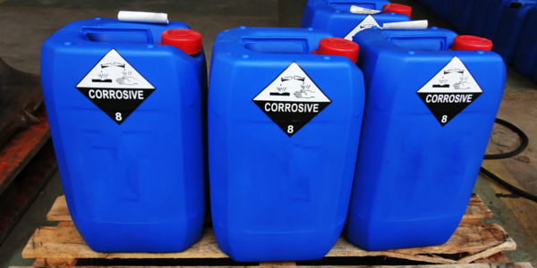
HOUSEKEEPING
Accident prevention
The occurrence of accidents in a workplace could lead to damage to employees' health and in severe cases death.
Precautions must be taken when dangerous substances are stored or used.
Containers should be clearly labelled and the labels easily visible.
Regular maintenance and checking of the equipment and devices can reduce risks.
The storage and disposal of chemicals or hazardous wastes should be done carefully.
Accidental spillage and spread of waste or contaminants can be avoided through proper assignment of duties, instruction, training and good Housekeeping.

Slide 9
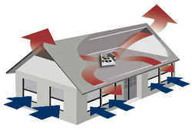
GENERAL VENTILATION
Ventilation is the process of supplying and removing air by natural or mechanical means to and from a workplace.
The term "natural ventilation" covers both the uncontrolled inward air leakage through cracks, windows, doorways and vents (infiltration) as well as the air leaving the room (ex-filtration) through the same routes.
Infiltration and ex-filtration are often affected by the weather and are beyond control.

Slide 10
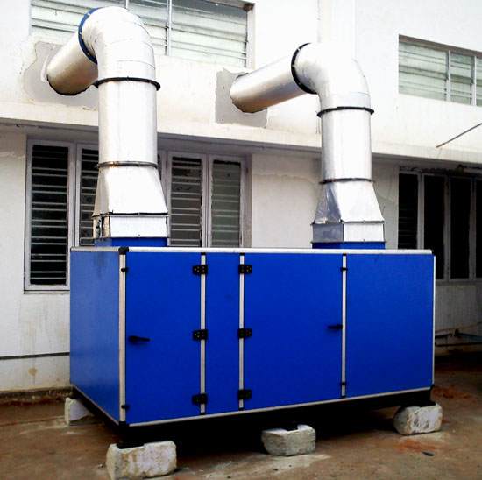
GENERAL VENTILATION
Provision of Fresh Air
It is essential to ensure that adequate ventilation is provided to a workplace, especially in an enclosed building.
General ventilation is designed to provide fresh air for breathing by the occupants, control of thermal conditions and keeping the air free from contaminants (such as tobacco smoke, body odor and other air-borne contaminants).
The fresh air intake points of a ventilation system should be away from any source of contaminants.
Filtration or cleaning of the incoming air before being supplied to a workplace is recommended.

Slide 11
GENERAL VENTILATION
Fresh air supply rate for general work activities in air-conditioned workplaces
For places where the number of persons present is normally constant.
Type of Work Activity | Minimum fresh air supply rate (m /min/person) | Remark
Open plan offices (non-smoking) | 0.43 | The normal daily working hours or hours of stay are long e.g. 8 hours
Private offices ( with moderate smoking ), laboratories | 0.6
Conference rooms or offices (with heavy smoking ) | 1.0
Canteens, restaurants | 0.3 (based on the seating capacity and the number of employees | On average , people may not stay in the area for a long period

Slide 12
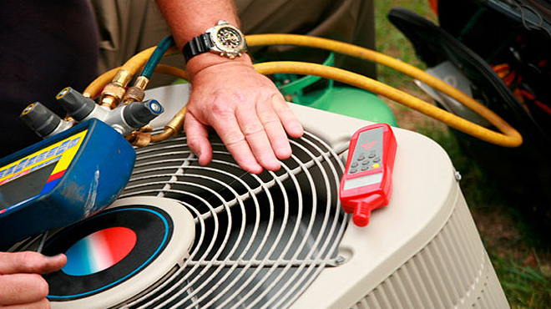
GENERAL VENTILATION
Maintenance
If a mechanical ventilation system is used, regular checks (e.g. annually) should be carried out to reveal malfunctions and prevent breakdowns.
Visible deposit or dirt on the fans and duct work system is likely to cause health risks and should be removed.

Slide 13
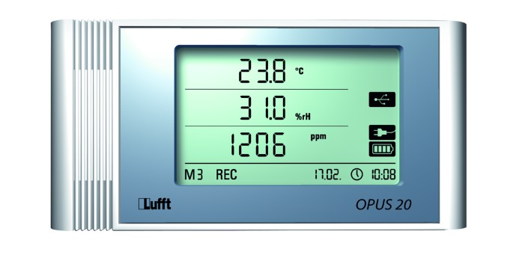
GENERAL VENTILATION
Monitoring of the ventilation system
In a workplace without a specific source of contamination, the adequacy of ventilation can be measured indirectly with a carbon dioxide index method.
As the concentration of carbon dioxide increase with human activities, background levels of other contaminants also increase.
Carbon dioxide level frequently exceeding 1000 ppm (although carbon dioxide at such level is not a health concern) could be a useful indicator for review of the fresh air supply rate, distribution and the activities going on, especially when there is a complaint.

Slide 14
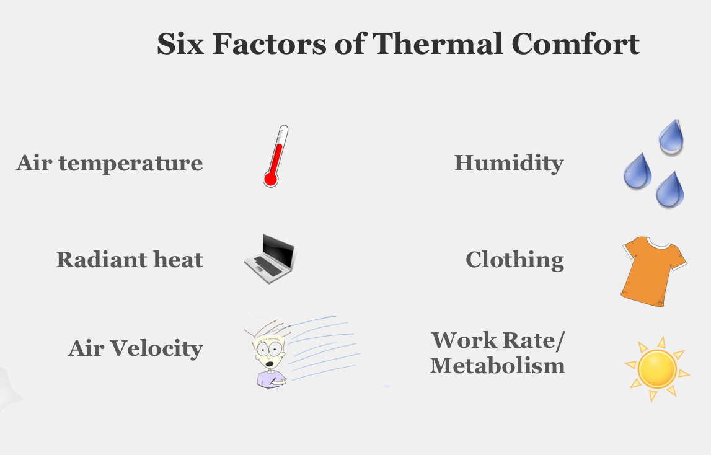
GENERAL VENTILATION
Thermal conditions
Thermal conditions for enclosed workplaces should be commensurate with the activities in the area. The factors affecting these conditions include air temperature, humidity and air movement.

Slide 15
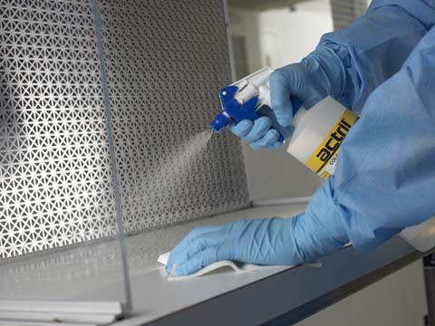
CLEANING AND DISINFECTION
Effective cleaning is essential to eliminate harmful bacteria and to prevent them from being introduced into food.
This section tells you about effective cleaning, how to wash and clean while on the go "and created a schedule for cleaning.
Effective cleaning is essential to eliminate harmful bacteria and to prevent them from being introduced into food.

Slide 16
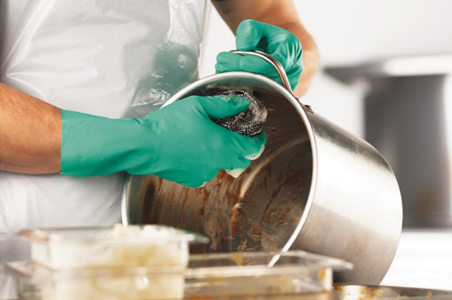
CLEANING AND DISINFECTION
Cleaning with high priority
Regularly wash / wipe and disinfecting of all tools which often affect people, such as surfaces, sink, water taps, door handles, switch to the end of each day / replacement.
It is important that you keep these clean to prevent contamination and spread bacteria in people's hands and then transferred from hands to food and other parts.
Dried naturally helps prevention of spread of bacteria in these objects in the towel or cloth which is used for wiping (drying).
Wash and disinfecting refrigerators when there is not much food inside.
Transfer food to another freezer or in a cold and safe place and keep it covered.
Pay special attention to the frequency of cleaning of equipment parts are moving parts.

Slide 17
CLEANING AND DISINFECTION
Washing hand
Ensure that all staff who works with food wash their hands in the regular way: -
  After entering the kitchen as e.g. after break or after returning from toilet.
  Before touching food ready to eat.
  After each touch raw meat and eggs.
  After clearing the garbage pail.
  After touching of any remedy or after change of the clothes.
  Bacteria can be spread easily by hands of men in food.

Slide 18
CLEANING AND DISINFECTION
Washing hand
Effective way of washing hands
  Step I: wet hands thoroughly in lukewarm water and then take liquid soap and put on the one hand forehand.
  Step II: wipe hands together to make foam.
  Step III: wipe palms of one hand on the back of the hand and another through your fingers. Then repeat with other hand.
  Step IV: wipe between all fingers on both hands and around the thumb, then the tops of the fingers and fingernails.
  Step V: rinse with clean water and soap.
  Step VI: dry hands with towels to use. Turn water taps with towel and then throw the towel.

Slide 19
CLEANING AND DISINFECTION
Fabrics - cloth (for cleaning)
Fabrics can be one of the main causes of cross-contamination in the kitchen
Always use new fabrics or fabrics that newly cleaned to clean work surfaces,
Remove fabrics (usable again) for a thorough cleaning after use of them to the unprepared meat, meat of poultry, unprepared eggs or vegetables- and the surface where these foods touched
Using unclean fabrics may easily spread the bacteria.
If food and pollution is still in the fabric, it will prevent the disinfection process to be effective, so harmful bacteria cannot be destroyed
  Use different fabrics for different job
  Washing dishes – use fabric containers
  Use fabric or use a paper towel to work the following:
  Cleaning of surfaces
  Wet cleaning
  Cleaning hands
  Cleaning the edges of the container before serving
  Drying of other elements

Slide 20
CLEANING AND DISINFECTION
Cleaning schedule
Tools should be cleaned and disinfected
Tools that have been in contact with food Work surfaces and cutting boards
  Tools such knives
  Fridge
  Equipment with moving parts, e.g. mixers, food processors and cutters
  Glasses of sinks and soap (liquid)
  Fabrics with many uses and work clothes
  Equipment for ice Often affected objects
  Garbage pail, broom and floor swab
  Gloves of the door, taps, switch and other controllers
  Can openers
Items to be cleaned
  The floor, walls, ceiling
  Parts of storage and frieze
  Parts of trash and pipelines
  Self-service and staff areas

Slide 21
CONTAINMENT AND OTHER MEAN OF ENGINEERING CONTROL
In the case of activities that cause exposure to air-borne contaminants, special control measures or facilities should be considered.
Such measures would be useful in protecting employees from inhalation of air-borne impurities and in avoiding accumulation of harmful substances in the work environment.
Physical barriers
Mechanical ventilation
Local exhaust ventilation

Slide 22
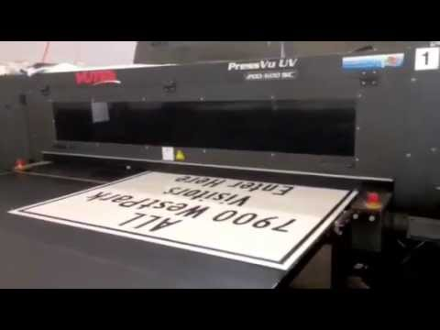
CONTAINMENT AND OTHER MEAN OF ENGINEERING CONTROL
Physical Barrier
Hazardous operations (e.g. a printing job being done in an office) should be separated from other activities by physical barriers partially or completely to prevent the spread and accumulation of air-borne contaminants into the normal working area.
Other means of control should be provided in the (printing) area for the protection of the employees.

Slide 23
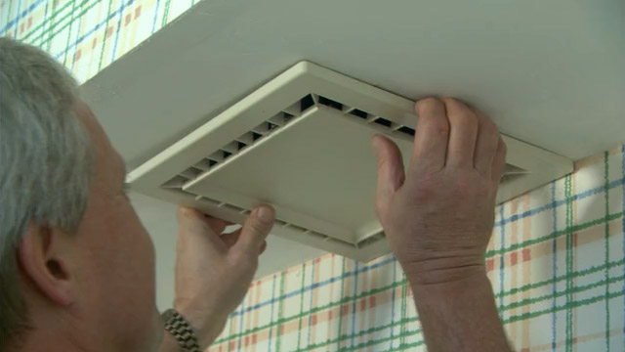
CONTAINMENT AND OTHER MEAN OF ENGINEERING CONTROL
Mechanical ventilation
To prevent accumulation of air-borne contaminants in the work area,
Mechanical exhaust ventilation is required to remove the impurities in air and to discharge them properly.
Sufficient make-up air should be provided to facilitate the removal of contaminated air.

Slide 24
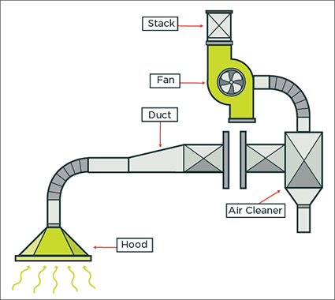
CONTAINMENT AND OTHER MEAN OF ENGINEERING CONTROL
Local exhaust ventilation
Control atmospheric contamination at its source.
A local exhaust system should normally contain an enclosing hood, ducting, an air cleaner and an exhaust fan.

Slide 25
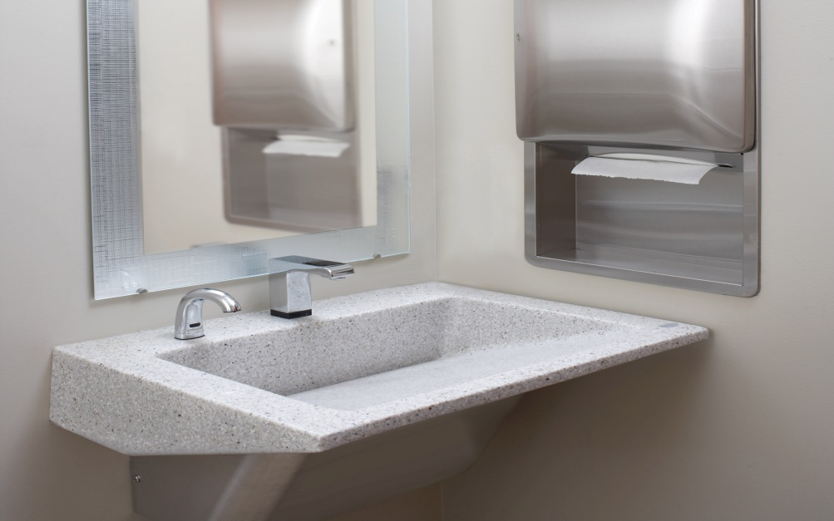
LAVATORIES AND WASHING FACILITIES
Suitable and sufficient sanitary conveniences and wash basins should be provided at readily accessible places.
They are supposed to be adjacent to but separate from other sanitary facilities such as changing rooms and shower facilities.
  Sanitary facilities should be provided for men and women separately.
  The facilities must be maintained tidy, clean and hygienic. Daily cleaning is recommended.
  The conditions of cleanliness of the sanitary facilities should be inspected regularly (e.g. weekly) by an appointed personnel.

Slide 26
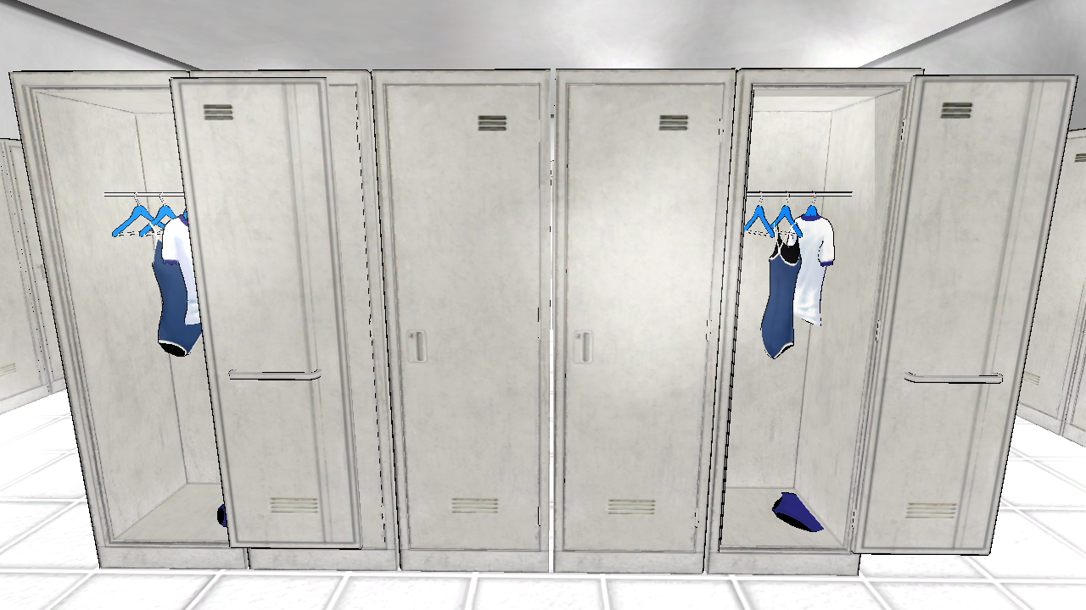
LAVATORIES AND WASHING FACILITIES
Changing rooms and shower facilities
When the activities in the workplace are likely to produce bodily contamination, an adequate, suitable and secure place should be provided for employees to store their own clothing and work clothing.
  Changing rooms should be equipped with lockers.
  To maintain good personal hygiene.
  When a highly dangerous operation is carried out in a workplace, an emergency shower or eye-washers should be provided at suitable locations.
  All the facilities should be properly maintained and be kept sanitary for use in emergency situations.

Slide 27
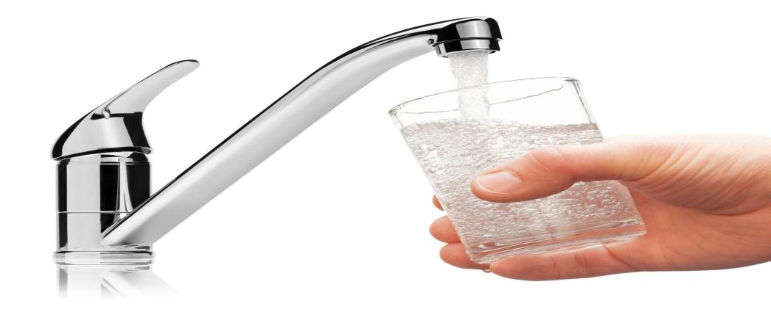
LAVATORIES AND WASHING FACILITIES
Drinking water supply
Employers have a duty to provide an adequate supply of drinking water.
Good drinking facilities and rest places can do much to prevent fatigue and to maintain employees' health.
It is especially important in a hot environment.
  The supply of drinking water facilities or wholesome drinking water such as tap water or drinking fountains should be easy to access.
  Bottled drinking water or other beverages can be alternatives to drinking water facilities.
  They are hygienic and require the least maintenance.
  In a hot environment or summer, it is important to provide cool water. If there is no water cooling device, the water containers can be placed in a cool location of the workplace.

