Slide 1
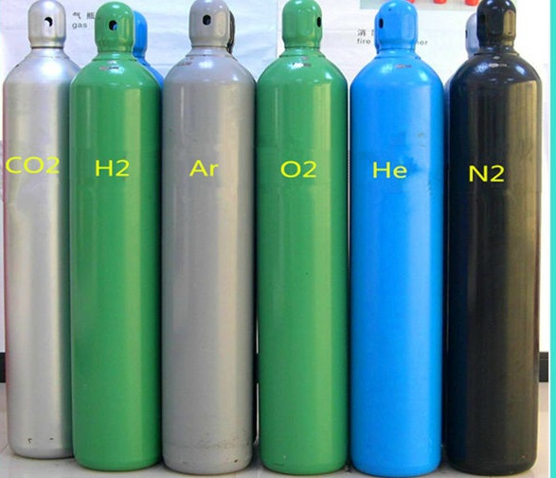
SAFE WORK PRACTICES OF COMPRESSED GAS CYLINDERS

Slide 2
ABOUT PMG
“BUILDING FOOD FACTORIES WITH TOP QUALITY STANDARDS OF NESTLE, MONDELEZ,ABBOTT, DANONE USING 3D DESIGN AND HYGIENIC ENGINEERING.”
At PMG, we deliver Engineering Design and Project Management scopes in Food and Beverage industry. Our team of design engineers and engineering executives has rich experience in Project Planning, Design, Execution and Commissioning with key competencies in areas like 3D Plant Design, Hygienic Engineering, and Project Management. Our safe-by-choice, result-oriented, and pro-active work-ethics allow us deliver work scopes meeting objectives, complete stakeholder alignment and first-time quality.
PMG Knowledge Repository: Targeted Knowledge Sharing & Skill Development
Precise and focused training modules for the exhaustive set of people working in manufacturing industry, instilling qualities of self-belief, creative thinking & widened perspective.
Clear Learning Objectives
Focused approach to skill development and knowledge sharing
Progressive Evaluation
Gauging improvement on every step and keeping audience connected.
After-training follow-ups
We systematically track differential progress of recipients after the training.
Audience Specific Approach
Programs are fine-tuned to the ability and interests of the recipients.
Multiple Awe-moments
Awe-moments are refreshing and increase receptivity many-fold.
Seasoned Trainers
PMG trainers are subject matter experts with substantial work experience.

Slide 3
AGENDA
1
Introduction
2
Definition
3
The three major group of compressed gases
4
Special hazards of certain compressed gases
5
Compressed gases: general requirments
6
Compressed gas cylinder storage
7
Handling and use of cylinders
Notes:
3

Slide 4
AGENDA
8
Regulators
9
Hoses and connections
10
Manifolds
11
Personal protactive equipments
12
Handling emergencies
13
Filling ba (breathing appraratus) cylinders
14
Management systems
Notes:
4

Slide 5
INTRODUCTION
Compressed gases present a unique hazard.
Depending on the particular gas, there is a potential for simultaneous exposure to both mechanical and chemical hazards.
Gases may be Flammable or combustible, Explosive, Corrosive, Poisonous, Inert or a combination of all these hazards.
Hazards of reactivity and toxicity of the gas, as well as asphyxiation, can be caused by high concentrations of even "harmless" gases such as nitrogen.
Since the gases are contained in heavy, highly pressurized metal containers, the large amount of potential energy resulting from compression of the gas makes the cylinder a potential rocket or fragmentation bomb.

Slide 6
DEFINITIONS
Compressed Gas: A material, or mixture of materials, that is a gas at 20°C (68°F) or less at an absolute pressure of 101.325 kPa (14.696 psia) and (2) that has a boiling point of 20°C (68°F) or less at an absolute pressure of 101.325 kPa (14.7 psia) and that is liquefied, nonliquefied, or in solution, except those gases that have no other health or physical hazard properties are not considered to be compressed gases until the pressure in the packaging exceeds an absolute pressure of 280 kPa (40.6 psia) at 20°C (68°F).
Corrosive Gas: A gas that causes visible destruction of or irreversible alterations in living tissue by chemical action at the site of contact.
Flammable Gas: A material that is a gas at 20°C (68°F) or less at an absolute pressure of 101.325 kPa (14.7 psia), that is ignitable at an absolute pressure of 101.325 kPa (14.7 psia) when in a mixture of 13 percent or less by volume with air, or that has a flammable range at an absolute pressure of 101.325 kPa (14.7 psia) with air of at least 12 percent, regardless of the lower limit.

Slide 7
DEFINITIONS
Flammable Gas: A material that is a gas at 20°C (68°F) or less at an absolute pressure of 101.325 kPa (14.7 psia), that is ignitable at an absolute pressure of 101.325 kPa (14.7 psia) when in a mixture of 13 percent or less by volume with air, or that has a flammable range at an absolute pressure of 101.325 kPa (14.7 psia) with air of at least 12 percent, regardless of the lower limit.
Flammable Liquefied Gas: A liquefied compressed gas that, when under a charged pressure, is partially liquid at a temperature of 20°C (68°F) and is flammable.
Inert Gas: A non reactive, non-flammable, non corrosive gas such as argon, helium, krypton, neon, nitrogen, and xenon.
Irritant Gas: A chemical that is not corrosive, but that causes a reversible inflammatory effect on living tissue by chemical action at the site of contact.
Non-flammable Gas: A gas that does not meet the definition of a flammable gas.

Slide 8
DEFINITIONS
Oxidizing Gas: A gas that can support and accelerate combustion of other materials.
Pyrophoric Gas: A gas with an auto ignition temperature in air at or below 54.4°C (130°F).
Toxic Gas: A gas with a median lethal concentration (LC50) in air of more than 200 ppm, but not more than 2000 ppm by volume of gas or vapour, or more than 2 mg/L, but not more than 20 mg/L of mist, fume, or dust, when administered by continuous inhalation for 1 hour (or less if death occurs within 1 hour) to albino rats weighing between 200 g and 300 g (0.44 lb and 0.66 lb) each.
Highly Toxic Gas: A chemical that has a median lethal concentration (LC50) in air of 200 ppm by volume or less of gas or vapour, or 2 mg/L or less of mist, fume, or dust, when administered by continuous inhalation for 1 hour (or less if death occurs within 1 hour) to albino rats weighing between 200 g and 300 g (0.44 lb and 0.66 lb) each.

Slide 9
DEFINITIONS
Unstable Reactive Gas: A gas that, in the pure state or as commercially produced, will vigorously polymerize, decompose, or condense, become self reactive, or otherwise undergo a violent chemical change under conditions of shock, pressure, or temperature.
Hazard Rating: The numerical rating of the health, flammability and self reactivity and other hazards of the material including its reaction with water
Lethal Concentration (LC): Toxic concentration in air which cause death of test animals. LC50: Concentration that killed 50% test animals.
Lethal Dose (LD): Dose which killed test animals. Toxicity of a substance entering the body by ingestion or absorption is measured in lethal dose.
Cylinder: A pressure vessel designed for pressures higher than 276 kPa (40 psia) and having a circular cross section. It does not include a portable tank, multiunit tank car tank, cargo tank, or tank car.

Slide 10
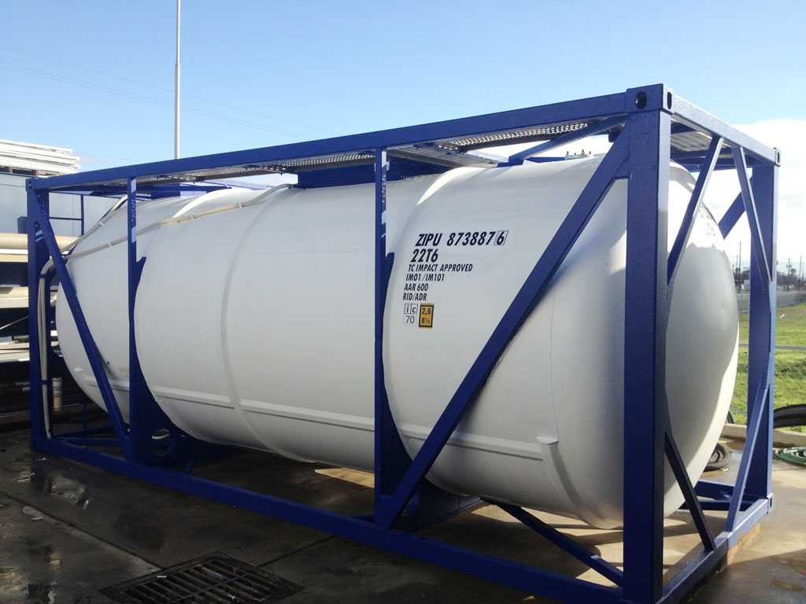
DEFINITIONS
Portable Tank: Any packaging over 227.1 L (60 gal) capacity designed primarily to be loaded into or on, or temporarily attached to, a transport vehicle or ship and equipped with skids, mountings, or accessories to facilitate handling of the tank by mechanical means.

Slide 11
THE THREE MAJOR GROUP OF COMPRESSED GASES
There are three major groups of compressed gases stored in cylinders:
  liquefied,
  non- liquefied and
  dissolved gases.
In each case, the pressure of the gas in the cylinder is commonly given in units of kilopascals (kPa) or pounds per square inch gauge (psig).
Gauge pressure = Total gas pressure inside cylinder - atmospheric pressure Atmospheric pressure is normally about 101.4 kPa (14.7 psi).
Note that compressed gas cylinder with a pressure gauge reading of 0 kPa or 0 psig is not really empty.
It still contains gas at atmospheric pressure.

Slide 12
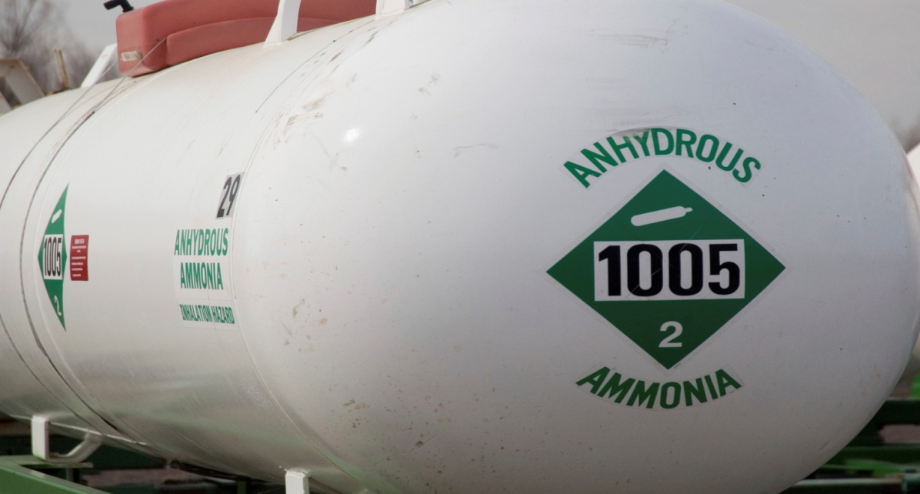
THE THREE MAJOR GROUP OF COMPRESSED GASES
Liquefied Gases
Liquefied gases are gases which can become liquids at normal temperatures when they are inside cylinders under pressure.
They exist inside the cylinder in a liquid-vapour balance or equilibrium.
Initially the cylinder is almost full of liquid, and gas fills the space above the liquid.
As gas is removed from the cylinder, enough liquid evaporates to replace it, keeping the pressure in the cylinder constant.
Anhydrous ammonia, chlorine, propane, nitrous oxide and carbon dioxide are examples of liquefied gases.

Slide 13
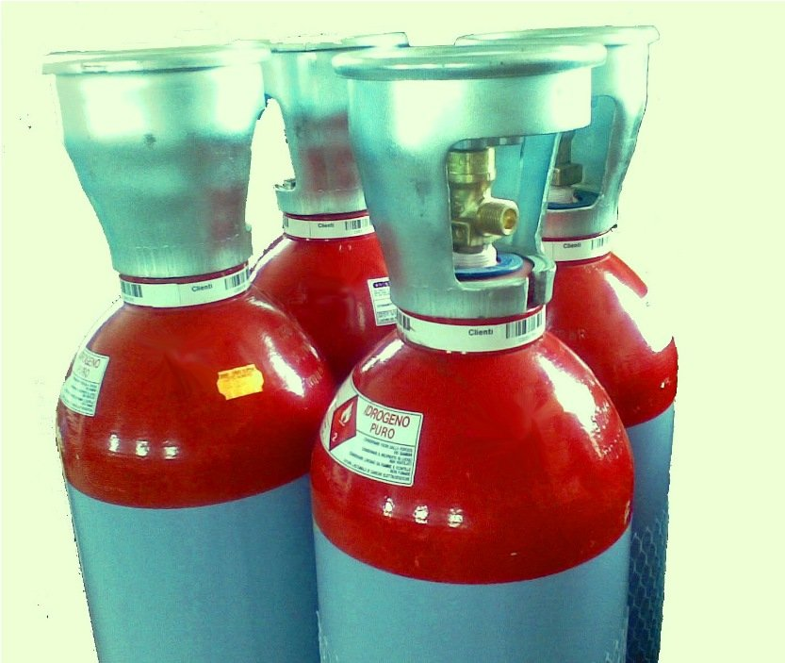
THE THREE MAJOR GROUP OF COMPRESSED GASES
Non-Liquefied Gases
Non-liquefied gases are also known as compressed, pressurized or permanent gases.
These gases do not become liquid when they are compressed at normal temperatures, even at very high pressures.
Common examples of these are oxygen, nitrogen, helium and argon.

Slide 14
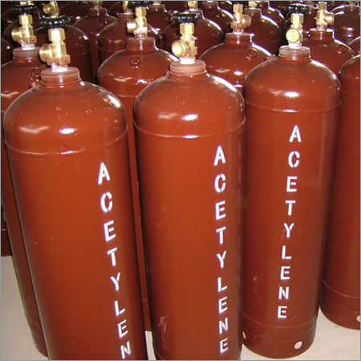
THE THREE MAJOR GROUP OF COMPRESSED GASES
Dissolved Gases
Acetylene is the only common dissolved gas.
Acetylene is chemically very unstable.
Even at atmospheric pressure, acetylene gas can explode.
Nevertheless, acetylene is routinely stored and used safely in cylinders at high pressures (up to 250 psig at 21°C).
This is possible because acetylene cylinders are fully packed with an inert, porous filler.
The filler is saturated with acetone or other suitable solvent.
When acetylene gas is added to the cylinder, the gas dissolves in the acetone.
Acetylene in solution is stable.

Slide 15
THE THREE MAJOR GROUP OF COMPRESSED GASES
Pressure hazards
All compressed gases are hazardous because of the high pressures inside the cylinders.
Gas can be released deliberately by opening the cylinder valve, or accidentally from a broken or leaking valve or from a safety device.
Even at a relatively low pressure, gas can flow rapidly from an open or leaking
cylinder.
There have been many cases in which damaged cylinders have become uncontrolled rockets or pinwheels and have caused severe injury and damage.
This danger has happened when unsecured, uncapped cylinders were knocked over causing the cylinder valve to break and high pressure gas to escape rapidly.
Most cylinder valves are designed to break at a point with an opening of about 0.75 cm (0.3 inches).
This design limits the rate of gas release and reduces cylinder velocity. This limit may prevent larger, heavier cylinders from "rocketing" although smaller or lighter cylinders might take off.
Poorly controlled release of compressed gas in chemical reaction systems can cause vessels to burst, create leaks in equipment or hoses, or produce hrunaway reactions.

Slide 16
SPECIAL HAZARDS OF CERTAIN COMPRESSED GASES
Fire and explosion hazards
Flammable Gases- such as acetylene, butane, ethylene, hydrogen etc., can burn or explode under certain conditions:
  Gas Concentration within the Flammable Range: The concentration of the gas in air (or in contact with an oxidizing gas) must be between its lower flammable limit (LFL) and upper flammable limit (UFL) [sometimes called the lower and upper explosive limits (LEL and UEL)].
  For example, the LFL of hydrogen gas in air is 4 percent and its UFL is 75 percent (at atmospheric pressure and temperature). This means that hydrogen can be ignited when its concentration in the air is between 4 and 75 percent.
  A concentration of hydrogen below 4 percent is too "lean" to burn.
  Hydrogen gas levels above 75 percent are too "rich" to burn.
  The flammable range of a gas includes all of its concentrations in air between the LFL and UFL.
  The flammable range of any gas is widened in the presence of oxidizing gases such as oxygen or chlorine and by higher temperatures or pressures. For example, the flammable range of hydrogen in oxygen gas is 4 to 85 percent and the flammable range of hydrogen in chlorine gas is 4.1 to 89 percent.

Slide 17
SPECIAL HAZARDS OF CERTAIN COMPRESSED GASES
Oxidizing Gases
Oxidizing gases include any gases containing oxygen at higher than atmospheric concentrations (above 23-25 percent), nitrogen oxides, and halogen gases such as chlorine and fluorine. These gases can react rapidly and violently with combustible materials such as the following:
  organic (carbon-containing) substances such as most flammable gases,
  flammable and combustible liquids, oils, greases, many plastics and fabrics
  finely-divided metals
  other oxidizable substances such as hydrazine, hydrogen, hydrides, sulphur or sulphur compounds, silicon and ammonia or ammonia compounds.
Fires or explosions can result from the above reactions.
The normal oxygen content in air is 21 percent.
At slightly higher oxygen concentrations, for example 25 percent, combustible materials, including clothing fabrics, ignite more easily and burn much faster. Fires in atmospheres enriched with oxidizing gases are very hard to extinguish and can spread rapidly.

Slide 18
SPECIAL HAZARDS OF CERTAIN COMPRESSED GASES
Dangerously Reactive Gases
  Some pure compressed gases are chemically unstable.
  If exposed to slight temperature or pressure increases, or mechanical shock, they can readily undergo certain types of chemical reactions such as polymerization or decomposition.
  These reactions may become violent, resulting in fire or explosion.
  Some dangerously reactive gases have other chemicals, called inhibitors, added to prevent these hazardous reactions.
  Common dangerously reactive gases are acetylene, methyl acetylene, vinyl chloride, tetrafluoroethylene etc.
Health hazards
  Many compressed gases are toxic or very toxic.
  They could cause various health problems depending on the specific gas, its concentration, the length of exposure and the route of exposure (inhalation, eye or skin contact).
  Contact between the skin or eye and liquefied gases in liquid form can freeze the tissue and result in a burn-like injury.

Slide 19
SPECIAL HAZARDS OF CERTAIN COMPRESSED GASES
Danger of inert gas
  Inert gases, such as argon, helium, neon and nitrogen, are not toxic and do not burn or explode.
  Yet they can cause injury or death if they are present in sufficiently high concentrations.
  They can displace enough air to reduce oxygen levels.
  If oxygen levels are low enough, people entering the area can lose consciousness or die from asphyxiation.
  Low oxygen levels can particularly be a problem in poorly ventilated, confined spaces.

Slide 20
SPECIAL HAZARDS OF CERTAIN COMPRESSED GASES
Corrosive hazards
  Some compressed gases are corrosive.
  They can burn and destroy body tissues on contact.
  Corrosive gases can also attack and corrode metals. Common corrosive gases include ammonia, hydrogen chloride, chlorine and methylamine.
Cryogenic Liquids and Gases
  Cryogenic liquids and their boil-off vapors rapidly freeze human tissue and cause embrittlement of many common materials which may crack or fracture under stress.
  All cryogenic liquids produce large volumes of gas when they vaporize and may create oxygen-deficient conditions. Examples of common cryogenic liquids include liquid oxygen, hydrogen etc.

Slide 21
COMPRESSED GAS CYLINDERS: GENERAL REQUIREMENTS
Following requirements, which are inline with the relevant international standard shall be followed while storing, handling and using of compressed gas cylinders.
  The name of the gas and chemical formula or symbol shall be clearly and legibly marked preferably on the neck (or upper half) of the cylinder.
  Letter height shall be 5mm minimum and marking shall not be readily Removable.
  Inspect all incoming cylinders before storing to ensure they are undamaged and properly labelled.
  Do not accept delivery of defective cylinders.
  Be sure they are not giving off odours, visible fumes or hissing sounds.
  Check that the cylinder was last tested within the required time.
  Also check that the cylinder labels are intact and that they match other identifying markings on the cylinder.
  Each cylinder shall have valid Inspection & hydro test certificate by an approved third party and the hydro test date/ validity shall be stamped on the cylinder neck.
  Cylinders in possession do not exceed due test date.

Slide 22
COMPRESSED GAS CYLINDERS: GENERAL REQUIREMENTS
  The gas cylinder supplier has to provide gas composition analysis certificate along with the cylinder.
  The certificate should contain as a minimum, cylinder number, cylinder valve type, date of certificate, method of preparation, method of analysis, accuracy, gas composition analysis results etc.
  Identification of the gas content of a cylinder is given by the labels on the cylinder and may be confirmed by reference to the colour of the cylinder.
  However, cylinder colours may change from vendor to vendor.
  It is important to read the cylinder label to identify the cylinder contents and not to rely upon the colour of the cylinder; this should only be a secondary means of identifying a cylinder's contents.
  In addition, colours appear different under artificial lights and some people are colour blind.
  The basic principle of color-coding is to use yellow marking to represent toxic gas, red for flammable gas, bright green for inert gas and light blue for oxidizing gas Also, never rely on labels on caps because caps are interchangeable.

Slide 23
COMPRESSED GAS CYLINDERS: GENERAL REQUIREMENTS
  No compressed gas cylinder should be accepted for use that does not legibly identify its contents by name.
  If the labelling on a cylinder becomes unclear the cylinder should be marked “contents unknown” and returned to the supplier.
  Hazard warning labels shall be displayed on the cylinder.
  Users shall be fully aware of the hazards, precautions and emergency actions.
  Valve of the cylinder shall be protected by a cap, or a collar or a recess.
  All liquefied gas cylinders shall be kept upright with their valve ends up.
  These shall be secured against fall by using suitable cylinder stands or chains.
  Empty cylinders shall be marked ‘EMPTY’ or ‘MT’ and kept separately from full cylinders to avoid confusion and mistakes.
  Cylinders shall not be subjected to contact with direct flame, electric arc, molten metal, and other sources of heat, corrosive material or corrosive Environment.
  Measures shall be taken to prevent grit, dirt, oil, grease or water from entering through the cylinder valves.
  Safety devices in valves or cylinders shall not be tampered with.
  Rusted or dented cylinders must not be used.

Slide 24
COMPRESSED GAS CYLINDER STORAGE
General
Store compressed gas cylinders separately, away from processing and handling areas, and from incompatible materials. Separate storage can minimize personal injury and damage in case of fires, spills or leaks.
Many compressed gases can undergo dangerous reactions if they come in contact with incompatible materials (gases, liquids or solids), so store them apart from each other. For example, store oxidizing gases at least 6 metres (20 feet) away from fuel gases or other combustible materials, or separate them with an approved fire wall.
Check the reactivity information and storage requirements sections of the MSDS for details about which materials are incompatible with a particular compressed gas.
Hazard identification signs shall be placed at all entrances to locations where compressed gases are stored or used.
Electrical fittings for the storage area shall conform to Area Classification requirements.
If compressed gas cylinders are stored outside, use a well-drained, securely fenced area.
Keep them on a raised concrete pad or non-combustible rack.
Protect cylinders from the weather and do not allow them to stand directly on wet soil as this can cause corrosion.

Slide 25
COMPRESSED GAS CYLINDER STORAGE
General
Indoor storage areas must have walls, floors and fittings made of suitable materials.
For example, use non-combustible building materials in storage areas for oxidizing gas and corrosion-resistant materials in storage areas for corrosive gas.
Make sure floors are level and protect cylinders from dampness.
Avoid overcrowding in storage areas or storing cylinders in out-of-the-way locations.
Always chain or securely restrain cylinders in an upright position to a wall, rack or other solid structure wherever they are stored, handled or used.
Securing each cylinder individually is best. Stacking of groups of cylinders together offers some protection, but if this is done improperly, the entire group or individual cylinders could fall.
Containers or cylinders with a water volume of 5 L (1.3 gal) or less shall be permitted to be used in a horizontal position. Store compressed gas cylinders in areas which are:
  dry, cool, out of direct sunlight and away from steam pipes, boilers or other heat sources.
  fire-resistant and supplied with suitable fire fighting equipment including sprinklers, where appropriate
  accessible at all times, but away from elevators, staircases or main traffic routes where cylinders may be dangerous obstacles

Slide 26
COMPRESSED GAS CYLINDER STORAGE
General
Always store full cylinders separately from empty cylinders.
Follow the MSDS recommendations for storage and use.
Recommended PPE shall be available at the place of storage and use.
To prevent excessive pressure buildup, never expose cylinders to temperatures above 52°C (125°F).
Do not subject them to temperatures below -29°C (-20°F), unless they are designed for this.
Cylinders that become frozen to a surface can be freed by using warm water (less than 52°C).
Never apply direct heat to a cylinder.
Chlorine storage and use areas shall have emergency handling kit readily available.
At all times:
  Allow only trained, authorized people into storage areas.
  Keep the amount of compressed gases in storage as minimum as possible.
  Inspect storage areas regularly for any deficiencies such as damaged or leaking cylinders and poor housekeeping.
  Correct all deficiencies as soon as possible.

Slide 27
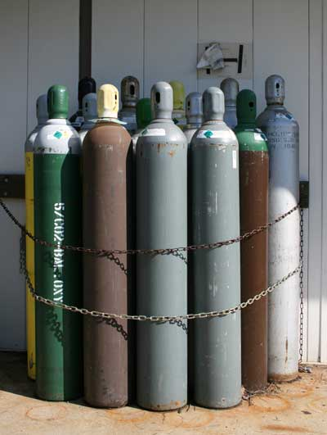
COMPRESSED GAS CYLINDER STORAGE
General
Acetylene cylinders must never be stored on their sides.
Always place valve protectors on gas cylinders when the cylinders are not connected for use.

Slide 28
COMPRESSED GAS CYLINDER STORAGE
Ventilation
Indoor storage and use areas and storage buildings for compressed gases and cryogenic fluids shall be provided with mechanical exhaust ventilation or natural ventilation, where natural ventilation is adequate for the material as stored.
Mechanical Ventilation. Where mechanical ventilation is provided, the system shall be operational during the time the building or space is occupied.
Inlets to the Exhaust System.
  The exhaust ventilation system design shall take into account the density of the potential gases released.
  For gases that are heavier than air, exhaust shall be taken from a point within 12 in. (304.8 mm) of the floor.
  For gases that are lighter than air, exhaust shall be taken from a point within 12 in. (304.8 mm) of the ceiling.
Floor Level Exhaust. The location of both the exhaust and inlet air openings shall be designed to provide air movement across all portions of the floor or room to prevent the accumulation of vapors.

Slide 29
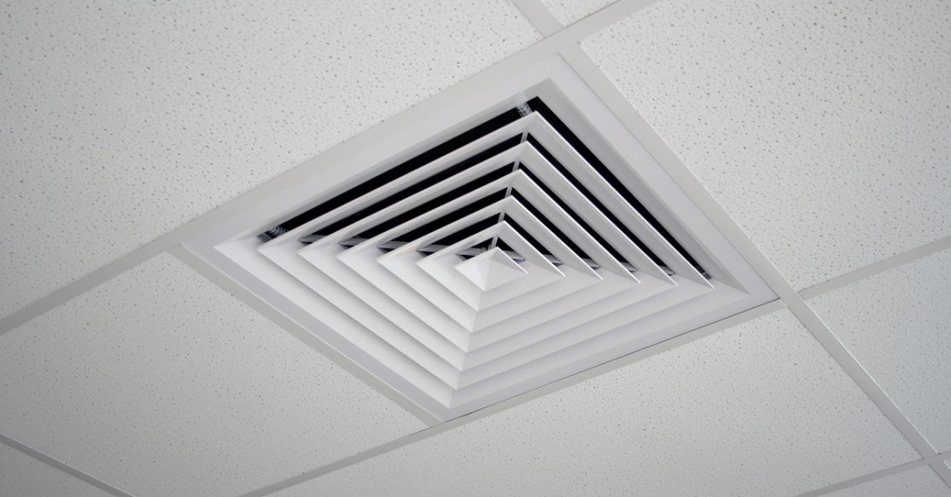
COMPRESSED GAS CYLINDER STORAGE
Ventilation
Recirculation of Exhaust. Exhaust ventilation shall not be re-circulated within the room or building if the cylinders, containers, or tanks stored are capable of releasing hazardous gases.
Ventilation Discharge. Ventilation systems shall discharge at a minimum of 15m(50 ft) from intakes of air-handling systems, air-conditioning equipment and air compressors.

Slide 30
HANDLING AND USE OF CYLINDERS
General Precaution
Never open a damaged valve.
Contact the gas cylinder supplier for advice.
Never subject a gas cylinder to abnormal heat.
Never strike, damage, weld, or attempt to repair a compressed gas cylinder.
In general, do not lubricate any cylinder valves, fittings, or regulator threads, or apply jointing compounds and tape.
Use only lubricants and sealants recommended by the gas supplier.
Oxygen cylinder and its fittings shall be kept away from oil and grease and shall not be handled with oily hands, gloves or clothing.
Metal cap to protect cylinder valve shall only be removed immediately prior to use.
Cap shall be preferably chained to avoid loss.
Use only recommended keys or hand wheel to open valves.
Never use longer keys or modify keys to increase their leverage.
Avoid using even the correct key if it is badly worn.
Do not use pipe wrenches or similar tools on hand wheels.
Any of these practices could easily damage the valve seat or spindle.

Slide 31
HANDLING AND USE OF CYLINDERS
General Precaution
Before making connection to a cylinder valve outlet, the valve should be cracked open for an instant to blow away dust particles.
The valve opening shall be pointed away from personnel and sources of ignition.
Grit, dirt, oil or dirty water should not be allowed to enter cylinder valve sockets.
Verify that adjusting screw of the regulator is closed (turn counter clockwise) before opening cylinder valve.
Always open valves on all gas discharge equipment slowly.
Rapid opening of valves results in rapid compression of the gas in the high-pressure passages leading to the seats.
The rapid compression can lead to temperatures high enough to burn out the regulator and valve seats.
Many accidents involving oxidizing gases result from burned out regulator and valve seats, usually caused by opening valves too quickly.
Do not use excessive force when opening cylinder valves--use no more than three quarters of a turn if possible. If a problem develops, the valve can then be closed quickly.
Do not strike by a hammer to open the valve.

Slide 32
HANDLING AND USE OF CYLINDERS
General Precaution
Leave keys on cylinders when valves are open so the valve can be closed quickly in an emergency.
Some cylinder valves, such as oxygen valves, have double seating.
These valves should be fully opened, otherwise they may leak.
When closing, turn it just enough to stop the gas flow completely.
Never force the valve shut.
Close cylinder valves when the cylinder is not actually in use.
Do not stop the gas flow from a cylinder by just backing off on the regulator.
Regulators can develop seat leaks, allowing pressure to build up in equipment attached to the regulator.
Close the cylinder valve first and then close the regulator.
Use the smallest practical cylinder size for a particular job.
Do not keep cylinders for longer periods than the supplier recommends.
Do not drop cylinders or otherwise allow them to strike each other.
Rough handling, including using cylinders as hammers or as rollers to move equipment, can seriously damage them.

Slide 33
HANDLING AND USE OF CYLINDERS
General Precaution
Do not strike an electric arc on a cylinder. Arc burns can make the metal brittle and weaken the cylinder.
Never tamper with cylinders in any way.
Do not repaint them, change markings or identification, or interfere with valve threads or safety devices.
Maintain good housekeeping at all times in the workplace:
  Never hang clothes or equipment over a compressed gas cylinder.
  Never use oxygen or even compressed air to remove dust from clothing or equipment.
  Promptly remove combustible wastes including wood, paper or rags, from the work area.
  Properly and promptly dispose of "empty" or unlabelled cylinders.
When moving cylinders, securely fasten them to a suitable cylinder transporting device.
Smaller cylinders weighing less than 20 kilos may be rolled on bottom edge but shall not be dragged.

Slide 34
HANDLING AND USE OF CYLINDERS
General Precaution
When cylinders are transported by powered vehicles, they shall be secured in a vertical position.
Always have the protective cap covering the valve when transporting the cylinder.
Never transport the cylinder with the regulator in place.
Make sure the cylinder is secured to the vehicle/cart before moving it.
Do not use the valve cover to lift cylinders; they could be damaged and become unattached
At the site, chain or otherwise secure the cylinder in place.
Remove the valve cap only after the cylinder has been safely installed, then check the cylinder valve and fixture.
Remove any dirt or rust. Grit, dirt, oil or dirty water can cause gas leaks if they get into the cylinder valve or gas connection.
A cylinder should never be emptied to a pressure lower than 172 kPa (25 psi) (the residual contents may become contaminated if the valve is left open).
Valves of empty cylinders shall be closed and valve protection caps replaced before returning to warehouse/suppliers.

Slide 35
REGULATORS
Regulators or pressure reducing valves shall be used on all gas cylinders to maintain a uniform gas supply at the desired pressure.
There are two basic types of automatic pressure regulators: single-stage, and double- or two-stage.
Generally, two-stage regulators deliver a more constant pressure under more precise conditions than single-stage regulators.
Sometimes, manual flow controls are used on non-liquefied gases.
Fine flow control can be obtained, but an operator must be present at all times.
Manual flow controls do not automatically adjust to pressure build-ups in blocked systems.
  Regulators are delicate piece of equipment and shall be handled carefully.
  It shall not be dropped or subjected to shock.
  The threads on regulator or any other fitting shall match to those on the cylinder valve outlet.
  Force shall not be used on connections that do not fit.
  Only regulators listed by international agencies e.g.
  UL or FM shall be used.

Slide 36
REGULATORS
  Oxygen regulator shall be equipped with a safety relief valve or shall be so designed that broken parts will not fly in the event of a diaphragm rupture.
  Flash back arrestors and hose check valves shall be fitted to both oxygen and fuel gas regulators.
  Refer document :Safe Work Practices on Welding & Cutting for sketch.
  Regulators designed for oxygen shall not be used for fuel gases or vice versa.
  To protect against this hazard the regulators are painted in different colour and are provided with different threads. Right hand threads are provided for regulators to be used with oxygen and non-combustible gases, while left-hand threads are provided for acetylene and combustible gases.
  Leaky or "creeping" regulators are a source of hazard and shall not be used without being repaired.
  A leak or creep is indicated by a steady build-up of pressure on low pressure gauge when consumption is not taking place.
  Repair to the regulator shall be done by authorized service personnel only.
  When regulators are connected and not in use, the pressure adjusting device should be released.

Slide 37
HOSES AND CONNECTIONS
Separate hoses shall be used for fuel gases and oxygen with different colour and shall not be interchangeable.
Use of unnecessary long hose shall be avoided. Where long hoses are used, care should be taken that they do not become kinked or tangled.
Leaking hoses normally shall not be repaired.
However for emergency situations on temporary basis leaking hoses shall be repaired by cutting the hose and inserting a splice.
They shall not be repaired using tapes.
Hose shall be protected from hot/sharp objects, grease and oil.
They shall be stored in a cool place.
When oxygen and acetylene hoses are taped together for convenience, not more than 4 inch of each 12-inch length should be taped.
Right hand threaded fittings should be used for oxygen.
Left hand threaded fittings should be used for fuel gases.

Slide 38
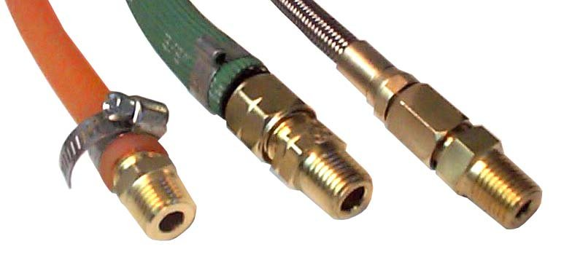
HOSES AND CONNECTIONS
Connections for joining the hose nipple to the torches and regulators shall be either the ferrule or clamp type.
Gaskets shall not be used. Lengths of hoses with the ends firmly attached to nipples having screwed unions suitable for connecting to standard regulator outlets and torch inlets should be preferred.
Hoses shall be inspected daily prior to use and checked for cuts, cracks, wear and tear and physical deterioration. Damaged hoses shall not be used.
Hoses should be laid in an orderly manner to avoid damage and tripping hazards.
Hoses should be removed from the regulator only after closing the cylinder valves and residual gas is released from the regulator.

Slide 39
MANIFOLDS
Cylinders are manifold to centralize the gas supply and to provide gas continuously, at a higher rate than possible from a single cylinder.
  Manifolds of suitable design for particular gas and service shall be selected.
  Manifold shall be obtained from and installed under the supervision of a reliable manufacturer or Contractor familiar with safe practices in construction and use of manifolds.
  Inspection & Corrosion shall approve the design drawing and fabrication of the manifold system respectively.
  Manifolds shall be inspected and pressure tested at an interval of 5 yrs as per Inspection procedure and due date of next inspection shall be marked.
  Maintenance Planning will arrange for the inspection.
  One or more permanently mounted regulators shall be provided to reduce and regulate the pressure of the gas flowing from the manifold.
  Oxygen manifolds shall be located away from flammable material.
  Oxygen manifold shall not be located in close proximity to cylinders of flammable gases.

Slide 40
MANIFOLDS
Piping
The following rules shall be followed in regard to piping:
  Copper piping shall not be used for acetylene and ammonia.
  Plastic piping shall not be used for any portion of a high-pressure system.
  Cast iron piping shall not be used for chlorine.
  Distribution lines shall not be concealed where a high concentration of a leaking hazardous gas can build up and cause an accident.
  Distribution lines and their outlets should be clearly labelled as to the type of gas contained.
  Piping systems should be inspected for leaks on a regular basis.
  Special attention should be given to fittings as well as possible cracks that may have developed.

Slide 41
PERSONAL PROTECTIVE EQUIPMENT
If other methods, such as engineering controls, are not available or effective in controlling exposure to compressed gases, wear suitable personal protective equipment (PPE).
Choosing the right PPE for a particular job is essential. Material Safety Data Sheets MSDSs) should provide general guidance.
Avoid Skin Contact
  When using gases that are harmful by skin contact, wear protective gloves, aprons or other clothing depending on the risk of skin contact.
  Choose clothing made of materials that resist penetration or damage by the chemical.
  Refer MSDS for recommended materials.
Protect Your Eyes and Face
  Always wear eye protection when working with compressed gases.
  Use safety goggles.
  MSDS will specify additional eye/face protection if required.

Slide 42
PERSONAL PROTECTIVE EQUIPMENT
Avoid Breathing Harmful Gases
  If respirators must be used for breathing protection, these should be as per respiratory protection program.
  Sorbents in air-purifying respirator cartridges and canisters must be compatible with the chemical they are supposed to protect against.
  For example, oxidizable sorbents, such as activated charcoal, may not be acceptable if high concentrations of oxidizing gases are present.
  A hazardous reaction might occur. Keep in mind that air-purifying respirators do not protect against oxygen-deficient environments.
  Know and be familiar with the right PPE for use in emergencies as well as during normal operations

Slide 43
HANDLING EMERGENCIES
Minor leak shall be arrested by tightening the packing nut or closing the cylinder valve.
  If the above does not stop the leak or the leak occurred from fuse plug or other safety device, cylinder shall be moved outdoors to a well ventilated area away from any source of ignition.
  The contents of the cylinder should be allowed to disperse into the atmosphere under carefully controlled and supervised conditions.
  If it cannot be moved, location shall be evacuated and area barricaded.
  Minor fire shall be extinguished if possible, by closing the cylinder valve or use of water, wet cloth, or fire extinguisher.
  Leak shall be attended thereafter.
  If the fire results from an unstoppable leak, cylinder shall be kept wet by water fog and allowed to burn in controlled manner.
  If the cylinder is engulfed in external fire, it shall be kept wet and removed if possible.
  Use of water is not advised in all cases.

Slide 44
HANDLING EMERGENCIES
Act fast in emergencies such as chemical fires or gas cylinder leaks:
  Evacuate the area at once if you are not trained to handle the problem or if it is clearly beyond your control.
  Alert other people in the area to the emergency.
  Call ECCC immediately.
  Obtain first aid and remove all contaminated clothes if you have been exposed to harmful chemicals.

Slide 45
HANDLING EMERGENCIES
Act fast in emergencies such as chemical fires or gas cylinder leaks:
  Evacuate the area at once if you are not trained to handle the problem or if it is clearly beyond your control.
  Alert other people in the area to the emergency.
  Obtain first aid and remove all contaminated clothes if you have been exposed to harmful chemicals.
  Filling ba air cylinders
  Air cylinders used as part of Breathing apparatus are being filled at Fire stations.
  The safety precautions for filling cylinders will vary with each brand of air compressor.
  Different make of compressors are used at the refineries.
  The precautions may vary depending on the specific make and the Operating manual of the compressor shall be referred for the same.
  The precautions mentioned below are general in nature. Follow all cautions, warnings, and procedures contained in the Compressor operation Instructions.

Slide 46
HANDLING EMERGENCIES
  Only trained personnel may store, fill, maintain, handle, use or dispose of cylinders.
  Use personal protective equipment, such as safety glasses, gloves, safety shoes and hard hat, when filling and handling cylinders.
  Make certain the cylinder retest date has not expired.
  Sometimes the manufacturers recommend that the cylinder be filled or "topped off" inside a suitable enclosure or in a way that prevents injury and property damage; the same shall be followed.
  Cylinders should be handled carefully when charged and stored properly.
  The potential for mass energy release exists if the valve is dislodged or cylinder is punctured.
  Inspect the exterior of the cylinder for dents, gouges or rusted areas, and evidence of exposure to high temperature such as darkened or blistered paint, charred decals, melted or distorted gauge lens, etc. Do not fill damaged cylinders.
  Inspect valve for damage and ease of operation.

Slide 47
HANDLING EMERGENCIES
  Certain compressor manufacturers recommend that the cylinder may be partially immersed (DO NOT submerge the cylinder valve) in a water bath to minimize the temperature rise that occurs as the cylinder is filled.
  The filler hose (for certain make) should be equipped with a restraining cable to prevent uncontrolled “whipping” in case of hose failure.
  Fill the cylinder slowly. Monitor pressure during filling carefully.
  DO NOT exceed maximum service pressure which is stamped on shoulder or collar of the cylinder.
  When compressor is in “ON” position, it will cycle on and off as needed.
  Do not open front cage of filling station unless main compressor switch is in “OFF” position.

Slide 48
HANDLING EMERGENCIES
Support Resources
  SH&E Dept. shall assist in the implementation of this document.
Management Records
  All records must be maintained in compliance with this document
Audit requirements
  Application of this document must be audited as part of Safety Performance audits to assure compliance.
Document renewal process
  This document must be reviewed and revised as necessary and, at a minimum, not later than 3 years from the date of the latest revision.
Deviation process
  Deviations from this document must be approved by EAMD after consultation with SH&E Department. Deviations must be documented, and documentation must include the relevant facts supporting the deviation decision.

Slide 49

About PMG Consultants
PMG Consultants is group of competent people with expertise in respective domains. Delivering commitments, exceeding expectations & creating value for clients in every interaction is our non-negotiable objective. Using the most advanced design & collaboration work systems, we aspire to become Inspirational business partners for our clients.
Get in touch
We would love to hear from you. Gauge our capabilities by speaking to us. You can visit us at our New Delhi Design Office, or meet our representative at your location.
Our Office
Address:
162A/9, 3rd Floor, Kishangarh,
Vasant Kunj, , New Delhi, 110070
Phone: +91-9871115995, +91-11-23361790
Email: connect@pmg-consultants.com
abhinav.pandey@pmg-consultants.com

