Slide 1
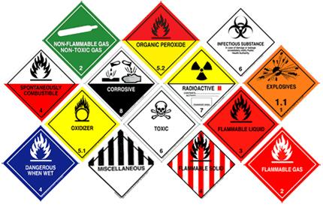
HANDLING AND STORAGE
OF
HAZARDOUS MATERIALS

Slide 2
ABOUT PMG
“BUILDING FOOD FACTORIES WITH TOP QUALITY STANDARDS OF NESTLE, MONDELEZ,ABBOTT, DANONE USING 3D DESIGN AND HYGIENIC ENGINEERING.”
At PMG, we deliver Engineering Design and Project Management scopes in Food and Beverage industry. Our team of design engineers and engineering executives has rich experience in Project Planning, Design, Execution and Commissioning with key competencies in areas like 3D Plant Design, Hygienic Engineering, and Project Management. Our safe-by-choice, result-oriented, and pro-active work-ethics allow us deliver work scopes meeting objectives, complete stakeholder alignment and first-time quality.
PMG Knowledge Repository: Targeted Knowledge Sharing & Skill Development
Precise and focused training modules for the exhaustive set of people working in manufacturing industry, instilling qualities of self-belief, creative thinking & widened perspective.
Clear Learning Objectives
Focused approach to skill development and knowledge sharing
Progressive Evaluation
Gauging improvement on every step and keeping audience connected.
After-training follow-ups
We systematically track differential progress of recipients after the training.
Audience Specific Approach
Programs are fine-tuned to the ability and interests of the recipients.
Multiple Awe-moments
Awe-moments are refreshing and increase receptivity many-fold.
Seasoned Trainers
PMG trainers are subject matter experts with substantial work experience.

Slide 3
AGENDA
1
Introduction
2
Definitions
3
Classifications
4
Hazmat information & responsibilities
5
Flammable & combustible liquids
6
Flammable solids
7
Poisons (toxic materials)
8
Corrosive materials
9
Radioactive materials
Notes:
3

Slide 4
INTRODUCTION.
“Hazardous Material” means a substance or material, which is capable of posing an unreasonable risk to health, environment and property.
Explosives, Oxidizers, Corrosives, Compressed gases and Flammable liquids etc. Are considered as Hazardous Materials.
This Chapter discusses the storage and day to day handling of various types of hazardous materials
When properly handled, stored and transported, these materials constitute no hazard. but, experience teaches us that human error; structural failure etc. can create situations harmful to the well being of man and his environment.
Because of the dissimilarity of the hazardous materials, prior knowledge and training is required to have an effective control on any hazardous materials emergencies.

Slide 5
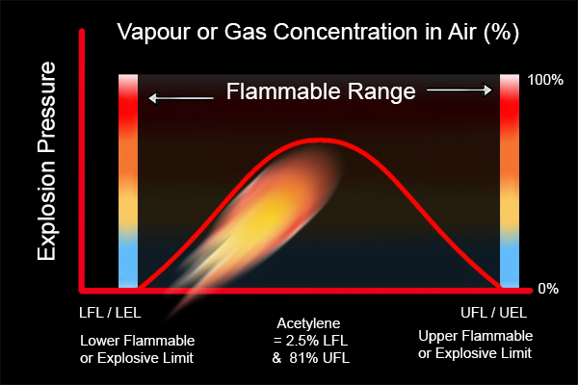
DEFINITIONS
Flammable (explosive) limits
Lower Explosive / Flammable Limit (LEL / LFL)
  Minimum concentration of vapor or gas in air which will burn when a source of ignition (spark) is introduced.
  Note-1: Flammable Gas Detectors (Meters) measure % LEL, hence actual LEL means 100% or full-scale reading of the meter. Below LEL (100% of meter reading), a mixture is “too lean” to burn.
  Note-2: LEL of airborne combustible dust: If the dust obscures vision at a distance of 5 feet (1.52 m) or less it is considered as at LEL (ex. sulphur or coke).
Upper Explosive / Flammable Limit (UEL / UFL)
  Maximum vapor/gas to air concentration above which flame propagation will not occur, i.e. the mixture is “too rich” to burn.

Slide 6
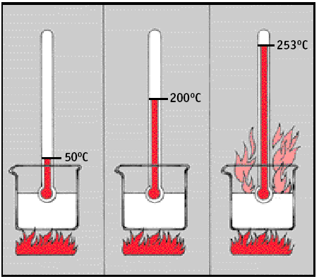
DEFINITIONS
Flash point & auto ignition temperature
Flash Point (FP)
  Minimum temperature at which a flammable mixture of gas or vapor in air will momentarily flash when a source of ignition (spark) is introduced
Auto Ignition Temperature (AIT or IT)
  Minimum temperature required to initiate self-sustained combustion of a solid, liquid or gas in the absence of a source of ignition

Slide 7
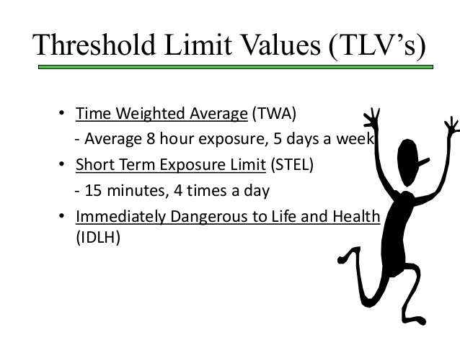
DEFINITIONS
Threshold limit value (tlv)
Atmospheric concentration of a contaminant to which, most workers may be exposed.
  TLV-TWA- Time Weighted Average concentration of the contaminant in air over the normal work shift of 8 hours, to which workers can be exposed without respiratory protection in a 40-hour workweek
TLV-STEL- Short Term Exposure Limit when exposed only for a short period of 15 minutes.
  This maximum concentration can be allowed to breathe 4 times during 8 hours with minimum 1-hour interval between exposures.
IDLH-Minimum concentration of contaminant in air which is Immediately Dangerous to Life and Health. (Note: Air supplied respirators are required in IDL H atmospheres.)

Slide 8
DEFINITIONS
Toxicity
Toxicity of a material entering the body by inhalation is measured in Toxic and Lethal Concentrations (i.e. TC & LC for gases, vapor or dust).
  TC (Toxic Concentration)
    Minimum toxic concentration in air which cause toxic effect
  LC (Lethal Concentration)
    Toxic concentration in air which cause death of test animals Toxicity of a substance entering the body by ingestion or absorption is measured in Toxic and Lethal Doses (i.e. TD & LD for liquids, etc).
  TD (Toxic Dose)
    Minimum dose to cause toxic effects
  LD (Lethal Dose)
    Dose which killed test animals (ex. LD50 = dose or the amount that killed 50% of test animals)

Slide 9
CLASSIFICATIONS
Flammable gases
  The flammable gases have flash point below room temperature and will form explosive mixture with air or oxygen within the lower & upper explosive limits (e.g. Hydrogen, light hydrocarbons like propane & acetylene).
Flammable and combustible liquids
  Flammable liquid
    A liquid having a closed-cup flash point below 100 0F (37.80C) and having a Reid Vapor Pressure (RVP) not exceeding 40 psia (2068.6 mm Hg) at 100oF (37.80C). (e.g.. Naphtha, Gasoline)
Flammable Liquid | Flash Point Below 1000F (37.80C) | Boiling Point
Class I A | Below 730F (22.80C) | below 100 0F
Class I B | Below 730F (22.80C) | at or above 100 0F
Class I C | 73-100 0F (22.8-37.80C) | n/a

Slide 10
CLASSIFICATIONS
Combustible Liquid
Lammable solids
  A Flammable solid is any solid material other than an explosive which is liable to cause fire through friction or retained heat from manufacturing or processing or that can be ignited readily and when ignited, burns so vigorously and persistently as to create a serious hazard. (e.g. Sulphur, Coke, Pyrophoric)
Combustible Liquid | Flash Point 1000F (37.80C) & above
Class II | 100-140 0F (37.8-600C)
Class III A | 140-200 0F (60-93.30C)
Class III B | 200 0F (93.30C) & above

Slide 11
CLASSIFICATIONS
Explosives
  An explosive is any chemical compound, mixture, or device whose primary purpose is to function by explosion with substantial releases of heat and gas (eg. Dynamite).
Compressed gases
  A compressed gas is any material having an absolute pressure in the container exceeding 40psi(2.72 Kg/cm2) at 70oF(21.1oC), or having an absolute pressure exceeding 104psi(7.07Kg./cm2) at 130oF(54oC). (For more details see Ch.-10)
Corrosive material
  Corrosive materials are liquids, gases or solids that can destroy human skin tissue, severely corrodes steel or other materials. (e.g. HCl, H2So4, Caustic)

Slide 12
CLASSIFICATIONS
Toxic substances
  Poison - A is a gas or vapour of a liquid of such a nature that a very small amount mixed in air is dangerous to life. (e.g. hydrogen cyanide, phosgene, nitrogen tetroxide).
  Poison - B is any substance (liquid, solid, paste or semi solid) known to be so toxic that a severe health hazard exists. (E.g. TEL/TML, parathion. Aniline).
  Irritating Material is a liquid or solid, which upon contact with fire or exposure to air, gives off dangerous or intensely irritating fumes.

Slide 13


CLASSIFICATIONS
Oxidizers
  Oxidizers are materials that contain large amounts of chemically bound oxygen that is easily released, especially when heated, and that will stimulate the burning of combustible material (e.g. Nitrate, Chlorate, Permanganate, and Peroxide).
Radioactive materials
  Any material, or combinations of materials, that spontaneously emit ionizing radiation, and have a specific activity greater than 0.002 micro curies per gram. (e.g. Iridium192, Cobalt60, Radium, Cesium, Uranium)

Slide 14
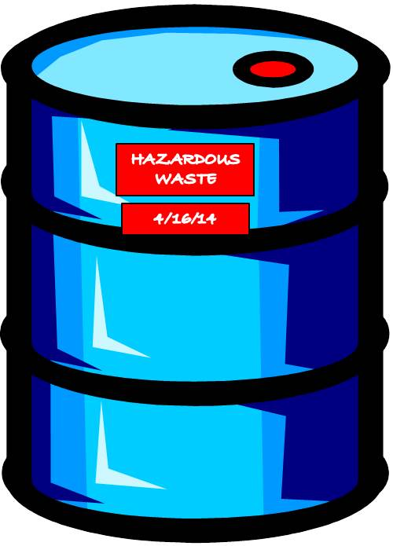
HAZMAT INFORMATION & RESPONSIBILITIES
Labelling and marking of hazardous materials
The containers or systems that hold hazardous materials shall display name of the material and the hazards of its contents by labelling and marking.
This includes fixed storage, portable tanks, modules, drums, cans and tankers.
Labelling and marking shall be according to international standards such as UN, ISO, OSHA, IATA or DOT.

Slide 15
HAZMAT INFORMATION & RESPONSIBILITIES
Material safety data sheet (msds)
Material Safety Data Sheets (MSDS) select and interpret information that is useful in determining the hazardous nature and severity of the chemical.
The major information categories required in the MSDS are as follows:
  Manufacturer’s name, emergency telephone number, and address;
  Chemical name and synonyms; trade name and synonyms; chemical family and formula.
  Hazardous ingredients
  Physical data
  Fire and explosion hazard
  Reactivity data
  Health hazard data
  Spill or leak procedures
  Special protection information
  Special precautions
  Storage & Handling information
MSDS shall be readily available at warehouse, user (operator shelter, lab)

Slide 16
HAZMAT INFORMATION & RESPONSIBILITIES
General precautions
Safety Shower/eyewash shall be available near the chemical handling area.
It shall be painted in green & white and provided with green & white identification symbol visible from distance.
Plant chemical shelters should be away from hazardous area. Overstocking of chemicals shall be avoided in unit chemical shelters.
Hazardous materials shall be stored only in approved areas, which are equipped with proper fire protection and safety features as per MSDS requirements.
Separate storage areas shall be provided for “incompatible chemicals” as these chemicals may react together and create a hazardous condition because of this reaction.
Expired material shall be.
Waste material (including radioactive waste) shall be disposed in accordance with the Environmental Regulations.

Slide 17
HAZMAT INFORMATION & RESPONSIBILITIES
User's responsibilities
The word ‘user’ shall mean the personnel involved in using, handling, storing, transporting and emergency response of hazardous materials.
  Suppliers, Materials Section, transporters and end users shall make sure that all hazardous material containers are properly labelled and identified.
  Users shall be aware of chemical labelling system and shall understand information on MSDS.
  User division superintendent shall ensure all users are aware of nature, uses and hazards of the material.
  Users shall be properly trained on general handling of hazardous material and special training on highly hazardous materials applicable for a particular user.
  Highly hazardous materials should be handled in closed systems wherever possible.
  User division superintendent shall ensure the provision of required PPE and user compliance.
  PPE signs shall be displayed at locations wherever hazardous materials are handled or stored (e.g. eye goggles, gloves, and respiratory protection signs).
  Users shall check all empty containers, equipment and tools prior to use for the condition, cleanliness, and compatibility with the material.

Slide 18
HAZMAT INFORMATION & RESPONSIBILITIES
General safety measures
The most common flammable and combustible liquids are crude oil, coal tars, hydrocarbons, alcohol, and their by-products. They are chemical combinations of hydrogen and carbon.
The combination may also contain oxygen, nitrogen, sulfur or other elements.
Manufactured liquids and fluid commodities which contain flammable liquids, such as paints, floor polish, cleaning solutions, dryers and varnishes shall be considered as flammable liquids and classified according to the flash point of the mixture.
Precautions pertaining to their handling and use differ according to their flash points, volatility, and the amount of flammable liquid within the mixture.
MSDS, operation manual, etc.

Slide 19
HAZMAT INFORMATION & RESPONSIBILITIES
Ignition Sources
  Smoking and carrying of matches, lighters and other spark or flame producing devices shall not be permitted in a building or area where flammable liquids are stored, handled, or used.
  The extent of the restricted area will depend on the type of products handled, the design of the building, and local conditions.
  Suitable ‘NO SMOKING’ and other signs shall be posted in buildings, and areas where smoking is prohibited.
Static Electricity
  Static electricity is generated by the contact and separation of dis-similar materials. For example, static electricity is generated when a fluid flows through a pipe or from an orifice into a tank.
Electrical Equipment
  Electricity is a common source of ignition where flammable vapors exist.
  Hence, the proper type of electrical equipment for these atmospheres (e.g. Explosion proof, Intrinsically safe) shall be installed and they shall be properly maintained

Slide 20

HAZMAT INFORMATION & RESPONSIBILITIES
Health And Flammability Hazards
  Most of flammable vapors are heavier than air and it can flow into pits, tank openings, confined areas, and low places in which they contaminate the normal air and, thus cause a toxic as well as explosive atmosphere.
  Oxygen deficiency may occur in closed containers, such as a tank, which has been closed for a long time and in which rusting has consumed the oxygen.
  All containers shall be ventilated and tested for flammable, toxic and oxygen deficient atmosphere before man entry or any work.

Slide 21
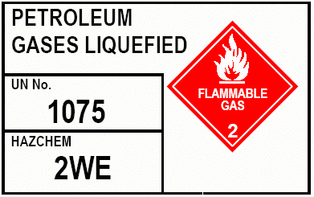
HAZMAT INFORMATION & RESPONSIBILITIES
LOADING ROAD TANK VEHICLES
  Vehicles are to be loaded only with the class of products for which they are designed and authorized to carry.
  The driver shall be aware of the hazards and trained for emergency actions.
  MSDS and minimum required emergency equipment shall be available in the cabin.

Slide 22
HAZMAT INFORMATION & RESPONSIBILITIES
Bulk Loading of Road Tank Vehicles
If a loading bay is occupied, an approaching vehicle shall not come closer than 6 meters from the loading position and the engine shall be stopped.
Loaded vehicles are to be parked well clear of the loading gantry.
Loading attendant shall be in attendance at all times when loading is in progress.
While loading or unloading is in progress, driver and his attendant/s shall stay out side the vehicle all the time.
A bond to the earth shall effectively connect vehicles before loading or unloading operation is commenced.
The earth-bond is not to be removed nor the high level cut-off plug removed, until the operations are completed, all product lines disconnected and dome covers closed.
Faulty earth bond wires, clips etc. shall be reported at once to the appropriate Supervisor and steps taken to correct the fault.
In order to prevent leakage by distortion of the tank by expansion of its contents due to a rise in temperature during transit, no cargo tank or compartment shall be made liquid full.

Slide 23
HAZMAT INFORMATION & RESPONSIBILITIES
Loading of Class I and II Petroleum
  When vehicles are top loaded with Class I or II petroleum products, the drop of the loading arm shall be lowered to the bottom of the tank compartment before loading commences in order to avoid splash loading.
Change of Product and Switch Loading
  When tank vehicles are required to be loaded with a change of grade from that previously carried, the tank or compartment shall be completely drained off the entire previous product.
  Switch Loading: Where it is unavoidable and become necessary to load an intermediate flash stock such as kerosene, gas oil or fuel oil, into a tank or compartment which has previously contained a low flash stock such as gasoline, the operation shall be carried out with the same safety precautions as for gasoline.
  Should a tank or compartment be accidentally over-filled, the excess product shall be drawn off into a suitable container and transferred immediately to a dump tank or closed container.

Slide 24
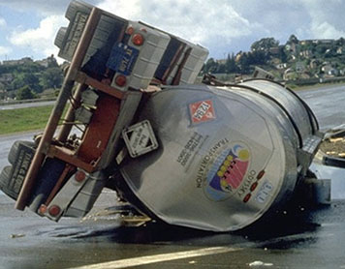
HAZMAT INFORMATION & RESPONSIBILITIES
Spillage
  Every care shall be taken to avoid spillage.
  If a spillage of Class I or II petroleum product occur, all operations at the point of spillage and adjoining positions shall cease immediately and foot valves on vehicles be closed.
  The engines of vehicles shall not be started.
  The spillage shall be cleaned up, as quickly as possible and loading operations not be recommenced until the area has been pronounced safe by the incident controller.
  In the case of spillage of class III petroleum, the spillage shall be cleaned up immediately and the source of spillage shall be controlled.
  ECCC should be informed immediately and incident report submitted.

Slide 25
BITUMEN LOADING AND UNLOADING
Handling Temperatures
  Although some bitumen is supplied in drums, blocks or sacks, it is mostly handled in liquid form.
  Bitumen has to be kept hot to be in this state. Harder grades of bitumen require higher temperatures to keep it in liquid form.
  Maximum bitumen handling temperatures shall not exceed 1600C.
Pipe Work
  Piping shall be designed for self-draining and to prevent solidification of the bitumen.
  It should be insulated and equipped with safe heating system, which incorporates a temperature control.
  Insulation shall be provided to protect personnel from accidental burns.
  Open Flame Heating or any uncontrolled heating source shall not be used to free blockage in pipe work, (e.g. direct flame heating).
  It shall be heated starting from the nearest release point.
  The temperature shall be maintained at the melting point.

Slide 26
BITUMEN LOADING AND UNLOADING
Elimination of Moisture
  Before loading or unloading operations are commenced, all traces of moisture shall be eliminated by draining or by blowing with air or inert gas.
Loading Bulk Bitumen
  A check shall be made to ensure that all discharge valves are closed on the receiving tank.
  Where a tank or receiver has been used to carry bitumen emulsion or has been injected with steam, it shall be thoroughly drained before being loaded.
  Before loading is commenced, the tank or receiver shall be examined for the presence of water or volatile liquid and any trace of these shall be eliminated before filling.
  During loading, no source of ignition may be permitted in the vicinity of the tank or receiver.
  The field operator responsible for loading shall maintain a constant watch at the loading platform during the filling operation.
  He shall not leave the platform, until all loading ceases and all valves are closed.

Slide 27
BITUMEN LOADING AND UNLOADING
Tankers Fitted with Heating Aids
  Drivers shall be warned that parking of vehicles on sloping ground may cause heating tubes to become uncovered and can cause dangerous over heating.
  When discharging a tanker, burners shall be turned off and tubes allowed to cool for at least 20 minutes before discharging.
  The heating system shall not be used whilst travelling and tanks shall not be unloaded if the heating system is working.
  When LPG heating systems are used, all gas pipe joints shall be tight.
  The cylinder stop valve shall be closed at all times except when heating or testing the gas lines.
  When LPG cylinders are changed, all lines and connections from the cylinder to the burners shall be tested using soap water before attempting to light the burners.
  If a leak is detected, the cylinder stop valve shall be closed immediately, the leak shall be rectified and a further test made.

Slide 28
BITUMEN LOADING AND UNLOADING
Storage Inside Buildings
  Egress
    Flammable or combustible liquids, shall not be stored so as to limit use of exits, stairways or areas normally used for the safe egress of people.
  Office Occupancies
    Storage shall be prohibited except for quantities required to operate office equipment.
    Such storage shall be in closed metal containers and stored in a storage cabinet or in safety cans.
Flammable and Combustible Liquid Warehouses or Storage Buildings
  The total quantity of liquids within a building shall not be restricted.
  Containers in piles shall be separated by pallets or dunnage(mats) where necessary to provide stability and to prevent excessive stress on container wall.

Slide 29
BITUMEN LOADING AND UNLOADING
NOTE
  Class 1 liquid shall not be stored in basements.
  When 2 or more classes of materials are stored in a single pile, the maximum gallonages permitted in that pile shall be the smallest of the 2 or more separate maximum gallon ages.
  Aisles shall be provided so that no container is more than 12ft. from an aisle.
  Main aisles shall be at least 8ft. wide and side aisles at least 4 ft. Wide.
  Each pile shall be separated from each other by at least 4 ft.
General precautions
  The dust content of the flammable solid in air must be kept below the lower explosive limit (i.e. it should not obscure vision at 5ft distance or less).
  Water spray system shall be readily available.
  All sources of ignition shall be excluded from the area of a potentially explosive dust.
  The no smoking rule shall be rigidly enforced.
  Wiring, lights and switches shall be in compliance with area classification

Slide 30

POISONS (TOXIC MATERIALS)
Storage
  If any container is found to be leaking it has to be disposed by an approved disposal method only (Refer MSDS).
  Toxic materials shall not be stored near the sources of food or water etc.
  Eating, drinking and smoking inside the storage rooms shall be strictly prohibited.
Handling
  Handling of all toxic materials shall be done using appropriate protective equipment (Refer MSDS).
  In addition, tools used for handling the toxic materials or containers of toxic materials shall not be used for any other purpose before cleaning properly.
  All contaminated clothes and tools to be cleaned at a separate cleaning room.
  Clothes worn during the working time shall not be worn afterwards.

Slide 31
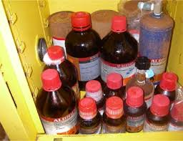
CORROSIVE MATERIALS
Storage shall be under cover in dry well ventilated area, away from all Foodstuffs, segregated as required from other goods and from each Other, on pallets or dunnage and not directly on the floor, under a System of first in first out (FIFO) and allowing access for regular examination for leaking packages.
Corrosive materials shall be handled only with using the appropriate Protective equipment as per MSDS

Slide 32
RADIOACTIVE MATERIALS
Storage
  When not in use or transit, the containers shall be kept in the locked storage pit so as to minimize the risk of their coming into the possession of unauthorized and untrained persons.
  The storage pit shall be surrounded by a fence on which warning notices are posted.
  The store shall be under the supervision of the authorized person who is responsible for keeping the source records
Personal Safety
  Radiographers and assistants shall be medically certified and ministry approved for their task They shall be re-certified every six months.
  The following safety equipment shall be used when radiation work is to be executed.
    Film badges
    Radiation Dose rate meters (Survey meters)
    Pocket Dose meters (Optional)
    Radiation warning signs and signals

Slide 33
RADIOACTIVE MATERIALS
Working on Site
Enclosure
  Where reasonably practicable, the radiography shall be carried out in a suitable enclosure, having a fence incorporating a lockable gate which must be kept locked whilst radiography is in progress.
  All except authorized persons will be excluded from the enclosure.
  Where X-rays are used these dimensions shall be governed by the operating conditions of voltage & current; other factors include beam filtration, the effectiveness of any collimator used to limit the size and direction of the useful beam.
  In both processes, there will be some attenuation of the radiation by the material of the work-place itself and local shielding such as concrete blocks or lead screens.
  The enclosure shall be adequately marked with suitable radiation warning signs when ionizing radiation are about to be used.

Slide 34
RADIOACTIVE MATERIALS
Suitably Marked Area
  Where it is not reasonably practicable to use a radiation enclosure, and the work has to be carried out on site, steps shall be taken to provide a suitably marked area encircled by a rope barrier.
  The barrier shall be set up at 0.25 millirems per hour distance from the source and shall exclude all except authorized persons.
Warning Signals
  In all cases adequate warning to all persons in the vicinity shall be given by lamps or audible signals or both when a sealed source is about to be exposed or when an X-ray machine is about to be energized.
  In the case of X-ray machine it is mandatory that the means for giving warning shall be integrated with control circuitry, so that they operate automatically, and the equipment shall be unable to function unless they are so connected.
Dose Rate Measurement
  Measurement shall be made with an appropriate Dose Rate meter during radiography to ensure that dose rate at the barrier does not exceed 0.25 millirems per hour.

Slide 35
RADIOACTIVE MATERIALS
General Precautions
  The average person’s knowledge of radiation and its hazards is very limited.
  Therefore it is not enough to erect barriers and provide warning signals just to comply with the regulation.
  The radiographer or an assistant shall maintain a strict vigil to prevent unauthorized persons entering the area.
  If this cannot be done, work involving ionizing radiation shall cease until these persons can be persuaded to keep out.
Monitoring Dose Rate Meters
The meter shall be used to achieve the following objectives:-
  To check initially that the safety barriers are positioned where the Dose rate is not greater than 0.25 millirems per hour.
  To monitor the Dose Rate at safety barriers, particularly when the radiographic technique varies.
  To help locate a lost source.
  To monitor working conditions.

Slide 36

About PMG Consultants
PMG Consultants is group of competent people with expertise in respective domains. Delivering commitments, exceeding expectations & creating value for clients in every interaction is our non-negotiable objective. Using the most advanced design & collaboration work systems, we aspire to become Inspirational business partners for our clients.
Get in touch
We would love to hear from you. Gauge our capabilities by speaking to us. You can visit us at our New Delhi Design Office, or meet our representative at your location.
Our Office
Address:
162A/9, 3rd Floor, Kishangarh,
Vasant Kunj, , New Delhi, 110070
Phone: +91-9871115995, +91-11-23361790
Email: connect@pmg-consultants.com
abhinav.pandey@pmg-consultants.com

