Slide 1

HUMAN SAFETY TRAINING

Slide 2
AGENDA
1
Safety measurements
2
Objectives of safety induction training
3
Benefits of induction programs
4
Definitions
5
Type of hazards
6
Personal protective equipment (PPE’S)
7
Working at height
8
Emergency preparedness and response plan
9
Fire fighting and first aid facility
10
Machine safety
11
Material handling
12
DO and DON’T

Slide 3
SAFETY MEASUREMENTS
FATALITY
SEVER INJURY
MINOR INJURY
NEAR MISS
UNSAFE ACT AND CONDITIONS
RESULT
BEHAVIOR

Slide 4
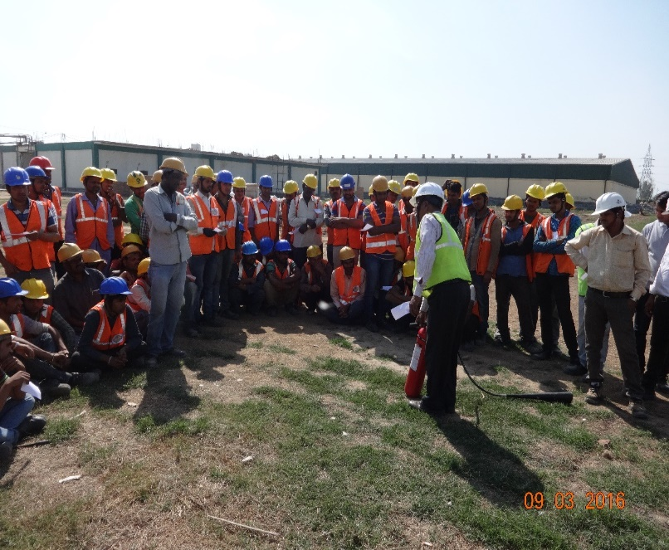
OBJECTIVES OF SAFETY INDUCTION TRAINING
When a new entrant joins an organisation, he/she is an utter stranger to the co-workers, work­place and work environment.
As such, he/she may feel insecure, shy and nervous.
The first few days may be all anxious and disturbing ones for the new entrant.
Particularly when a new entrant comes from rural area, he/she finds himself/herself completely at sea in an industrial town and city.
Then, induction helps reduce such anxieties and dispels doubts and nervousness from the mind of the new entrant.

Slide 5
OBJECTIVES OF SAFETY INDUCTION TRAINING
An induction programme is designed to achieve the following Objectives:
  To reduce the initial anxiety all new entrants feel when they join a new job in a new organisation
  To familiarize the new employees with the job, people, work-place, work environment and the organisation.
  To facilitate outsider – insider transition in an integrated manner.
  To reduce exploitation by the unscrupulous co-workers.
  To reduce the cultural shock faced in the new organisation.

Slide 6

BENEFITS OF INDUCTION PROGRAMS
A well-designed induction programme reduces anxiety, nervousness, and absenteeism and em­ployee turnover.
Induction helps minimize the reality or cultural shock new employees undergo on joining a new organisation.
Effective induction also helps integrate the new employees into the organisation and fosters the feeling of belongingness to the new organisation.
Induction also binds the newcomer and the present employees in a team.

Slide 7
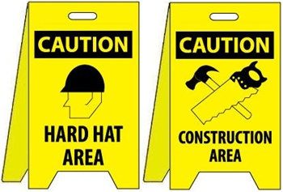
DEFINITION
Safety is free from risk and danger.
Accidents is defined as an unexpected and desirable event resulting in damage or harm.
Hazards is an unsafe condition or activity, that if left uncontrolled can contribute to an accident.
Risk is the assessment of ’probability of loss’ and ’potential amount of loss’.
Near Miss an accident that is just barely avoided

Slide 8

TYPE OF HAZARDS
Chemical Hazards - dusts, fumes, fibers (solids) liquids, mists gases, vapor
Physical Hazards - Noise Vibration Temperature extremes Radiation
Biological - soil water insects (mosquitoes, ticks) bird, bat droppings animals structures

Slide 9
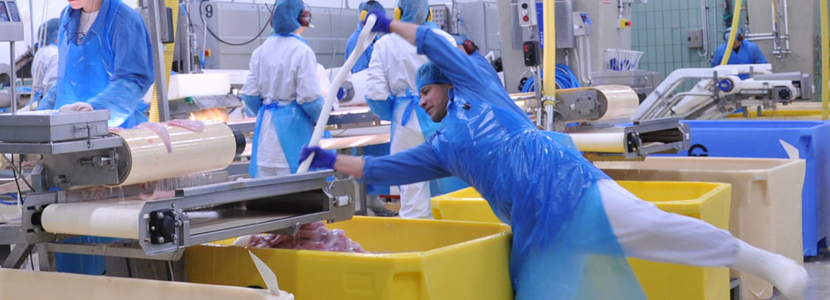
TYPE OF HAZARDS
Ergonomic
Heavy, frequent, or awkward lifting
Repetitive tasks
Awkward grips, postures
Using excessive force, overexertion
Using wrong tools for the job or using tools improperly
Using improperly maintained tools
Hand-intensive work

Slide 10
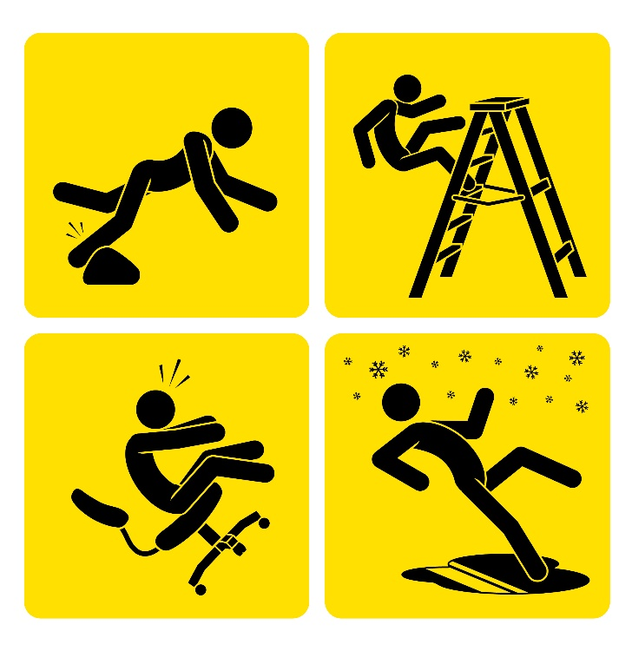
TYPE OF HAZARDS
Types of accident measurements
Death
Fatal injury (broken leg, hips, amputation)
Non-fatal injury (finger cut)
Occupational accidents (MSD, hearing loss)

Slide 11
PERSONAL PROTECTIVE EQUIPMENT (PPE’S)
Selection of personal protective equipment for identified conditions
SAFETY WEAR / APPLIANCES | WHEN TO USE? | WHY TO USE?
Safety Helmet (Approved Safety Helmet ) Shock and fire resistant | Building construction site, while working on high structure. In process plants, while working in enclosed vessels, pipes, drums, while working in open trenches or pits deeper than 1.5 meter, near crane, while riding on vehicles without hard cabin / hood, beneath erection operations, at all operational and construction area. | To protect head injuries in all cases of impact from falling objects, accidental fall from structures, collision with low structures and projecting objects
Safety belt with full body harness to be used and life line attached to them | While working in closed spaces, on heaps of loose materials, in confined vessels, tanks, at all elevated location, on vertical ladders, in digging deeper than 2 meter, while working with hose or gas mask in confined space/, on unsteady working surfaces, at all working height more than 2 meter from ground / floor level | To arrest the fall , to pull out from gassy areas or confined areas if he drops in

Slide 12
PERSONAL PROTECTIVE EQUIPMENT (PPE’S)
Selection of personal protective equipment for identified conditions
Hand Gloves | Rubber gloves while working with electrical equipment's, . Asbestos gloves while working in heat / high temperature area. | To protects hand and prevent finger injuries.
Ear Plugs / Ear muff | While working in areas with noise level above 85decibels | Protection to ear drum
Welding Helmet | While welding | Protection to eyes from welding light, chips from welding arc etc.
Plastic face shield (transparent) | While metal sawing /grinding , buffing, handling chemicals | Face & eyes protection from flying particles and splashing liquids

Slide 13
PERSONAL PROTECTIVE EQUIPMENT (PPE’S)
Selection of personal protective equipment for identified conditions
Acid / chemical Hood | While working with corrosive chemicals | Face and eyes protection from corrosive chemicals, causing skin burns, blindness (temporary/ permanently
Goggles. | Chipping, riveting, sledge hammer jobs | Eyes protection from impact of flying particles
Spectacles with side shield plastic | While grinding metals, wood etc | Eyes protection from saw dust, metal scales, ordinary dust etc
Safety clothing ( Proximity suit, Diving suit, no loose clothing ,clean clothing ) | While working with / near molten metal etc. | Loose clothes can cause accident. Dirty clothes with oil / chemical soaked can cause fire accidents, and even skin diseases. Proximity suit provides protection from spillage/sparkles; loose clothing tangles with moving parts.
Dust Mask | While working in dusty areas (cement bagging plant/ storage areas, / handling practices ) | To protect the workers from irrespirable dust

Slide 14
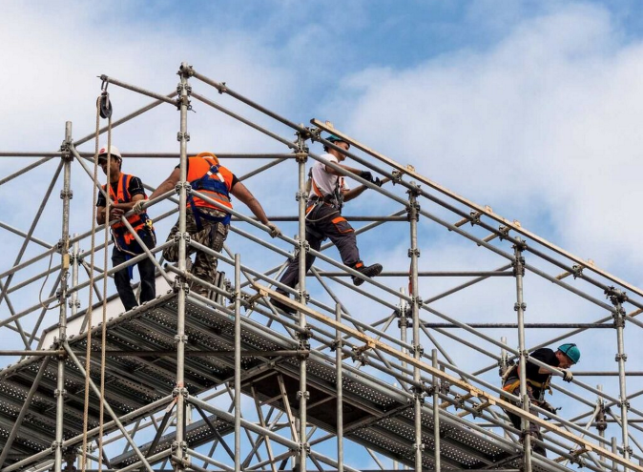
WORKING AT HEIGHT
The construction industry by virtue of the nature of work and the effect of weather condition has been ranked as one of the danger prone industry.
  Fall prevention – is elimination of hazards that cause fall, by erecting safe platform and railing etc.
  Fall protection –it is necessary when it is not possible to provide safe platform and railing.
  Falls are classified broadly into two groups.
    Falls due to working on the same level.
    Falls from working at height to lower level.
The cause of accident while working at height comprises the following:
  Fall of persons.
  Fall of materials.
  Fall of erected structures.
  Collapse of scaffolds.
  Fire and explosion.
  Electrocution.

Slide 15
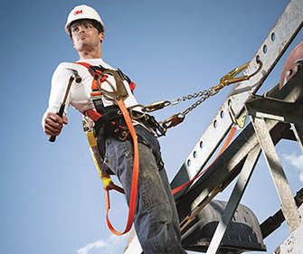
WORKING AT HEIGHT
The following may cause the fall of persons from height:
  Poor workmanship and loss of balance.
  In experience work man and poor supervision.
  Inadequate structural design.
  Faulty design of working platform and scaffolds.
  Opening near or adjacent to the working area
  Faulty lay out of power cable / welding cable
  Poor illumination.
  Fatigue of the workman and supervisors.
  Fragile roof materials.
  Non use of PPE’s
  Poor housekeeping.
  Unguarded (without hand railing) access / staircases.
Some other causes like :
  Walking on the beam.
  Electric shock.
  Handling materials at height.
  Stumbling hazards.

Slide 16
WORKING AT HEIGHT
Checklist for working at height
The following check should be made before and during working at height.
  Keeping access ways clear to permit free passage of workers.
  Safe access (stairway, ladder, ramp) to work areas.
  The scaffolds are of proper strength and there is no gap through which person, equipment or materials may fall.
  Anchorage point is strong enough to support at least two times the potential impact load of a work man’s fall.
  The anchorage point allows free movement of the attachment ( life line of safety belt )
  It is located as high as possible and is as vertical as possible in order to reduce swinging.
  Anchorage point should not be sharp to cut the rope etc.
  P.P.E.’s are being used properly. Fall arrestor is being used.
  Materials are not left at height.
  Area below is cordoned off and nobody is working under below unless head protection is there.

Slide 17
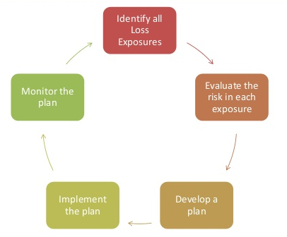
EMERGENCY PREPAREDNESS AND RESPONSE PLAN
Emergency preparedness and response plan prepared for following possible emergencies.
  Fire and Explosion.
  Ammonia Leakage.
  Terrorist Attack.
  Food poisoning.
  Toxic Release emergency procedure.
  Earth Quake.
  Civil disobedience ( Unrest)
  Bio gas leakage.

Slide 18

EMERGENCY PREPAREDNESS AND RESPONSE PLAN
Following emergency facilities provided
Emergency Telephone Nos : Telephone Nos of Company Authority and External Agency are displayed in the Plant premises.
Emergency Siren/Air Horn system : Shift Officer/Operator/ Security will raise alarm in case of emergency.
  Emergency Exit : All exit and exit routes shall be known to all partners. Necessary exit route drawings are displayed in Plant.
Wind Socks : Wind sock shows the direction of wind. In case of gas leakage, the partners should assemble at up wind direction.

Slide 19
EMERGENCY PREPAREDNESS AND RESPONSE PLAN
Following emergency facilities provided
 | Plant Manager | (R)
 |  | (M)
 |  | (O)
 |  | Intercom
Shift Coordinator- Main Plant | Main Plant | (M)
 |  | Intercom
Maint. Shift Coordinator | Maintenance. Shift in charge | (M)
 |  | Intercom
Security Main Gate/ Ambulance | Security Officer on duty | Intercom
 |  | Intercom
 |  | Direct Line
Police | External Agency | (O)
Municipal Fire Brigade & Ambulance | External Agency | (O)
MIDC Fire Brigade | External Agency | (O)
Dr. | Hospital | (R) / (H)
 |  | (M)
Dr. | Hospital | (H)
Hospital, | Govt. Hospital | (H)
Silver Jubilee ,BMT | Govt. Hospital | (H)

Slide 20
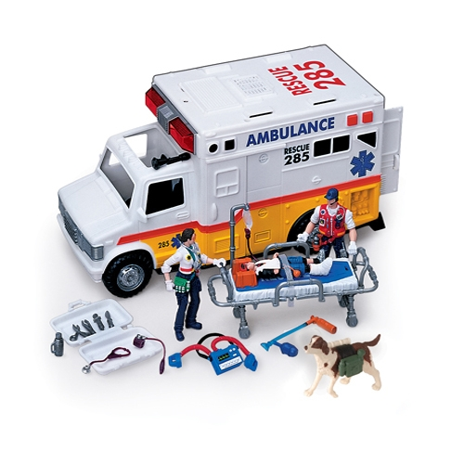
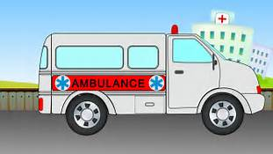
EMERGENCY PREPAREDNESS AND RESPONSE PLAN
Following emergency facilities provided
Rescue team/Fire fighting team
  Members shall be available to shift the affected partners at safe area.
  The rescue team/fire fighting team shall be trained in first aid, fire fighting, artificial respiration etc.
Ambulance/Fire Bridge
  We may call as and when required Ambulance/Fire Bridge.
  If required outside ambulance van may be called depending upon situation.
  At worst-case we may call outside fire brigade for help.

Slide 21
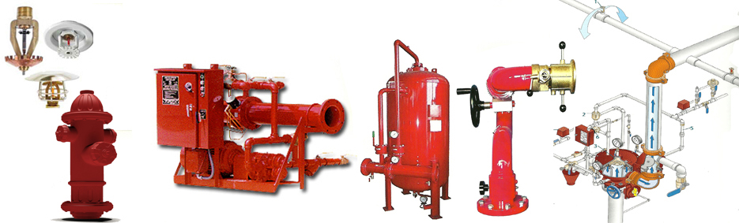
FIRE FIGHTING AND FIRST AID FACILITY
Fire Hydrant system.
Portable Fire Extinguishers.
Fire Brigade from Municipal corporation and other
nearby Factories

Slide 22
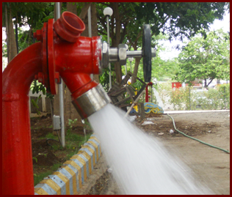
FIRE FIGHTING AND FIRST AID FACILITY
Fire Hydrant System
Jockey pump
Main Pump
Diesel Engine pump
Jockey Pump
To maintains the system pressurized (manage small leakages)
Starts at 5.5 kg/cm2 and stops after attaining a pressure of 7 kg/cm2
Auto Start and Auto Stop.
Electrically Driven Main Pump
Starts at 4.5 kg/cm2 and has to be manually be stopped
Auto Start and manual Stop.
Diesel Engine Driven Standby Pump
When there is power failure, It will starts at 3.5 kg/cm2 and has to Be manually stopped. Auto Start and manual Stop.

Slide 23
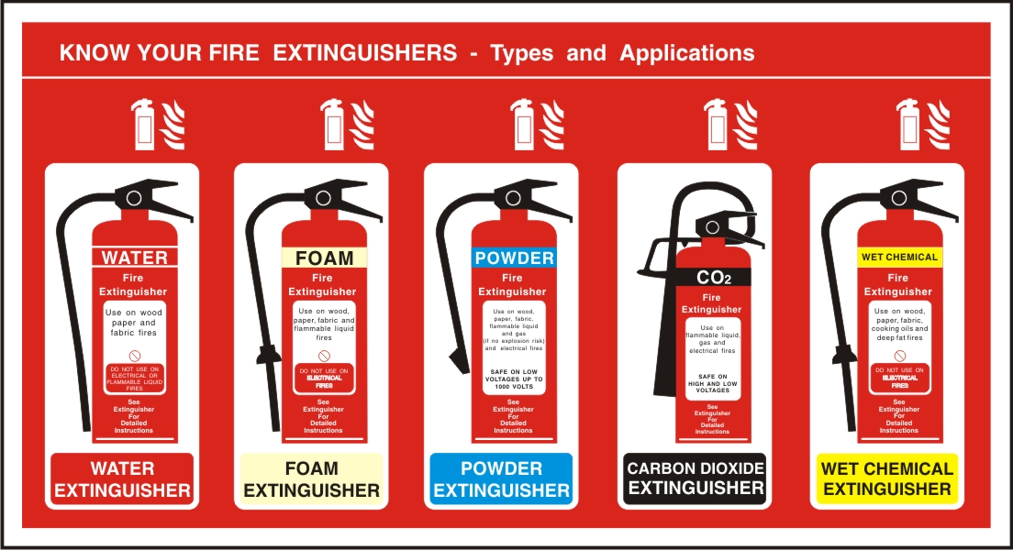
FIRE FIGHTING AND FIRST AID FACILITY
Fire Extinguishers
  To prevent fire at preliminary stages various types of fire extinguisher are placed across the plant.
  Four types of extinguishers - ABC type, DCP, CO2, Mech. Foam cylinders are available. Total- 200 Nos.
  Monthly inspection & servicing done as per schedule.
  Periodical demos are taken to increase awareness.
Types of Fire Extinguishers
  Dry Powder Fire Extinguisher.
  CO2 type fire extinguisher.
  ABC type Fire Extinguisher.
  Mech. Foam Fire Extinguisher.
  Water CO2 type extinguisher.

Slide 24
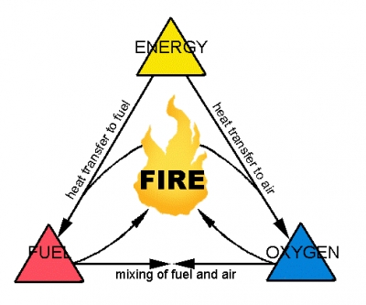
FIRE FIGHTING AND FIRST AID FACILITY
Fire Extinguishers
Fire is a chemical reaction in which a combustible material combines with oxygen in the atmosphere then an external source of heat is applied to the fuel and given out heat and flame.
The three factors needed to support combustion (FIRE) are:
  Heat
  Oxygen
  Fuel
Classification of Fire & appropriate use of Extinguishers
Class | Material Type of extinguishers to | Type of extinguishers to be used
A | Wood, paper, plastic, rags | Water CO2, Mech. Foam, ABC type
B | Oil, grease, paint ,thinner | Mech. Foam, CO2, ABC type, DCP
C | Flammable gas, electrical fire | CO2, ABC type, DCP
D | Metal fires-Potassium, magnesium | DCP

Slide 25
FIRE FIGHTING AND FIRST AID FACILITY
Role of Fire Fighter
When there is emergency siren/alarm thru’ air horn or other means , all fire fighters on duty after hearing the sound or receiving the message, shall contact to Main Gate Security/Coordinators to know the type of emergency and location of emergency.
  After confirming the emergency they should report to their concern shift officer and rush to Effected area.
  Required PPE shall be arranged and bring to the affected site to attend emergency.
  Necessary action shall be taken to reduce casualty and prevent property damages at affected area.

Slide 26
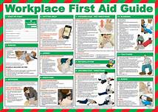
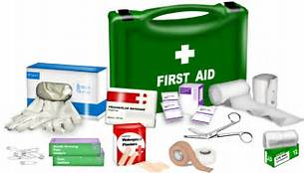
FIRE FIGHTING AND FIRST AID FACILITY
Role of Fire Fighter
First Aid Facility
  Definition- First aid is an aid rendered to an injured person with the available means (material) till he is either taken to hospital or to doctor for further treatment.
  Aim and objective of First Aid is –
    To preserve Life.
    To promote recovery.
    To prevent the injury or illness from becoming worse.
  First Aid Facility
    First aid box with material is made available at 14 places in plant.
    Partners trained in First Aid from various section/dept. - 42 nos. Names displayed in Plant.
    Regular inspection of first aid box conducted. Ensured expiry items are not available in box.
    In case of first aid accident in plant necessary first aid is given to injured partner.
    In case of LTA/MTA, partner sends to Hospital for further treatment.

Slide 27
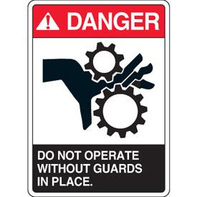
MACHINE SAFETY
Safe guarding of dangerous part of machinery is a measure in accident prevention.
Section 21, 22, and 26 of the Factories Act and applied provision in the Factories Rules deal with guarding of dangerous parts of machinery.
Parts to be guarded
  The parts of machinery which are to be guarded may be classified as:
    Moving parts of prime movers including fly wheel.
    Dangerous parts of any other machinery.
    Transmission machinery.
  These parts must be effectively and adequately guarded and should be in such a position or construction so that it is out of reach by any person while working.
  Other parts which are to be guarded :
    A projecting shaft ends.
    Collars and coupling (U- shaped guard
    All set screws in moving parts of machinery.
    Shafts and pulleys.
    Belt and chain drives.
    Clutches, cut off coupling or clutch pulleys.

Slide 28
MACHINE SAFETY
Points of operation.
  The starting point of the contact and release points are called nip points.
  These nip points are the greatest sources of potential accident hazards.
  The point of operation should be guarded in such a way that the working of the machine should not be disturbed and at the same time trapping of human body should not occur while the machine is in motion.
Basic requirements of guards.
  Guards should do the following:
    It should protect the operator
    It should protect others.
    It should not interfere with efficiency.
    It should be fool proof.
    It allows repairs.
    It allows lubrication /oiling.
    It should be well constructed.
    It should be well secured.
    It should not create new hazards.

Slide 29
MACHINE SAFETY
The following types of guards are commonly
used in the factory.
  Fixed guards.
  Automatic guards.
  Interlock guards.
  Trip guards.
  Positional guards or distance guard.

Slide 30
MACHINE SAFETY
Electric safety do's and don'ts
Do's
Pull the plug itself, not the cord attached to it.
Disconnect any appliance that sparks and have it repaired immediately.
Always disconnect appliances before cleaning them.
Turn off appliances when you leave home.
Keep electrical cords away from hot appliances.
Keep appliances clean and free of dust, lint and grease.
Use moisture resistant cords when outside.
Wear rubber soled shoes when operating power tools.
Follow manufacturers' instructions when operating electrical devices.
All electrical devices should carry an Underwriters Laboratory approval tag.

Slide 31
MACHINE SAFETY
Electric safety do's and don'ts
Don'ts
Never turn on an appliance when standing or sitting in water. Shocks can be fatal.
Never overload a circuit by plugging in too many appliances.
Plug three-way grounded plugs into appropriate outlets. Never tamper with the third prong.
Never install cords under rugs where they will become worn by foot traffic.
Overload motors, circuits, or outlets
Never Run cords along the floor Never Use temporary wiring
Never Put anything but a plug into an electrical outlet

Slide 32
MACHINE SAFETY
Electric safety do's and don'ts
Do's
Make sure outdoor electrical outlets are covered with weatherproof covers.
Use extension cords only for temporary applications.
Use heavy duty cords when using power tools.
Keep work areas clean and dry. Sparks can ignite wood scraps, sawdust and solvents.
Make sure your power tools are grounded or certified double insulated.
When utilizing adapters, make sure to screw in the wire for grounding.
Certain outlets for outdoor appliances or tools should have a ground fault interrupter (G.F.I).
This type of circuit breaker, installed in an outlet, protects the user from shock.

Slide 33
MACHINE SAFETY
Electric safety do's and don'ts
Don'ts
Never Touch anything electric with wet hands
Never Leave machinery or electrical equipment running unattended after working hours
Never Let cords get twisted or tangled
Never Get closer than 10 feet to power lines
Never Reach blindly into a space that may contain energized equipment
Never Wear metal jewellery when working with electrical equipment

Slide 34

MATERIAL HANDLING
Manual Material Handling
Mechanical Material Handling
  Chain pulley block.
  Conveyor.
  Crane.
  Fork lift.
  Truck.& Trailer etc.
  By sea route.
  By rail route

Slide 35
MATERIAL HANDLING
The following should be followed while handling materials:
  Materials, tools, and other objects should not be thrown from a height if liable to cause injury.
  Loose materials when not required for use should be placed where they will not impede the passage of any person.
  Materials should not stack insecurely in place where they might cause danger.
  Materials should not be kept on scaffolds unless needed for work within a reasonable time.
  Loads placed on scaffolds should be evenly distributed, as far as practicable.
  Materials should not be stored in place provided for meals or for shelter.
  Vehicles or Trailers used for transporting of materials should be in efficient working order and in good condition.

Slide 36
MATERIAL HANDLING
Chemical handing safety
Always read the safety data sheet and the text on the packaging carefully when you are about to use a product with which you are not completely familiar with the risks.
Contact the environmental co-ordinator if you are unsure about handling methods.
Use personal protection equipment (e.g. gloves, face mask) where necessary.
Information in the safety data sheet.
First Aid equipment must be available.
Workplaces must be cleaned regularly. There must not be chemical spills on the floor.
Ensure safety signage in any restricted areas such as chemical storage areas is observed.
Do not store flammable materials near timbered areas, or electrical equipment
Do not leave flammable materials, cleaning rags, on motors
When transporting flammable materials keep them in sealed containers and ventilated at all times.
Any spillage of chemicals cleans up immediately.

Slide 37
MATERIAL HANDLING
Chemical handing safety
Material Safety Data Sheet ( MSDS)
  Identification of product
  Composition/Specification
  Hazardous Identification
  First Aid Measures
  Fire Fighting Measures
  Accident Release Measures
  Handling and Storage
  Handling and Storage
  Identification of product
  Composition/Specification
  Hazardous Identification
  First Aid Measures
  Fire Fighting Measures
  Accident Release Measures

Slide 38
MATERIAL HANDLING
Chemical handing safety
Provision of secondary container
  Purpose of providing container is to avoid mixing of chemicals resulting violent reaction
  Wash the container regularly when there is spillage in container
  Keep the chemicals with container at proper place i.e. at ventilated area
National Fire Protection Association Labelling
NFPA uses a symbol system designed as a diamond-shaped label containing four differently colored squares. A number (0-4) or an abbreviation is added to each square indicating the order of hazard severity. The higher the number, the greater the hazard.
NFPA Labelling System

Slide 39
MATERIAL HANDLING
Chemical handing safety
Red background = Flammability | Yellow Background = Reactivity
4 - flash point < 73º F 3 - flash point < 100ºF 2 - flash point > 100ºF to < 200 ºF 1 - flash point > 200ºF 0 - will not burn | 4 - Explosive at room temperature. 3 - Shock and heat may detonate 2 - Violent reaction with water 1 - Unsafe if heated, not violent 0 - Not reactive with water.
Blue Background = Health Hazard. | White Background = Specific Hazard.
4 - Deadly 3 - Extreme danger 2 - Hazardous 1- Slightly Hazardous 0 - Normal material | Oxidizer : OX Acid: ACID Alkali: ALK Corrosive: CORR Use No Water: W

Slide 40
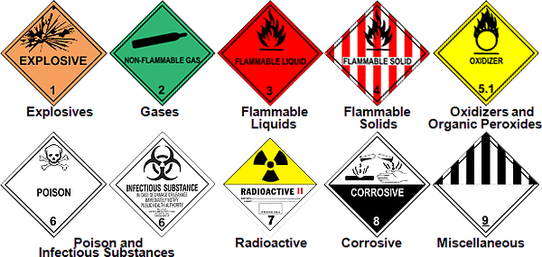
MATERIAL HANDLING
Chemical handing safety
UN Classification of Hazardous Materials
    Class 1: Explosives
    Class 2: Gases
    Class 3: Flammable Liquids
    Class 4: Flammable Solids
    Class 5: Oxidizing Substances
    Class 6: Poisons
    Class 7: Radioactive Materials
    Class 8: Corrosive Materials
    Class 9: Miscellaneous Hazardous Materials

Slide 41
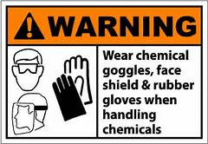
MATERIAL HANDLING
Chemical handing safety
Safety Protective
  Safety glasses, goggles and face shields
  Gloves
  Respirators and dust masks
  Head protection
  Foot protection
  Aprons or full body suits
Provision of PPE Box.
  Keep the PPE box neat and clean.
  Keep all PPE’s in the Box.
  Respirators and Goggle shall be
  kept in polythine bags
  Wash the PPE if there is any
  spillages of chemical on surface.
  Do not keep other material in PPE box

Slide 42
DO’S AND DON’T
Do's
Pull the plug itself, not the cord attached to it.
Disconnect any appliance that sparks and have it repaired immediately.
Always disconnect appliances before cleaning them.
Turn off appliances when you leave home.
Keep electrical cords away from hot appliances.
Keep appliances clean and free of dust, lint and grease.
Use moisture resistant cords when outside.
Wear rubber soled shoes when operating power tools.
Follow manufacturers' instructions when operating electrical devices. All electrical devices should carry an Underwriters Laboratory approval tag.
Make sure outdoor electrical outlets are covered with weatherproof covers.
Use extension cords only for temporary applications.
Use heavy duty cords when using power tools.
Keep work areas clean and dry. Sparks can ignite wood scraps, sawdust and solvents.
Make sure your power tools are grounded or certified double insulated.
When utilizing adapters, make sure to screw in the wire for grounding.
Certain outlets for outdoor appliances or tools should have a ground fault interrupter (G.F.I). This type of circuit breaker, installed in an outlet, protects the user from shock.

Slide 43
DO’S AND DON’T
Don't
Never turn on an appliance when standing or sitting in water. Shocks can be fatal.
Never overload a circuit by plugging in too many appliances.
Plug three-way grounded plugs into appropriate outlets. Never tamper with the third prong.
Never install cords under rugs where they will become worn by foot traffic.
Overload motors, circuits, or outlets
Never Run cords along the floor Never Use temporary wiring
Never Put anything but a plug into an electrical outlet
Never Touch anything electric with wet hands
Never Leave machinery or electrical equipment running unattended after working hours
Never Let cords get twisted or tangled
Never Get closer than 10 feet to power lines
Never Reach blindly into a space that may contain energized equipment
Never Wear metal jewellery when working with electrical equipment

Slide 44
DO’S AND DON’T
LOCK OUT TAG OUT (LOTO)
The Do's
Follow the Lock Out/Tag Out procedure established by your company.
Personally de-energize, lock out and tag out all power circuits and electrical equipment before any work is done on such circuits and equipment.
Personally de-energize, lock out and tag out all start-up switches on mechanical equipment before any work is done on such equipment.
Make sure that each person working on an electrical circuit or system applies his or her own personal lock and tag.
Make sure that all persons, including you, are in a safe location before energizing any equipment.
Wear appropriate Personal Protective Equipment, including electrically rated gloves, hard hat, and eye protection.
Always maintain de-energizing devices in operable condition.
Always block machinery against motion even after it has been locked out and tagged out.
Always familiarize yourself with electrical circuits before you perform any electrical work. Ask for help or consult a wiring diagram/schematic.

Slide 45
DO’S AND DON’T
LOCK OUT TAG OUT (LOTO)
The Do's
Follow the Lock Out/Tag Out procedure established by your company.
Personally de-energize, lock out and tag out all power circuits and electrical equipment before any work is done on such circuits and equipment.
Personally de-energize, lock out and tag out all start-up switches on mechanical equipment before any work is done on such equipment.
Make sure that each person working on an electrical circuit or system applies his or her own personal lock and tag.
Make sure that all persons, including you, are in a safe location before energizing any equipment.
Wear appropriate Personal Protective Equipment, including electrically rated gloves, hard hat, and eye protection.
Always maintain de-energizing devices in operable condition.
Always block machinery against motion even after it has been locked out and tagged out.
Always familiarize yourself with electrical circuits before you perform any electrical work. Ask for help or consult a wiring diagram/schematic.

Slide 46
DO’S AND DON’T
LOCK OUT TAG OUT (LOTO)
The Do's
Make sure that electrical work is performed only by a qualified electrician or persons trained to do electrical work under the direct supervision of a qualified electrician.
Make sure that all electrical circuits and circuit breakers are properly identified before troubleshooting or performing electrical work.
Check for proper grounding of power conductors where required.
Use properly rated non-contact voltage testers to ensure that circuits are de-energized.
Provide an audible or visible warning system to warn persons that a conveyor is starting.
Maintain electrical meters and testing instruments in good condition to verify that the circuit is de-energized before beginning work.
Communicate your intentions to work on an electrical circuit to ensure the circuit is, and remains, protected.
Provide safe access to all working areas.
Discharge all capacitors after the circuit has been locked out.
Relieve hydraulic and pneumatic pressure after equipment has been locked out and before performing maintenance.
Isolate all energy sources, including electric, hydraulic, mechanical and pneumatic, before commencing work.

Slide 47
DO’S AND DON’T
LOCK OUT TAG OUT (LOTO)
The Don'ts
Never defeat manual or automatic de-energizing devices.
Never remove guarding to perform maintenance or inspection until the machine has been properly de-energized and locked out.
Never perform maintenance or work on moving machines.
Never rely on someone else to de-energize or disconnect a circuit for you.
Never remove someone else's lock or tag.
Never perform work on an electrical circuit before testing to make sure it has been de-energized.
Never remove or disturb an electrical lock or tag.
Never assume that a circuit breaker will not be reset by someone else. Always lock it out.
Never loan or share your lock or key with someone else.

