Slide 1

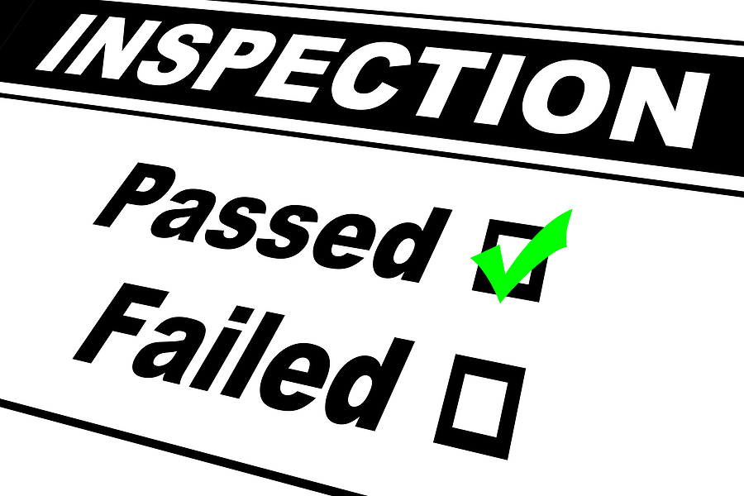
SAFETY INSPECTION

Slide 2
AGENDA
1
Safety Inspection
2
Summary
3
Definition
4
Type of Inspection
5
Benefit of Inspection
Notes:
2

Slide 3
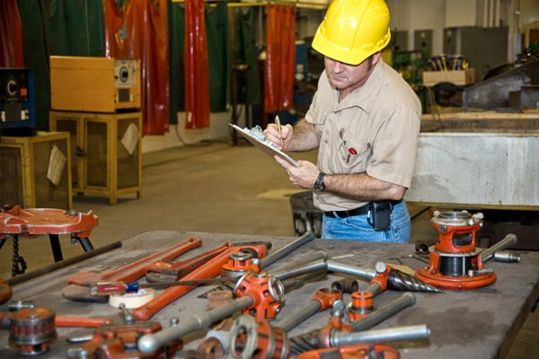
SAFETY INSPECTION
Safety inspection is the best ways to identify these potentially fatal or harmful things is to conduct workplace inspections.
Once these things have been identified, they can be properly addressed.
It is very important, therefore, that inspections be part of your safety/loss prevention program.
We have too many Incidents in our workplace Physical Plant A CORTM Certified Workplace That is why we do workplace inspections! and do something about them.
To find the hazards that cause incidents

Slide 4
SUMMARY
The inspection process provides valuable information in identifying and formulating an action plan to eliminate the situations that could injure a worker.
It is everyone’s responsibility to identify and control hazards. It should be done immediately.
Doing our job will reduce incidents and improve the quality of life for everyone at the workplace.
Identification
elimination
Learning
Improvement
Inspection

Slide 5
DEFINITIONS
Inspection: An organized method of identifying hazards and eliminating or controlling them.
A formal inspection is a planned walk-through or an examination of:
  A workplace
  Selected work areas
  Particular hazard(s)
  Work practices
  Machinery, tools, equipment

Slide 6
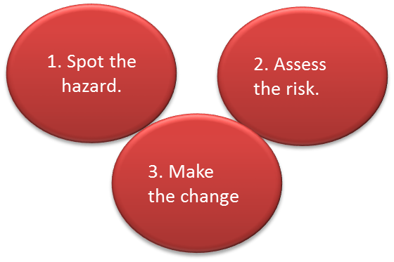
DEFINITIONS
Hazard: A condition that has the potential to injure you.
Simple method of inspection
  Spot the hazard.
  Assess the risk.
  Make the change

Slide 7
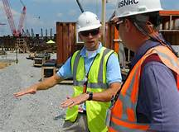

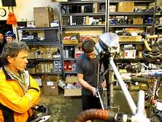
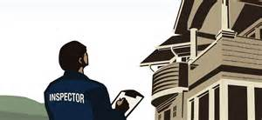
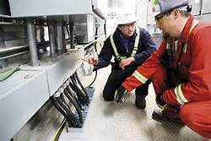
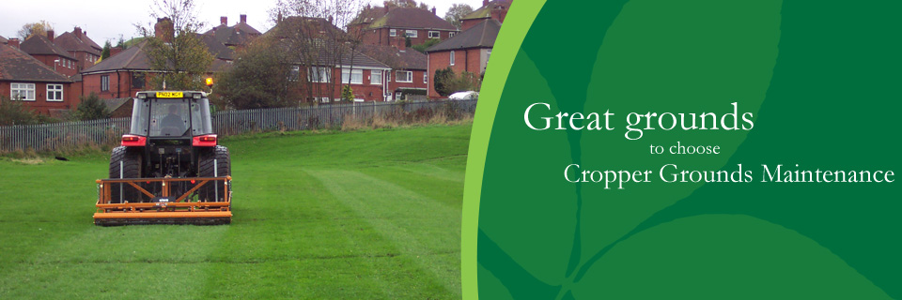
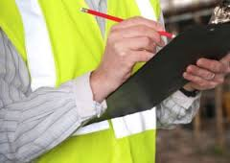
TYPE OF INSPECTION
Vehicle Inspections - Daily
Worksite Inspections - Daily
Shop Inspections – Monthly
Building Inspections - Annually
Grounds Inspections - Annually
Equipment Inspections -Preventative Maintenance
Inspection Process:
  Individuals are selected and scheduled to carry out an inspection
  Inspection Form is given to the individual
  Inspection is carried out
  Inspection Form is returned to the supervisor

Slide 8
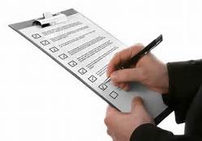
TYPE OF INSPECTION
Formal Inspections are those that are scheduled in advance. They may include the Safety Officer and Safety Committee members
Daily, all employees are required to conduct informal visual inspections of their work areas prior to beginning operations. Supervisors should continuously monitor work areas for developing hazards or unsafe practices.
Special function inspections are conducted after accidents and upon the introduction of new equipment or new procedures. They may be conducted by other regulatory agencies.

Slide 9
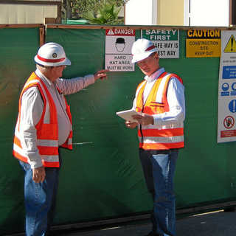
TYPE OF INSPECTION
Who can conduct inspections ?
  Employees
  Supervisors
  Safety Coordinators
  Management
  Safety Committee Members
  Outside Vendors/insurance companies

Slide 10
TYPE OF INSPECTION
Anyone performing inspections should be trained on how to conduct those inspections.
Daily, all employees should make a visual inspection of their workplace prior to beginning work.
Supervisors, Safety Coordinators, and Management personnel, as part of their daily work routine, should make continuous visual inspections and take corrective action to address any unsafe acts or unsafe conditions observed.
Safety Coordinators, Management personnel, and/or Safety Committee Members may inspect workplaces, accident scenes, etc. when necessary

Slide 11
TYPE OF INSPECTION
Prevent incidents and illnesses
Help avoid many of the costs associated with incidents
Communication with workers

