Slide 1
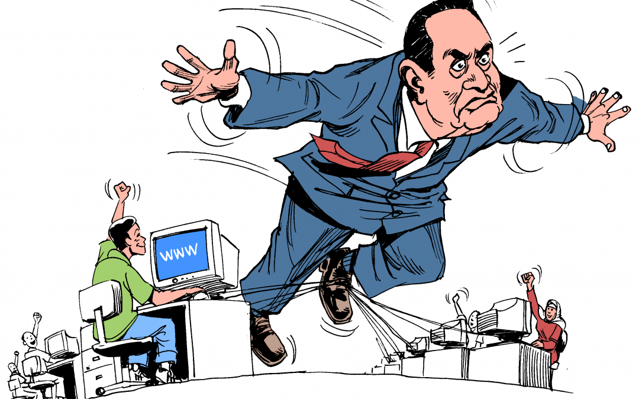
OFFICE SAFETY

Slide 2
AGENDA
1
Office safety
2
Good practices of office safety
3
Fall prevention
4
Strains and overexertion
5
Housekeeping and storage
6
Ergonomy
7
Lighting
8
Noise
9
Electrical hazards
10
Fire prevention
11
General prepardness for emergency sitiuations
12
Fire emergency procedures

Slide 3
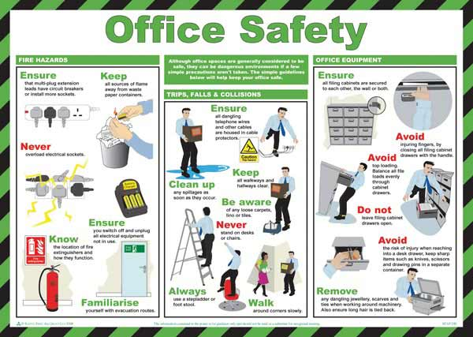
OFFICE SAFETY
Office-Related Illness and Injury.
  The leading types of disabling accidents that occur within the office are the result of falls, strains and overexertion's, falling objects, striking against objects, and being caught in or between objects.

Slide 4
GOOD PRACTICES OF OFFICE SAFETY
Office spaces can have common workplace hazards that can be dangerous when not properly mitigated.
Always use common sense when safety may be a concern
  Slipping, tripping, and falling hazards
  Burning, cutting, and pinching hazards
  Improper lifting and handling techniques
  Unobservant and inattentive employees
  Improper office layout and arrangement
  Dangerous electrical wiring
  Exposure to toxic substances
  Horseplay
  Using chairs or other office furniture to serve as a ladder.

Slide 5
FALL PROTECTION
Falls are the most common office accident, accounting for the largest number of disabling injuries.
The disabling injury rate of falls among office workers is 2 to 2.5 times higher than the rate for non-office employees.
In order to prevent falls, employees must:
  Be sure the pathway is clear before walking.
  Close drawers completely after each use.
  Avoid excessive bending, twisting, and leaning backward while seated.
  Secure electrical cords and wires away from walkways.
  Always use a stepladder for overhead reaching, never a chair.
  Clean up spills immediately.
  Report loose carpeting or damaged flooring.
  Never carry anything that obscures one’s vision.
  Wear stable shoes with non-slip soles.

Slide 6
STRAINS AND OVEREXERTION
Strains and overexertion type injuries occur more frequently in offices than people realize.
Before picking up an object, employees must always consider the weight of the load, the height to which it will be lifted, and the distance the person will be carrying it.
If the person feels that the lift is beyond his/her ability, he/she must contact his/her supervisor or ask another employee to assist.

Slide 7
STRAINS AND OVEREXERTION
The following guidelines can help prevent strains and overexertion:
  When lifting something from the floor, squat close to the load.
  Keep your back in its neutral or straight position.
  Grip the object securely and draw it close to your body.
  Lift by straightening your legs, letting your leg muscles, not your back muscles, do the work.
  If you are doing a lot of twisting while lifting, try to rearrange the space to avoid this.
  Store materials at knee level whenever possible instead of on the floor.
  If you have to carry a heavy object some distance, use a hand truck or cart to transport it.
  Break up loads so each weighs less.
  Avoid lifting objects from the floor in a seated position.
  Move your chair out of the way and then squat and stand with the load.

Slide 8
HOUSEKEEPING AND STORAGE
Office materials that are improperly stored can lead to objects falling on workers, poor visibility, and create a fire hazard.
A good housekeeping program will reduce or eliminate hazards associated with improper storage of materials.
The following guidelines apply material storage:
  Always stack material in such a way that it will not fall/topple over
  Store heavy objects on lower shelves and position them so that you do not have to reach across something to retrieve them
  Whenever possible, store materials inside lockers and file cabinets
  Do not place office equipment such as monitors, calculators, etc. on the edges of desks, cabinets and tables
  Avoid obstruction of aisles, corners, and passageways
  Avoid obstruction of fire equipment, extinguishers, fire door exits, and sprinkler heads. Materials should be stored at least 18 inches from sprinkler heads.

Slide 9
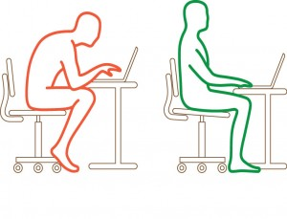
ERGONOMY
Workstations
  Ergonomics means fitting the workplace to the workers by modifying or redesigning the job, workstation, tool or environment.
  Workstation design can have a big impact on office workers health and well-being. When setting-up your computer workstation, the key to comfort is in maintaining the body in a relaxed and neutral position.

Slide 10
ERGONOMY
Arrange the workstation as follows to fit you:
  Adjust the height of the chair’s seat such that the thighs are horizontal while the feet are flat on the floor.
  Adjust the seat pan depth such that your back is supported by the chair backrest.
  Adjust the backrest vertically so that it supports/fits the curvature of your lower back.
  With the arms at your sides and the elbow joint at 90 degrees, adjust the height/position of the chair armrests to support the forearms.
  Adjust the height of the keyboard such that the fingers rest on the keyboard home row when the arm is to the side, elbow at 90 degrees, and the wrist straight.
  Place the mouse, trackball, or special keypads, next to the keyboard tray.
  Adjust the height of the monitor such that the top of the screen is at eye level.
  Place reference documents on a document holder close to the screen and at the same distance from the eye.
  Use a footrest if you cannot rest your feet comfortably on the floor.

Slide 11
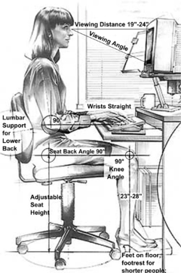
OTHER GOOD WORK PRACTICES
Adjust the drapes or blinds and move the monitor away from sources of glare or direct light.
Position the monitor directly in front of you.
Avoid cradling the telephone between the head and shoulder.
Keep frequently used items like the telephone, reference materials, and pens/pencils within easy reach.
Move between different postures regularly, and vary your tasks to avoid a long period of one activity.
Use the minimum force necessary to strike the keyboard or to activate the hole punch and stapler.

Slide 12
LIGHTING
Lighting is one of the most important factors affecting personal comfort on the job.
There are a few measures that employees can use to prevent and control poor lighting conditions in the work environment.
  Whenever possible, office workers should not face windows, unshielded lamps, or other sources of glare.
  Adjustable shades should be used if workers face a window.
  Consider adjustable task lamps to supplement general office lighting for those who require or prefer additional lighting. Choose task lamps that permit several light levels.
  Report dull or burned out lights or bulbs to building maintenance for immediate replacement.

Slide 13
NOISE
Noise can be defined very simply as unwanted sound.
Noise can produce tension and stress levels and cause distraction from mental activities.
Office workers are subjected to many noise sources including VDT’s, printers, telephones, fax machines, and human voices.
The following measures are useful for reducing the level of noise or its effects:
  Whenever possible, select the quietest equipment available.
  Ensure office equipment is properly maintained, such as lubrication and tightening of loose parts.
  Use barrier walls or dividers to isolate noise sources, and locate loud equipment in areas where its effects are less detrimental.
  Enclose equipment, such as printers, with acoustical covers or housings.
  Schedule noisy tasks at times when it will have less effect on the other tasks in the office.

Slide 14
ELECTRICAL HAZARDS
Electrical equipment used in an office is potentially hazardous if improperly used or maintained.
The types of electrical hazards that can be found in an office environment are varied, but are usually easy to spot and prevent.
The following guidelines apply:
  Ensure equipment electrical cords or plugs are grounded and in good condition.
  Avoid overloading electrical outlets by providing sufficient number of outlets, minimizing the need for extension cords.
  Place electrical cords away from foot traffic, making sure it is secured and protected from damage.
  Switch off or unplug equipment at end of workday and on weekends. To remove a plug from an outlet, take a firm grip on the plug and pull. Never pull a plug out by the cord.
  Do not block electrical panels.
  If the problem cannot be resolved using instructions provided, call equipment technician.

Slide 15

FIRE PREVENTION
To prevent fire, follow these guidelines:
  Smoke only where it is permitted.
  If electrical equipment is not working properly or is giving off an unusual odor, disconnect the equipment and call the appropriate maintenance department.
  Keep all heat producing appliances and equipment away from the wall and away from anything that might burn.
  Keep storage areas, stairway landings and other locations free of waste paper, empty cartons, dirty rags and other material that could fuel a fire.

Slide 16
GENERAL PREPAREDNESS FOR EMERGENCY SITUATIONS
In order to be prepared for emergency situations in general, the following guidelines apply:
  Know the location of the two exits closest to your work area.
  Learn where the nearest fire alarm is located and how to activate it.
  Post the fire department and/or building security emergency numbers on your telephone.
  Learn the sound of your buildings fire alarm and participate in regularly scheduled fire or evacuation drills.
  Know/Identify the individuals responsible for emergency preparedness and response in your building or work area, and follow their direction.
  If you have any disability that could delay or prevent your evacuation, let someone in authority know.
  Remember to never use an elevator during a fire emergency

Slide 17
FIRE EMERGENCY PROCEDURES
No matter how small the fire seems to be, if a fire breaks out, sound the alarm, call the fire department and/or building security and escape quickly. Large fires start as small ones.
The following specific rules and recommendations apply:
  If possible and only if you have received appropriate training, use a portable fire extinguisher to control a small fire. However, you should not attempt to fight even a small fire until people have been safely evacuated from the area and the fire department has been called.
  Proceed directly to the nearest fire exit. Do not collect personal or official items.
  If you must use an escape route where there is smoke, stay as low as possible.
  Before you open a closed door, feel it with the back of your hand. If it is hot, leave it closed and use an alternate escape route.
  As you are evacuating, follow the directions from the fire and security personnel.
  Once outside, move well away from the building and report to your designated safe meeting area.
  If you are a supervisor, try to account for your employees, keep them together and report any missing persons to the emergency personnel at the scene

