Slide 1
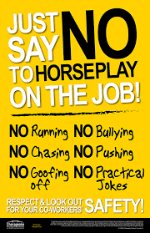
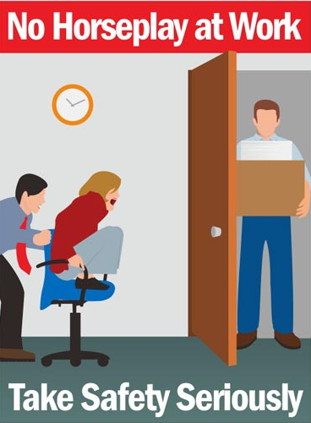
HORSEPLAY SAFETY

Slide 2
AGENDA
1
Introduction
2
Objectives
3
Benefits of induction programs
4
Do & don’t

Slide 3
HORSEPLAY
The building trades industry is potentially dangerous and anything that unnecessarily increases the chance of an injury must be eliminated.
Horseplay benefits no one and usually only builds up resentment and fosters retaliation.
Practical jokes should be discouraged.
At some point, if they continue they need to be reported.
Examples of Horseplay Scaring someone:
  Air hosing someone.
  Wrestling with someone.
  Boxing, Goosing.
  Dropping objects next to someone.
  Throwing water on someone.
  Throwing objects or tools at someone.
  Placing tacks under someone.

Slide 4
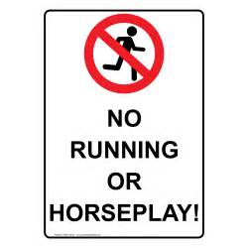
AVOID HORSEPLAY
Avoid horseplay to instil a safe working environment.
Horseplay may sound fun but it can lead to low work productivity, compromised working environment and even serious work injuries which can be potentially fatal in some cases.
Every year hundreds of injuries are reported in the United States alone due to pranks pulled at work.
Some states have laws against horseplay or prank injuries that could result in criminal prosecution.
Whether or not your state has such laws, it is imperative that you maintain a horseplay-free environment not only for better work productivity but also to ensure the safety of your employees.

Slide 5
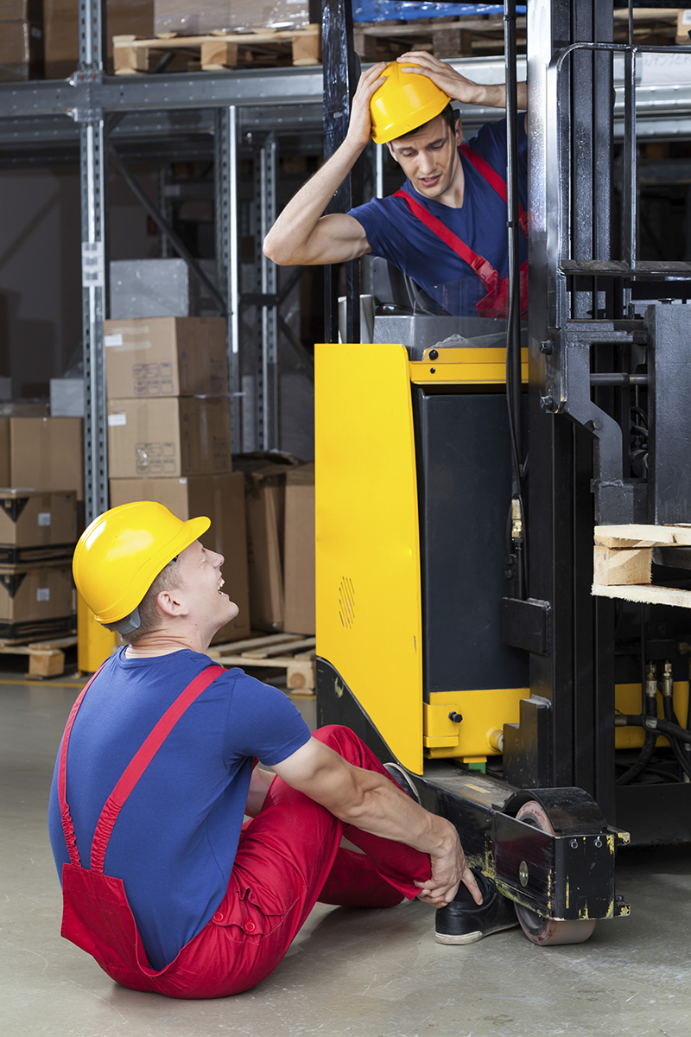
AVOID INJURIES
The best way to avoid hazardous situations at your workplace is to have proper policies in place which will limit if not eliminate horseplay.
Horseplay after all, creates unnecessary risks and accidents which can include slipping, falling, crashing into objects, etc.
Prevent injuries from occurring in the first place by ensuring everyone knows the rules and strictly abides by them.
Injuries at work can create a lot of problems in the work environment including lost time from work and increases to workers’ compensation premiums.

Slide 6

BE ALERT FOR POTENTIAL RISK AND DANGER
When employees are engaged in horseplay, often they are also not paying attention to other people and objects around they may make contact with.
Engaging in this type of behaviour can lead to the individual and other workers being distracted or providing less attention to their immediate environment.

Slide 7
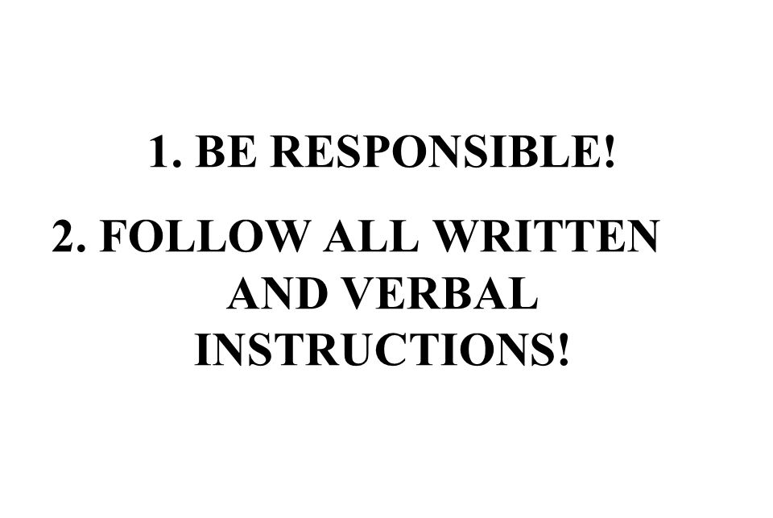
BE RESPONSIBLE
Be Responsible for the Safety of ourselves and others:
  Horseplay can result in an injury by accident, to the person engaging in it and to those who are by-standers.
  If employees are not in control of their emotions and the impact it has on other employees, it can lead to a physical confrontation and possibly violence.

Slide 8
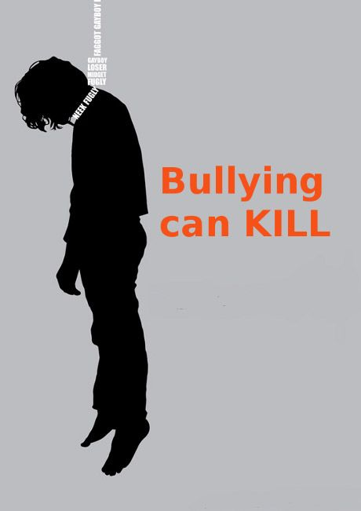
WORKPLACE BULLYING
Workplace Bullying is repeated, health-harming mistreatment of one or more persons (the targets) by one or more perpetrators. It is abusive conduct that is: threatening, humiliating, or intimidating, or work-interference, i.e. sabotage, which prevents work from getting done,” from Workplace Bullying

Slide 9

PRACTICES AND BEHAVIOURS
This is not only applicable to employees at inherently dangerous work-sites, where this type of behaviour should already be prohibited.
Tolerating horseplay will impact the safety culture of any workplace because it provides allowance, for those individuals who may find it harder to follow the safe rules or policies, to break them on a continually basis without consequence.
This behaviour unnecessarily increases potential dangers and risk for other workers, who could also become distracted while engaging in their workplace tasks. :

Slide 10
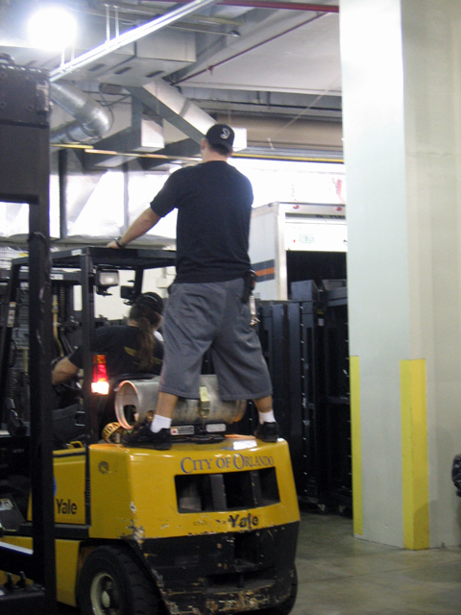
HORSEPLAY EFFECTS ON WORKPLACE
When practical jokes are common in the workplace, employees pay less attention to their jobs because they’re always on the lookout for the next joke.
Horseplay is a serious safety hazard that can quickly get out of hand and lead to injury or death.
If a workmate gets hurt as a result of your horseplay or joke you may be liable and you’ll likely lose your job.
Even if a practical joke isn’t dangerous, it may be viewed as bullying or harassment and can have an emotional impact on the target.

Slide 11
HORSEPLAY EFFECTS ON WORKPLACE
Make sure you have a policy clearly outlined in your employee handbook.
It is imperative that your employees are aware of the consequences of their behaviour and are knowledgeable of what is and isn’t allowed in the workplace.
You should clearly outline the policy in your employee handbook.
Unacceptable behaviour like practical jokes, pranks, playing within the premises etc.
Should be clearly outlined and consequences should occur for such behaviour.
Required to follow all regulations and work rules to ensure the safety of themselves, employees, and non-employees;
Not permitted to engage or participate in any type of horseplay, regardless of whether they are on-site
Encouraged to report violations of this policy to the Safety & Compliance Manager or the Safety & Compliance Assistant.
Educate new employees and re-educate existing employees about the Horseplay Prevention Policy.
Take steps to secure the safety and future non-harassment of any known victim(s) of horseplay.

