Slide 1

SAFETY LEADERSHIP BASIC BEHAVIOURS

Slide 2
AGENDA
1
What is safety leadership?
2
Expected behaviours
3
Team leaders behaviours
4
Managers behaviours

Slide 3

WHAT IS SAFETY LEADERSHIP?
Safety leadership is defined as the process of interaction between leaders and followers, through which leaders can exert their influence on followers to achieve organizational safety goals.
The feature of this definition that most often confuses people is the concept of leaders and followers. The terms ‘leadership’ and ‘management’ are used interchangeably.
The problem here is that many do not recognize the critical differences between these roles and the vital functions of each in building strong safety performance.
Specifically, managers exist as part of the organization’s structural hierarchy and exert formal influence over their subordinates, while leadership is a voluntary activity by which an individual exerts social influence over co-workers by setting an example of appropriate behaviour to elicit shared goals and effect Positive change in the organization.
Certainly one individual can be both a manager and a leader but this only occurs through conscious effort to effectively perform both roles.

Slide 4

EXPECTED BEHAVIOURS
Company expects all its employees, i.e. managers, team leaders and employees in general, to display Behaviours that lead to a strong safety culture.
Contractors who work in the same environment Are asked to adhere to the same standards.
These behaviours are linked through four themes:
  Standards
  Communication
  Risk Management
  Involvement

Slide 5

EXPECTED BEHAVIOURS
“Managers”, “Team Leaders” and “Everyone” there are four sets of behaviours. As the name implies, Everyone” behaviours apply to all of us. Those occupying functions of first line supervision or management display also additional behaviours that correspond to the functions of “Team Leader” and “Manager”.
Each behaviour has a letter code for ease of reference.
    E refers to Everyone
    L to Team Leaders
    M to Managers
    P refers to a positive Safety and Health behaviour
    N refers to a negative Safety and Health behaviour.
Each behaviour is also numbered.

Slide 6

EXPECTED BEHAVIOURS
Follow Rules
Do I always follow safety rules and procedures?
Context:
In companies that excel in safety, everybody follows the rules that guarantee safe operation and therefore the prevention of accidents.
They do so because they want to, because they understand that safety is to their own advantage.

Slide 7

EXPECTED BEHAVIOURS
Follow Rules
I Will
  Learn and respect relevant local standards, rules and procedures
  Strictly follow rules, and always use the right procedure for the job.
I Will Not
  Ignore rules and procedures; e.g. by cutting corners skipping steps
  not wearing full protection, not wearing seat belt Fail to consider the implications of not following a procedure
I will …..
I will not….

Slide 8
EXPECTED BEHAVIOURS
Speak up
Communication
In matters of safety, do I always express myself if I see opportunity for improvement?
Context:
Safety is an important matter for organised work. Since everyone is affected by safety, if I see something wrong, or a way to improve our safety, I must speak up, for my own good and that of my team mates.

Slide 9

EXPECTED BEHAVIOURS
Speak up
I WILL
  Ask questions to gain clarification and understanding, listen to others’ views and concerns
  Challenge any unsafe behaviour immediately
I WILL NOT
  Ignore unsafe behaviours
  Fail to support discussions and decision-making that encourages and promotes safety
I will
I will
not

Slide 10

EXPECTED BEHAVIOURS
Be mindful
  Risk Management
  Am I always alert to safety matters?
  Context
  Safety requires a constant awareness of the situation and a capability to anticipate what will happen next.
  Nobody is born with such ability; we must develop it consciously, through an effort of concentration, until it becomes automatic.

Slide 11
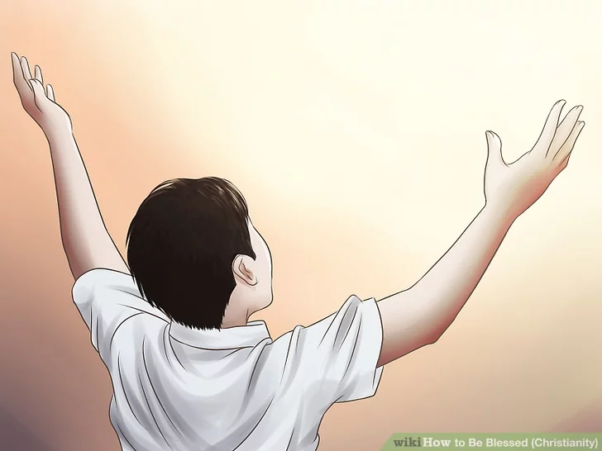
EXPECTED BEHAVIOURS
Be mindful
I WILL
  Stay vigilant; maintain continual awareness of hazards, surroundings and adjacent work, e.g. is equipment correctly guarded? Are emergency doors/stairs accessible?
  Anticipate possible risks and problems; constantly ask “what could go wrong?”
I WILL NOT
  Expect somebody else to consider the Safety and Health implications of a task
  Begin a task without thinking the job through
I will…
I will not….

Slide 12

EXPECTED BEHAVIOURS
Get involved
Am I willing to get involved, do my part and get my part?
Context:
Excellence in safety is a collective performance. If one team player fails to contribute, it is impossible to reach the best possible state. Teams without 100% participation are – by definition – weaker than teams with total involvement. Eventually, this weakness will lead to an accident.
I Will
  Take responsibility for own safety and safety of co-workers, and support team Safety and Health standards
  Share personal Safety and Health knowledge and learning with others
I WILL NOT
  Tend to follow others regardless of the consequences
  Try to solve the problem without involving others; put self before team

Slide 13
TEAM LEADERS’ BEHAVIOURS
Ensure compliance
Standards
Am I aware that I am one of the few keys for my team’s excellence?
Context:
In all collective endeavours, all along history, it is indispensable to have a main coordinator that helps the team to perform.
I WILL
Visit the worksite frequently to ensure compliance, and discuss Safety and Health issues with team
Help team to resolve production/ Safety and Health conflicts
I WILL NOT
Set poor example by breaking Safety and Health standards or rules
Fail to think fully about the implications of not following procedures or systems

Slide 14

TEAM LEADERS’ BEHAVIOURS
Encourage the team
Communication
Do I make my team know how grateful and glad I am that they perform so well?
Context:
To get involved and put all their will into the task, people need to be motivated deeply in their hearts. Then, as human beings, they will be glad to provide an effort for the benefit of other human beings.

Slide 15
SAFETY LEADERSHIP
Encourage the team
I WILL
  Seek and listen to team Safety and Health suggestions, concerns and ideas
  Recognize and reward good individual and team Safety and Health performance, and deal firmly and fairly with poor performance
I WILL NOT
  Reject feedback. Tend to give direct orders instead of asking for input from them
  Neglect to address poor performance and avoid tough or unpopular decisions

Slide 16
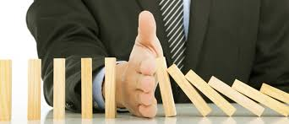
TEAM LEADERS BEHAVIOURS
Promote Risk Awareness
Risk Management
As a team leader, do I do enough to help my team become autonomous?
Context:
No matter how competent the leader is, the only way to reach excellence is by ensuring that each team member reaches his/her highest potential. Everyone must become excellent in detecting the risks and anticipating their control.

Slide 17
TEAM LEADERS BEHAVIOURS
Promote Risk Awareness
Risk Management
I WILL
  Take time to plan work with team, challenging any complacency about routine work
  Encourage the team to be cautious, and stop the job if they have Safety and Health concerns
I WILL NOT
  Rush into the activity without first recognising the hazards and implementing controls
  Consider Safety and Health activities (e.g. risk assessment) as non-essential
  Team Leaders’ Behaviours

Slide 18

TEAM LEADERS BEHAVIOURS
Team Leaders’ Behaviours Involve the Team
Involvement
Am I demonstrating constantly my commitment?
Context:
If the leader does not do what he/she says must Be done, exactly as any other team member, he/she loses credibility and people do not feel Inclined to follow. The team leaded is like any other member he/she must listen and improve himself/herself too. No one is perfect.

Slide 19
TEAM LEADERS BEHAVIOURS
Team Leaders’ Behaviours Involve the Team
I WILL
  Work with the team to ensure they understand their Safety and Health goals and responsibilities
  Regularly discuss Safety and Health performance during operational meetings e.g. shift handover or shop floor meetings, and share lessons learned
  Support, coach and involve team members in implementing Safety and Health improvements
I WILL NOT
  Fail to show willingness to listen to the team or to proposals for change
  Ignore Safety and Health concerns that are raised. Fail to follow through to address concerns
  Give insufficient support to Safety and Health initiative, preventing the message getting through to the workforce

Slide 20

MANAGERS’ BEHAVIOURS
Set High Standards
Standards
Am I dedicating enough effort to safety, so that I can expect always higher performance from my organisation?
Context:
Managers set the performance of their organisations through their high expectations. Usually, you will get from an organisation the minimum you expect from it, or may be just a bit more. If you want to reach excellence, you must adopt the highest standards you know.

Slide 21
MANAGERS’ BEHAVIOURS
Set High Standards
I WILL
  Regularly explain Safety and Health expectations, and verify understanding and compliance Continually emphasise that our commitment to Safety will never be sacrificed in pursuit of achieving any other business targets or KPIs
I WILL NOT
  React to circumstances; do not plan how to achieve desired Safety performance
  Tolerate variable and inconsistent Safety and Health standards

Slide 22
MANAGERS’ BEHAVIOURS
Communicate Openly
Communication
Do I tell my organisation how much I feel responsible for safety, how important that is for me? Do I do this often enough?
Context:
Successful managers obtain from others that they work well, willingly and gladly. To succeed, they must excel in communication at all levels.

Slide 23
MANAGERS’ BEHAVIOURS
Communicate Openly
I WILL
  Talk face-to-face with the staff about Safety and Health performance and concerns
  Provide prompt, honest feedback on concerns raised by the workforce
I WILL NOT
  Wait for others to communicate on Safety and Health; do not take initiative
  Fail to include Safety and Health on the leadership meeting agenda

Slide 24
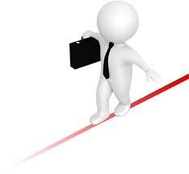
MANAGERS’ BEHAVIOURS
Confront Risk
Risk Management
Am I aware of all the risks people in my organisation encounter every day in the course of their work? What do I do to make sure I know those risks and to enable employees to protect themselves against any danger?
Context:
“Walk the talk” means: “I go around, I know what my people do, how they do it, how easy or difficult is each task, which are the dangers we must worry about. I know what my people need to do their work well and I make sure they have what they need.”

Slide 25
MANAGERS’ BEHAVIOURS
Confront Risk
Risk Management
I WILL
  Ensure effective mechanisms exist for people to raise Safety and Health and welfare concerns
  Be approachable by any employee to discuss Safety and Health concerns that the employee would like to address
I WILL NOT
  Fail to seek new ideas to support Safety and Health performance improvement
  Fail to provide response or feedback to workforce about Safety and Health or welfare concerns raised

Slide 26

MANAGERS’ BEHAVIOURS
Involve the Workforce
Involvement
Am I demonstrating that our organisation needs everyone’s involvement including mine, uncompromised – to build and maintain a safe work environment?
Context:
No leader in history has accomplished anything alone. The great men in all periods were those that had the ability to involve people at all levels in a common cause. Why should safety in our company be different?

Slide 27

MANAGERS’ BEHAVIOURS
Involve the Workforce
I WILL
  Ensure adequate Safety and Health resources and training are available; allocate sufficient time and priority for these initiatives.
  Take personal action to improve Safety and Health performance by showing enthusiasm, decisiveness and support.
I WILL NOT
  Unnecessarily delegate attendance at Safety and Health meetings, and personal involvement in Safety and Health initiatives.
  Show no positive interest, enthusiasm or support for Safety and Health initiatives or issues.

