Slide 1

OFFICE SAFETY

Slide 2
AGENDA
1
Introduction
2
General office safety
3
Types of hazard
4
Risk assessment
5
Office machinery
6
Office ergonomics
7
Stacking & storage
8
Office lighting & illumination
9
Electrical safety
10
Back injuries

Slide 3
AGENDA
11
Accident reporting
12
Slips, trips & falls
13
Stairs
14
Preventing hand injuries
15
Welfare facilities
16
First aid
17
Hygiene

Slide 4
INTRODUCTION
An office does not have an agreed definition, but it is normally regarded as a place of work where clerical and administrative work activities are carried out. Health and safety issues such as noise, thermal comfort, lighting and ergonomics apply to a variety of workplaces as well as offices; therefore the definition of an office should not be interpreted too narrowly.

Slide 5
GENERAL OFFICE SAFETY
A large percentage of workplace accidents and injuries occur in office buildings. Like the shop or laboratory, the office requires a few preventive measures to ensure a safe and healthful environment. Common causes of office accidents include the following:
  Slipping, tripping, and falling hazards
  Burning, cutting, and pinching hazards
  Improper lifting and handling techniques
  Unobservant and inattentive employees
  Improper office layout and arrangement
  Dangerous electrical wiring
  Exposure to toxic substances
  Horseplay

Slide 6
GENERAL OFFICE SAFETY
What Can Go Wrong In An Office?
ISSUES
  Absences
  Sickness
  Conflict
INJURIES
  Physical
  Psychological
  Illness & disease

Slide 7
TYPES OF HAZARD
Basic hazard categories
Behavioural
Psychological
Ergonomic
Biological
Chemical
Physical

Slide 8

RISK ASSESSMENT
Office chemicals
Cleaning Agents
Toners & Developers
Inks, Cleansers,
Solvents
Paints

Slide 9
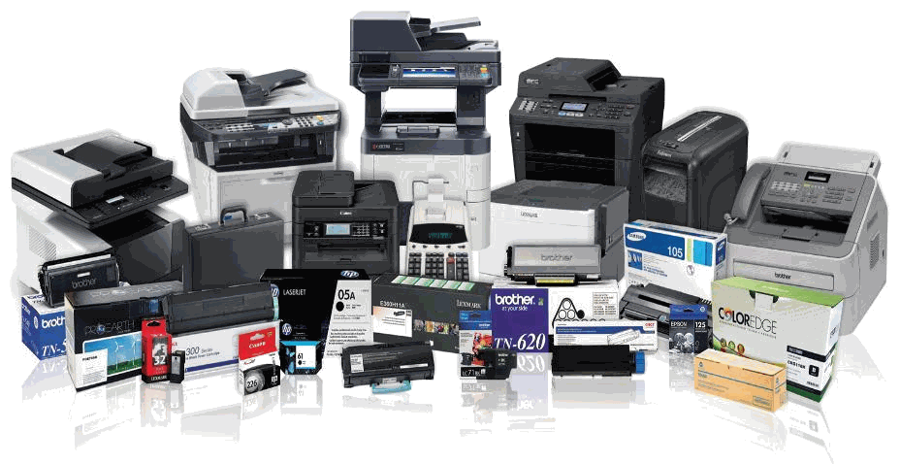
OFFICE MACHINERY
Electricity
  Cords,
  Cables &
  Electrical hazards
Printers
  Noise,
  Inks,
  Ozone (laser)
Photocopiers
  Toner,
  Enveloper,
  Noise,
  Ozone,
  Light
Computers
  Eyestrain,
  Posture – ergonomics,
  Repetitive motion

Slide 10
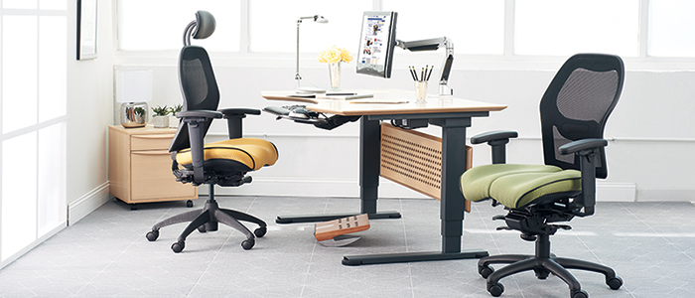
OFFICE ERGONOMICS
OFFICE EQUIPMENT
  Workstations,
  Chairs,
  Keyboards
PLACEMENT OF EQUIPMENT
  Strains,
  Sprains – obsolete &
  Out-of-service items
POSTURE
  Height & distance of equipment – periods of sitting & standing
BREAKS & EXERCISES
  5-10 minutes per hour recommended

Slide 11
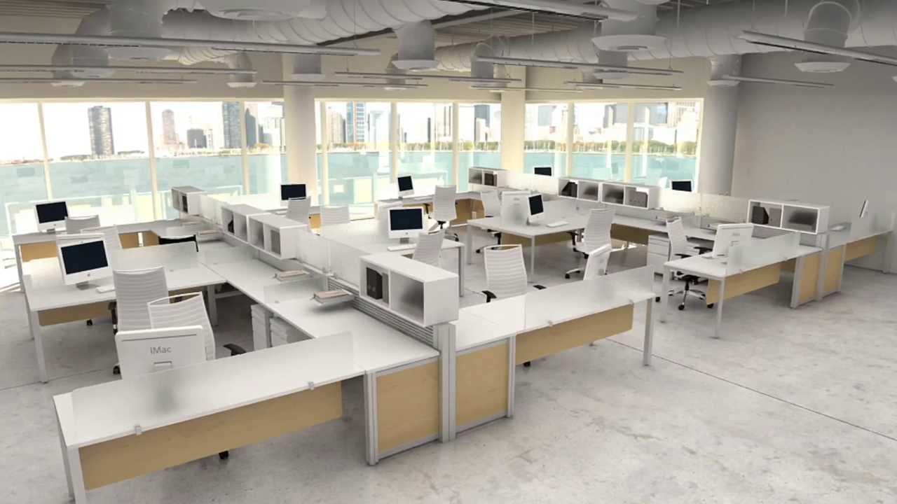
OFFICE ERGONOMICS
Employee workstations
Designed to reduce excessive bending & stretching.
Should be fully adjustable.
Good housekeeping is absolutely essential.
Never store items under your desk, or on floors.
Never store items on top of shelves & cabinets.
Never leave desk and/or filing cabinet drawers open.=]

Slide 12
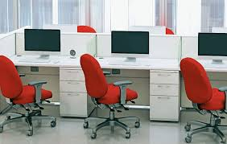
OFFICE ERGONOMICS
Office furniture: chairs & desks
Adjustable chairs are recommended.
Good chairs have adjustable lower back support.
Height adjustable - knees and hips should be level.
Chairs on castors should have five (5) legs.
If your desk is too high, compensate by raising the chair seat height, keeping feet flat on the floor.
Never stand on an office chair to reach anything, especially if the chair has wheels or swivel.

Slide 13
OFFICE ERGONOMICS
Computer
A badly positioned computer not only makes the user unproductive, it also causes discomfort.
If the monitor is badly positioned the user will likely suffer eyestrain, headaches, stiff neck & shoulders, and backache.
The monitor should be placed directly in front of the user to optimize a visual range of 3000 in any direction.
The screen should be 45-60 cm away from the user’s eyes.
Adjust your computer and seating position for comfort — seek assistance from the Safety Office if necessary.
The top of the monitor should be at eye level to help reduce risk of neck and back strain.
The keyboard should be directly in front of the user.
The user’s elbows should be bent at a 900 angle.
The keyboard should be angled to allow the user’s wrists to be in a neutral position.
The monitor screen should be positioned at right angles to the window to avoid glare.
Back-ups must be done regularly - per your IT administrator’s recommendations.

Slide 14
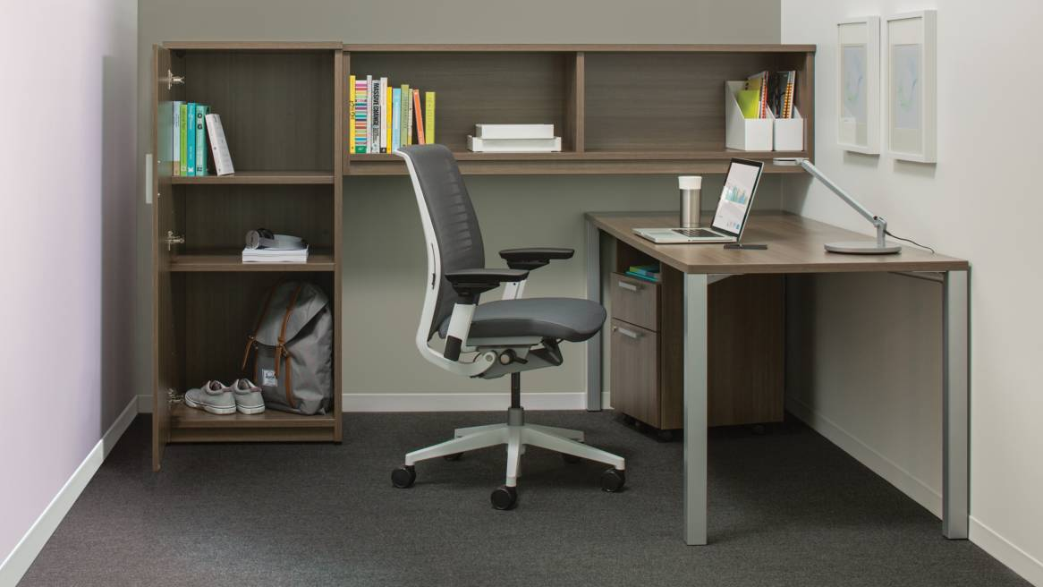
STACKING & STORAGE
Light objects must be stored on top (high) and heavy objects in the bottom (low) - in filing cabinets, shelves, cabinets, and other displays.
Boxes, files, and other heavy articles must not be stacked on top of cabinets, shelves, or window sills.
Keep walkways clear, and fire fighting equipment unobstructed.
Do not store unnecessary items in an office area.

Slide 15
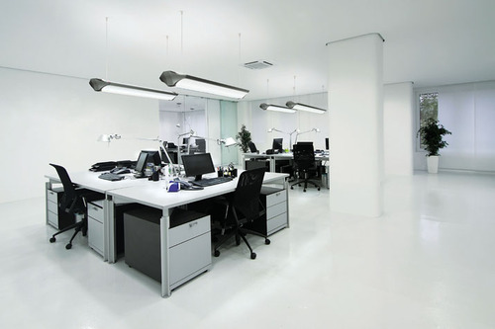
OFFICE LIGHTING & ILLUMINATION
Adjust lighting to prevent eye strain.
Eliminate glare and reflection.
See your physician for a routine eye & vision examination
Take a 5-minute break from computer work at least once an hour; look away from your monitor and focus the eyes on both near and far objects.

Slide 16
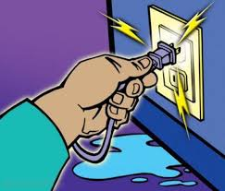
ELECTRICAL SAFETY
Electrical cords or plugs are grounded and in good condition.
Avoid overloading electrical outlets and extension board
Use only “approved” equipment/appliances (coffee makers, radios, lamps, etc.).
Place electrical cords away from foot traffic protected from damage.
Switch off or unplug after competition work and end of the day.
Do not block electrical panels.
All electrical equipment's operate “user instruction” such as copiers or paper shredders.

Slide 17


BACK INJURIES
Stress – Chronic, Slow, Long-term effects
Strains – Acute, Rapid, Short-term effect
Can Reduce: –
    Mobility
    Productivity
    Employment scope & capability

Slide 18

ACCIDENT REPORTING
Report all job-related injuries within 24-hr.
Report all safety-related incidents within 24-hr..

Slide 19
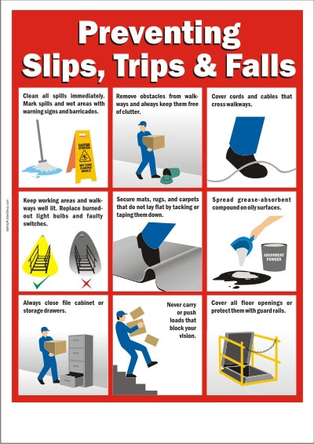
SLIPS, TRIPS & FALLS
Do not allow cords & cables to create a tripping hazard.
Clean up all spills quickly.
Do not block passageways and walkways.
Keep office areas clean, neat & organized.
Keep stacking and storage areas safe.
Report all hazards and concerns.

Slide 20
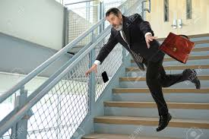
STAIRS
Avoid distraction on stairs.
Take one step at a time.
Don’t load your arms so full of items that you can’t see.
Keep one hand on the handrail.
Don’t congregate on stairs or landings.
Keep stairs well lighted.
Never use stairs or stairwells for storage.
Use the elevator when transporting heavy loads.

Slide 21
PREVENTING HAND INJURIES
When you stick them into drawers & cabinets.
When you handle papers, staplers, and other office devices.
Keep sharp objects in safe containers, or guard blades and points.
Use needles & syringes carefully to avoid injury to yourself and to others.
Pick up broken glass with a broom & dust pan, or wear leather gloves.
Wrap the glass in thick paper, and label it so that the cleaning staff will know what it is.
Slivers of glass should be picked up with a damp paper towel — then, discard the paper towel.
If you have a lot of broken glass, purchase a “Broken Glass Container” from a safety supply vendor.

Slide 22
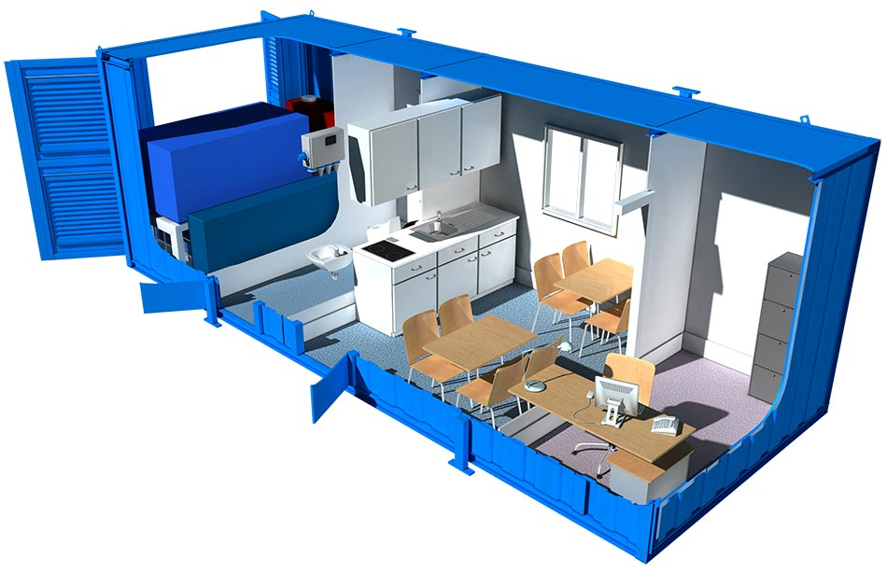
WELFARE FACILITIES
Welfare facilities include the provision of adequate toilet and washing facilities.
The facilities should be in sufficient numbers and be clean, well maintained and have adequate ventilation.
Hot and cold water, soap and hand drying facilities should also be in place.
The provision of suitable drinking water is also a statutory requirement.

Slide 23
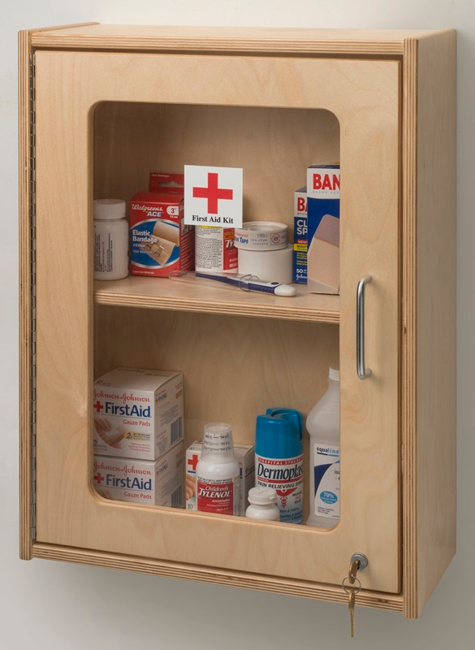
FIRST AID
If your office has a first aid kit:
Make sure you know where the kit is.
Ensure the kit is well stocked.
Consider taking a first aid course.

Slide 24


HYGIENE
Practice good personal hygiene to reduce your risk of disease and illness.
  Wash your hands frequently, using soap & water.
Keep your office & work area(s) clean.
  Leave them in the same condition as you expect to find them.
Report cleaning needs to Custodial Services or to the Building Proctor.
Keep restrooms & break areas clean. Report cleaning & maintenance needs as soon as possible.

