Slide 1

CONTRACTOR SAFETY MANAGMENTS

Slide 2
AGENDA
1
Definition
2
Contractor selection
3
Sub-contractor
4
Induction
5
Site rules
6
Contractor equipment
7
Permit to work
8
General information
9
Monitoring
10
Supervision
11
End of contract assessment

Slide 3
DEFINITION
Contractors are companies on either fixed or open term contracts (typically providing maintenance, construction, gardening services, security services, pest control, catering, milk tanker deliveries, etc.).
Contractor Employees work for the contractor and are not on the Company salary/ wage payroll and are NOT generally, directly supervised by Company

Slide 4
CONTRACTOR SELECTION
All contractors must be assessed to ensure they are capable of carrying out the work that they have been engaged to do.
It is the responsibility of the contractor to ensure they employ competent staff but the site should carry out reasonable checks to ensure that competence of the contractor’s employees has been assessed.
The reasonable checks are about seeing evidence that competence has been established and could, for example, be in the form of:
  A valid license.
  Membership of trade associations.
  Training records.
  A C.V. (curriculum vitae) showing previous experience in similar work.

Slide 5
CONTRACTOR SELECTION
The selection criteria will depend to a large extent on the type of services required.
Then selecting a contractor to provide specialist skills, technical skill will be very important.
Some general selection criteria may be:
  availability of an appropriate skill mix
  processing experience
  adequate quality control procedures
  value for money
  capacity to meet the council's workload requirements
  the ability to integrate into the council's systems
  responsiveness for overflow processing
  quality of references from previous clients.
If competence has not been established or is found to be lacking, then appropriate action must be taken.
This may be in the form of restricted working, supervised working or prohibition from working.

Slide 6

SUB-CONTRACTOR
Sub-contractors are the responsibility of the main contractor.
The main contractor must have adequate arrangements in place to select, assess, manage and monitor the activities of the sub-contractors they engage.

Slide 7
INDUCTION
A competent person should establish a system to ensure all contractor employees undergo a site induction before they start work.
Contractor employees need to understand that they cannot start work until they have been through an induction programme.
A record of inductions must be kept.
The induction programme will include, as a minimum, the following elements:
  Emergency procedures
  Permit-to-Work procedures
  Site specific hazards
  Accident reporting procedures
  Waste disposal procedures
Refresher programmes should be carried out on a regular basis for longer-term contractor employees.

Slide 8

SITE RULE
Contractors must be given an up to date copy of the site rules. It is the responsibility of the contractor to ensure his employees are familiar with the site rules.

Slide 9
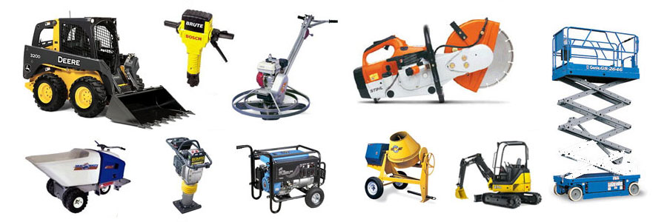
CONTRACTOR EQUIPMENT
The contractors must keep their equipment in safe working order.
The contact must as part of the monitoring process make random checks to ensure that equipment has been maintained and electrically tested, where applicable.
Where equipment does not meet the required standard it must be removed from site.

Slide 10

PERMIT TO WORK
There are certain tasks that will require a permit-to-work.
This will be explained as part of the site induction programme.
Under no circumstances should a contractor perform such tasks without first getting a permit from the authorized person.

Slide 11
GENERAL INFORMAION
Contractors must be given sufficient details of the work required to enable them to carry out any necessary risk assessments and prepare an adequate Safety Method Statement.
The Safety Method Statement should cover all aspects of the work (i.e. removal of existing equipment, alterations to buildings, installation of new equipment, finish required to walls and floors, etc) and include information on normal site operations and other ongoing activities that may be affected by, or affect, the contract.
The detail must be relevant to the size and risk of the project.
Small, low risk projects will require less detail than large high-risk projects.
Contractor employees must inform their Nestlé contact if they have been involved in an accident.
They must provide their own first aid facilities.

Slide 12
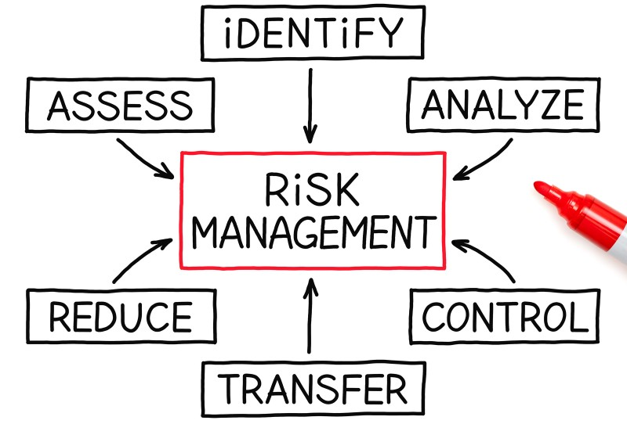
MONITORING
The company staff should monitor contractor employee working practices on a risk basis (the higher the risk, the more frequent the monitoring) by visiting the work area / compound to check for compliance with submitted Safety Method Statements.
These checks should be both formal inspections and informal walkabouts.
Where non-compliance with accepted Safety Method Statements is observed, appropriate action must be taken.
Regular meetings should be held with contractors involved in longer-term projects to review ongoing occupational health and safety issues.

Slide 13

SUPERVISION
Contractors must have adequate arrangements in place for supervision of their employees.
This may mean the full time presence of an onsite supervisor, or the appointment of one of their employees as a temporary supervisor who has access to further supervision from the contractor, if required.
The level of supervision will depend on:
  Magnitude of risk from the work.
  Complexity of the work.
  Number of contractor employees working in the area.
  Number of different contract companies working in the area.

Slide 14

END OF CONTRACT ASSESSMENT
As part of the arrangements for reviewing the performance of contractors, a final assessment of performance should be carried out and retained on file.
Where any significant health and safety issues have arisen, this information should be communicated to the site purchasing authority and consideration given to removing the named contract company from the preferred supplier list.

